Slide 1


Image Processing Basics using OpenCV in Python
Jing Wan

Slide 2
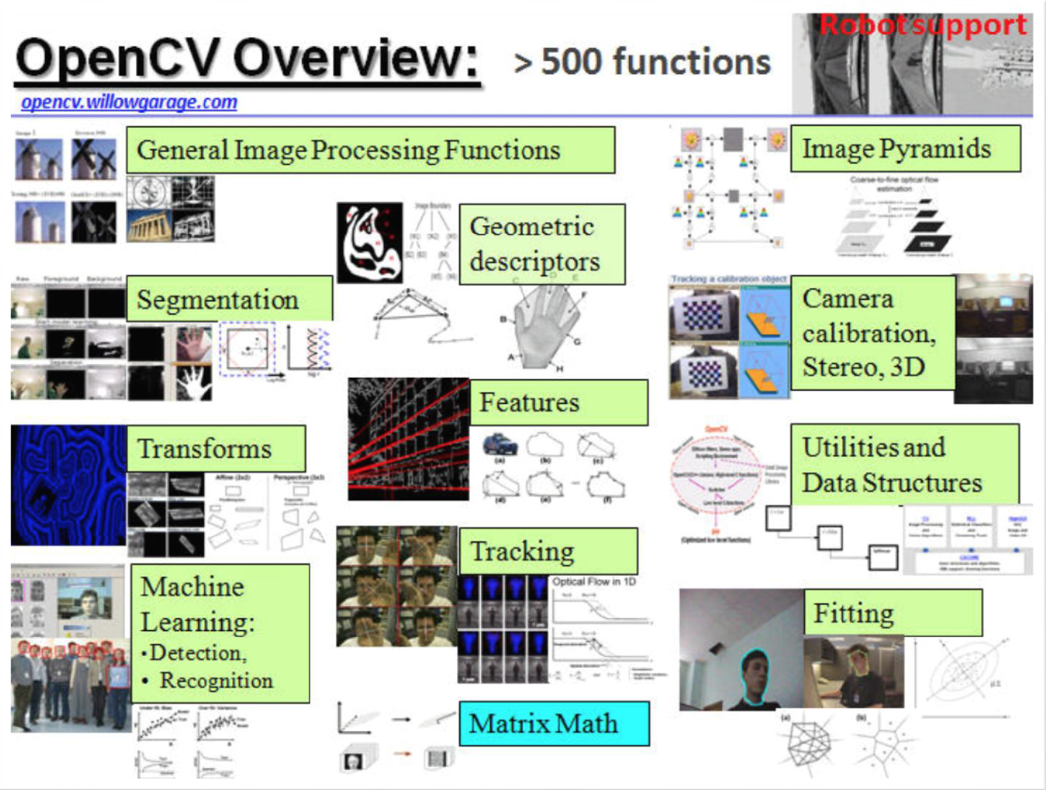
What is OpenCV?
An open source library of over 500 algorithms
Written natively in C/C++
An easy tool for experimenting with computer vision
C/C++/Python/Java API
Windows/Linux/Android/Mac OS/iOS platforms
over 9 million downloads

Slide 3
What’s new in 3.0 vs 2.4?
Opencv_contrib repository has been added for the development of so-called "extra" modules, contributed functionality.
~40 OpenCV functions have been accelerated using NEON intrinsics.
Greatly improved and extended Python & Java, newly introduced Matlab bindings.
Some new successful algorithms have been integrated in opencv 3.0, such as
  text detection
  many computational photography algorithms (HDR, inpainting, superpixels, …)
  tracking and optical flow algorithms
  new features, including line descriptors, KAZE/AKAZE
  general use optimization (hill climbing, linear programming)
  2D shape matching module and 3d surface matching module
  RGB-D module
  VTK-based 3D visualization module
  etc.
Notes:
http://github.com/itseez/opencv_contrib

Slide 4
Install OpenCV in Python
Download OpenCV-3.0.0 from OLEX
Need Xcode and CMake

Slide 5
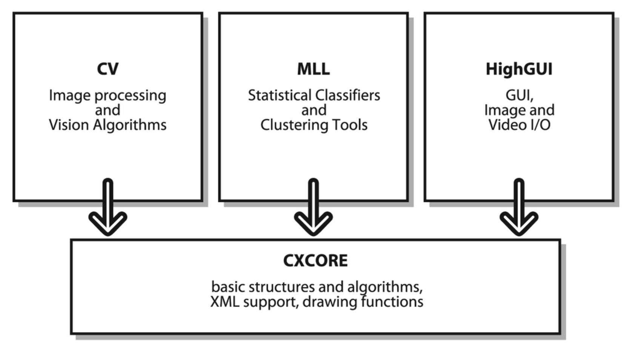
OpenCV Structure
CvAux
Defunct areas and experimental algorithms
Notes:
OpenCV is broadly structured into five main components, four of which are shown the figure.
The CV component contains the basic image processing and higher-level computer vision algorithms;
ML is the machine learning library, which includes many statistical classifiers and clustering tools.
HighGUI contains I/O routines and functions for storing and loading video and images,
CXCore contains the basic data structures and content.
CvAux contains both defunct areas (embedded HMM face recognition) and experimental algorithms (background/foreground segmentation).

Slide 6
What OpenCV can do?
Image Processing
Gradients, Edges, Corners and Features, Sampling, Interpolation and Geometrical Transforms, Morphological Operations, Filters and Color Conversion, Pyramids and the Applications, Image Segmentation, Connected Components and Contour Retrieval,
Image and Contour Moments, Special Image Transforms, Histograms, Matching
Structural Analysis
Contour Processing , Computational Geometry, Planar Subdivisions
Motion Analysis and Object Tracking
Accumulation of Background Statistics, Motion Templates, Object Tracking, Optical Flow, Feature Matching, Estimators
Pattern Recognition
Object Detection
Camera Calibration and 3D Reconstruction
Single and Stereo Camera Calibration, Pose Estimation, Epipolar Geometry, Stereo Correspondence

Slide 7
What OpenCV can do?
Image Processing
Gradients, Edges, Interpolation and Geometrical Transforms, Morphological Operations, Histograms, Corners and Features, Sampling, Filters and Color Conversion, Pyramids and the Applications, Image Segmentation, Connected Components and Contour Retrieval,
Image and Contour Moments, Special Image Transforms, Matching
Structural Analysis
Contour Processing , Computational Geometry, Planar Subdivisions
Motion Analysis and Object Tracking
Accumulation of Background Statistics, Motion Templates, Object Tracking, Optical Flow, Feature Matching, Estimators
Pattern Recognition
Object Detection
Camera Calibration and 3D Reconstruction
Single and Stereo Camera Calibration, Pose Estimation, Epipolar Geometry, Stereo Correspondence

Slide 8
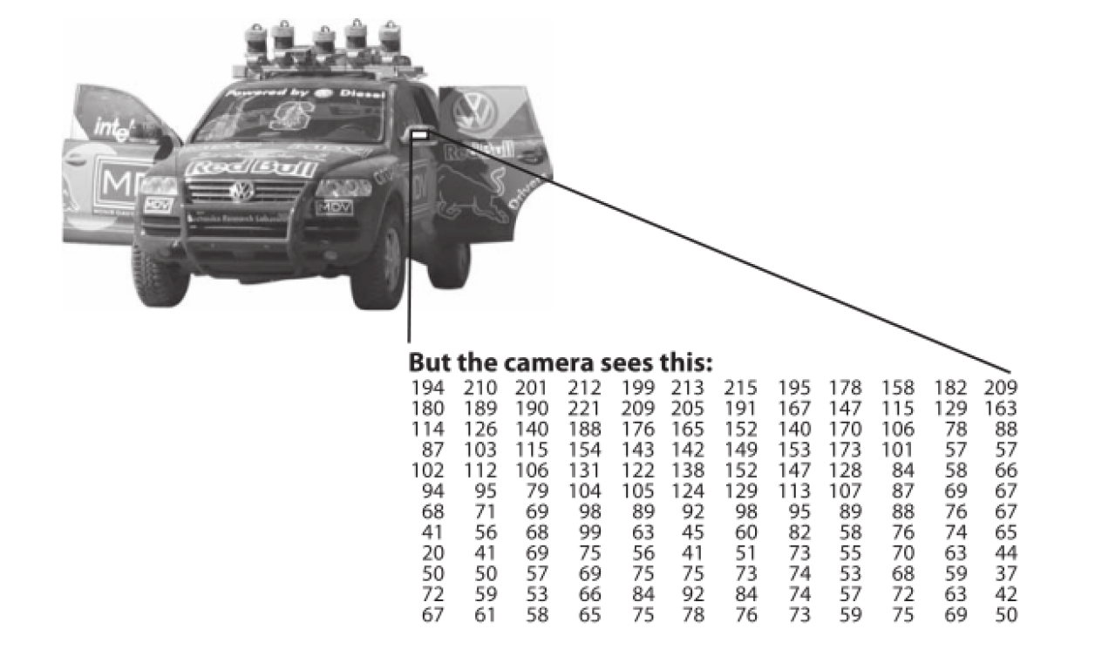
Image Processing Basics
The basics – An “Image” and A “Frame”
  An Image = 2D array or 3D array
  A frame = a single image in a video sequence.
Read, display and write an image in OpenCV
cv2.imread()
cv2.imshow()
cv2.imwrite()

Slide 9
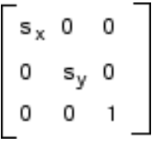
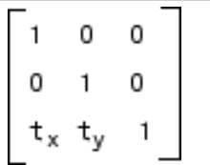
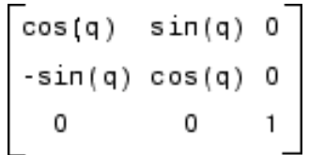
Geometric Transformation
Scaling
Resizing an image. Need to use interpolation.
cv2.resize()
Translation
Shifting of object location. cv2.warpAffine()
Rotation
Rotating an image by an angle. Cv2.warpAffine()
Affine transformation
In affine transformation, all parallel lines in the original image will still be parallel in the output image. To find the transformation matrix, we need three points from input image and their corresponding locations in output image.
Notes:
In many cases, the images have geometric distortion introduced by perspective irregularities.
Applying an affine transformation to a uniformly distorted image can correct this distortions (For example, this is useful in satellite imaging where the ground maps can be geometrically corrected.)
An affine transformation is equivalent to the composed effects of translation, rotation, isotropic scaling and shear.
positive angles being clockwise rotations

Slide 10
Morphological Transformation
Morphological transformations is normally performed on binary images.
Two inputs: original image and kernel.
Erosion
Dilation
Open
Close

Slide 11
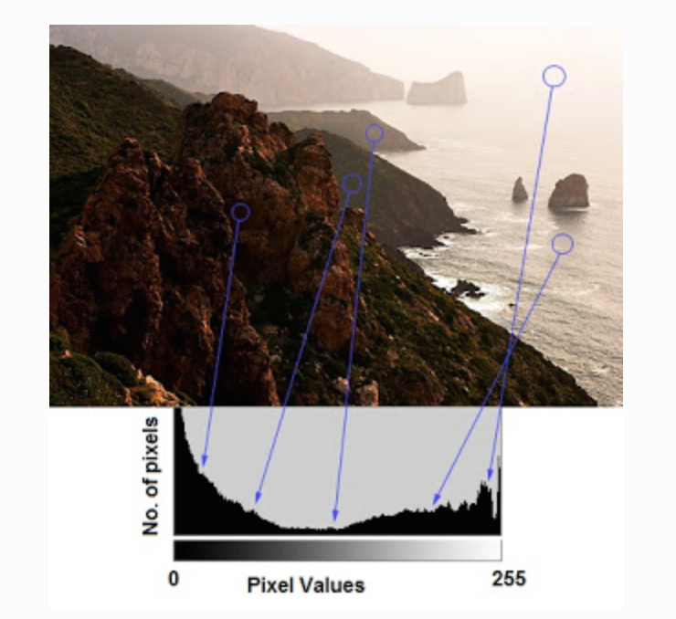
Histogram
Histogram: intensity distribution of an image. Get intuition about contrast, brightness, intensity distribution.

Slide 12
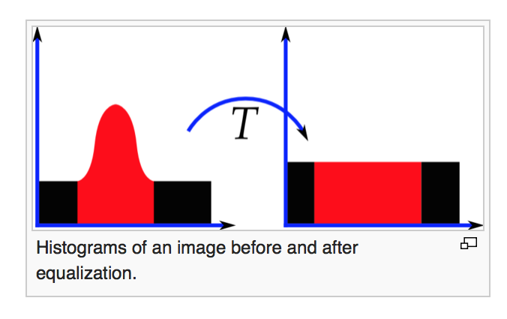
Histogram Equalization
Histogram equalization: a method to adjust image intensities to enhance contrast using histogram.
We would like to create a transformation of the form y = T(x) to produce a new image {y}, with a flat histogram.
Notes:
The method can lead to better views of bone structure in x-ray images, and to better detail in photographs that are over or under-exposed
It may increase the contrast of background noise, while decreasing the usable signal
histogram equalization on a grayscale image. However it can also be used on color images by applying the same method separately to the Red, Green and Blue components of the RGB color values of the image.
if the image is first converted to another color space, Lab color space, or HSL/HSV color space in particular, then the algorithm can be applied to the luminance or value channel without resulting in changes to the hue and saturation of the image.

Slide 13
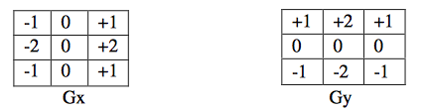
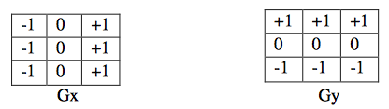
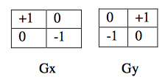
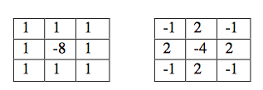
Edge Detection
Sobel edge detection
Prewitt edge detection
Roberts
Laplacian of a Gaussian (LoG)
Canny edge detection
Notes:
Using different mask to get approximation to the derivatives.
Canny edge detection: finds edges by looking for local maxima of the gradient of f(x,y). The gradient is calculated using the derivative of a Gaussian filter. The method uses two thresholds to detect strong and weak edges, and includes the week edges in the output only if they are connected to strong edges.

Slide 14
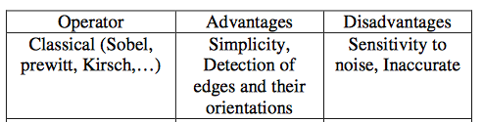
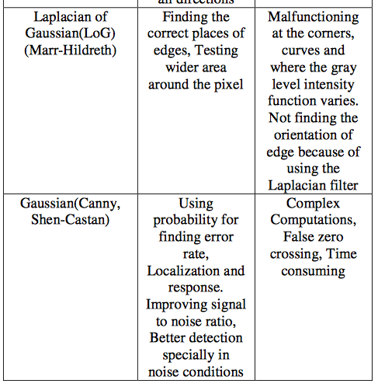
Edge Detection Comparison

