Slide 1
An Introduction to H2O via R
Brad Sliz (d7oz)

Slide 2
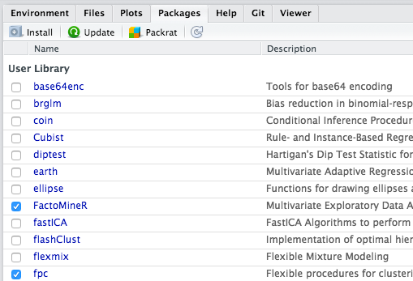
Installing the latest available H2O R package

Slide 3
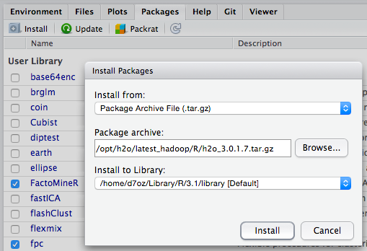
Installing the latest available H2O R package

Slide 4
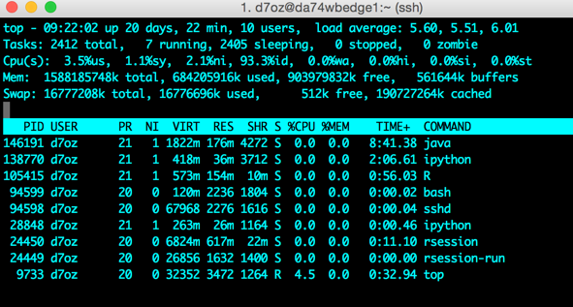
Detecting an H2O VM

Slide 5
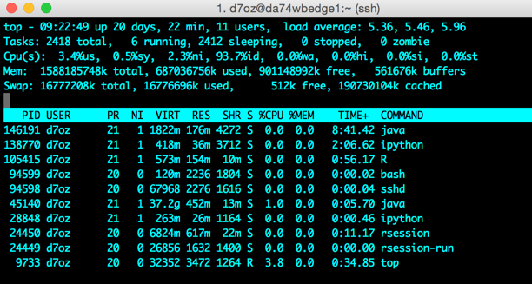
Detecting an H2O VM

Slide 6
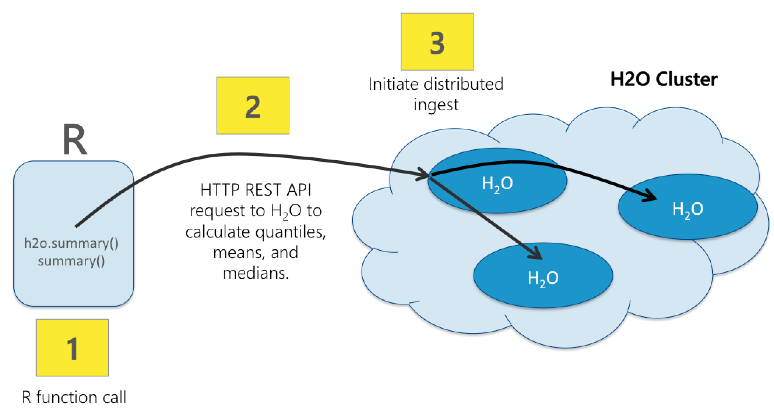
Interacting with H2O

Slide 7
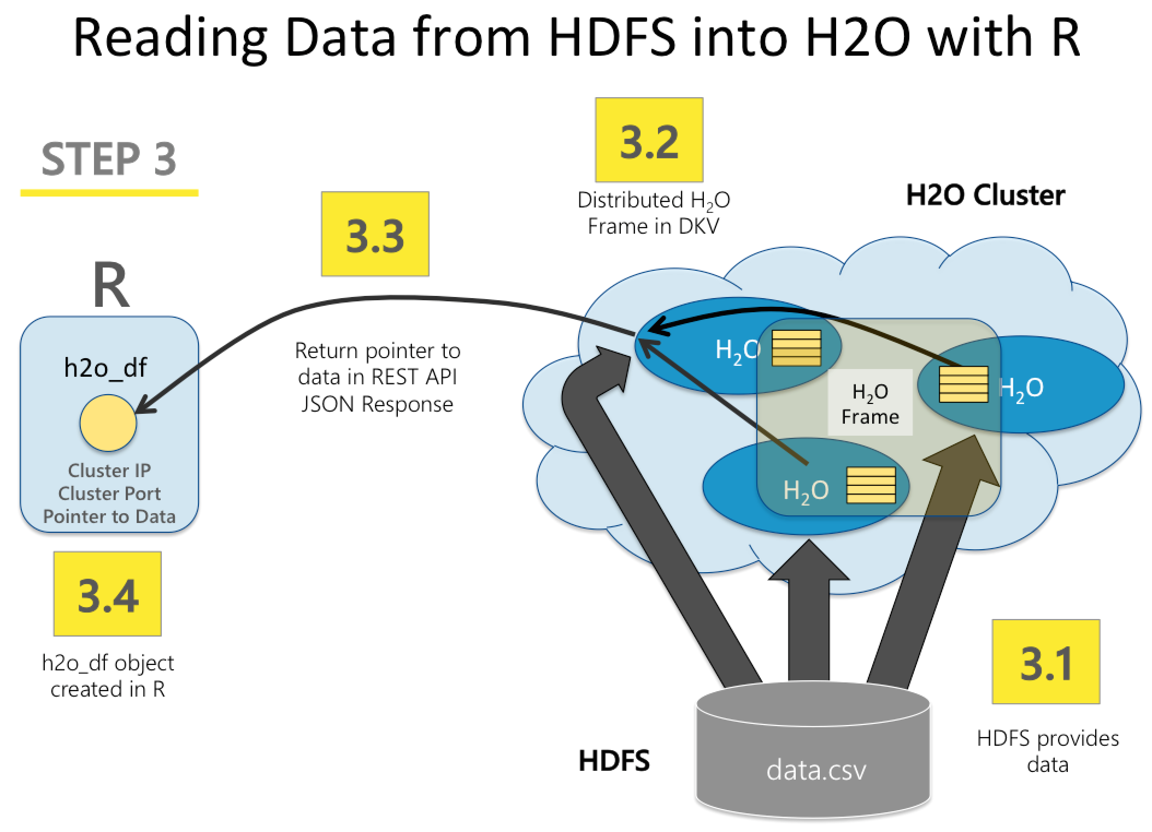
Reading from HDFS into H2O with R

