Slide 1
GROUP 43
Abhishek Vishwakarma IIT2017091
Anuj Raj IIT2017092

Slide 2
Problem Statement
Our required aim is to design an algorithm to find
the shortest distance between any pair of vertices using branch and bound.

Slide 3
Introduction
The shortest-path problem is one of the well-studied topics
in computer science, specially in graph theory.This is a
problem of finding the shortest path or route from a starting
point to a final destination. Generally, in order to represent
the shortest path problem we use graphs. The majority of
shortest-path algorithms fall into two broad categories. The
rst category is single- source shortest-path (SSSP), where the
objective is to find the shortest-paths from a single-source vertex
to all other vertices. The second category is all-pairs shortest-
path (APSP), where the objective is to find the shortest-paths
between all pairs of vertices in a graph. This paper aims to
solve the latter category.

Slide 4
Algorithm
The graph G(V, E) is represented by adjacency matrix.
Where a ij contains the weight or cost or distance between
node i and j. Another matrix Dist stores the final distance
between any two vertices of the graph. Initially d ij is set to
INF value.

Slide 5
Approach 1: Branch and Bound
There is two layer in this algorithm. First shortest path
between source and destination is found. Then this is repeated
for each pair of node in the graph. First goes in the following
manner:
To find shortest path between source and destination pair we
check every possible path from source to destination. Since it
is known that cycle does not exist in the shortest path. Thus
while travelling through a path there visited node is not visited
again.
Travelling through a path the current distance till the current
node from source is maintained. There are two sets of vertices
visited and non visited. starting with the source node, it is
set to visited with current distance set to zero.

Slide 6
Each adjacentnode to the current node which is not visited is considered as
a separate branch i.e. a separate path. for a particular branch
with ith node as the next node, the current distance is updated
as:
currentDist+ = weight(currentN ode, ithnode)
If this currDistance is not less than the last shortest distance
bound between source and destination then the branch will
not give the shortest path. Finally if a branch has visited
the destination and the currDistance is less than last best
known shortest distance of the source destination pair then
last solution is updated with current solution. when every
branch is exhaustively searched the final shortest solution is
attained. This algorithm is repeated for all source destination
combination.

Slide 7
Approach 2: Dijkstra’s Algo
Dijkstra’s algorithm is be used to find the shortest path from
one node in a graph to every other node within the same graph
data structure, provided that the nodes are reachable from the
starting node.
This algorithm will run until all the vertices in the graph
have been visited.This means shortest path between two nodes
can be saved and looked up after.
In Dijkstra’s algorithm, a starting node is given.A distance
matrix is maintained to store the distance of nodes from the
source vertex in each subsequent round and a visited array is
used to check a node is visited or not. Initially, distance matrix
is set to infinity and visited array to false.

Slide 8
Every time we decide to move to a new node,we will choose
the node with the shortest known distance/cost to visit first.
Once we’ve moved to the node,we’re going to visit,we check
each of its neighbouring nodes.
For each neighbouring node, we calculate distance/cost for
neighbouring nodes by summing the cost of the edges that
lead to the node we’re checking from the starting node.
Finally,if the distance/cost to a node is less than a known
distance,we update the shortest distance that we have for that
vertex.

Slide 9
Pseudo Code(Branch and Bound)
procedure FIND DISTANCE (currPath, level, currDistance,
src, des, size)
bound ← dis[src][des]
if currentNode == des then
if currDistance < bound then
dis[src][des] ← currDistance
return
else
for each adj non visited node do
currDistance
←
currDistance +
weight[currentNode][adjNode]
if currDistance < bound then
vis[adjNode] ← true
currPath[level − 1] ← adjNode
findDistance(currPath, level
+
1, currDistance, src, des, size)
\*Prune the node by resetting the currDistance and visited
node list*\
procedure MAIN
Store weights in adjacency matrix
\*Apply findDistance to all pair of source and destina-
tion*\

Slide 10
Pseudo Code (Dijkstra’s algo)
procedure DIJKSTRA (v, matrix[], alldist[], src)
dist[] ← min dist of all vertices f rom source
set[] ← visited array
dist[] ← INT_MAX
set[] ← false
dist[src] ← 0
for count from 0 → v − 1 do
u ← index which is min and unvisited
set[u] ← true
for I from 1 → v do
if !set[I] and dist[u] + matrix[u][i] <
dist[I] and matrix[u][I] and dist[u]! = INT_MAX
then
dist[I] ← dist[u] + matrix[u][I]
for I from 1 → v do
alldist[src][I] ← dist[I]
procedure MAIN
Store weights in adjacency matrix
Apply dijkstra() to all vertices as source

Slide 11
Experimental Analysis
For the experimental analysis of this algorithm, size of the
adjacency matrix varied, that is number of nodes is varied to
see how the execution time varies with number of nodes. The
inputs are taken from the standard random generator in the
range 1 < W < 20. Where w ij is the weight or cost of the
edge between i and j. The graph of order vs execution time.
is plotted using .dat file generated from the source code.

Slide 12
Time Complexity Discussion
1) Branch and Bound Brute Force ASAP: Total possible paths (if the graph is complete, which is the worst case). Thus total worst complexity is O(V^2).
But since the bound is updated periodically since all possible
path branch is not executed average running time is much
faster.

Slide 13
Dijkstra’s Algorithm ASAP: Dijkstra’s approach as dis-
cussed in the algorithm design section optimises the branch
and bound by applying the greedy approach. The most general
case of APSP is a graph with non-negative edge weights. In
this case, Dijkstra’s algorithm can be computed separately for
each vertex in the graph. The time complexity of Dijkstra’s
algorithm for a single source is be O(V^2) This is the worst
case complexity when the graph is complete. Best case will
be the case when the there is no connected edge . Here V
is the number of vertices in the graph. Thus for every source
Dijkstra’s will have the order O(V^3 )

Slide 14
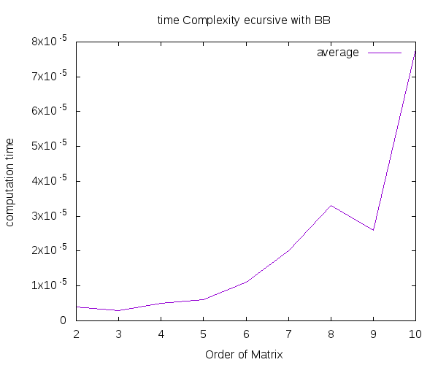
Graph(Branch and Bound)

Slide 15
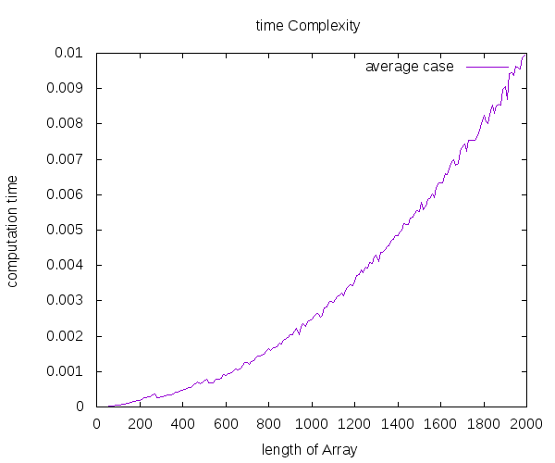
Graph(Dijkstra’s Algo)

Slide 16
Conclusion
The proposed Algorithm to find shortest path for all
source destination pair using branch and bound has factorial
complexity. Average cases experiment with sparse adjacency
matrix shows that the branch and bound strategy is much
faster than the hypothesis. The proposed Dijkstra’s algorithm
ASAP improves the complexity of the branch and bound
approach providing polynomial time solution with complexity
O(V^3 ).

Slide 17
Thank You!

