Slide 1
GROUP 22
Lovely Digra IIT2017090
Abhishek Vishwakarma IIT2017091
Anuj Raj IIT2017092

Slide 2
Problem Statement
Our required aim is to design an algorithm to find a
polynomial by rearranging the coefficients of the given polynomial such that sum of its roots is minimum.

Slide 3
Introduction
Any general polynomial of degree n:
P (x) = a n x n + a n−1 x n−1 + a n−2 x n−2 + …
Fundamental theorem of Algebra says that, in a n-degree
polynomial, total number of roots is n,real or complex not
necessarily distinct. Vieta’s formulas relate the polynomial’s
coefficients a k to signed sums as follows :
x 1 + x 2 + ... + x n = − a^(n-1)/a^n.

Slide 4
For further discussion a^n and a^(n−1) is referred as ‘a’
and ‘b’ respectively. We are given an array of coefficients of
the polynomial. If the polynomial is of degree n then the
array contains n+1 elements one for constant. Except the first
element, any element can be a zero. Also length of the array
is greater than 1.

Slide 5
Algorithm
The problem of minimizing the sum of roots is converted
into maximizing the ratio a b . For this, b should be the maxi-
mum value in the array and a should be the minimum value
and also a.b > 0. So the coefficients of array is divided in
three set : positive coefficients, negative coefficients and zero
coefficients. This type of grouping will result in the following
four cases. a and b are swapped according to the following
cases. Note that the non-zero a n constraint is followed.
Case 1: When the number of positive coefficients and the
number of negative coefficients both are greater than or equal
to 2. In this case, we will find a maximum and minimum from
positive elements and from negative elements also and we will
check which is smallest among −(maxPos)/(minPos) and −(

Slide 6
abs(maxNeg) )/ ( abs(minNeg) ) and print the answer after.
Case 2: When the number of positive coefficients is greater
than equal to 2 but the number of negative coefficients is less
than 2. In this case, we will consider the case of the maximum
of positive and minimum of positive elements only. Because if
we picked up one from positive elements and the other from
negative elements, the result of -b/a will be a positive value
which is not minimum (as we require a large negative value).
Case 3: When the number of negative coefficients is greater
than equal to 2 but the number of positive coefficients is less
than 2. In this case, we will consider the case of the maximum
of negative and minimum of negative elements only. Because
if we picked up one from positive elements and the other from
negative elements, the result of -b/a will be a positive value
which is not minimum (as we require a large negative value).

Slide 7
Case 4: When both the counts are less than or equal to 1.
In this case whatever value of a and b are selected the product
will be negative or zero , so the maximum possible value of
the ratio can zero. Thus this case can be further divided in two
sub cases:
case 4.1: Atleast one coefficient is zero: If there is
a zero coefficient in the array , b is swapped with zero. for
example :
input: 1 -2 0 0
output: -2 0 1 0
i.e. if given polynomial is x 3 − 2x 2
output polynomial is −2x 3 + x with sum zero.
case 4.2:There are two coefficient. None of them is zero. The
answer is found by simple comparision.

Slide 8
Pseudo Code
procedure getM inSum(intarr[], intn)
vector<int> res;
//Store coefficients of final polynomial
vector<int> pos;
//Store indices of positive no
vector<int> neg;
//Store indices of negative no
vector<int> zero;
//Store indices of occurrence of zero
for all i = 0 to n do
if A[i] < 0 then
neg.push back(i);
else
pos.push back(i);
if pos.size() >= 2 && neg.size() >= 2 then
findRatio of both();
else if pos.size() >= 2 then
findRatio of pos();
else if neg.size() >= 2 then
findRatio of neg();
else
findRatio();
//Print coefficients of final polynomial
for all i = 0 to res.size() do
Print(res[i])

Slide 9
Pseudo Code (Case 1)
//For pos.size() >= 2 && neg.size() >= 2
procedure f indRatio of both()
posM ax ← maximium positive number
posM in ← minimum positive number
posM axIdx ← index of max +ve number
posM inIdx ← index of min +ve number
negM ax ← maximium negative number
negM in ← minimum negative number
negM axIdx ← index of max -ve number
negM inIdx ← index of min -ve number
//Store value of ratios
posV al ← -1.0*(posMax / posMin);
negV al ← -1.0*(negMax /negMin);
//Store coefficients of final polynomial in res
if posV al < negV al then
res.push back(arr[posMinIdx]);
res.push back(arr[posMaxIdx]);
for all i = 0 to n do
if i 6 = posM inIdx&&ı 6 = posMaxIdx then
res.push back(arr[i]);
else
res.push back(arr[negMinIdx]);
res.push back(arr[negMaxIdx]);
for all i = 0 to n do
if i 6 = negM inIdx&&ı 6 = negMaxIdx then
res.push back(arr[i]);

Slide 10
Pseudo Code (Case 2)
// For pos.size() >= 2
Input: vector res,
vector pos,
int arr[],
int n
procedure f indRatio of pos()
posM ax ← maximium positive number
posM in ← minimum positive number
posM axIdx ← index of max +ve number
posM inIdx ← index of min +ve number
res.push back(arr[posMinIdx]);
res.push back(arr[posMaxIdx]);
for all i = 0 to n do
if i 6 = posMinIdx && i 6 = posMaxIdx then
res.push back(arr[i]);

Slide 11
Pseudo Code (Case 3)
/For neg.size() >= 2
Input: vector res,
vector neg,
int arr[],
int n
procedure f indRatio of neg()
negM ax ← maximium negative number
negM in ← minimum negative number
negM axIdx ← index of max -ve number
negM inIdx ← index of min -ve number
res.push back(arr[negMinIdx]);
res.push back(arr[negMaxIdx]);
for all i = 0 to n do
if i 6 = negMinIdx && i 6 = negMaxIdx then
res.push back(arr[i]);

Slide 12
Pseudo Code (Case 4)
//For pos.size <=1 && neg.size <=1
Input: vector res,
vector zero,
int arr[],
int n
procedure f indRatio()
if zero.size() == 0 then
//Store value of ratios
val1 ← -1.0*(arr[1] / arr[0]);
val2 ← -1.0*(arr[0] / arr[1]);
if val1 <= val2 then
res.push back(arr[0]);
res.push back(arr[1]);
else
res.push back(arr[1]);
res.push back(arr[0]);
else
res.push back(arr[0]); //rest as it is
res.push back(0); // b = 0
for all i = 0 to n do
if i 6 = zero[0] then
res.push back(arr[i]);

Slide 13
Experimental Analysis
For the experimental analysis of this algorithm, we will take
no.of coefficients of a polynomial(n) as an input and plot a
graph of no. of coefficients vs execution time. A .dat file is
generated.

Slide 14
Time Complexity Discussion
The General Time Complexity of the above algorithm
comes to be : O(n), where n is number of coefficients of the
given polynomial.

Slide 15
Best Time Complexity: Omega(n) , when all the coefficients
are positive or negative and the maximum and minimum value
among them are first and second term respectively.
Worst Time Complexity: O(n) , when all the coefficients
are positive or negative and the maximum and minimum value
among them are nth and (n-1)th term respectively.
Space Complexity: O(n), as the number of coefficients is
n . Therefore, nth size array or vector is used to store these
coefficients.

Slide 16
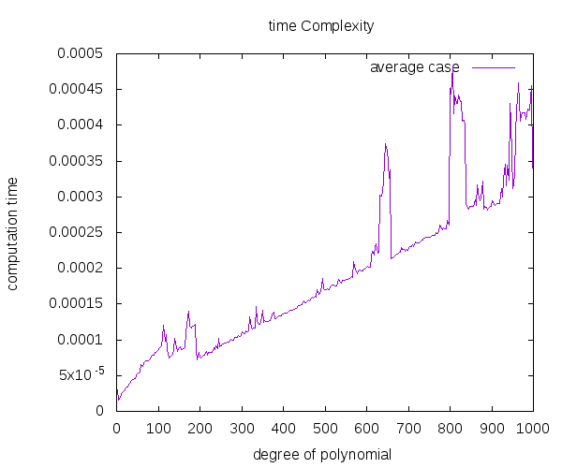
Graph

Slide 17
Conclusion
We designed an algorithm to find a polynomial by rearrang-
ing the coefficients of the given polynomial such that sum of
its roots is minimum. We also analyzed the algorithm that
resulted in general time complexity of O(n) and plotted the
graph number of coefficients vs time elapsed and found that
the nature of graph is straight line..

Slide 18
Thank You!

