Slide 1
Distributed Storage Implementation in a Travel Bureau
Submitted By:
Abhishek Vishwakarma-IIT2017091
Anuj Raj-IIT2017092
Kiran Kumar Datti-IIT2017094
Jai Khurana-ISM2017006
Nayan Agarwal-IWM2017501

Slide 2
Introduction
With the ever-growing technological expansion of the world, distributed systems are becoming more and more widespread. They are a vast and complex field of study in computer science. A distributed system in its most simplest definition is a group of computers working together to appear as a single computer to the end-user. These machines have a shared state, operate concurrently and can fail independently without affecting the whole system’s uptime. For us to distribute this database system, we’d need to have this database run on multiple machines at the same time.

Slide 3
With the quick headway of web based innovation, web based booking administrations has come as an incredible help to most travellers. Most travel offices just as different organizations that are occupied with travel business presently have on their site online transport ticketing booking gateways. From this website page one can undoubtedly book and pay for transport tickets on the web. Our venture is an online framework which uses the benefits of the web to give travel administrations extending from transport passes to movement and lodging reserving for clients from their homes. It gives a straightforward web interface to make the movement solicitation and administrations booking process simple.

Slide 4
Motivation
According to Claudia Leopold, there are eight main motivations for implementing a distributed system instead of simply utilizing the computing resources of a standard computer. These advantages are described briefly below:
(1) Distributed systems improve the “absolute performance” of the computing system
(2) The Price to Performance ratio for the system is more favorable for a distributed system
(3) Technological advantages
(4) Some applications are inherently distributed problems (they are solved most easily using the means of distributed computing

Slide 5
(5) Distributed computing allows the sharing of resources - both hardware and software
(6) Each piece of hardware is replaceable should it fail.
(7) Distributed Computing allows the system to grow incrementally as computers are added one by one.
(8) Distributed computing allows for “scavenging.” According to Leopold, “a lot of power is wasted, particularly during business hours. By integrating the computers into a distributed system, the excess computing power can be made available to other users or applications.
Our motivation was to learn how these features applies to a Online Travel Agency System. To experience the problem faced in implementing the concepts. And to refine the concepts of Distributed systems the we learned during the course

Slide 6
Problem Definition
Implement Online Travel Agency as a distributed storage with following functionalities:
Authentication - Register, Login, Recovery
Book hotels and buses
Be a service provider - create and delete hotel and bus services
Manage services and bookings
Be an admin - handle databases, user permissions and heartbeat rate
Collaborate with users to manage services

Slide 7
Literature Review
The first Travel Agency of the world was established by Thomas Cook in 1845 in England. The use of the term travel trade dates back from the early years of the 19th century, but this should not obscure the fact that what we today describe as travel trade (travel agency and tour operation business) was taking place much earlier in history.
In 1841 a fortunate day came in the history of travel trade when Thomas Cook, as secretary of South Midland Temperance Association, organized a trip by a train for 570 members for his association to the distance of 22 miles. He bought railway tickets in bulk to sell them to people.

Slide 8
Travel agency is one of the most important organizations in the tourism private sector which plays a significant and crucial role in the entire process of developing and promoting tourism in the country or at a destination and helps in making arrangements for travel tickets and various travel related services.
This is a web based application for an online travel agency that helps travelers to check for bus ticket availability, book a ticket ,check the running status of the bus and book a hotel. Various services providers are attracted as they are allowed to create and delete bus and hotel services.
A distributed database is a database in which data is stored across different physical locations.[1] It may be stored in multiple computers, located in the same physical location (e.g. a datacenter); or may be dispersed over a network of interconnected computers. Unlike parallel systems, in which the processors are tightly coupled and constitute a single database system, a distributed database system consists of loosely coupled sites that share no physical components.

Slide 9
Replication involves using specialized software that looks for changes in the distributive database. Once the changes have been identified, the replication process makes all the databases look the same. The replication process can be complex and time-consuming depending on the size and number of the distributed databases. This process can also require a lot of time and computer resources.
Duplication, on the other hand, has less complexity. It basically identifies one database as a master and then duplicates that database. The duplication process is normally done at a set time after hours. This is to ensure that each distributed location has the same data. In the duplication process, users may change only the master database. This ensures that local data will not be overwritten.

Slide 10
Homogeneous Distributed Databases Management System
In homogeneous distributed database, all sites have identical software and are aware of each other and agree to cooperate in processing user requests. Each site surrenders part of its autonomy in terms of right to change schema or software. A homogeneous DBMS appears to the user as a single system. The homogeneous system is much easier to design and manage. The following conditions must be satisfied for homogeneous database:

Slide 11
Heterogeneous DDBMS
In a heterogeneous distributed database, different sites may use different schema and software. Difference in schema is a major problem for query processing and transaction processing. Sites may not be aware of each other and may provide only limited facilities for cooperation in transaction processing. In heterogeneous systems, different nodes may have different hardware & software and data structures at various nodes or locations are also incompatible. Different computers and operating systems, database applications or data models may be used at each of the locations. For example, one location may have the latest relational database management technology, while another location may store data using conventional files or old version of database management system. Similarly, one location may have the Windows operating system, while another may have UNIX

Slide 12
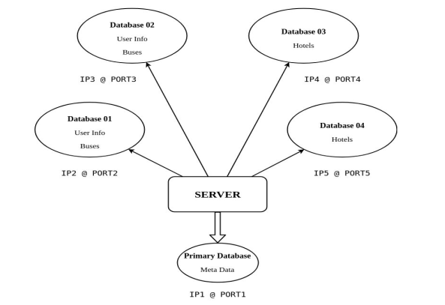
Proposed Methodology
Architecture

Slide 13
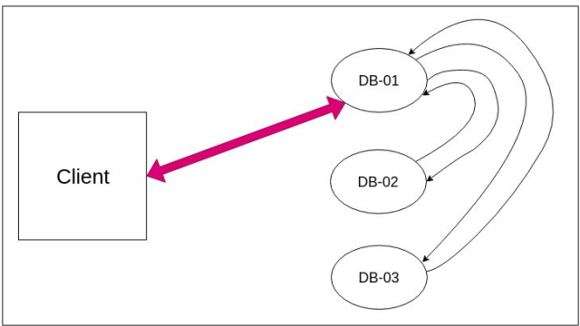
Architecture

Slide 14
ASSUMPTIONS and DETAILS
The master server never crashes (single point failure)
➢ More than 2 servers are never down at any point of time (replication = 3)
➢ Transaction handling is out of scope for this project
➢ There may be a finite delay in message requests
➢ There are no permanent crashes
➢ There are at least 3 databases available (active) at any point of time
➢ Primary server may not crash while waiting for response
➢ There is a single master server and 8 data servers
➢ Heartbeat rate can be changed by the admin
➢ New databases can be added only by the superuser
➢ Replication factor is set to 3, i.e 3 copies of any data are stored.

Slide 15
Handling Writes
These are possibilities of write request:
Request received at master
Request received at active data server
Handling Write Request received at master:
Master forwards the request until 3 data servers respond positive
Assign “primary” to one of the 3 servers and “secondary” to the other 2
Returns status = 200 OK (positive) to the client

Slide 16
Handling Write Request received at active data server:
Request forwarded by master
Write data
Response status = 200 OK to the master, if successful
Response status = 404 BAD REQUEST (or any other relevant status), if unsuccessful
To create a new record, we need to select 3 active machines and insert data into them. Also, we name one of them as primary.

Slide 17
Handling Updates
Updates need to be consistent, meaning all the data servers should have the same updated record. As soon as the master receives the request for update, it forwards it to the primary data server of that record. It is the primary data servers' duty to update the remaining 2 secondary servers. This technique would help to reduce the load on the master. If it happens that any of the secondary data servers is down, then the primary informs the master regarding the pending update. The master later updates the record when the secondary server becomes active again. If it happens that the primary itself is down, then the master simple chooses a new primary and makes the current one a secondary

Slide 18
These are possibilities of Update request:
Request received at master
Request received at primary server
Handling Update Request received at master:
Figure out the primary database and secondary databases
If primary is not active, make any of the active secondary server primary
Forward update request to the primary and wait for response

Slide 19
Handling Update Request received primary server:
Write data
Forward the request to the secondary servers
Return relevant response
All OK
Any DB not updated?

Slide 20
Handling Reads
To fetch any record, we iterate through the active data servers and try to get the required record. We return it to the user as soon as we get it from the database.
These are possibilities of read request:
Request received at master server
Request received at Data Server

Slide 21
Request received at master server:
Forward request one after another to all active databases (or just 3, depends on the situation)
Return as soon as any one responds
Request received at Data Server:
Return status along with requested data

Slide 22
HeartBeat
The master pings all data servers periodically to check which ones are crashed and which ones are active. The time period can be altered and set in the application by the admin.
A parallel thread manages heartbeat requests along with the running masterserver.
Sends request to all registered data servers and marks their status.
Recommended to have heartbeat below 10 seconds, else user has to wait long to update data (receives Internal Error)

Slide 23
Handling Failures
As already mentioned in assumptions, the primary data server may not crash while waiting for a response.
Consider the following cases:
Case1: At Master
Make sure primary is active
Forward update request to primary
In case 1 if the primary server crashed in between steps 1 and 2 then the user receives a message - “Internal Error”.

Slide 24
Case2: At Master with Heartbeat rate = 30 seconds
T = 0, heartbeat detects primary data server alive
T = 5, primary data server fails
T = 10, update request for a record where primary is the failed server
Next heartbeat at t = 30
In this case also the user receives a message - “Internal Error”.
The replication factor is fixed to 3, meaning data would be inserted in 3 different machines (called data servers). Replication factor of 3 ensures that even if any two systems are down, the application would still run smoothly.And one among them will be the primary server.

Slide 25
Tools Used
Front End : HTML, CSS (Bulma UI), Javascript
Back -End : Python Django
Database : PostgreSQL

Slide 26
RESULTS
Database details , access Privileges and Heartbeat Rate
Here in Database details we can observe that there are 4 secondary databases at different ports which have the same data with a primary database which checks the status of all the secondary databases according to the heartbeat rate as discussed in the earlier sections.

Slide 27
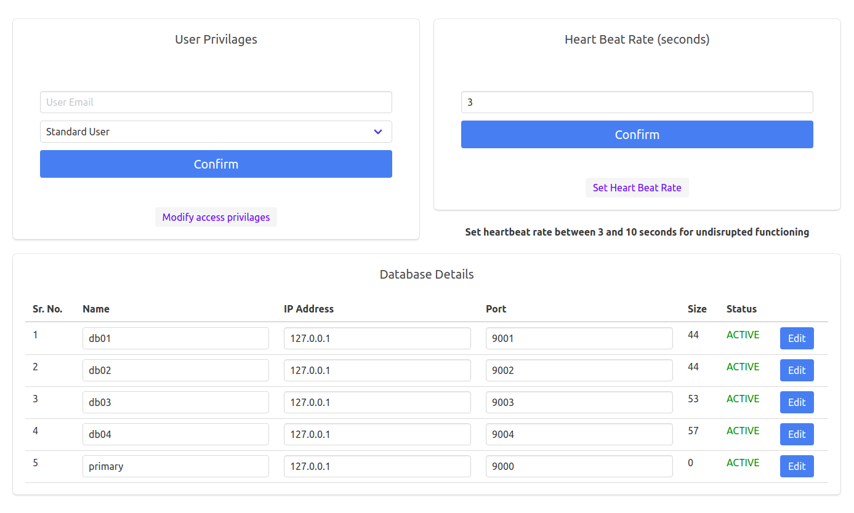

Slide 28
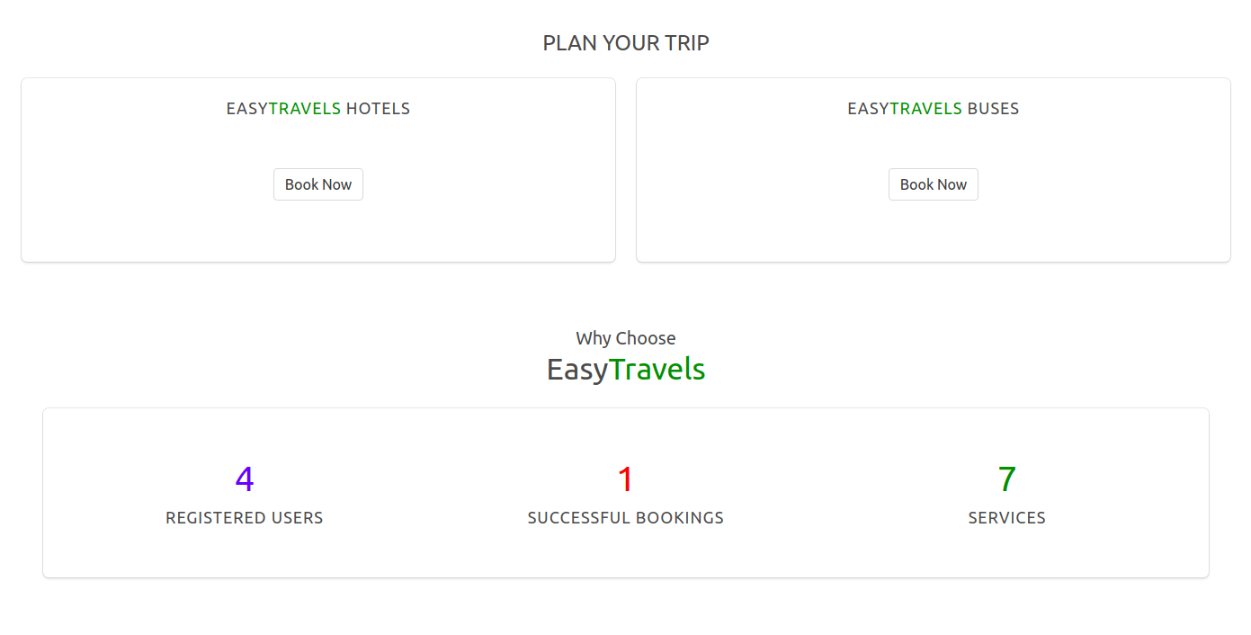
Other User Interface Functionalities

Slide 29
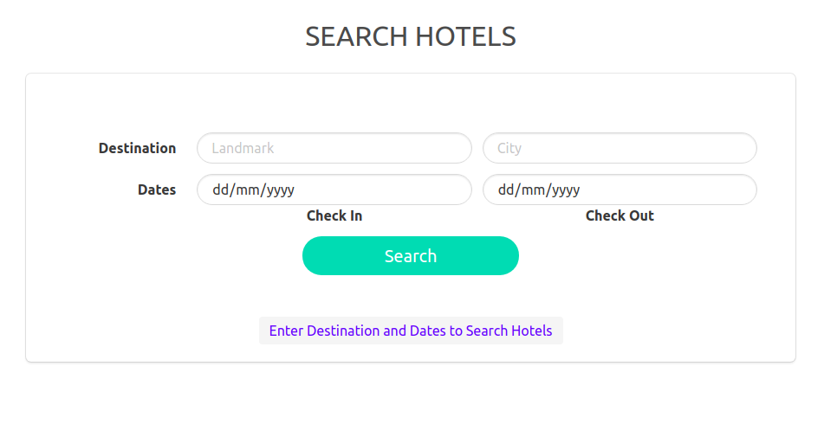

Slide 30
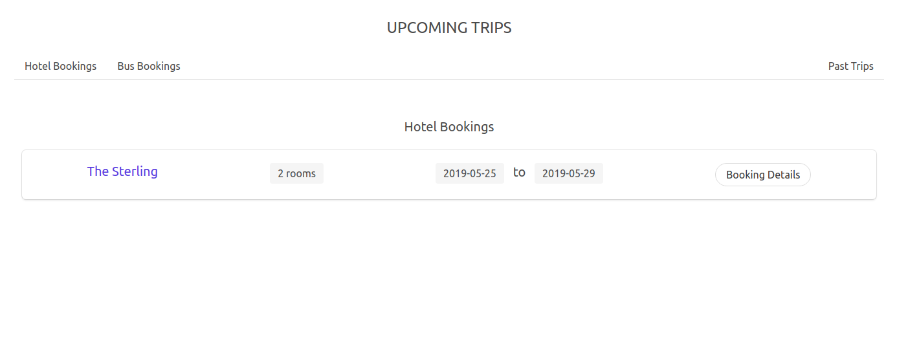
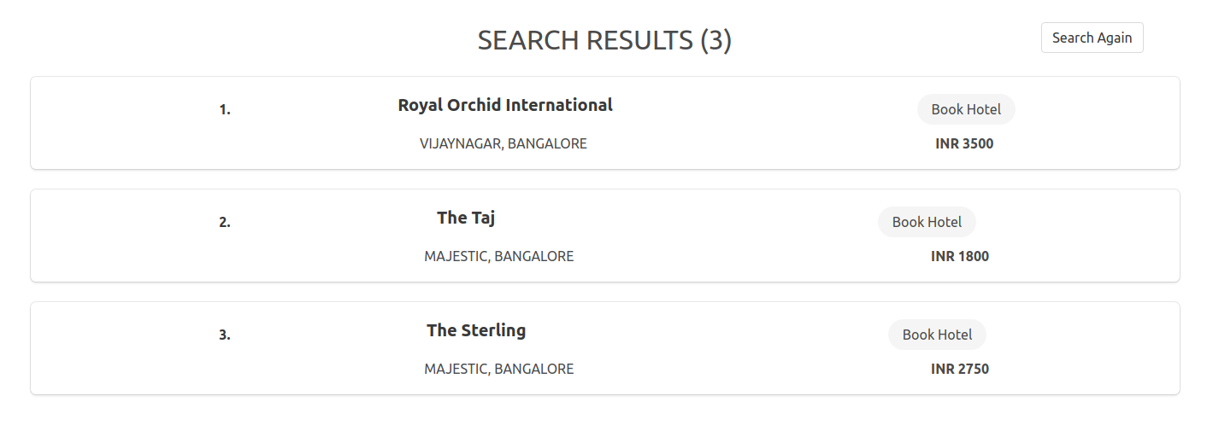

Slide 31
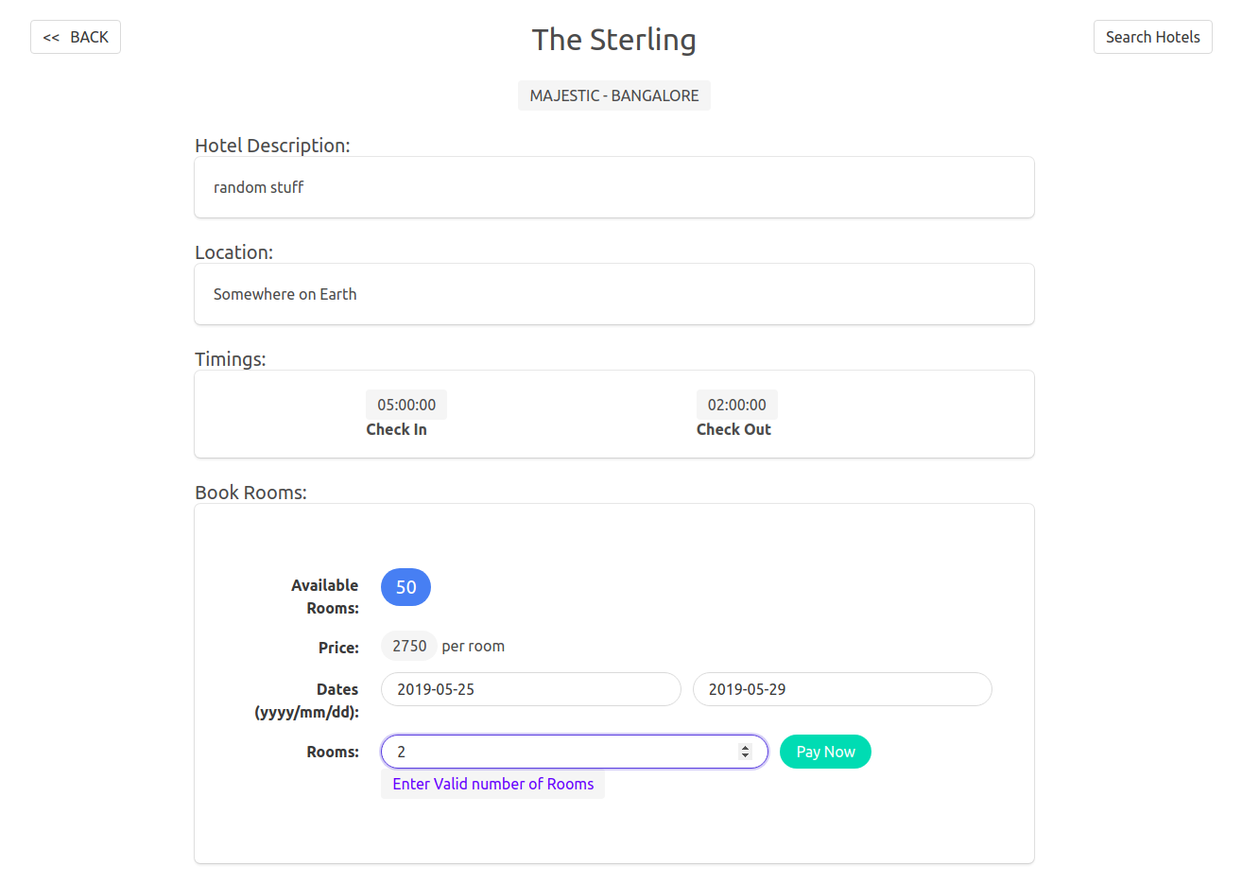

Slide 32
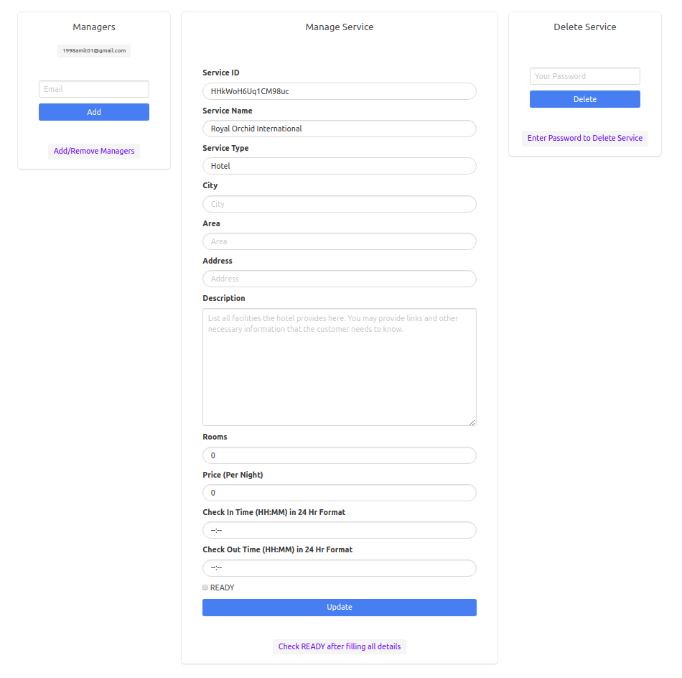

Slide 33
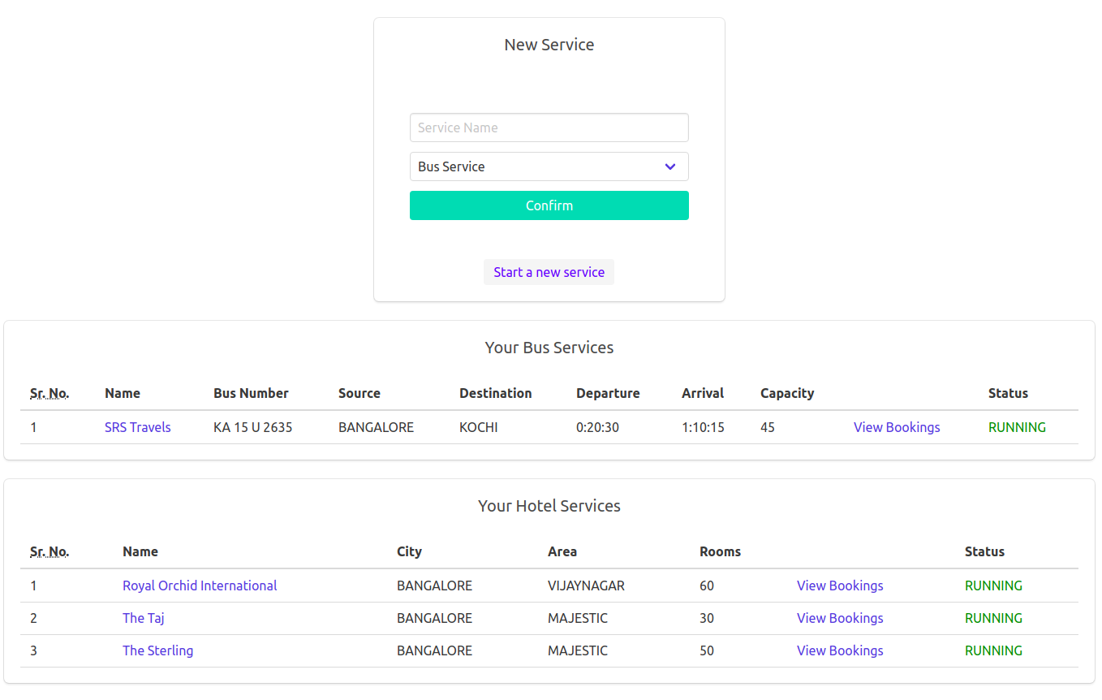

Slide 34
Future Work
As a future scope of this project, we can add a recommendation section, where we can build an ML engine to provide necessary travel information to tourists. It must give up-to-date, accurate and timely information regarding destinations mode of travel, accommodation, sightseeing, shopping, immigration, passport, visa, customs clearance and procedure, health and security rules and about various permits required to travel in particular areas etc.

Slide 35
References
[1] Xu, Lihao & Bruck, Jehoshua. (1998). Highly Available Distributed Storage Systems.. 307-330. 10.1007/BFb0110096.
[2] F. E. Oggier and A. Datta, "Maintenance of distributed storage systems,” CoRR, vol. abs/1107.3129, 2011.

