Slide 1
AUTOMATION OF THE
MARKETING LEADS PROCESS

Slide 2
CONTEXT AND NEEDS
Marketing Department currently collects customer interest for bank products through emails received from various sources including branches as well as call centre. These emails do not use standard templates and haphazard in nature, with the department being unable to action since necessary information to follow-up on the customer’s interest is not available most of the time. Besides, any reporting done for this purpose is done manually and considered as incomplete.
The following section presents a series of ideas aimed at understanding the problem, its main challenges, and the possible ways to solve them through the combined implementation of process engineering and digital and automation technologies.

Slide 3
UNDERSTANDING THE REQUIREMENT
✅ The main objective is to collect customer interest in banking services and products.
🛠️ The current process is highly manual, based on email communication.
⚠️ The main issue is the low efficiency due to manual handling and process immaturity.
🧑‍💼 This process Involves the following departments: Marketing, Sales, and Customer Support.
💻 Any technology may be used to implement the proposed solution.
📍 The scope is focused only on branches and the call center.
📊 Business rules, data structure, and result reporting are defined by the presenter.

Slide 4
PAINT POINTS

Slide 5




PAINT POINTS
A high-level overview of the current As-Is process is shown below.
The Pain Points are
shown below
Users
📋 Lack of standardization in data collection
Start
Collecting Comments and Interest
Send email
?
Branches, Call Center and Other Channels
🛠️ Manual and inefficient process
❗ Incomplete or inconsistent information
Marketing Leads
📉 Low process maturity
Take action?
🚫 Missing business rules, priorities, and alerts
Email is received
Review emails
Yes
Follow Up
Generate report
Marketing Department
End
🔍 No traceability or follow-up actions
No
Other process actions
Notes:
Identified Challenges
📋 Lack of standardization in data collection
Makes it harder to interpret messages, reduces team efficiency, and limits their ability to act.
🛠️ Manual and inefficient process
Prone to errors, difficult to scale, and negatively impacts employee motivation.
❗ Incomplete or inconsistent information
Makes proper follow-up difficult and may lead to lost sales or missed opportunities to improve products and services.
📉 Low process maturity
Lack of standardization and automation causes delays in customer responses and in implementing improvements.
🔍 No traceability or follow-up
Prevents performance measurement, hinders continuous improvement, and limits visibility of business impact.
🚫 Missing rules, priorities, and alerts
Leads are classified inconsistently or not at all, with no automated mechanisms for follow-up based on urgency level.

Slide 6
TARGET SCENARIO

Slide 7
TARGET SCENARIO
Suggested Solution Strategy for Development and Implementation
The form fields will be:
Timestamp (automatic) | Channel
Customer Name | Branch
Customer Number | Employee Name Completing
Email Address | Urgency Level
Product(s) of Interest | Priority Product
Comment of the Interest | Processed/Notified (From NLP Model)
Business Rules: We define Urgency Level and Priority Product as key business parameters to support decision-making and process monitoring.
  Urgency Level: represents the degree of need or interest expressed in the customer's message (evaluated through sentiment analysis). The source is the subjectivity of the comment.
  Priority Product: reflects the business importance of the product (e.g., products with higher margins or part of marketing campaigns). This is defined by policies or business rules and is useful for investment and marketing decisions.

Slide 8
TARGET SCENARIO
Suggested Solution Strategy for Development and Implementation
Potential KPIs for this process include:
  % of Urgent Leads
  % of Priority Products
  Average Response Time to Urgent Leads
  % of Urgent Leads Without Follow-up
For this demo, we will focus on:
✅ % of Urgent Leads
✅ % of Priority Products

Slide 9
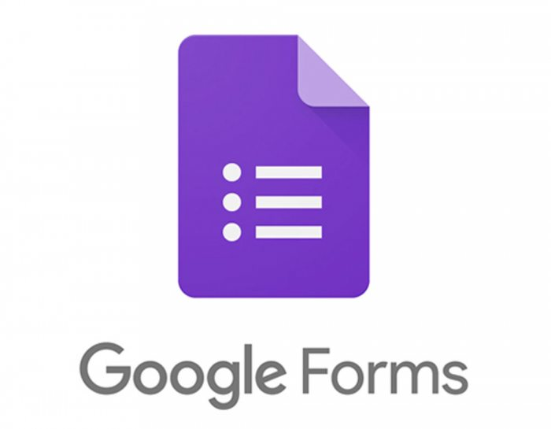







TARGET SCENARIO
The following diagram shows the high-level To-Be process
Start
Collect comments and interests
Users
Branches, Call Center and Other Channels
Google
Forms
Google
Sheets
Marketing Leads
Python
Google
App Script
Is it priority and urgent lead?
API
Chat GPT
Records stored in the cloud
Analyze sentiments and needs
Send alert and follow-up
Summary and follow-up dashboard
End
Marketing Department
Yes
Google
Looker
Studio
No
Other process actions
Notes:
❌ Lack of standardization in data collection
✅ Solution: Implement a standardized form using Google Forms for branch and call center employees. All required fields (customer, product, channel, comments) are clearly defined and validated.
❌ Manual and inefficient process
✅ Solution: Automate the workflow with Apps Script, Python, and data analysis tools to process information, analyze comments, and update spreadsheets without human intervention.
❌ Incomplete or inconsistent information
✅ Solution: The form enforces completion of key fields, avoiding missing data. Integration with Apps Script and data analysis models (Python) ensures minimum quality standards before processing.
❌ Low process maturity
✅ Solution: A fully digital, centralized, and traceable process is established. Text processing (sentiment analysis) enables smart classification and prioritization, while serverless tools help automate other workflow areas.
❌ Lack of traceability and monitoring
✅ Solution: Results are logged in Google Sheets with timestamps and processing tags. Looker Studio connects directly to generate real-time dashboards, supporting team performance monitoring and statistics generation.
❌ Missing rules, priorities, and alerts
✅ Solution: Standardization and process analysis, supported by technology and analysis models, assign urgency and priority to each lead. Automatic alerts are generated by email (Apps Script + Gmail) or through task creation based on urgency levels.

Slide 10
LIVE DEMO

Slide 11
NEXT STEPS AND RECOMMENDATIONS
Explore new customer communication channels, such as integrating WhatsApp or similar platforms into the process flow to enhance mid-point interactions.
Scale sentiment analysis techniques to handle more complex scenarios with greater efficiency and accuracy.
Continuously improve the forms based on feedback from both customers and internal staff to ensure better data quality and easier downstream processing.
Start with a controlled pilot, ideally at a single branch or with a selected call center team, before gradually scaling the solution across the organization.
Establish a continuous improvement loop, using performance metrics to fine-tune the analysis model and automation flow when needed.

Slide 12
QUESTIONS

