Slide 1
Coupling Structure and Dynamics in Complex Ecological Networks
Rich Williams

Slide 2
Who am I?
Engineer, physical oceanographer, software developer, theoretical ecologist, network scientist, data scientist

Slide 3
Ecology as a complex system
Many interacting entities (organisms)
Interactions occur across a wide range of spatial and temporal scales
Hierarchical structure?
Notes:
At scales below the individual, hierarchical structure is reflected in physical structure. In ecology, at scales larger than the individual, hierarchical structure is foten imposted by human attempts to categorize and order so as to understand. Exceptions do occur – flocks, hives, other social systems in animals, forests (so some extent)??

Slide 4
Hierarchy in Biology and Ecology
Biological Hierarchy: Organism-organ-tissue-cell-organelle-molecule
- Hierarchy of spatial and temporal scales
Ecological Hierarchy: Ecosystem - ??? – organism
- Organisms in an ecosystem span many orders of magnitude of scales: body size, metabolic rate, generation time, movement
- Aggregates of organisms – populations, functional groups, body-size groupings

Slide 5
Ecological Models
Individual-based
Aggregate individuals
Species
Species and age cohort
Species and life history stage
Body size group
Functional group
Aggregate Rules
Aggregate-level feeding rate and functional response
Growth function

Slide 6
Networks in Ecology
Interactions between
Individuals
Species
Functional groups
Links – feeding, pollination, providing habitat, transmitting information
Notes:
Network science has been emerging as a useful abstraction for understanding complex systems

Slide 7
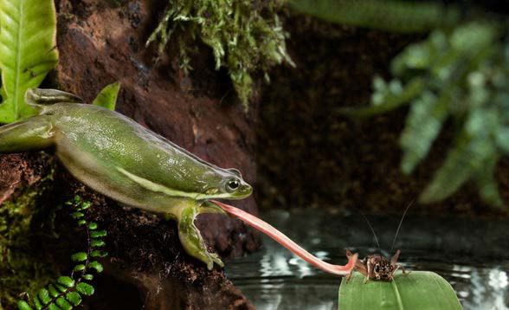
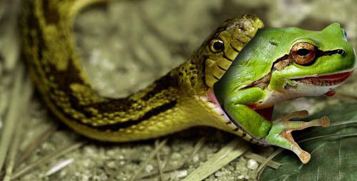
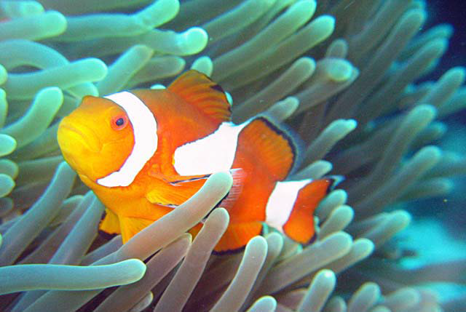
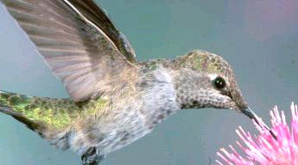
Ecological Interactions
Notes:
Feeding interactions, Feeding plus pollination – mutualistic interaction
Habitat interaction

Slide 8
Food Webs
A network of feeding interactions between
Species
Functional groups
Links might be weighted (diet fraction, net flow of biomass) but more often just indicate presence of a feeding interaction
Even presence/absence data is difficult to compile

Slide 9
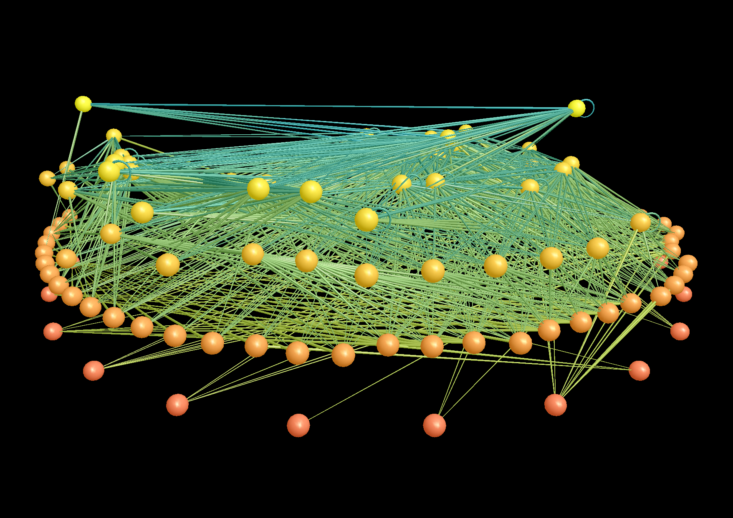
Little Rock Lake, Wisconsin 997 Feeding Links among 92 Taxa: 10 Basal, 72 Invertebrates, 10 Fishes
Martinez, N.D. 1991. Artifacts or attributes? Effects of resolution on the Little Rock Lake food web. Ecological Monographs 61:367-392
Secondary
Carnivory
Fishes
Insects
Primary
Carnivory
Zoo-
plankton
Herbivory
Algae
Link Color Indicates
Type of Feeding Link
Node Color Indicates
Trophic Level of Taxon

Slide 10
Network and Food Web Concepts
Connectance (link density) = L/S² = O(0.1)
Degree – number of links attached to a node
Trophic level – average number of number of feeding links to the base of the food web

Slide 11
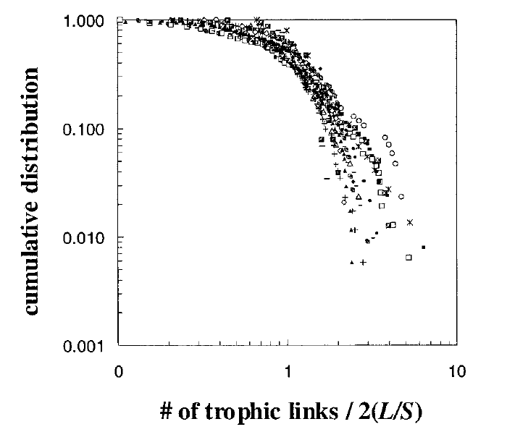
Food Webs Degree Distributions
How many nodes have a particular number of links?
Are food webs scale-free? No…
• Most food webs display single-scale
(exponential-like) distributions.
-i.e., no structurally ‘over-dominant’
taxa in food webs.
• The relatively high L/S and low S of
food webs limits potential heterogeneity of feeding link distribution.
Dunne, Williams and Martinez
2002 PNAS 99:12917

Slide 12
A simple MaxEnt model explains food web degree distributions
Cumulative Resource Distributions
x: # of links
y: log(fraction of nodes)

Slide 13
Modeling Food Web Structure
Predict the structure of empirical networks given their size and number of interactions
Constrain which links are possible by using insights from earlier ecological studies
Hierarchy: big things eat smaller things (or small things parasitize big things)
Niche: organisms consume resources that fall in a constrained range of values of one or more traits

Slide 14
Niche Model of food web structure:
3 Simple Rules
r_{i}
n_{i}
0
1
c_{i}
Step 1: Create a one-dimensional community niche space. Each species is assigned a uniform random n_{i}
Step 2: Each species gets a (beta) random feeding range r_{i}
Step 3: Each feeding range is placed by uniformly choosing a random range center (c_{i}) so that r_{i}/2 < c_{i} < min(n_{i}, 1- r_{i}/2)
A relaxed hierarchy which allows some looping and cannibalism
Constrains each species to consume from a contiguous region in the one-dimensional community niche space.
(Williams & Martinez 2000 Nature)

Slide 15
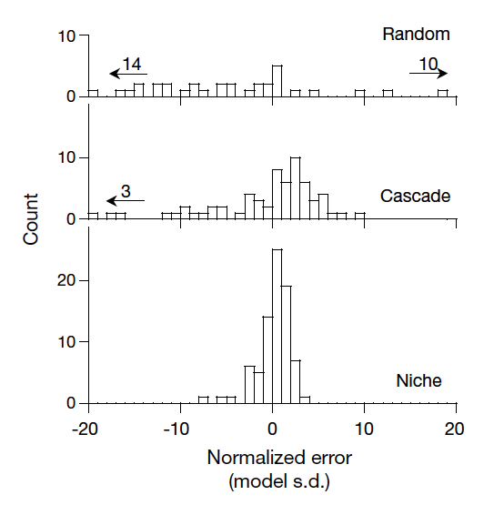
Niche model results
Unconstrained
Hierarchy
Hierarchy and niche

Slide 16
Modeling Food Web Dynamics
Allometric Trophic Network Model
Netwrok structure and energy (biomass) flow between nodes in the network
1. Food Web Structure: Niche Model (Williams and Martinez 2000) or Empirical Data (Boit et al. 2012)
2. Predator-Prey Interactions: Allometric Bioenergetic Model (Yodzis and Innes 1992, Williams and Martinez 2004, Brose et al. 2006)
- Everything needs energy to stay alive
- Body size is important in constraining how energy is acquired and used

Slide 17
Bioenergetic Predator-Prey Dynamics (Animals)
Rate of change of biomass_{i} at time t
3
1
2
Biomass of each species (i) at time (t) is balance of
1. gain from consuming prey species
2. loss to being consumed by other species
3. loss to metabolism

Slide 18
Bioenergetic Predator-Prey Dynamics (Animals)
Consumption
Functional Response
mass-specific metabolic rate
Prey Abundance
assimilation
efficiency
maximum metabolic-specific
ingestion rate
x_{i} scales with body size (allometric scaling)
typically body size is correlated with web structure

Slide 19
Bioenergetic Predator-Prey Dynamics (Plants)
mass-specific
growth rate
metabolic loss
loss to herbivores/omnivores
Density-dependent
growth rate of plants
r_{i} , x_{j} scale with body size (allometric scaling)

Slide 20
Allometrically Scaled Parameter Values
From individual ecology, a llometric (body size) scaling of metabolic and growth rates:
x_{i} = a_{X}M_{i}^{-0.25}
r_{i} = a_{R}M_{i}^{-0.25}
The constants a_{X ,} a_{R} and y_{ij} are derived from empirical observation of metabolic rates, growth rates and feeding behavior respectively.
The metabolic and feeding rate parameters depend on the broad category of the organism (invertebrate, ectotherm vertebrate, endotherm vertebrate).
Body size scaling drastically constrains parameter values
Notes:
Incorporating knowledge from another sub-discipline (metabolic theory) drastically constrains the parameter space

Slide 21
Multi-species Functional Response
Based on foraging theory and measurement of predator-prey interaction rates
q = 0 gives type II response, q > 0 gives type III response (Holling 1959, Real 1977)
d controls predator interference/prey resistance: increased predator density decreases per capita consumption rate (Beddington 1975, De Angelis 1975)

Slide 22
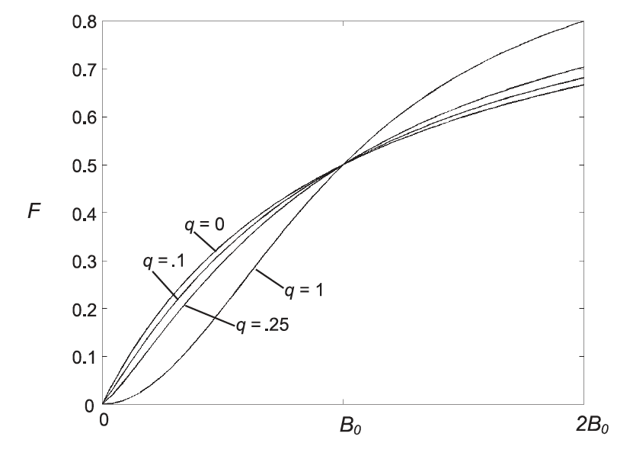
Role of the Functional Response in System Dynamics
Single-species functional response
Small changes in q are empirically indistinguishable

Slide 23
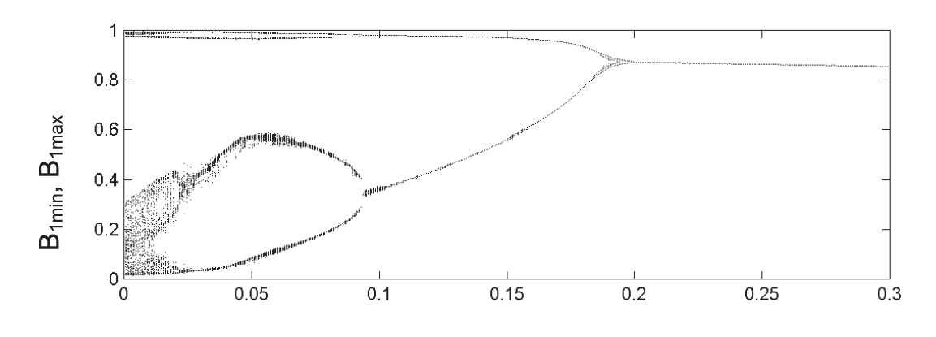
Role of the Functional Response in System Dynamics
Three-species food chain
Small changes in q drive significant changes in dynamics

Slide 24
Role of the Functional Response in System Dynamics
In multispecies systems, small changes in q drive changes in dynamical regime and in ability of species to co-exist, with many more extinctions in systems with q = 0
Are these sensitivities reflective of the dynamics of the underlying system or of the approximations inherent in aggregating from individual organisms to species?

Slide 25
Species can be viewed as having processes operating on short time scales (foraging) and long time scales (breeding)
How do we model systems in which the long time scale (generation time) of some species is similar in magnitude to the short time scale (feeding frequency) of other species?
Are there better ways to aggregate individuals, and to describe the dynamical evolution of the aggregates?

Slide 26
Thank you!

