Slide 1
The Maximum Entropy Theory of Ecology:
John Harte
University of California, Berkeley
SFI
March 15, 2018
What is METE?
When does it work? When/how does it fail?
The relevance of the workshop questions
Possible approaches to finding answers

Slide 2
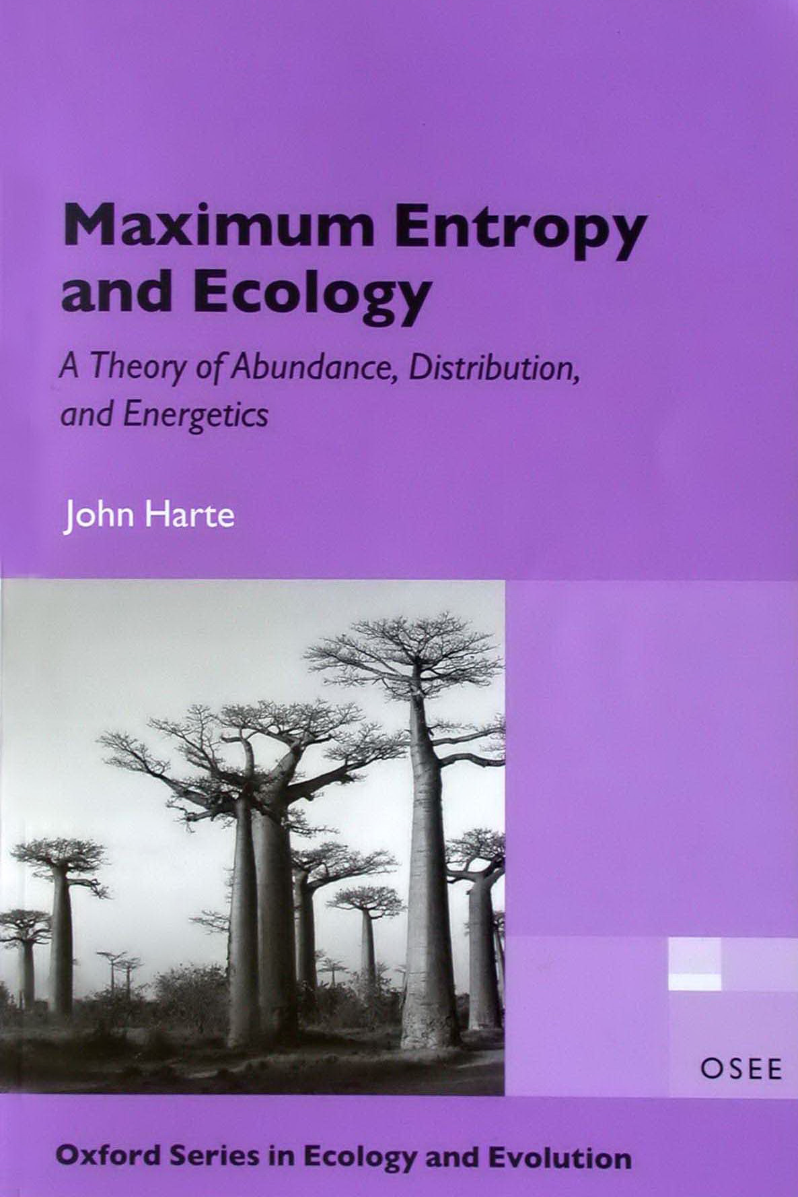

The Maximum Entropy Theory of Ecology (METE)
The State Variables:
A = Area;
S = # species;
N = # individuals;
E = total Metabolic throughput
Add more to predict more!
The theory predicts:
Species Abundance Distributions
Species-Area Relationships
Endemics-Area Relationships
Spatial Distributions of Individuals within species
Metabolic Rate Distributions across individuals
Metabolism
J. Harte, Oxford U. Press text book on Information Entropy and Ecology, 2011
J. Harte and E. Newman, Maximum information entropy: A foundation for ecological theory, 2015

Slide 3
MaxEnt gives
The Ecological Structure Function
(Summing over n)
(Integrating over ε)
Species-level spatial distribution
Distribution of metabolic rates over individuals
fraction
of occupied cells
= n₀/(n₀+ A₀/A
Distribution of abundances over species
Abundance-occupancy relation
Intraspecific metabolic rate distribution
(Taking the mean)
The species-area relationship
The endemics-area relationship
Abundance-metabolism relation for species

Slide 4

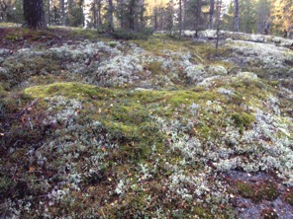
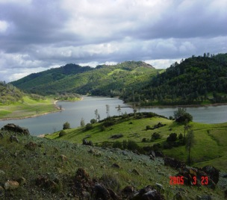
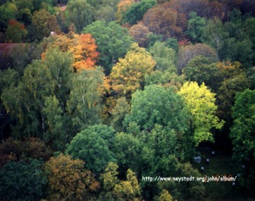
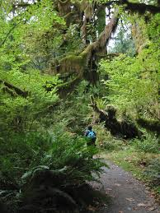
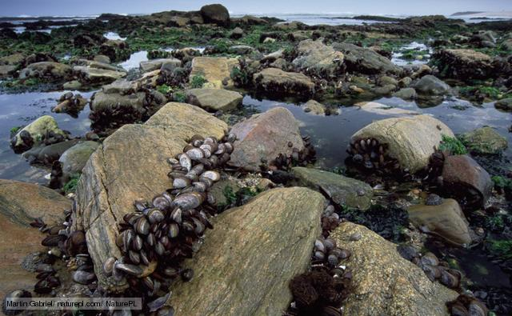


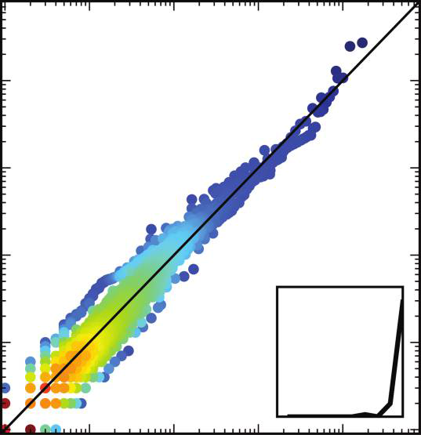
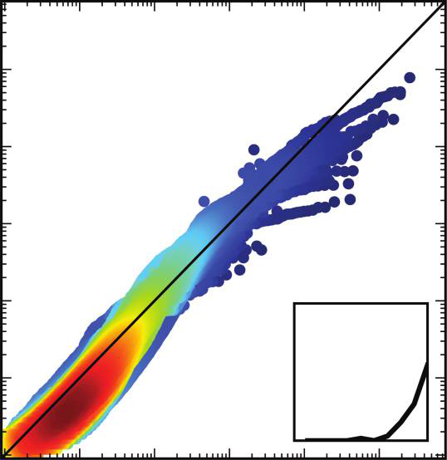
Many Tests of Predictions At ~ 25 distinct habitats: ~ 10⁵ Species, ~10⁹ individuals
36 serpentine meadow plots in CA
11 Smithsonian tropical forest plots
A 9.8 ha dry forest plot at San Emilio, Costa Rica
Plant census in Anza Borrego desert
Breeding bird censuses in southern Africa
Forest floor vegetation
Tree census data from the Western Ghats i. India
Hawaiian arthropods
Panamanian arthropods
Human gut microbiome
Species-Area slope
Species Abundance dist.
Individuals Metabolism dist.
R² = 0.96
R² = 0.89
Observed Abundance²
Observed DBH²
Predicted Abundance²
Predicted DBH²
15,848 plant, mammal, arthropod, and bird communities: (White et al., 2012
60 forest communities: (Xiao et al. 2015)
Harte et al., Ecology Letters, 2009;

Slide 5
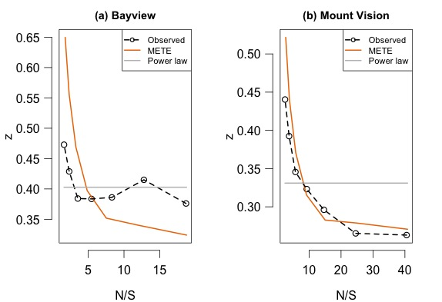
BUT: The predictions fail for ecosystems
in which the State Variables are rapidly changing!
We have assembled many examples of this: here is one: aftermath of fire in a fire-adapted Bishop Pine Forest
recently burned, rapidly changing
mature, quasi-steady-state
✖
✔
Data from Erica Newman, 2016

Slide 6
Another Example
The BCI 50 ha plot: A dynamic system
The creation of Gatun Lake isolated the plot from its immigrant source pool. It is losing species (Condit et al.; Egbert Leigh, pers. comm.)
The predicted log-series abundance distribution fails at BCI.
METE works much better for undisturbed and relatively static tropical forest plots.
BCI
12
observed
10
predicted
log(abundance)
8
6
4
2
0
0
100
200
300
400
rank
Other examples of failure in disturbed or rapidly changing systems:
Plant diversity in the highly fragmented UK (Kunin et al., Ecological Monographs, 2018)
Arthropods in newly-fallowed fields at Rothampsted (Kempton and Taylor, J. Animal Ecol. 1974)
Arthropods on Hawaiian islands of differing ages (Rominger et al., Glob. Ecol. Biogeogr. 2016)
Rodents in exclosure experiments at Portal (Supp et al., Ecology 2012)

Slide 7
Stochastic Dynamic Hybrid theory (DynaMETE)
Information-theoretic Parent:
MaxEnt predicts the static structure function conditional on State Variables S, N, E
Mechanistic Parent:
The probability distribution, P(S,N,E,t), of the dynamic state variables is governed by a Markov process “Master Equation” that is driven by growth, birth, death, migration, speciation, and extinction transition probabilities
The “Mating Eq.”:
Dynamic Structure Function
Time-dependent ecological patterns can now be derived from D(n,ε,t).
Preliminary tests of predictions are promising.

Slide 8
Is a micro-macro split essential to the application of the MaxEnt inference procedure?

Slide 9
Multiple hierarchical levels are easily accomodated:
An ecological example
Harte, Rominger, & Zhang ,Ecol. Lett. 2015

Slide 10
Adding additional levels in the taxonomic tree (e.g., genera, families): a. improves some of the predictions,
Log(abundance)
Log(abundance)
Increasing species richness of family
Log(metabolic rate of individual)
Log(metabolic rate of individual)
METE predicts energy equivalence: all species take an equal share of the energy pie.
Augmented METE predicts metabolic rate of a species is inversely proportional to the species richness of the family it is in.

Slide 11
b. And makes new accurate predictions
Extended METE predicts the distribution of species across families for arthropods, plants, birds, and microorganisms
m = # species per family
λ = λ(F₀, S₀)
Arthropod data from Basset et al. (2011), and Gruner (2007)
Bird data consist of ten transects chosen randomly from the Breeding Bird Census (Sauer et al. 2014)
Plant data from: census plots at Cape Point Preserve (Slingsby, pers. comm.); the Smithsonian Tropical Forest Research Institute plots at BCI (Condit 1998, Condit et al. 2004; Hubbell et al. 2005), Luquillo (Thompson et al. 2002); Sherman and Cocoli (Pyke et al. 2001; Condit et al. 2004); Yasuni (Valencia et al. 2003; 2004);
Microbiome data (Wu et al. 2013; Larry Smarr pers. comm.).

Slide 12
Within the MaxEnt inference framework, one can add arbitrarily many layers of state variables and constraints, from the coarsest macroscale to just above the microscale. Will that continue to improve predictions? And make new accurate predictions?
In ecology, one could extend METE to entire taxonomic tree and even to a phylogeny?
Similarly, in economics, functional clusters exist at numerous scales, from individual workers to factory employees to unions…
But what if there are a continuum of scales, all dynamically coupled?

Slide 13
Conclusion
 | Steady state | Dynamic
Hierarchical | METE works well | A hybrid Info-Metric/mechanistic theory is in the works
Non-Hierarchical | Arbitrarily many discrete levels of state variables can be accommodated, and this even improves the accuracy of predictions. Continuous limit??? | Terra Incognito

Slide 14
Thanks:
To my Collaborators:
Erin Conlisk Adam Smith Xiao Xiao Mark Wilber
Justin Kitzes Andrew Rominger Ethan White Chloe Lewis
Erica Newman Tommaso Zillio Yu Zhang Wenyu Zhang
To Other Sources of Data:
J. Green R. Krishnamani J. Godinez W. Kunin Brian Enquist
R. Condit P. Harnik K. Cherukumilla E. White Cory Merow
D. Gruner J. Goddard STRI David Storch D. Bartholomew Yves Basset
To the Funders:
NSF, Miller Foundation, Gordon and Betty Moore Foundation
To my Hosts during the development of METE:
Santa Fe Institute, Rocky Mountain Biological Laboratory, NCEAS, The Chilean Ecological Society, Charles University, University of Padua
Notes:
14

