Slide 1
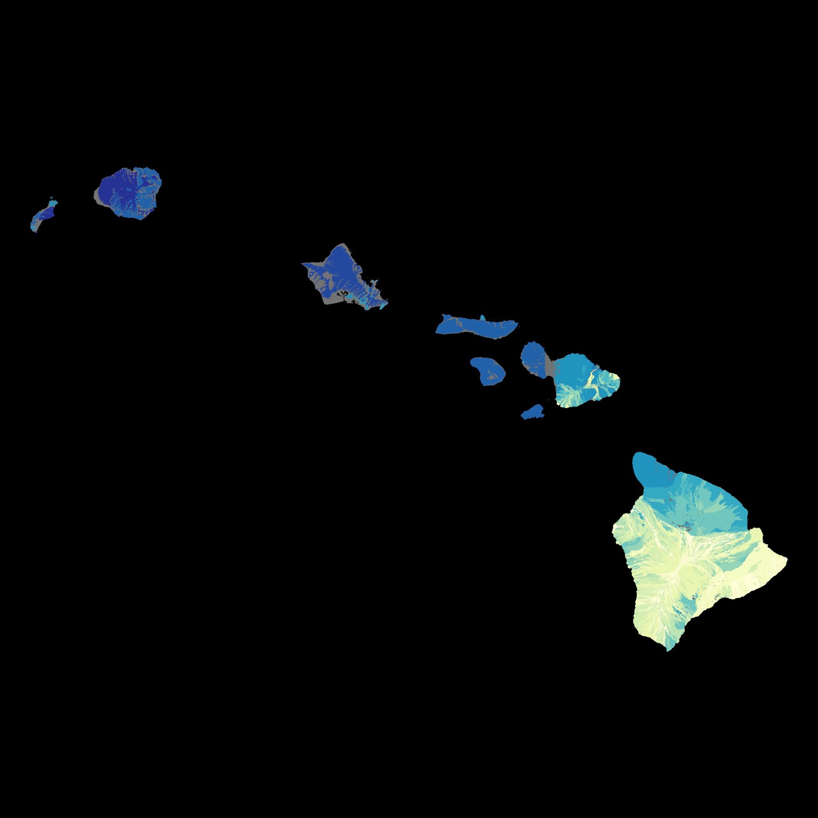
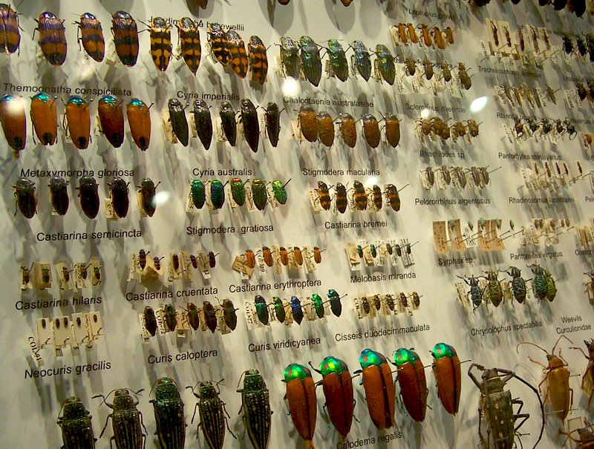
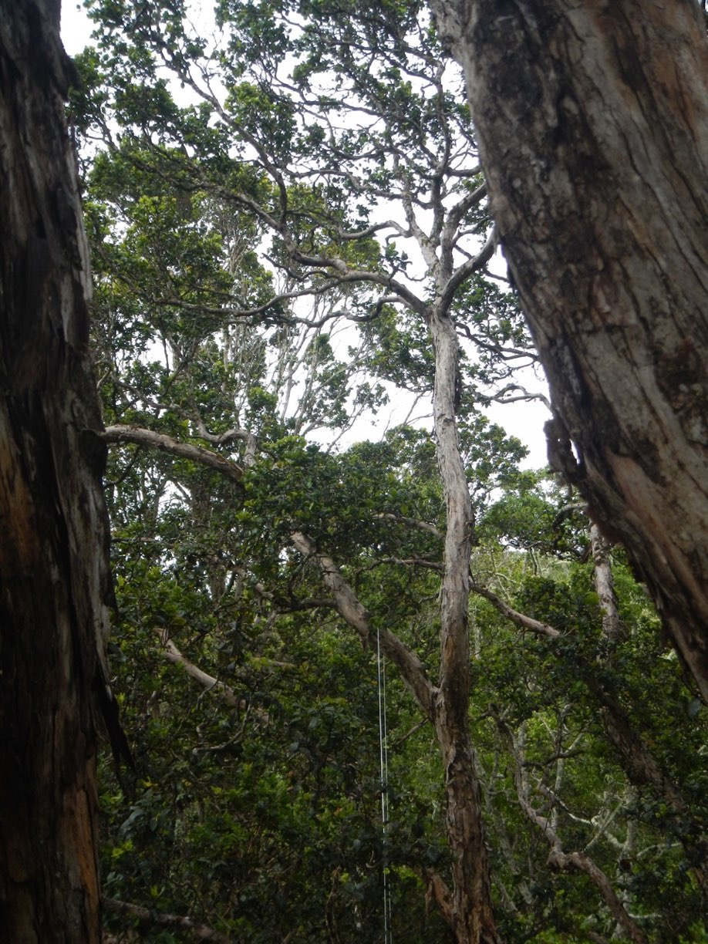
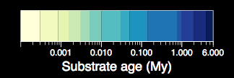
Capturing evolving communities
15,997 arthropods collected
Data: D. Gruner (2007) Biol. J. Linn. Soc.
Notes:
a slide showing the data sources and sampling locations along the chronosequence

Slide 2

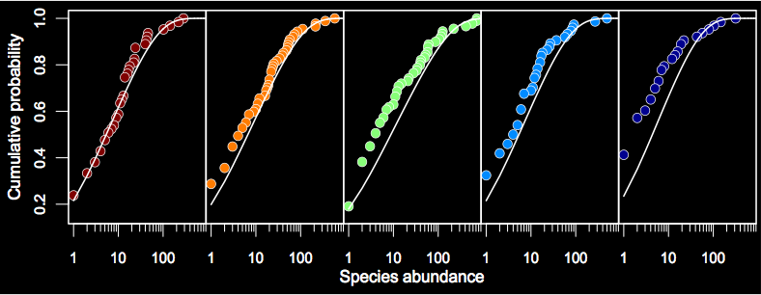
Detritivores
Notes:
empirical CDF of species abundance distributions (numbers of individuals per species) showing more deviation at younger sites

Slide 3
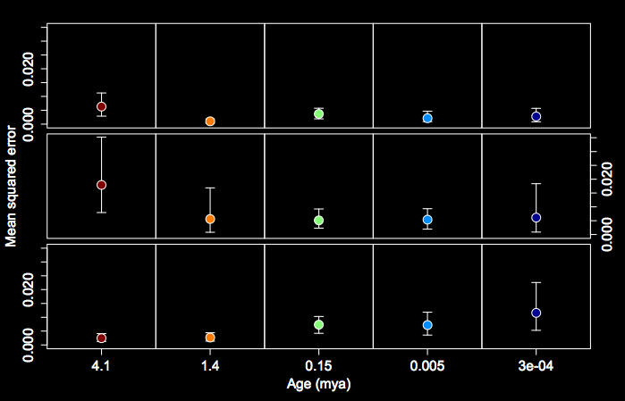
Species abundance
Detritivores
Notes:
showing mean squared error from pervious results

Slide 4
Species abundance
Predators
Herbivores
Detritivores
Notes:
showing mean squared error for other trophic groups—key finding really is that predators are well fit across the chronosequence, herbivores are best fit at middle aged sites, detritivores best at old sites (I have this one in white at the end too)

Slide 5
Incomplete assembly
Notes:
these two slides i’m setting the stage for talking about dispersal limitation driving deviation from maxent at young cites

Slide 6
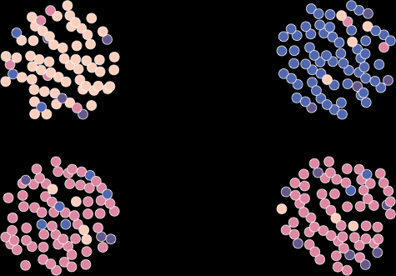
Incomplete assembly
dispersal limitation
free dispersal

Slide 7
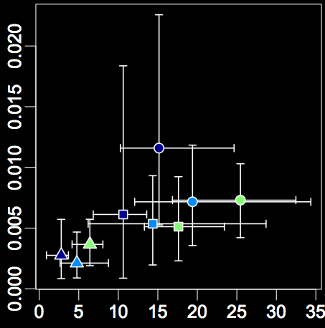
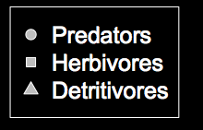
Incomplete assembly
Deviation from theory
Dissimilarity
Notes:
this is the relevant result, the x-axis is a measure of dispersal limitation, the y-axis is the mean squared error measure of deviation again (i have this one in white at the end too)

Slide 8
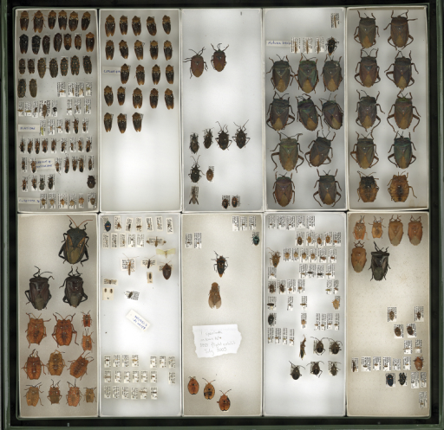
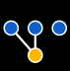
Network construction
Rominger et al. 2015. Global. Ecol. Biogeogr.
Notes:
these are completely different results in you’d like them—based on bipartite networks compiled for herbivorous insects from the literature

Slide 9




Rominger et al. 2015. Global. Ecol. Biogeogr.
Notes:
here are the networks, plants are bluish, bugs are orangish

Slide 10
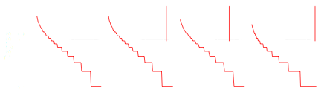
Rominger et al. 2015. Global. Ecol. Biogeogr.
Notes:
the degree distributions, maxent predictions in red

Slide 11
Rominger et al. 2015. Global. Ecol. Biogeogr.
Notes:
insets are null distributions, we fail to reject maxent if the vertical red line falls in the shaded region—we only do that for the middle aged site

Slide 12
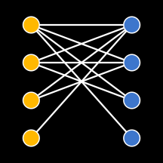
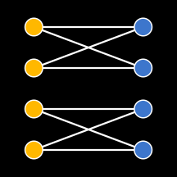
Nestedness
Modularity
Rominger et al. 2015. Global. Ecol. Biogeogr.
Notes:
these two metrics ecologists (and nobody else??) use to think about assembly of networks—high nestedness might be high immigration, whereas modularity might be in situ diversification

Slide 13
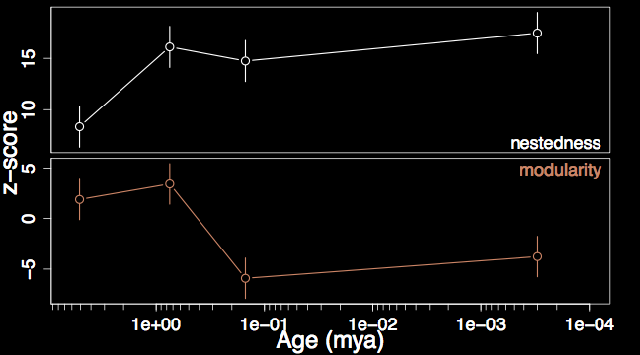
Diversification
Immigration
Rominger et al. 2015. Global. Ecol. Biogeogr.

Slide 14
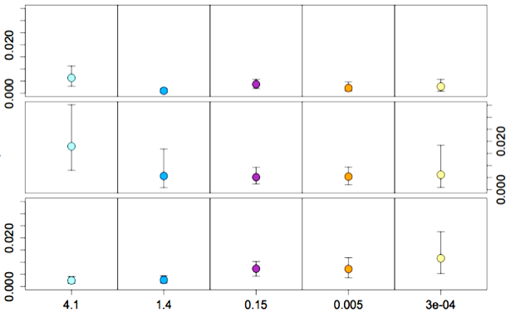
Predators
Herbivores
Mean squared error
Detritivores
Age (My)

Slide 15
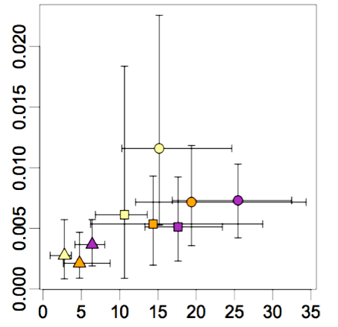
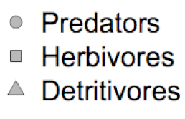
Mean squared error
Normalized spatial turnover

