Slide 1
Developing A Reinforcement Learning Interface for Partial Differential Equation Control
By Aakash Khatri

Slide 2
Motivation

Slide 3
Structure
Partial differential equations (PDE)
Feedback control
Model predictive control
Reinforcement learning
PhysicsGym Interface
Experiments
Conclusion

Slide 4
Partial Differential Equations
Introduction
  The Heat equation
  The Burgers equation
Boundary conditions
  Dirichlet
  Neumann
  Periodic
Solution methods
  Finite elements method

Slide 5
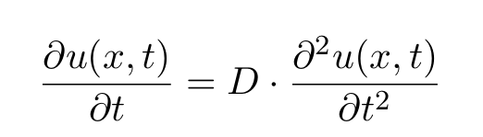
The Heat Equation

Slide 6
The Heat Equation
Dependent
variable

Slide 7
The Heat Equation
Dependent
variable
Independent variables

Slide 8
The Heat Equation
Diffusivity
Dependent
variable
Independent variables

Slide 9
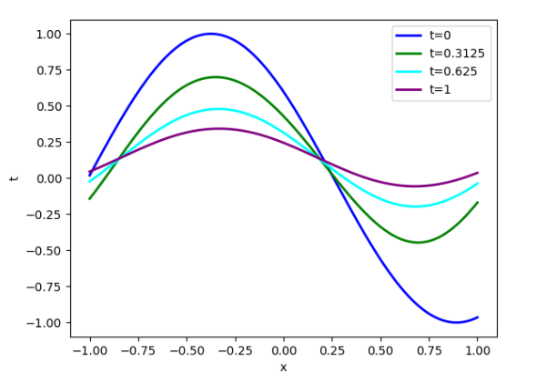
The Heat Equation

Slide 10
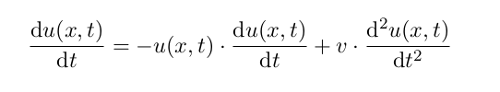
The Burgers Equation

Slide 11
The Burgers Equation
Dependent variable

Slide 12
The Burgers Equation
Dependent variable
Independent variables

Slide 13
The Burgers Equation
Dependent variable
Independent variables
Viscosity

Slide 14

Inviscid Burgers Equation

Slide 15
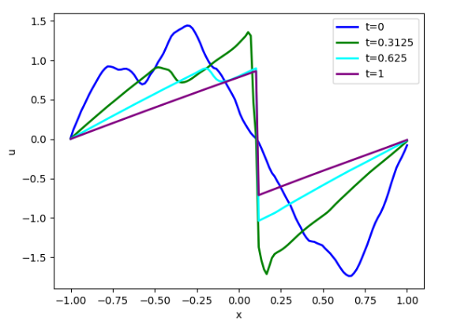
The Burgers Equation

Slide 16
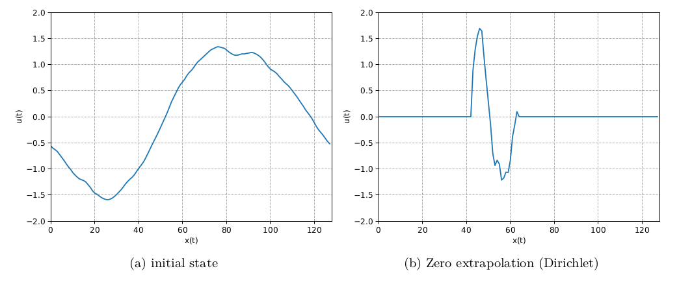
Boundary Conditions

Slide 17
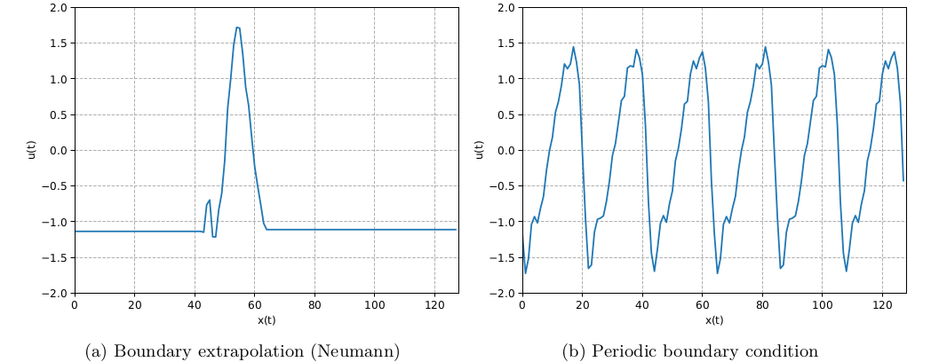
Boundary Conditions

Slide 18
Finite Elements Method

Slide 19
Feedback Control
Open-loop vs Closed-loop systems
Model predictive control
Reinforcement learning

Slide 20
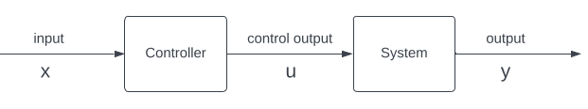
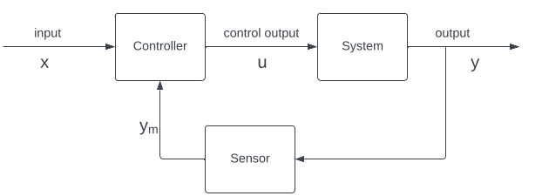
Open loop vs Closed loop
Open-loop system
Closed-loop system

Slide 21
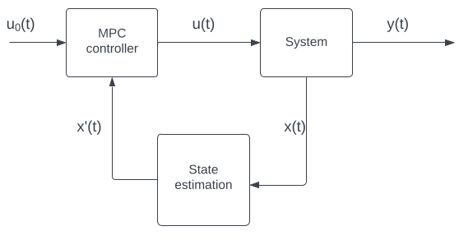
Model Predictive Control
Model predictive control

Slide 22
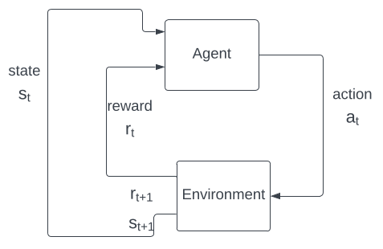
Reinforcement Learning
Reinforcement learning

Slide 23
Model Predictive Control (MPC)
Introduction
Components of MPC
Example: Dynamic System
Algorithm

Slide 24
MPC: Introduction

Slide 25
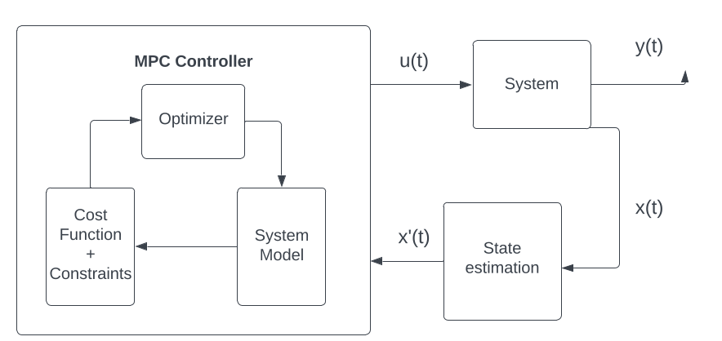
Components of MPC

Slide 26

Example: A Dynamic System

Slide 27
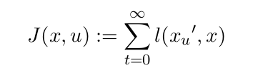
Cost Function

Slide 28
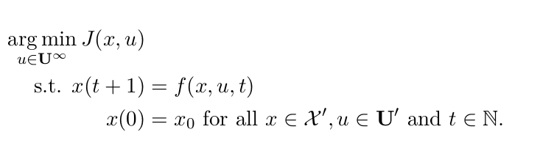
Optimization Problem

Slide 29
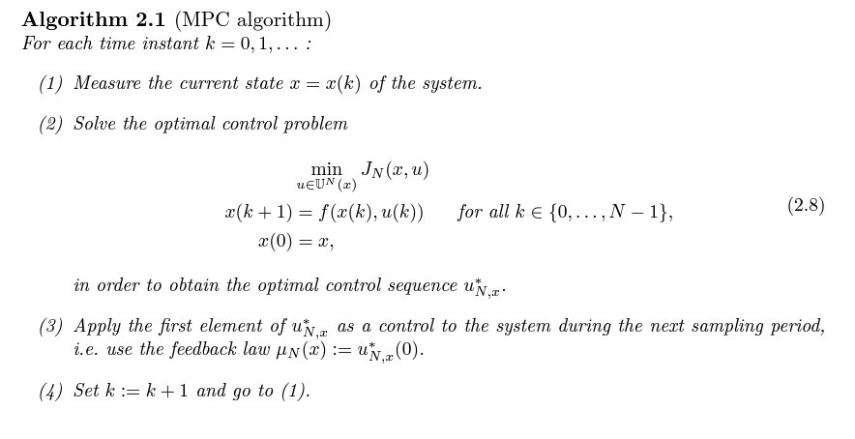
MPC Algorithm

Slide 30
Reinforcement Learning
Introduction
Components of RL
Markov Decision Process
PDE as MDP

Slide 31
RL: Introduction

Slide 32
Components of RL
Agent
Environment
Reward
Value function
Model

Slide 33

Markov Decision Process

Slide 34
Markov Decision Process
State space

Slide 35
Markov Decision Process
State space
Action space

Slide 36
Markov Decision Process
State space
Action space
Transition
Probability

Slide 37
Markov Decision Process
Reward
State space
Action space
Transition
Probability

Slide 38
Markov Decision Process
Reward
State space
Action space
Discount factor
Transition
Probability

Slide 39
PDE as MDP (PENDING)
State space →
Action space →
Transition Probability →
Reward →
Discount Factor →

Slide 40
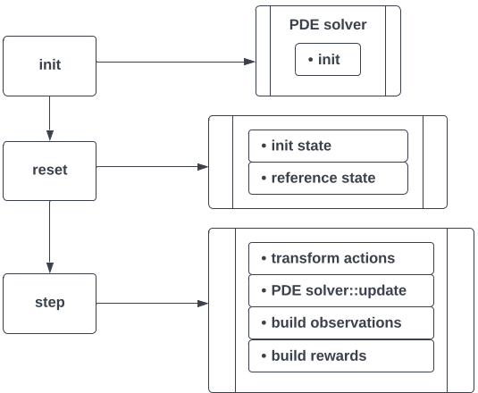
PhysicsGym Interface

Slide 41
Experiments
Introduction
The Heat equation control experiment
The Burgers equation control experiment

Slide 42
Introduction

Slide 43
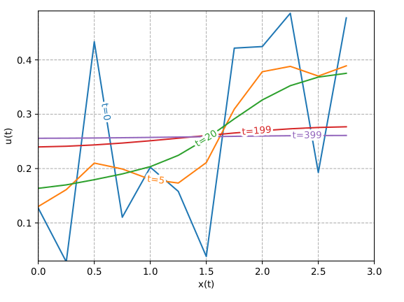
Uncontrolled
Heat equation

Slide 44
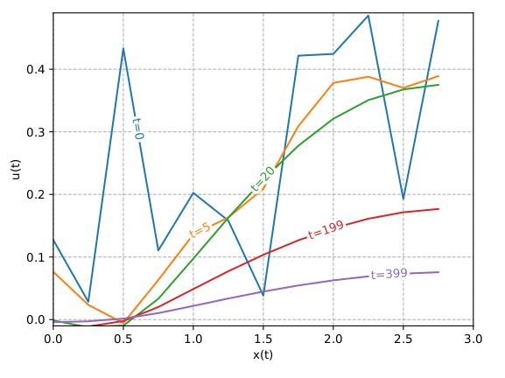
Baseline
Heat equation

Slide 45
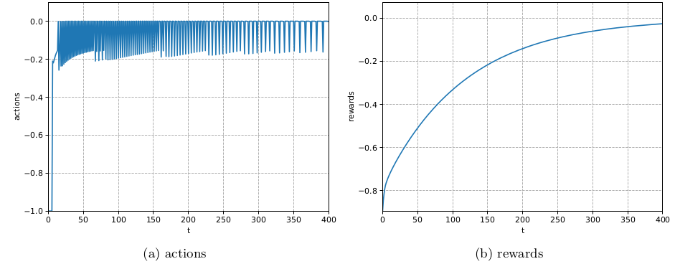
Baseline
Heat equation

Slide 46
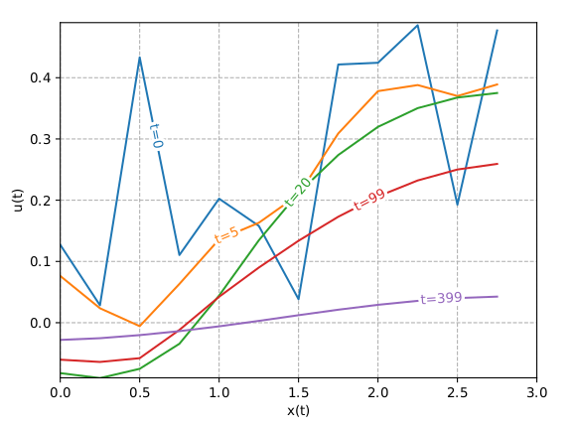
RL Agent
Heat equation

Slide 47
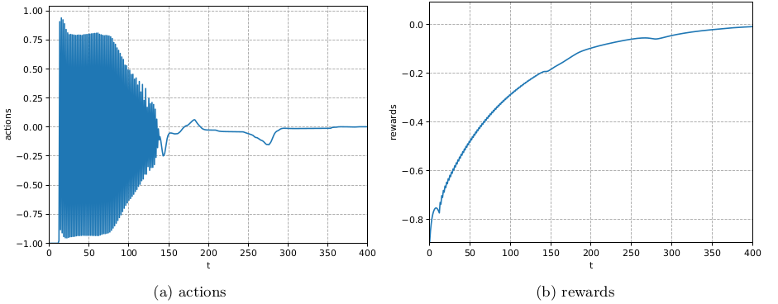
RL Agent
Heat equation

Slide 48
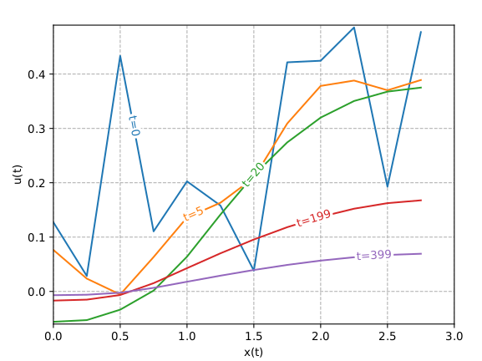
MPC Agent
Heat equation

Slide 49
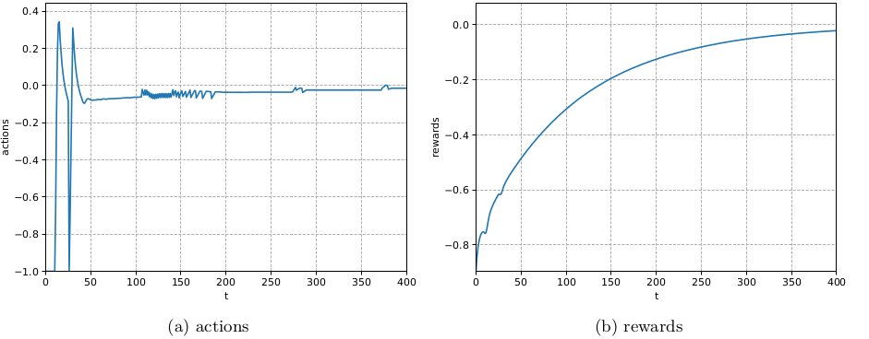
MPC Agent
Heat equation

Slide 50
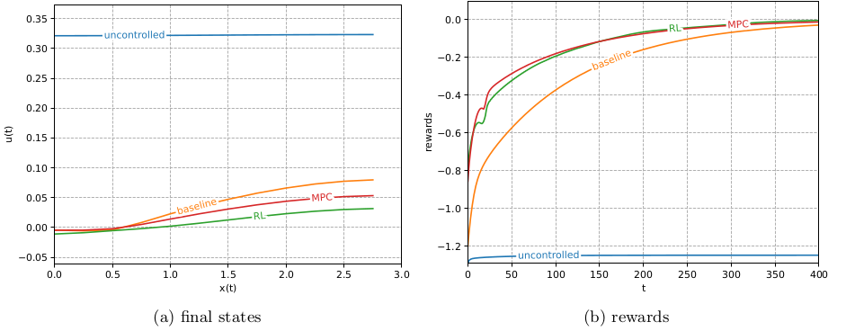
Evaluation

Slide 51
Conclusions

