Slide 1
Developing A Reinforcement Learning Interface for Partial Differential Equation Control
By Aakash Khatri

Slide 2
Motivation

Slide 3
Structure
Partial differential equations (PDE)
Feedback control
Model predictive control
Reinforcement learning
PhysicsGym Interface
Experiments
Conclusion

Slide 4
Partial Differential Equations
Introduction
  The Heat equation
  The Burgers equation
Boundary conditions
  Dirichlet
  Neumann
  Periodic
Solution methods
  Finite elements method

Slide 5
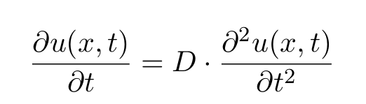
The Heat Equation

Slide 6
The Heat Equation
Dependent
variable

Slide 7
The Heat Equation
Dependent
variable
Independent variables

Slide 8
The Heat Equation
Diffusivity
Dependent
variable
Independent variables

Slide 9
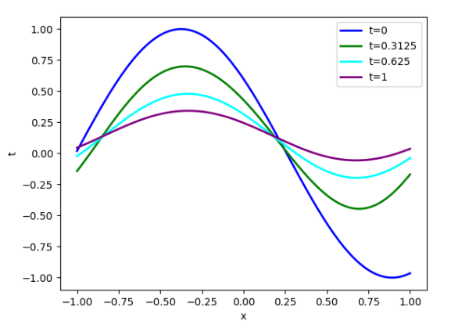
The Heat Equation

Slide 10
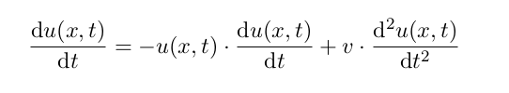
The Burgers Equation

Slide 11
The Burgers Equation
Dependent variable

Slide 12
The Burgers Equation
Dependent variable
Independent variables

Slide 13
The Burgers Equation
Dependent variable
Independent variables
Viscosity

Slide 14

Inviscid Burgers Equation

Slide 15
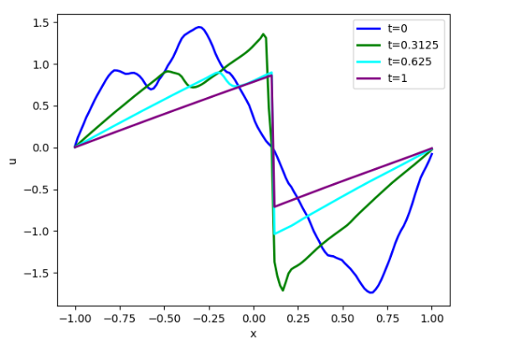
The Burgers Equation

Slide 16
Boundary Conditions
External constraints for a unique solution
Three types of boundary conditions
  Dirichlet boundary condition
  Neumann boundary condition
  Periodic boundary condition

Slide 17
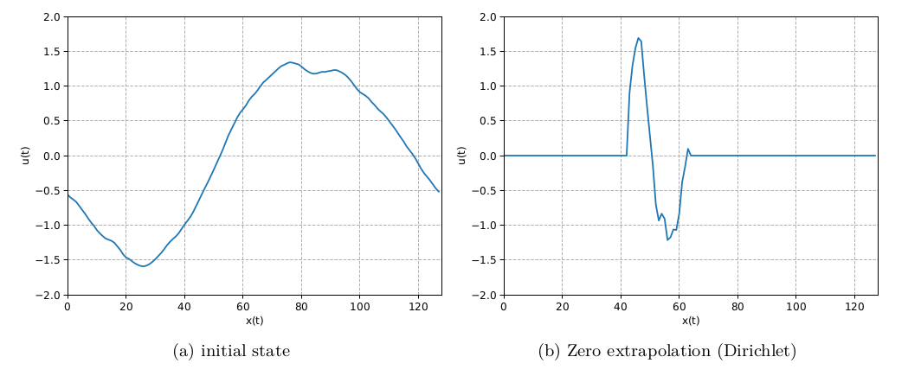
Boundary Conditions

Slide 18
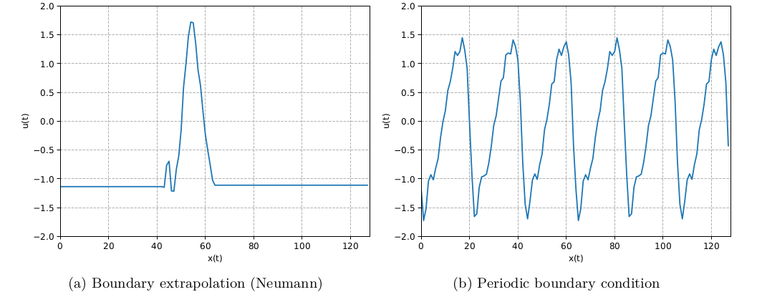
Boundary Conditions

Slide 19
Finite Elements Method

Slide 20
Feedback Control
Open-loop vs Closed-loop systems
Model predictive control
Reinforcement learning

Slide 21
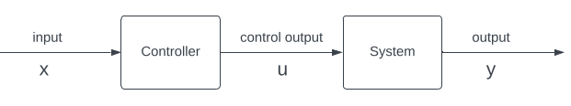
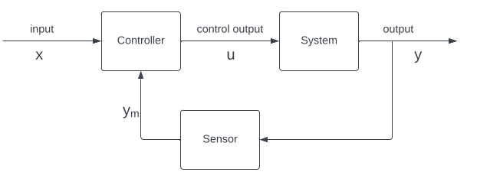
Open loop vs Closed loop
Open-loop system
Closed-loop system

Slide 22
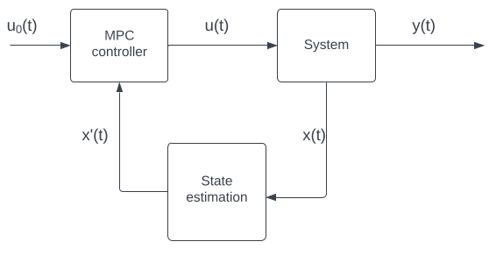
Model Predictive Control
Model predictive control

Slide 23
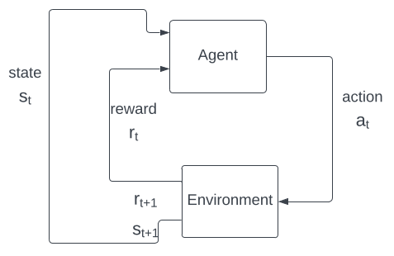
Reinforcement Learning
Reinforcement learning

Slide 24
Model Predictive Control (MPC)
Introduction
Components of MPC
Example: Dynamic System
Algorithm

Slide 25
MPC: Introduction

Slide 26
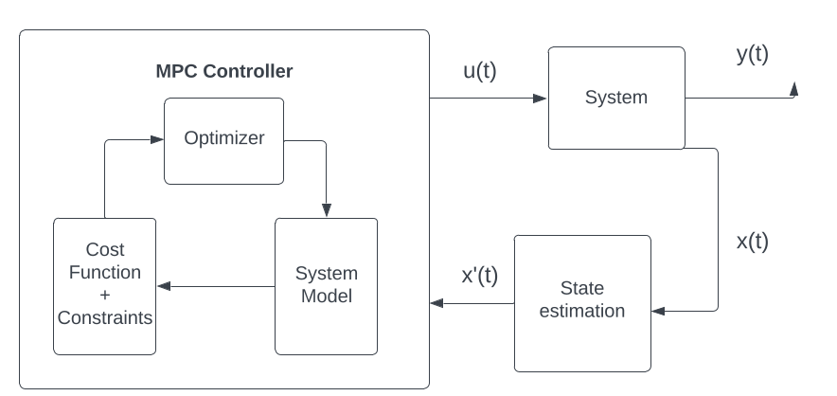
Components of MPC

Slide 27

Example: A Dynamic System

Slide 28
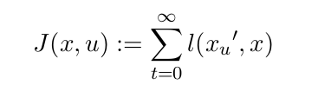
Cost Function

Slide 29
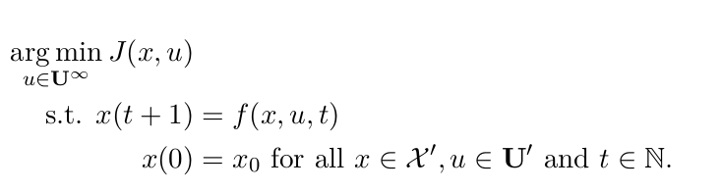
Optimization Problem

Slide 30
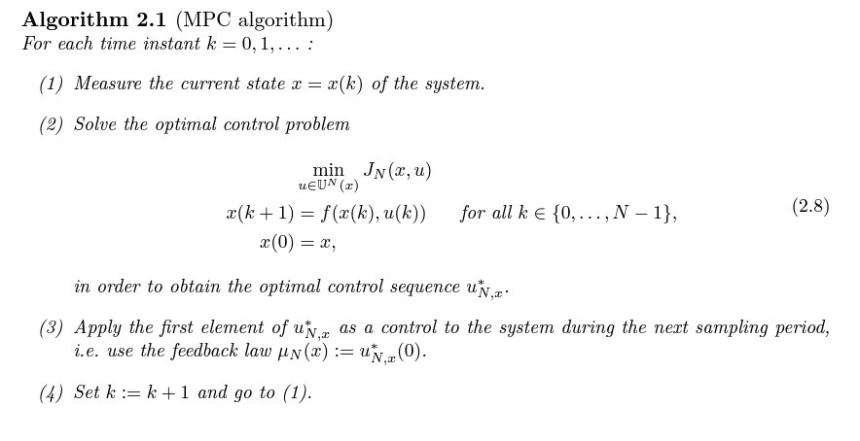
MPC Algorithm

Slide 31
Reinforcement Learning
Introduction
Components of RL
Markov Decision Process
PDE as MDP

Slide 32
RL: Introduction

Slide 33
Components of RL
Agent
Environment
Reward
Value function
Model

Slide 34

Markov Decision Process

Slide 35
Markov Decision Process
State space

Slide 36
Markov Decision Process
State space
Action space

Slide 37
Markov Decision Process
State space
Action space
Transition
Probability

Slide 38
Markov Decision Process
Reward
State space
Action space
Transition
Probability

Slide 39
Markov Decision Process
Reward
State space
Action space
Discount factor
Transition
Probability

Slide 40
PDE as MDP (PENDING)
State space →
Action space →
Transition Probability →
Reward →
Discount Factor →

Slide 41
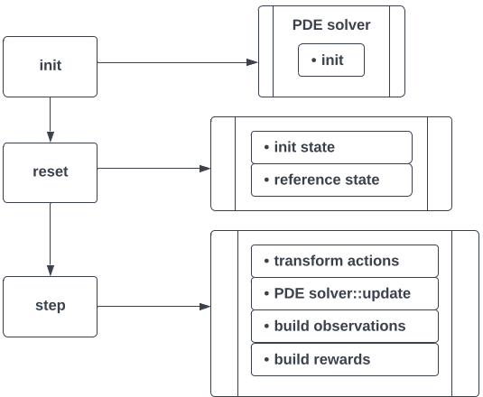
PhysicsGym Interface

Slide 42
Experiments
Introduction
The Heat equation control experiment
The Burgers equation control experiment

Slide 43
Introduction

Slide 44
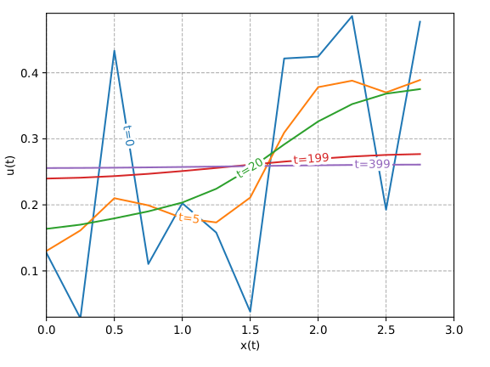
Uncontrolled
Heat equation

Slide 45
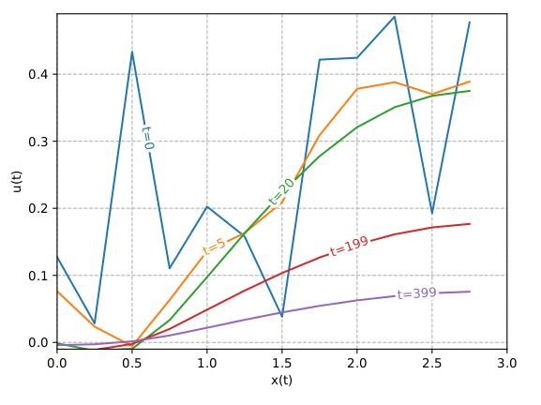
Baseline
Heat equation

Slide 46
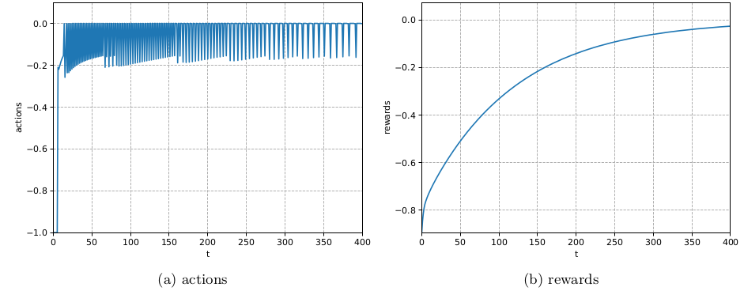
Baseline
Heat equation

Slide 47
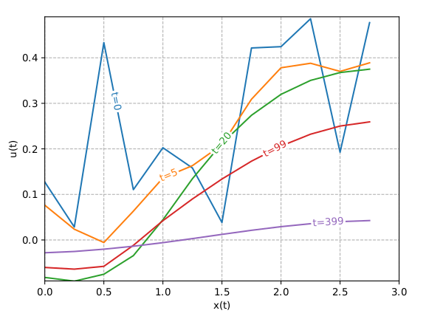
RL Agent
Heat equation

Slide 48
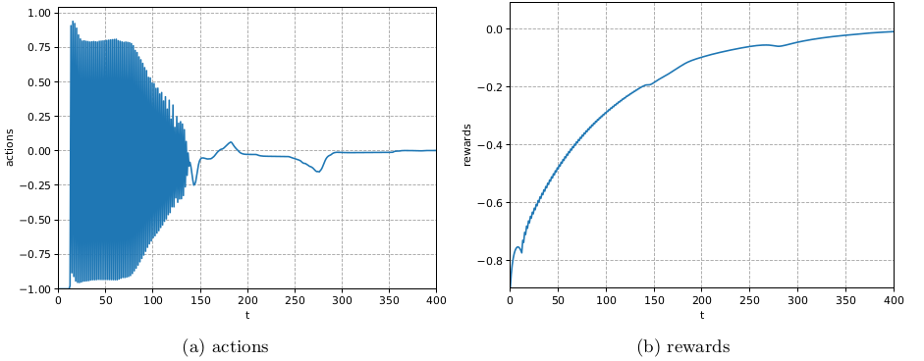
RL Agent
Heat equation

Slide 49
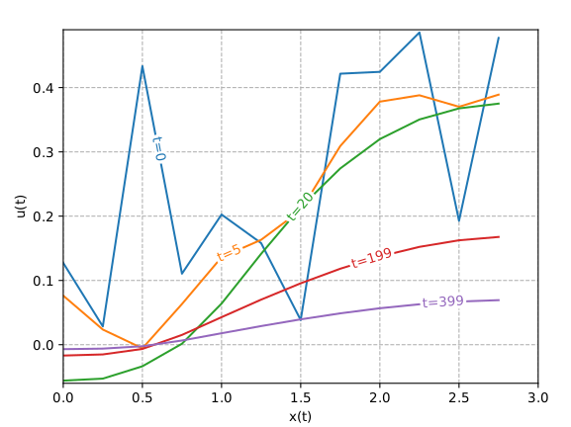
MPC Agent
Heat equation

Slide 50
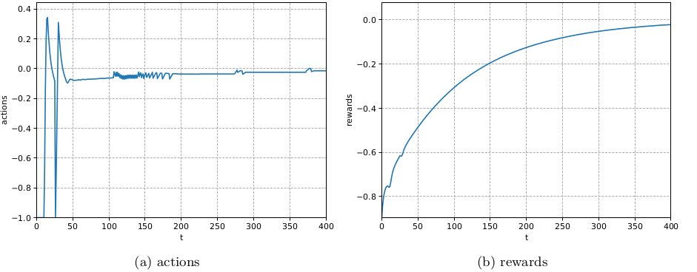
MPC Agent
Heat equation

Slide 51
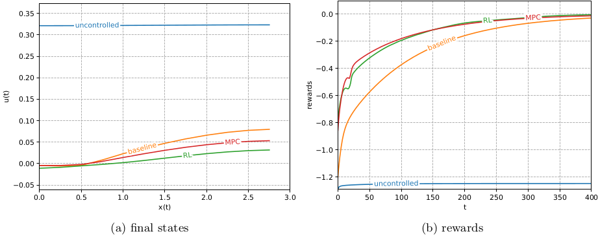
Evaluation

Slide 52
Conclusions

