Slide 1
Corpus Linguistics
2023-11-03
Levels of Linguistic Representation

Slide 2
Main topics
Variants
Internal vs. external conditioning
Lexical semantics
Synonyms and meaning clusters
Phonetics
Morphology
Syntax
Discourse

Slide 3
Variants
There are different ways of saying things, or expressing certain meanings
e.g.
  the boy’s hat vs. the hat of the boy
  The boy was hit by the car vs. the car hit the boy
  I’ll go vs. I will go
  etc.

Slide 4
Variants
When we talk about variants, we can talk about the variation occurring at a specific level of linguistic structure
The alternation between Saxon genitive ‘s and of is variation at the level of syntax and partially morphology
sneaked~snuck, dived~dove, throve~thrived etc... these variants would be morphological
militaristic -> mɪlətɹɪstɪk vs. mɪləɾɪɹɪstɪk

Slide 5
Variants
Variants can be more or less probable contingent on different types of context
The textbook puts these in two overarching categories
external context: who is talking, their status, conversation
internal context: depends on other words around it

Slide 6
Variants
Saxon genitive vs. of possession
What do you think the variation is based on? (external vs. internal)

Slide 7
Variants
Saxon genitive vs. of possession
Saxon genitive more likely to be used in speaking rather than writing
  (external)
Saxon genitive less likely to be used before a sibilant sound (fish, jazz)
  (internal)

Slide 8
Variants
Variationist corpus linguistics: understanding what conditions the variants we find in text.
take away – linguistic behavior is constrained beyond grammar rules, in a probabistic fashion by internal and external context

Slide 9
Structural levels of variation
Lexical semantics
Phonetics
Phonology
Morphology
Syntax
Discourse

Slide 10
Lexical semantics
Lexical semantics – the meaning of specific lexical items
Lexical items are memorized forms like dictionary elements (remember the distinction between word-form and lexeme)
A lexical item has a behavioral profile or configarational profile that reflects the different meanings it can take on in different contexts

Slide 11
Lexical semantics
A lexical item has a behavioral profile or configarational profile that reflects the different meanings it can take on in different contexts
I’ve also heard the term potential used to talk about all the variants
Variation at the level of lexical semantics will be about meaning variants

Slide 12
The meanings of run
It can be intransitive or transitive
fast pedestrian motion
uncontrolled movement
escaping from something unpleasant
toward something more pleasant
abstract motion
functioning
causing to function

Slide 13
The meanings of run
Intransitive vs. transitive
Simons had run down to the villa to get help (intranstive)
his brother ran a mile (transitive)

Slide 14
The meanings of run
fast pedestrian motion
Simons had run down to the villa to get help (intranstive)
his brother ran a mile (transitive)

Slide 15
The meanings of run
uncontrolled movement
Dogs ran about
He was running his mouth

Slide 16
The meanings of run
escaping from something unpleasant
When he loses his temper with her she runs off
towards something pleasant
She ran away with him

Slide 17
The meanings of run
Gries finds 56 senses of run and then uses behavior profiles to answer questions about these forms
Can we predict the specific sense being used based on the surrounding context?

Slide 18
Emotions and their senses
Krawczak (2014) analyzed the meanings of ashamed and words that could be considered synonyms like humilated ...
How?
By coding properties such as the source of the feeling, the time span of the feeling, etc.

Slide 19
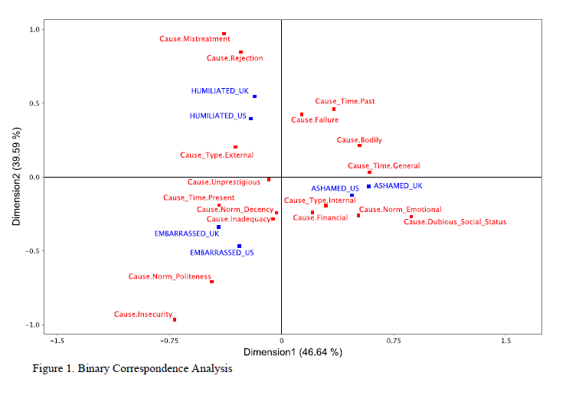

Slide 20
Emotions and their senses
embarrased are for situations that are less serious and more fleeting
humiliated is more grevious and is used for externally cuased emotions

Slide 21
Phonology and phonetics
Phonetics is the physical manifestation of speech
Phonology is about the contrastive sounds
Let‘s do a recap of the core concepts

Slide 22
Contrastive vs. Non-contrastive
Contrastive sound: For a given language two or more sounds are contrastive if the distinction between them can be used to build distinct words that speakers do not consider homophones.
Two sounds can be used to make a meaningful distinction in the language.
Non-contrastive sound: For a given language two sounds are non-contrastive if their distinction cannot be used to make a meaningful distinction between words.

Slide 23
Contrastive vs. Non-contrastive
Two sounds might be contrastive in one language and non-contrastive in another.
Recall in our description of English we can make a distinction between aspirated and non-aspirated sounds.
[t^{h}ɑp] “top”
[stɑp] “stop”

Slide 24
Contrastive vs. Non-contrastive
But English speakers cannot exploit that the difference between these sounds in the same way that they can for the distinction between [d] and [t].
/tεl/ vs. /dεl/
/dɑɪ/ vs. /tɑɪ/
/tu/ vs. /du/
So in English [d] vs. [t] is contrastive
[t] vs. [t^{h}] is non-contrastive

Slide 25
Contrastive vs. non-contrastive
Actually we can be more general.
English exploits a voiced:voiceless contrast but not a aspirated:non-aspirated is non-contrastive.
Notice that saying that a feature is non-contrastive for a language is very different from saying that the language just doesn’t have that sound; English speakers systematically produce aspirated stops.

Slide 26
Contrastive vs. non-contrastive
How we know sounds are contrastive;
Try thinking of words that contrast only /k/ and /g/ in English?

Slide 27
Contrastive vs. non-contrastive
How we know sounds are contrastive;
Try thinking of words that contrast only /k/ and /g/ in English?
Easy… “gill” vs. “kill”; “come” vs. “gum” etc…

Slide 28
Phonology vs. phonetics
So phonological corpus linguistics in principle should be about alternations that involve changing/deleting/adding phonemes
Phonetic corpus linguistics should be about alternations that affect pronunciation variants.
But the problem is that when you change one phoneme to another you are also changing the phonetics.

Slide 29
Phonology vs. phonetics
For corpus studies, the difference in practice relates to measurement (for the most part)
You are more likely doing phonological corpus linguistics if you are looking at categorical change and you are looking at alternations that can be found directly in a alphabetically written text
You are more likely doing phonetic corpus linguistics, if you are looking at measurements.

Slide 30
Orthography and phonemic represetation
‘For some languages, the written words are similar enouh to their phonemic representations that text corpora can be used to examine questions relating to phonology.’ (Barth & Schnell 2022:52)

Slide 31
Phonology questions that could involve corpora
What clusters of consonants are more common in natural speech?
What phonemes are more common in natural speech?
What phonemes rarely occur adjacent to one another inside words?
etc.

Slide 32
Corpus linguistics for phonetics
A corpus study using phonetics would involve making phonetic measurements.
While in principle this could be done with articulation, in practice it is always done with acoustic measurements (sound wave).
The most common acoustic analysis program is Praat.

Slide 33
Praat
website: https://www.fon.hum.uva.nl/praat/download_win.html

Slide 34
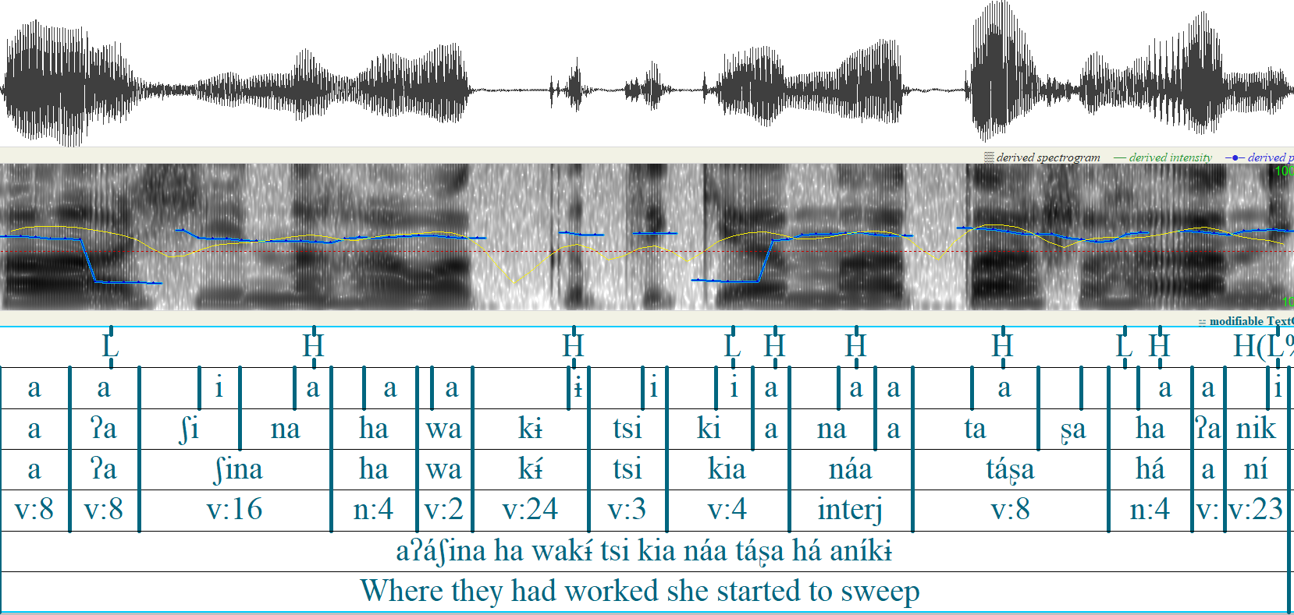
This is a Praat annotation of a sentence in Chácobo, a southern Pano language of the northern Bolivian Amazon.

Slide 35
Waveform
Spectrogram
Tiers
This is a Praat annotation of a sentence in Chácobo, a southern Pano language of the northern Bolivian Amazon.

Slide 36
Phonetic measurements
Phones have different phonetic measurements associated with them.
A consonant has
  Duration (milliseconds)
  Voice onset and offset time (milliseconds)
  Voicing (milliseconds or amplitude
Vowel
  Duration (milliseconds)
  Pitch (F0)
  Intensity (amplitude)

Slide 37
Phonetic measurements
F1 and F2
Vowels have an F1 and an F2
These are the main measurements of vowel quality.
F1: Vowel height (low F1 means high)
F2: Vowel frontness (high F2 means front)

Slide 38
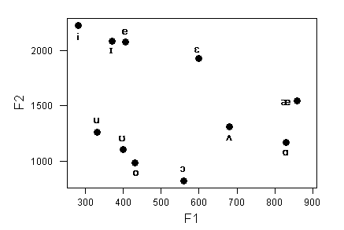

Slide 39
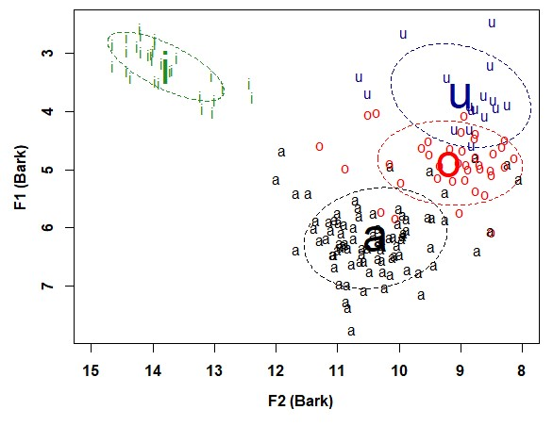
Phonetic measurements
Actual vowel tokens are much more variable
https://fass.ubd.edu.bn/research/dusun/vowels3.html

Slide 40
Phonetic measurements
How does one develop a phonetic annotation? (e.g. know the boundaries between different sounds)
There are acoustic ‘landmarks’ that can be used to segment speech into phones.
But
Developing a phonetic corpus by hand is very time consuming – which is why people use forced alignment systems.

Slide 41
Morphology
Morphology is concerned with word internal structure (generally)
A central concept is the morpheme
Words are made up of morphemes – morphemes are the smallest meaningful parts of words.
complete-ness has two morphemes

Slide 42
Morphology
Some other core concepts:
Bound: Some morphemes are ‘free’ (they can occur on their own) and others are bound (they depend on the appearance of something else to occur)
Roots: The base of th Word, e.g. (complete in completeness)
Affixes: The bound parts that are modifying the base (-ness in completeness

Slide 43
Morphological producitivity
Morphemes vary in terms of their productivity.
Some morphemes like –ness are highly productive
Others like –th in warmth only occur with a small number of forms.

