Slide 1
Basic concepts and corpus types
Introduction to Corpus Linguistics
Adam J.R. Tallman
2023-10-27

Slide 2
Corpus & text
Corpus: collection of texts
Text: an instance of recorded language
Modern concern: corpus should be machine-readable
That means you can search it

Slide 3
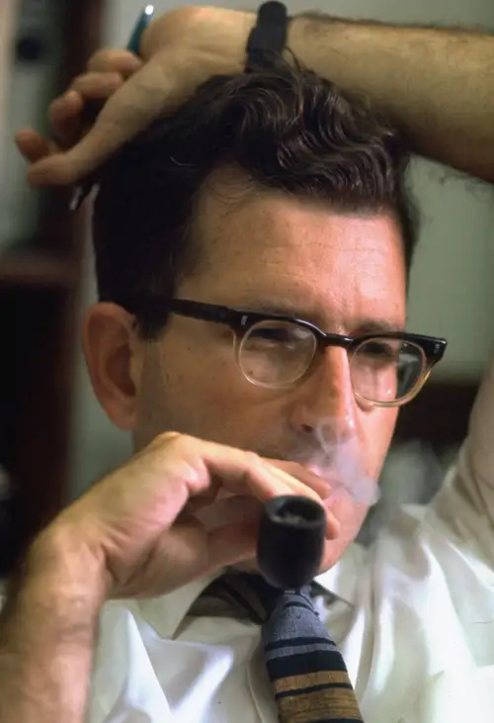
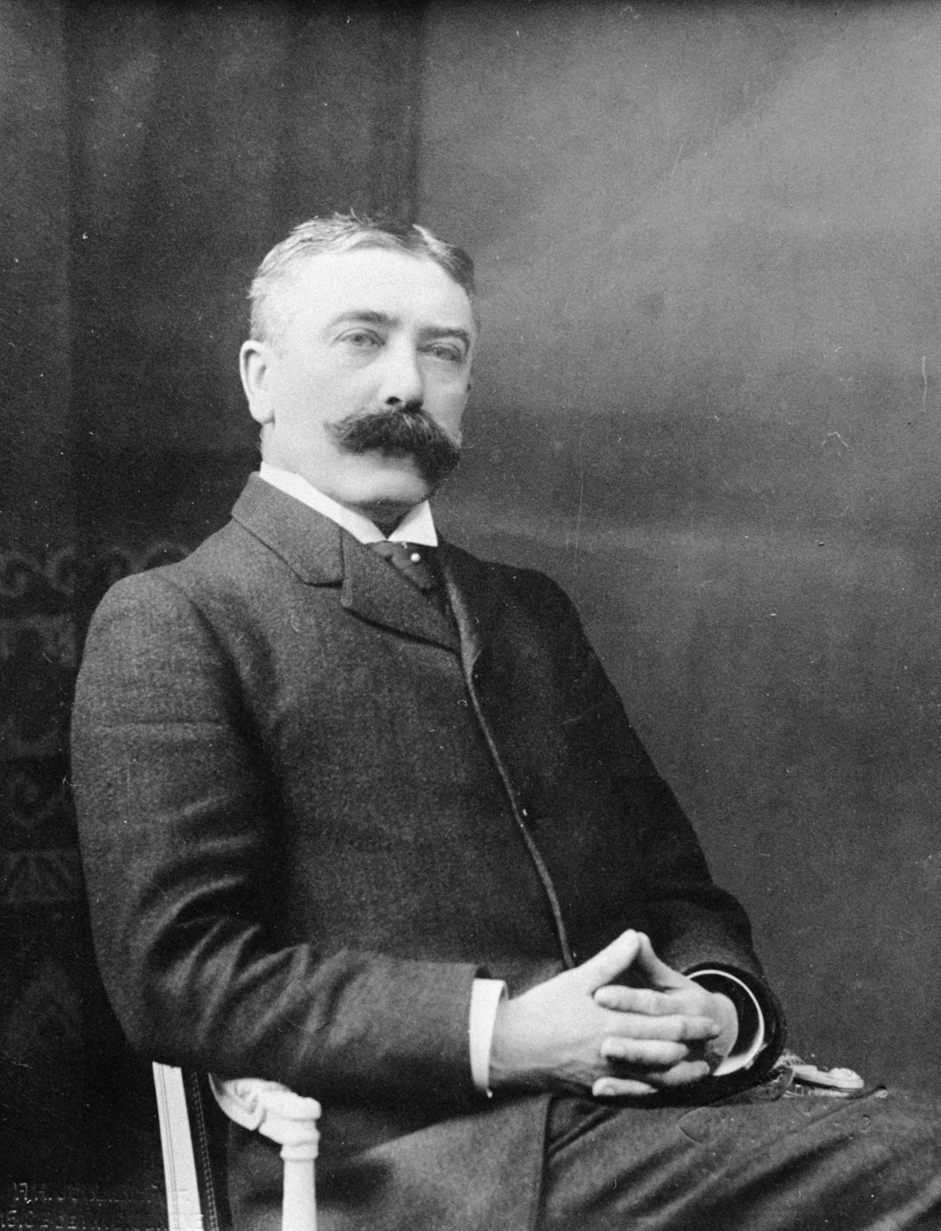
Language knowledge vs. language use
There’s a distinction in linguistics between knowledge and use
Competence and performance (Chomsky)
Langue and parole (Saussure)

Slide 4
Knowledge and use
So what’s the relationship?
To what extent does language use condition linguistic knowledge?
To what extent does linguistic knowledge constrain language use?
Linguists are very much divided on this issue (at least on the surface)

Slide 5
Corpus Linguistics
Corpus linguistics
“regularities of language use” (Barth & Schnell 2022)
what people are most likely to say rather than what the possibilities are of what they could say.

Slide 6
Corpora
There’s not a very precise definition of what a corpus is – people vary according to what they consider a corpus.
Only ‘authentic’ texts (McEnery & Wilson 2001; Stefanowitsch 2020)
Experimental corpora are not allowed for example.
Main problem is that its hard to draw a line between authentic and nonauthentic

Slide 7
Corpora
What does not matter for inclusion
The difference between proper and improper speech
Corpus linguistics is not prescriptivist

Slide 8
Text
Strings of ‘words’ ... but structured into a coherent and meaningful series and recognized by speakers of the language as such.
Usually corpora are annotated for different properties (e.g. part of speech, noun, verb, adjective etc.)
They could also be annotated with glosses, translation equivalents from another language

Slide 9
Lexeme vs wordform
There is an important distinction between wordform and lexeme
Lexeme often means the same thing as lemma
Wordforms are directly observable manifestations of lexemes in particular contexts
e.g. GO = LEXEME, which has the wordforms, going, gone, goes etc.

Slide 10
Lexeme vs. wordform
The relationship between lexemes and wordforms is usually thought to be mediated by inflection
For instance, runs is the present tense, third person singular subject inflected form of the lexeme RUN

Slide 11
Lemmatization
We might want to search lexemes rather than wordforms
Lemmatization is the process whereby wordforms are given lexeme representations (or annotations) – running would just be run
Caveat: This discussion is all very Eurocentric, since a clear distinction between inflection and other types of modification, not to mention a distinction between words and phrases is primarily a property of the European grammatical tradition.

Slide 12
Types versus tokens
A related distinction but broader in application is between types versus tokens
Types: a type of construction or word-form defined broadly than lexeme
Token: specific instance of a wordform

Slide 13
Token vs. type
A lexeme is a type, but a type is not necessarily a lexeme
Because a type can be defined more broadly
For instance, a type could be PAST TENSE FORMS or PAST TENSE FORMS marked with –ed or PREFIX-ROOT combinations

Slide 14
Type vs. token
Its the relationship between type and token that is thought to be important in linguistics
Type/token ratio: A low type/token ratio is associated with irregularity (broadly).
What does this mean?

Slide 15
Frequency measures (central tendency)
arithmetic mean: Take the sum of the frequencies you have and divide by the number of frequency measurements
mode: the most value for a frequency measurement
range: the difference between the most frequent and the least frequent
These are measurements of ‘central tendency’

Slide 16
Frequency measures (spread)
A distribution is defined by a combination of measurements for central tendency and for spread
Spread refers to how diverse the data are, how different they are from one another.

Slide 17
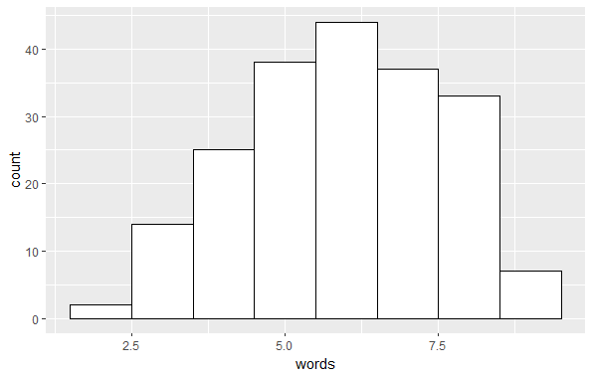
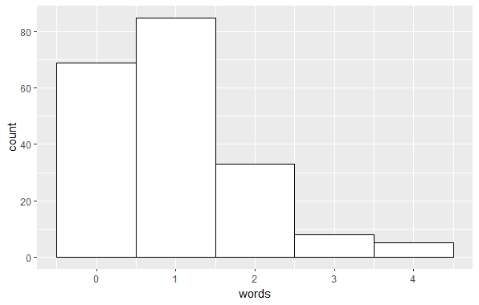
More spread out values Less spread out values

Slide 18
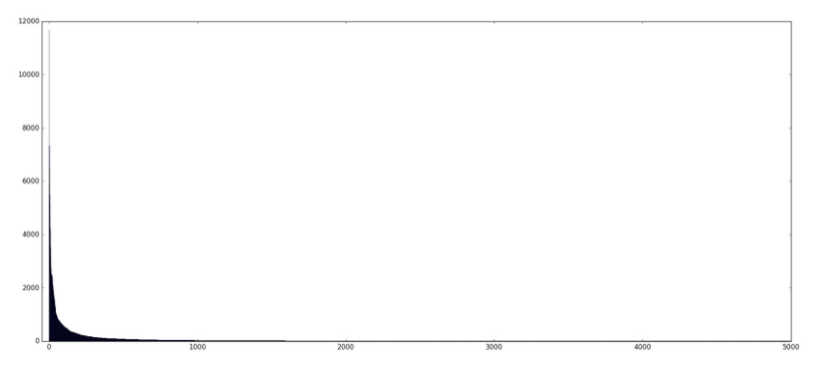
Zipfian distribution
There’s a famous distribution for word frequencies

Slide 19
Contexts
What is relevant for interpretation of the text as a whole?
Language-internal: derived by other properties internal to the text
Language-external: background knowledge, the audience etc.

Slide 20
Language-internal
Syntagmatic context: which words (morphs or elements) come before or after a word-form, morph etc.
Constructional context: what position it has in a higher order construction

Slide 21
Syntagmatic context
There’s a distinction between paradigmatic and syntagmatic in linguistics.
Imagine grammar as a set of positions and elements that can fit out those positions, then the relationship between elements that could occur in a specific position is a paradigmatic one and the relationship between elements in a different position is a syntagmatic one.
The | student |  | read | his | textbook | yesterday
 | Adam |  | prepared | the | lecture | today
The | Dean |  | gave | a | speech | last week
My | cat | will | eat | the | plants

Slide 22
Syntagmatic context
Syntagmatic
The | student |  | read | his | textbook | yesterday
 | Adam |  | prepared | the | lecture | today
The | Dean |  | gave | a | speech | last week
My | cat | will | eat | the | plants
Paradigmatic

Slide 23
Constructional context
Construction is a very broad term – but it just refers to any type of ‘frame’ that you can put sentences in
We can talk about a passive construction
SUBJECT | BE | VERB-ed | by NP
The lecture | was | given | by | the teacher

Slide 24
Constructional context
We could say that the lecture is a subject in a passive construction
We could say that The is a determiner of a subject in a passive construction etc.
These are statements about the constructional context
SUBJECT | BE | VERB-ed | by NP
The lecture | was | given | by | the teacher

Slide 25
‘Concordancing’
McEnery & Hardie (2012)
‘The procedures themselves are still developing , and remina an unclearly delineated set – though some of them, such as concordancing are well established and viewed as central to the approach’ (p.1)
Concordanding just means looking that the syntagmatic context of a form...

Slide 26
Collocations
Collocations: A combination of adjacent forms.
N-gram: We can talk about bigram, trigram etc. collocations
Collocates: A forms collocates are the forms it occurs beside
Let’s do a search on the COCA corpus

Slide 27
Colligation
A special form of collocation but refer to more abstract categories (e.g. part of speech categories)
We can ask often the occurs before a noun rather than an adjective
This is a question about colligation.

Slide 28
Language-external context
Background knowledge
Who the audience is
Aspects about the speaker, or writer etc.
All texts require background knowledge (about a culture for example) in order to understand

Slide 29
Situational context
Critical discourse analysis is concerned with the ideologies embedded in texts and their relationship to particular social groups
The use of words frame particular situations beyond the literal meaning of the text
For example, what do the use of words in one newspaper as opposed to another say about the ideology of the newspaper producers (or their view of their intended audience)

Slide 30
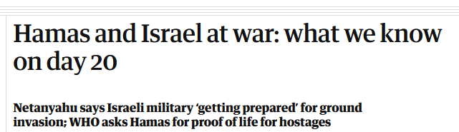
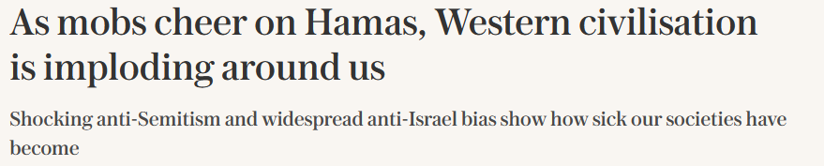
Situational context
How do different newspaper report about the conflicts in Israel/Palestine and Russia/Ukraine ... for instance.
Guardian
vs.
The Daily Telegraph

Slide 31
Types of corpus

Slide 32
Sample & Population
We often make a distinction between a sample and its population
Population: All instances of something
Sample: some subset of that
A lot of science is based on sampling from a population and making inferences about the population from a sample

Slide 33
Sample and Population
Buts there’s of ways that the inference from sample to population can be problematic
Samples vary in terms of how representative they are of the population
We talk about sampling procedures in science in general that are designed to overcome or attenuate these problems
Samples can be biased (‘sampling bias’ refers to a property of a sampling procedure which is thought to result in systematic bias)

Slide 34
Representativeness
A corpus is a sample of some population
How representative is it of that population?
This requires us to think or have some theory about the structure of the population.

Slide 35
‘Skewing’
Let’s say I want to study contemporary English
I tell you that the verb begot is extremely frequent in English.
But then I tell you that I only relied on Biblical texts to come to that conclusion.
Maybe this is just a property of biblical texts not of English in general

Slide 36
Balance
We should try to find balance in the sample, but we do this according to some theory of what the population is like
What proportion of our corpus should contain science fiction comopared to speeches given by politicians?
The important point is that its obvious that language use varies according to genre and register etc.

Slide 37
Parameters of a corpus
Representativeness: how representative is the corpus of its population
Spontaneity: Texts can be more or less spontaneous (a planned speech versus a conversation)
Routinized: Texts can be more or less routinized (e.g. prayers vs. creative writing)
Saturation: The property whereby as a text grows, the probability of seeing a new construction decreases (only true if we are looking at different types of text)

Slide 38
Spontaneity
How might a spontaneous conversation differ from a planned one?

Slide 39
Spontaneity
How might a spontaneous narrative differ from a planned one?
  More speech errors
  Less complex sentences?
  More reduction
  Different vocabulary
  Less repetition?

Slide 40
Routinization
How might routinized speech compare to less routine speech?

Slide 41
Routinization
How might routinized speech compare to less routine speech?
  -routinized speech has more reduction?
  more idiomatic expressions?
  Routinized speech is likely faster ...

Slide 42
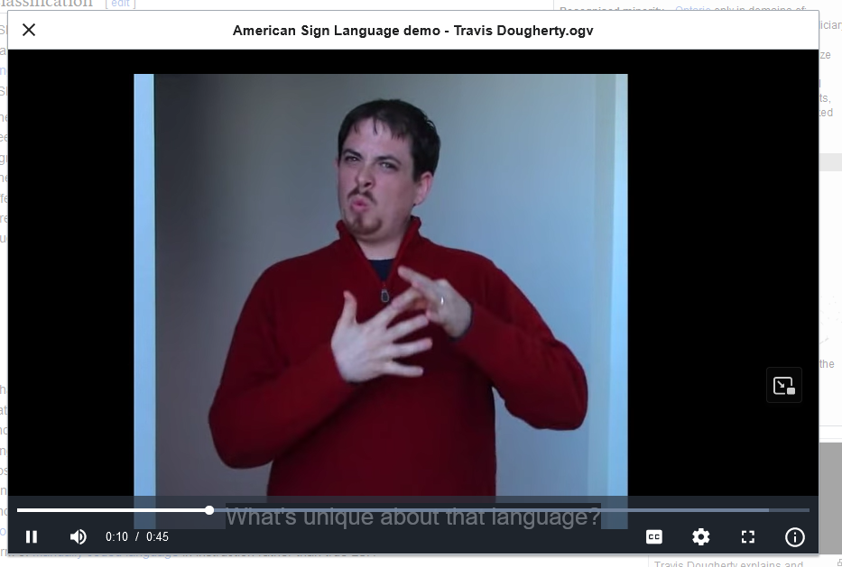
Register
mode: spoken versus signed
participants: who are the people involved and what relationships do they have to one another
communicative purpose: why are you talking to one another
https://en.wikipedia.org/wiki/American_Sign_Language

Slide 43
Genre
A genre is defined by linguistic features that are conventionally used with it.
Prose writing, poetry, fairy tales
Note that genres are culturally specific (they usually have names)
Genre marker: A specific property that marks off a genre

Slide 44
Genre
In Chácobo there is a specific ‘male joking genre’ of speech, which is characterized heavily by the liberal use of adjectivalizers.
Typically between men drinking chicha
Some sentences which appear in this context are judged unacceptable or ungrammatical outside of it.
jënë pohi=xëni mia
chicha shit-ter you
“You are a habitual chicha shitter.”

Slide 45
Style
Like genre but about individuals:
Some people just use certain constructions more than others
These can be markers of social identity, but they can also be very specific.

Slide 46
Linked data
Rawa vs. primary data
Time alignment
Metadata

