Slide 1
Corpus linguistics
2023-11-24
Corpus Building, XML, ELAN

Slide 2
Prep for class:
Tell students to bring their laptops and download ELAN
Tell them to download R, warn them that they will be using it in two weeks
Ask them to download a .wav file online and etf template

Slide 3
Corpus building & compilation
An important part of corpus linguistics is corpus construction
Barth & Schnell (2022) distinguish three types of corpora
General corpus
Language documentation corpus
Research corpus
Barth, Danielle & Stefan Schnell. 2022. Understanding Corpus Linguistics. London: Routledge.

Slide 4
Corpus building & compilation
General corpus
‘over-studied’, large, can be linked to audio-visual content, pre-existing texts
for language planning, general reference
Language documentation corpus
‘under-studied’, small, generally linked to audio-visual content (circa 1990s),
for linguistic description, community work (e.g. dictionary production), indigenous pedagogy
Research corpus
small, some type of special annotation, narrow or focused research question
Barth, Danielle & Stefan Schnell. 2022. Understanding Corpus Linguistics. London: Routledge.

Slide 5
Processing texts
Processing a text can involve
Audio-visual recording
transcription
time-aligned at a specific level
phone
utterance
annotated at a specific level
phone
phoneme
grapheme
utterance ...
(translation into metalanguage)
Barth, Danielle & Stefan Schnell. 2022. Understanding Corpus Linguistics. London: Routledge.

Slide 6
Transcription and Annotation
Transcription and Annotation are done in the first place to make the text searchable.
If you want to know when people tend to pause or interrupt people in actual speech these have to be transcribed
See transcription conventions from du Bois 1993, in Barth & Schnell 2022:101
Barth, Danielle & Stefan Schnell. 2022. Understanding Corpus Linguistics. London: Routledge.

Slide 7
Software for corpus construction
ELAN
time-aligned with play back option
allows hierarchically organized tiers for annotation & multiple levels of transcription
typically for utterance level alignment
FLEx
allows semi-automatic interlinear morph-level glossing
used for construction of lexicon or dictionary
has no linked audio
Praat
for phone level alignment
for phonetic research
Barth, Danielle & Stefan Schnell. 2022. Understanding Corpus Linguistics. London: Routledge.

Slide 8
Software / Mark-up languages
The softwares read,import and export files in different mark-up languages.
Praat uses .TextGrid files
ELAN uses .eaf files, a type of XML file
Flex uses .flextext files, a type of XML file

Slide 9
Software / Mark-up languages
You can import and export files between the programs
Praat uses .TextGrid files
ELAN uses .eaf files, a type of XML file
Flex uses .flextext files, a type of XML file
export (ELAN to Praat)
import/export (ELAN to FLEx and FLEx to ELAN)

Slide 10
XML grammar
Tags
Comments
Document declaration
Root element
Trees and nodes
Parsing an xml file

Slide 11
XML tags
Tags are written in between pointy brackets
<sometag>
The tag must be succeeded by a closing tag
</sometag>
Tag names cannot begin with numbers or contain any of the following characters:
; @ # $ % ^ ( ) + ? =
. – should be avoided
Based on Pozrikidis, C. 2013 XML in Scientific Computing. CRC Press

Slide 12
XML tags
Tags
‘The linguistics class’
<sentence>
<word>The</word>
<word>linguistics</word>
<word>class</word>
</sentence>
Based on Pozrikidis, C. 2013 XML in Scientific Computing. CRC Press

Slide 13
XML tags
Tags have attributes, written with ‘=‘ and in quotations “”
‘The linguistics class’
<sentence id = “1”>
<word pos= “D”>The</word>
<word pos=“N”>linguistics</word>
<word pos=“N”>class</word>
</sentence>
Based on Pozrikidis, C. 2013 XML in Scientific Computing. CRC Press

Slide 14
XML tags
Note you always have the option of writing an attribute as another nested tag
<sentence id = “1”>
<word><dem>The</dem></word>
<word><noun>linguistics</noun></word>
<word><noun>class</noun></word>
</sentence>
Based on Pozrikidis, C. 2013 XML in Scientific Computing. CRC Press

Slide 15
XML tags
XML tags cannot ‘branch cross’
This:
<word><dem>The</dem></word>
Rather than this:
<dem><word><The</dem></word>
Based on Pozrikidis, C. 2013 XML in Scientific Computing. CRC Press

Slide 16
XML comments
A lot of programming languages allow you to write in comments
Basically the purpose of this in XML is so you can write comments that are ignored by XML parsers
You use <!--...-->
<sentence id = “1”> <!-- This is the first utterance of our corpus, id gives us information about that -->
<word><dem>The</dem></word>
<word><noun>linguistics</noun></word>
<word><noun>class</noun></word>
</sentence>
Based on Pozrikidis, C. 2013 XML in Scientific Computing. CRC Press

Slide 17
XML comments
In programming commenting out lines of code is really important for debugging
Comments are also important for understanding the author’s purpose in writing the code
(Let’s see what happens if we ignore this line)
We’ll see what this looks like in R
Based on Pozrikidis, C. 2013 XML in Scientific Computing. CRC Press

Slide 18
XML Document declaration
The first line of an xml file declares that the file contains an xml document
<?xml version="1.0“ encoding =“utf-8”?>
<sentence id = “1”> <!-- This is the first utterance of our corpus, id gives us information about that -->
<word><dem>The</dem></word>
<word><noun>linguistics</noun></word>
<word><noun>class</noun></word>
</sentence>
Based on Pozrikidis, C. 2013 XML in Scientific Computing. CRC Press

Slide 19
Root elements
The first tag after the declaration is a a root element
<?xml version="1.0“ encoding =“utf-8”?>
<story>
<sentence id = “1”> <!-- This is the first utterance of our corpus, id gives us information about that -->
<word><dem>The</dem></word>
<word><noun>linguistics</noun></word>
<word><noun>class</noun></word>
<word><verb>is</verb></word>
<word><adjective>exciting</adjective></word>
</sentence>
</story>
Based on Pozrikidis, C. 2013 XML in Scientific Computing. CRC Press

Slide 20
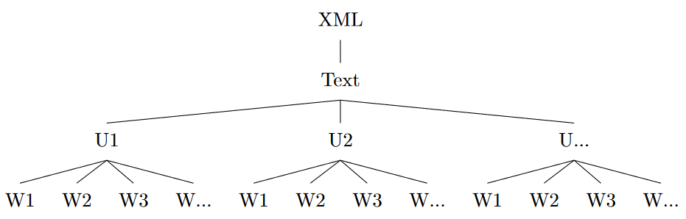
Trees and nodes
Element nesting results in an XML tree originating from the root
Inspired by materials on
https://alvinntnu.github.io/NTNU_ENC2036_LECTURES/xml.html

Slide 21
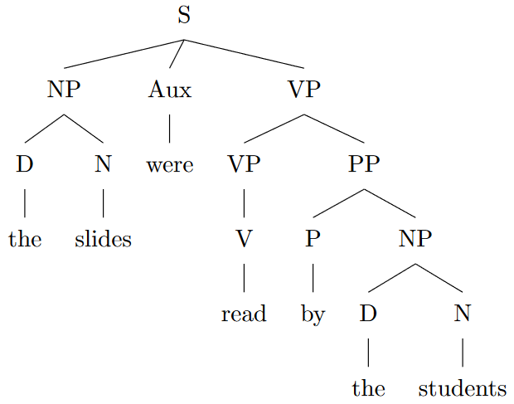
Trees and nodes
Element nesting results in an XML tree originating from the root
<S>
<NP><D>the</D>
<N>slides</N></NP>
<Aux>were</Aux>
<VP><VP><V>read</V></VP>
<PP><P>by</P>
<NP><D>the</D>
<N>students</N></NP></PP></VP>
</S>
Based on Pozrikidis, C. 2013 XML in Scientific Computing. CRC Press

Slide 22
Parsing XML
Different softwares can parse XML code
XML code has to be parsed to be used for corpus analysis
In this course we will practice using R to parse
Gries, Stefan Th. 2017. Quantitative Corpus Linguistics with R: A Practical Introduction. Routledge.
Desaguiler, Guillaume. 2017. Corpus Linguistics and Statistics with R. Springer.
Barr, Dale J. 2015. Read ELAN XML files to tidy output. https://github.com/dalejbarr/elan/blob/master/README.md

Slide 23
ELAN
People do not write up XML tagging by hand, but use some type of software that creates the XML files.
A popular software, and that which is most used for language documentation, is ELAN.
Please download if you have not already
https://archive.mpi.nl/tla/elan/download

Slide 24
ELAN and eaf files
ELAN files are saved as EAF files, which are a type of XML file.
EAF files are time-aligned to specific recordings – usually at the level of utterances (sentences or speech between pauses)
Download the WAV file

