Slide 1
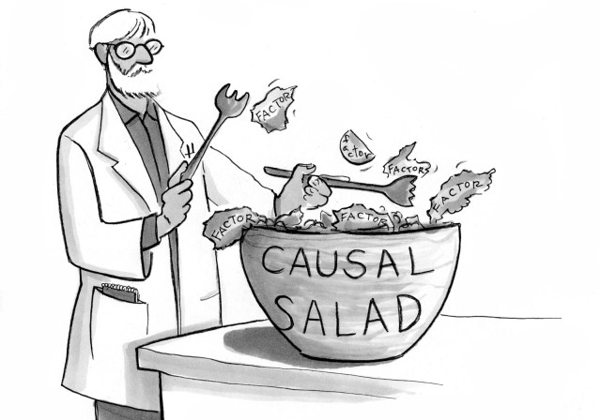
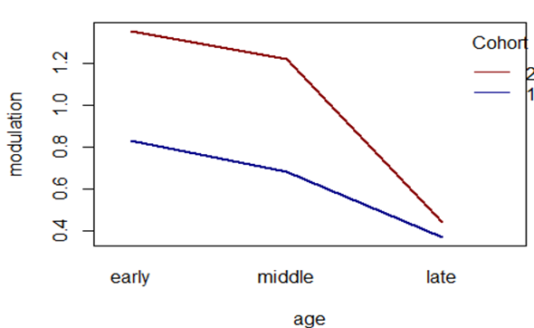
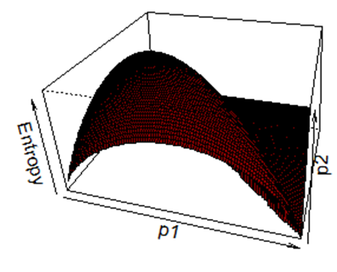
Statistics for linguists
2023-12-13
Confounds, model fitting, interactions, multivariate regression

Slide 2
Packages for today
library(dagitty) library(ggdag) library(V8) library(Rling) library(AICcmodavg) library(tidyverse) library(gridExtra)

Slide 3

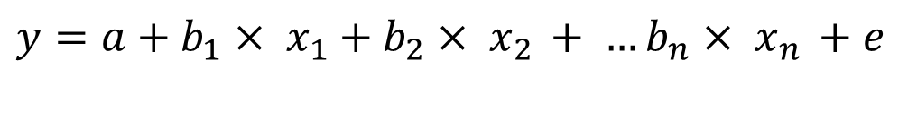
Multivariate regression
We have thus far considered models with a single predictor
A multivariate model has the following structure
$y=a+b_{1}× x_{1}+$ $b_{2}× x_{2 }+ …b_{n}× x_{n }+e$
$$e \sim N(0,s)$$

Slide 4
Multivariate regression
We have thus far considered models with a single predictor
A multivariate model has the following structure
$y=a+b_{1}× x_{1}+$ $b_{2}× x_{2 }+ …b_{n}× x_{n }+e$
Independent variables
Dependent variable
$$e \sim N(0,s)$$
Coefficients
Normally distributed error term

Slide 5

Multivariate regression
We have thus far considered models with a single predictor
A multivariate model has the following structure
$y=a+b_{1}× x_{1}+$ $b_{2}× x_{2 }+ …b_{n}× x_{n }+e$
$$e \sim N(0,s)$$
Independent variables
Dependent variable
Coefficients
Normally distributed error term

Slide 6
Correlations and confounds
Multivariate regression is a powerful research because it can allow us to better distinguish between cause and effect.
Why is this the case?
What is the reason that causation cannot always be inferred from correlation?

Slide 7
Confounds or confounding
1. to perplex or amaze , esp. by a sudden disturbance or surprise; bewilder; confuse
The complicated directions confounded him
2. to throw into confusion or disorder
The revolution confounded the people
3. to throw into increased confusion or disorder
4. to treat or regard erroneously as identical; mix or associate by mistake
truth confounded with error
5. to mingle so that the elements cannot be distinguished or separated
6. to damn (used in mild imprecations)
Confound it!
7. to contradict or refute
to confound their arguments
https://www.collinsdictionary.com/de/worterbuch/englisch/confound

Slide 8
Confounds or confounding
“If we undertake to estimate the effect of one variable (X) on another (Y) by examining the statistical association between the two, we ought to ensure that the association is not produced by factors other than the effect under study. The presence of spurious association – due, for example, to the influence of extraneous variables – is called confounding because it tends to confound our reading and to bias our estimate of the effect studied. Conceptually, therefore, we can say that X and Y are confounded when there is a third variable Z that influences both X and Y; such a variable is then called a confounder of X and Y.”
Pearl 2009: 183
Pearl, Judea. 2009. Causality: Models, Reasoning and Inference (Second Edition). Cambridge.

Slide 9
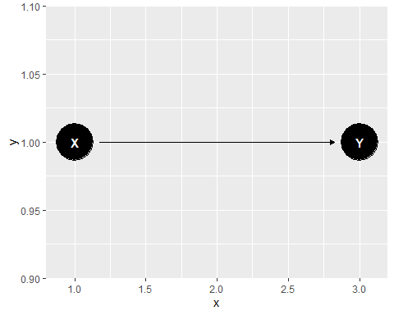
Fork
coord_dag <- list( x = c(X=1, Y=3), y = c(X=1, Y=1) ) our_dag <- ggdag::dagify(Y~X, coords = coord_dag) ggdag::ggdag(our_dag)

Slide 10
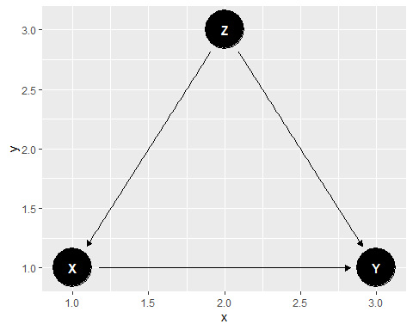
Fork
coord_dag <- list( x = c(X=1, Y=3, Z=2), y = c(X=1, Y=1, Z=3) ) our_dag <- ggdag::dagify(Y~X, X~Z, Y~Z, coords = coord_dag) ggdag::ggdag(our_dag)

Slide 11
Fork
To illustrate we can simulate the Fork confounder
set.seed(1234) z <- rnorm(100, 10, 10) b1 <- 2 b2 <- 3 a1 = 3 a2 = 4 y <- a1 + b1*z + rnorm(100, 0, 3) x <- a2 + b2*z + rnorm(100, 0, 3) d <- list(y, z, x) summary(lm(y~x, data=d))

Slide 12
summary(lm(y~x, data=d))
## ## Call: ## lm(formula = y ~ x, data = d) ## ## Residuals: ## Min 1Q Median 3Q Max ## -8.5904 -2.1783 0.0315 2.5965 7.1595 ## ## Coefficients: ## Estimate Std. Error t value Pr(>|t|) ## (Intercept) 0.52548 0.48810 1.077 0.284 ## x 0.65398 0.01148 56.953 <2e-16 *** ## --- ## Signif. codes: 0 '***' 0.001 '**' 0.01 '*' 0.05 '.' 0.1 ' ' 1 ## ## Residual standard error: 3.485 on 98 degrees of freedom ## Multiple R-squared: 0.9707, Adjusted R-squared: 0.9704 ## F-statistic: 3244 on 1 and 98 DF, p-value: < 2.2e-16

Slide 13
summary(lm(y~x, data=d))
## ## Call: ## lm(formula = y ~ x, data = d) ## ## Residuals: ## Min 1Q Median 3Q Max ## -8.5904 -2.1783 0.0315 2.5965 7.1595 ## ## Coefficients: ## Estimate Std. Error t value Pr(>|t|) ## (Intercept) 0.52548 0.48810 1.077 0.284 ## x 0.65398 0.01148 56.953 <2e-16 *** ## --- ## Signif. codes: 0 '***' 0.001 '**' 0.01 '*' 0.05 '.' 0.1 ' ' 1 ## ## Residual standard error: 3.485 on 98 degrees of freedom ## Multiple R-squared: 0.9707, Adjusted R-squared: 0.9704 ## F-statistic: 3244 on 1 and 98 DF, p-value: < 2.2e-16
There appears to be a significant relationship even though we know there is none.

Slide 14
summary(lm(y~x+z, data=d))
## ## Call: ## lm(formula = y ~ x + z, data = d) ## ## Residuals: ## Min 1Q Median 3Q Max ## -8.6577 -1.8151 0.0409 1.8996 8.6932 ## ## Coefficients: ## Estimate Std. Error t value Pr(>|t|) ## (Intercept) 2.7516 0.6181 4.452 2.28e-05 *** ## x 0.1027 0.1090 0.942 0.348 ## z 1.6817 0.3310 5.081 1.82e-06 *** ## --- ## Signif. codes: 0 '***' 0.001 '**' 0.01 '*' 0.05 '.' 0.1 ' ' 1 ## ## Residual standard error: 3.113 on 97 degrees of freedom ## Multiple R-squared: 0.9768, Adjusted R-squared: 0.9764 ## F-statistic: 2045 on 2 and 97 DF, p-value: < 2.2e-16
The relationship disappears when put in the actual causal factor

Slide 15
Colliders and causal salad
It is not so simple as adding as many factors as possible to a model – we can create a bias by adding variables – something that is rarely considered when basic model fitting is taught.
A collider confound is one which creates a spurious correlation between variables by being added to a model.
A pipe does something similar but removes a correlation where there would be one.
The practice of unthinkingly adding all the variables one can think of to a model to find correlations, without thinking about causal relationships is referred to as causal salad – it is extremely wrong and widely practiced

Slide 16
“... there is Causal Salad: You put everything into a regression equation, toss with some creative story-telling, and hope the reviewers eat it. In general, this is not a valid approach, for well-known reasons. But it can get you published. Causal salad can discover causes too. But you have to get lucky. The Salad isn’t only regression. Really any procedure that hopes to take a list of variables (features) and return causal inference is Causal Salad. No amount of data reliably turns salad into sense.” - McElreath
https://elevanth.org/blog/2021/06/15/regression-fire-and-dangerous-things-1-3/
https://bigthink.com/surprising-science/judea-pearls-the-book-of-why-brings-news-of-a-new-science-of-causes/
Pearl, Judea (& Dana Mackenzie). 2018. The Book of Why: The New Science of Cause and Effect. Penguin

Slide 17
Confounding types
Fork
Pipe
Collider
Descendant

Slide 18
Interactions
Sometimes the strength, significance or even direction of an effect is related to
An interaction is a term which allows the direction and structure (slope) of a term to vary with another term.
It’s most easily illustrated and conceptualized with an ANOVA model

Slide 19
Interactions
Download the data modref from the Rlang package
data("sharedref") head(sharedref)
## mod age cohort ## 1 0.75 early 1 ## 2 0.85 early 1 ## 3 0.93 early 1 ## 4 0.80 early 1 ## 5 1.24 early 2 ## 6 1.38 early 2

Slide 20
Interactions
The data show how many modulations of a given sign occur according to age.
These are data from Nicaraguan sign language – modulation should decrease by age and cohort (the age group that started learning)
But cohort and age are not independent from one another.
Senghas, Richard J. et al. 2005. The Emergence of Nicaraguan Sign Language: Questions of Development, Acquisition, and Evolution. Biology and Knowledge revisited: From neurogenesis to psychogenesis. Lawrence Erlbaum Associates. 287-306.

Slide 21
Interactions
mod = continuous: number of spatial modulations per verb
age = categorical: early, middle, late
cohort = categorical: 1, 2, 3

Slide 22
Interactions
model1 <- lm(mod~age, data=sharedref) anova(model1)
## Analysis of Variance Table ## ## Response: mod ## Df Sum Sq Mean Sq F value Pr(>F) ## age 2 4.2243 2.11217 38.663 1.691e-10 *** ## Residuals 45 2.4584 0.05463 ## --- ## Signif. codes: 0 '***' 0.001 '**' 0.01 '*' 0.05 '.' 0.1 ' ' 1

Slide 23
Interaction plot
ref <- aggregate(mod~age+cohort, data=sharedref, FUN = mean) interaction.plot(ref$age, ref$cohort, ref$mod, xlab="age", ylab ="modulation", lty = 1, lwd = 2, col = c("blue4", "red4"), trace.label = "Cohort")

Slide 24
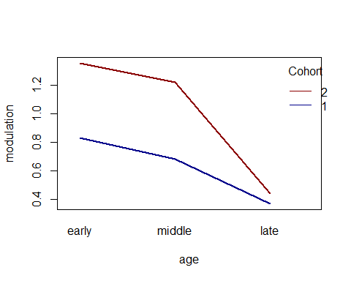
Interaction plot
In both cohorts the amount of modulation goes down by age.
But the slope is different depending on the age.

Slide 25
model2 <- lm(mod~age*cohort, data=sharedref) anova(model2)
## Analysis of Variance Table ## ## Response: mod ## Df Sum Sq Mean Sq F value Pr(>F) ## age 2 4.2243 2.11217 491.884 < 2.2e-16 *** ## cohort 1 1.7101 1.71008 398.243 < 2.2e-16 *** ## age:cohort 2 0.5679 0.28397 66.132 1.054e-13 *** ## Residuals 42 0.1804 0.00429 ## --- ## Signif. codes: 0 '***' 0.001 '**' 0.01 '*' 0.05 '.' 0.1 ' ' 1

Slide 26
summary(model2)
## ## Call: ## lm(formula = mod ~ age * cohort, data = sharedref) ## ## Residuals: ## Min 1Q Median 3Q Max ## -0.16000 -0.03438 0.00000 0.04000 0.11750 ## ## Coefficients: ## Estimate Std. Error t value Pr(>|t|) ## (Intercept) 0.816250 0.009458 86.30 < 2e-16 *** ## age1 -0.138750 0.006688 -20.75 < 2e-16 *** ## age2 -0.272500 0.011584 -23.52 < 2e-16 *** ## cohort1 0.188750 0.009458 19.96 < 2e-16 *** ## age1:cohort1 -0.036250 0.006688 -5.42 2.70e-06 *** ## age2:cohort1 -0.117500 0.011584 -10.14 7.32e-13 *** ## --- ## Signif. codes: 0 '***' 0.001 '**' 0.01 '*' 0.05 '.' 0.1 ' ' 1 ## ## Residual standard error: 0.06553 on 42 degrees of freedom ## Multiple R-squared: 0.973, Adjusted R-squared: 0.9698 ## F-statistic: 302.9 on 5 and 42 DF, p-value: < 2.2e-16

Slide 27
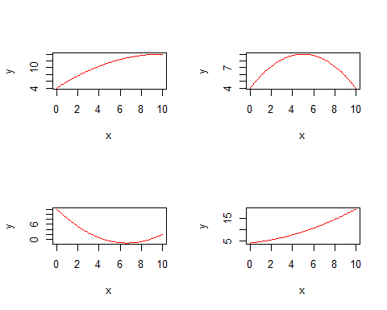
Model fitting and overfitting
There are different types of relationships we can construct by adding variables to our regression equation in different ways.
Crawley, Michael J. 2015. Statistics: An Introduction using R. Wiley.

Slide 28
Code
par(mfrow=c(2,2)) curve(4+2*x-0.1*x^2,0,10,col="red",ylab="y") curve(4+2*x-0.2*x^2,0,10,col="red",ylab="y") curve(12-4*x+0.3*x^2,0,10,col="red",ylab="y") curve(4+0.5*x+0.1*x^2,0,10,col="red",ylab="y")
Crawley, Michael J. 2015. Statistics: An Introduction using R. Wiley.

Slide 29
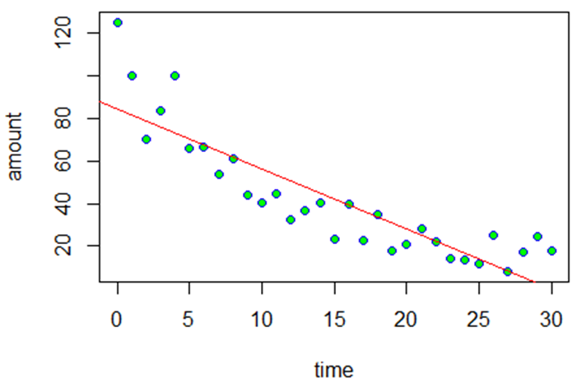
Model fitting and overfitting
Download the decay.csv data which shows nuclear waste decay over time.
par(mfrow=c(1,1)) data <- read.csv(“YourPathway/decay.csv", header=TRUE) attach(data) plot(time,amount,pch=21,col="blue",bg="green") abline(lm(amount~time),col="red")
Crawley, Michael J. 2015. Statistics: An Introduction using R. Wiley.

Slide 30
Model fitting and overfitting
We could develop a more complex model
$$amount=a+b_{1}∗time+b_{2} ∗{time}^{2}+e$$
Crawley, Michael J. 2015. Statistics: An Introduction using R. Wiley.

Slide 31
model2 <- lm(amount~time) model3 <- lm(amount~time+I(time^2))
p1 <- ggplot(data=data, aes(x=time, y =amount))+ geom_point(color='blue')+ geom_line(color='red', data=predict_model3, aes(x=time, y=amount_pred))+ ggtitle("R^2 = 0.9014") predict_model2 <- data.frame(amount_pred = predict(model2, data), time= data$time) p2 <- ggplot(data=data, aes(x=time, y =amount))+ geom_point(color='blue')+ geom_line(color='red', data=predict_model2, aes(x=time, y=amount_pred))+ ggtitle("R^2 = 0.7608") grid.arrange(p2, p1, nrow = 1, ncol =2)
Crawley, Michael J. 2015. Statistics: An Introduction using R. Wiley.

Slide 32
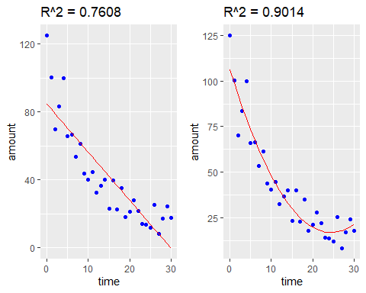
Crawley, Michael J. 2015. Statistics: An Introduction using R. Wiley.

Slide 33
summary(model2)
## ## Call: ## lm(formula = amount ~ time) ## ## Residuals: ## Min 1Q Median 3Q Max ## -19.065 -10.029 -2.058 5.107 40.447 ## ## Coefficients: ## Estimate Std. Error t value Pr(>|t|) ## (Intercept) 84.5534 5.0277 16.82 < 2e-16 *** ## time -2.8272 0.2879 -9.82 9.94e-11 *** ## --- ## Signif. codes: 0 '***' 0.001 '**' 0.01 '*' 0.05 '.' 0.1 ' ' 1 ## ## Residual standard error: 14.34 on 29 degrees of freedom ## Multiple R-squared: 0.7688, Adjusted R-squared: 0.7608 ## F-statistic: 96.44 on 1 and 29 DF, p-value: 9.939e-11
Crawley, Michael J. 2015. Statistics: An Introduction using R. Wiley.

Slide 34
summary(model3)
## ## Call: ## lm(formula = amount ~ time + I(time^2)) ## ## Residuals: ## Min 1Q Median 3Q Max ## -22.302 -6.044 -1.603 4.224 20.581 ## ## Coefficients: ## Estimate Std. Error t value Pr(>|t|) ## (Intercept) 106.38880 4.65627 22.849 < 2e-16 *** ## time -7.34485 0.71844 -10.223 5.90e-11 *** ## I(time^2) 0.15059 0.02314 6.507 4.73e-07 *** ## --- ## Signif. codes: 0 '***' 0.001 '**' 0.01 '*' 0.05 '.' 0.1 ' ' 1 ## ## Residual standard error: 9.205 on 28 degrees of freedom ## Multiple R-squared: 0.908, Adjusted R-squared: 0.9014 ## F-statistic: 138.1 on 2 and 28 DF, p-value: 3.122e-15
Crawley, Michael J. 2015. Statistics: An Introduction using R. Wiley.

Slide 35
model4 <- lm(amount~time+I(time^2)+I(time^3)) predict_model4 <- data.frame(amount_pred = predict(model4, data), time= data$time) p3 <- ggplot(data=data, aes(x=time, y =amount))+ geom_point(color='blue')+ geom_line(color='red', data=predict_model4, aes(x=time, y=amount_pred))+ ggtitle("R^2 = 0.9055, model3") model5 <- lm(amount~time+I(time^2)+I(time^3)+I(time^4)) predict_model5 <- data.frame(amount_pred = predict(model4, data), time= data$time) p4 <- ggplot(data=data, aes(x=time, y =amount))+ geom_point(color='blue')+ geom_line(color='red', data=predict_model5, aes(x=time, y=amount_pred))+ ggtitle("R^2 = 0.9069, model4") grid.arrange(p3, p4, ncol=2)
Crawley, Michael J. 2015. Statistics: An Introduction using R. Wiley.

Slide 36
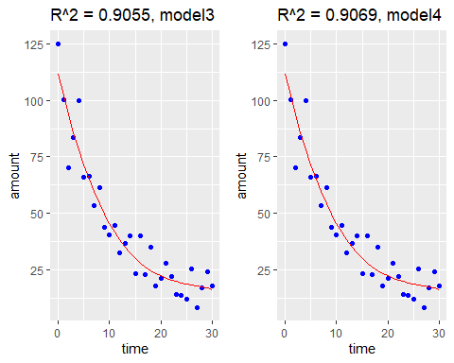
Crawley, Michael J. 2015. Statistics: An Introduction using R. Wiley.

Slide 37
Model fitting
If we keep adding more complexity to the polynomial equation, we can make the model fit exactly the line
$y=a+bx+cx^{2}+dx^{3}$ $+ ex^{4}+fx^{5} …$
Crawley, Michael J. 2015. Statistics: An Introduction using R. Wiley.

Slide 38
Akaike Information Criterion
Complex models tend to not extend beyond the data they are modelling
We should ask to what extent are we modelling noise (deviations due to error by adding a parameter.
Akaike information criterion is a criterion for model selection that makes the model incur penalties for its complexity.
Akaike, H. A new look at the statistical model identification. IEEE Transactions of Automatic Control 19: 6: 716-723.

Slide 39

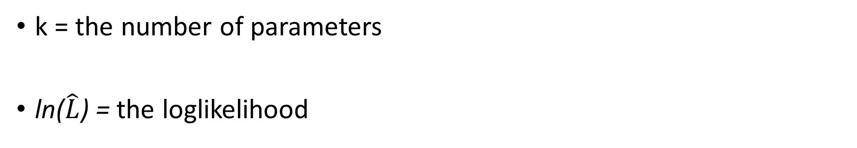
Akaike Information Criterion
k = the number of parameters
ln($\hat{L}$) = the loglikelihood
$$AIC=2K −2ln⁡(\hat{L})$$
Akaike, H. A new look at the statistical model identification. IEEE Transactions of Automatic Control 19: 6: 716-723.

Slide 40
AIC(model2)
## [1] 257.0016
AIC(model3)
## [1] 230.4445
AIC(model4)
## [1] 229.9901
AIC(model5)
## [1] 230.3781
The AIC is based on information theory, concerned with entropy, the degree of disorder in a system
Akaike, H. A new look at the statistical model identification. IEEE Transactions of Automatic Control 19: 6: 716-723.

Slide 41
‘Basic’ model fitting
Once one understands the causal relationships we are interested in, we need some methodology for weighing simplicity against accuracy/fit.
The simplest way of doing this is by starting with a maximal model and moving to a minimal adequate model
Crawley, Michael J. 2015. Statistics: An Introduction using R. Wiley.

Slide 42
Basic types of models
Saturated model: There is one parameter for every data (perfect fit)
Maximal model: Contains all factors, interactions and covariates that might be of interest (+ and that should be added considering their causal relations).
Minimal adequate model: A simplified model which has removed superfluous variables.
Null model: Just one parameter, the overall mean.
Crawley, Michael J. 2015. Statistics: An Introduction using R. Wiley.

Slide 43
Classic model selection process (simplified)
Fit maximal model: Fit all the factors, interactions and covariates of interest. Note the Akaike Information Criterion
Begin model simplification: Inspect the parameter estimates using summary(). Remove the least significant terms first, using update(), starting with highest order interactions.
What does the deletion do to the AIC?
If it increases the AIC > Keep the interaction term and go back to step one looking at another term
If it decreases the AIC -> Leave the parameter deleted and continue to simplify the model
Check assumptions: Use plot() to check model assumptions making sure there is no heteroskedasticity (unequal scatter of residuals)
Crawley, Michael J. 2015. Statistics: An Introduction using R. Wiley.

Slide 44
Classic model selection process (simplified)
Main problems / issues / questions for the trad-stat modelling practice:
What should go in the maximal model? Does it incorporate confounds? By adding one variable do we confound our ability to assess the causal effect of another?
Controversial: To what extent does the process of deleting variables result in an informative statistical model vis-a-vis causes? Are we really removing confounds?
Can’t we fit more than one model to assess our causal relationships?

Slide 45
Iconicity data
Let’s practice with the iconicity data of Winter (2017)
icon <- read.csv("/YourPathWay/perry_winter_2017_iconicity.csv") head(icon)
## Word POS SER CorteseImag Conc Syst Freq Iconicity ## 1 a Grammatical NA NA 1.46 NA 1041179 0.4615385 ## 2 abide Verb NA NA 1.68 NA 138 0.2500000 ## 3 able Adjective 1.73 NA 2.38 NA 8155 0.4666667 ## 4 about Grammatical 1.20 NA 1.77 NA 185206 -0.1000000 ## 5 above Grammatical 2.91 NA 3.33 NA 2493 1.0625000 ## 6 abrasive Adjective NA NA 3.03 NA 23 1.3125000
Winter, B., Perlman, M., Perry, L. K., & Lupyan, G. (2017). Which words are most iconic? Iconicity in English sensory words. Interaction Studies: Social Behaviour and Communication in Biological and Artificial Systems, 18(3), 443–464. https://doi.org/10.1075/is.18.3.07win

Slide 46
Iconicity data
POS: part of speech
SER: Sensory experience rating (does the word evoke a sensory experience)
Conc: Concreteness
Syst: Systematicity, overall contribution to form meaning correlation
Freq: Frequency
Iconicity: how much does the form sound like the word
Winter, B., Perlman, M., Perry, L. K., & Lupyan, G. (2017). Which words are most iconic? Iconicity in English sensory words. Interaction Studies: Social Behaviour and Communication in Biological and Artificial Systems, 18(3), 443–464. https://doi.org/10.1075/is.18.3.07win

Slide 47
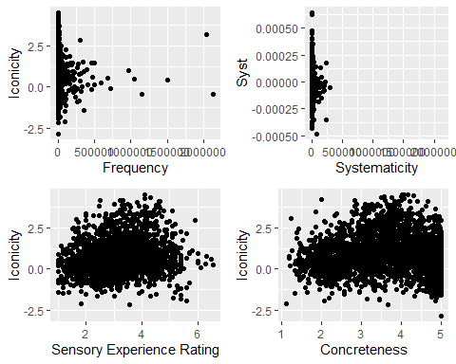
Data exploration
p1 <- ggplot(icon, aes(x=Freq, y = Iconicity))+ geom_point()+ xlab("Frequency") p2 <- ggplot(icon, aes(x=Freq, y = Syst))+ geom_point()+ xlab("Systematicity") p3 <- ggplot(icon, aes(x=SER, y = Iconicity))+ geom_point()+ xlab("Sensory Experience Rating") p4 <- ggplot(icon, aes(x= Conc, y = Iconicity))+ geom_point()+ xlab("Concreteness") grid.arrange(p1, p2, p3, p4, nrow = 2, ncol =2)

Slide 48
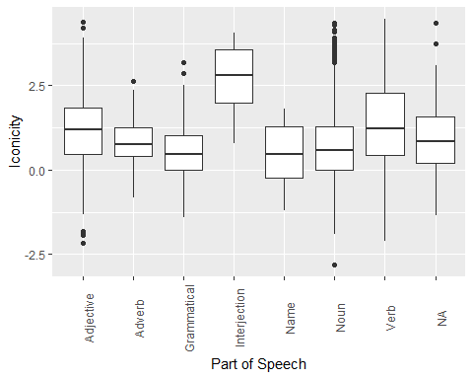
Data exploration
ggplot(icon, aes(x=POS, y = Iconicity))+ geom_boxplot()+ xlab("Part of Speech")+ theme(axis.text.x = element_text(angle = 90))

Slide 49
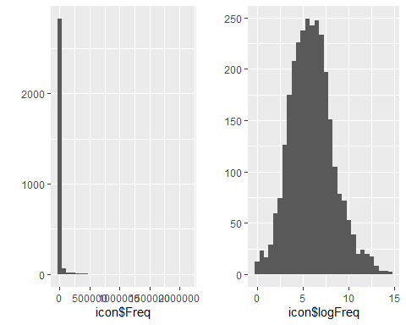
Data transformation
p1 <- qplot(icon$Freq)
icon$logFreq <- log(icon$Freq) p2 <- qplot(icon$logFreq) grid.arrange(p1, p2, ncol=2)

Slide 50
model.saturated <- lm(Iconicity~logFreq+Syst+Conc+SER, data=icon) summary(model.saturated)
## ## Call: ## lm(formula = Iconicity ~ logFreq + Syst + Conc + SER, data = icon) ## ## Residuals: ## Min 1Q Median 3Q Max ## -3.12346 -0.73861 -0.07942 0.66380 2.82933 ## ## Coefficients: ## Estimate Std. Error t value Pr(>|t|) ## (Intercept) 1.88197 0.22289 8.443 < 2e-16 *** ## logFreq -0.13414 0.01717 -7.813 1.43e-14 *** ## Syst 376.62000 270.60854 1.392 0.164 ## Conc -0.34187 0.03967 -8.618 < 2e-16 *** ## SER 0.47043 0.04128 11.396 < 2e-16 *** ## --- ## Signif. codes: 0 '***' 0.001 '**' 0.01 '*' 0.05 '.' 0.1 ' ' 1 ## ## Residual standard error: 1.021 on 976 degrees of freedom ## (2020 observations deleted due to missingness) ## Multiple R-squared: 0.1859, Adjusted R-squared: 0.1826 ## F-statistic: 55.71 on 4 and 976 DF, p-value: < 2.2e-16

Slide 51
model2 <- lm(Iconicity~logFreq+Conc+SER, data=icon) summary(model2)
## ## Call: ## lm(formula = Iconicity ~ logFreq + Conc + SER, data = icon) ## ## Residuals: ## Min 1Q Median 3Q Max ## -3.2650 -0.7107 -0.0936 0.6282 3.3881 ## ## Coefficients: ## Estimate Std. Error t value Pr(>|t|) ## (Intercept) 1.37487 0.15695 8.760 < 2e-16 *** ## logFreq -0.09372 0.01244 -7.535 7.75e-14 *** ## Conc -0.13750 0.02771 -4.962 7.65e-07 *** ## SER 0.19445 0.02764 7.035 2.84e-12 *** ## --- ## Signif. codes: 0 '***' 0.001 '**' 0.01 '*' 0.05 '.' 0.1 ' ' 1 ## ## Residual standard error: 1.051 on 1761 degrees of freedom ## (1236 observations deleted due to missingness) ## Multiple R-squared: 0.06841, Adjusted R-squared: 0.06683 ## F-statistic: 43.11 on 3 and 1761 DF, p-value: < 2.2e-16

Slide 52
AIC
AIC(model.saturated)
## [1] 2831.413
AIC(model2)
## [1] 5188.832

