Slide 1

SE265 Capstone
By AJ Saporito and Tristen Jussaume

Slide 2

Project Overview
Users on this site can post or request to work on jobs related to software development.
When a user is satisfied with their job and the results, they can leave a review towards whoever worked on it.

Slide 3
Team Members Contributions
AJ Saporito
Technical design
Navbar/footer
Login/signup
Edit user settings
Delete profile
Adding reviews
Adding jobs
Searching for users/jobs
Tristen Jussaume
Dashboard
Database relationships
Requesting jobs
Accepting job requests
Calculating/storing reviews
Moving job to in progress
Moving job to complete
Open job/public profile view

Slide 4
Timeline
1 week to plan idea and directory setup.
Weeks 2-3 to plan database and prototype design.
Weeks 4-5 to complete user functionalities.
Weeks 5-7 to complete job functionalities with requests.
Week 7 to add skills to jobs.
Weeks 7-8 to complete add reviews to users.
Weeks 8-10 to finalize and fix bugs.

Slide 5

Database Organization
6 tables in a MySQL database
Jobs
JobSkills
Requests
Reviews
Skills
Users

Slide 6
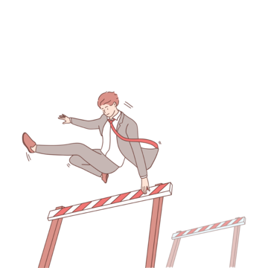
Obstacles Overcame
Planning the idea and executing it
First long-term collaboration project
XHR requests/AJAX
jQuery/JavaScript
GitHub
Time management
Number of SQL tables

Slide 7

Technical Design
Procedural PHP in a Model-View-Controller architecture.
Requests are processed by checking the URI against an array of routes.
Backend resources and client-side assets are dynamically rendered to the index file.

Slide 8
Summary
Great learning experience
Increased skills and repetition in full-stack web development
SQL practice
A test of our hard and soft skills
Pushed to create something to the best of our abilities

Slide 9

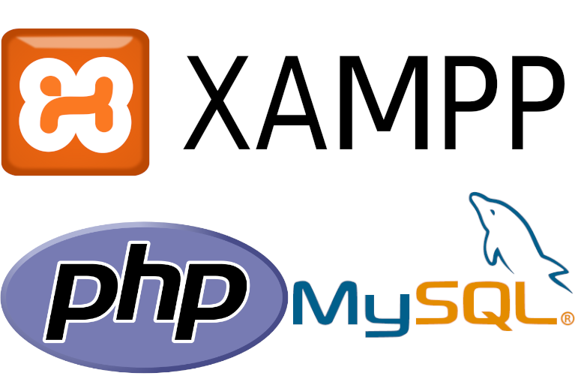
Live Demo…

