Slide 1
MLB Player Performance Analytics
Where Traditional Stats and Statcast Metrics Agree, Disagree, and What It Means for Player Evaluation
AJ Schoolcraft | ISBA 4715 Capstone | Spring 2026
Target Role: Baseball Operations Analyst, San Francisco Giants

Slide 2
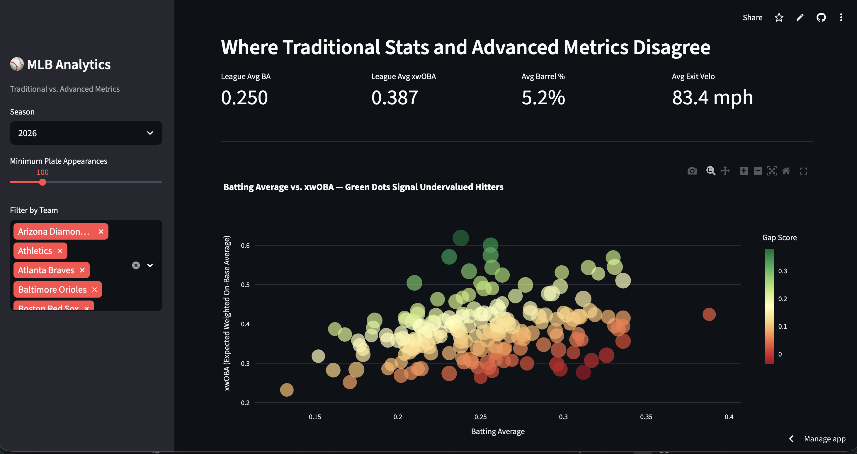
Traditional Stats Systematically Undervalue Elite Contact Quality
Descriptive: What happened across the league?
Players with barrel rates above 10% outperform their batting average by ~45 points in xwOBA
Barrels produce a .684 BA and 2.236 SLG vs. .292/.368 for non-barreled contact (2026 data)
The scatter plot reveals a clear cluster of 'undervalued' hitters — high xwOBA, low batting average
These gaps are not random — they correlate with measurable batted-ball quality (exit velocity, barrel %)

Slide 3
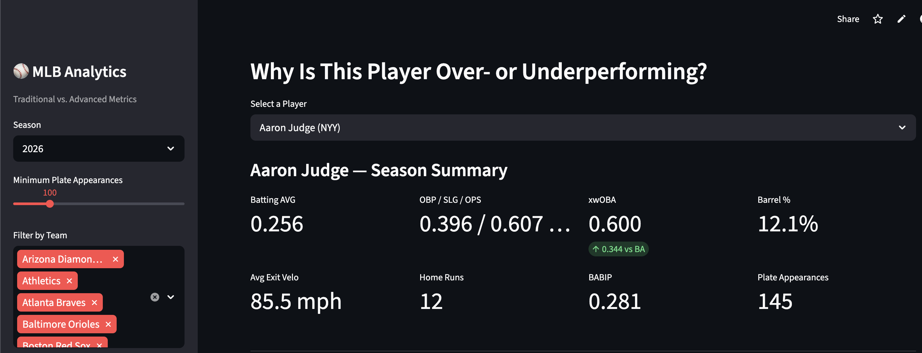
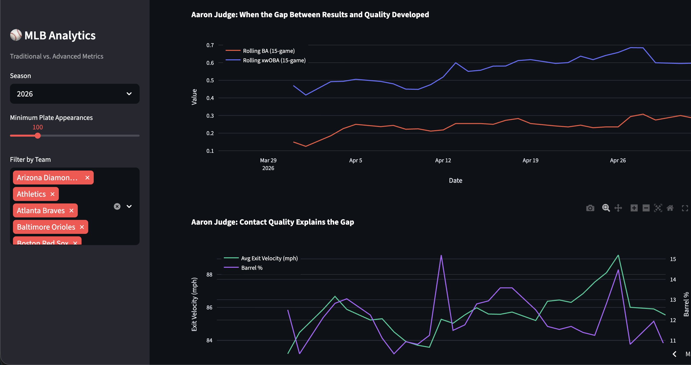
High Exit Velocity + Low BABIP = Unlucky, Not Untalented
Diagnostic: Why do results diverge from underlying quality?
The gap between xwOBA and batting average is largest for players with high exit velocity but below-average BABIP
Rolling 15-game trends reveal when the gap develops — often after a streak of hard-hit balls finding fielders
Contact quality charts (barrel % + exit velo) confirm the hitter's process is sound even when results lag
BABIP regresses toward ~.300 over time — players with low BABIP and high barrel rates are buy-low candidates
Positive
Gap

Slide 4
Recommendation: Target Undervalued Hitters for Acquisition
Action → Expected Outcome
ACTION: Target players with top-quartile barrel rates (>10%) and below-average BABIP (<.280)
OUTCOME: Expected regression to the mean projects 15–25 point batting average increases
VALUE: These players are available below market value because traditional stats understate their talent
Decision Framework
1. Screen: Barrel % > 10%, BABIP < .280, PA > 100
2. Diagnose: Check xwOBA vs. BA gap score (positive = undervalued)
3. Confirm: Review rolling trend — is contact quality sustained or fluky?
4. Act: Acquire before BABIP regression corrects the market price

Slide 5
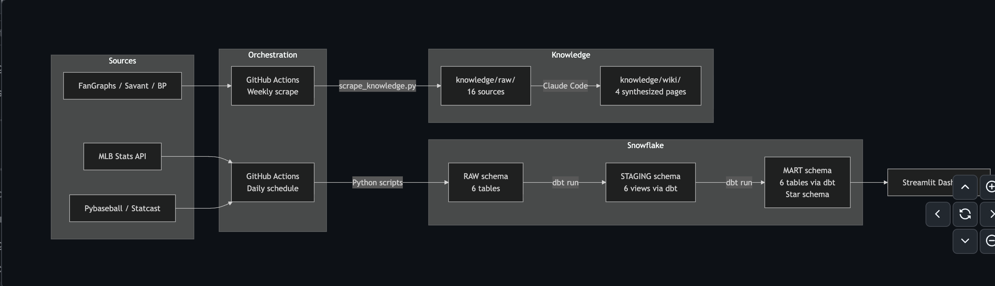
End-to-End Pipeline: From Raw APIs to Actionable Dashboard
Architecture & Tech Stack
Extract: MLB Stats API + Pybaseball (Statcast) pull player stats, game logs, and batted-ball data
Load: Python scripts write to Snowflake RAW schema via snowflake-connector-python
Transform: dbt builds staging views and mart tables (star schema: 2 facts + 4 dimensions)
Present: Streamlit dashboard with Plotly charts deployed to Community Cloud
Knowledge Base: 16 sources scraped from FanGraphs, Baseball Savant, BP → 4 synthesized wiki pages
Orchestrate: GitHub Actions runs daily ELT and weekly knowledge base re-scrape

