Slide 1
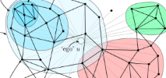
Kaggle Learning Social Circles in Networks
http://www.kaggle.com/c/learning-social-circles
Kathleen Perez-Lopez
GADSDC2
Final Project Status Report
10/6/2014

Slide 2
Background
Behavioral norms are conveyed through SOCIAL NETWORKS
Health – eating, exercising, sleeping, drinking
Consumer – what we think we need/must buy
Political – attitudes, activities (GOTV, protesting, bombing)
Intellectual
Whether we sign up for - & stick with – GADSDC
Kaggle Learning Social Circles
Help us organize our FB friends into circle
Probably VERY interesting to other entities
My interest: social network analysis of online communities of practice for educators, .e.g., NSF CS10K

Slide 3
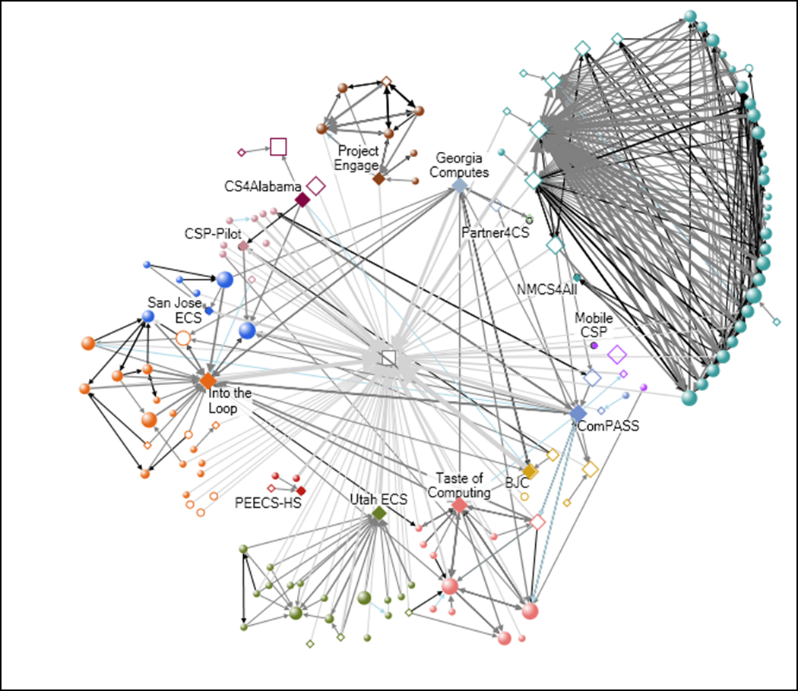
NSF CS10K Community of Computer Science Educators Posts during 2013

Slide 4
Competition Description
Goal: Infer the FB users’ circles of friends
Data
Egonets for 110 FB users (include alters, not ego; coded by ego)
For 60 training egos, a file of circles of alters
For all 110 , file of anonymized features
Measuring submission, derived circles for 50 test egos
Minimum edit distance[submission, ground truth]
Provided
Python code to implement edit distance
Sample submissions
one big circle of all friends: score = 5553
connected components submission: score = 5199
Notes:
Add images of network w/ ego and of egonet (i.e., w/o ego)
Birthday, work info, education info, hometown id, languages, political (?), religion, first name- last name codes
(http://www.kaggle.com/c/learning-social-circles/details/evaluation)
Each of the following operations costs one edit:
Add a user to an existing circle
Create a circle with one user
Remove a user from a circle
Delete a circle with one user

Slide 5
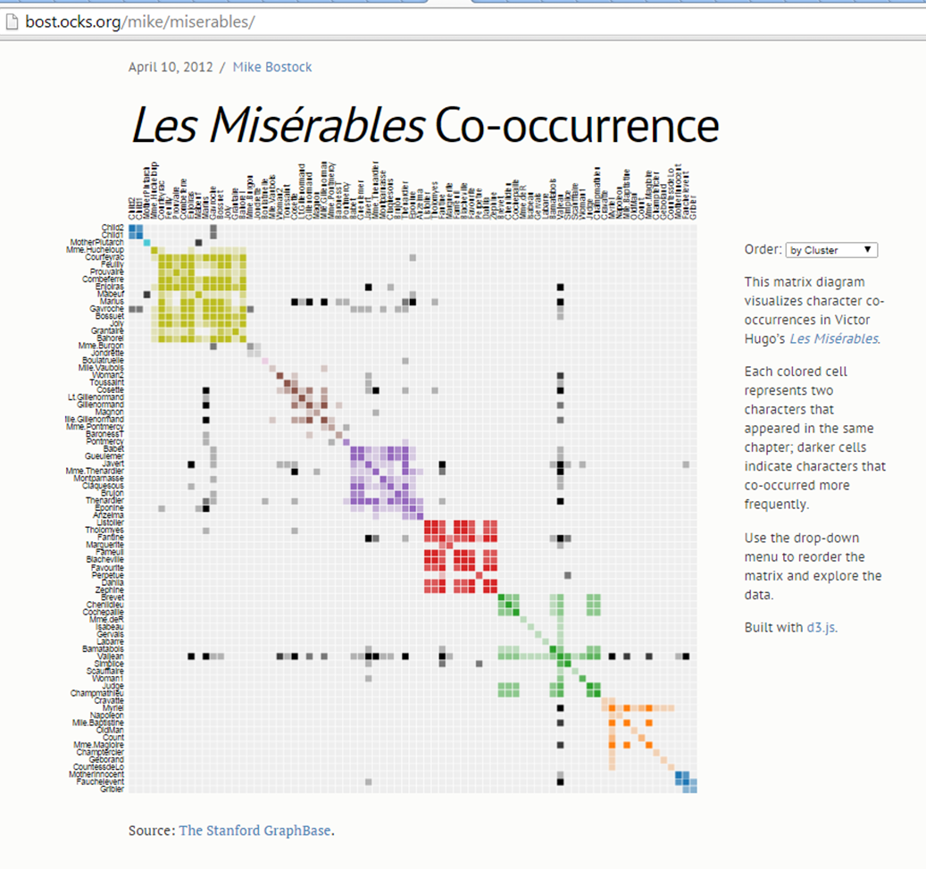
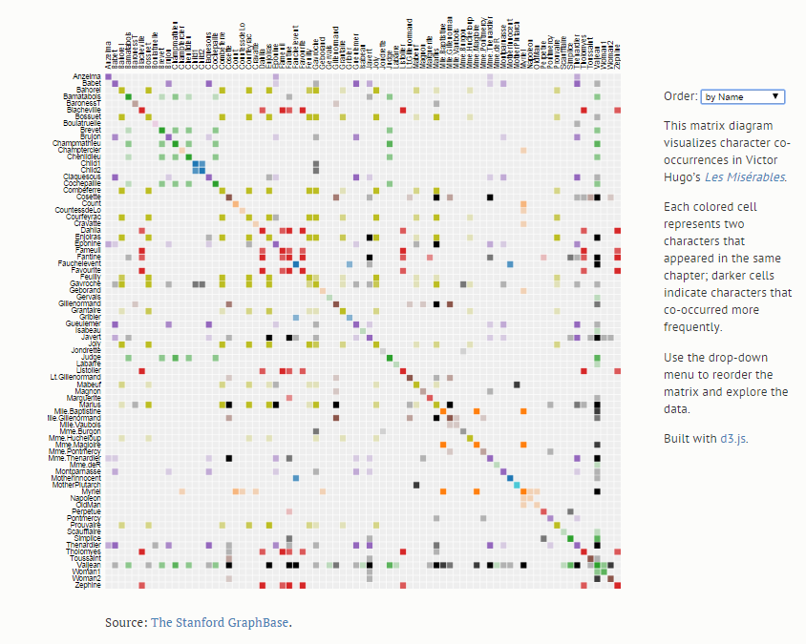
Network as Adjacency Matrix
http://bost.ocks.org/mike/miserables/

Slide 6
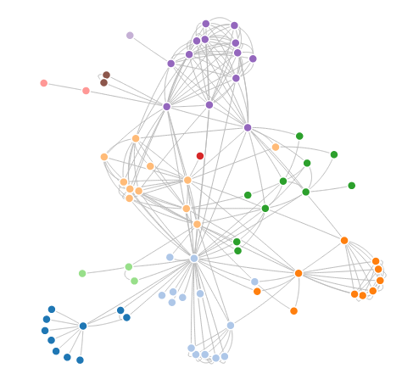
Network Clusters as Adjacency Matrix Partitions
http://bl.ocks.org/mbostock/4600693

Slide 7
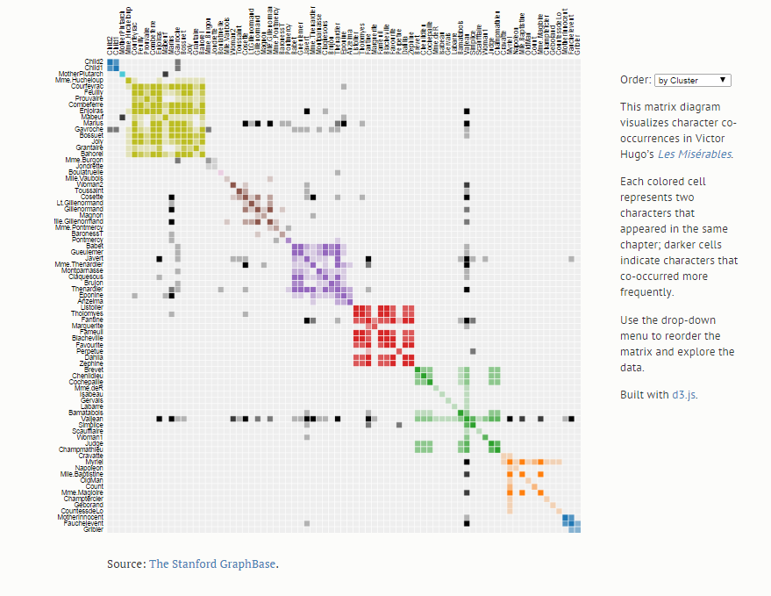
Network Clusters as Adjacency Matrix Partitions
http://bost.ocks.org/mike/miserables/

Slide 8
Strategy: Use Egonet Structure
Examine and characterize egonets
Compute & visualize graph-level metrics
Number of nodes, edges, components; density; ave nodes/component; transitivity; cluster_coefs; geodesic; ave shortest path
Visualize egonets
Tailor clustering algorithm to egonet
Apply many graph clustering algorithms
Classify each egonet as good/poor wrt each alg
Predict algorithm outcome based on egonet metrics
Test: select best clustering algorithm based on metrics
Improve using user users’ features
Submit by OCTOBER 28

Slide 9
Status: ~40%
Examine and characterize egonets
Compute & visualize graph-level metrics
Number of nodes, edges, components; density; ave nodes/component; transitivity; cluster_coefs; geodesic; ave shortest path
Visualize egonets
Tailor clustering algorithm to egonet
Apply some graph clustering algorithms, Louvain Method
Classify each egonet as good/poor wrt each alg
Edit distance program doesn’t produce benchmark values
Predict algorithm outcome based on egonet metrics
Test: select best clustering algorithm based on metrics
Improve using user users’ features
Submit by OCTOBER 28
Notes:
Grey area BUT: if I prorate the difference for the Louvain Method, -> 3195 ->#59 on the Leaderboard.

Slide 10
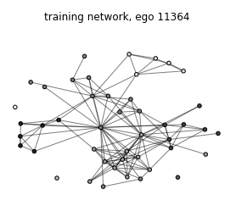
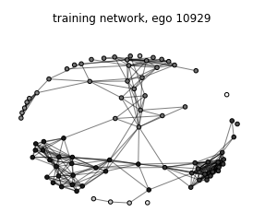
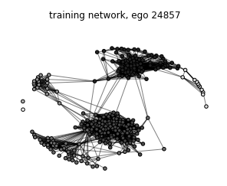
Louvain Partitions
Density: 0.13
Transitivity: 0.54
Clustering: 0.63
Density: 0.09
Transitivity: 0.70
Clustering: 0.58
Density: 0.09
Transitivity: 0.55
Clustering: 0.63
Notes:
NetworkX
Python
Munkres for edit distance (skeleton provided)

Slide 11
extra
NetworkX
Python
Munkres for edit distance (skeleton provided)

