Slide 1


NPR One: Prediction User Behavior with N-Nearest Neighbor Stories

Slide 2
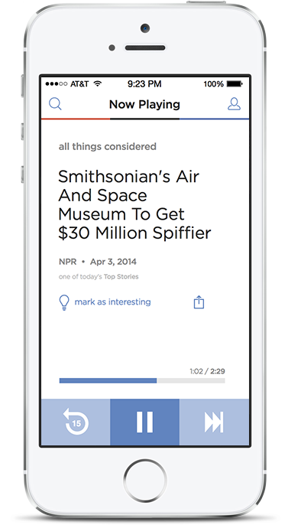
NPR One
Public radio made personal
Serendipitously play you your favorite stories
Minimize the touches required
Find things that you love
Demote things that you don’t love

Slide 3
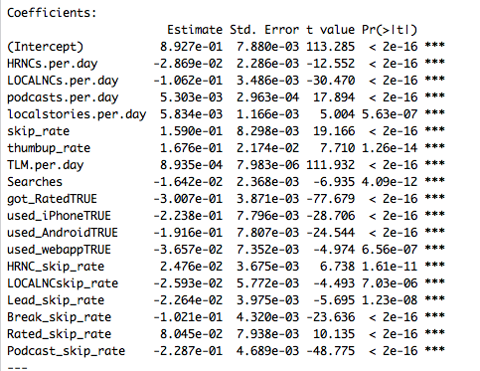
Value in Personalization
Some skips are good, many are not

Slide 4
Two Approaches
Collaborative Filtering
User – user similarities predict what stories to play
Attempted with beta audience
Computationally difficult
Personal Listening History Determination
Story – story relationships in listening history predict what stories to play
Acknowledges differences in user preferences and gives no weight to “wisdom of the crowd”
True solution is probably a combination of both

Slide 5
N-Nearest Neighbor Similarity
Approach:
Find Similar stories by shared word frequency
Use this similarity algorithm to predict the “rating” assigned
Determine a cutoff score and measure predictability
Data:
Title text + Teaser text concatenated
Rating assigned by user (converted to binary positive / negative)

Slide 6
Title + Teaser text

Slide 7
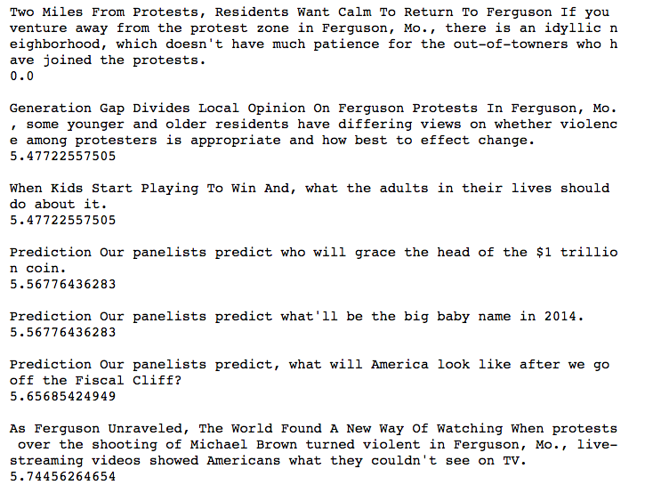
Using Euclidian Distance
Input story
5-nearest
score

Slide 8
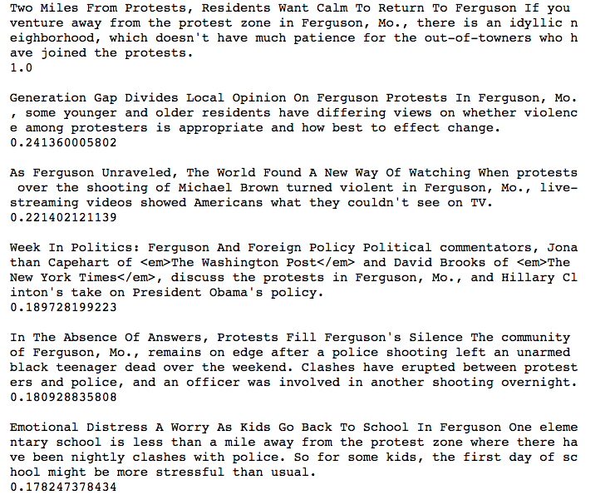
Using TFIDF Cosine Similarity
Input story
5-nearest
score

Slide 9
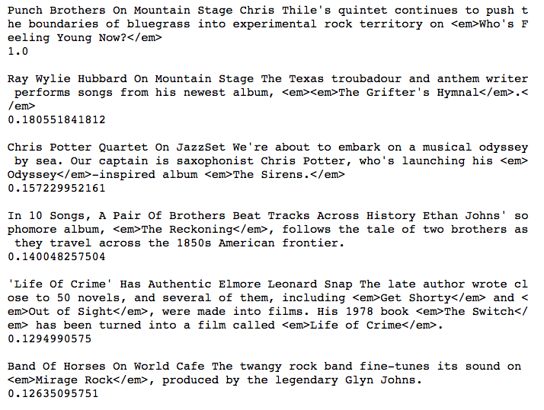
Another example using TFIDF Cosine Similarity
Input story
5-nearest
score

Slide 10
Predicting User Ratings with TFIDF
What?
Predict from a user’s listening history whether they will react positively or negatively to a story we’re thinking about playing
Value Proposition:
Hide/Demote stories in real-time so user doesn’t have to get out the phone and use the skip button
Dig deep into the archives to pull out something that we haven’t played for you that we think you’ll like

Slide 11
Predicting User Ratings with TFIDF
Process:
Input a userid, storyid, and N value
For each userid and storyid, find the N nearest stories
Compute a “vote” as a tally of the positive and negative signals sent by the user for N-nearest stories to the given storyid
Compute the rate of positive signals given among N-nearest
Set a cutoff rate, make a prediction 1 or 0 for each story
Measure performance with confusion matrix
Rinse, Repeat

Slide 12
Scoring: How to think about success
Prediction
0
1
You don’t like it and we didn’t play it for you
You don’t like it and we played it for you
0
Actual
You like it and we didn’t play it for you
You like it and we played it for you
1

Slide 13
Scoring: How to think about success
Prediction
0
1
You don’t like it and we didn’t play it for you
You don’t like it and we played it for you
0
Actual
You like it and we didn’t play it for you
You like it and we played it for you
1

Slide 14
Predicting User Ratings with TFIDF
Many Attempts:
Tried fixing the number of stories to return N at various values between 5 and 25
Tried a home-made grid search for N parameter
Tried a home-made grid search for the cutoff rate
Tried setting cutoff value at user’s avg rating
Best Results:
No fixed N… Set a Cosine-Similarity score cutoff at 0.12 rather than a fixed N value
Use a minimum “votes” parameter

Slide 15
Predicting User Ratings with TFIDF
Many Attempts:
Tried fixing the number of stories to return N at various values between 5 and 25
Tried a home-made grid search for N parameter
Tried a home-made grid search for the cutoff rate
Tried setting cutoff value at user’s avg. rating
Best Results:
No fixed N… Set a Cosine-Similarity score cutoff at 0.12 rather than a fixed N value
Use a minimum “votes” parameter
Rather than use a positive rate, set a min number of negative ratings as an absolute

Slide 16

Results
Best accuracy score achieved: 77% (compare to overall positive signal rate of 68%)
But only achieved a True Negative Rate > 50% when using extreme cutoffs that severely limited the affected population

Slide 17
Additional Challenges / Opportunities
Opportunities for Improvement
Only performed over a small sample of the users who had a critical mass of listening history
Not limited to any particular story type (some “aggregations” will likely produce more accurate results)
Challenges
No cross-validation performed (essentially all train-set)
Implementation is a challenge

Slide 18
Conclusions
TFIDF N-nearest similarity is a valid measure of similarity
But as a signal for predicting a user’s behavior, it’s rather weak
In production, it is possible that this algorithm could be tweaked to be effective in demoting stories
But it would only affect some users and occur infrequently ( < 3% of stories)

Slide 19
Next Steps
Segment algorithm by story type (maybe this is valid for arts/culture stories but not lead news stories)
Transform the algorithm to find something you’ll love rather than something you’ll hate
Re-purpose the code as a tool for finding similar stories (agnostic to user behavior)
A completely different exercise:
Cluster stories together using k-means
Measure cluster performance, cluster size

Slide 20
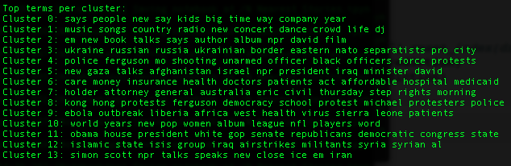
Clustering Stories

