Slide 1
Improving Yelp predictions
using sentiment analysis
General Assembly Data Science
Daniel Chung
October 6th, 2014

Slide 2
Agenda
Introduction
Analytical data set
Python libraries used
KNN results
Logistic regression results
Next steps

Slide 3
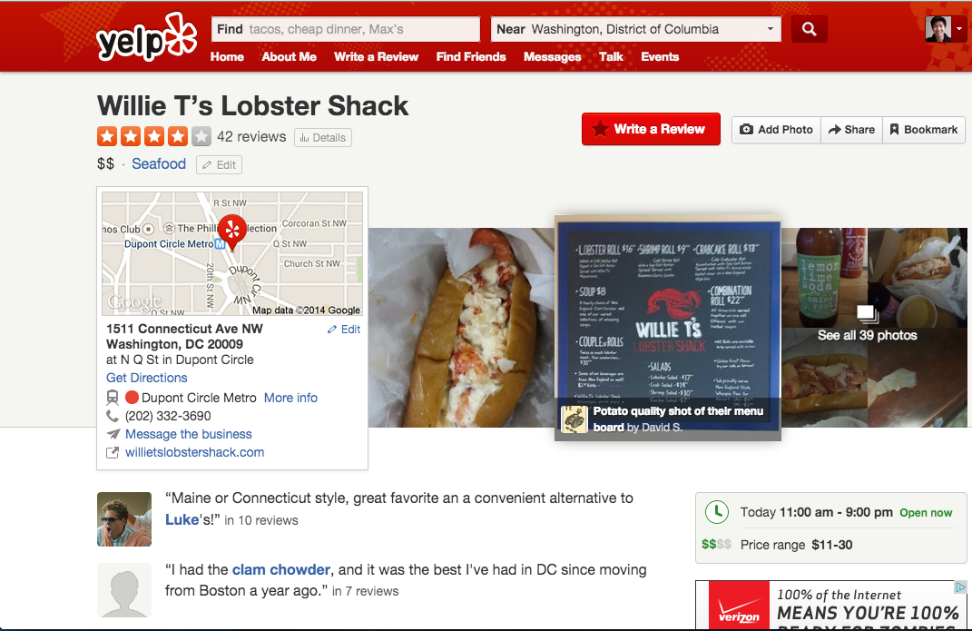
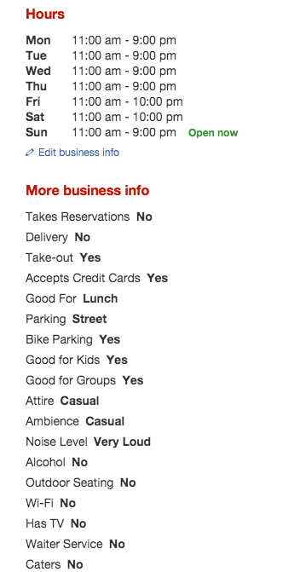
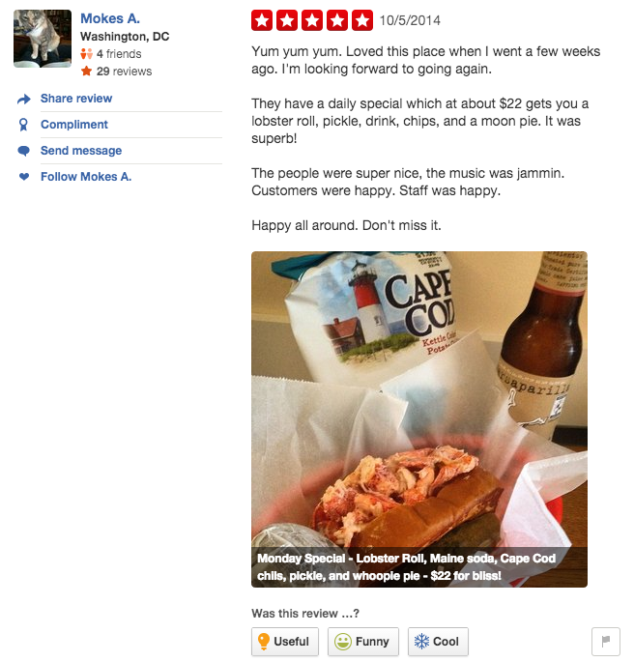

Slide 4
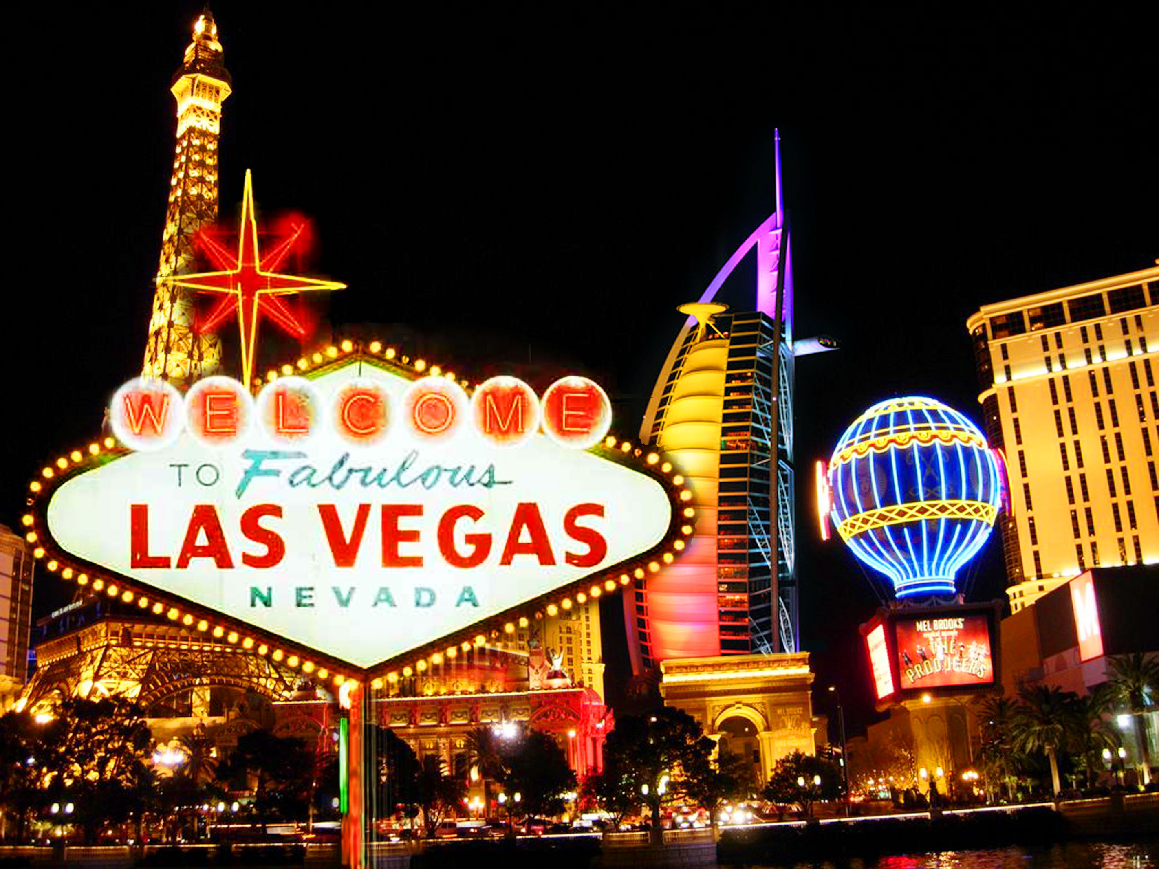
Analytical data set
Yelp academic data set
Limited to Las Vegas restaurants
2,583 businesses

Slide 5
Python libraries
import json
import pickle
import pandas as pd
import statsmodel.formula.api as smf
from sklearn import neighbors
from sklearn.cross_validation import cross_val_score

Slide 6
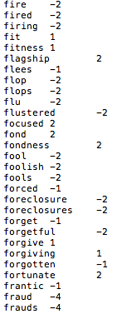
AFINN
2,477 words with scores
Scores range from -5 to +5

Slide 7
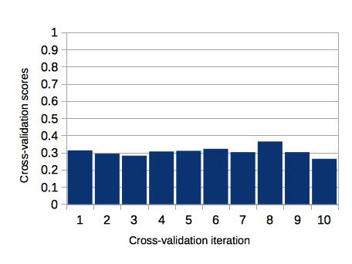
KNN with stars label

Slide 8
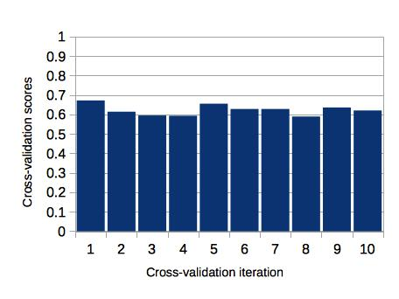
KNN with high rating label

Slide 9
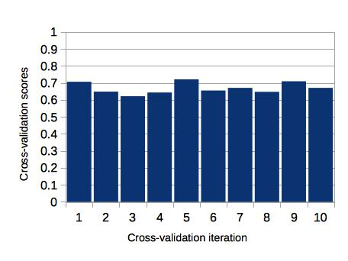
KNN with high rating label and text score

Slide 10
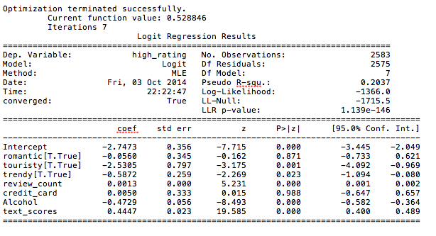
Logistic regression

Slide 11
Next steps
Improving sentiment analysis
Refining sentiment analysis feature
Incorporating different models
Expanding analysis to more cities

Slide 12
Improving Yelp predictions
using sentiment analysis
General Assembly Data Science
Daniel Chung
October 6th, 2014

