Slide 1
DRISHTI · दृष्टि · SIGHT
Drishti
A live terminal for any record, without a screen per product
Any data. Any domain. One grammar.
Ashutosh Sinha
October 2026
Release 1.18 · Java 21 or later · console on any device
IN THIS DECK
1 The idea: a screen is a paragraph
2 Drishti 1.18: the product
3 Security, drawn as flows
4 Evidence, by the numbers
5 Where it is going
Drishti • Ashutosh Sinha
Notes:
Source: README.md (name, 'sight', the tagline 'Any data. Any domain. One grammar.'); RELEASE_NOTES.md 1.18.0; pom.xml (Java 21 bytecode).
Talk track: Drishti is Sanskrit for sight. The promise is in the tagline: any record from any system, in any domain, shown through one grammar instead of a screen written per product. The deck runs idea, product, security, evidence and roadmap; every number in it is measured or counted from the repository.

Slide 2
Executive summary
TL;DR
What is a live entity terminal?
One dense, keyboard-driven, ticking screen for any single record — a swap, an FX trade, a netting set, a gene variant — linked to everything it touches, with its provenance shown.
What is Drishti?
A Java 21 server and a web console that turn any record from any system into that screen. A short YAML Sutra describes the view; inference fills whatever it leaves out.
Why does it matter?
Every entity kind traditionally gets a bespoke screen, written once and rotting for ever. Drishti makes a screen a paragraph, not a project — and day one is never raw JSON.
What can it do today?
Release 1.18: 14 packs, 230 Sutras, 21 panel kinds, 15 source plugins, live views at p99 11 ms, collaboration with compliance, data loads, a CLI, and views embedded in other apps.
Where is it going?
Finish embedding (tests, npm package, more elements), then server-side pricing, a proven Windows build, a real deployment and scale on a real server.
Notes:
Source: README.md; ARCHITECTURE.md §1; RELEASE_NOTES.md 1.18.0; docs/admin/PERFORMANCE.md; ELEMENTS.md; IMPLEMENTATION_PLAN.md Roadmap.
Talk track: If you remember one slide, make it this one. Five questions and five short answers; the rest of the deck earns each answer.

Slide 3
1
The idea: a screen is a paragraph
Describe the view once, in a grammar. Let the data's shape fill the rest.
Notes:
Source: drishti-console/web/templates/landing.html ('A screen is a paragraph, not a project'); ARCHITECTURE.md §1.
Talk track: Before the product, the idea: screens as data, not code.

Slide 4
What is a live entity terminal?
THE CATEGORY
▪ One record, one dense screen
A swap, an FX trade, a netting set, a ticket or a gene variant, with its headline figures in a strip and its detail in up to twenty-one kinds of panel.
▪ Live, not refreshed
When the source changes, the open screen changes: only the changed figures are sent, measured at p99 11 ms from tick to frame.
▪ Linked
Every id on the screen is a link: a trade's counterparty, its netting set, its curve — one keystroke away, across systems.
▪ Explained
Every view says where its data came from, how fresh it is, and why it is laid out the way it is.
Key insight The terminal is the standard for dense, live screens — Drishti makes one for any record you have, not only the vendor's.
Notes:
Source: README.md first line; ARCHITECTURE.md §1 and §1.1 goals; landing.html.
Talk track: Define the words once. One entity, one dense screen, live, linked and explained. Read-only by design: trade capture and pricing are non-goals.

Slide 5
Every entity kind gets a bespoke screen — and the screen rots
THE PROBLEM
A screen per product, in the documents' own words
And what people do in the meantime
▪ Hundreds of entity kinds
“Front-office, risk and operations staff look at hundreds of entity kinds.”
▪ Written once, rotting for ever
“Each one traditionally gets a bespoke screen, written once and rotting forever.”
▪ Data outruns screens
“The data changes shape faster than screens can be rebuilt.”
▪ Tab between systems
“A trade lives in one system, its netting set in another, its curve in a third … the desk tabs between them.”
▪ Wait for a screen
“Every new product type waits for a screen.”
▪ Read raw JSON
“A new feed or product has no screen at all, so on day one people read raw JSON or wait.”
Key insight Nobody here is short of data — they are short of a screen for it that is dense, live and linked.
Notes:
Source: ARCHITECTURE.md §1 'Problem and intent'; drishti-console/config/competitive.yaml (rows any-entity, no-coded-screens, inference).
Talk track: These are the problem statements from the architecture and the competitive analysis in the repository, not invented customers.

Slide 6
From a coded screen per product — to one grammar and inference
THE SHAPE OF THE FIX
Your systems
A screen per kind
A backlog
Drift
Trades, curves, tickets, variants
Coded by a developer, per product
New products wait for a screen
The data changes; the screen does not
Your systems
DRISHTI
A live view
Sutra ⊕ inference
Read where they are, through plugins
Dense, linked, explained — day one
A short YAML Sutra describes the view; scored, explainable rules read the data's shape and fill the rest
Key insight A brand-new product with no Sutra still renders a usable view on day one; a Sutra makes it beautiful.
Notes:
Source: ARCHITECTURE.md §1 ('A screen is not code'); HOW_IT_FITS.md §1; competitive.yaml.
Talk track: Top row is the world today: each product type waits for a developer. Bottom row is Drishti: a Sutra is a paragraph of YAML, and inference covers what nobody has described yet.

Slide 7
Six goals the design is held to
SIX GOALS
1
One grammar
2
Any source
Every view is a Sutra in Rachana, or inferred; no screen code.
Sources plug in through a small, Spring-free interface.
3
Linked
4
Live
Every id on a screen is navigable, across systems.
Changes reach the open view; p99 is measured and shown in the top bar.
5
Provenance
6
Keyboard first
Every view shows how it was built and where its data came from.
<MNEMONIC> <ID> <GO>, F-keys for panels, F9 for raw JSON.
Key insight Six goals, each one testable — the p99 is not a claim on a slide, it is in the top bar of every view.
Notes:
Source: ARCHITECTURE.md §1.1 Goals G1–G6; README 'Contributing rules'.
Talk track: These six are the acceptance test for every feature. Keyboard first is literal: mnemonic, id, GO, as on a terminal.

Slide 8
Each family does part of the job, and is good at it
WHAT THE FIELD SAYS · FOUR FAMILIES OF PRODUCT
Family | Examples | Good at | What it leaves you
Market data terminals | Bloomberg Terminal, LSEG Workspace, FactSet | Dense, keyboard-driven, live screens | The vendor's screens, for the vendor's data
Trading and risk platforms | Murex, Calypso, in-house systems | Deep screens for every product they book | A coded screen per product type, for that platform's data
Low-code internal tools | Retool, Appsmith, Power Apps | Internal screens assembled quickly | A person still assembles each screen
BI and dashboards | Tableau, Power BI, Grafana | Aggregates and charts | Weaker at one entity, live, with its links
Key insight The screens that are dense and live are coded per product; the screens that are quick to make are not terminals.
Notes:
Source: drishti-console/config/competitive.yaml (as of September 2026; categories, not vendors), served at /about/competitive.
Talk track: Four families put entities on a screen. The pattern on the last line is the whole argument for Drishti.

Slide 9
Eight primitives carry the whole model
THE PRIMITIVES
Primitive | What it is | Where you meet it
Pack | A folder for one domain: kinds, mnemonics, links, connectors, Sutras, samples, help text; packs inherit | packs/ — 14 shipped, e.g. trading, genomics
Sutra | A short, versioned YAML description of one view, in the Rachana grammar | 230 Sutras in the shipped packs
Match | kind + where (a closed expression) + priority; the highest match wins | match: { kind: trade, where: …, priority: 10 }
Strip | Up to eight headline figures across the top of a view | Notional, MTM, DV01 …
Panel | One of 21 kinds on a 12-column grid, each with an F-key | table, ladder, pivot, surface, graph …
Inference | Explainable rules that read the data's shape and lay out what no Sutra covers | infer: true; 'completed by inference'
ViewModel | Plain JSON the server returns and the browser draws | GET /api/v1/views/{kind}/{id}
Frame | A patch of what changed, sent over one live channel per browser | Server-sent events
Notes:
Source: README.md; RACHANA_REFERENCE.md; PANEL_KINDS.md; INFERENCE.md; ADR-004; LIVE.md.
Talk track: Everything else in the product is built from these eight words.

Slide 10
From your systems to a view, in one direction
ARCHITECTURE
Stores and lakes
DRISHTI SERVER · JAVA 21
Console
Fetch, match, infer, link, bind
Delta Lake, JDBC, Aerospike, MongoDB, Redis, Iceberg, DuckDB
Web terminal, any device
Virtual threads fetch in parallel; the engine matches a Sutra, merges inference, links ids and binds values — 15 source plugins behind one interface
Streams and queues
REST API
Kafka, ActiveMQ, RabbitMQ
/api/v1, OpenAPI at /api/docs
Files and services
SAME SERVER
CLI
JSON, CSV, S3, REST
Identity, packs, audit
tools/drishti.py, six groups
Users, roles and masks; packs per user; the access log and audit; a signed pack registry
Public market data
Other apps
NY Fed SOFR, ECB, US Treasury, FRED
<drishti-view>, no iframe
Notes:
Source: README.md 'How it is built'; pom.xml modules; ARCHITECTURE.md §2.
Talk track: Modules depend one way only, and an architecture test enforces it. The plugin interface is Spring-free so connectors stay small.

Slide 11
One command, seven stages, one view
SEVEN STAGES
1
2
3
4
5
6
7
Command
Fetch
Classify
Fingerprint
Layout
Bind
Link
TRD MX-20000001 <GO>, or plain words
Sources in parallel on virtual threads
Which kind is this record?
The data's shape, hashed
Sutra ⊕ inference, cached by shape
Values into panels, in parallel
Every id navigable, time-boxed
0.6 ms
3.0 ms
7.2 ms
Server work for a warm view
Warm view over HTTP, p99 (gate: 50 ms)
Structured search over 750 trades
Key insight The expensive part — deciding the layout — happens once per shape, not once per request.
Notes:
Source: landing.html (pipeline stages); HOW_IT_FITS.md §1; docs/admin/PERFORMANCE.md (warm view p99 3.0 ms over HTTP, gate p99 < 50 ms).
Talk track: Read left to right. The layout is cached by the shape's fingerprint, so a warm view costs well under a millisecond of server work.

Slide 12
A swap's whole screen, in one short file
ONE SUTRA, END TO END
irs-vanilla.v3.sutra.yaml (trimmed)
▪ When it applies
A trade whose product type is IRS with two legs; the highest priority match wins.
▪ What it shows
A titled, linked header, two headline figures and a panel per key — F2 legs, F3 cashflows.
▪ A closed language
Rachana-EL has no side effects and no loops; a bad edit keeps the last good version live.
▪ Shipped through review
Saved Sutras reload at once; in production a second person approves (four eyes).
rachana: 1
sutra: irs-vanilla
version: 3
match:
kind: trade
priority: 10
where: "$.productType == 'IRS' && size($.legs) == 2"
title: { pill: "Trade · Interest rate swap", id: $.tradeId }
strip:
- { label: Notional (USD), bind: $.notional }
- { label: MTM (USD), bind: $.mtm, tone: sign }
panels:
- { id: legs, kind: tabs, key: F2, each: $.legs }
- { id: cashflows, kind: table, key: F3,
rows: $.legs[0].cashflows }
Notes:
Source: packs/finance/sutras/rates/irs-vanilla.v3.sutra.yaml (98 lines); RACHANA_REFERENCE.md; ADR-013 (Sutras go live through review).
Talk track: This is the real file, trimmed. Four things in one statement: when it applies, what the title says, the strip, and the panels. Everything it does not mention, inference lays out.

Slide 13
One subscription per entity, one channel per browser
LIVE, END TO END
Source
TopicHub
ViewStream
PatchDiffer
Browser
subscribe()
One topic per entity; latest wins
One per open view; cached layout
Old vs new ViewModel
Patches over one SSE channel
2.4 ms
11.2 ms
50 ms
1
Tick to frame, p50
Tick to frame, p99 (gate: 40 ms)
A topic sends at once if it has not sent within this window
Live channel per browser, however many views
Key insight A view does not poll and does not redraw — only the figures that changed travel, and only to the views that show them.
Notes:
Source: docs/architecture/LIVE.md (live path); docs/admin/PERFORMANCE.md (tick to frame p50 2.4 ms, p99 11.2 ms, gate 40 ms).
Talk track: A source change fans out through one topic per entity; each open view rebuilds with its cached layout, and only the difference is sent.

Slide 14
What a grammar of screens buys
BENEFITS
Day one, every product
Inference shows a new feed at once; nobody reads raw JSON.
Screens as reviewed data
A Sutra is versioned, tested, diffed and approved like code — without being code.
One place to look
A trade, its curve and its netting set from three systems on one linked screen.
Trust in the number
Provenance and freshness on every view; masks applied for every reader.
Anywhere it is needed
The console on any device, the API, the CLI, and the same view inside other apps.
Key insight The cost of a new screen falls from a project to a paragraph — and to nothing at all on day one.
Notes:
Source: ARCHITECTURE.md §1; competitive.yaml; PANEL_KINDS.md; README.
Talk track: Five benefits, each tied to something built and shown later in the deck.

Slide 15
2
Drishti 1.18: the product
Built, measured and documented — every screen here is a real capture.
Notes:
Source: RELEASE_NOTES.md; USER_GUIDE.md 'The pages at a glance'.
Talk track: Now the product as it stands at 1.18, page by page.

Slide 16
Drishti 1.18 — overview
RELEASE 1.18 · JAVA 21 OR LATER
14
230
21
15
Domain packs: trading, market risk, genomics, logistics, climate …
Sutras shipped in those packs
Panel kinds, from tables to surfaces and graphs
Source plugins behind one interface
▪ A terminal on any device
Command line with type-ahead, F-keys, seven themes, business-date time travel, and phones with finger-sized controls.
▪ Build without code
A workbench to drag panels and fields, a YAML tab with completion, tests, versions and four-eyes review.
▪ Work together, provably
Shares, discussion threads, an inbox, email digests and chat bridges — hash-chained, sealable and exportable.
▪ Run it
Pack bundles deployed with preview and rollback, data-load signals, a CLI for every build step, and views embedded in other apps.
Notes:
Source: README.md; packs/ (14 packs, 230 Sutra files); PANEL_KINDS.md; pom.xml plugins (15); git tag (23 releases, 2026-09-30 to 2026-10-06).
Talk track: The numbers are counted from the repository on 6 October 2026.

Slide 17
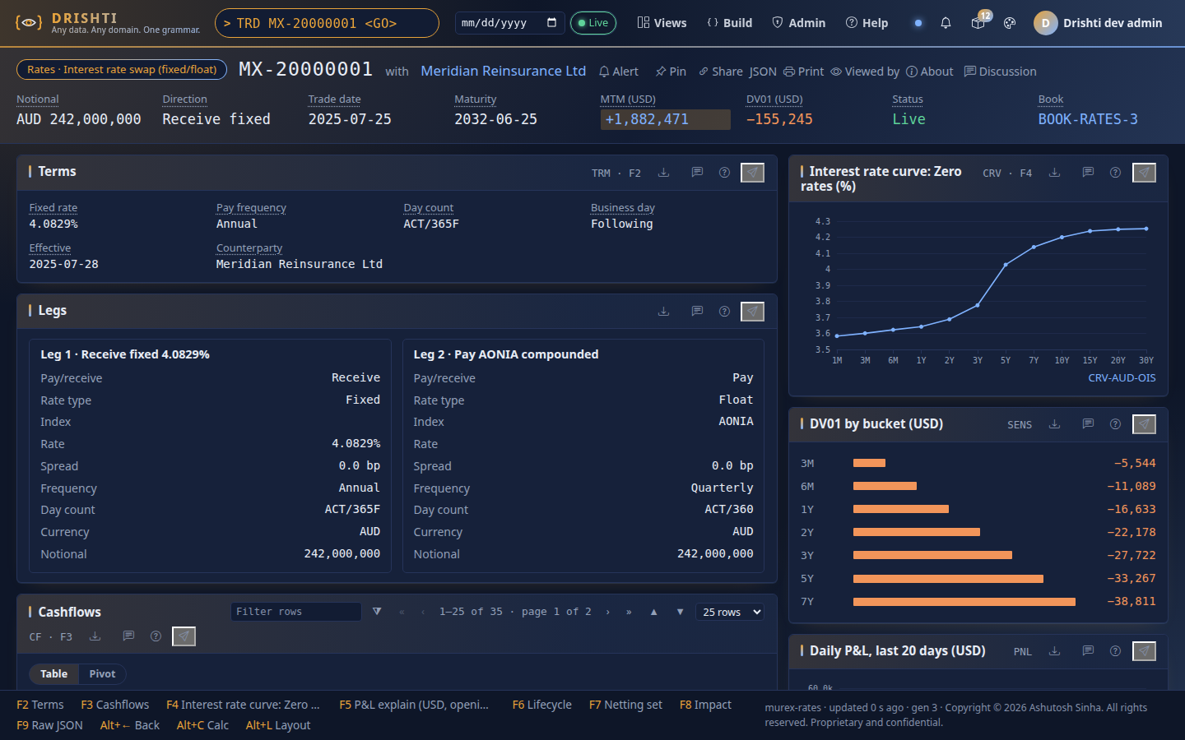
One trade, live, linked and explained
THE VIEW
▪ Strip
Notional, MTM, DV01 and status, toned by sign.
▪ Panels by key
F2 to F9; Alt+L to rearrange; Calc for Python.
▪ Linked
Counterparty, book, netting set and curve open in one keystroke.
▪ Live
The Live pill and generation update on each frame.
A live interest-rate swap view, captured from 1.18.
Notes:
Source: Fresh capture of /v/trade/MX-20000001 on a scratch 1.18 server (dark theme).
Talk track: Headline strip, then panels by F-key: terms, legs, the zero curve, DV01 by bucket, daily P&L. The top bar shows live state; the footer lists every panel's key.

Slide 18
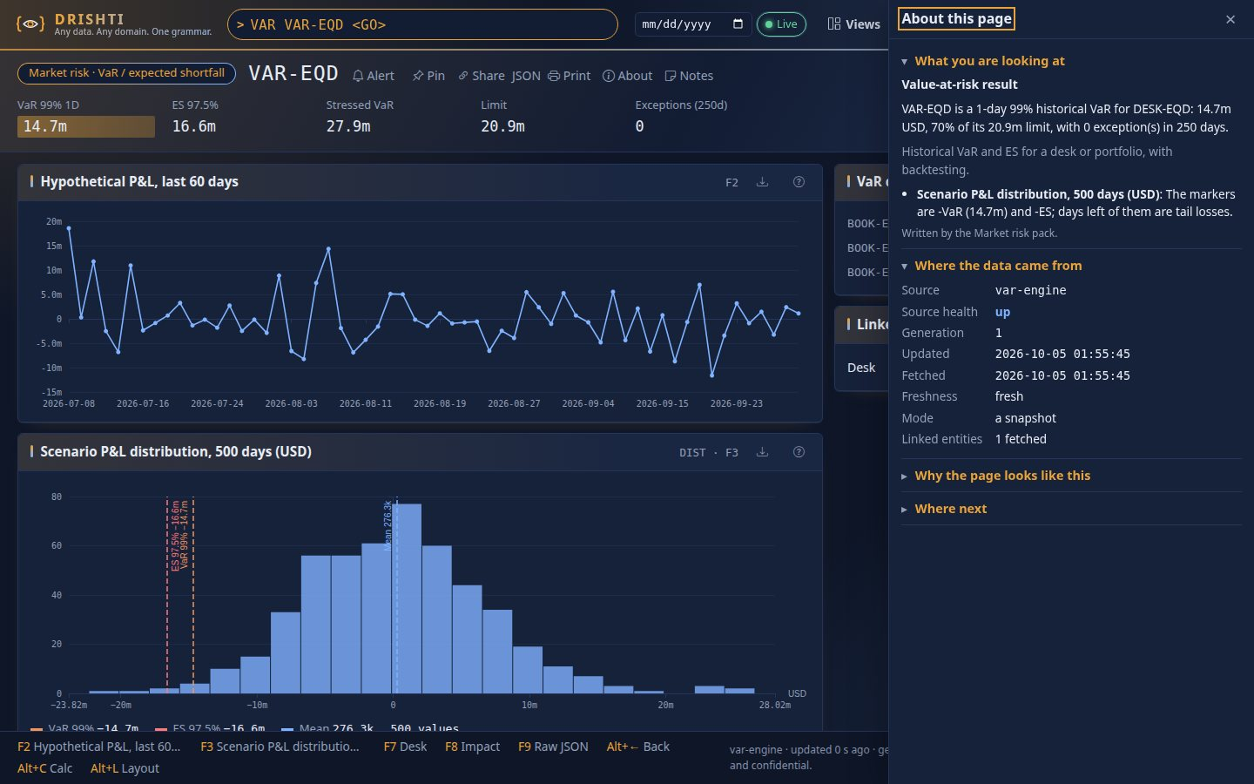
Every view explains itself, in five layers
ABOUT THIS PAGE
▪ What you are looking at
From the pack's own help text and glossary.
▪ Where the data came from
Source, health, generation and freshness.
▪ Why it looks like this
Which Sutra matched, which lost, what inference added.
▪ Masked for you
Says which fields your role cannot see.
Notes:
Source: docs/architecture/CONTEXT_HELP.md; USER_GUIDE 'About this page'; capture docs/guides/img/about/01-var-drawer.jpg.
Talk track: Press ? on any view. The drawer reads the same trace the server used to build the page, so it cannot drift from what you see. Ask, the optional language-model answer, is off by default.

Slide 19
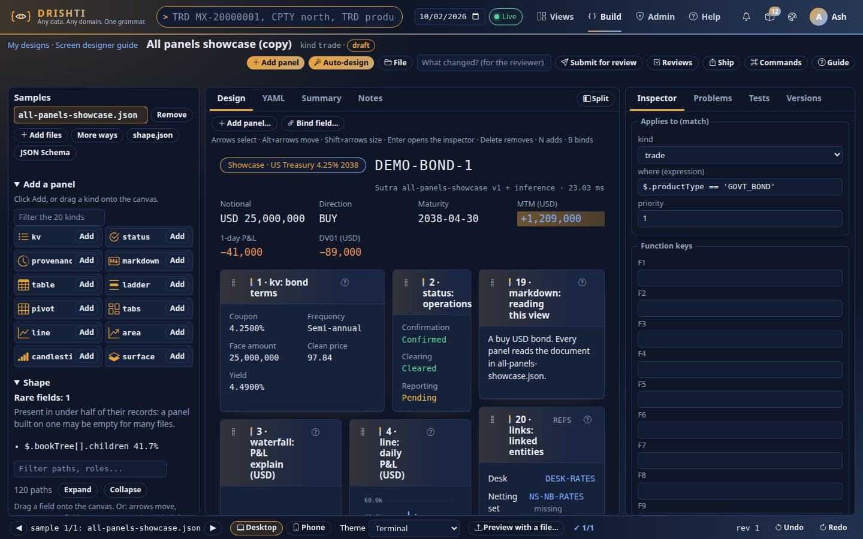
Design a screen without writing code — and ship it through review
BUILD
▪ From data you have
Start from JSON files, a schema or stored entities.
▪ Drag, or type
Palette and inspector, or the YAML tab with completion.
▪ Tested before shipped
Sutra tests run on sample data in the tests tab.
▪ Four eyes
An approver reviews the evidence and cannot approve their own.
Notes:
Source: docs/guides/BUILD_WORKBENCH_TUTORIAL.md; SCREEN_DESIGNER.md; capture designer/02-workbench.jpg.
Talk track: The workbench writes the Sutra for you. Every design has tests, versions and a rebase; publishing needs a second person.

Slide 20
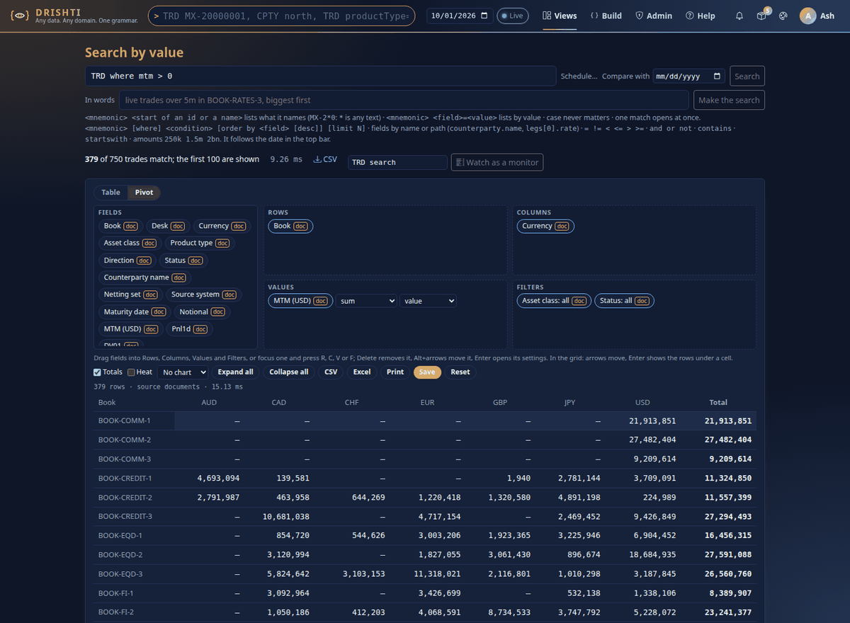
Ask in a grammar or in plain words; pivot what comes back
SEARCH AND PIVOT
TRD where mtm < -10m order by mtm
live trades over 5m in BOOK-RATES-3
DPNL DESK-RATES <GO>
134 ms
29 ms
Search all 1M trades a day, 2,017 matches
Type-ahead at 1M trades a day
Measured on a 24-core workstation, 1,000,000 trades a day for three days (5.2 GB).
Key insight Search is a question in the terminal's own grammar — and its answer is a view you can pivot, compare and share.
Notes:
Source: README.md example commands; USER_GUIDE search and pivot; capture drishti-console/web/static/img/guide/pivot-search.png; PERFORMANCE.md (1M trades/day).
Talk track: The plain-words parser is deterministic: no AI service is involved. Searches across a million trades a day come back in about a seventh of a second.

Slide 21
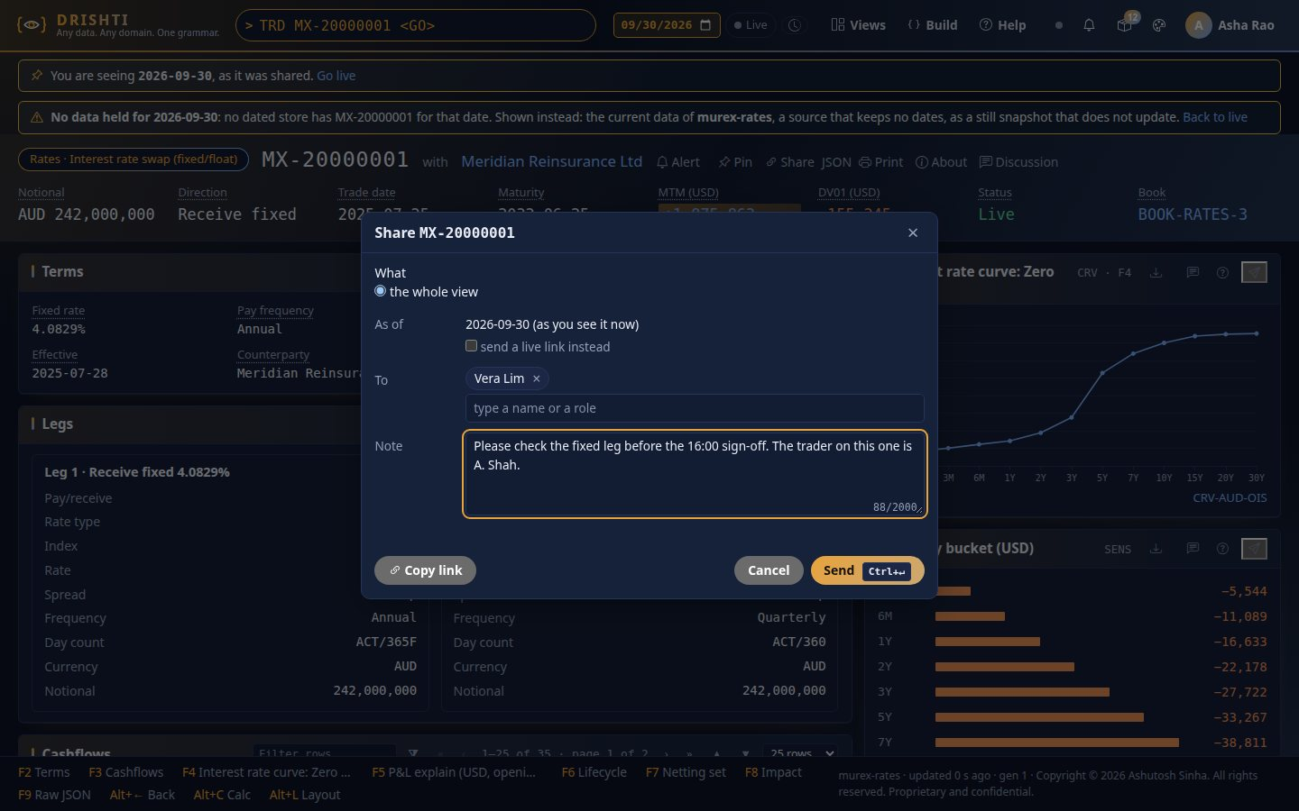
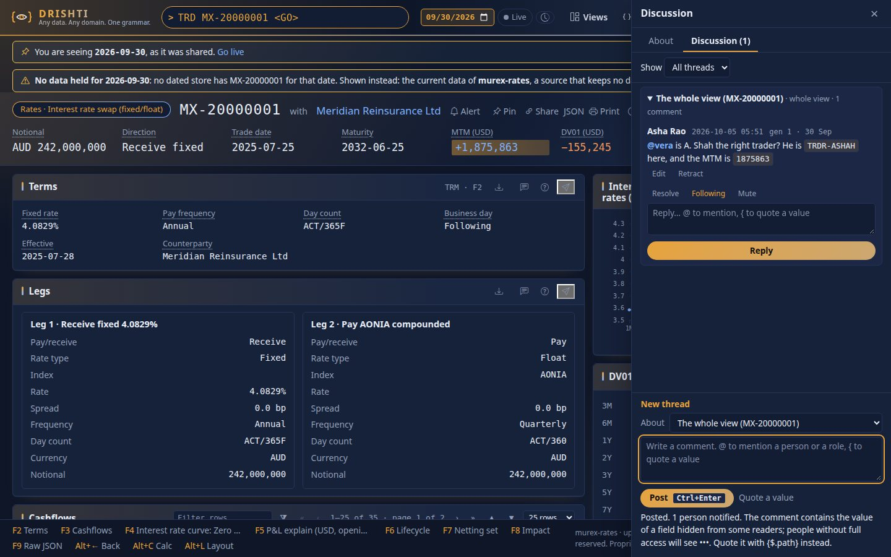
Share what you see, discuss it, and prove what was said
COLLABORATION
Share with a note, to people or roles.
A discussion thread with @mentions and quoted fields.
Key insight Every comment is hash-chained and sealable; retract and hide never delete — evidence, not just conversation.
Notes:
Source: docs/architecture/COLLABORATION.md; captures collab/01-share-dialog.jpg and collab/07-discussion-author.jpg.
Talk track: A share reopens the view as the sender saw it, pinned to that data generation. Emails and chat bridges carry values, masked for each recipient.

Slide 22
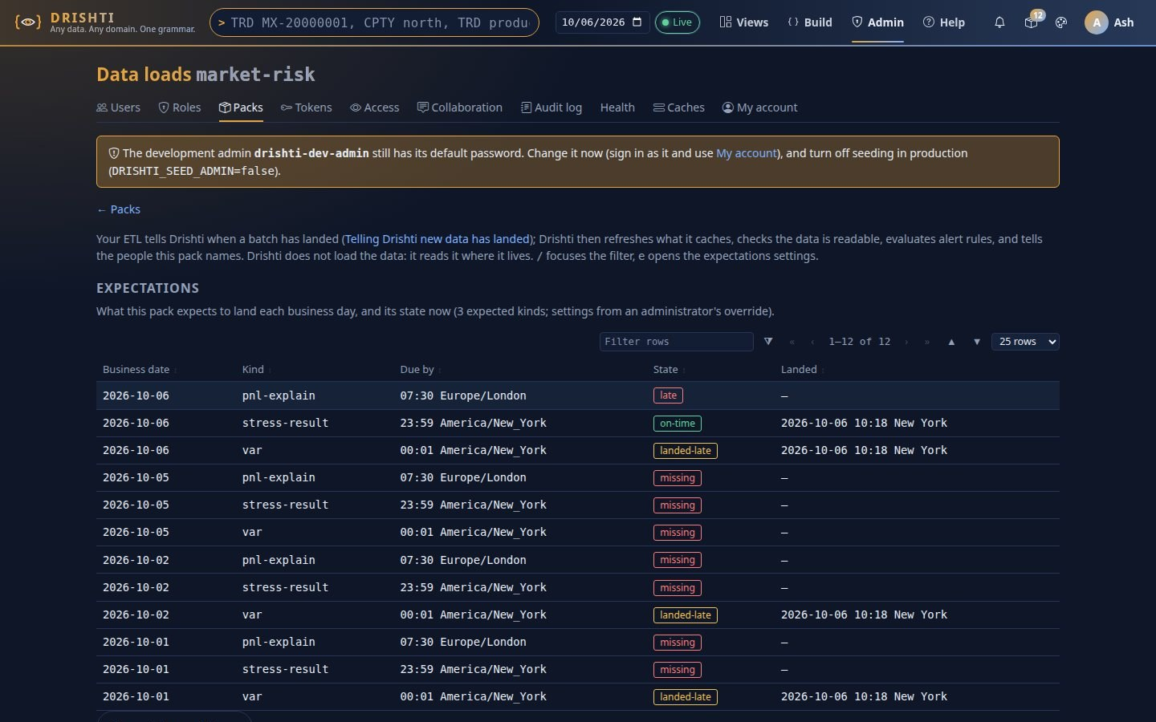
Tell Drishti new data has landed — and it acts on it
DATA LOADS
drishti.py data landed --pack trading \
--kind trade --date 2026-10-05 --rows 10000
# or POST /api/v1/packs/trading/loads
▪ Refresh, verify, alert, notify
Caches refreshed, the date checked, alert rules run on it, bell, inbox and email.
▪ Late is a fact, said once
Per-kind expectations with time zone and calendar; Health shows 'data late'.
▪ Safe to repeat
Idempotent per pack, kind, date and batch; token scope loads:write.
Notes:
Source: docs/guides/DATA_LOADS.md; RELEASE_NOTES 1.18.0; capture loads/01-data-loads-history.jpg.
Talk track: Drishti does not ingest data; your ETL does. One call says a batch landed, and Drishti refreshes, verifies, evaluates alerts and tells people. Expectations flag late or missing data once.

Slide 23
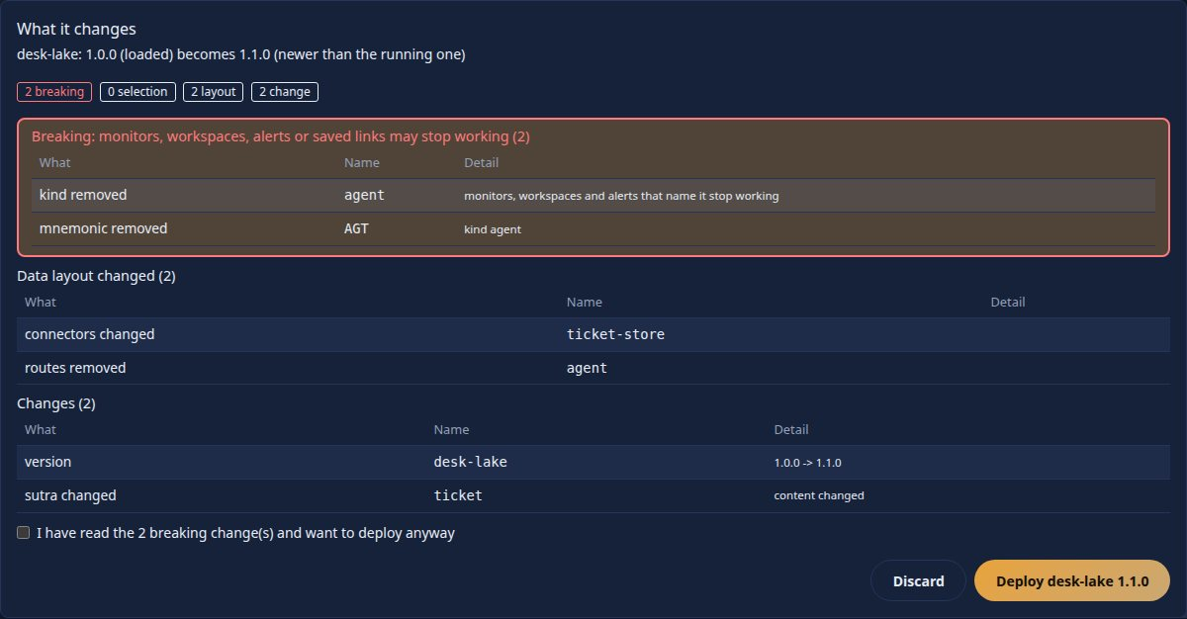
From a folder of JSON Lines to a deployed pack
PACKS · FROM A FOLDER TO PRODUCTION
One command
drishti.py pack make ./trades --pack desk \
--kind trade --key tradeId \
--match product_type --date trade_date
# → desk/ pack, sutras per product type,
# Delta lake by date, desk.tar.gz + sha256,
# README.txt, run scripts
▪ Checked before it lands
Checksums, paths, server version, Sutra tests and an optional Ed25519 signature.
▪ Never stuck
The previous version is kept; a failed deploy rolls back; history has Roll back.
Key insight Archives carry the pack, never the data — where data lives stays an admin's decision.
Notes:
Source: docs/guides/CLI_GUIDE.md 'Quickest path: pack make'; OPERATIONALISING.md; RELEASE_NOTES 1.17.0; ADR-018; capture deploy/02-deploy-preview.jpg.
Talk track: One command makes a deployable folder: pack, Sutras per product type, data laid out by date, a bundle and a README. An admin uploads the bundle and sees a preview of what breaks before deploying.

Slide 24
Every build step from the command line
THE CLI · TOOLS/DRISHTI.PY
Group | What it does | Examples
sutra | Generate, lint, test and preview Sutras from data | shape, design --each, gen, lint, test, preview
pack | Make, check, bundle, sign, deploy and roll back packs | make, check, bundle, verify, deploy, rollback, keygen
data | Profile and ingest JSON Lines; say a batch landed | profile, ingest --watch, landed, loads
server | Health, packs on and off, smoke tests | health, packs list|load|on|off, smoke
design | The screen designer over REST | create, save, check, propose, approve, export
docs · doctor | Regenerate screenshots; diagnose a setup | docs screenshots, doctor, view explain
Key insight Anything the console can build, a script can build — and a pipeline can check it.
Notes:
Source: docs/guides/CLI_GUIDE.md (six groups, exit codes, PyCharm section); tools/drishti.py.
Talk track: Production runs Java 21 and every build activity is scriptable. Exit codes are a contract: 0 ok, 1 problems found, 2 usage.

Slide 25
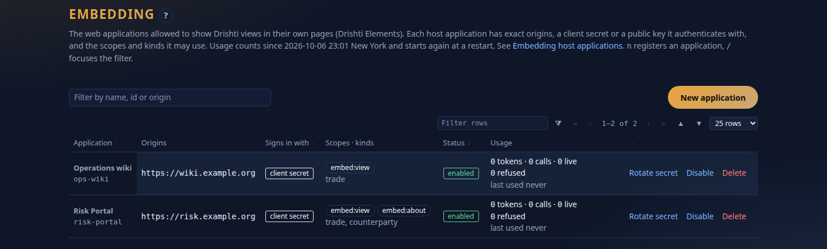
The same live view, inside other web applications
DRISHTI ELEMENTS · NO IFRAME
<script type="module" src=
"https://drishti.example/embed/v1/elements.js">
</script>
<drishti-view server="https://drishti.example"
kind="trade" entity="MX-20000001"></drishti-view>
Admin → Embedding: host apps, origins, scopes and usage.
HTML
1 stream
@container
Masked
Over the wire: the console's own templates, sanitised, in a Shadow DOM
Shared by every element on the host page
Responsive to its own box: a sidebar gets the narrow layout
Always, whatever the user's roles; every call audited
Key insight Other teams get the view, not a copy of it — still live, still masked, still audited.
Notes:
Source: docs/architecture/ELEMENTS.md (design, build plan, steps 0 to 10 as built); fresh capture of Admin → Embedding.
Talk track: A host page adds one tag. The console sends HTML over the wire into a Shadow DOM, so styles never leak either way, and one live connection serves every view on the page.

Slide 26
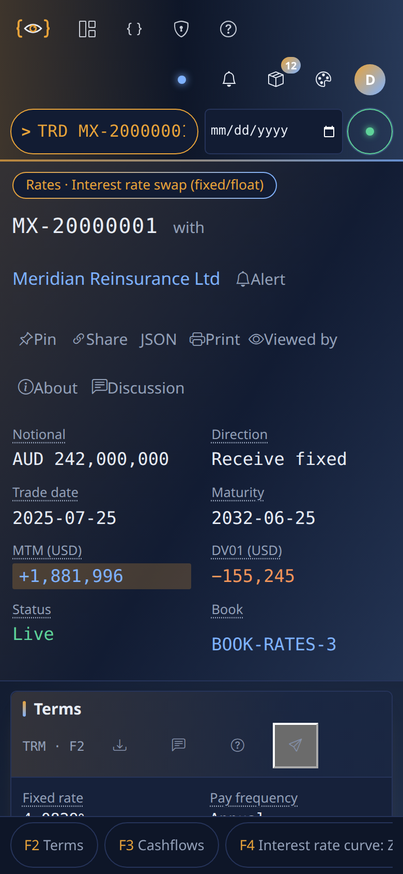
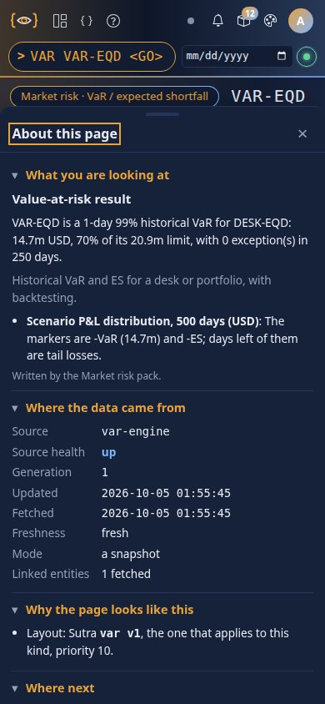
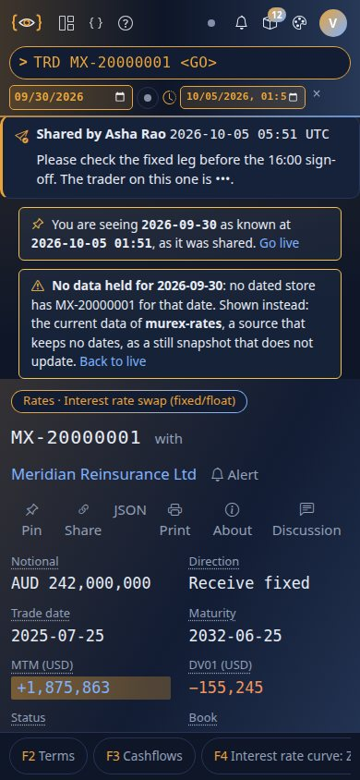
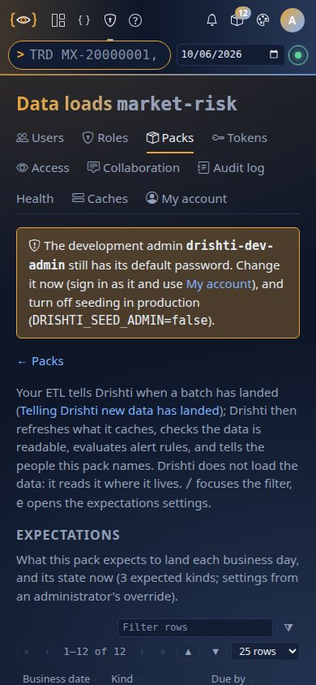
The same terminal in a pocket
ON A PHONE
▪ 44 px
Every control, on touch screens only
▪ 390 px
Every page tested at phone width
▪ 3 engines
Embedded views in Chromium, Firefox, WebKit
A live trade
About this page
A shared view
Data loads
Notes:
Source: USER_GUIDE 'On a phone'; tests/test_page_widths_browser.py (390 px touch sweep: content, 44 px targets, no clipping); captures about/03-var-phone.jpg, collab/06-shared-phone.jpg, loads/06-phone.jpg, fresh phone-trade.png.
Talk track: Every page is tested at a 390-pixel phone width with touch: real content, finger-sized controls and nothing clipped. A desktop with a mouse keeps its compact sizes.

Slide 27
3
Security, drawn as flows
Who you are, what you may see, and what was recorded — kept apart.
Notes:
Source: docs/admin/USER_MANAGEMENT.md; OPERATIONS.md §8; ELEMENTS.md §8.
Talk track: Security as flows, not as a feature list.

Slide 28
Authentication, authorization and audit are kept apart
THREE SEAMS, ONE RULE
Authentication
Who you are
Authorization
What you may see and do
Audit
What happened
Local passwords: PBKDF2-SHA256, 240,000 iterations
Or SSO over OIDC: Keycloak, Entra, Okta, Ping
Lockout after 5 failures in 15 minutes
Disable a user and their sessions end everywhere
Roles name the kinds you may open
Six powers: raw, author, approve, admin, calc, layout
Masked fields shown as ••• without raw
Packs assigned per user
Sign-ins, changes, token use, purges
Access log: who viewed what, for which date
Hash-chained collaboration, sealed
Legal holds and an eDiscovery export
Key insight A mask is applied where a value leaves — in views, search, emails, chat bridges and snapshots alike.
Notes:
Source: USER_MANAGEMENT.md §2, §5, §6; OPERATIONS.md §8.
Talk track: The rule: every value that leaves the server is checked against the reader's roles at the moment it leaves.

Slide 29
Authentication — a person signs in to the console
FLOW · SIGNING IN
Browser → Console → Server
▪ Lockout
Five failed sign-ins lock the account for fifteen minutes; an admin's reset unlocks it.
▪ The last admin is protected
You cannot remove the last administrator.
▪ Forced change
The development admin is flagged in every page until its password changes.
1. Browser → console: any page but landing, help
→ 303 to /login (or to the identity provider)
2. Password: server checks PBKDF2-SHA256 hash
or OIDC: server verifies the ID token itself
3. Server → signed session; console sets cookie
HttpOnly, SameSite=Lax, Secure by default
4. Every write: same-origin check (else 403)
and JSON only (else 415)
5. Every 10 s: is this user still enabled?
disabled, deleted or reset → session ends
Key insight A cross-site form cannot post: writes must come from the console and must be JSON.
Notes:
Source: USER_MANAGEMENT.md §5–6; OPERATIONS.md §8.4 (CSRF, cookies); ADR-014.
Talk track: The console holds no credential of its own; the server decides, and re-checks every ten seconds.

Slide 30
Authorization — a script acts as its owner, never as more
FLOW · PERSONAL API TOKENS
Scope | Opens | Still required
(none) | Read: views, search, explain, read-only commands | The owner's roles and packs
design:write | Create and save designs | The author power
design:approve | Approve someone else's design | The approve power; never your own
packs:admin | Deploy, roll back and switch packs | The admin role
loads:write | Say a batch of data landed | The pack in the owner's packs
▪ Hashes only
Secrets are stored as SHA-256; shown once.
▪ Write scopes expire
At most 90 days.
▪ Never open
Users, roles, tokens, sign-in, caches and collaboration state.
▪ Audited
Every write and every refusal.
Key insight A scope only opens the endpoint — the owner's roles are still checked on every call.
Notes:
Source: USER_MANAGEMENT.md 'Personal API tokens'; RELEASE_NOTES 1.17.0.
Talk track: A token is a person's key for scripts and notebooks. It is read-only unless a write scope is named, and write scopes expire.

Slide 31
Token exchange — the host proves itself, and the user
FLOW · EMBEDDING A VIEW IN ANOTHER APP
Host app → Server → Console → Browser
▪ Off by default
drishti.embed.enabled; each host app registered by an admin.
▪ Always masked
An embedded view never shows raw values, whatever the user's roles.
▪ CORS, exactly
Only registered origins; never *, never credentials.
1. Host server → POST /api/v1/embed/token (RFC 8693)
client: secret (hash stored) or private_key_jwt
subject: the IdP's ID token, or a host-signed
assertion (≤ 60 s, used once)
2. Server → ES256 token, 300 s (max 900)
audience = app, origin-bound, scopes embed:view
3. Browser → console /embed/v1/... with the token
console checks signature (JWKS), audience, origin
4. Server checks again: app, user, origin, kind,
rate limit — and always masks
5. Live stream: event: token → renewed in place
Key insight The token proves who and where; the server still decides what — on every call.
Notes:
Source: ELEMENTS.md §8 and steps 1–3, 7 as built; RFC 8693; DRS-8001 to 8006.
Talk track: No plain user name is ever accepted. The host app authenticates, presents a signed statement of who the user is, and gets a short-lived, origin-bound, read-only token.

Slide 32
Evidence, not just conversation
COMPLIANCE
Chained
Sealed
Held
Exported
Every revision of a thread or share hashes the one before
Seals cover comments, thread heads, holds and audit; verify on demand
Legal holds by entity, user, thread or all (423 while held)
eDiscovery zip with a manifest; one-shot download
▪ Retract and hide, never delete
Retention keeps for ever by default; a hidden comment is still in the record.
▪ Measured
An export of 8,300 comments builds in 2.0 s and downloads (19.8 MB) in 3.1 s.
▪ Only for compliance
Legal holds and the export need the compliance power; an export downloads once.
Key insight Tamper evidence is the honest claim: Drishti cannot stop a database administrator, but it shows when one acted.
Notes:
Source: COLLABORATION.md 'Retention, legal hold and export' and 'Tamper evidence'; docs/qa/2026-10-05/BEHAVIOUR.md (8,300-comment export).
Talk track: Collaboration is regulated communication in many firms, so it is built as a record: chained, sealed, held and exportable.

Slide 33
4
Evidence, by the numbers
Counted from the repository on 6 October 2026: measured, tested, found and fixed.
Notes:
Source: Commands and files cited on each slide.
Talk track: Claims are cheap; these are counts and measurements.

Slide 34
65 error codes, every one documented
ERRORS AS A CONTRACT
Family | Area | Codes
DRS-1xxx | Entities and sources | 7
DRS-2xxx | Grammar and Sutras | 8
DRS-3xxx | Inference | 1
DRS-4xxx | Commands and search | 8
DRS-5xxx | Requests and limits | 9
DRS-6xxx | Users, roles, tokens | 10
DRS-7xxx | Collaboration | 16
DRS-8xxx | Embedding | 6
$ curl -s server/api/v1/views/trade/NOPE-404
Content-Type: application/problem+json
{ "status": 404,
"code": "DRS-1001",
"title": "entity not found",
"detail": "no source holds the entity" }
65
34
RFC 7807
Codes in eight families, one table
Sutra problem codes in the grammar reference
problem+json, the same shape everywhere
Key insight Errors are a contract: a stable code, an HTTP status and a row that says what to do.
Notes:
Source: drishti-common ErrorCode enum; docs/guides/API_GUIDE.md 'Error code table' (65 rows); RACHANA_REFERENCE.md 'Problem codes' (34).
Talk track: Every error is RFC 7807 problem+json with a stable DRS code, and every code has a row that says what it means and what to do. Sutra problems have their own 34 codes.

Slide 35
1,939 tests, three browsers, one gate
HOW IT IS TESTED
1,063
739
137
3
Java tests (plus 19 parameterised)
Console tests, browser tests included
CLI and tool tests
Browser engines for embedded views
▪ Gates in every build
Error Prone and Spotless; ArchUnit for module direction; a licence-header test; no source file over 1,500 lines; no external asset.
▪ Pages at three widths
Every page at 390, 1,600 and 2,560 px; at 390 with touch: real content, 44 px targets, nothing clipped.
▪ Embedded views, adversarially
A tampered payload is sanitised; Trusted Types enforced; a 30-second token renews on a live stream.
Notes:
Source: git ls-files: 1,063 Java @Test (+19 parameterised), 739 console pytest, 137 tools pytest; tests/test_embed_elements_browser.py; tests/test_page_widths_browser.py; tools/drill.sh.
Talk track: Counts are test methods, before parameterised expansion. The console's browser tests run in Chromium; embedded views in Chromium, Firefox and WebKit.

Slide 36
Fast where people wait
PERFORMANCE · MEASURED
Gate | Target | Measured
Warm view p99 | < 50 ms | 3.0 ms
Live p99 | < 40 ms | 11.2 ms
Netting set impact | — | 0.7–0.9 s, 143,982 trades
▪ One workstation
24 cores; 1,000,000 trades a day for three days, 5.2 GB.
▪ Cold vs cached
Opening a trade cold is 137–157 ms; from the cache 48 ms.
Key insight The gates are written down first and measured after — and every one has headroom.
Notes:
Source: docs/admin/PERFORMANCE.md (24-core workstation, 2026-09-30 and 10-01); SCALE_BENCHMARK.md (extrapolations labelled as such).
Talk track: All measured on one workstation. At a million trades a day, opening a trade from the cache is 48 ms and a whole-book search is 134 ms.

Slide 37
Written to break a promise — and fixed
ADVERSARIAL QA · FOUR ROUNDS
94
72
29
4,640
Findings in round one (10 high), security, data and UX
Findings in round two, the build workbench (0 high)
Findings in the collaboration and safety pair (2 high)
Randomised searches matched brute force exactly
Round | Scope | High | Outcome
2026-10-01 | Security, data and UX of 1.13 | 10 | All high fixed, each with its commit
2026-10-03 | Build workbench: 25 endpoints × 6 callers | 0 | All 18 medium fixed
2026-10-05 | Data safety: collaboration, Ask, bridges | 1 | 12 of 12 resolved
2026-10-05 | Behaviour: About, time, failure modes | 1 | All resolved or owned
Key insight No XSS anywhere, about 250 settings that match the code, 190 grammar fuzz cases with clean problem codes.
Notes:
Source: docs/qa/2026-10-01/README.md; docs/qa/2026-10-03/README.md; docs/qa/2026-10-05/DATA_SAFETY.md and BEHAVIOUR.md.
Talk track: Each round set out to break specific promises. The first round's headline is the strongest evidence: thousands of randomised searches agreed exactly with an independent brute-force evaluation.

Slide 38
Nothing reaches main without the full gate
THE DRILL · TOOLS/DRILL.SH
Licences
Java 21
Java 25
Console
Tools
Push
A header on every file
Full verify; bytecode pinned to 21
Verify in a copy of the commit
Tests on parallel workers
CLI tests
develop, then main
~11 min
23
543
A full drill, down from about 22
Releases, 1.0 to 1.18, 30 Sep to 6 Oct 2026
Commits, every push through the drill
Key insight A failed test stops the push; a flaky one is retried once and written down — never ignored.
Notes:
Source: tools/drill.sh; RELEASE_NOTES 1.17.1 ('about 9 minutes instead of about 22'); pom.xml enforcer (maxJdkVersion 21).
Talk track: One command verifies and only then pushes. Production runs Java 21; the same commit is also verified on Java 25 so upgrades are not a surprise.

Slide 39
Where the work is
SIZE · GIT LS-FILES
▪ 99 guides and references
User, admin, CLI, IDE, packs, connectors, architecture and 20 ADRs.
▪ Every screen documented
With real captures, regenerated by a script.
▪ 12 core modules
Plus 15 source plugins, a server, integration tests and benchmarks.
Notes:
Source: git ls-files | wc -l by top folder and by language, 2026-10-06.
Talk track: Packs are mostly sample data and Sutras. The Java is split into small modules that depend one way.

Slide 40
5
Where it is going
Finish embedding, then price on the server, prove Windows, and run it for real.
Notes:
Source: ELEMENTS.md build plan; IMPLEMENTATION_PLAN.md 'Roadmap'.
Talk track: What is left, in order.

Slide 41
What is left — and what each item is
ROADMAP
Next | What it is | Done when
Elements: tests | A foreign-origin host app, framework smoke tests in three browsers, a small load test | All pass in Chromium, Firefox and WebKit
Elements: distribution | npm package, TypeScript declarations, version aliases, SRI hashes | A host installs one exact version
Elements: more elements | <drishti-panel>, <drishti-about>, <drishti-search> | One panel or search box anywhere
Server-side pricing | A quant service on QuantLib, in five phases | Prices beside the data, explained
Windows, proven | CI green and PowerShell on real Windows | Every guide works there
A real deployment | Security on, SSO, HTTPS, compose with pricing | Runbook followed end to end
Scale and load | 1M trades a day per store on a server; many users | Extrapolations replaced by measurements
Notes:
Source: ELEMENTS.md steps 11–15; docs/architecture/IMPLEMENTATION_PLAN.md 'Roadmap' (everything planned up to 1.18.0 is built).
Talk track: Embedding is two-thirds done. After it, the order is pricing, Windows, a real deployment, scale and load.

Slide 42
From a clone to a live view in ten minutes
WHERE TO START
Five commands
QUICKSTART
./mvnw -q package -DskipTests
uv venv drishti-console/.venv
uv pip install -r drishti-console/requirements.txt
java -jar drishti-server/target/*-exec.jar
python drishti-console/run_drishti_web.py
# open http://<host>:17480/t and type:
TRD MX-20000001 <GO>
Ten minutes, fresh clone to first live view
IDE_GUIDE
Server in IntelliJ, console in PyCharm
CLI_GUIDE
pack make, then every build step
USER_GUIDE
Every page, every key
Key insight Start with your own JSON Lines: one pack make, one deploy, and your records have a terminal.
Notes:
Source: docs/guides/QUICKSTART.md; IDE_GUIDE.md; CLI_GUIDE.md; USER_GUIDE.md.
Talk track: QUICKSTART is the ten-minute path; IDE_GUIDE runs both halves in IntelliJ and PyCharm; CLI_GUIDE starts with pack make.

Slide 43
Thank you
Any data. Any domain. One grammar.
Drishti • Ashutosh Sinha • October 2026
Notes:
Source: README.md.
Talk track: Questions.

