Slide 1
M A Y A
Model & AI Lifecycle
Assurance
Feature two clocks
Pin sealed by hash
Model a typed formula
Evidence, not assertion.
Training warrant fit, escrowed
Ashutosh Sinha
October 2026
MAYA 1.0.0
Execution warrant a live licence

Slide 2
M A Y A
Model & AI Lifecycle Assurance
TL;DR — Executive summary
What is the problem?
Months after a model's number was used, nobody can say which data it saw, which mathematics ran, or whose approval it ran under. A model register lists things people typed; none of the three answers was ever stored.
What is MAYA?
A system of record for models and the data they read. It keeps features with two clocks, freezes training data by content hash, holds the mathematics as a typed formula, and licenses fitting and running through warrants.
Why does it matter?
The facts a supervisor asks for are derived from the work rather than declared about it — so they cannot be typed wrong, cannot drift, and verify on a machine with no MAYA installed.
What can it do today?
The whole lifecycle in version 1.0.0: features to execution warrants, findings, tiers, periodic review that suspends, monitoring, champion and challenger, black boxes and LLM applications, 268 API endpoints, 15 case studies run end to end.
Where is it going?
Live certification of the MLflow and SageMaker connectors, an external security review, a timed first-model study with real users, and OS isolation on Windows.
Evidence, not assertion.
MAYA • Ashutosh Sinha 2

Slide 3
M A Y A
Model & AI Lifecycle Assurance
Months later: which data, which mathematics, whose approval?
A committee asks about one number in last March's impairment charge.
Which data did it see?
Not which table — which rows, with which values, as they stood that day. A vendor restated two quarters in August and the row was updated in place.
1
Which mathematics ran?
A PDF describes the model, a repository implements it, the desk runs a spreadsheet. Each was right once; no test compares them.
2
Whose approval was it under?
The memo has a date. It names no code version, no parameters, no data — so it approves something that can no longer be identified.
3
Key insight: None of these is a documentation problem. Each is a question about an object that was never stored — and everything in MAYA exists to make all three a lookup.
Evidence, not assertion.
MAYA • Ashutosh Sinha 3

Slide 4
M A Y A
Model & AI Lifecycle Assurance
10 principles: why every model needs evidence, not assertion
1
Derive, don't declare
A fact a person types rots silently. A fact computed from the work cannot disagree with it.
2
Keep two clocks
When a value was true and when it was known. A correction is a new row, never an overwrite.
3
Freeze what you train on
A pin is named by the hash of its rows; the same name always means the same bytes.
4
License before you compute
No fit without a training warrant; no run without a live execution warrant.
5
Score blind
The holdout is escrowed when the warrant is drawn; the developer never sees it, and every attempt is counted.
6
Nobody approves their own work
Separation of duties on every governed object, a finding included.
7
Policy is data
Workflow states, checks and approvals are records, and changing them is itself governed.
8
Evidence leaves the building
A signed bundle verifies and re-executes with Python, pyarrow and numpy — no MAYA, no network.
9
One contract, every surface
The web UI is an SDK client; every endpoint has an SDK method, held by a gate.
10
State the limits
What MAYA cannot check is said in the report's first words, not discovered later.
Evidence, not assertion.
MAYA • Ashutosh Sinha 4

Slide 5
M A Y A
Model & AI Lifecycle Assurance
What supervisors say
“The use of models invariably presents model risk, which is the potential for adverse consequences from decisions based on incorrect or misused model outputs and reports.”
— Federal Reserve and OCC, SR 11-7 (2011)
“Model risk should be managed like other types of risk.”
— Federal Reserve and OCC, SR 11-7 (2011)
“Critical analysis by objective, informed parties who can identify model limitations and assumptions and produce appropriate changes.”
— SR 11-7's definition of effective challenge
The PRA's SS1/23, in force since May 2024, sets five principles to the same end: model identification and risk classification, governance, development and use, independent validation, and risk mitigants.
Evidence, not assertion.
MAYA • Ashutosh Sinha 5

Slide 6
M A Y A
Model & AI Lifecycle Assurance
The objects MAYA keeps
Object | What it is | What it guarantees
Feature | A governed series: a name, an owner, a schema, a source, a rule for gaps | Two clocks on every value; a correction never overwrites
Feature set | Features aligned on one index, mapped to a model's inputs | One place where the join — the judgement — is reviewable
Pin | A feature or feature set resolved as of a date and sealed | Named by the hash of its rows: the same name, the same bytes, forever
Model version | The mathematics as a typed formula, its specification and code | Code checked against the formula; diffs by meaning, not text
Parameter set | The fitted or agreed values a model's parameters take | Tied by checksum to the training data MAYA issued
Training warrant | A licence to fit one model version on one pinned feature set | Holdout escrowed; leakage certified; every score counted
Execution warrant | A licence to run approved parameters, where, until when | Expires, can be revoked, suspends itself on a covenant breach
Evidence, not assertion.
MAYA • Ashutosh Sinha 6

Slide 7
M A Y A
Model & AI Lifecycle Assurance
MAYA architecture — surfaces, platform, stores
Surfaces
Web UI | REST API, 268 endpoints | Python SDK | Command line
Governance
Workflow | Findings | Tiers | Periodic review | Monitoring | Inventory
Core
Features & pins | Formula IR | Warrants | Lineage | Hash-chained audit
Boundary
Sandbox for uploaded code | Resolution engine | Signed evidence bundles
Stores
SQLite or PostgreSQL, never both | maya_delta lake | Blob store
▪ The web UI is a client of the SDK with no private path; a gate fails the build if the web tier imports past it.
▪ MAYA never trains a model and never serves a prediction: it is where the evidence lives, not where the arithmetic runs.
▪ FastAPI on Python 3.13, one process by default; several web processes and job workers on PostgreSQL.
Evidence, not assertion.
MAYA • Ashutosh Sinha 7

Slide 8
M A Y A
Model & AI Lifecycle Assurance
How a model travels through MAYA
1
Define the features
Sources, schemas, gap rules; values loaded with the time they became known; approved by somebody else.
2
Pin the data
A feature set frozen as of a date, sealed by the hash of its rows.
3
Register the mathematics
LaTeX, Python or a spreadsheet becomes a typed formula, with a specification and generated code.
4
Fit under a training warrant
Train and validation rows downloaded by checksum; the holdout escrowed; leakage certified.
5
Score blind, then approve
MAYA scores the uploaded parameters on rows the developer never saw; a manager approves.
6
License it to run
An execution warrant with environments, an expiry and covenants that suspend it on a breach.
Key insight: Every arrow is a refusal waiting to happen: an unapproved feature cannot be pinned, unpinned data cannot be warranted, and parameters fitted on data MAYA did not issue cannot be approved.
Evidence, not assertion.
MAYA • Ashutosh Sinha 8

Slide 9
M A Y A
Model & AI Lifecycle Assurance
What that buys
Benefit | What it means in practice
Answers instead of archaeology | Which data, which maths, whose approval: three lookups
Restatements that cannot rewrite history | What was known on 31 March stays answerable
Code that is the mathematics | Generated reference code; uploaded code compared to it
Validation the developer cannot game | Escrowed holdout, counted attempts, blind scores
Controls that act | An overdue review or a breached covenant stops the model running
Evidence a supervisor can verify | A signed bundle re-executes offline, byte for byte
One inventory, never re-typed | SR 11-7 and SS1/23 layouts read from the records
Every kind of model | Formulas, black boxes, imports and LLM applications, one chain
Evidence, not assertion.
MAYA • Ashutosh Sinha 9

Slide 10
M A Y A
01
The vocabulary
Seven words, each defined before it is used, each earning its place by naming the failure it prevents.
Kernel and dials · Features, parameters, constants · Two clocks · Pins · Warrants

Slide 11
M A Y A
Model & AI Lifecycle Assurance
A model is a compute kernel, and a set of dials
INPUTS
THE KERNEL
THE DIALS
What varies row by row
The fixed arithmetic
Numbers held apart
This borrower's arrears, this option's strike: one value per row, per input.
Turns inputs into an output. It does not change between rows, and it does not change between runs.
The same for every row of a run: a coefficient, a threshold, a fee. They change every time the model is refitted.
Holding the dials apart is where everything else comes from: almost every question a reviewer asks — what sample, what estimator, whose sign-off — is about how the dials were set.
Evidence, not assertion.
MAYA • Ashutosh Sinha 11

Slide 12
M A Y A
Model & AI Lifecycle Assurance
Features, parameters and constants
Every input of a model has a role, and the role says where its value comes from.
Role | What it is | Where its value comes from | PD scorecard example
Feature | A fact about each case — one value per row | Data: a warrant maps it to a feature set column | bureau, delinquencies, dti, utilisation
Parameter | A setting of the model itself — one value for every row | Fitted on training data, or agreed, and approved as a parameter set | intercept and four weights
Constant | A number written into the definition | Changes only with a new model version | the 680 and 60 that scale the bureau score
They fail differently, so they are controlled differently: a wrong feature is bad data, caught by quality checks and pins; a wrong parameter is a bad model, caught by blind scoring and approval.
Evidence, not assertion.
MAYA • Ashutosh Sinha 12

Slide 13
M A Y A
Model & AI Lifecycle Assurance
Two clocks: when it was true, and when you found out
The two times
What follows
▪ Event time
  When the fact held: the quarter a set of accounts describes.
▪ Knowledge time
  When MAYA could first have known it: the night the file landed.
▪ Never the same
  Accounts arrive weeks after their quarter; a default is confirmed months after the missed payment.
▪ A correction is a new row
  Same event time, later knowledge time; nothing is overwritten.
▪ “What did we know on 31 March?”
  Becomes a filter, not an archaeology project.
▪ Look-ahead is caught
  The silent failure that improves every metric it corrupts.
Evidence, not assertion.
MAYA • Ashutosh Sinha 13

Slide 14
M A Y A
Model & AI Lifecycle Assurance
A version freezes how; a pin freezes what
VALUES, SEALED
IMMUTABLE
NAMED BY ITS HASH
Resolved once
By construction
Verifiable by anyone
One version, read as of a date under its gap rules, written down and never recomputed.
No operation edits a pin. A correction makes a new pin; the old one returns the same bytes for ever.
The name is a hash of canonical values, so a reviewer outside the firm recomputes it rather than trusting it.
Re-pinning unchanged data costs nothing: identical rows give identical fragments, so a month-end pin shares almost everything with last month's.
Evidence, not assertion.
MAYA • Ashutosh Sinha 14

Slide 15
M A Y A
Model & AI Lifecycle Assurance
A warrant is a licence to compute, not a document about one
Training warrant
Execution warrant
▪ What may be fitted, on what
  This model version, this pinned feature set, until this date.
▪ Drawn only if the data fits
  Every missing input is named in the refusal.
▪ Certifies the data first
  No row known later than the decision it describes.
▪ What may run, with what
  This version, these approved parameters, in these environments.
▪ It is alive
  It expires, it can be revoked, and covenants suspend it on a breach.
▪ So a wrong model stops
  Every consuming call fails closed and says whom to contact.
Evidence, not assertion.
MAYA • Ashutosh Sinha 15

Slide 16
M A Y A
Model & AI Lifecycle Assurance
Seven words, and each one now means something
Source
Feature
Pin
Model
Parameters
Warrant
Where rows come from
An input with two clocks
Rows frozen by hash
A kernel and its dials
The dials, with provenance
A licence binding it all
▪ Which data? The pin. Which mathematics? The model version. Whose approval? The warrant. The three questions the deck opened with are now three lookups.
▪ Every arrow is checked: a model cannot be bound to data that does not satisfy it, and a warrant cannot be drawn against unpinned data.
Evidence, not assertion.
MAYA • Ashutosh Sinha 16

Slide 17
M A Y A
02
The lifecycle, end to end
One chain, from a delivered file to a model running under a live licence and reporting back. Each link is a governed object, and each refuses something on purpose.
Writing the mathematics · Fitting under a warrant · The holdout · Running under a licence · Evidence that travels

Slide 18
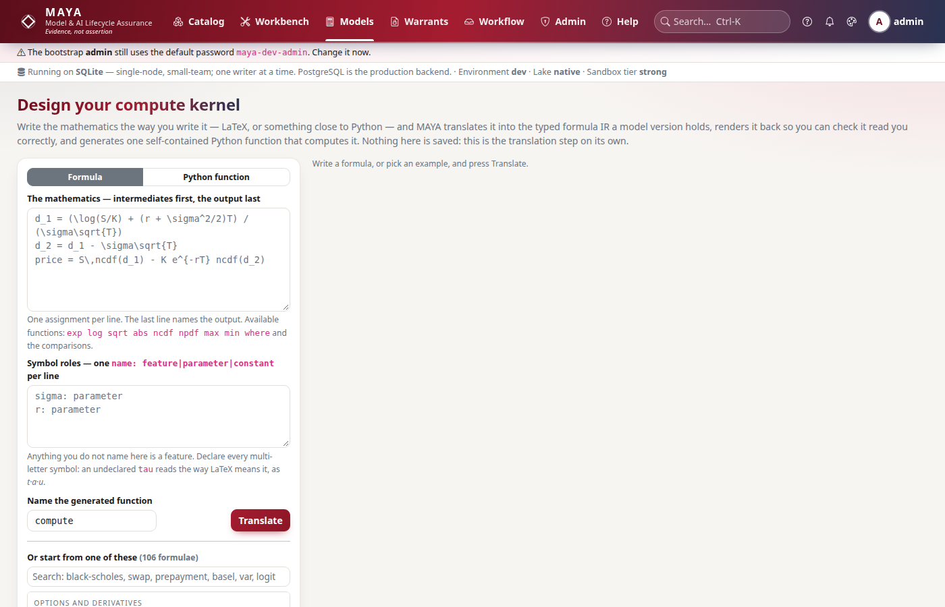
M A Y A
Model & AI Lifecycle Assurance
Write the mathematics; read back what MAYA made of it
▪ Write it as you would. LaTeX or plain text; say which symbols are the dials.
▪ Read it back. The tree, each input with its role, the intermediates in order — or a refusal naming the position.
▪ Take the function. One self-contained kernel, or the full reference module.
▪ Nothing is created. It is a place to get the formula right before a version exists to attach it to.
▪ 106 templates to start from, in ten groups: credit, rates, options, insurance and more.
The compute-kernel designer: LaTeX in, the typed tree and one Python function out
Evidence, not assertion.
MAYA • Ashutosh Sinha 18

Slide 19
M A Y A
Model & AI Lifecycle Assurance
The checksum cycle that turns paperwork into a control
Draw
An approved model against a pinned feature set; the input contract is checked and every miss named.
1
Certify
A signed leakage certificate is issued with the warrant, or the warrant is refused.
2
Download
Train and validation rows only; who, when and the content hash are recorded.
3
Upload
Parameters checked against that hash, their bounds and any joint constraint.
4
Seal
Approved by policy; every object it references becomes undeletable.
5
Key insight: Parameters fitted on data matching no checksum MAYA issued are flagged and cannot be approved without a written justification — so a judgement is recorded honestly instead of being disguised as a fit.
Evidence, not assertion.
MAYA • Ashutosh Sinha 19

Slide 20
M A Y A
Model & AI Lifecycle Assurance
The leakage certificate, and the holdout nobody sees
Leakage certificate
Escrowed holdout
▪ The rule
  Every row's knowledge time is at or before its event date plus the declared lag.
▪ Three verdicts
  Certified; certified with justified exceptions; refused.
▪ Specific
  Rows examined, violations with example rows, every exception's reason — signed.
▪ Fixed at drawing
  The test rows are hashed and counted when the warrant is drawn.
▪ Scored by MAYA
  The developer never receives them; MAYA returns metrics only.
▪ Every attempt numbered
  “Scored forty times, best reported” becomes visible.
Evidence, not assertion.
MAYA • Ashutosh Sinha 20

Slide 21
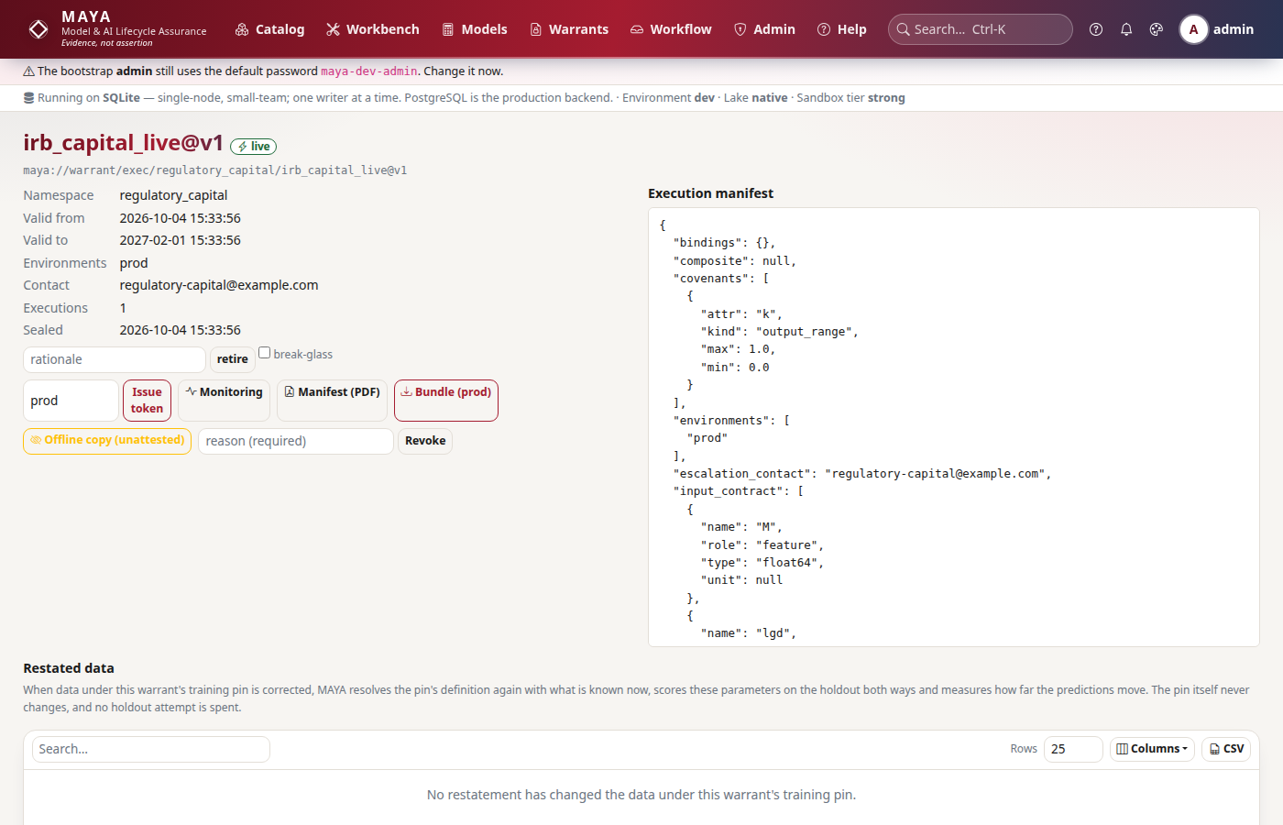
M A Y A
Model & AI Lifecycle Assurance
An execution warrant is a live licence
▪ Environments dev, uat, prod — each permitted explicitly.
▪ Covenants Null rate, input range, population stability, output range, rows per day, staleness. A breach suspends the warrant at once.
▪ Drift Population stability against a baseline fixed when the warrant was drawn.
▪ Restated data Corrections under its training pin, and how far they move the model.
▪ Fails closed A revoked, expired or suspended warrant refuses every call and says whom to contact.
An execution warrant: what may run, where, until when, and how it has run
Evidence, not assertion.
MAYA • Ashutosh Sinha 21

Slide 22
M A Y A
Model & AI Lifecycle Assurance
A bundle that proves itself on a machine with no MAYA
In the archive
What the verifier does
▪ The subject
  Warrant, model, mathematics, specification, code, parameters, leakage certificate, training frame and pins.
▪ The definition of the hash
  MAYA's canonical encoder ships inside, so the hash is recomputed, not described.
▪ A signed manifest
  Every file's digest and the expected output hash.
▪ Needs only Python, pyarrow, numpy
  No MAYA, no network.
▪ Bounds the archive first
  Size, entry count, compression ratio, paths.
▪ Recomputes, then re-executes
  Digests, signature, content hash, outputs.
▪ Refuses on one changed byte
  Before anything is read.
Evidence, not assertion.
MAYA • Ashutosh Sinha 22

Slide 23
M A Y A
03
The MAYA platform
One platform reached four ways, governed by roles, deployable on a laptop or a team server, and measured rather than promised.
Overview · The web UI · Two teams, one contract · Access and security · Deployment · Measured

Slide 24
M A Y A
Model & AI Lifecycle Assurance
MAYA 1.0.0 — overview
Production-grade Python
FastAPI on Python 3.13; one process by default, several web processes and job workers on PostgreSQL.
1
Four surfaces, one contract
Web UI, REST API with 268 endpoints, Python SDK, command line — every endpoint has an SDK method.
2
The whole lifecycle
Features, pins, models, warrants, findings, tiers, reviews, monitoring, challengers, inventory.
3
Every kind of model
Formulas, spreadsheets, composites, black boxes, imports from MLflow and SageMaker, LLM applications.
4
Held by gates
17 static gates plus test, fallback, security and benchmark stages, on every commit.
5
Evidence, not assertion.
MAYA • Ashutosh Sinha 24

Slide 25
M A Y A
Model & AI Lifecycle Assurance
Why MAYA — what makes it different
DEFINITIONS ARE CODE
A CLOSED ALGEBRA
MATHEMATICS AS DATA
Data is a consequence
Derived objects are ordinary
A typed expression tree
MAYA stores how a number is produced and materialises values only when asked.
Type-checked, rendered, diffed by meaning, and the yardstick code is tested against.
union, intersect, compose, coalesce, extend, project, aggregate — each yields a definition.
TWO CLOCKS
EVIDENCE TRAVELS
LICENCES, NOT MEMOS
From the first table
Hashes over canonical values
Warrants that act
A restatement is a new row, so a backtest cannot silently consume restated values.
They expire, revoke, suspend on a breach and verify offline.
Two pins of the same data hash the same across engine versions.
Evidence, not assertion.
MAYA • Ashutosh Sinha 25

Slide 26
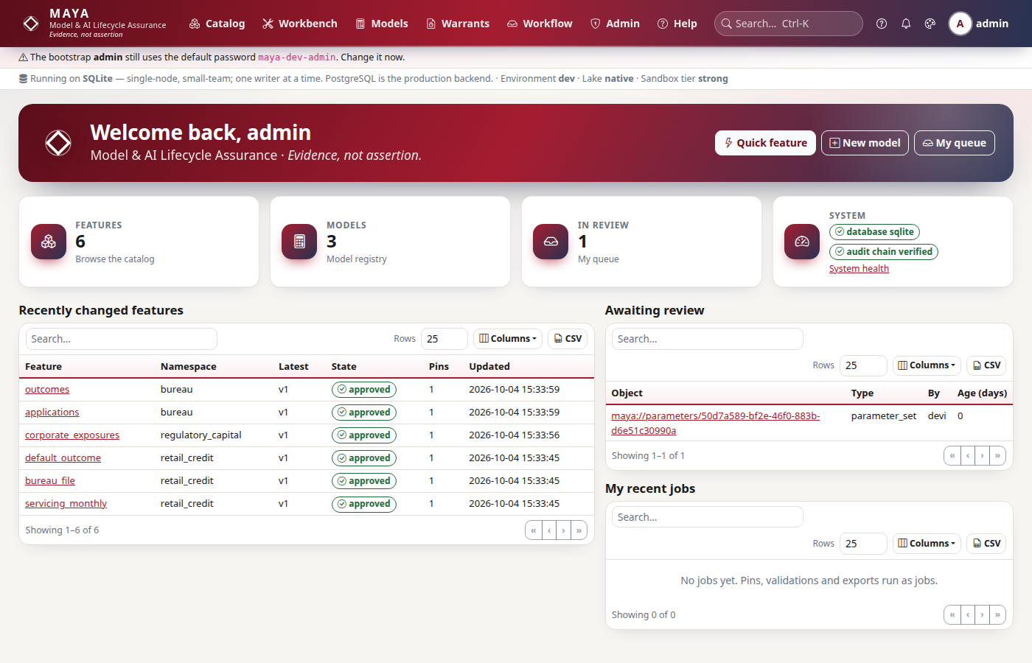
M A Y A
Model & AI Lifecycle Assurance
The web UI — your home page
▪ Your queue Reviews only you, or your role, can act on.
▪ Jobs Slow work — pins, validations, documents — runs in the background.
▪ About this page Every screen ends with what it is for and a link to Help.
▪ Search anywhere Ctrl-K; only what you may read is found.
▪ On a phone Every page fits a 390-pixel screen.
Signed in: quick actions, the tiles, recent changes, your queue and your jobs
Evidence, not assertion.
MAYA • Ashutosh Sinha 26

Slide 27
M A Y A
Model & AI Lifecycle Assurance
The web UI — where the work happens
Area | What you do there
Catalog | Find features and feature sets; versions, pins, data, lineage, history
Workbench | Define a feature, upload data, build a feature set, try a change in a workspace
Models | The kernel designer, definitions, code, specification, parameters, documents
Warrants | Draw a training warrant, fetch data, upload parameters, seal and verify
Workflow | Your queue, policies, delegations, campaigns, access requests
Governance | Findings, tiers, periodic reviews, challengers, the inventory
Monitoring | Every live model graded ok, watch or breach
Admin | Users, namespaces, sources, AI models, jobs, health, audit, custody
Evidence, not assertion.
MAYA • Ashutosh Sinha 27

Slide 28
M A Y A
Model & AI Lifecycle Assurance
Two teams, one contract
Model developers
Design
Fit
Upload
Iterate
Write the mathematics
On the warrant's rows
Parameters, by checksum
A new version, a new warrant
MAYA — the warrant is the contract: data, mathematics, holdout, approval
Model risk
Review
Score blind
Approve
Monitor
Specification and code
On the escrowed holdout
Never their own work
Findings, reviews, drift
▪ Two teams, two release cycles, no hand-offs by e-mail: each works against the same warrant, and neither can change what the other relies on.
▪ The developer never sees the holdout; the validator never edits the model; the approver is never the author.
Evidence, not assertion.
MAYA • Ashutosh Sinha 28

Slide 29
M A Y A
Model & AI Lifecycle Assurance
Roles — who may do what
Role | Responsible for
admin | Users, roles, SSO, system settings, storage, workflow policy
feature_designer | Feature definitions, schemas, resolution rules, sources
feature_manager | Approval of features and feature sets, pin authorisation
model_designer | Model definitions, formula, Python artifact, LaTeX specification
model_developer | Training warrants, parameter upload, experiment iteration
model_manager | Approval of models, warrants and parameter sets
model_owner | Access policy for a model and its lineage; accountable for its use
model_validator | Independent validation: findings and periodic reviews; approves nothing
techops | Runtime health, job queues, retries, storage compaction, backups
Roles grant capabilities; access to one object is also decided by its grants, with row filters, column masks and time bounds.
Evidence, not assertion.
MAYA • Ashutosh Sinha 29

Slide 30
M A Y A
Model & AI Lifecycle Assurance
Security in layers
Layer | Mechanism | Protects against
Sign-in | Passwords with lockout; OIDC and SAML 2.0 single sign-on; TOTP and security keys | Unauthorised access
API keys | Narrowed to roles, namespaces, actions and networks; expiring | Over-broad automation
Authorisation | One function: the role ceiling, then grants, row filters and masks | Privilege escalation
Uploaded code | Six-rung validation, then a sandbox with no network or storage | Hostile artifacts
Webhooks | Signed; sent only to the address that was vetted | DNS rebinding, leaks
Audit | Hash-chained, anchored outside the database | Rewritten history
Every request is authenticated, authorised and audited — denials included, even though they roll back.
Evidence, not assertion.
MAYA • Ashutosh Sinha 30

Slide 31
M A Y A
Model & AI Lifecycle Assurance
Deploy where the data is allowed to be
A laptop or one server
A team server
Air-gapped
▪ SQLite, one process
▪ Python 3.13, no services to install
▪ Data, lake and blobs on local disk
Evaluation, a small team
▪ PostgreSQL 16, 17 or 18
▪ Several web processes and job workers
▪ Behind your TLS proxy; your SSO
Production
▪ No outbound calls required
▪ LLM providers optional, self-hosted allowed
▪ Evidence verifies offline
Regulated, sovereign
▪ Data never leaves your infrastructure unless a connector you configure sends it.
▪ One database at a time, never mixed; a database from another schema is refused at start-up, and the upgrade is export, recreate, import.
Evidence, not assertion.
MAYA • Ashutosh Sinha 31

Slide 32
M A Y A
Model & AI Lifecycle Assurance
A team deployment
People and programs
TLS proxy
Identity provider
Your certificate.
Browser, SDK, CLI.
OIDC or SAML.
HTTPS
sign-in
MAYA
Web processes and job workers, one configuration.
PostgreSQL
maya_delta lake
Write-once storage
Prometheus
Objects and audit.
Rows and sealed pins.
/metrics, /healthz.
Audit anchors.
Evidence, not assertion.
MAYA • Ashutosh Sinha 32

Slide 33
M A Y A
Model & AI Lifecycle Assurance
Measured, not promised
0.16 s
0.15 s
59.7 MB/s
1.26 s
catalog search p95 over 100,000 objects
worst metadata page p95 (target 0.3 s)
pin write throughput, one worker
cold start to serving
▪ A 50-column, ten-year daily feature set — 1.26 million rows — resolves in under a second warm, 6.1 s with forward fill on every column (target 15 s).
▪ 20,000 feature sets, 10,000 models and 100,000 pins without degradation; 134,962 small jobs an hour on one worker.
▪ The one target not met reliably: 200 concurrent users on one node, p95 0.22–0.43 s against 0.3 s. Every figure is in docs/quality/BENCHMARKS.md with its result file.
Evidence, not assertion.
MAYA • Ashutosh Sinha 33

Slide 34
M A Y A
04
Governance a model risk function works in
Nothing here is a new form. Every screen reads the warrants, pins, scores and reports the lifecycle already produced.
Findings · Materiality · Periodic review · Monitoring · Champion and challenger · Fairness · The inventory

Slide 35
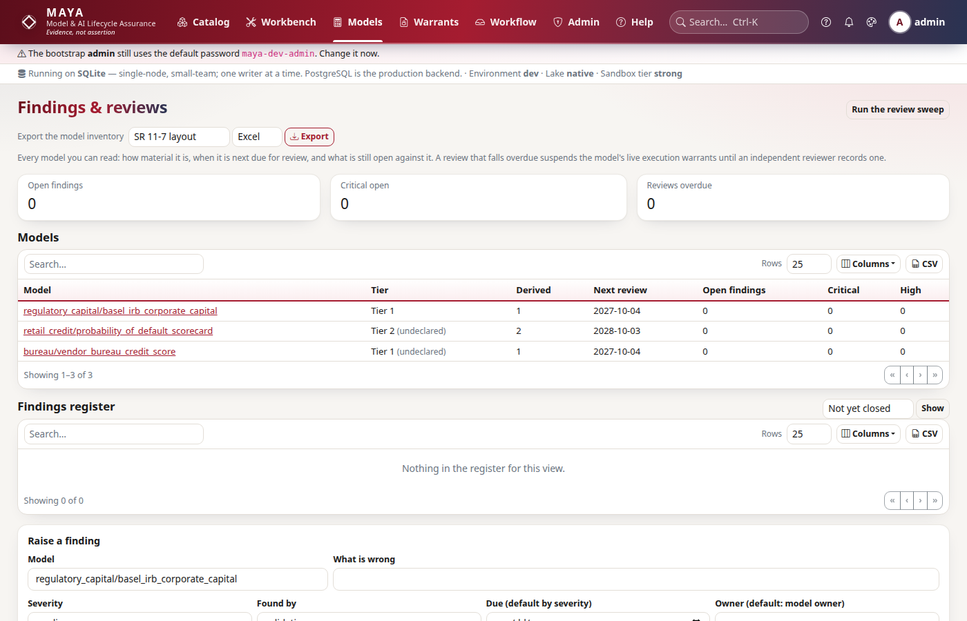
M A Y A
Model & AI Lifecycle Assurance
Findings and reviews, in one place
▪ Tier How material a model is; it sets how often it is reviewed.
▪ Findings Severity, owner, due date and history on every defect.
▪ Periodic review Overdue means suspended, not a red cell.
▪ Inventory Exported in SR 11-7 or SS1/23 layout, straight from the records.
Governance: every model with its tier, next periodic review and findings
Evidence, not assertion.
MAYA • Ashutosh Sinha 35

Slide 36
M A Y A
Model & AI Lifecycle Assurance
A finding has an owner, a due date — and an independent closer
Raised
By a validator, with a severity; due in 30, 90, 180 or 365 days by default.
1
Remediated
By the owner — often as a new model version.
2
Closed
Only by someone who did not remediate it, or sent back as not fixed.
3
Or accepted
The risk kept rather than fixed, with a written reason — never the owner's call.
4
Key insight: In study 09 the owner fixed a missing maturity floor and cap as version 2, tried to close the finding herself, and was refused; the validator closed it.
Evidence, not assertion.
MAYA • Ashutosh Sinha 36

Slide 37
M A Y A
Model & AI Lifecycle Assurance
Materiality: a tier derived from evidence
Tier 1 is the most material. The tier is the highest driver's score, one tier higher for a black box; an override needs a reason, and one that lowers it is flagged.
Driver | Where it comes from | Scores
Use | Declared by the owner: regulatory, reporting, decision, internal | 3 · 3 · 2 · 1
Exposure | Declared by the owner | 3 over 1bn, 2 over 10m
Reach | Measured: live execution warrants and executions | 3 at three warrants or 10,000 runs
Transparency | Measured: formula or black box | +1 tier for a black box
Questionnaire | The firm's own file, config/tiering.yaml | Highest answer, or points against thresholds
Evidence, not assertion.
MAYA • Ashutosh Sinha 37

Slide 38
M A Y A
Model & AI Lifecycle Assurance
An overdue review stops the model running
The tier sets the interval
One, two or three years, or set per model.
1
The due date
From the last review, or from the first approval.
2
The sweep
Hourly: an overdue model's live execution warrants are suspended.
3
The review
Recorded by a model manager, validator or administrator — never the owner.
4
Lifted
Exactly the suspensions the sweep made, and no others.
5
Key insight: A review is not a reminder in someone's calendar; it is a condition of running. A warrant suspended for a breach stays suspended when a review is recorded.
Evidence, not assertion.
MAYA • Ashutosh Sinha 38

Slide 39
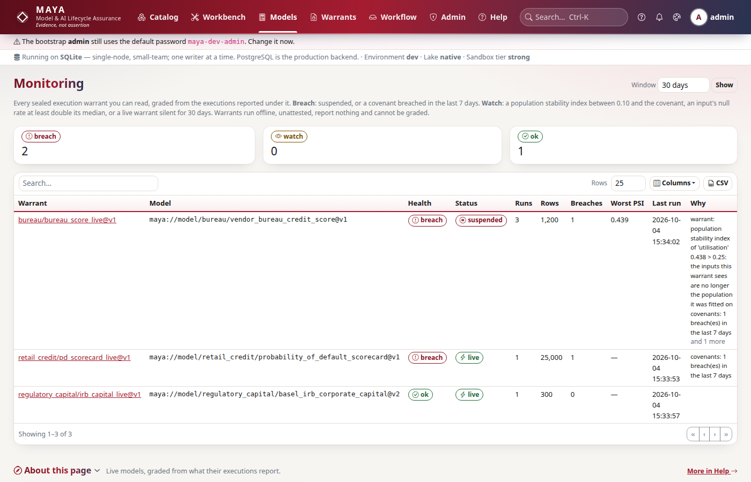
M A Y A
Model & AI Lifecycle Assurance
Every live model graded ok, watch or breach
▪ Breach Suspended, or a covenant broken in the last seven days.
▪ Watch Population stability above 0.10, a null rate doubling, or a live model silent for thirty days.
▪ Per warrant Rows per day; drift, nulls and means per input, against the covenant's bounds.
▪ Study 19 A bureau score goes ok, watch, breach as utilisation drifts: PSI 0.009, 0.109, 0.438.
Monitoring: live models graded from what their executions report
Evidence, not assertion.
MAYA • Ashutosh Sinha 39

Slide 40
M A Y A
Model & AI Lifecycle Assurance
Champion and challenger, on evidence
Two warrants on the same pin with the same seed hold the same escrowed rows. MAYA scores both and compares them row by row.
What is reported
What is refused
▪ The difference
  In RMSE or MAE, challenger minus champion.
▪ A paired bootstrap interval
  95%, 2,000 draws, a fixed seed.
▪ The verdict
  Challenger better only if the whole interval is below zero.
▪ Different holdouts
  Not compared at all.
▪ The author deciding
  The challenger's owner never decides.
▪ Study 42
  Log-log beats linear: −0.031, interval [−0.040, −0.022], winning 60% of rows.
Evidence, not assertion.
MAYA • Ashutosh Sinha 40

Slide 41
M A Y A
Model & AI Lifecycle Assurance
Fairness and explainability, on the holdout
Error by segment
What drives it
▪ Per segment
  RMSE, MAE, bias and mean prediction for each value of a column.
▪ Flagged
  MAE a quarter above the overall figure.
▪ Systematic
  Bias over half the MAE: wrong in one direction.
▪ Suppressed
  Under twenty rows, no figures.
▪ Permutation importance
  Each input shuffled; the rise in error is its weight.
▪ Black boxes too
  Measured through the sandbox: it needs only predictions.
▪ Study 45
  Men's and women's errors are the same size and opposite in sign — both systematic.
Evidence, not assertion.
MAYA • Ashutosh Sinha 41

Slide 42
M A Y A
Model & AI Lifecycle Assurance
The supervisory inventory, never re-typed
Excel, CSV or JSON in an SR 11-7 or SS1/23 layout, built from the records MAYA keeps. The file says how many models the exporter could not see.
Column group | What it holds
Identity | Purpose, use, type, vendor or provider, owner
Materiality | Tier, derived tier, its basis, any override and why, exposure
Approval and evidence | Status, approval, what shows the code computes the model
Review and findings | Last review, next due, open, overdue and accepted findings
Use | Live warrants, environments, executions, monitoring grade, limits on use
Evidence, not assertion.
MAYA • Ashutosh Sinha 42

Slide 43
M A Y A
05
Beyond formulas
Most of what a bank now runs is not a formula anyone can read. Each gets the same chain, and forfeits exactly the evidence it cannot give — no more.
Black boxes · Is the code the mathematics? · Connectors · Beside your ML platform · LLM applications

Slide 44
M A Y A
Model & AI Lifecycle Assurance
A black box, scored blind where nobody sees the data
Declared
It states what it estimates and how it is built.
1
Validated
Its code through six rungs, then run twice in the sandbox.
2
Scored blind
In the sandbox, on the holdout's inputs only — the target never enters.
3
Metrics out
MAYA computes them; rows never leave; the artifact's hash is recorded.
4
Key insight: A black box with no validated artifact is refused by name, and one that reads the target as an input is refused rather than handed the answer.
Evidence, not assertion.
MAYA • Ashutosh Sinha 44

Slide 45
M A Y A
Model & AI Lifecycle Assurance
Is the code the mathematics?
A model has two descriptions: the formula MAYA holds and the Python someone uploaded. MAYA compares them on numbers instead of asking anyone to assert it.
Conformance testing
Honest about itself
▪ The comparison
  Uploaded code against MAYA's own evaluation, to a relative 1e-9.
▪ Counterexamples
  Up to ten disagreeing rows, expected and actual.
▪ Tied to the artifact
  No advance until conformance ran on that hash.
▪ Sampled, not proved
  The report says so in its first words.
▪ Dials off-centre
  So a test cannot miss a bug on a round number.
▪ Study 11
  A bug a recalibration absorbs exactly — only this test sees it.
Evidence, not assertion.
MAYA • Ashutosh Sinha 45

Slide 46
M A Y A
Model & AI Lifecycle Assurance
Models trained elsewhere come in; lineage goes out
System | What MAYA does | What it insists on
MLflow | Imports a model from its MLmodel file or tracking server | A signature: the input contract is the vendor's
Amazon SageMaker | Imports a model package: image, data, framework, approval | Inputs named, since SageMaker records none
OpenLineage | Every lineage edge as a RunEvent, to Marquez or any consumer | Administrators only
Snowflake, Databricks | Read-only SQL sources through their dialects | A read-only role; SELECT only
Tested against each system's published documents and a recorded exchange — not yet against a live service, and the documentation says so.
Evidence, not assertion.
MAYA • Ashutosh Sinha 46

Slide 47
M A Y A
Model & AI Lifecycle Assurance
Beside your ML platform, not instead of it
Step | What MAYA does | What it never does
Registry | Sets an MLflow alias while the execution warrant is live | Deploy: your deployment follows the alias
Scoring call | An SDK guard checks the warrant before and reports after | Sit in your request path
Training | Turns a warrant into a signed Kubernetes or SageMaker job | Run the job: it goes to your compute
Batch scoring | Scores a pinned table under a live warrant, output sealed | Serve online
Evidence, not assertion.
MAYA • Ashutosh Sinha 47

Slide 48
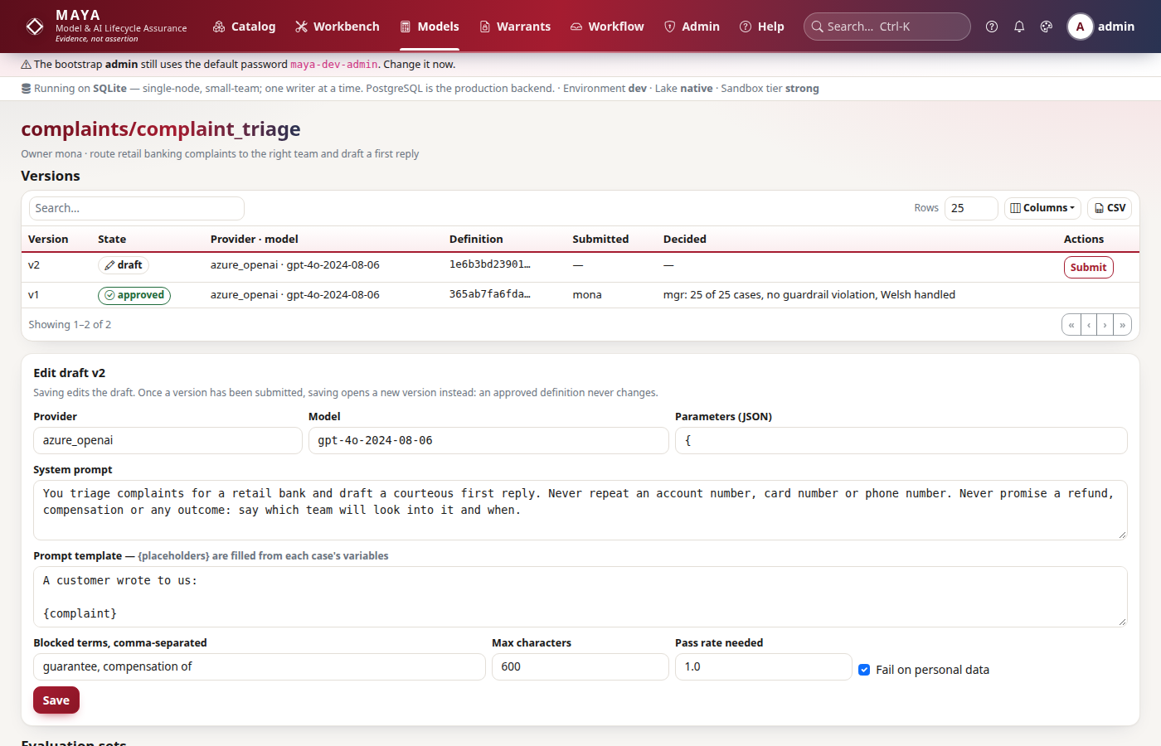
M A Y A
Model & AI Lifecycle Assurance
LLM applications: a prompt is a model's parameters
▪ A version seals Provider, model, prompts, parameters and guardrails under one hash.
▪ Evaluated Deterministic checks — contains, equals, regex, JSON, length — and guardrails for blocked terms and personal data.
▪ Approved on evidence A clean run on exactly that hash, by a manager who is not the owner.
▪ Study 49 Version 1 gets every category right and still fails: it read a card number back.
An LLM application: sealed versions, evaluation sets and runs
Evidence, not assertion.
MAYA • Ashutosh Sinha 48

Slide 49
M A Y A
Model & AI Lifecycle Assurance
MAYA's own AI, under a policy
Every call MAYA makes to a language model passes one gateway and one policy before anything leaves, and is audited without its prompt.
Control | What it does
Features and roles | Drafts, documents, the challenger, evaluations, ask, explain, narrate — each allowed only to the roles named for it
Rate limits | Calls per person and per feature per minute
Daily budget | A token cap always; a spending cap for profiles that declare a price
Masking | E-mail, card and phone numbers, long digit runs and named fields, out of every prompt
Providers | 21, from OpenAI, Azure, Gemini, Cohere and Bedrock to Ollama, vLLM and a rule-driven mock; a profile file each, none on by default
Governed like any model | MAYA registers its own AI features as LLM applications, evaluated and approved on evidence
Evidence, not assertion.
MAYA • Ashutosh Sinha 49

Slide 50
M A Y A
Model & AI Lifecycle Assurance
Ask MAYA: a checked query, never prose
“Which live models read data that was restated since August?”
1
Words first
Common phrasings are read by a rule-based parser — no model at all.
2
Then the model
Anything else becomes JSON over a fixed vocabulary of kinds, fields and operators — never SQL.
3
Checked
An answer outside the vocabulary is refused, sent back once with the reasons, then turned away.
4
Run as you
Through the screens' own listings: it cannot find what you may not read.
5
Shown, editable
The rows and the query MAYA ran, which you can edit and run again with no model.
Key insight: Explanations get the same discipline: every figure a model writes is checked against the record's structured fields, and any it added is named on the page.
Evidence, not assertion.
MAYA • Ashutosh Sinha 50

Slide 51
M A Y A
06
Fifteen models, carried the whole way
Each case study is a real modelling problem taken through MAYA end to end by named people with real roles, so the refusals are the platform's. The suite runs every one from nothing.
The fifteen · A scorecard · A prescribed formula · A bought score · A challenger · A fairness question · An LLM application

Slide 52
M A Y A
Model & AI Lifecycle Assurance
Fifteen studies, different in kind
Study | Model | What it is really about
01 Retail PD scorecard | Fitted logistic | Two clocks; a certificate that refuses
02 Mortgage cash flow | Closed form | Whether the desk's code is the mathematics
03 Prepayment | Fitted hazard | A change priced by shadow replay
04 HELOC exposure | Composite router | Two members, two parameter sets, one seal
05 Option pricing | Calibrated | A parameter nobody can observe
06 IFRS 9 ECL | Composite | Committee judgements as parameter sets
07 Card fraud | Declared black box | What is left to hold to account
08 AR(2) and GARCH | Formula and black box | The last dates held out
09 Basel IRB | Prescribed formula | Reconciliation, a finding, closure
10 Factor models | Two versions | A semantic diff
11 Nelson–Siegel | Non-linear | A bug a recalibration absorbs
19 Vendor bureau score | Bought, from MLflow | Blind scoring; drift to breach
42 Demand elasticity | Linear vs log-log | A paired interval
45 Mortality table | Non-linear law | A bias the law requires
49 Complaint triage | LLM application | Guardrails and evaluation sets
Evidence, not assertion.
MAYA • Ashutosh Sinha 52

Slide 53
M A Y A
Model & AI Lifecycle Assurance
Study 01 — a scorecard from three CSVs to a licence to run
“Can we put this probability-of-default scorecard into production, and prove how we got there?”
1
Ingest — dana
Three features, with knowledge times; approved by mick.
2
Assemble and pin — devi
The panel, cascade-pinned as of 2025-06-30: 9,600 rows.
3
Register — mona
The logistic formula, four features, five parameters; approved by mgr.
4
Fit — devi
Under a training warrant, by IRLS in twelve lines of numpy.
5
Score blind — MAYA
The uploaded parameters scored on rows devi never saw.
6
Seal — lara
An execution warrant, approved by a second person.
Key insight: Nothing in the study touches the database: every action goes through the SDK as a user with the role for it, so every refusal on the way is the platform's.
Evidence, not assertion.
MAYA • Ashutosh Sinha 53

Slide 54
M A Y A
Model & AI Lifecycle Assurance
Study 09 — a bracket left out, found by reconciling every obligor
0.00982
6.5m
1
5.7e-17
RMSE of K for version 1 against the regulator's reference
capital overstated on the year-end book: 179.6m against 173.1m
statement in the semantic diff that fixes it
RMSE of K for version 2, floor and cap restored
▪ A model with nothing to fit is proved by reconciliation; the leakage certificate records a written exception, because reporting uses figures finalised after the quarter by design.
▪ A high finding was raised, fixed as version 2, refused when the owner tried to close it herself, and closed by the validator.
Evidence, not assertion.
MAYA • Ashutosh Sinha 54

Slide 55
M A Y A
Model & AI Lifecycle Assurance
Study 19 — a bought score, validated blind, taken out of service by drift
Imported from its MLflow signature, its code validated in the sandbox, scored blind on 171 held-out applications: Brier 0.082, utilisation 43% of the importance. Then three months in production:
Month | Mean utilisation | PSI | Warrant | Dashboard
January | 0.411 | 0.009 | live | ok
February | 0.451 | 0.109 | live | watch
March | 0.497 | 0.438 | suspended | breach
Nobody had to notice. The covenant broke, the warrant suspended itself, and every consuming call failed closed naming whom to contact.
Evidence, not assertion.
MAYA • Ashutosh Sinha 55

Slide 56
M A Y A
Model & AI Lifecycle Assurance
Study 42 — winning 60% of rows, and still clearly better
0.2250
0.1940
[−0.040, −0.022]
−1.62
blind RMSE of the linear champion on 657 escrowed rows
blind RMSE of the log-log challenger, same rows
95% paired bootstrap interval
the challenger's elasticity; the truth is −1.6
▪ The challenger wins by more where it wins: at the deepest discount 0.276 against 0.235. Two headline RMSEs hide that; a paired comparison shows it.
▪ A warrant with another seed was refused rather than compared; the challenger's developer was refused the decision; a second manager promoted it.
Evidence, not assertion.
MAYA • Ashutosh Sinha 56

Slide 57
M A Y A
Model & AI Lifecycle Assurance
Study 45 — wrong by the same amount, in opposite directions
1.08
+0.0259
−0.0240
6.6 years
MAE ratio between the sexes: by size, nothing stands out
bias for women: the unisex table overstates
bias for men: it understates
for mortality to double, from the fitted slope
▪ Both segments are marked systematic. The first version of MAYA's fairness evidence flagged on MAE alone and reported nothing; this study is why the systematic flag exists.
▪ The table must be unisex by law, so the finding is accepted, not fixed — by a manager, with the ruling cited.
Evidence, not assertion.
MAYA • Ashutosh Sinha 57

Slide 58
M A Y A
Model & AI Lifecycle Assurance
Study 49 — right about every category, and still not fit to use
A triage application on the firm's own Azure OpenAI deployment. MAYA does not call it: answers are recorded where it runs and scored here.
Run | Passed | What happened
Version 1 | 21 of 24 | Every category right; one promises a refund, two repeat phone and card numbers
Draft fixed | 24 of 24 | New definition hash: the failing run no longer describes it
Set extended | refused | A validator adds a Welsh complaint; the clean run no longer counts
Scored again | 25 of 25 | The owner refused approval; a model manager approved
Evidence, not assertion.
MAYA • Ashutosh Sinha 58

Slide 59
M A Y A
07
The formal core
Why the facts above can be derived rather than typed. Proofs are in the research paper; this is the engineer's view.
Four facts that rot · One order · The point-in-time read · Where a machine may do the work

Slide 60
M A Y A
Model & AI Lifecycle Assurance
Four declared facts, and how each one rots
 | The declaration | How it rots | The damage
Kind | What sort of artefact this is | Typed once, at registration | A monitor that detects nothing reads as coverage
Fit | Whether this data or version fits | Four code paths drift apart | Towards permitting more: nobody files that bug
Currency | What a row could have known | A convention in each query | Look-ahead that improves every metric
Support | What a conclusion rests on | A log, not a derivation | “Still supported?” needs a person to read it
Each of the four is derivable from structure that has to exist anyway, and a derived fact cannot be typed wrong, cannot drift, and cannot disagree with its object.
Evidence, not assertion.
MAYA • Ashutosh Sinha 60

Slide 61
M A Y A
Model & AI Lifecycle Assurance
One order — “A can stand in for B” — written down once
A replacement version
Its inputs accept at least what the incumbent's did; its outputs still provide what it provided.
1
Binding data to a model
The feature set's schema can stand in for the model's input contract.
2
A dependency edge
What the source produces can stand in for what the target reads.
3
One set, two models
The set can stand in for the meet of the two contracts.
4
Key insight: Four implementations of one relation are four chances to disagree — always towards permitting more, because a wrong refusal is reported within the hour and a wrong permission never is.
Evidence, not assertion.
MAYA • Ashutosh Sinha 61

Slide 62
M A Y A
Model & AI Lifecycle Assurance
The point-in-time read, and the four properties it has
The latest record whose event time is at or before the label, and whose knowledge time is at or before the earlier of the label and the observation.
Property | What it says | Why it matters
Idempotent | Reading its own result returns it | Cached and recomputed rows agree
Commutes with projection | Dropping columns first changes nothing | A narrower query is the same query
Monotone in observation | A later observation admits a superset | Nothing knowable stops being knowable
Saturating at the label | After the label, the same set always | Reproducibility, as a property of the read
Evidence, not assertion.
MAYA • Ashutosh Sinha 62

Slide 63
M A Y A
Model & AI Lifecycle Assurance
Where a machine may do the work
If an answer can be checked, it matters little what produced it. If it cannot, trusting the answer is trusting the producer.
A check exists: an error costs time
No check exists: the answer is its producer
▪ Encode a regime
  Truth is kept under translation, or it is not.
▪ Bind data, wire models
  The one order; a refusal names the slot.
▪ Assemble evidence
  Recomputed by a second route, then cited.
▪ Choose the tiering rule
  It is the standard.
▪ Conclude a validation
  An exercise of authority, not a property of text.
▪ Accept residual risk
  Somebody's decision, recorded as theirs.
MAYA's assistant sits entirely on the left: it proposes, never approves, never blocks, and never writes to a sealed object.
Evidence, not assertion.
MAYA • Ashutosh Sinha 63

Slide 64
M A Y A
08
Built today, and what comes next
What version 1.0.0 does, how it compares, what it does not do, and where it is going.
Built · Compared · Limits · Next · Where to start

Slide 65
M A Y A
Model & AI Lifecycle Assurance
Built: the evidence core
FEATURES AND PINS
FORMULA IR
WARRANTS
Two clocks, sealed data
Mathematics as data
The checksum cycle
Restatements append; pins are byte-identical on re-resolution.
LaTeX, Python and spreadsheets parsed, rendered, diffed and turned into code.
Leakage certificates, escrowed holdouts, covenants that suspend.
EVIDENCE BUNDLES
WORKFLOW
AUDIT AND CUSTODY
Verify offline
Policy as data
Hash-chained
Signed, re-executed, refused on one changed byte.
Separation of duties, delegation, break-glass, campaigns.
Anchored outside the database, timestamped on request.
Evidence, not assertion.
MAYA • Ashutosh Sinha 65

Slide 66
M A Y A
Model & AI Lifecycle Assurance
Built: governance and reach
GOVERNANCE
MONITORING
VALIDATION
Findings to inventory
Graded dashboards
Challengers and fairness
Tiers, periodic review that suspends, the SR 11-7 and SS1/23 export.
ok, watch or breach from what executions report.
Paired intervals, segments, permutation importance.
BLACK BOXES
CONNECTORS
LLM APPLICATIONS
Scored in the sandbox
MLflow, SageMaker, OpenLineage
Sealed versions
Six-rung validation; conformance where a formula exists.
Evaluation sets, guardrails, approval on evidence.
Snowflake and Databricks as read-only sources.
Evidence, not assertion.
MAYA • Ashutosh Sinha 66

Slide 67
M A Y A
Model & AI Lifecycle Assurance
How MAYA compares, by category
Capability | MRM platforms | ML platforms | Feature stores | MAYA
Inventory, approval workflow, separation of duties | Yes | Partial | No | Yes
Overdue periodic review stops the model running | Partial | No | No | Yes
Champion and challenger on the same sealed holdout | Partial | Partial | No | Yes
Point-in-time training data, two clocks | No | Partial | Yes | Yes
Data sealed by content hash, reproducible years later | No | Partial | Partial | Yes
Mathematics as a specification code is checked against | No | No | No | Yes
Licence to fit or run, granted in advance and refusable | Partial | Partial | No | Yes
Evidence verified without the platform installed | No | No | No | Yes
Training infrastructure and model serving | No | Yes | Partial | No
Scale of deployment, ecosystem, vendor support | Yes | Yes | Yes | No
Categories, not vendors: a feature-by-feature claim about a named product would be wrong by its next release. The last two rows are where MAYA loses, and it says so.
Evidence, not assertion.
MAYA • Ashutosh Sinha 67

Slide 68
M A Y A
Model & AI Lifecycle Assurance
What MAYA does not do, stated rather than discovered
Limit | Why, and what it costs
It trains and serves nothing itself | By design: it licenses what your platform does
Linux is what is tested | Windows runs the case studies, but its sandbox has no OS isolation
Connectors not yet met live | Tested against published documents and recorded exchanges
MAYA's own live LLM calls, stubbed | Recorded runs are unaffected
Not yet deployed at a supervised firm | No external security review; one author's work, open to inspection
Evidence, not assertion.
MAYA • Ashutosh Sinha 68

Slide 69
M A Y A
Model & AI Lifecycle Assurance
What comes next
CERTIFY CONNECTORS
SECURITY REVIEW
FIRST MODEL IN AN HOUR
Live MLflow and SageMaker
An external one
Timed, with real people
Run the connector suites against live services, not only their documents.
The one review a project cannot do for itself.
The success criterion that needs a stopwatch and a newcomer.
WINDOWS ISOLATION
RICHER BLIND SCORES
MORE EXTENSION POINTS
A sandbox tier there
AUC, Gini, log loss
Plugins in use
So the tested platform list can grow past Linux.
Discrimination and calibration for binary targets, on the escrowed holdout.
Wire the remaining declared points the way LLM providers already are.
Evidence, not assertion.
MAYA • Ashutosh Sinha 69

Slide 70
M A Y A
Model & AI Lifecycle Assurance
Where to start
Fifteen minutes to a running MAYA with a model in it.
docs/getting-started/QUICKSTART.md
Nine steps on Python 3.13, each saying what you should see.
1
docs/getting-started/IDE.md
PyCharm or IntelliJ IDEA: run, debug and test the server and the UI.
2
case_studies/
Fifteen worked models; any one fills the catalog in under a minute.
3
docs/reference/API_GUIDE.md
The REST API from a first curl to a sealed warrant, every example executed by the tests.
4
Help, inside MAYA
Every screen ends with what it is for and a link to the full guide.
5
Evidence, not assertion.
MAYA • Ashutosh Sinha 70

Slide 71
Thank you
Evidence, not assertion.
Ashutosh Sinha
ajsinha@gmail.com

