Slide 1
Introduction
Goal: Predict neighborhood-level auto insurance risk using public data.
Method: Gradient Boosting (XGBoost) with SHAP explainability.
Contribution: Highlights socio-economic and commuting factors influencing crash risk.

Slide 2
Background
• Traditional actuarial models (GLMs) struggle with non-linear relationships in urban risk.
• NYC traffic risk influenced by socio-economic disparities and pandemic-related changes.
• Ensemble ML models like XGBoost outperform GLMs for frequency-severity prediction.
• SHAP explainability enables transparency and interpretability.

Slide 3
Research Questions
1. Can socio-economic and crash data be combined to model geographic auto insurance risk?
2. Which socio-economic, transportation, and demographic factors are most predictive of crash risk?
3. How interpretable and accurate is gradient boosting compared to traditional actuarial models?

Slide 4
Data and Sources
• Crash Data: NYC Motor Vehicle Collisions (2018–2023), aggregated at the census tract level.
• Socio-Economic Data: ACS 5-year estimates (2018–2023).
- Includes demographics, income, housing, commuting patterns.
- Interaction features (e.g., poverty × vehicle ownership).
• Dataset Size: 13,518 tract-year observations.

Slide 5
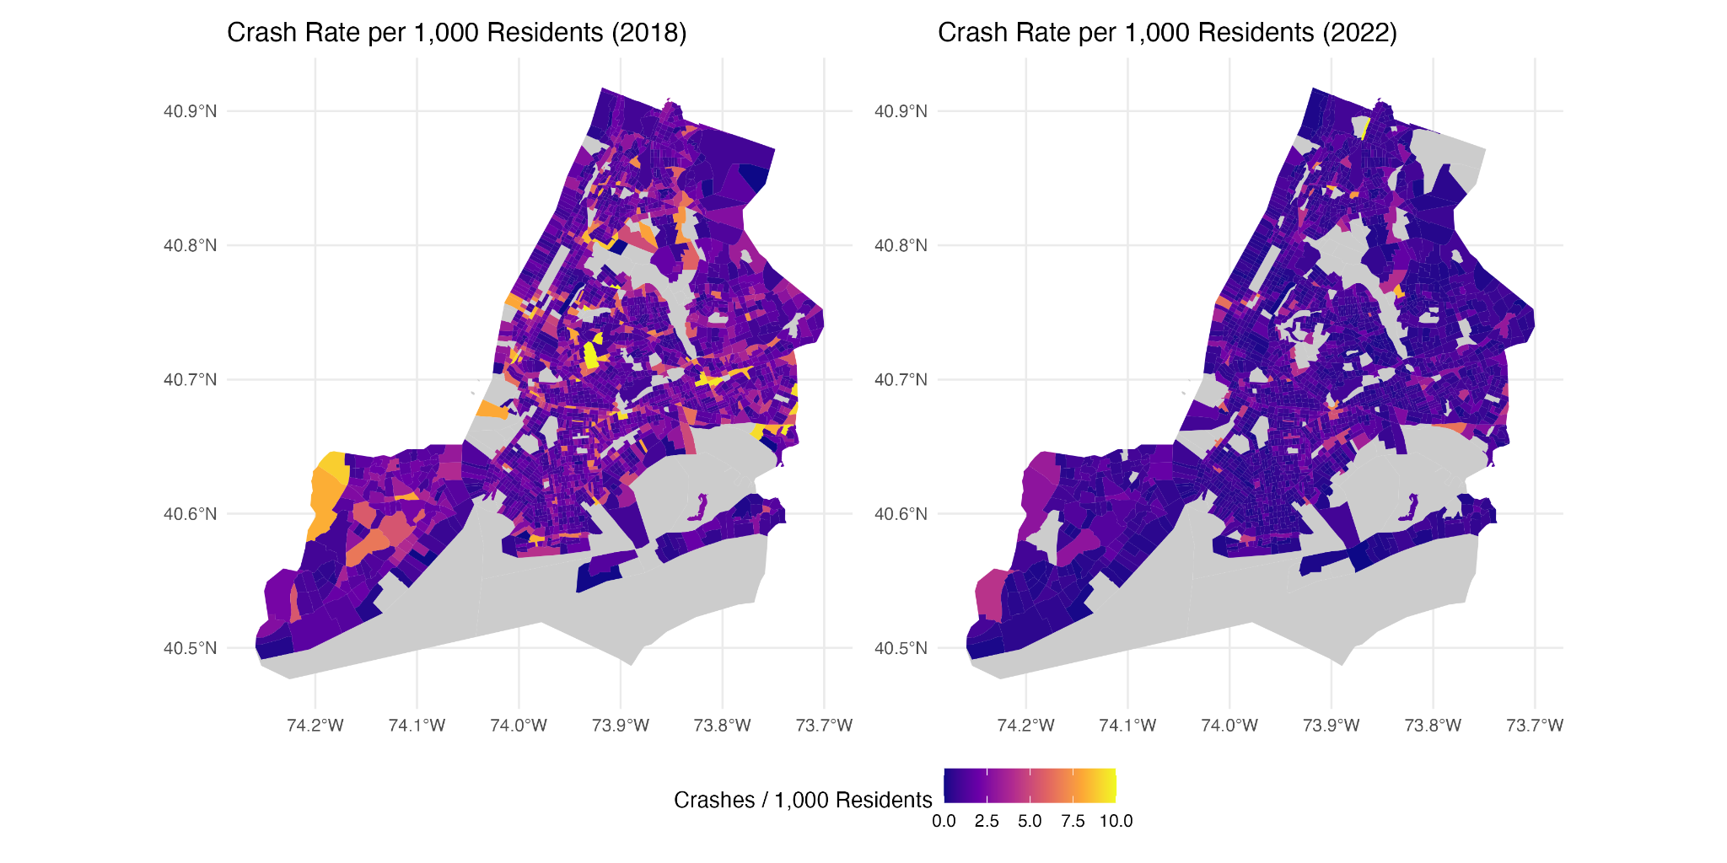
Descriptive Statistics
• Average crash rate: 1.43 crashes/1,000 residents (max > 23/1,000).
• Median household income: $74,681; median gross rent: $1,589.
• Public transit use: 3.7%; walking 0.66%; biking 0.05%.
• Crash rates declined during the pandemic (2020) with gradual rebound.
• Hotspots: South Bronx, central Brooklyn, northern Manhattan.

Slide 6
Modeling Strategy
• Model: Gradient Boosting (XGBoost) with crash rate per 1,000 residents as target.
• Validation: Spatial cross-validation by borough.
• Hyperparameter tuning: max_depth=4, eta=1.55, regularization applied.
• Explainability: SHAP values identify feature importance and interactions.

Slide 7
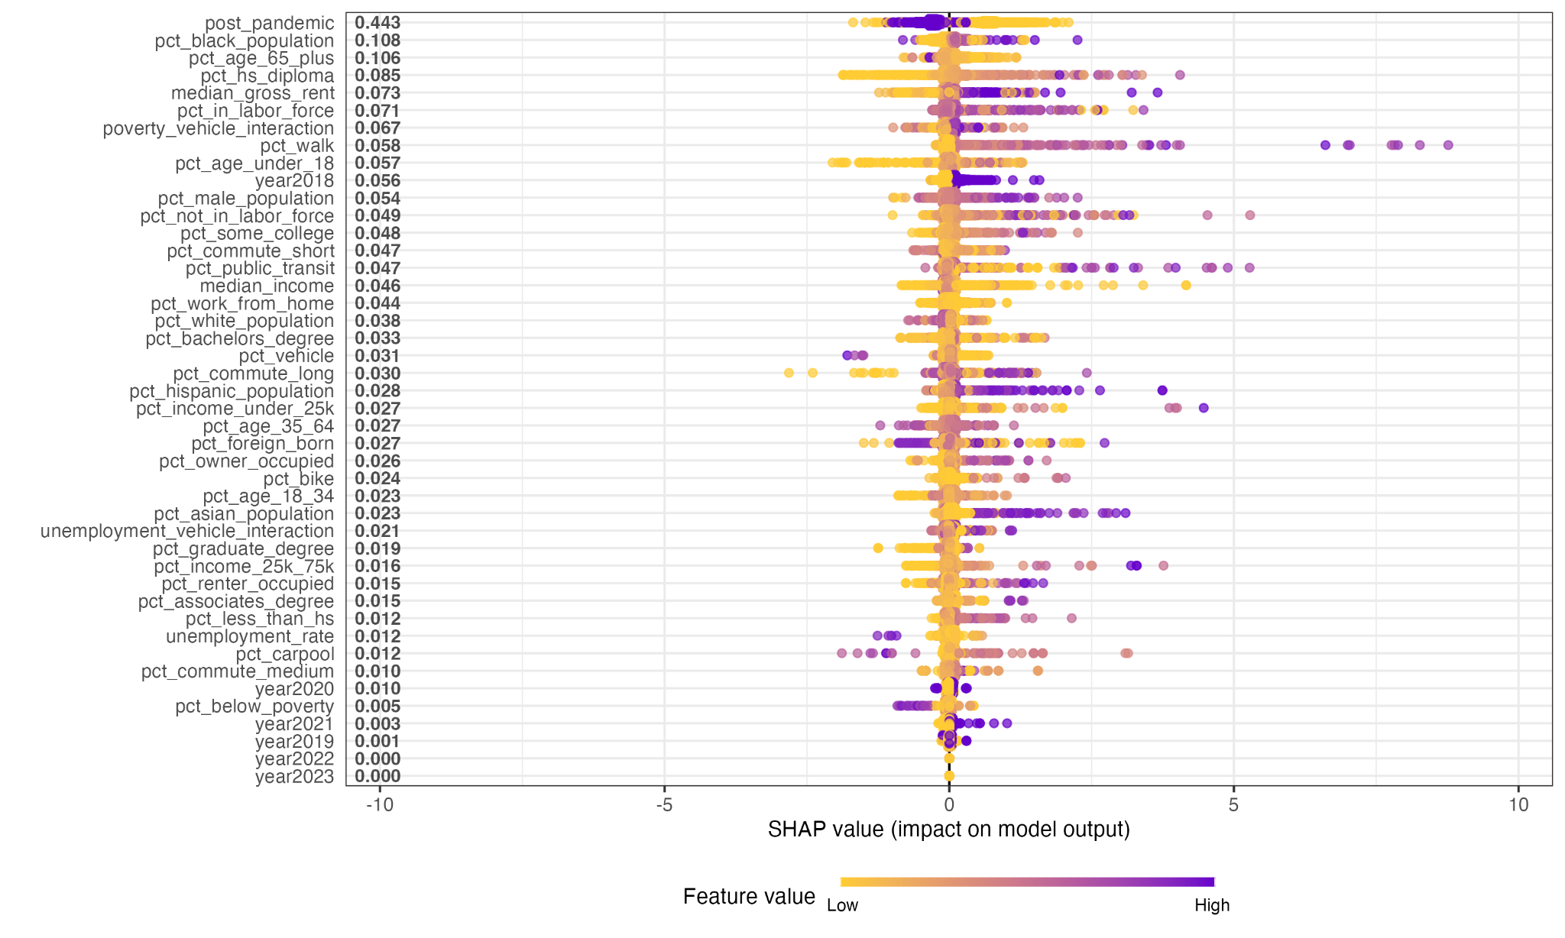
Results
• Model Metrics: R² = 0.26, RMSE = 1.55, MAE = 0.84.
• Top Predictors (via SHAP):
- Post-pandemic indicator.
- Median gross rent.
- Labor force participation (peak risk at 60–70%).
- Poverty × vehicle ownership interaction.

Slide 8
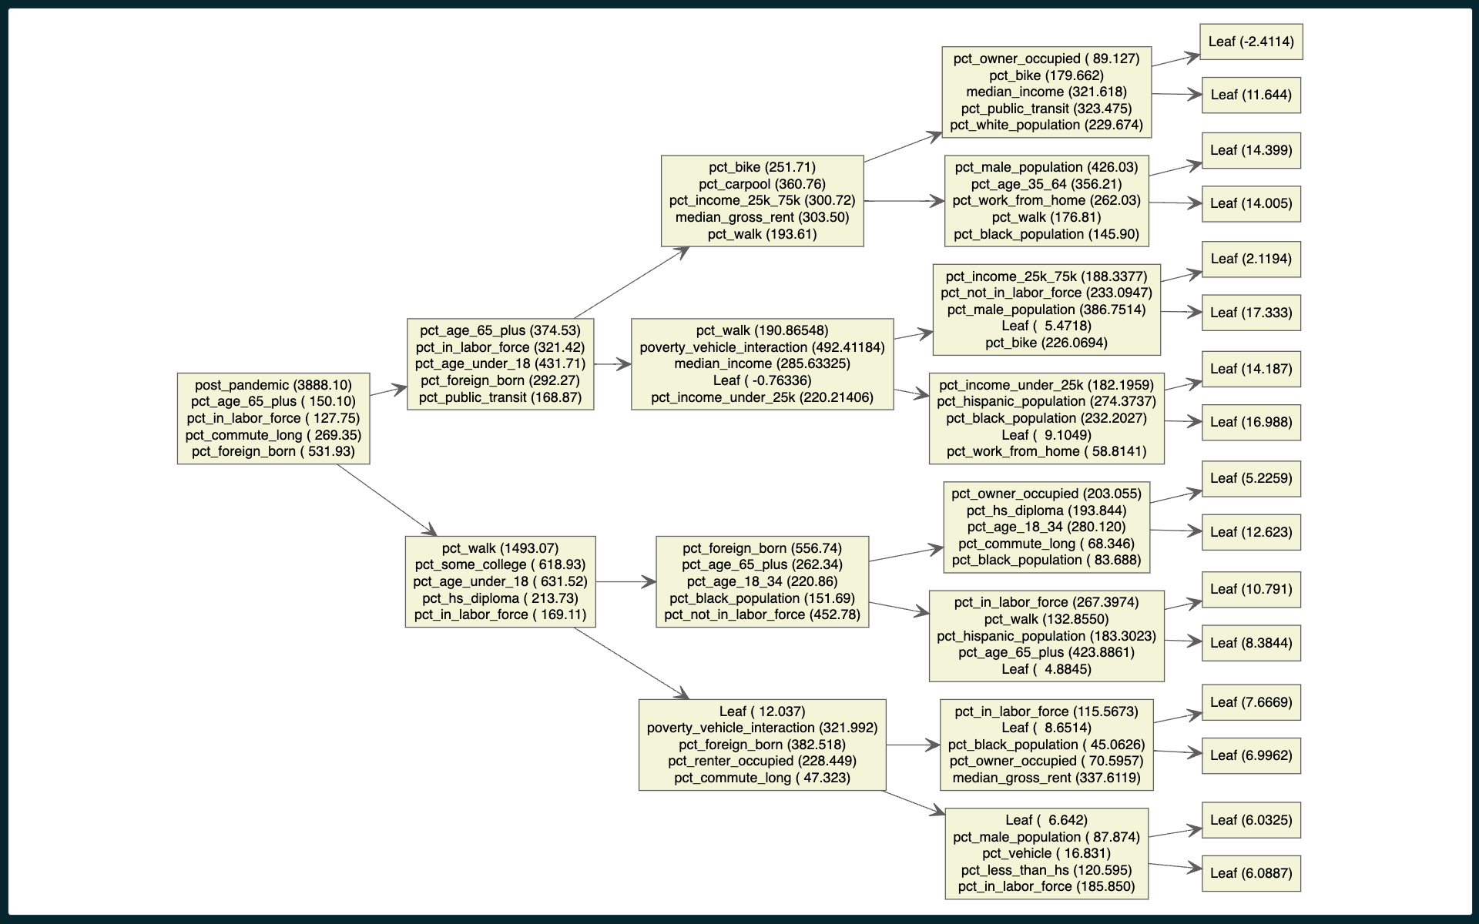
Insights
• Socio-economic drivers: income, rent, and commuting patterns strongly correlate with crash risk.
• Post-pandemic traffic changes increased crash severity.
• Equity issues: Higher crash risks in economically vulnerable communities.
• Application: Useful for neighborhood-level portfolio risk analysis, not individual underwriting.

Slide 9
Conclusions and Future Research
• Gradient boosting reveals interpretable, socio-economic crash risk patterns.
• Model limitations: Only explains ~26% variance; fairness concerns for underwriting.
• Future Work:
1. Integrate telematics (real-time driving behavior).
2. Develop fairness-aware ML to reduce socio-economic bias.
3. Explore temporal modeling for seasonal and event-driven risk factors.

