Slide 1
October 2011 – CHADNUG – Chattanooga, TN
What is Hadoop?
Josh Patterson | Sr Solution Architect
Notes:
Its all about the love, baby.

Slide 2
Who is Josh Patterson?
josh@cloudera.com
Twitter: @jpatanooga
Master’s Thesis: self-organizing mesh networks
Published in IAAI-09: TinyTermite: A Secure Routing Algorithm
Conceived, built, and led Hadoop integration for openPDC project at Tennessee Valley Authority (TVA)
Led team which designed classification techniques for time series and Map Reduce
Open source work at
http://openpdc.codeplex.com
https://github.com/jpatanooga
Today
Sr. Solutions Architect at Cloudera

Slide 3
Outline
Let’s Set the Stage
Story Time: Hadoop and the Smartgrid
The Enterprise and Hadoop
Use Cases and Tools

Slide 4
Data Today: The Oil Industry Circa 1900
“After the refining process, one barrel of crude oil yielded more than 40% gasoline and only 3% kerosene, creating large quantities of waste gasoline for disposal.”
--- Excerpt from the book “The American Gas Station”
Notes:
Theme: they through away a lot of valuable gas and oil just like we through away data today

Slide 5
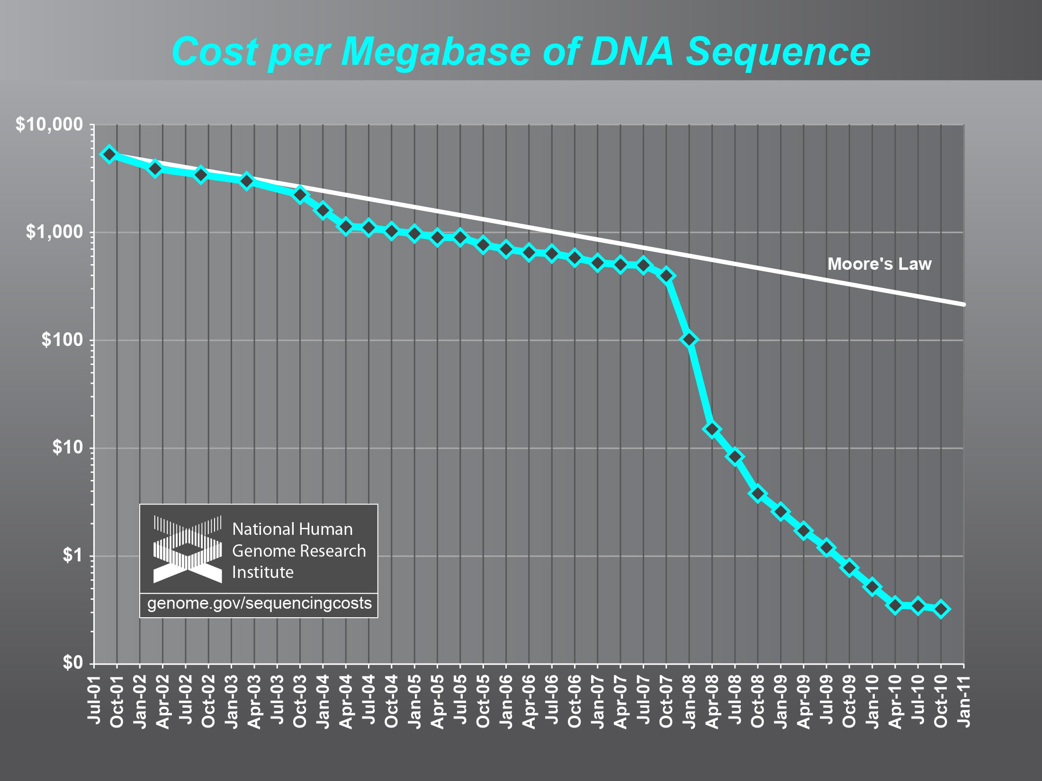
DNA Sequencing Trends
Cost of DNA Sequencing Falling Very Fast
Notes:
Example of data production trends

Slide 6
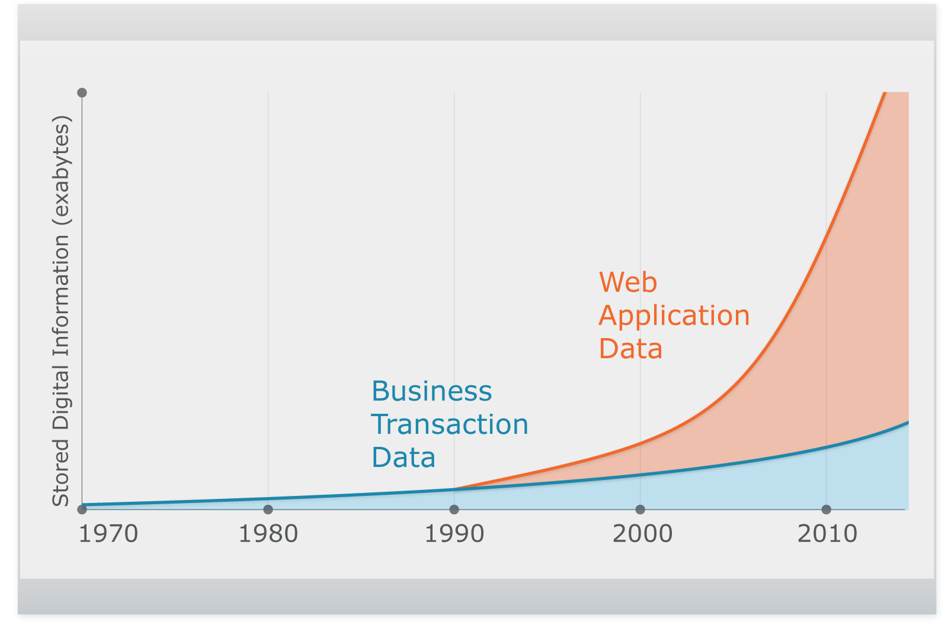

Unstructured Data Explosion
Complex,
Unstructured
Relational
2,500 exabytes of new information in 2012 with Internet as primary driver
Digital universe grew by 62% last year to 800K petabytes and will grow to 1.2 “zettabytes” this year

Slide 7
Obstacles to Leveraging Data
Data comes in many shapes and sizes: relational tuples, log files, semistructured textual data (e.g., e-mail)
Sometimes makes the data unwieldy
Customers are not creating schemas for all of their data
Yet still may want to join data sets
Customers are moving some of it to tape or cold storage, throwing it away because “it doesn’t fit”
They are throwing data away because its too expensive to hold
Similar to the oil industry in 1900
Notes:
But what if some constraints changed?

Slide 8
A Need for a Platform in an Evolving Landscape
Need ability to look at true distribution of data
Previously impossible due to scale
Need lower cost of analysis
Ad Hoc analysis now more open and flexible
Need Greater Flexibility, “BI Agility”
Less restrictive than SQL-only systems
Speed @ Scale is the new Killer App
Results in that previously took 1 day to process can gain new value when created in 10 minutes.
Notes:
Talk about changing market dynamics of storage cost
What if some of the previously held constraints changed? Enter hadoop

Slide 9
Story Time: Hadoop and the Smartgrid
“We’re gonna need a bigger boat.”
--- Roy Scheider, “Jaws”

Slide 10
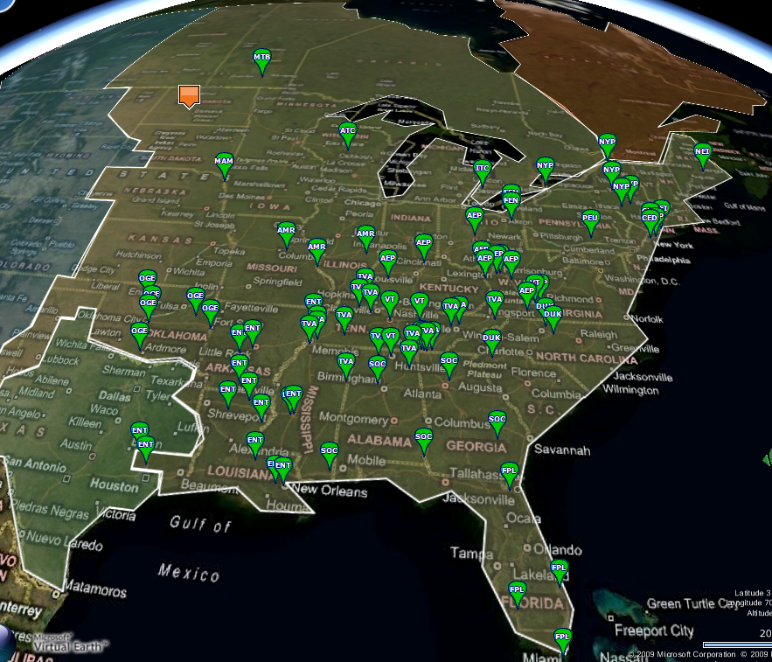
NERC Sensor Data Collection
openPDC PMU Data Collection circa 2009
120 Sensors
30 samples/second
4.3B Samples/day
Housed in Hadoop
Notes:
Let’s set the stage in the context of story, why we were looking at big data for time series.

Slide 11
NERC Wanted High-Res Smartgrid Data
Started openPDC project @ TVA
http://openpdc.codeplex.com/
We used Hadoop to store and process smartgrid (PMU) time series data
https://openpdc.svn.codeplex.com/svn/Hadoop/Current%20Version/
Notes:
Ok, so how did we get to this point?
Older SCADA systems take 1 data point per 2-4 seconds --- PMUs --- 30 times a sec, 120 PMUs, Growing by 10x factor

Slide 12
Major Themes From openPDC
Velocity of incoming data
Where to put the data?
Wanted to scale out, not up
Wanted linear scalability in cost vs size
Wanted system robust in the face of HW failure
Not fans of vendor lock-in
What can we realistically expect from analysis and extraction at this scale?
How long does it take to scan a Petabyte @ 40MB/s?
Notes:
Data was sampled 30 times a second
Number of sensors (Phasor Measurement Units / PMU) was increasing rapidly
was 120, heading towards 1000 over next 2 years, currently taking in 4.3 billion samples per day
Cost of SAN storage became excessive
Little analysis possible on SAN due to poor read rates on large amounts (TBs) of data

Slide 13

Apache Hadoop
Open Source Distributed Storage and Processing Engine
Consolidates Mixed Data
Move complex and relational data into a single repository
Stores Inexpensively
Keep raw data always available
Use industry standard hardware
Processes at the Source
Eliminate ETL bottlenecks
Mine data first, govern later
MapReduce
Hadoop Distributed File System (HDFS)

Slide 14
What Hadoop does
Networks industry standard hardware nodes together to combine compute and storage into scalable distributed system
Scales to petabytes without modification
Manages fault tolerance and data replication automatically
Processes semi-structured and unstructured data easily
Supports MapReduce natively to analyze data in parallel

Slide 15
What Hadoop does not do
No random access or transactions
Hadoop is not a database
Not real-time
Hadoop is batch oriented
Push-button install or configure
Hadoop requires some advanced skills
This aspect is part of Cloudera’s value add

Slide 16
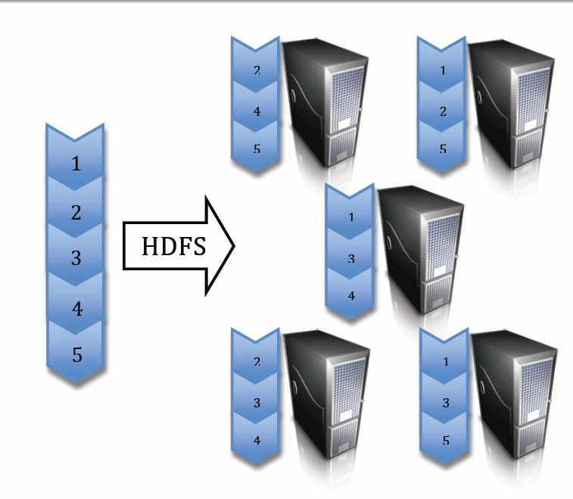
HDFS: Hadoop Distributed File System
Block Size = 64MB
Replication Factor = 3
Cost/GB is a few ¢/month vs $/month
Notes:
Pool commodity servers in a single hierarchical namespace.
Designed for large files that are written once and read many times.
Example here shows what happens with a replication factor of 3, each data block is present in at least 3 separate data nodes.
Typical Hadoop node is eight cores with 16GB ram and four 1TB SATA disks.
Default block size is 64MB, though most folks now set it to 128MB

Slide 17
MapReduce
In simple terms, it’s an application with 2 functions
Map Function
Think massively parallel “group by”
Reduce Function
Think “aggregation + processing”
Not hard to write
Can be challenging to refactor existing algorithms
Designed to work hand-in-hand with HDFS
Minimizes disk seeks, operates at “transfer rate” of disk
Notes:
Note: these are not simple queries, they are DEEP COMPLEX SCANS

Slide 18
Speed @ Scale
Scenario
1 million sensors, collecting sample / 5 min
5 year retention policy
Storage needs of 15 TB
Processing
Single Machine: 15TB takes 2.2 DAYS to scan
MapReduce@ 20 nodes: Same task takes 11 Minutes
Notes:
Note: these are not simple queries, they are DEEP COMPLEX SCANS

Slide 19
MapReduce Tools
Pig
Procedural language compiled into MR
Hive
SQL-like language compiled into MR
Mahout
Collection of data mining algorithms for Hadoop
Streaming
Ability to write MR with tools such as python, etc

Slide 20
The Enterprise and Hadoop
“What if you don’t know the questions?”
--- Forrester Report
Notes:
Theme: they through away a lot of valuable gas and oil just like we through away data today

Slide 21


Apache Hadoop in Production
How Apache Hadoop fits
into your existing infrastructure.
OPERATORS
ENGINEERS
ANALYSTS
BUSINESS USERS
CUSTOMERS
Management Tools
IDE’s
BI / Analytics
Enterprise Reporting
Web Application
Enterprise Data Warehouse
Operational Rules Engines
Logs
Files
Web Data
Relational Databases
Notes:
Apache Hadoop is a new solution in your existing infrastructure.
It does not replace any existing major existing investment.
Apache brings data that you’re already generating into context and integrates it with your business.
You get access to key information about how your business is operating but pulling together
Web and application logs
Unstructured files
Web data
Relational data
Hadoop is used by your team to analyze this data and deliver it to business users directly and via existing data management technologies

Slide 22
What the Industry is Doing
Microsoft
ships CTP of Hadoop Connectors for SQL Server and Parallel Data Warehouse
(based on Cloudera’s Sqoop)
http://blogs.technet.com/b/dataplatforminsider/archive/2011/08/25/microsoft-ships-ctp-of-hadoop-connectors-for-sql-server-and-parallel-data-warehouse.aspx
Oracle
Announcments at Oracle Open World
Connector to Hadoop allowing data flow into Oracle
Hadoop Accelerator for Exalogic
In-memory processing for MapReduce
ETL using Hadoop
Integrated analytics on Oracle and Hadoop

Slide 23











Integrating With the Enterprise IT Ecosystem
Drivers, language enhancements, testing
File System Mount
UI Framework
SDK
FUSE-DFS
HUE
HUE SDK
Sqoop* frame-work, adapters
Workflow
Scheduling
Metadata
APACHE OOZIE
APACHE OOZIE
APACHE HIVE
More coming…
Data Integration
Languages / Compilers
Fast Read/Write Access
APACHE PIG, APACHE HIVE
APACHE FLUME, APACHE SQOOP
APACHE HBASE
Coordination
APACHE ZOOKEEPER
Packaging, testing
*Sqoop supports JDBC, MySQL, Postgres, HSQLDB
Notes:
Allows vendor specific solutions to build on top
Certain custom code would be written for the platform as well

Slide 24
Forester Report
World Economic Forum
Declared that data is a new asset class
Big data is an applied science project in most companies
Major potential constraint is not the cost of the computing technology
but the skilled people needed to carry out these projects
the data scientists
What if you don’t know the questions?
Big data is all about exploration without preconceived notions
Need tools to ask questions to understand the right questions to ask
Much of the software is based on open-source Hadoop
http://blogs.forrester.com/brian_hopkins/11-09-30-big_data_will_help_shape_your_markets_next_big_winners

Slide 25
What Can Hadoop Do For Me?
Ever been recommended a friend on Facebook?
Ever been recommended a product on Amazon?
Ever used the homepage at Yahoo?
Notes:
Theme: they through away a lot of valuable gas and oil just like we through away data today

Slide 26
Problems Addressed With Hadoop
Text Mining
Index Building
Search Engines
Graph Creation
Twitter, Facebook
Pattern Recognition
Naïve Bayes Classification
Recommendation Engines
Predictive Models
Risk Assessment
Notes:
Transition into “hadoop as a platform”, but vendors are building on top of it for specific vertical challenges

Slide 27





A Few Named Examples
Analyze search terms and subsequent user purchase decisions to tune search results, increase conversion rates
Digest long-term historical trade data to identify fraudulent activity and build real-time fraud prevention
Model site visitor behavior with analytics that deliver better recommendations for new purchases
Continually refine predictive models for advertising response rates to deliver more precisely targeted advertisements
Replace expensive legacy ETL system with more flexible, cheaper infrastructure that is 20 times faster
Correlate educational outcomes with programs and student histories to improve results

Slide 28
Packages For Hadoop
DataFu
From Linkedin
http://sna-projects.com/datafu/
UDFs in Pig
used at LinkedIn in many of off-line workflows for data derived products
"People You May Know”
"Skills”
Techniques
PageRank
Quantiles (median), variance, etc.
Sessionization
Convenience bag functions
Convenience utility functions

Slide 29
Integration with Libs
Mix MapReduce with Machine Learning Libs
WEKA
KXEN
CPLEX
Map side “groups data”
Reduce side processes groups of data with Lib in parallel
Involves tricks in getting K/V pairs into lib
Pipes, tmp files, task cache dir, etc

Slide 30
Ask the right questions up front..
Is the job disk bound?
What is the latency requirement on the job?
Does it need a sub-minute latency? (not good for Hadoop!)
Does the job look at a lot or all of the data at the same time?
Hadoop is good at looking at all data, complex/fuzzy joins
Is large amounts of ETL processing needed before analysis?
Hadoop is good at ETL pre-processing work
Can the analysis be converted into MR / Pig / Hive?
Notes:
This is probably a better slide 30

Slide 31
What Hadoop Not Good At in Data Mining
Anything highly iterative
Anything that is extemely CPU bound and not disk bound
Algorithms that can’t be inherently parallelized
Examples
Stochastic Gradient Descent (SGD)
Support Vector Machines (SVM)
Doesn’t mean they arent great to use
Notes:
Check this against the Mahout impl

Slide 32
Questions? (Thank You!)
Hadoop World 2011
http://www.hadoopworld.com/
Cloudera’s Distribution including Apache Hadoop (CDH):
http://www.cloudera.com
Resources
http://www.slideshare.net/cloudera/hadoop-as-the-platform-for-the-smartgrid-at-tva
http://gigaom.com/cleantech/the-google-android-of-the-smart-grid-openpdc/
http://news.cnet.com/8301-13846_3-10393259-62.html
http://gigaom.com/cleantech/how-to-use-open-source-hadoop-for-the-smart-grid/
Timeseries blog article
http://www.cloudera.com/blog/2011/03/simple-moving-average-secondary-sort-and-mapreduce-part-1/

Slide 33
More?
Look at www.cloudera.com/training to learn more about Hadoop
Read www.cloudera.com/blog
Lots of great use cases.
Check out the downloads page at
www.cloudera.com/downloads
Get your own copy of Cloudera Distribution for Apache Hadoop (CDH)
Grab Demo VMs, Connectors, other useful tools.
Contact Josh with any questions at
josh@cloudera.com

