Slide 1
Lumberyard Time Series Indexing At Scale

Slide 2
Today’s speaker – Josh Patterson
josh@cloudera.com
Master’s Thesis: self-organizing mesh networks
Published in IAAI-09: TinyTermite: A Secure Routing Algorithm
Conceived, built, and led Hadoop integration for the openPDC project at TVA
Led small team which designed classification techniques for timeseries and Map Reduce
Open source work at http://openpdc.codeplex.com
Now: Sr. Solutions Architect at Cloudera

Slide 3
Agenda
What is Lumberyard?
A Short History of How We Got Here
iSAX and Time series Data
Use Cases and Applications
Notes:
I want to give some context about this project with a short story about hadoop and smartgrid data
Then I want to look deeper into how time series indexing works with iSAX
At the end, I’ll bring it all together with Lumberyard and how we might use it

Slide 4
What is Lumberyard?
Lumberyard is time series iSAX indexing stored in HBase for persistent and scalable index storage
It’s interesting for
Indexing large amounts of time series data
Low latency fuzzy pattern matching queries on time series data
Lumberyard is open source and ASF 2.0 Licensed at Github:
https://github.com/jpatanooga/Lumberyard/

Slide 5
A Short History of How We Got Here

Slide 6
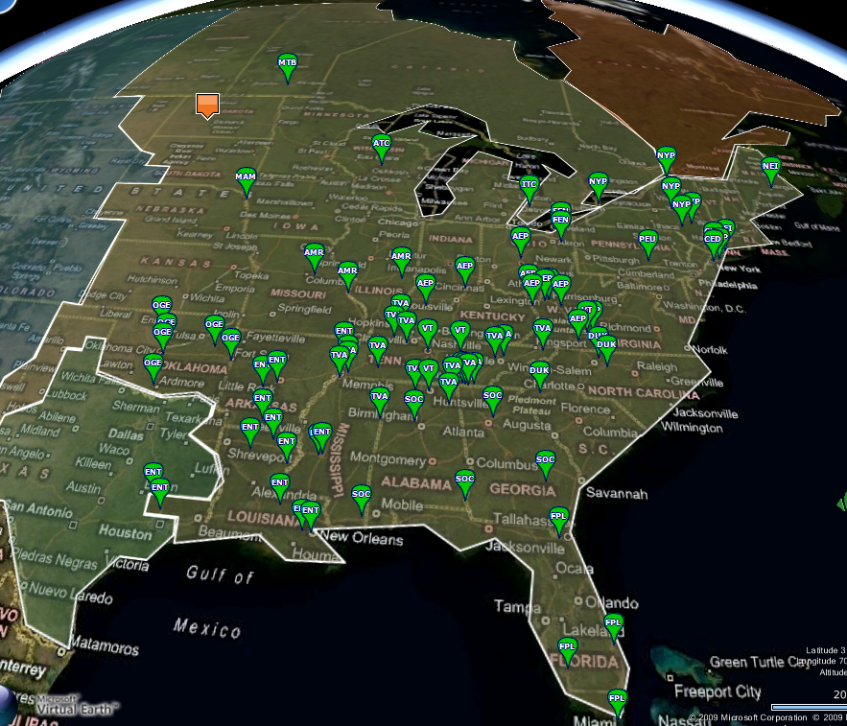
NERC Sensor Data Collection
openPDC PMU Data Collection circa 2009
120 Sensors
30 samples/second
4.3B Samples/day
Housed in Hadoop
Notes:
Let’s set the stage in the context of story, why we were looking at big data for time series.

Slide 7
Story Time: Keogh, SAX, and the openPDC
NERC wanted high res smart grid data tracked
Started openPDC project @ TVA
http://openpdc.codeplex.com/
We used Hadoop to store and process time series data
https://openpdc.svn.codeplex.com/svn/Hadoop/Current%20Version/
Needed to find “unbounded oscillations”
Time series unwieldy to work with at scale
We found “SAX” by Keogh and his folks for dealing with time series
Notes:
Ok, so how did we get to this point?
Older SCADA systems take 1 data point per 2-4 seconds --- PMUs --- 30 times a sec, 120 PMUs, Growing by 10x factor

Slide 8
What is time series data?
Time series data is defined as a sequence of data points measured typically at successive times spaced at uniform time intervals
Examples in finance
daily adjusted close price of a stock at the NYSE
Example in Sensors / Signal Processing / Smart Grid
sensor readings on a power grid occurring 30 times a second.
For more reference on time series data
http://www.cloudera.com/blog/2011/03/simple-moving-average-secondary-sort-and-mapreduce-part-1/

Slide 9
Why Hadoop is Great for the OpenPDC
Scenario
1 million sensors, collecting sample / 5 min
5 year retention policy
Storage needs of 15 TB
Processing
Single Machine: 15TB takes 2.2 DAYS to scan
Hadoop @ 20 nodes: Same task takes 11 Minutes
Notes:
So, I don’t have a smartgrid, how does this apply to me?

Slide 10
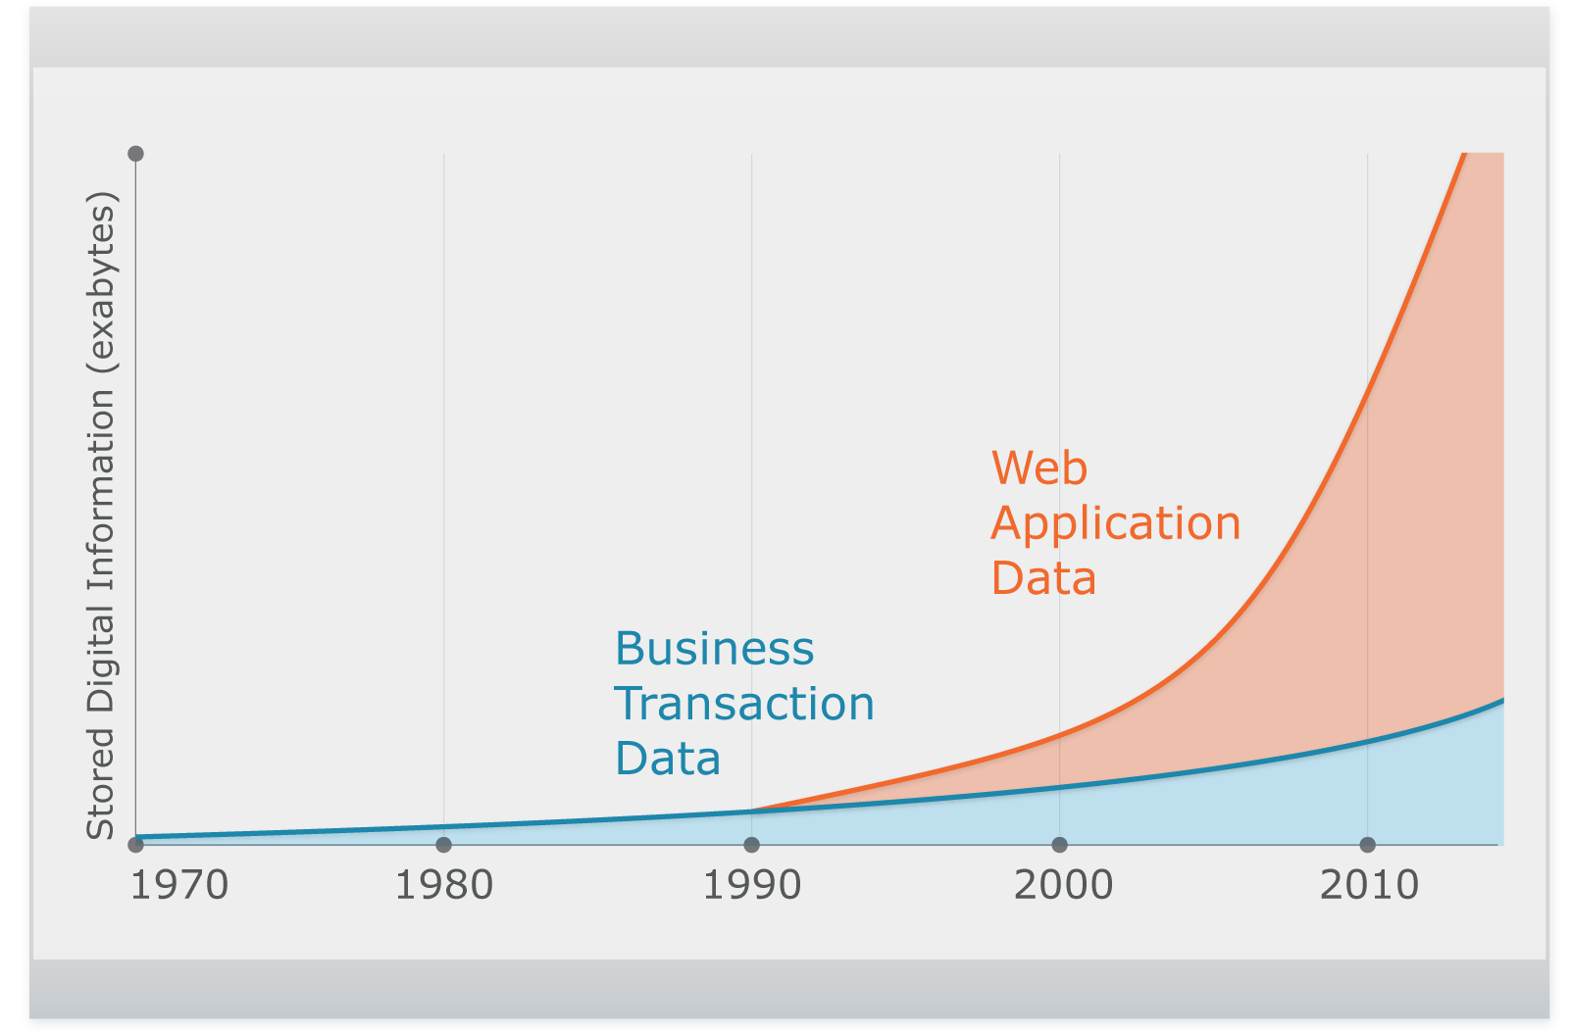

Unstructured Data Explosion
(you)
Complex, Unstructured
Relational
2,500 exabytes of new information in 2012 with Internet as primary driver
Digital universe grew by 62% last year to 800K petabytes and will grow to 1.2 “zettabytes” this year
Notes:
Ben Black wasn’t kidding when he said time series was growing fast

Slide 11

Apache Hadoop
Open Source Distributed Storage and Processing Engine
Consolidates Mixed Data
Move complex and relational data into a single repository
Stores Inexpensively
Keep raw data always available
Use industry standard hardware
Processes at the Source
Eliminate ETL bottlenecks
Mine data first, govern later
MapReduce
Hadoop Distributed File System (HDFS)

Slide 12

What about this HBase stuff?
In the beginning, there was the GFS and the MapReduce
And it was Good
(Then they realized they needed low latency stuff)
And thus BigTable was born, which begat…
HBase: BigTable-like storage for Hadoop
Open source
Distributed
Versioned
Column-family oriented
HBase leverages HDFS as BigTable leveraged GFS
Notes:
Stealing line from Omer’s Hbase deck
---- now recap the story we’ve told, and tease into “SAX”

Slide 13
iSAX and Time Series Data
Notes:
Ok, so we’ve set the stage as to why time series data at scale is interesting to me
Now let’s talk about some ways to deal with time series data with SAX and iSAX

Slide 14
What is SAX?
Symbolic Aggregate ApproXimation
In this case, not XML.
A symbolic representation of times series with some unique properties
Essentially a low pass filter
Lower bounding of Euclidean distance
Lower bounding of the DTW distance
Dimensionality Reduction
Numerosity Reduction
Notes:
Whats interesting about symbolic reps?
Hashing
Suffix Trees
Markov Models
Stealing ideas from text processing/ bioinformatics community
It allows us to get a better “handle” on time series data
Since time series data can be very unwieldy in its “natural habitat”
So, SAX? Whats interesting about that? What is it?
While there are more than 200 different symbolic or discrete ways to approximate time series, none except SAX allows lower bounding
Lower bounding means the estimated distance in the reduced space is always less than or equal to the distance in the original space.

Slide 15
SAX in 60 Seconds
Take time series T
Convert to Piecewise Aggregate Approximation (PAA)
Reduces dimensionality of time series T
Then Take PAA representation of T and discretize it into a small alphabet of symbols
Symbols have a cardinality of a, or “number of values they could possibly represent”.
We discretize by taking each PAA symbol and finding which horizontally predefined breakpoint the value falls in
This gives us the SAX letter
This complete process converts a time series T into a “SAX word”
Notes:
Dimensionality in this context means: “number of letters or numbers in the sequence ( {1, 2, 3, 4 } vs { 1.5, 3.5 } )
Example: cardinality 2 == { a, b }

Slide 16
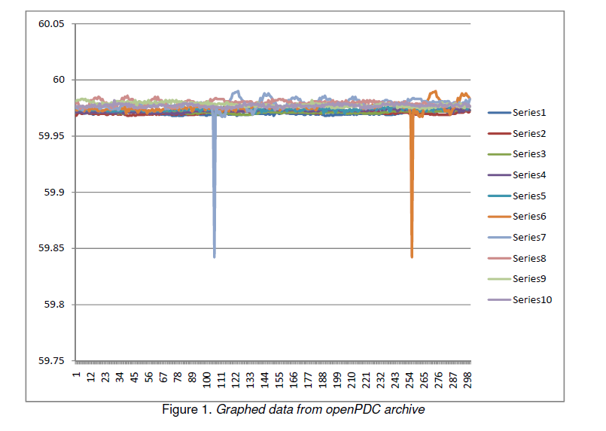
Why? Time Series Data is “Fuzzy”

Slide 17
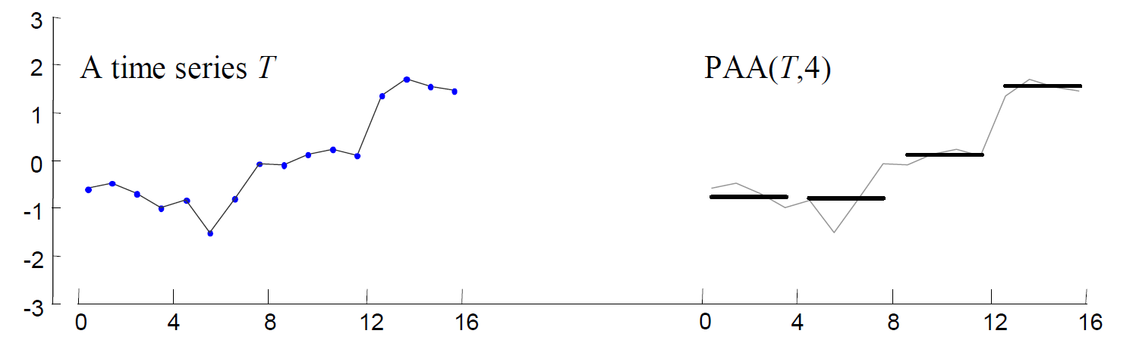
SAX: Fuzzy Things Become More Discrete

Slide 18
How does SAX work?
First convert the time series to PAA representation
Then convert the PAA to symbols to SAX letters:
baabccbc
0
0
20
40
60
80
100
120
c
1.5
1.5
c
1
c
1
b
0.5
0.5
b
b
0
0
-
-
0.5
0.5
(It takes linear time)
a
-
-
1
1
a
-
-
1.5
1.5
0
0
20
40
60
80
100
120
Slide Inspired by: http://www.cs.ucr.edu/~eamonn/SIGKDD_2007.ppt
Notes:
We make two parameter choices:
“word size”, which is number of letters in the SAX “word”
“alphabet size” which is the number of letters we use, or cardinality

Slide 19
SAX and the Potential for Indexing
The classic SAX representation offers the potential to be indexed
If we choose a fixed cardinality of 8, a word length of 4, we end up with 8⁴ (4,096) possible buckets to put time series in
We could convert a query sequence into a SAX word, and check that “bucket” represented by that word for approximate search as the entries in that bucket are likely very good
Exact search would require looking through multiple buckets using lower bounding
Data skew presents a problem here
Lot’s of data in one bucket means lots of scanning!
Notes:
iSAX offers a bit aware, quantitized, reduced representation with variable granularity
We could potentially have to search through up to 20% of the data in a single file due to data skew, and/or deal with empty files
- If we have to look at 20% of the data in a lot of queries, we can be at most 5 times faster than complete sequential scan!

Slide 20
iSAX
iSAX: indexable Symbolic Aggregate approXimation
Modifies SAX to allow “extensible hashing” and a multi-resolution representation
Allows for both fast exact search
And ultra fast approximate search
Multi-resolution property allows us to index time series with zero overlap at leaf nodes
Unlike R-trees and other spatial access methods
Notes:
iSAX was developed for indexing SAX
allows for a multi resolution representation
similar to extensible hashing
very fast approximate search

Slide 21
iSAX Word Properties
Key concepts
We can compare iSAX words of different cardinalities
We can mix cardinalities per symbol in an iSAX word
To compare two iSAX words of differing cardinalities
We represent each symbol as the bits of its integer
Examples
Cardinality == 4, “1” as 01, “2” as 10 (4 characters, 0-3 integers)
Cardinality == 8, “1” as 001, “2” as 010
The trick is, when we “promote” a symbol to a higher cardinality, we add bits to its representation
iSAX Symbol
iSAX word:
{ 4⁸ , 3⁴ , 3⁴ , 2⁴ }
iSAX word in binary:
{ 100, 11, 11, 10 }
Notes:
A “word” in this context means the letters or symbols representing a time series in SAX / iSAX form
Key concepts (comparison of different cardinalities, mixed cardinalities inside a word)
Now each symbol can have its own cardinality
With iSAX, instead of letters we use numbers, and sometimes we use the bit representation of the numbers
Bit representations? What?
When we increase the resolution we add bits to that dimension, or symbol of the word
Individual symbol promotion is a key part of iSAX and directly supports the dynamic cardinality property

Slide 22
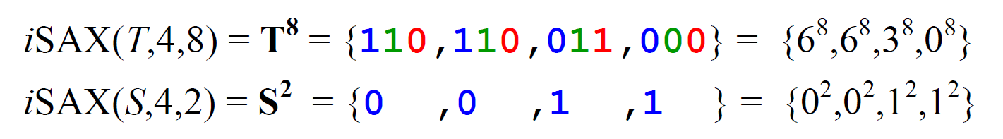


iSAX Dynamic Cardinality
T = time series 1
S = time series 2
(S fully promoted)
Notes:
If we want to compare two isax words of differing card, we have to promote the lesser to the higher card
Comparison here means a measure of similarity, a distance function
How do we promote cardinality? Remember the part about bit representation?
If the firsts bits of S form a prefix, we use the rest of the bits of T
If the first bits of S for that position is less than T, we use ‘1’ for the rest of the positions
If the first bits of S for that position are greater than T, we use ‘0’ for the rest…

Slide 23
How Does iSAX Indexing Work?
Similar to a b-tree
Nodes represents iSAX words
Has internal nodes and leaf nodes
Leaf nodes fill up with items to a threshold
Once full, a leaf node “splits”
Each time series sequence to be inserted is converted to a iSAX word
As we drop down levels in the tree with iSAX-”rehashes”
Notes:
Becomes a parent/internal node
Now has two child nodes
All nodes in old leaf node are re-hashed into 1 of the 2 new child nodes
Block2:
At each node as it traverses the tree
Is converted to a iSAX word based on the params of that node
Block3:
Index grows more “bushy” as more items inserted Our hashes actually gain “resolution” with more information
This property allows us to continually subdivide the search space

Slide 24
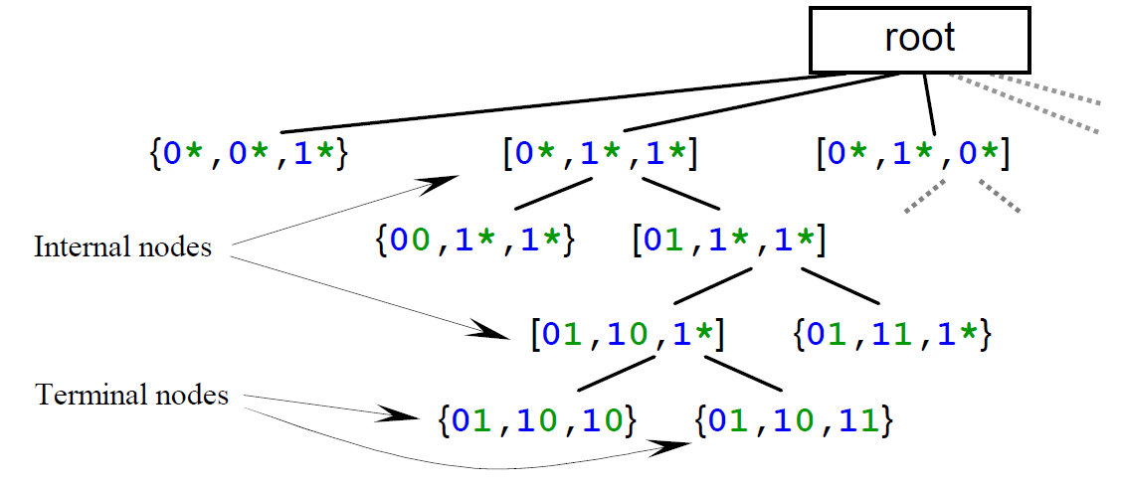
iSAX Indexing, Inserting, and Searching
Split Mechanics
{ 2⁴ , 3⁴ , 3⁴ , 2⁴ }
The value “2” at cardinality 4 is “10” in bits
If we split this dimension, we add a bit
“10” becomes “100” (4) and “101” (5)
we’re now at cardinality of 8
{ 4⁸ , 3⁴ , 3⁴ , 2⁴ }
{ 5⁸ , 3⁴ , 3⁴ , 2⁴ }
Notes:
Again, takes inspiration from btrees and extensible hashing
The framework converts each time series into an iSAX word before it inserts or searches
Index is constructed with
Given base card: b
Word len: w
Threshold: th
Index hierarchically subdivides the SAX space, dividing regions further as we insert more items
Notice the dimensions being split (on individual symbols in the “words”) as we move down the tree
If you’ll notice, we can see the split mechanics illustrated near the bottom

Slide 25
Some Quick Numbers From the iSAX Paper
100 million samples indexed, ½ TB of time series data
Times
linear scan: 1800 minutes
exact iSAX search 90 minutes
Approx iSAX search: 1.1 sec
Quality of results
avg rank of NN: 8th
The bottom line
we only have to look @ 0.001% of the data
To find a great quality result in the top .0001% (NN)
Notes:
Whats perfect accuracy worth to you?

Slide 26
SAX, iSAX, and jmotif
Both SAX and iSAX are implemented in the jmotif project
Senin Pavel did the original SAX implementation
Josh Patterson added the iSAX implementation
(Exact search currently is not complete in iSAX)
Check it out for yourself
http://code.google.com/p/jmotif/

Slide 27
What if our Data was … Large?
And we indexed … a lot of data
(And the index got large?)
iSAX Indexes actually store the sequence sample data
This ends up taking potentially a lot of space
NoSQL gets a bit interesting here
Needed fast GETs and PUTs for index nodes
HBase started to look attractive
Notes:
Sparky was a nice experiment, so I knew this Hbase stuff was good

Slide 28
HBase Strengths
High write throughput
Horizontal scalability
Auto failover
HDFS Benefits
With denormalized design, we can lay in any arbitrary computation
SQL is not Turing complete

Slide 29
Lumberyard: iSAX Indexing and HBase
Jmotif implements the core logic for iSAX
Lumberyard takes this logic, and implements a storage backend
We persist the nodes to rows in Hbase
Our potential index size now scales up into the Terabytes
We can now leverage Hbase’s properties in the storage tier
Queries scan a few rows for approximate search
An ancestor project to Lumberyard was called “Sparky”
Indexed on content of files in HDFS (sensor / time range)
https://openpdc.svn.codeplex.com/svn/Hadoop/Current%20Version/Sparky/
Notes:
Contributions of this project are twofold
Implementation of the iSAX indexing algorithms in jmotif
Addition of Hbase as the backend to iSAX indexes and jmotif

Slide 30
Use Cases and Applications
Notes:
So you are saying “that’s great, but I don’t happen to have a smart grid at home…”

Slide 31
How You Would Use iSAX and Lumberyard
For fast fuzzy query lookups that don’t need a perfect best match
Just a really good match (fast)
(We’ll fix that exact search thing soon. Promise.)

Slide 32
Sensor Data and the openPDC
Needed to find “unbounded oscillations” in PMU (Smartgrid) Data
TB’s of data stored in Hadoop
MapReduce has an interesting property:
Sorts numbers really fast via the “shuffle” process
Also: my data was not sorted
Check out the project
http://openpdc.codeplex.com/
https://openpdc.svn.codeplex.com/svn/Hadoop/Current%20Version/
We used SAX and a spatial tree to create a 1NN classifier to detect signal patterns
iSAX and Lumberyard allow for faster lookups
Notes:
Mention GE and Turbine data

Slide 33
Genome Data as Time Series
A, C, G, and T
Could be thought of as “1, 2, 3, and 4”!
If we have sequence X, what is the “closest” subsequence in a genome that is most like it?
Doesn’t have to be an exact match!
Useful in proteomics as well
1.5
1.5
A
1
1
C
0.5
0.5
0
G
0
-
-
0.5
0.5
T
-
-
1
1
-
-
1.5
1.5
0
0
20
40
60
80
100
120
Notes:
On Monday Steve from google talked about working with genomic data --- genomic data is time series
Our take home demo actually works with a small bit of genomic data
Lots of chatter @ oscon about genomics, I just sat in one today

Slide 34
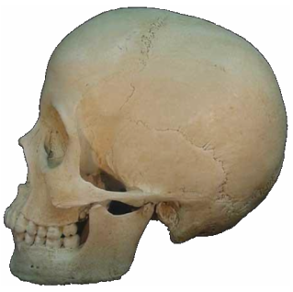
Images…as Time Series?
Convert shapes to 1D signals
Rotation and scale invariant
We deal with rotation in algo
0
200
400
600
800
1000
1200
Notes:
Find outline of image (can be tricky, can be done)
Convery shape to 1d signal, time series form
Index with sax
Use various string based tools now

Slide 35
Other fun Ideas
Use Flumebase and Lumberyard together
http://www.flumebase.org/
Could provide different query mechanics
Use OpenTSDB with Lumberyard
OpenTSB for raw data: http://opentsdb.net/
Lumberyard for fuzzy pattern matching
Image Pattern Matching
Imaging could be interesting. Someone needs to write the plugin. (Contact me if interested).
Use Lumberyard as a 1NN Classifier
Check out “Fast time series classification using numerosity reduction” [4]

Slide 36
Areas to Improve
SerDe mechanics
Finish
kNN Search
Exact Search
MapReduce parallel Index construction
Lots more testing
More plugins to decompose data into time series form
Image plugin would be interesting
Performance

Slide 37
Try it Yourself at Home
Download Lumberyard from github
https://github.com/jpatanooga/Lumberyard
Build and Install on Single Machine
Build with Ant
Setup a few dependencies (Hadoop, Hbase, jmotif)
Run genomic example: “Genome Data as Time Series”
Search for patterns in some sample genome data

Slide 38
Lumberyard Summary
Low latency queries
on a lot of time series data
Experimental, yet has some interesting applications
Backed by HBase
Open source ASF 2.0 Licensed

Slide 39
Questions?
(Thank you for your time)

Slide 40
Appendix A: Resources
Lumberyard
https://github.com/jpatanooga
Cloudera
http://www.cloudera.com/blog
http://wiki.cloudera.com/
http://www.cloudera.com/blog/2011/03/simple-moving-average-secondary-sort-and-mapreduce-part-1/
Hadoop
http://hadoop.apache.org/
HBase
http://hbase.apache.org/
SAX
Homepage
http://www.cs.ucr.edu/~eamonn/SAX.htm
Presentation
http://www.cs.ucr.edu/~eamonn/SIGKDD_2007.ppt
OpenPDC
http://openpdc.codeplex.com/
https://openpdc.svn.codeplex.com/svn/Hadoop/Current%20Version/
The jmotif project provides some support classes for Lumberyard:
http://code.google.com/p/jmotif/

Slide 41
References
SAX
http://www.cs.ucr.edu/~eamonn/SAX.htm
iSAX
http://www.cs.ucr.edu/~eamonn/iSAX.pdf
OpenPDC
http://openpdc.codeplex.com/
Xiaopeng Xi , Eamonn Keogh , Christian Shelton , Li Wei , Chotirat Ann Ratanamahatana, Fast time series classification using numerosity reduction, Proceedings of the 23rd international conference on Machine learning, p.1033-1040, June 25-29, 2006, Pittsburgh, Pennsylvania

