Slide 1
gatpkg: Developing a geographic aggregation tool in R for non-programmers
Abigail Stamm
New York State Department of Health
July 2021
Notes:
The NYS Department of Health developed the geographic aggregation tool (or GAT) as a way for anyone, irrespective of coding skills, to combine small geographic areas.
Citation (as of June 2021):
Abigail Stamm and Gwen Babcock (2021). gatpkg: Geographic Aggregation Tool (GAT). R package version 1.61.0.

Slide 2
GAT: what and why
Package development
  User dialogs and options
  Vignettes
  Function examples
Outline
Notes:
I’ll provide a brief overview of what GAT is and why we created it. Then I will focus on strategies we used when developing GAT to reduce the need for users to know R. I’ll speak from a public health perspective, but GAT can aggregate any geographic polygons by any numeric value, such as land area or species counts.

Slide 3
Why create GAT?
Need: Identify high risk areas
  Issues:
  Smoothing/masking (county)
  Small numbers (tract, town)
  Solution: Aggregation
Notes:
Why create GAT?
Regional data can mask variation, especially in regions with a mix of urban and rural populations. However, town-level data may be unstable due to very small populations. We aggregated census tracts for our project both to combine smaller towns and to create smaller areas within large cities.

Slide 4
GAT’s objective
Aggregate small areas to:
  Meet minimum counts
  Standardize process
Be as user friendly as possible
Notes:
GAT’s objective:
We developed GAT to standardize our aggregation. GAT combines areas with small counts until those counts meet the user’s minimum desired value. Since many public health workers are not computer programmers, we developed GAT to be accessible to non-programmers. I’ll cover a few of the strategies that we used.

Slide 5
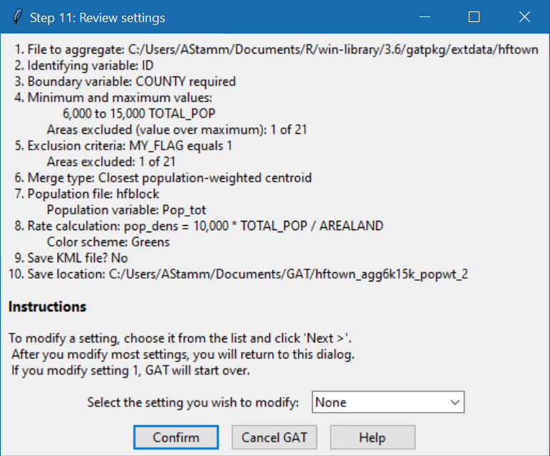
User dialogs
Shapefile
Minimum and maximum values
Boundaries
Exclusions
Aggregation method
Notes:
User dialogs:
We developed a series of dialogs to walk the user through GAT’s basic options using the packages tcltk and tcltk2. In the confirmation dialog shown, the user verifies all selections. The drop-down list at the bottom allows the user to return to a previous step, correct their selection, and jump seamlessly back to this dialog. Since this dialog shows all basic settings that the user selected, someone could replicate results just from this image and the user’s function call.

Slide 6
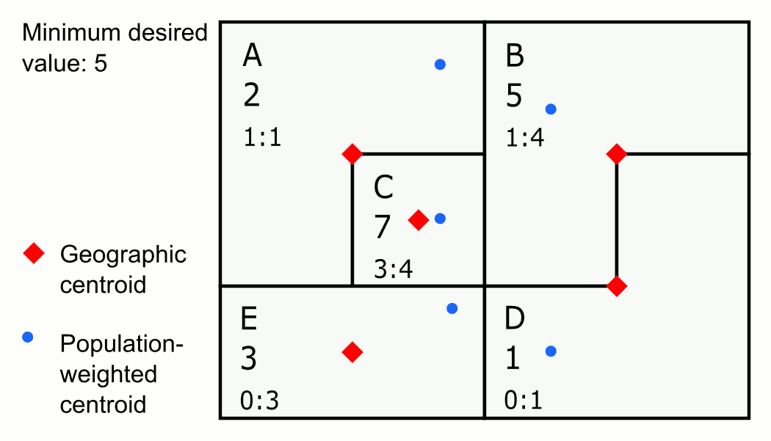
Preparing for aggregation
Notes:
Preparing for aggregation:
GAT begins with the area with the highest count below the minimum desired value and selects the area to merge first based on the aggregation method chosen. For this illustration, we will aggregate to the closest geographic centroid.

Slide 7
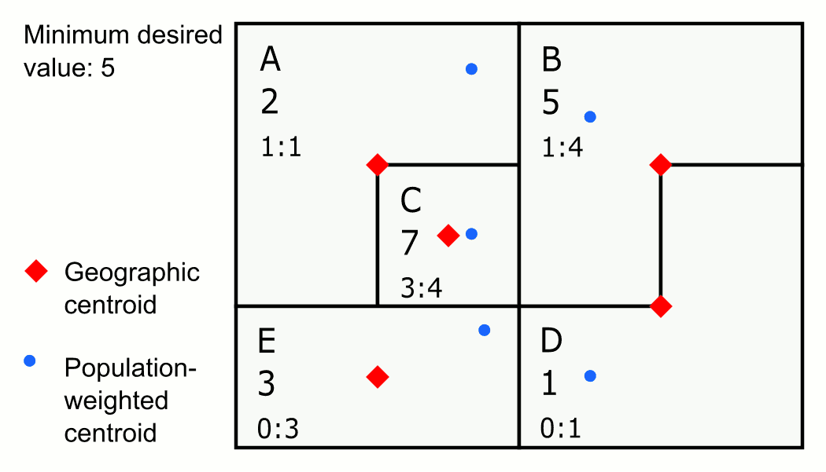
How GAT aggregates
Notes:
How GAT aggregates:
Here, the minimum desired value is 5. The area with the highest value below 5 is E. GAT evaluates E’s neighbors and determines the closest area is C, so GAT joins E to C. Aggregation continues until all areas contain values of at least 5.

Slide 8
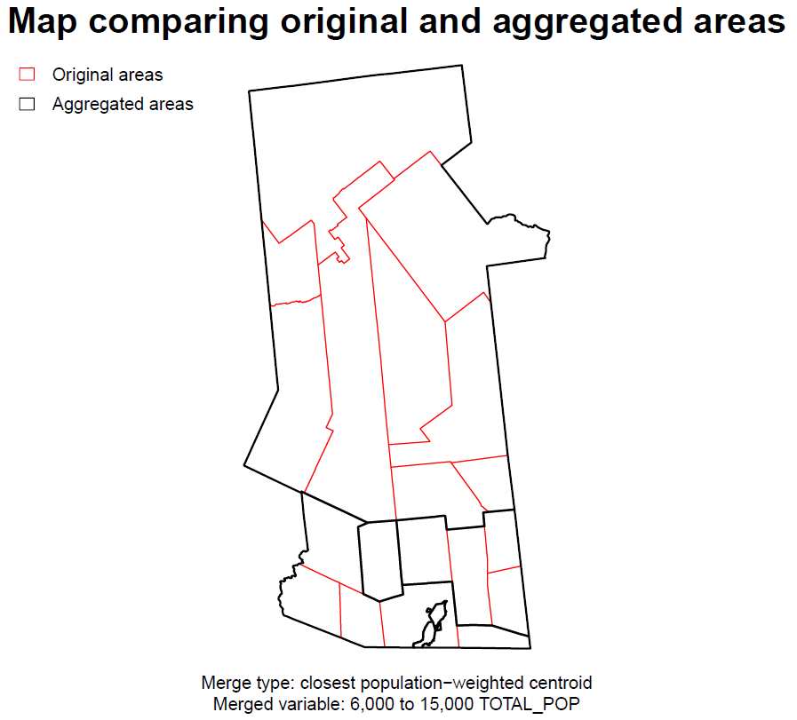
GAT’s process
Request user inputs
Run aggregation
Output shapefiles and documentation
Notes:
GAT’s process:
GAT generates several maps, including the one shown, which it writes to a PDF. GAT also writes a log of the entire process, a settings file, and on request, a KML file. The PDF, settings file, and log are designed to help the user evaluate and report aggregation results. Last, GAT saves two shapefiles, a shapefile of aggregated areas and a crosswalk shapefile that adds aggregated area IDs as a new variable to the original shapefile.

Slide 9
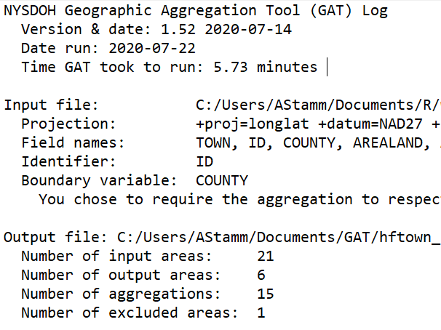
Reproducibility: Log
Notes:
Reproducibility: Log
The log contains information about GAT’s run, the input shapefile, merge settings, and aggregation variables. The log helps users to:
remember what settings they used six months later
identify areas that may not have aggregated correctly
read the output shapefile into another GIS program

Slide 10
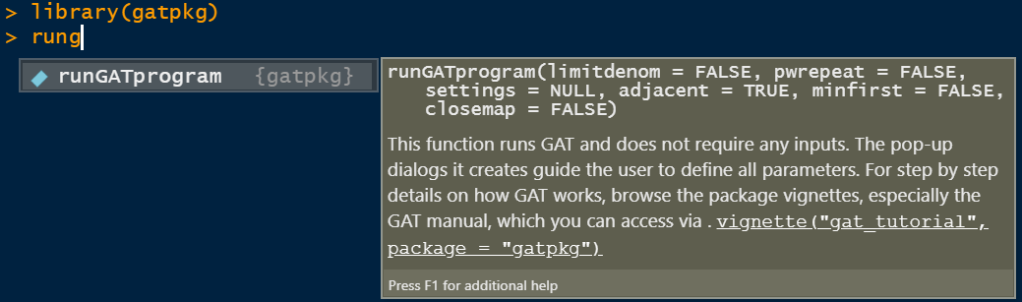
Advanced options
Notes:
Advanced options:
The function to run GAT is aptly named runGATprogram. These options were placed here instead of the dialogs for two reasons.
Defaults for these options are what we most commonly use.
These options are complicated to explain.
We felt that we could cover them more clearly in the technical notes and other documentation than in the brief dialog instructions.

Slide 11
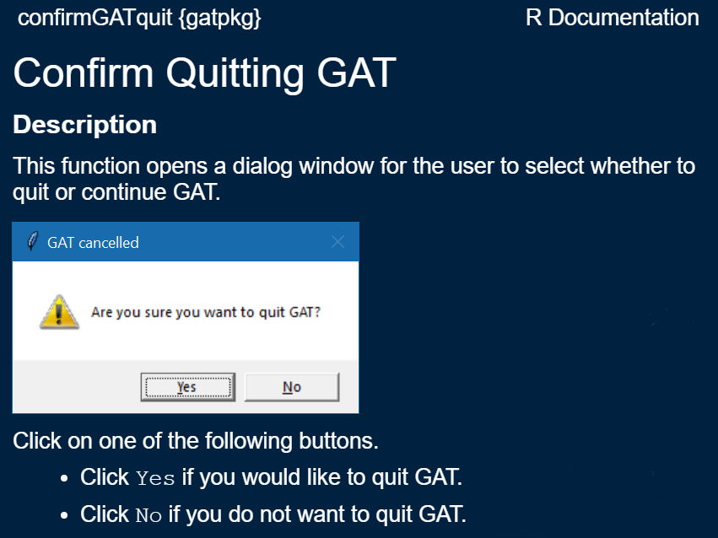
Accessibility: function help
Notes:
Accessibility: function help
This example shows the simplest dialog in GAT. All dialogs and maps are drawn using functions that standardize their appearance. Because GAT relies heavily on dialogs, we included images of those dialogs in both the help functions and the vignettes. Help buttons in most dialogs can send users to relevant help files in case they do not know how to access help via the console.

Slide 12
Accessibility: vignettes
Readable
Relevant
Easy to navigate
Self-contained
Notes:
Accessibility: vignettes
We have developed eight vignettes in three general categories: package information, technical notes, and using GAT. The vignettes on using GAT are designed for users with little to no prior knowledge of R. They include:
How to structure the shapefile to be read into GAT based on what the user plans to do
A step-by-step tutorial of using GAT with an embedded shapefile
How to identify areas that may not have merged correctly so the user can evaluate them separately
The tutorial includes links to other vignettes and help documentation for the relevant functions, so an advanced user who wants to customize GAT will know where to start.

Slide 13
Takeaways
Ways to increase accessibility
Dialog boxes
Scaled documentation
Detailed examples
Notes:
Takeaways:
At all stages of development, we asked how to tailor an R tool for people who do not regularly use R. We wrote dialog boxes to nearly eliminate the need to write code, documentation that catered to people with a range of R knowledge, and examples that detailed the necessary function inputs and could be run using only the resources bundled in GAT and the packages it requires.

Slide 14
Acknowledgements
CDC for funding
Gwen LaSelva for code and testing
NYS DOH EPHT team for testing and feedback
GAT online: https://github.com/ajstamm/gatpkg
or email me at abigail.stamm@health.ny.gov
Notes:
I acknowledge GAT coauthor Gwen LaSelva, the CDC, and the many people who have tested and provided feedback during GAT’s development. If you are interested in using GAT, please visit the GitHub link provided or email me.

