Slide 1
How do you adopt Open and Reproducible Research Practices?
Dr Andrew J. Stewart
E: drandrewjstewart@gmail.com
T: @ajstewart_lang
G: ajstewartlang

Slide 2
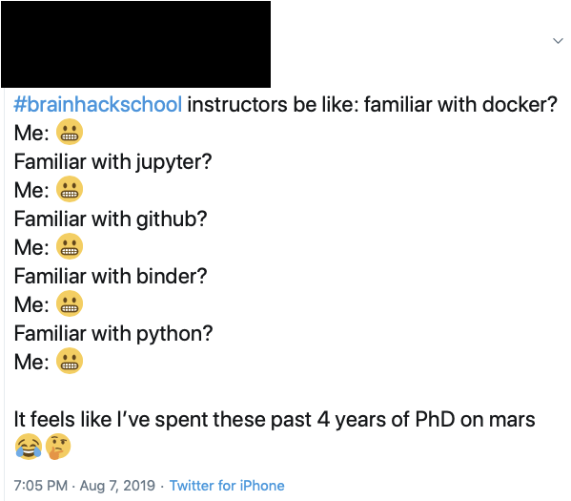
The world of research is rapidly changing...

Slide 3
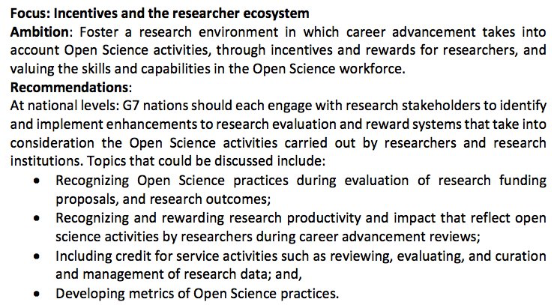
Open Research is recognised by the G7...

Slide 4
...by the REF...
200. The sub-panels welcome research practice that supports reproducible science and the application of best practice. Examples include registered reports, pre-registration, publication of data sets, experimental materials, analytic code, and use of reporting checklists for publication purposes and those relating to the use of animals in research. These contribute to the evaluation of rigour for submitted outputs. Replication studies may be submitted as outputs and will be evaluated on the extent to which they contribute significant new knowledge, improved methods, or advance theory or practice.
346...
Within the context of the institution’s strategy, how the submitting unit is progressing towards an open research environment, including where this goes above and beyond the REF open access policy requirements, and wider activity to encourage the effective sharing and management of research data, as appropriate to the discipline. Consideration of reproducibility should also be included where relevant to the discipline.

Slide 5
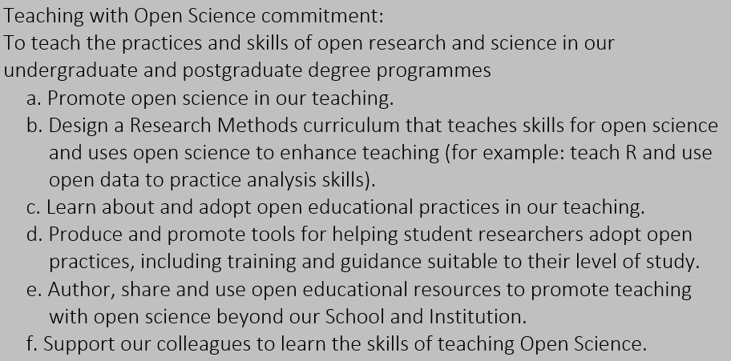
...is forming part of University’s teaching manifestos...

Slide 6
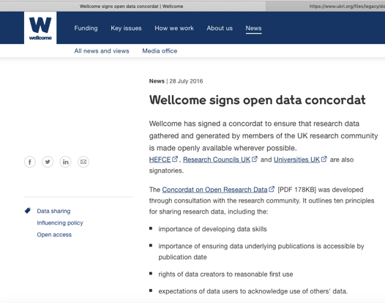
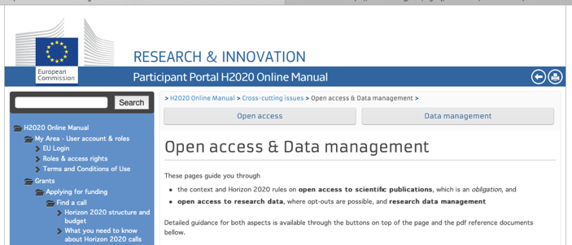
...and is required by many funders.

Slide 7
There are many aspects to Open Research...
Including pre-registering of studies before you start data collection, reproducible data wrangling and analysis, open data, open code, open publications, and community science involving diversity and inclusivity.

Slide 8
Before data collection
Specify your hypotheses and analysis plan.
Pre-register your hypotheses and analysis plan at osf.io
Consider data simulation so that you can write your analysis script before you have your real data.
Consider submitting as a registered report - currently more than 200 journals now support this route. This involves acceptance in principle before you have even started collecting your data - so you are guaranteed a publication regardless of what you find.

Slide 9

Registered Reports
https://www.cos.io/rr

Slide 10
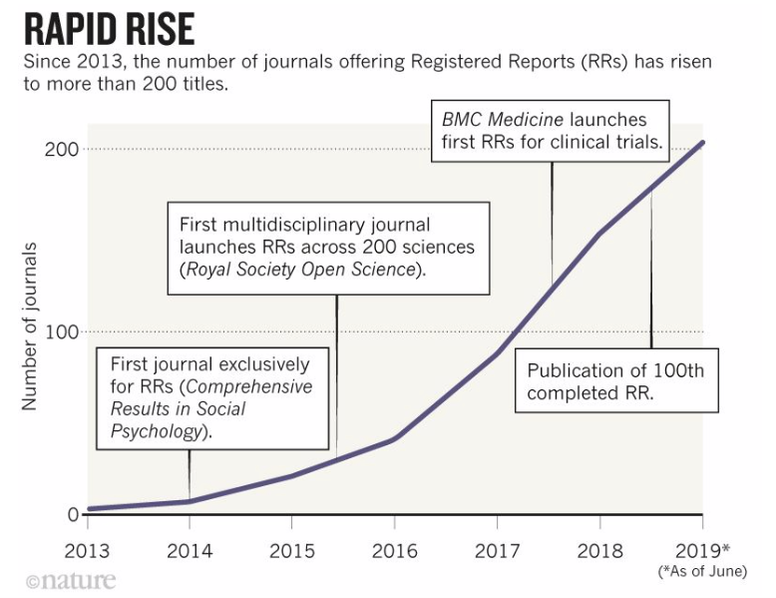
https://www.nature.com/articles/d41586-019-02674-6

Slide 11
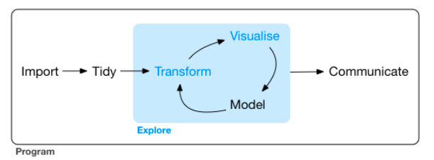
After data collection
You need to use analysis software that allows for open sharing and reproducibility of the entire data wrangling/analysis/write-up workflow.
Hadley Wickham and Garrett Grolemund, R4DS

Slide 12
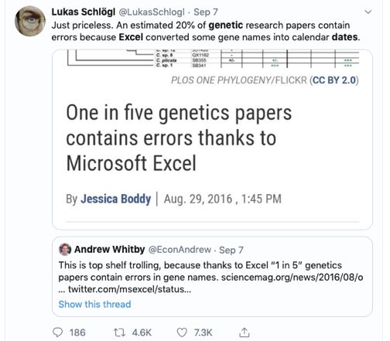
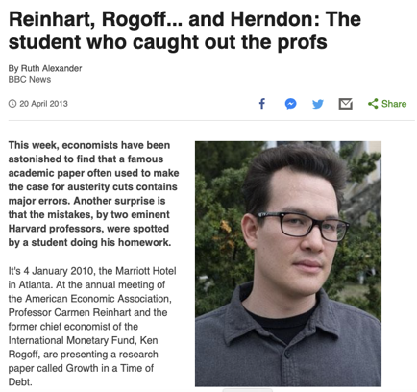

Slide 13
Codifying your Analysis Workflow
You can’t use proprietary (closed) software like SPSS, GraphPad, MATLAB etc.
You need to use open source analysis software such as R, Octave or Python.
You need to think about your entire analysis pipeline from data importing, data wrangling, visualisation, statistical modelling, and report generation.
Scripts are fine for small tasks but what about the multiple tasks needed in a research project? How do you connect them together so the entire workflow can be reproduced?
What happens when you want to share your workflow with colleagues elsewhere or in another lab (with a different infrastructure)?
"It worked on my machine!" - but it’s not good when it doesn't work on your collaborators' machines (or on your new machine!)

Slide 14
Adopt literate programming principles
Write analysis code that’s easy for others (and future you!) to understand - have lots of commenting - and break your code down into manageable chunks or separate scripts/functions controlled by a master script.
Later in this unit we’ll explore one example of literate programming using R Markdown where you can generate documents containing a blend of narrative, code, and output ‘knitted’ together (in lots of possible document formats - html, pdf, doc etc.)
The workshops in this unit are all written in R Markdown - you can even examine the source code behind each of these by looking at the .Rmd file in each workshop repository.

Slide 15
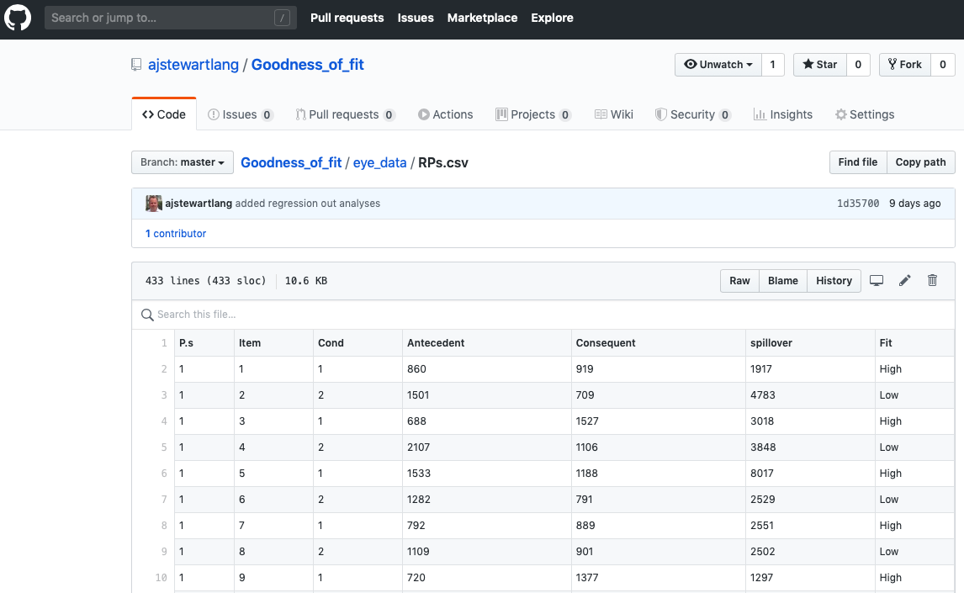

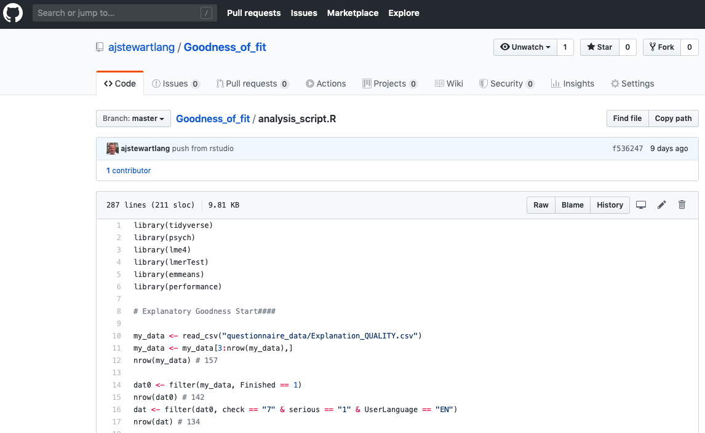
Sharing your data and code (and add a licence!)

Slide 16
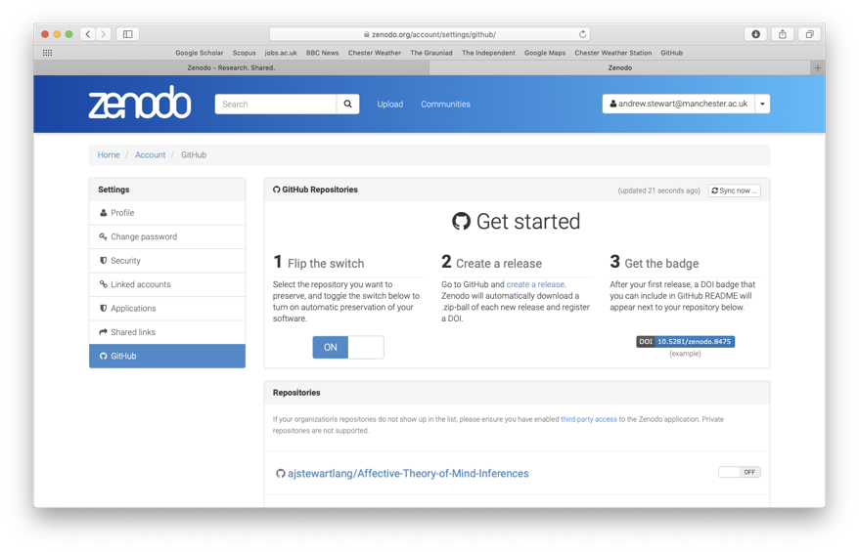
Make your data and code citeable - preserve it with a doi on Zenodo

Slide 17
Concordat on Open Research Data - Nine Principles
Open access to research data is an enabler of high quality research, a facilitator of innovation and safeguards good research practice.
There are sound reasons why the openness of research data may need to be restricted but any restrictions must be justified and justifiable.
Open access to research data carries a significant cost, which should be respected by all parties.
The right of the creators of research data to reasonable first use is recognised.
Use of others’ data should always conform to legal, ethical and regulatory frameworks including appropriate acknowledgement.
https://www.ukri.org/files/legacy/documents/concordatonopenresearchdata-pdf/

Slide 18
Concordat on Open Research Data - Nine Principles
Good data management is fundamental to all stages of the research process and should be established at the outset.
Data curation is vital to make data useful for others and for long-term preservation of data.
Data supporting publications should be accessible by the publication date and should be in a citeable form.
Support for the development of appropriate data skills is recognised as a responsibility for all stakeholders.
https://www.ukri.org/files/legacy/documents/concordatonopenresearchdata-pdf/

Slide 19
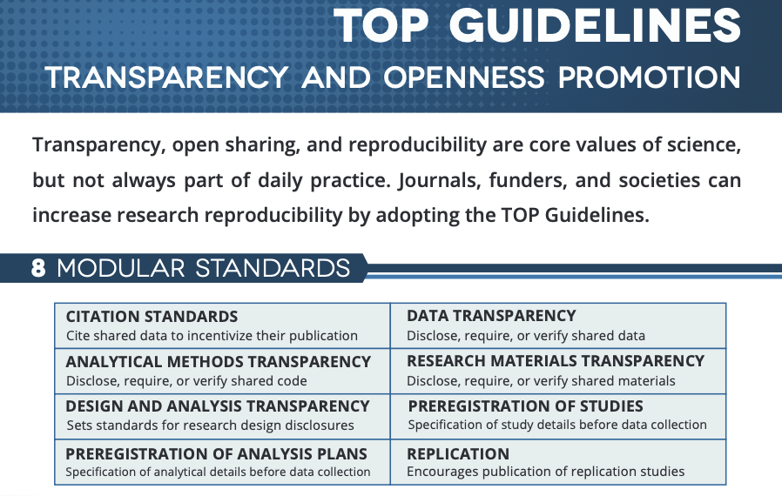

Slide 20
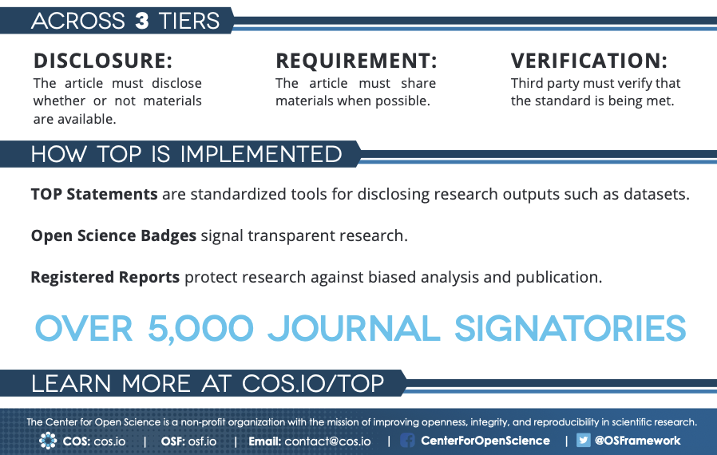

Slide 21
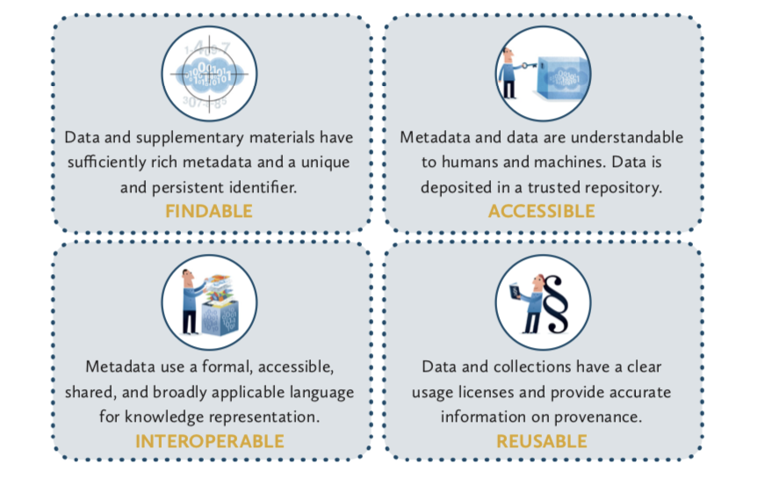
Your data need to be FAIR
https://libereurope.eu/wp-content/uploads/2017/12/LIBER-FAIR-Data.pdf

Slide 22
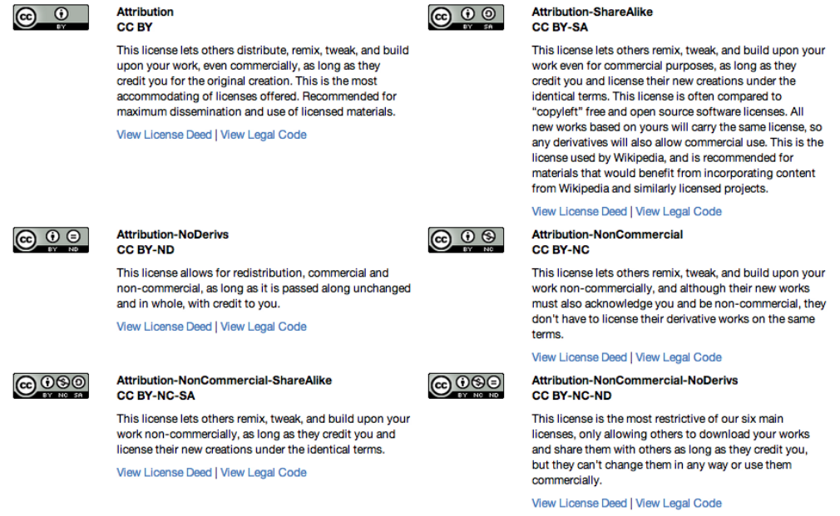
And you need to remember to add a license - such as CC BY

Slide 23
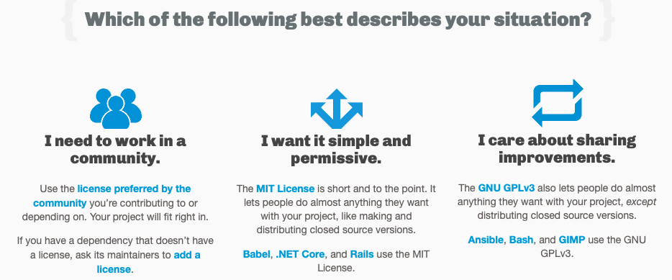
Choosing a License
https://choosealicense.com

Slide 24
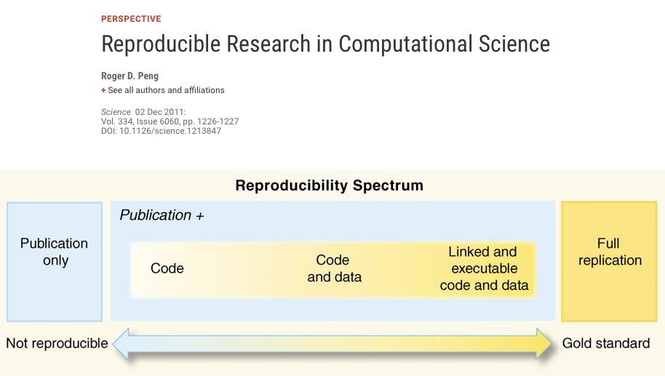

Slide 25
Why do we need to reproduce the computational environment?
Quite often analysis code ‘breaks’ - often in one of two ways:
Code that worked previously now doesn’t - maybe a function in an R package was updated (e.g., lsmeans became emmeans so old code using lsmeans wouldn’t now run).
Code that worked previously still works - but produces a slightly different result or now throws a warning where it didn’t previously (e.g., convergence/singular fit warnings in lme4 version 1.1-19 vs. version 1.1-20).
When R moved from version 3.5 to 3.6, the way in which random numbers were generated using the sample() function changed - so even with the same randomisation seed, different random numbers were produced.
Much Twitter confusion ensued!

Slide 26
Capturing your local computational environment
You need to capture the versions of your software packages (plus their dependencies incl. system-level ones).
This may sound trivial but trying running some old analysis code and be amazed at how many things now don’t work as they once did!

Slide 27
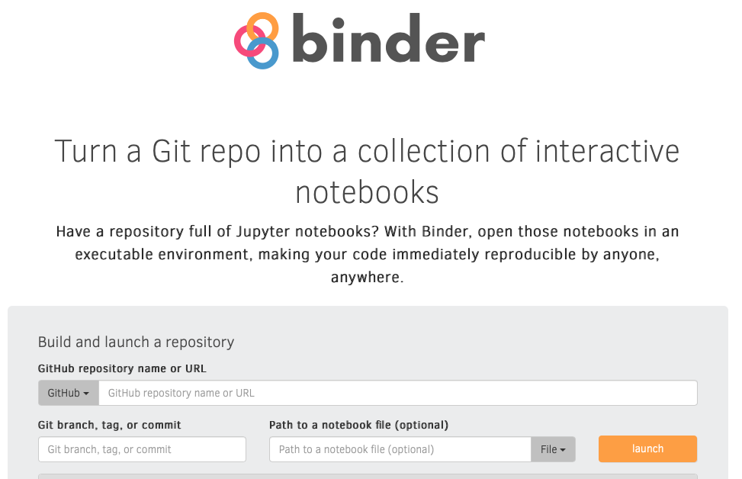
Binder to the rescue!

Slide 28
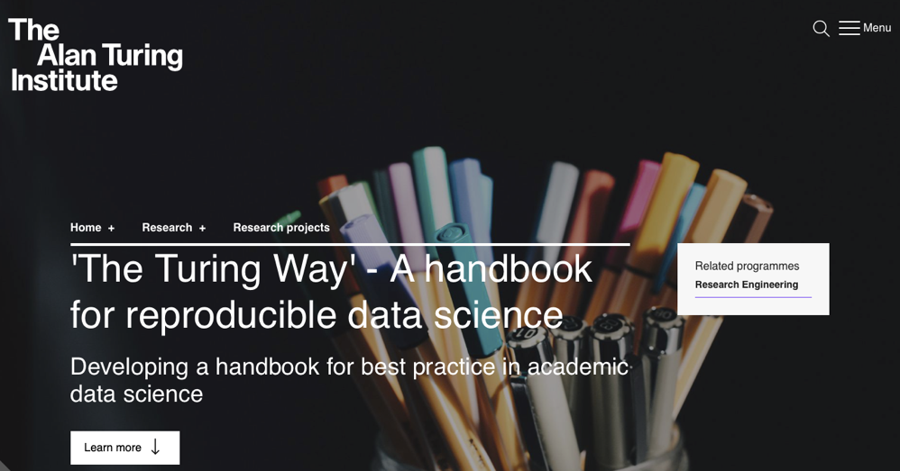
The Turing Way
https://www.turing.ac.uk/research/research-projects/turing-way-handbook-reproducible-data-science

Slide 29
Summary
Open data and open code are the future - remember to make your data FAIR and add a license to both your data and code.
Pre-registration allows you to capture your predictions - time-stamped at a point in time so when you come to write up your work you can use the pre-reg as evidence that you really did make your predictions before data collection commenced.
In many cases conducting research in a reproducible manner is easy - it requires a bit of planning and organisation up-front, but the pay-off is huge.
Not only will others be able to reproduce your results, but so will you at some future point in time.
Working in an open and reproducible manner also makes large-scale collaborations easier - with the extra computational skills that you acquire, you’ll be a more effective researcher.

