Slide 1
Writing Functions
Dr Andrew J. Stewart
E: drandrewjstewart@gmail.com
T: @ajstewart_lang
G: ajstewartlang

Slide 2
R is a functional language
This means that every command you type in R, is actually a call to a function. You have already used in-built functions like sum(), as well as functions from packages (e.g., the function summarise() from {dplyr}).
One of the powerful things about functional languages it that you can create your own functions that you can call with one command.
Very often, you’ll find yourself repeating the same chunk of code to complete a particular task (e.g., you might want to plot a bunch of visualisations for a large dataset where everything stays the same from one visualisation to the next, but maybe you have different variables on the x- and y-axis in each plot). If you’re using the same code over and over again, you probably want to turn that code into a function.

Slide 3
The basis of a function
There are three components to a function in R:
The body(), the code inside a function.
The formals(), the list of arguments that control how you call the function.
The environment(), the “map” of the location of a function’s variables.

Slide 4
Creating a new function
Let’s write a function that takes a number, and adds 5 to it.
add_five <- function(x) x + 5
So, we can then run the following line:
add_five(1)
We get the answer 6.

Slide 5
Creating a new function
We can examine the body, formals, and environment of the function we created as follows:
> body(add_five)
x + 5
> formals(add_five)
$x
> environment(add_five)
<environment: R_GlobalEnv>

Slide 6
Functions can call themselves
factorial_of_a_number <- function(x) {
if (x == 1) {
return(x)
} else {
return(x * factorial_of_a_number(x - 1))
}
}
> factorial_of_a_number(4)
[1] 24

Slide 7
A function to produce a plot...
my_plot_of_humans <- function(my_tibble, my_x, my_y, my_x_label, my_y_label) {
ggplot(data = filter(my_tibble, species == "Human" & !is.na(eval(my_y))),
aes(x = fct_reorder(eval(my_x), eval(my_y)), y = eval(my_y))) +
geom_point() +
coord_flip() +
labs(x = my_x_label, y = my_y_label) +
theme_minimal() +
theme(text = element_text(size = 5))
}
I’ve written the above function to work with the starwars dataset in the tidyverse that will display a visualisation of characters in the dataset that are human - as parameters the function takes a tibble, a variable for the x-axis, a variable for the y-axis, and labels for the x and y-axes. I can call this function to produce a plot of heights and names, mass and names etc.

Slide 8
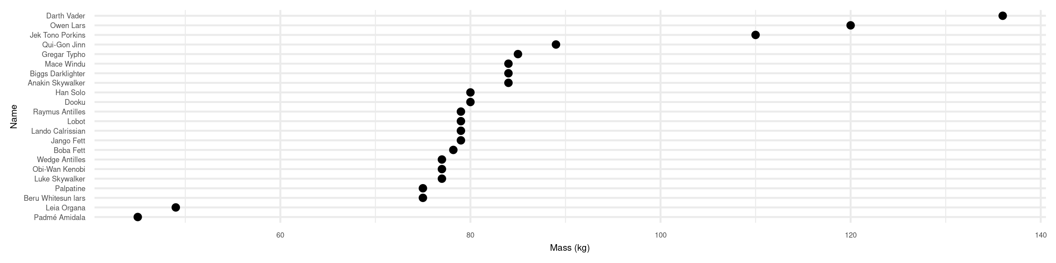
Calling the function to plot the mass variable
my_plot_of_humans(my_tibble = starwars,
my_x = quote(name),
my_y = quote(mass),
my_x_label = "Name",
my_y_label = "Mass (kg)")

Slide 9
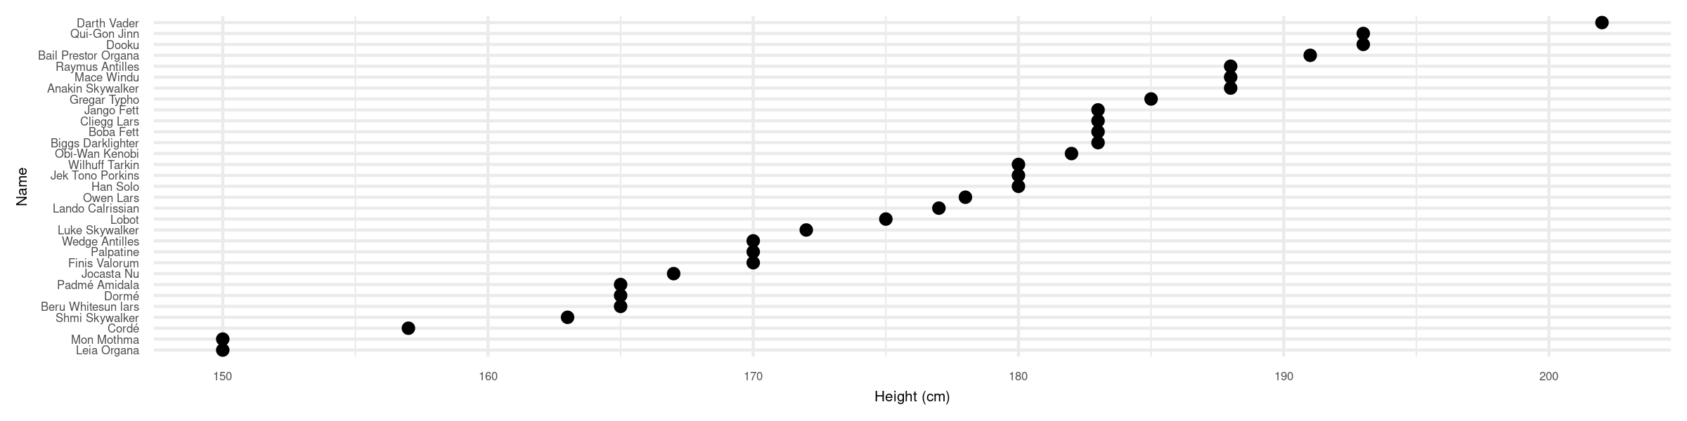
Calling the function to plot the height variable
my_plot_of_humans(my_tibble = starwars,
my_x = quote(name),
my_y = quote(height),
my_x_label = "Name",
my_y_label = "Height (cm)")

Slide 10
You could write your entire script as a set of functions
If you’re reading in data, tidying it, visualising it, modelling it, and conducting follow up analyses you could write your entire script as a set of functions - one function for each step (with the data as the first parameter in each function). You could save your script containing all your functions as my_functions.R
You can then write a new “master” script which contains the following:
source(“my_functions.R”)
read_in_data(location) %>%
tidy_my_data() %>%
visualise_my_data() %>%
model_my_data() %>%
follow_up_tests()

Slide 11
Purrr for functional programming
The purrr packages contains functions (such as map_df() and map()) which allow you to apply the same function over (e.g.) columns in a tibble, lists etc. For example, I create a function to square the values of a variable - and with map_df() I map this function over all columns in a tibble that are numeric:
square_the_values <- function(x) {
x <- x * x
}
starwars %>%
select_if(is.numeric) %>%
map_df(square_the_values)

Slide 12
Purrr for functional programming
# A tibble: 87 x 3
height mass birth_year
<int> <dbl> <dbl>
1 29584 5929 361
2 27889 5625 12544
3 9216 1024 1089
4 40804 18496 1756.
5 22500 2401 361
6 31684 14400 2704
7 27225 5625 2209
8 9409 1024 NA
9 33489 7056 576
10 33124 5929 3249
# … with 77 more rows

Slide 13
Writing anonymous functions
For simple functions, it can be easier to include the body of the function in the map() call without first assigning it to a function name. You can use the ~ operator to do this as follows:
starwars %>%
select_if(is.numeric) %>%
map_df(~(.x <- .x * .x))
which will achieve exactly the same result as we produced when the function was named.

Slide 14
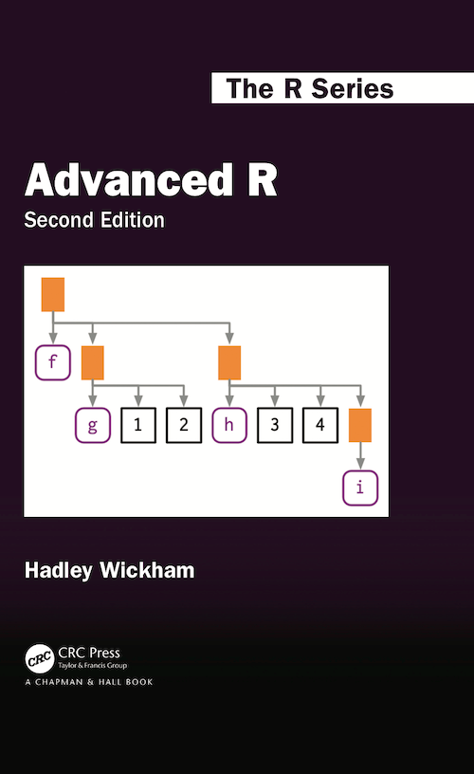
More on writing functions...
https://adv-r.hadley.nz/

Slide 15
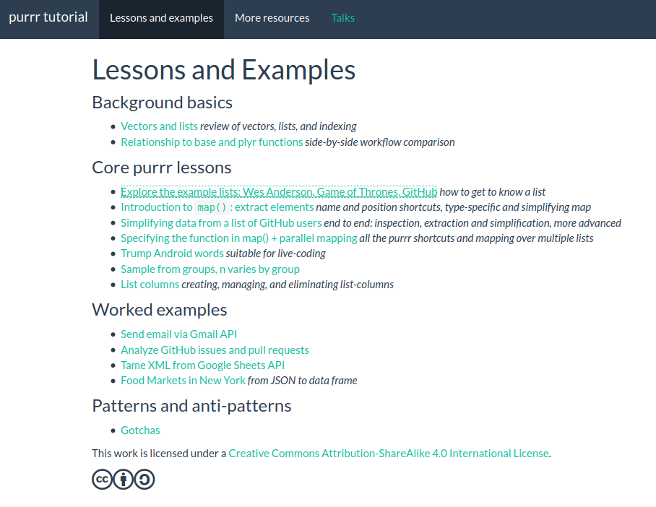
More on purrr and functional programming...
https://jennybc.github.io/purrr-tutorial/

