Slide 1
Drake - Reproducible Workflows at Scale
Dr Andrew J. Stewart
E: drandrewjstewart@gmail.com
T: @ajstewart_lang
G: ajstewartlang

Slide 2
Introducing Drake
“Data analysis can be slow. A round of scientific computation can take several minutes, hours, or even days to complete. After it finishes, if you update your code or data, your hard-earned results may no longer be valid. How much of that valuable output can you keep, and how much do you need to update? How much runtime must you endure all over again?
For projects in R, the drake package can help. It analyzes your workflow, skips steps with up-to-date results, and orchestrates the rest with optional distributed computing. At the end, drake provides evidence that your results match the underlying code and data, which increases your ability to trust your research."
https://books.ropensci.org/drake/index.html

Slide 3
Introducing Drake
Too many data science projects follow a Sisyphean loop:
Launch the code.
Wait while it runs.
Discover an issue.
Restart from scratch.
For projects with long runtimes, people tend to get stuck. But with drake, you can automatically:
Launch the parts that changed since last time.
Skip the rest.
https://books.ropensci.org/drake/index.html

Slide 4
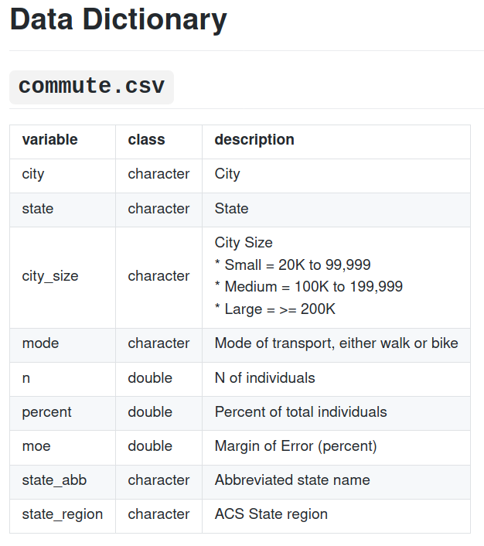
Working with a dataset
We’re going to use a TidyTuesday dataset to examine how the drake package works. We’ll be using the November 5th, 2019, dataset of commuting via walking/biking in US Cities 2008-2012. It can be accessed from here:
https://raw.githubusercontent.com/rfordatascience/tidytuesday/master/data/2019/2019-11-05/commute.csv

Slide 5
Getting started with drake
We first need to install the drake package with install.packages("drake")
When writing our script for visualising and understanding the dataset, we need to write our code chunks as functions.When we write our drake plan (which details the steps of our analysis) we list the various steps in our workflow - these are called targets.
Associated with each target is the command that is executed. These commands can be simple R commands, chunks of code or functions that you have written for each analysis step.

Slide 6
Developing our workflow...
Let's develop an workflow plan that does the following:
Reads in our data.
Generates a plot to visualise the top 10 States in the US with the highest % of people commuting via walking.
Generates a plot to visualise the % of people commuting via walking for small vs. medium vs. large sized cities.
Generates summary descriptives of the mean and sd of % people commuting via walking for small vs. medium vs. large sized cities.
Builds a linear model to examine how % of people commuting via walking is predicted by the size of a US city.
Produces a summary of the output of this model.

Slide 7
Reading in our data...
Below I create a function called read_my_data() which simply reads in a datafile. You don’t need to pass any parameters when you call the function, as in this case the location of where the data are to be loaded in from is hardwired into the body of the function itself.
read_my_data <- function(x){
read_csv("https://raw.githubusercontent.com/rfordatascience/tidytuesday/master/data/2019/2019-11-05/commute.csv")
}
Calling the function with read_my_data() will return a tibble of the dataset.

Slide 8
read_my_data()
Parsed with column specification:
cols(
city = col_character(),
state = col_character(),
city_size = col_character(),
mode = col_character(),
n = col_double(),
percent = col_double(),
moe = col_double(),
state_abb = col_character(),
state_region = col_character()
)
# A tibble: 3,496 x 9
city state city_size mode n percent moe state_abb state_region
<chr> <chr> <chr> <chr> <dbl> <dbl> <dbl> <chr> <chr>
1 Aberdeen city South Dakota Small Bike 110 0.8 0.5 SD North Centr…
2 Acworth city Georgia Small Bike 0 0 0.4 GA South
3 Addison village Illinois Small Bike 43 0.2 0.3 IL North Centr…
4 Adelanto city California Small Bike 0 0 0.5 CA West
5 Adrian city Michigan Small Bike 121 1.5 1 MI North Centr…
6 Agawam Town city Massachusetts Small Bike 0 0 0.2 MA Northeast
7 Agoura Hills ci… California Small Bike 84 0.8 1.1 CA West
8 Aiken city South Caroli… Small Bike 23 0.2 0.3 SC South
9 Alabaster city Alabama Small Bike 0 0 0.2 AL South
10 Alameda city California Small Bike 576 1.5 0.4 CA West
# … with 3,486 more rows

Slide 9
Generate a plot to visualise the top 10 States in the US with the highest % of people commuting via walking
The following function takes a tibble, and generates the plot:
my_overall_plot <- function(x) {
x %>%
group_by(state, mode) %>%
summarise(mean_percent = mean(percent)) %>%
ungroup() %>%
filter(mode == "Walk") %>%
arrange(-mean_percent) %>%
top_n(10, mean_percent) %>%
ggplot(aes(x = fct_reorder(state, mean_percent, median),
y = mean_percent, fill = state)) +
geom_col() +
guides(fill = FALSE) +
coord_flip() +
labs(x = "State", y = "Percentage of Walkers",
title = "States with the Highest Percentage of Walkers") +
theme(text = element_text(size = 10)) +
theme_minimal()
}

Slide 10
Generate a plot to visualise the % of people commuting via walking for small vs. medium vs. large sized cities
my_walk_plot <- function(x) {
x %>%
filter(mode == "Walk") %>%
group_by(city_size) %>%
ggplot(aes(x = city_size, y = percent, colour = city_size)) +
geom_jitter(width = .1, size = 3, alpha = .25) +
guides(colour = FALSE) +
labs(title = "% of Walkers by City Size",
x = "City Size",
y = "Percent of Walkers") +
theme(text = element_text(size = 12))
}

Slide 11
Generate summary descriptives of the mean and sd of % people commuting via walking for small vs. medium vs. large sized cities
desc_stats <- function(x) {
x %>%
filter(mode == "Walk") %>%
group_by(city_size) %>%
summarise(mean_walk = mean(percent), sd_walk = sd(percent))
}

Slide 12
We can then build our drake plan for our 6 analysis steps and call the functions we have just written…
my_plan <- drake_plan(commute_mode = read_my_data(),
show_overall_plot = my_overall_plot(commute_mode),
show_walk_plot = my_walk_plot(commute_mode),
show_stats = desc_stats(commute_mode),
fit = lm(percent ~ city_size,
data = filter(commute_mode, mode == "Walk")),
summary_fit = summary(fit))
We have 6 targets - commute_mode, show_overall_plot, show_walk_plot, show_stats, fit, and summary_fit
Associated with each target is the appropriate code - for targets 1, 2, 3, and 4 this is for functions we have written. For targets 5 and 6 this is for in-built R functions.

Slide 13
Our drake plan...
> my_plan
# A tibble: 6 x 2
target command
<chr> <expr>
1 commute_mode read_my_data()
2 show_overall_plot my_overall_plot(commute_mode)
3 show_walk_plot my_walk_plot(commute_mode)
4 show_stats desc_stats(commute_mode)
5 fit lm(percent ~ city_size, data = filter(commute_mode, mode == "Walk"))
6 summary_fit summary(fit)

Slide 14
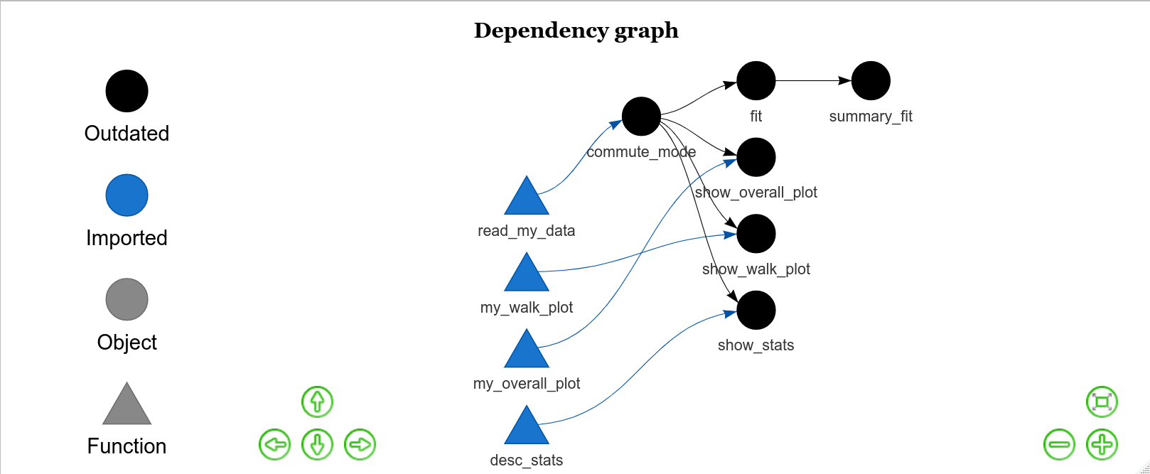
Our drake plan...
vis_drake_graph(my_plan)

Slide 15
Executing our plan
> make(my_plan)
▶ target commute_mode
Parsed with column specification:
cols(
city = col_character(),
state = col_character(),
city_size = col_character(),
mode = col_character(),
n = col_double(),
percent = col_double(),
moe = col_double(),
state_abb = col_character(),
state_region = col_character()
)
▶ target fit
▶ target show_overall_plot
`summarise()` regrouping output by 'state' (override with `.groups` argument)
▶ target show_walk_plot
▶ target show_stats
`summarise()` ungrouping output (override with `.groups` argument)
▶ target summary_fit

Slide 16
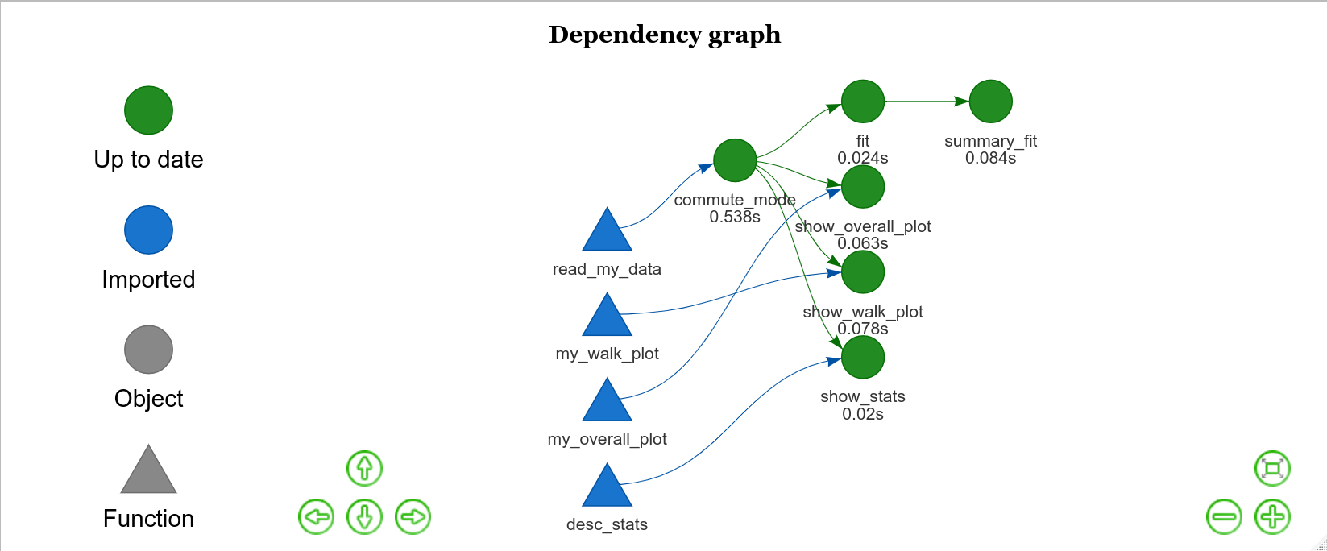

Slide 17
Analysing your drake history
> drake_history(analyze = TRUE)
# A tibble: 6 x 8
target current built exists hash command seed runtime
<chr> <lgl> <chr> <lgl> <chr> <chr> <int> <dbl>
1 commute_m… TRUE 2020-09-28 1… TRUE 4444ca6… "read_my_data()" 2.76e8 0.525
2 fit TRUE 2020-09-28 1… TRUE b2d8814… "lm(percent ~ city_size,… 1.11e9 0.00500
3 show_over… TRUE 2020-09-28 1… TRUE f8793d5… "my_overall_plot(commute… 1.85e9 0.028
4 show_stats TRUE 2020-09-28 1… TRUE 7d80d90… "desc_stats(commute_mode… 1.08e9 0.0160
5 show_walk… TRUE 2020-09-28 1… TRUE 8340ac7… "my_walk_plot(commute_mo… 1.67e9 0.033
6 summary_f… TRUE 2020-09-28 1… TRUE 741674a… "summary(fit)" 2.09e9 0.00100
drake keeps track of which components have been run so if you were to update your code and (re)make your drake plan, only the bits of code that have changed will be run. You can look at the runtime column to see which bit of code took the longest to execute.This is super useful as you don't want to have to re-run computationally intensive bits of code again - and only the bits you have changed.

Slide 18
Let’s change a small bit of our code...
Let's change one of our plot functions - let's keep is simple and just add a coord_flip() to the my_walk_plot() function:
my_walk_plot <- function(x) {
x %>%
filter(mode == "Walk") %>%
group_by(city_size) %>%
ggplot(aes(x = city_size, y = percent, colour = city_size)) +
geom_jitter(width = .1, size = 3, alpha = .25) +
guides(colour = FALSE) +
labs(title = "% of Walkers by City Size",
x = "City Size",
y = "Percent of Walkers") +
theme(text = element_text(size = 12)) +
coord_fpip()
}

Slide 19
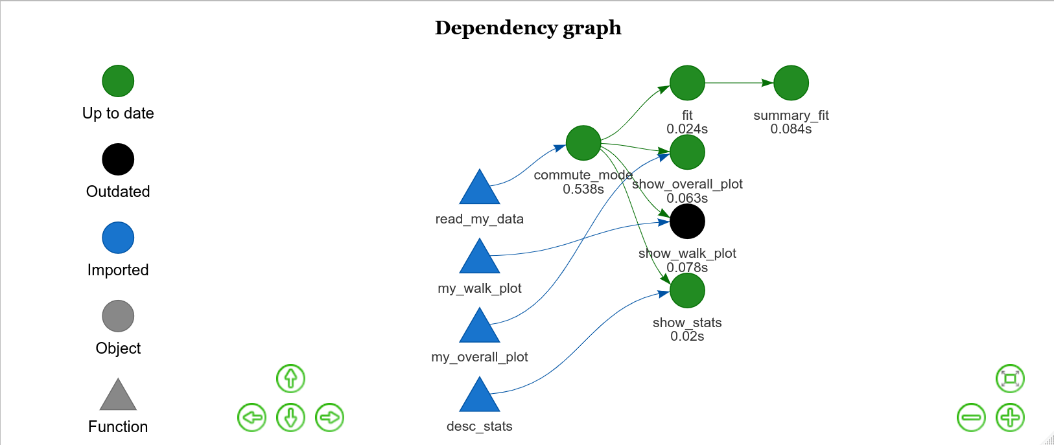
Let's run that function again and then look at the configuration of our plan with vis_drake_graph(my_plan)

Slide 20
The show_walk_plot() function is in black to indicate it is outdated.
If we now (re)make our drake plan, only that component is actually run!
> make(my_plan)
target show_walk_plot

Slide 21
And if we look at drake_history() we see that the show_walk_plot() function has now been run twice - with the most recent version being marked a the current one.
drake_history(analyze = TRUE)
# A tibble: 7 x 8
target current built exists hash command seed runtime
<chr> <lgl> <chr> <lgl> <chr> <chr> <int> <dbl>
1 commute_m… TRUE 2020-09-28 1… TRUE 4444ca6… "read_my_data()" 2.76e8 0.525
2 fit TRUE 2020-09-28 1… TRUE b2d8814… "lm(percent ~ city_size,… 1.11e9 0.00500
3 show_over… TRUE 2020-09-28 1… TRUE f8793d5… "my_overall_plot(commute… 1.85e9 0.028
4 show_stats TRUE 2020-09-28 1… TRUE 7d80d90… "desc_stats(commute_mode… 1.08e9 0.0160
5 show_walk… FALSE 2020-09-28 1… TRUE 8340ac7… "my_walk_plot(commute_mo… 1.67e9 0.033
6 show_walk… TRUE 2020-09-28 1… TRUE 8b4cf9e… "my_walk_plot(commute_mo… 1.67e9 0.0100
7 summary_f… TRUE 2020-09-28 1… TRUE 741674a… "summary(fit)" 2.09e9 0.00100
When we run make(), drake stores the targets in a cache in the .drake folder.

Slide 22
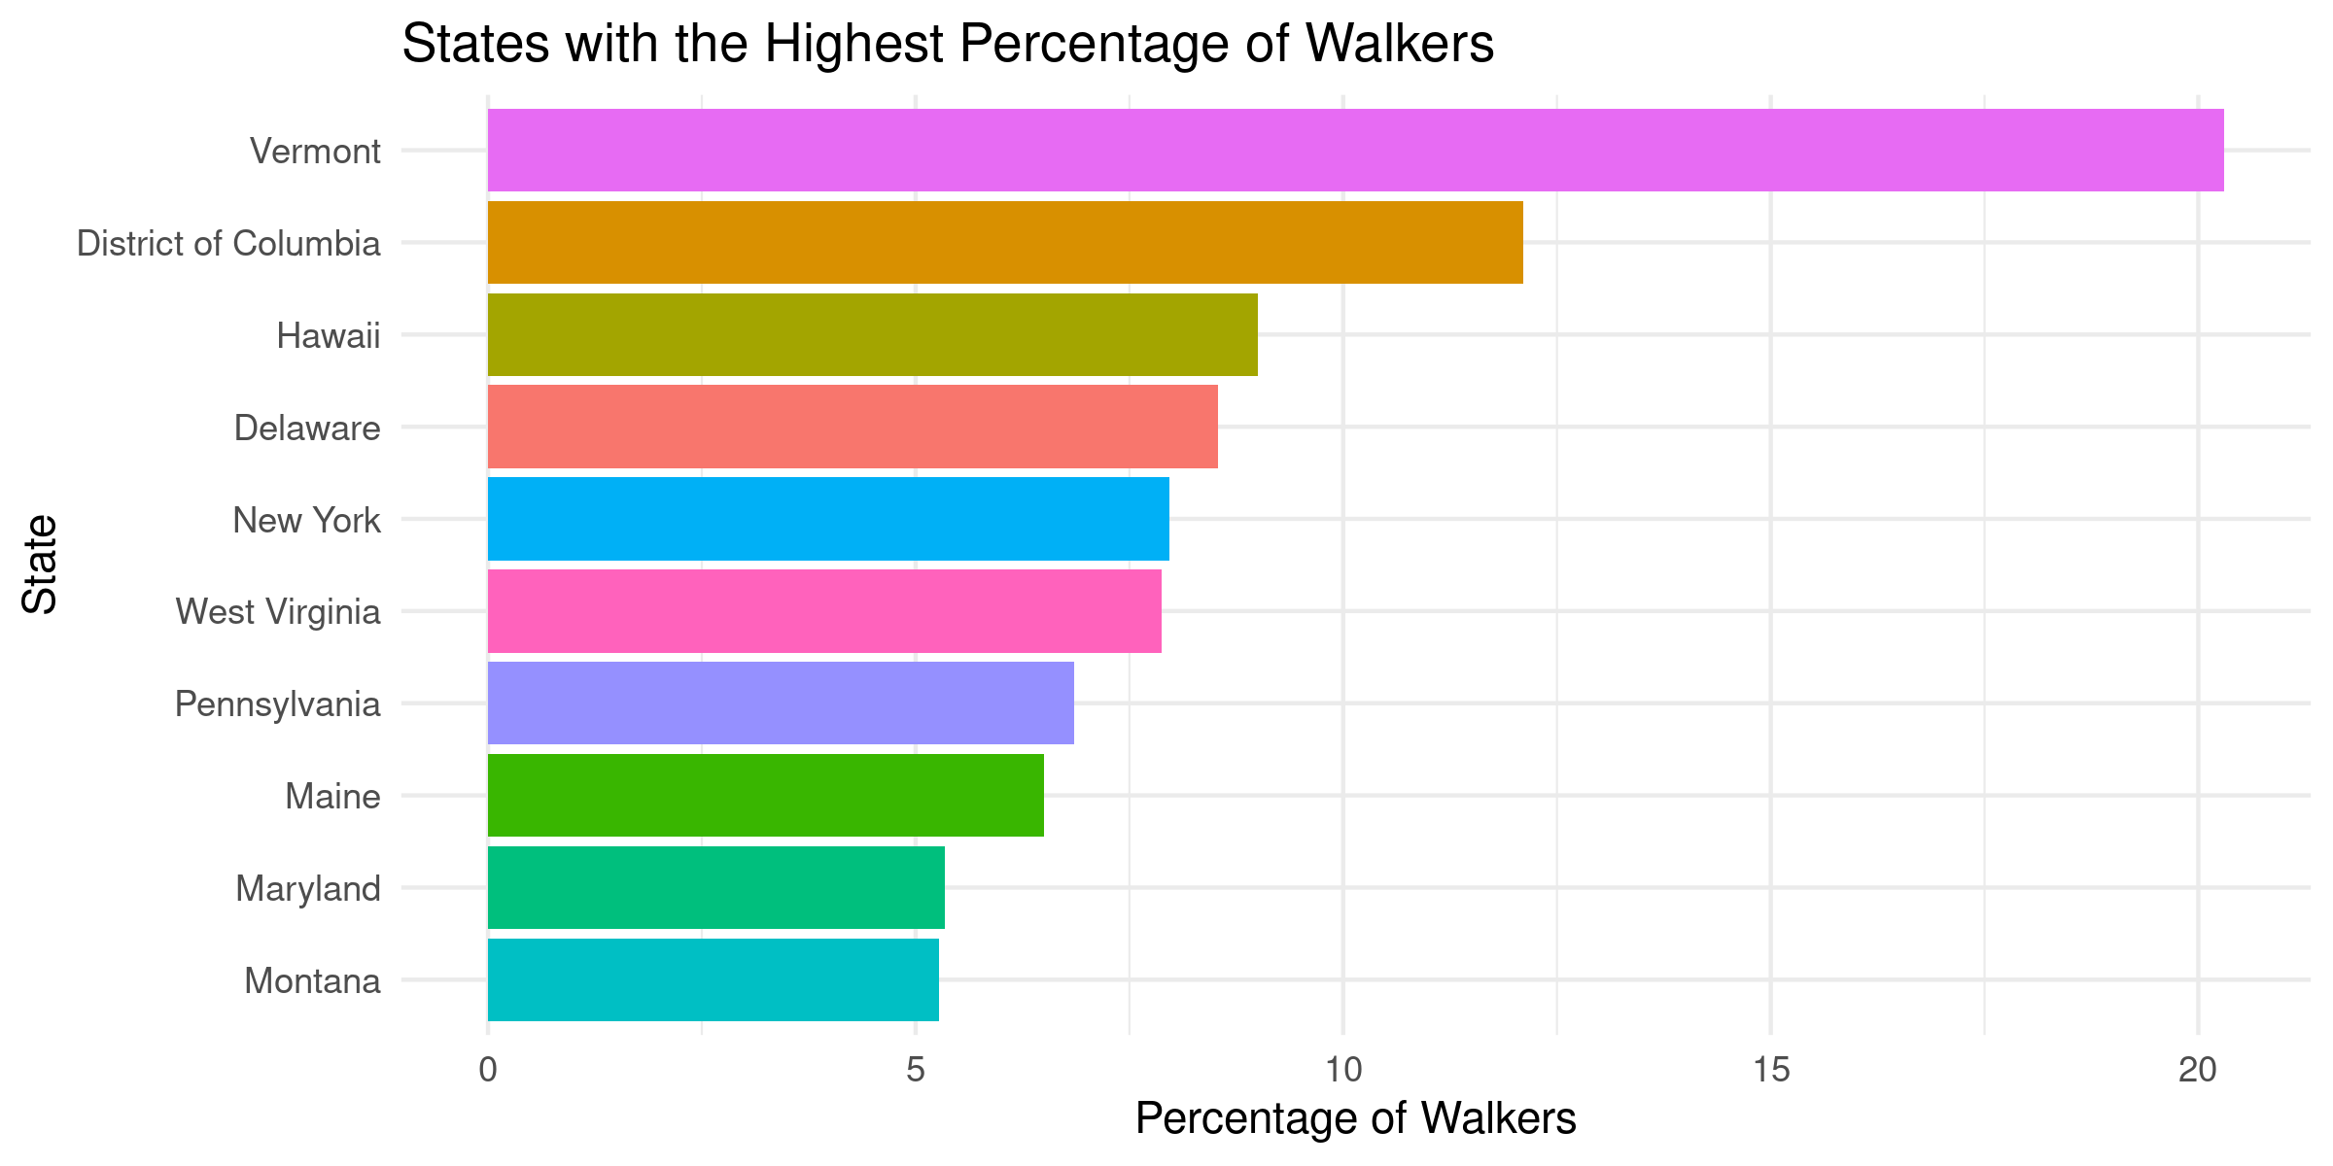
Read and return a target from the drake cache
We can use the readd() function to read and return the contents of a target in our cache. So, readd(show_overall_plot) will return:

Slide 23
And readd(summary_fit) will return the output of the linear model summary.
> readd(summary_fit)
Call:
lm(formula = percent ~ city_size, data = filter(commute_mode,
mode == "Walk"))
Residuals:
Min 1Q Median 3Q Max
-2.847 -1.847 -1.047 0.353 39.553
Coefficients:
Estimate Std. Error t value Pr(>|t|)
(Intercept) 3.4422 0.3338 10.311 <2e-16 ***
city_sizeMedium -0.4354 0.4248 -1.025 0.3056
city_sizeSmall -0.5950 0.3460 -1.720 0.0857 .
---
Signif. codes: 0 ‘***’ 0.001 ‘**’ 0.01 ‘*’ 0.05 ‘.’ 0.1 ‘ ’ 1
Residual standard error: 3.485 on 1745 degrees of freedom
Multiple R-squared: 0.001796, Adjusted R-squared: 0.0006519
F-statistic: 1.57 on 2 and 1745 DF, p-value: 0.2084

Slide 24
A consistent and reliable workflow using r_make()
If you change your code interactively (i.e., as you work in RStudio), you might end up making changes that accidentally invalidate targets - but you won't necessarily notice at the time.
One way to avoid this issue is to build your workflow in a new, temporary, R session. This will result in a more consistent and reliable workflow.

Slide 25
Setting things up for r_make()
You need to have a configuration script (the default is called _drake.R sitting above another folder (which we're calling R) which contains separate files for each bit of your make plan (and you need the drake plan itself as a separate file):
_drake.R
R/
├── packages.R
├── functions.R
└── plan.R
Here we have 3 .R files saved in a folder I’ve called R.

Slide 26
Setting things up for r_make()
Our _drake.R file contains the following 4 lines of code:
source("R/packages.R")
source("R/functions.R")
source("R/plan.R")
drake_config(my_plan, verbose = 2)
By setting verbose = 2, we get a progress bar and update as the plan targets are made. The source() function reads the code from the named location - this means that with source("R/functions.R") you can then use the functions contained within this file in the current R session.

Slide 27
Setting things up for r_make()
Our packages.R file contains these 2 lines of code:
library(drake)
library(tidyverse)
our functions.R file contains the code for all our functions such as the desc_stats() function here:
desc_stats <- function(x) {
x %>%
filter(mode == "Walk")
%>% group_by(city_size)
%>% summarise(mean_walk = mean(percent), sd_walk = sd(percent))
}

Slide 28
Setting things up for r_make()
Our plan.R file is simply the code for our drake plan:
my_plan <- drake_plan(commute_mode = read_my_data(),
show_overall_plot = my_overall_plot(commute_mode),
show_walk_plot = my_walk_plot(commute_mode),
show_stats = desc_stats(commute_mode),
fit = lm(percent ~ city_size,
data = filter(commute_mode, mode == "Walk")),
summary_fit = summary(fit))

Slide 29
With our config file set up and your .R files associated with loading your packages, functions etc. all in the right place you can simply type r_make() and your plan etc. will be loaded and run in your new temporary environment.
> r_make()
── Attaching packages ─────────────────────────────────────────────────── tidyverse 1.3.0 ──
✓ ggplot2 3.3.2 ✓ purrr 0.3.4
✓ tibble 3.0.1 ✓ dplyr 1.0.0
✓ tidyr 1.1.0 ✓ stringr 1.4.0
✓ readr 1.3.1 ✓ forcats 0.5.0
── Conflicts ────────────────────────────────────────────────────── tidyverse_conflicts() ──
x dplyr::filter() masks stats::filter()
x dplyr::lag() masks stats::lag()
/
Attaching package: ‘drake’
The following objects are masked from ‘package:tidyr’:
expand, gather
✓ All targets are already up to date.

Slide 30
A few other things...
If you want to force targets to be out of date in the cache (maybe you want to re-run everything) you can use the clean()function.
If you accidentally delete targets that you didn't mean to, you can try to recover them using make(my_plan, recover = TRUE)
You can find out the dependencies for your targets like this: deps_target("show_walk_plot", my_plan)
# A tibble: 2 x 3
name type hash
<chr> <chr> <chr>
1 my_walk_plot globals e865098e79741023
2 commute_mode globals 4444ca621fdd0dd5

Slide 31
A few other things...
For analyses that can take hours (or days) to run locally, you can throw your drake plan (and hence analysis) up to an HPC cluster, run it as a persistent background process, run targets in parallel, or use multiple cores on your own machine.
drake is really good in terms of scaleability.
More info. about these aspects here:
https://books.ropensci.org/drake/hpc.html

