Slide 1
Binder for Fully Reproducible Research
Dr Andrew J. Stewart
E: drandrewjstewart@gmail.com
T: @ajstewart_lang
G: ajstewartlang

Slide 2

The Turing Way
This workshop draws heavily upon The Turing Way Binder workshop which I attended in 2019 - The Turing Way Handbook is a fantastic resource on reproducible data science and I very much recommend you check it out!
https://www.turing.ac.uk/research/research-projects/turing-way-handbook-reproducible-data-science

Slide 3
Open and Reproducible Research
Shared Data
We already know this is important for reproducibility.
Shared Code
We already know this is important for reproducibility.
Shared Computational Environment
Why is this important and how do we do it?

Slide 4
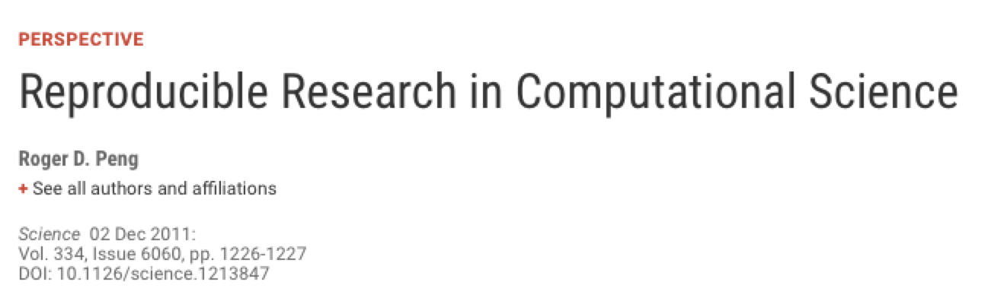
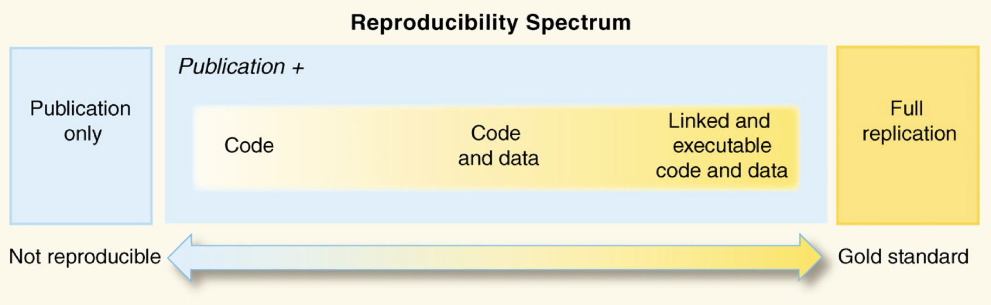
Open and Reproducible Research

Slide 5
Why do we need to reproduce the computational environment?
Analysis code can ‘break’ - often in one of two ways:
Code that worked previously now doesn’t - maybe a function in an R package was updated (e.g., lsmeans() became emmeans() so old code using the lsmeans() function wouldn’t now run).
Code that worked previously still works - but produces a slightly different result or now throws a warning where it didn’t previously (e.g., convergence/singular fit warnings in lme4:: version 1.1-19 vs. version 1.1-20).

Slide 6
Why do we need to reproduce the computational environment?
There have even been changes in the way that base R works - in R 3.6 the way in which sample() worked differed from how it had worked previously, and in R 4.0, when reading in data stringsAsFactors = FALSE (whereas previously stringsAsFactors = TRUE).
You need to capture the versions of the different R packages (plus their dependencies) and even the version of R you used in the original analysis.

Slide 7
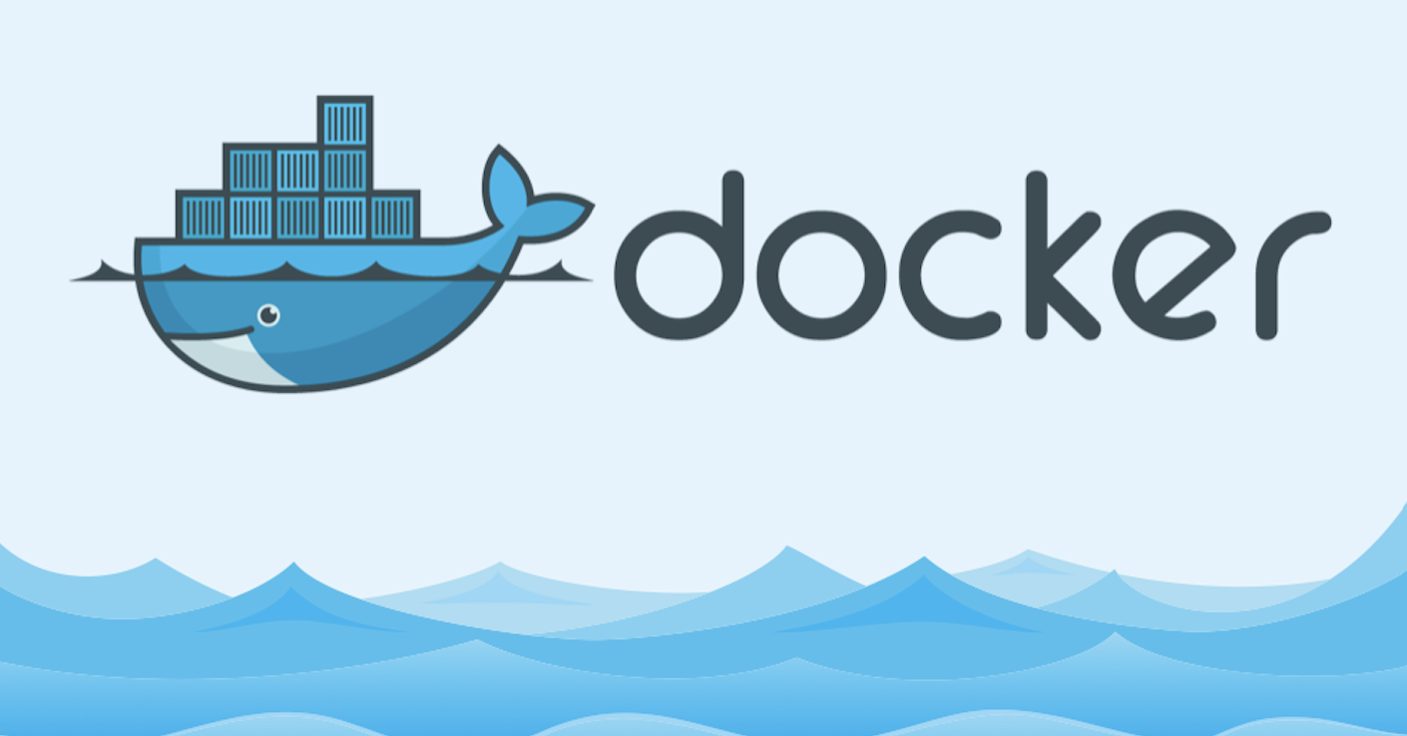
Introduction to Docker
Docker packages your data, code and all its dependencies in the form called a docker container to ensure that your application works seamlessly in any environment.
When you run a docker container it’s like running your analysis on a computer that has the same configuration as our own one at the point in time when you ran the original analysis.
https://medium.com/the-andela-way/docker-for-beginners-61e8e0ce6a19

Slide 8
So what’s Binder?
Binder is powered by BinderHub, which is an open-source tool that deploys the Binder service in the cloud.
Binder works by pulling a repository that you set up on GitHub into a Docker container using repo2docker.
Think of a repository as a folder containing your R code, your data, and a few other small bits and pieces - but it sits in the cloud rather than on your computer.
It pulls the versions of the R packages you specify (on the date you specify) from MRAN.

Slide 9
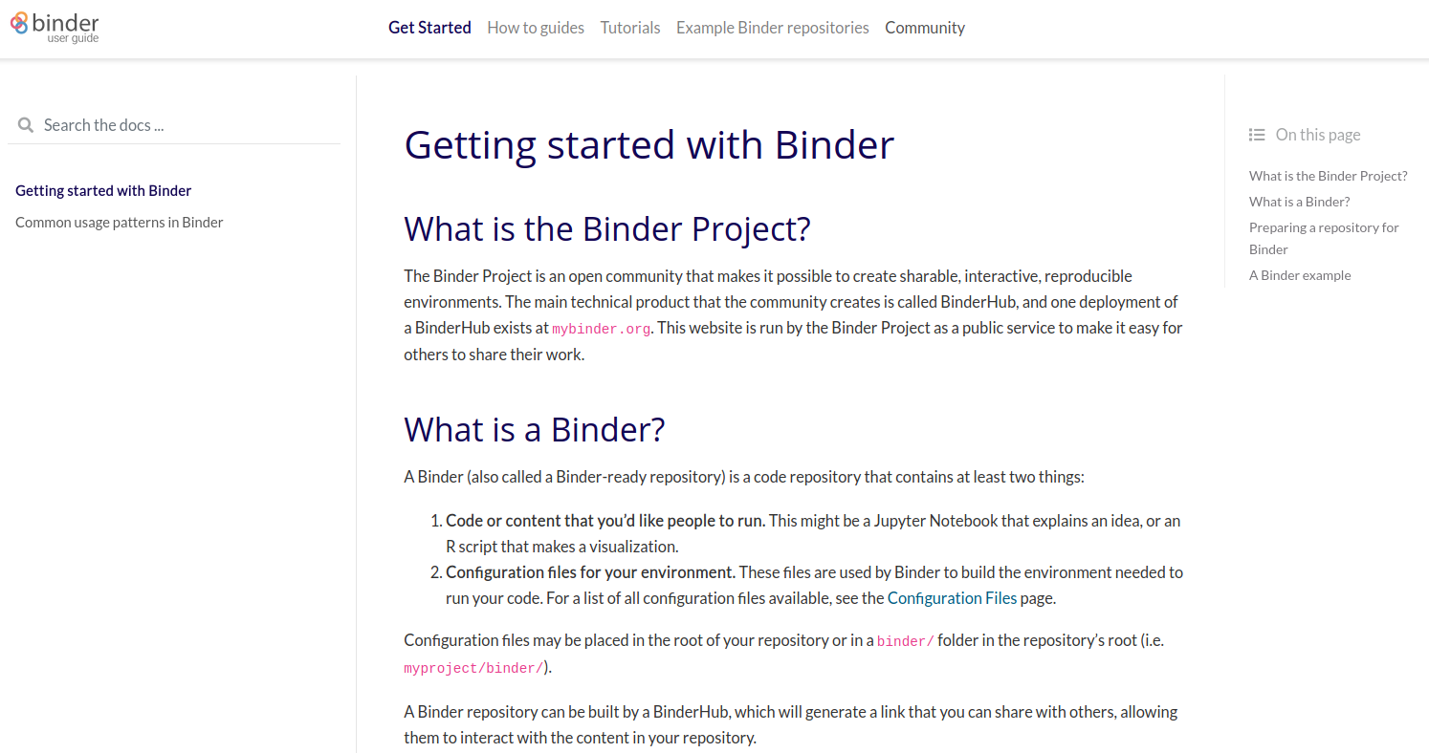
https://mybinder.readthedocs.io/en/latest/introduction.html

Slide 10
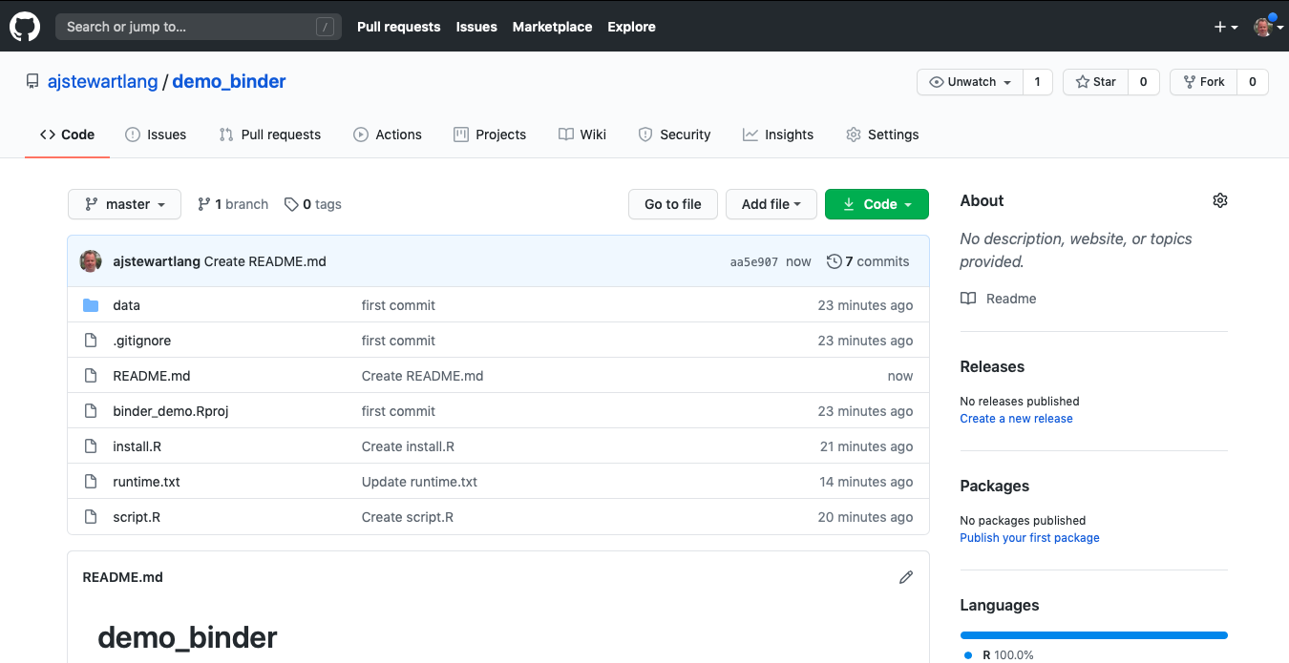
My GitHub Repo
This repo contains my data and R script (plus a few other files).

Slide 11
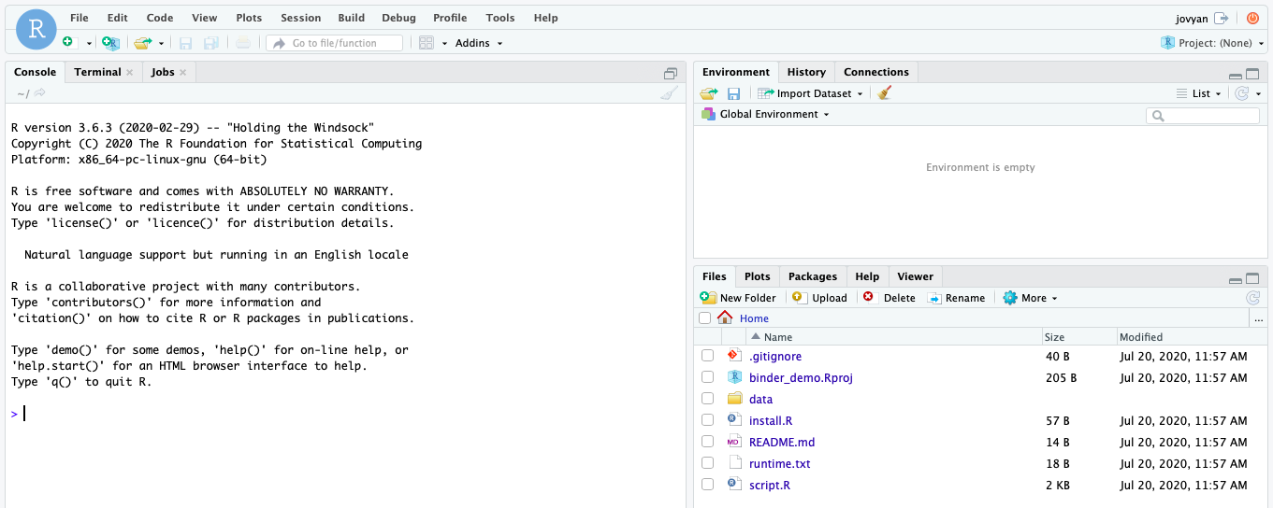
When I link my GitHub repository to Binder and launch it I then get the following in my web browser.
This is RStudio running the cloud using my code, my data and the appropriate versions of the packages that I was using when I did the analysis originally!
https://mybinder.org/v2/gh/ajstewartlang/demo_binder/master?urlpath=rstudio

Slide 12
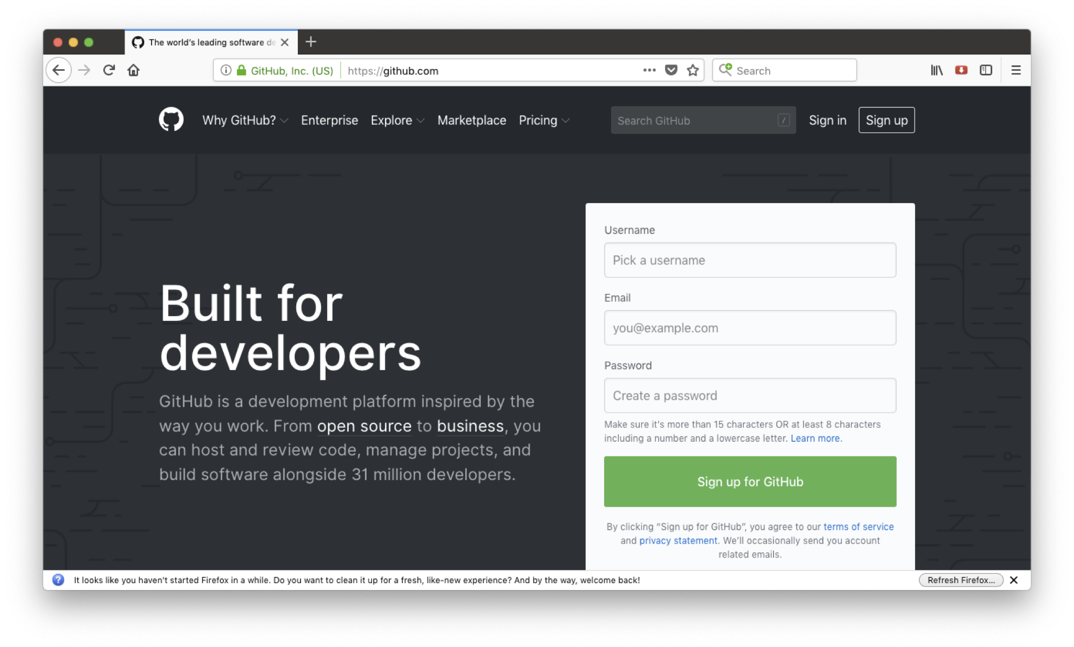
Step 1 - Set up a GitHub account
Go to github.com to set up an account.

Slide 13
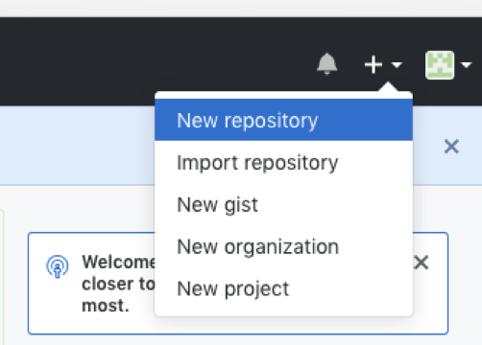
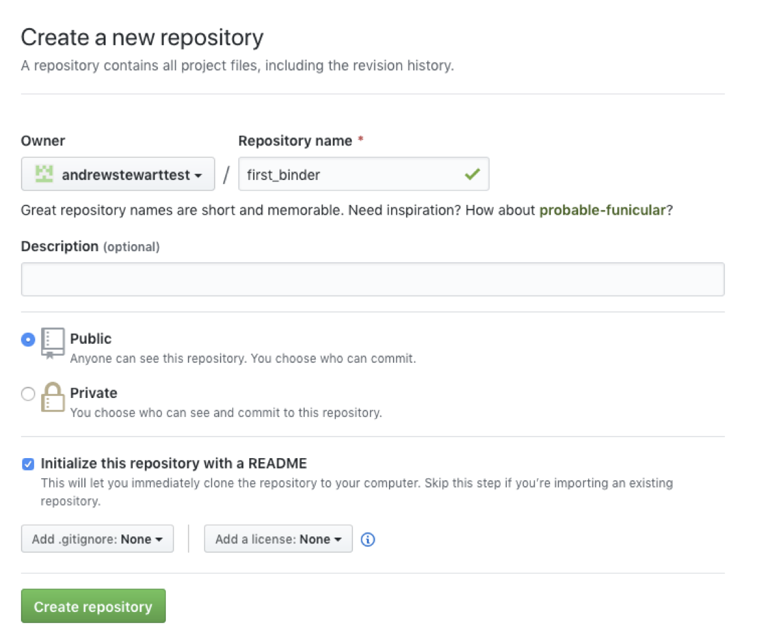
Step 2 - Create a new repository
Make it ‘Public’ and initialise it with a README.

Slide 14
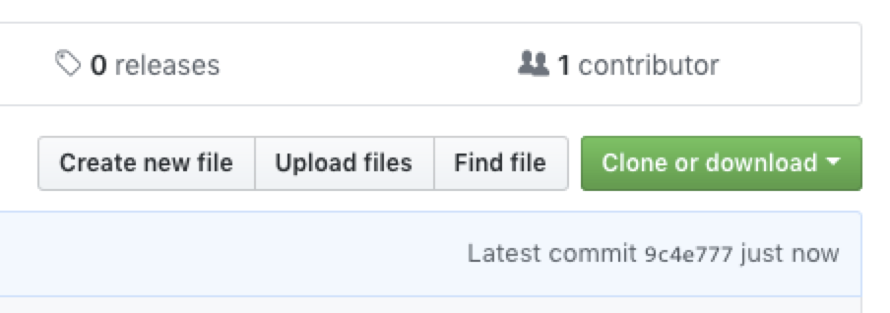
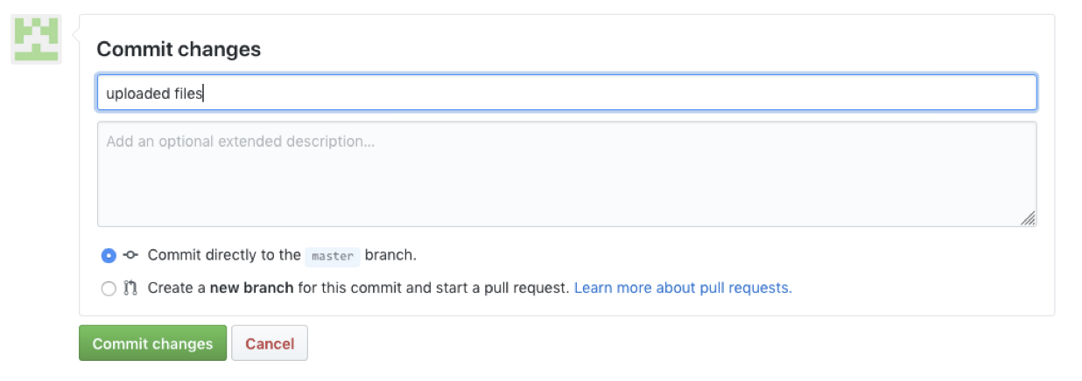
Step 3 - Upload your R script and data and make your first “Commit”
Click here to upload.
Click here to commit.

Slide 15
Step 4 - create the files “runtime.txt” and “install.R”
We need two other files at this point - one is called “runtime.txt” and contains the date and version of R and its associated packages that you want to simulate.
The other is called “install.R” and contains the list of R packages that need to be installed in order for your script to run.
To create a new file select “Create new file”

Slide 16
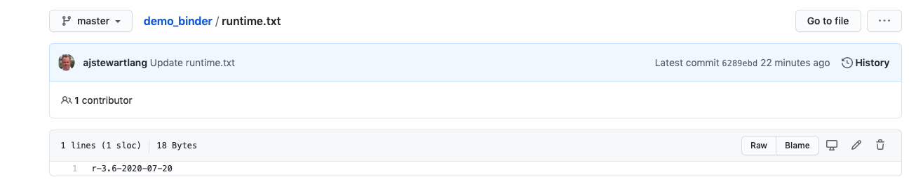
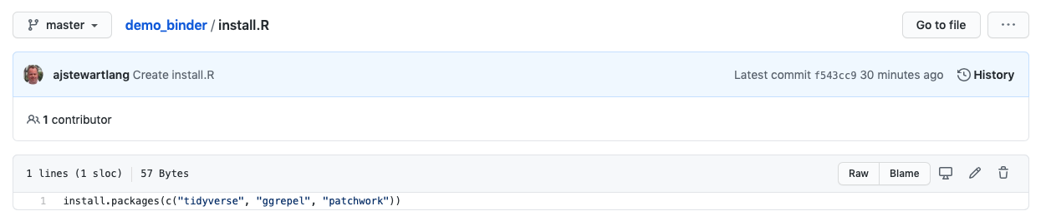
Step 4 - create the files “runtime.txt” and “install.R”
In the runtime.txt file type the R version and date of the packages on MRAN that you want in the format r-version-YYYY-MM-DD
List your packages like this in the install.R file
Don’t forget to click “Commit” after you’ve created each file!

Slide 17
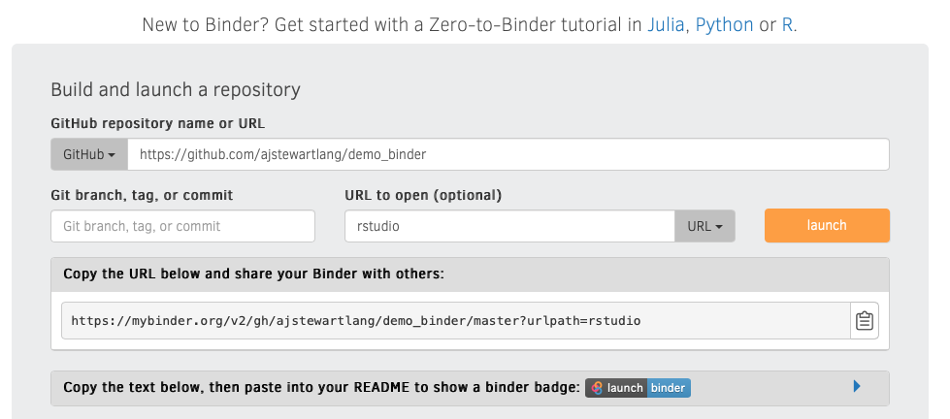
Step 5 - Now we need to link our repo to Binder (mybinder.org)
Paste the address of your GitHub repo you want to Binderise.
Type “RStudio” and select “URL”
Click on “Launch”
And this is the link to share with others.

Slide 18
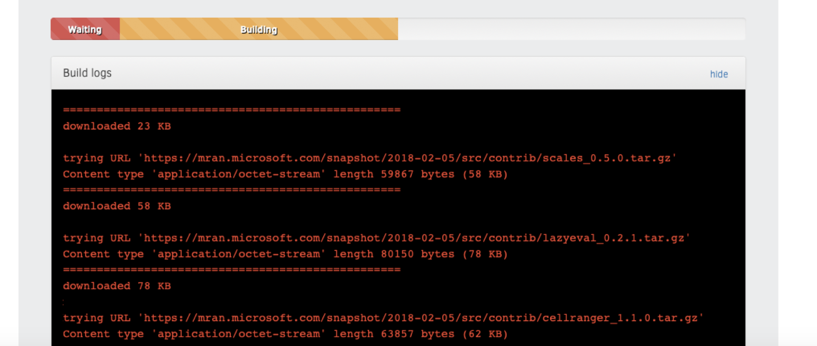
When you first click on “Launch”
You can check the progress of the build by clicking on the “Build logs” bar.

Slide 19
If Binder can find an image that you’ve built previously, it will simply launch that. If you’ve made changes to your GitHub repo, it will rebuild the Docker image and create a new Binder. Either way, once Binder launches you get the following in your browser (even on mobile devices so you can even R away on your phone)…

Slide 20
A few other things
Installing the entire Tidyverse in a Binder can take a long time - better to install only the packages you use (e.g., ggplot2, dplyr, readr etc.) - this will also ensure the individual packages are consistent with the date in your runtime.txt file.
Even with just a couple of packages it can take ~15 minutes or so for your Binder to be built. While your Binder builds you can close your computer as the build will continue in the cloud.
To change the version of R that Binder builds (to 3.5 say) change the R version in runtime.txt like this "r-3.5-2020-07-20"

Slide 21

For Ultimate Reproducibility
Make sure you have updated all your packages before you run your script locally.
Build your Binder and specify the day you ran your analysis in the runtime.txt file - and add a version of R if you don’t want it to go with the default.
Patience while your Binder builds.

Slide 22
Your turn
Start from Slide 12, take an R script you've already written and Binderise it!

