Slide 1
Introduction to Text Mining
Dr Andrew J. Stewart
E: drandrewjstewart@gmail.com
T: @ajstewart_lang
G: ajstewartlang

Slide 2
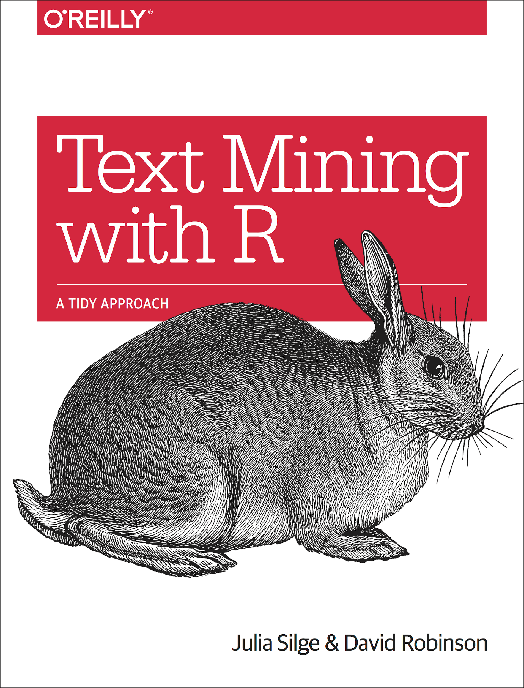

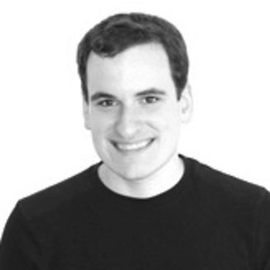
Text Mining in R
In any set of texts (such as books, interview transcripts etc.) it’s often useful to be able to quantify key aspects of the constituent parts (e.g., words, phrases). For example, some types of language may be more common in one interview transcript vs. another, and it can be useful to visualise the content of a particular text to compare it with others.

Slide 3
What we’ll cover in this introduction...
Summarising text data.
Sentiment analysis.
Extracting frequency information (and demonstrating Zipf's law).
Characterising text that makes a unique contribution to a particular instance.
N-gram analysis.

Slide 4
The Packages We’ll Be Using
We’ll use the {tidyverse} as we’ll need to do some data wrangling and visualisation. We’ll also use {tidytext} for working with text in a tidy format, and {gutenbergr} which allows us to connect to Project Gutenberg in order to download public domain texts.
library(tidyverse)
library(tidytext)
library(gutenbergr)

Slide 5
We’ll use the texts of some books by HG Wells in our examples...
We are going to download from Project Gutenberg the text of four books by HG Wells. We will combine these four books into a dataframe called books
titles <- c("The War of the Worlds",
"The Time Machine",
"Twenty Thousand Leagues under the Sea",
"The Invisible Man: A Grotesque Romance")
books <- gutenberg_works(title %in% titles) %>%
gutenberg_download(meta_fields = "title")

Slide 6
str(books)
tibble [27,540 × 3] (S3: tbl_df/tbl/data.frame)
$ gutenberg_id: int [1:27540] 35 35 35 35 35 35 35 35 35 35 ...
$ text : chr [1:27540] "The Time Machine" "" "An Invention" "" ...
$ title : chr [1:27540] "The Time Machine" "The Time Machine" "The Time Machine" "The Time Machine" ...
head(books, n = 8)
# A tibble: 15 x 3
gutenberg_id text title
<int> <chr> <chr>
1 35 "The Time Machine" The Time Machine
2 35 "" The Time Machine
3 35 "An Invention" The Time Machine
4 35 "" The Time Machine
5 35 "by H. G. Wells" The Time Machine
6 35 "" The Time Machine
7 35 "" The Time Machine
8 35 "CONTENTS" The Time Machine
books %>% distinct(title)
# A tibble: 4 x 1
title
<chr>
1 The Time Machine
2 The War of the Worlds
3 Twenty Thousand Leagues under the Sea
4 The Invisible Man: A Grotesque Romance

Slide 7
Examining rows 31:40 of the text column of our books tibble:
books$text[31:40]
[1] " I."
[2] " Introduction"
[3] ""
[4] ""
[5] "The Time Traveller (for so it will be convenient to speak of him) was"
[6] "expounding a recondite matter to us. His pale grey eyes shone and"
[7] "twinkled, and his usually pale face was flushed and animated. The fire"
[8] "burnt brightly, and the soft radiance of the incandescent lights in the"
[9] "lilies of silver caught the bubbles that flashed and passed in our"
[10] "glasses. Our chairs, being his patents, embraced and caressed us rather"
Currently the text is all in one column in our dataframe - we need to transform it into tidy format such that one word appears in each row. We do this by 'unnesting' the text column and removing 'stop words'. These are common words (e.g., function words like 'the' and 'of').
all_text <- books %>%
unnest_tokens(word, text) %>%
anti_join(stop_words)

Slide 8
all_text
# A tibble: 91,676 x 3
gutenberg_id title word
<int> <chr> <chr>
1 35 The Time Machine time
2 35 The Time Machine machine
3 35 The Time Machine invention
4 35 The Time Machine contents
5 35 The Time Machine introduction
6 35 The Time Machine ii
7 35 The Time Machine machine
8 35 The Time Machine iii
9 35 The Time Machine time
10 35 The Time Machine traveller
# … with 91,666 more rows

Slide 9
Summary Data of “The Time Machine”
all_text %>%
filter(title == "The Time Machine") %>%
count(word, sort = TRUE) %>%
top_n(10)
Selecting by n
# A tibble: 10 x 2
word n
<chr> <int>
1 time 207
2 machine 88
3 white 61
4 traveller 57
5 hand 49
6 morlocks 48
7 people 46
8 weena 46
9 found 44
10 light 43

Slide 10
Summary Data of “The War of the Worlds”
all_text %>%
filter(title == "The War of the Worlds") %>%
count(word, sort = TRUE) %>%
top_n(10)
Selecting by n
# A tibble: 10 x 2
word n
<chr> <int>
1 martians 163
2 people 159
3 black 122
4 time 121
5 road 104
6 night 102
7 brother 91
8 pit 83
9 martian 79
10 water 79

Slide 11
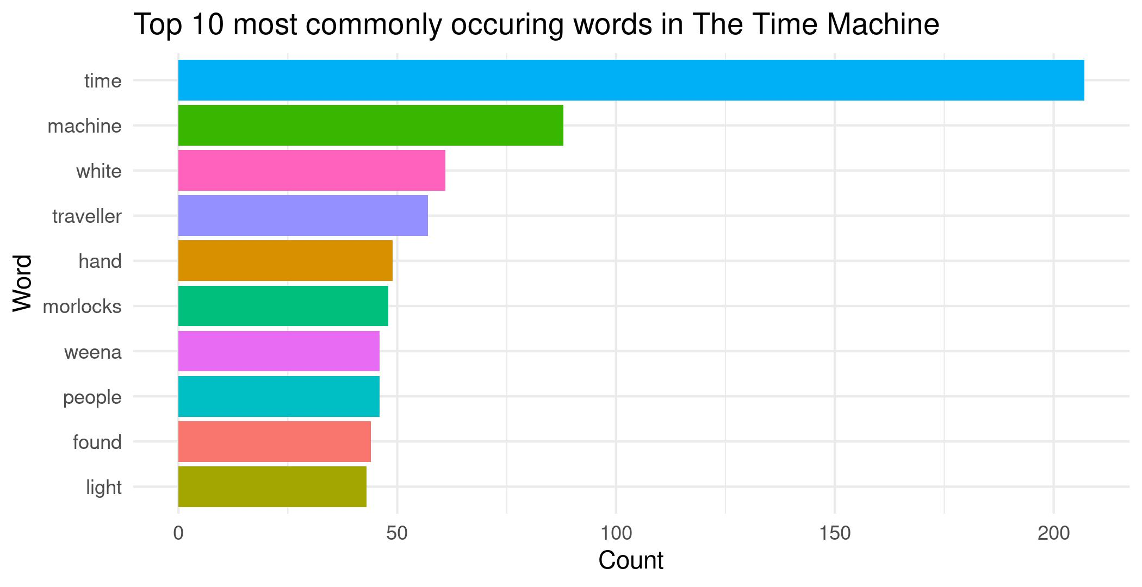

Slide 12
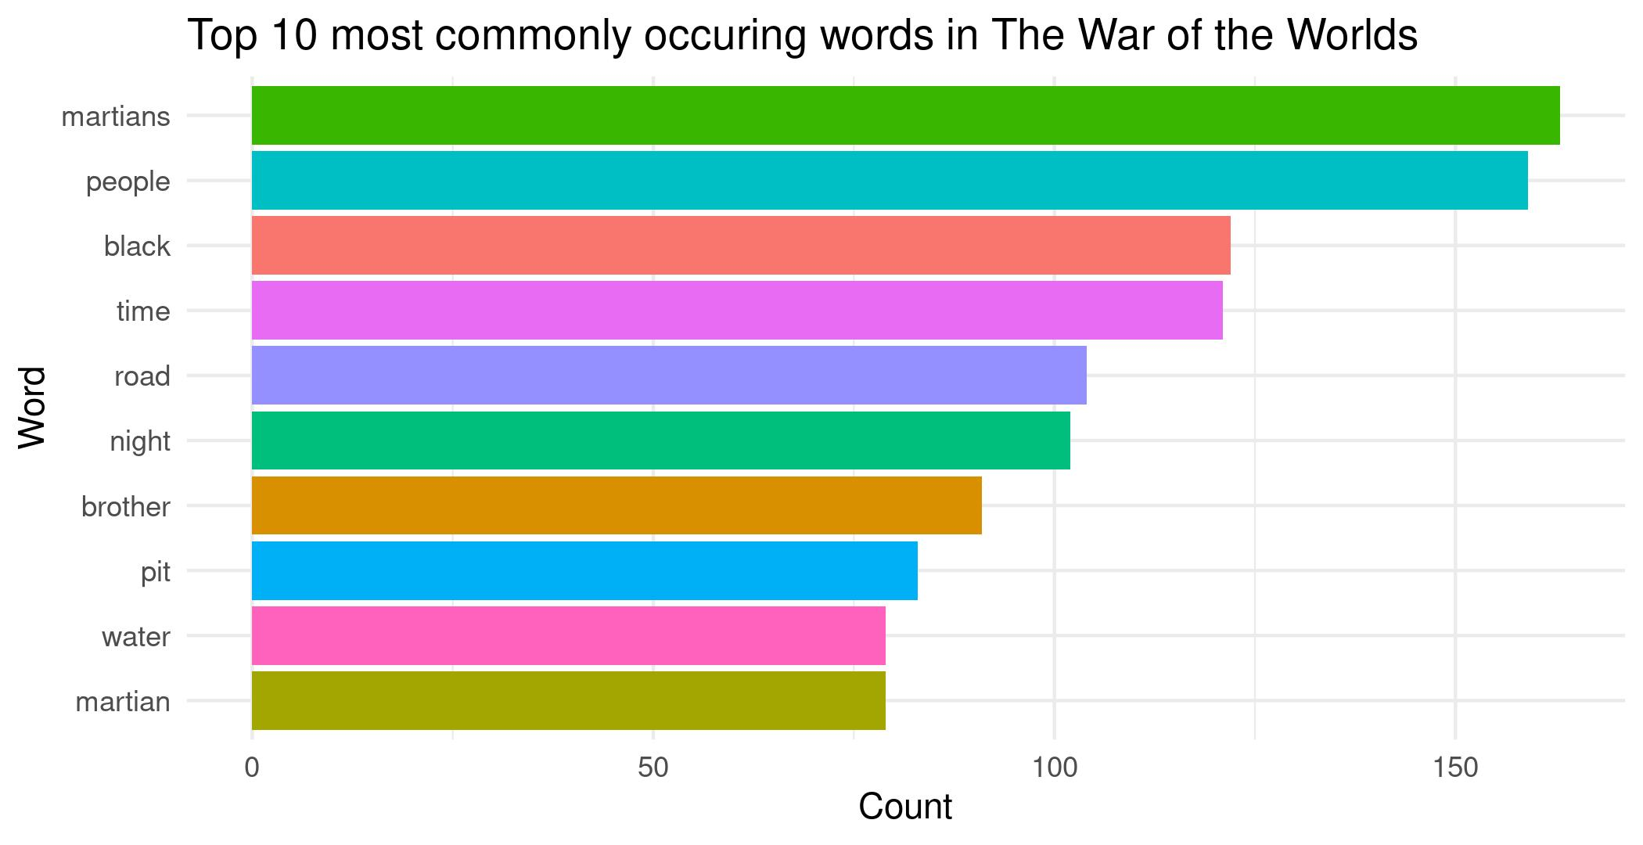

Slide 13
Sentiment Analysis
We can use one of the sentiment databases built-in to the tidytext package. The 'bing' database has sentiment ratings (positive vs. negative) for almost 7,000 words.
get_sentiments("bing")
# A tibble: 6,786 x 2
word sentiment
<chr> <chr>
1 2-faces negative
2 abnormal negative
3 abolish negative
4 abominable negative
5 abominably negative
6 abominate negative
7 abomination negative
8 abort negative
9 aborted negative
10 aborts negative
# … with 6,776 more rows

Slide 14
Sentiment Analysis
We can 'join' our all_text data to the sentiment dataset using the inner_join() function from {dplyr}
all_text_sentiments <- all_text %>%
inner_join(get_sentiments("bing"))
head(all_text_sentiments)
# A tibble: 6 x 4
gutenberg_id title word sentiment
<int> <chr> <chr> <chr>
1 35 The Time Machine golden positive
2 35 The Time Machine shock negative
3 35 The Time Machine darkness negative
4 35 The Time Machine trap negative
5 35 The Time Machine convenient positive
6 35 The Time Machine pale negative

Slide 15
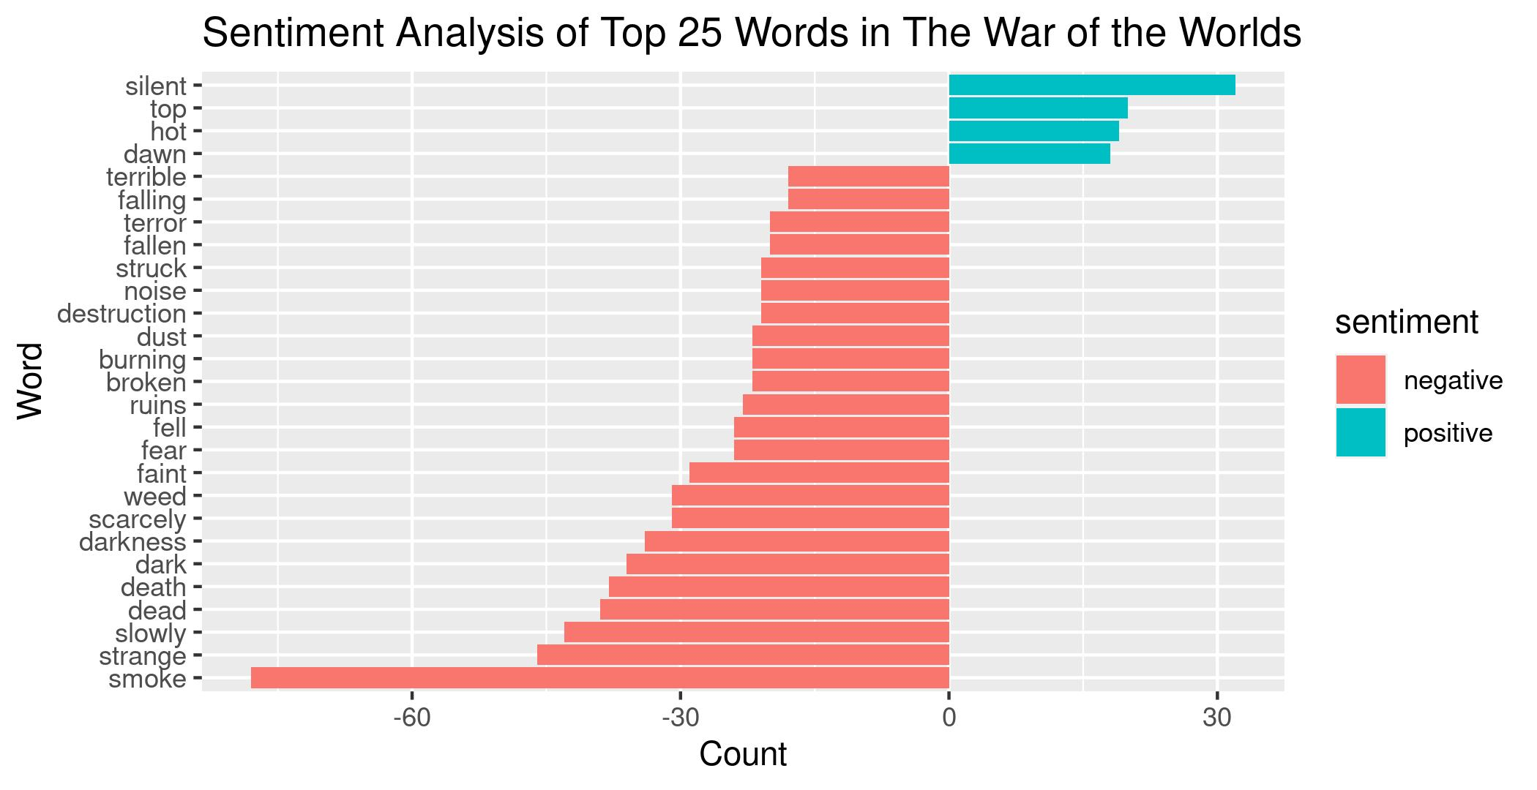

Slide 16
Examining the proportion of useage of each word in each book
book_words <- all_text %>%
group_by(title) %>%
count(title, word, sort = TRUE)
total_words <- book_words %>%
group_by(title) %>%
summarise(total = sum(n))
book_words <- left_join(book_words, total_words)
book_words %>%
mutate(proportion = n/total) %>%
group_by(title) %>%
arrange(desc(title, proportion)) %>%
top_n(3) %>%
select(-n, -total)

Slide 17
Selecting by proportion
# A tibble: 12 x 3
# Groups: title [4]
title word proportion
<chr> <chr> <dbl>
1 Twenty Thousand Leagues under the Sea captain 0.0153
2 Twenty Thousand Leagues under the Sea nautilus 0.0131
3 Twenty Thousand Leagues under the Sea sea 0.00880
4 The War of the Worlds martians 0.00722
5 The War of the Worlds people 0.00704
6 The War of the Worlds black 0.00540
7 The Time Machine time 0.0184
8 The Time Machine machine 0.00781
9 The Time Machine white 0.00541
10 The Invisible Man: A Grotesque Romance kemp 0.0117
11 The Invisible Man: A Grotesque Romance invisible 0.00990
12 The Invisible Man: A Grotesque Romance door 0.00930

Slide 18
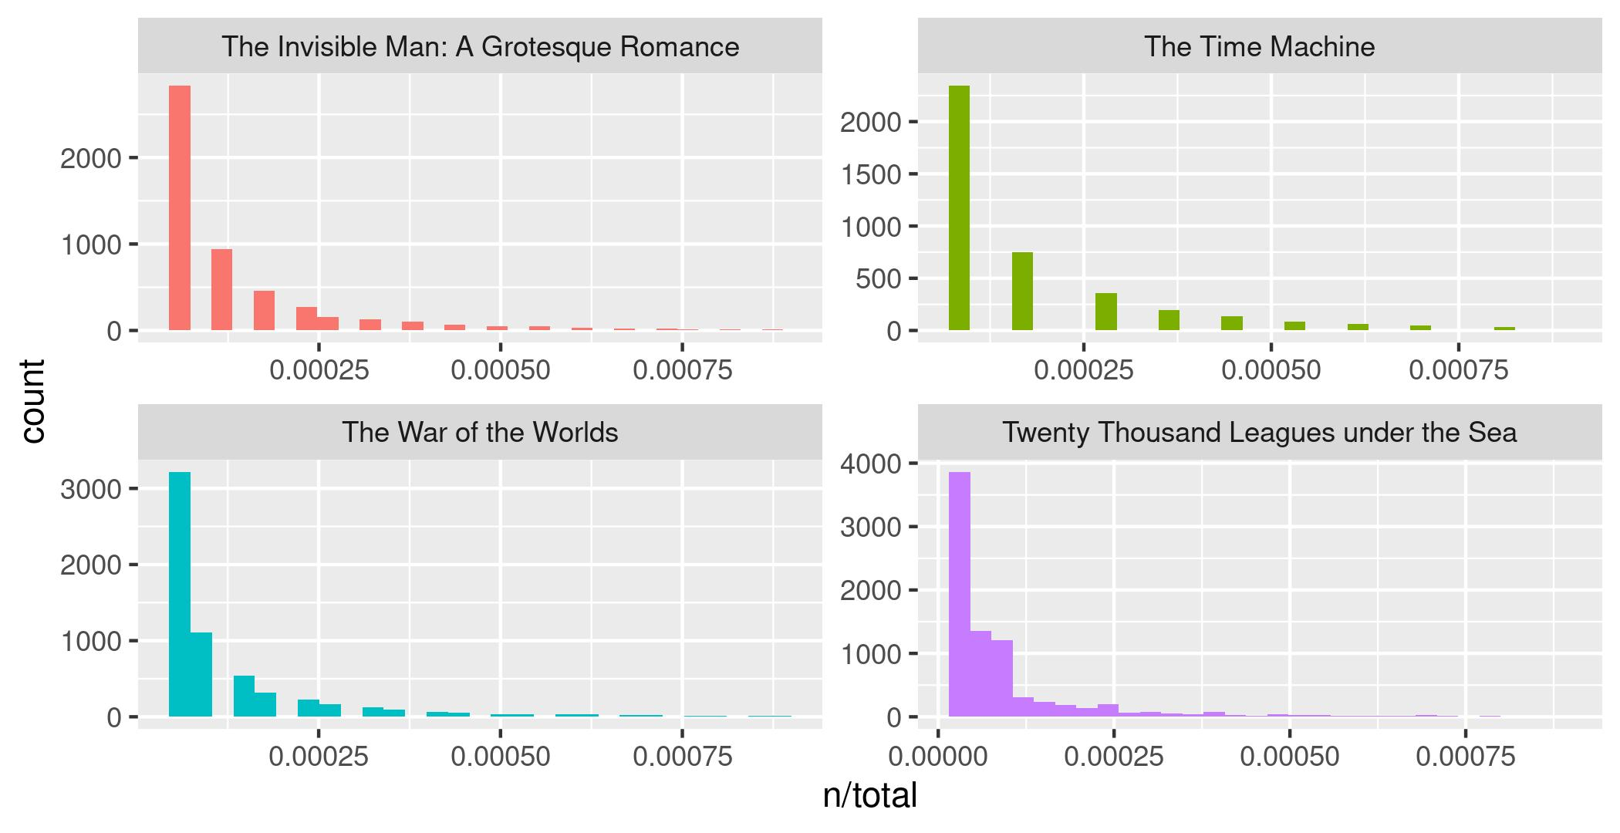
Visualizing the data - Zipf's Law

Slide 19
Which words are most important (and most unique) to each book?
The bind_tf_idf() function works out the important words for each book by adding a weighting to each word - decreasing the weight for commonly used words and increasing the weight for words not used much in the overall corpus. This is the term frequency-inverse document frequency measure used widely in text analysis.
This allows us to identify what words tend to be uniquely associated with each of the four books. This is known as the term frequency-inverse document frequency statistic.
book_words_tf_idf <- book_words %>%
bind_tf_idf(word, title, n)

Slide 20
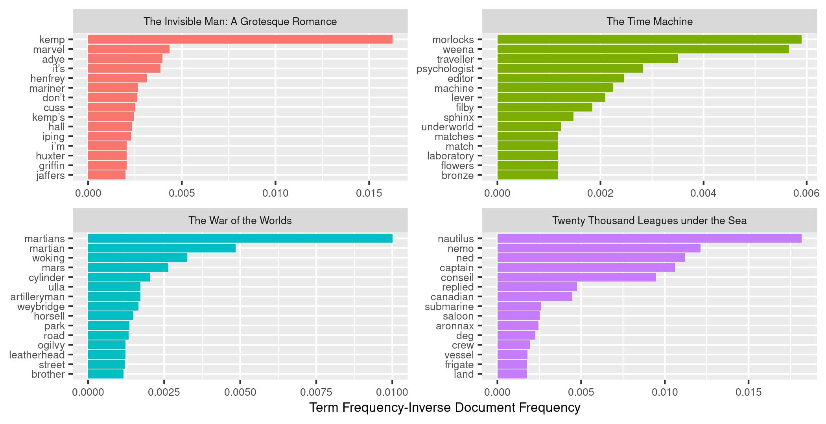

Slide 21
N-gram tokenizing
So far we've unnested such that each word is separate. But we can also unnest by n-grams to capture sequences of words. In this example, let's look at tokenizing by bigram.
wotw_bigrams <- books %>%
filter(title == "The War of the Worlds") %>%
unnest_tokens(bigram, text, token = "ngrams", n = 2) %>%
separate(col = bigram, into = c("word1", "word2", sep = " ")) %>%
filter(!word1 %in% stop_words$word) %>%
filter(!word2 %in% stop_words$word) %>%
count(word1, word2, sort = TRUE)

Slide 22
Plotting a network graph of bigrams
bigram_graph <- wotw_bigrams %>%
filter(n > 5) %>%
graph_from_data_frame()
set.seed(1234)
ggraph(bigram_graph, layout = "fr") +
geom_edge_link(alpha = .25) +
geom_node_point(alpha = .25) +
geom_node_text(aes(label = name), vjust = -.1, hjust = 1.25, size = 3) +
guides(size = FALSE) +
xlim(10, 22) +
theme_void()

Slide 23
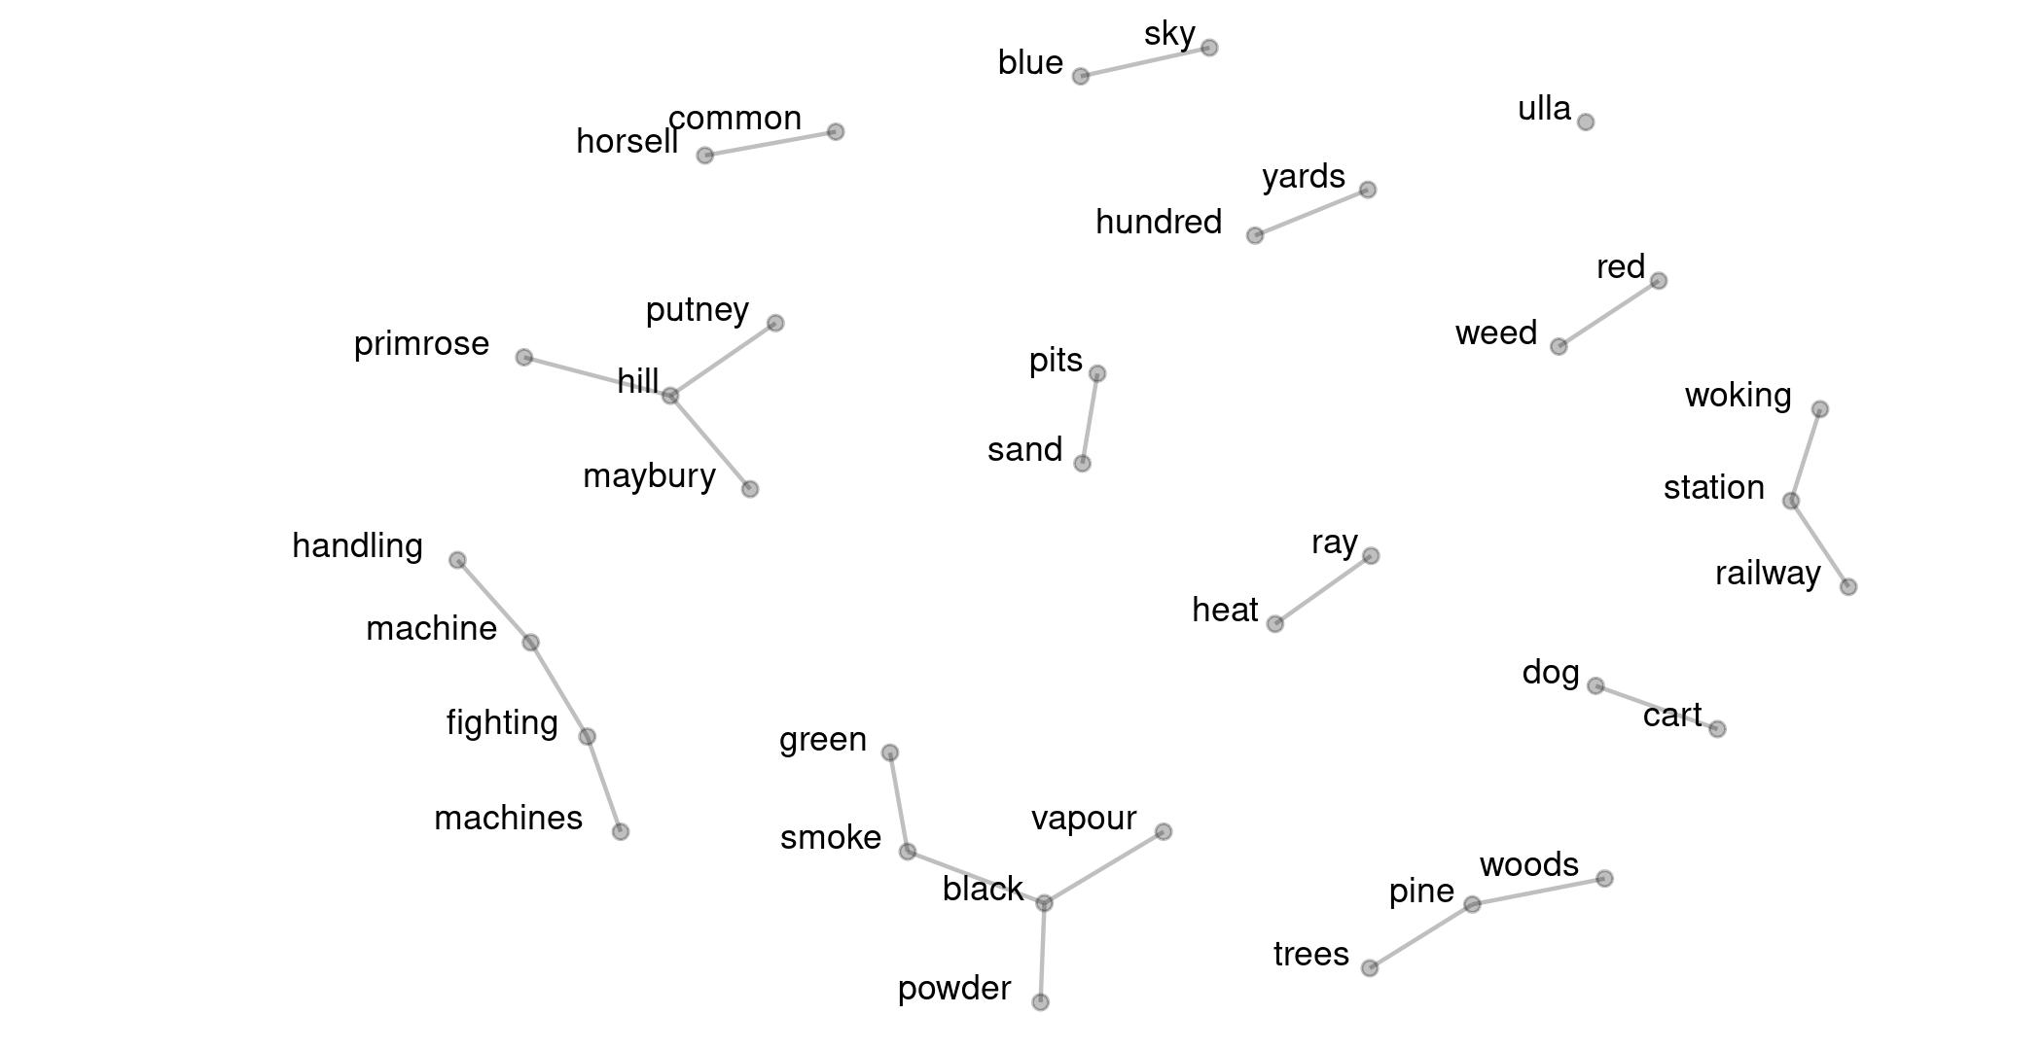

Slide 24
Summary
With {tidytext} in R you can extract a lot of information about different texts - you might consider applying the approach to interview transcripts (for example) as a way of providing quantitative insights in addition to qualitative approaches.
You might even want to use the term frequency-inverse document frequency measure as a way of understanding what words or n-grams are associated with particular interviews (or sets of interviews) and not with others.

