Slide 1
Establishing Your Digital Presence
Dr Andrew J. Stewart
E: drandrewjstewart@gmail.com
T: @ajstewart_lang
G: ajstewartlang

Slide 2
Why would you want to?
If you don't build your own presence, Google etc. will do it for you - and you might not like how you appear on the Web!
Applying for jobs, PhD positions etc. is likely to involve searches for your digital presence.
Better to take control of that than to let Google decide what to present to those searching for you.

Slide 3
Academic Twitter
You can have multiple accounts on Twitter - easiest way to do this is to tie each to a different email account.
Using the Twitter app (and other platforms) it's easy to switch between the two.
On academic Twitter (if you follow the right people) you'll be party to global conversations about where your research area is going.
Twitter is also the easiest way to stay ahead of the curve - pre-prints, new packages in R, discussions around the theories behind your science, funding opps, jobs etc.

Slide 4
Building Your Website
Your website can contain your biography, cv, blogs you've written, R markdown files you've generated - maybe with Tidy Tuesday datasets - that show off your data analysis and open research skills.
You could even link to presentations you've written as part of this MRes.
You can build your own network by linking your website to your Twitter page, your GitHub page, Facebook etc.
That way, when people search for your name in future they're likely to find your website as the top hit.

Slide 5
To Build Your Website
Step 1 - Build it!
Step 2 - Host it somewhere.
Step 3 - er, that’s it...

Slide 6
Building Your Website
We’re going to look at two options - using Wordpress, and using the {blogdown} package in R.
Both are free.
The wordpress option is easier, but the blogdown option will extend your R knowledge.

Slide 7
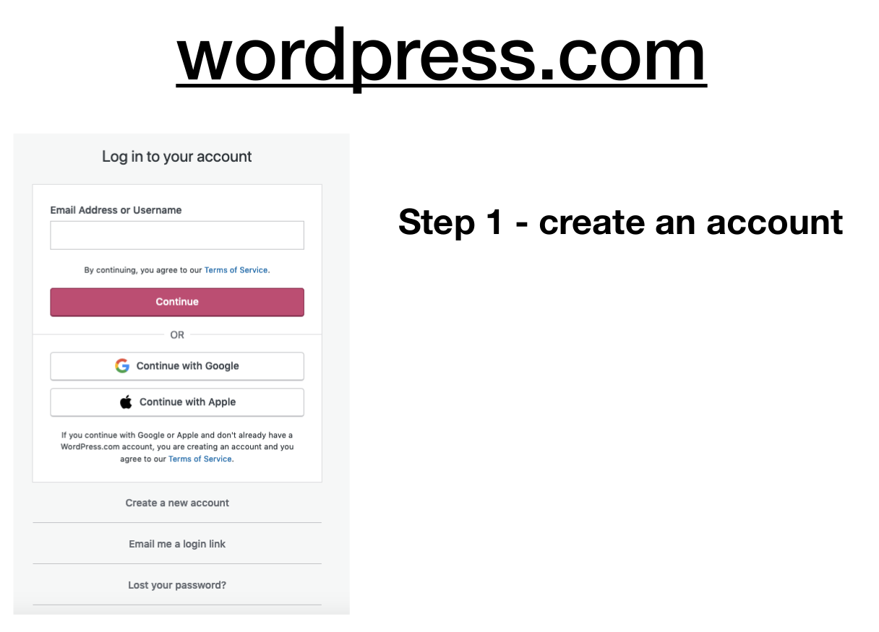

Slide 8
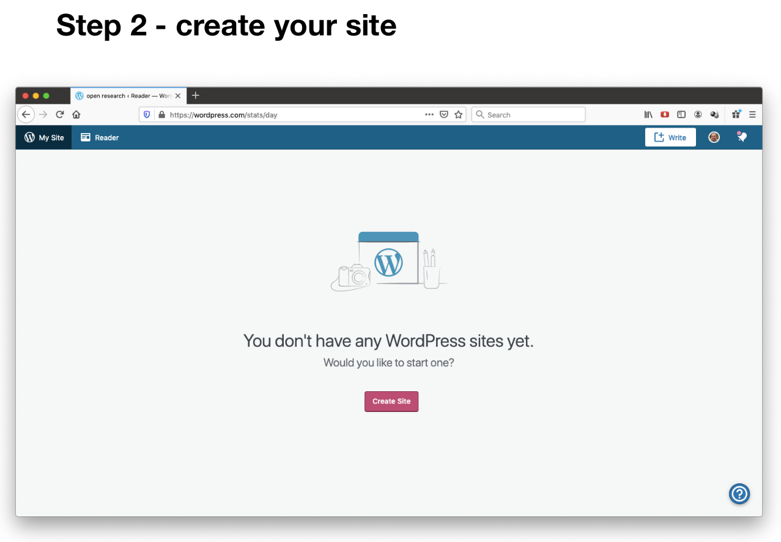

Slide 9
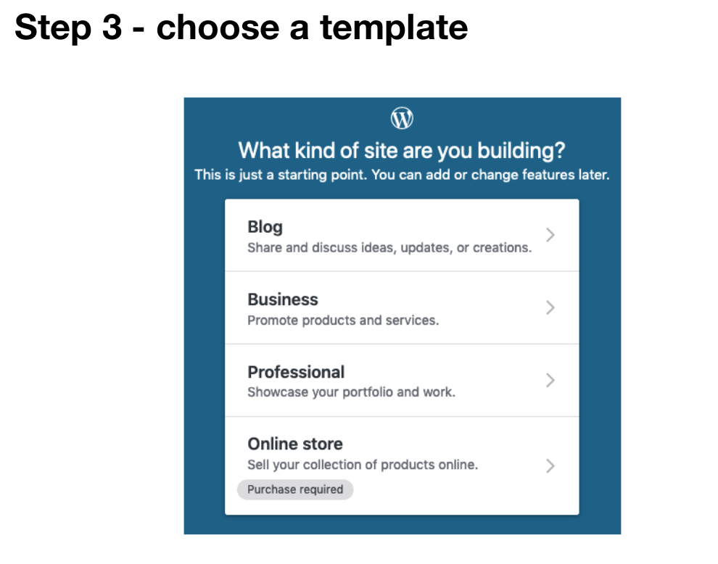

Slide 10
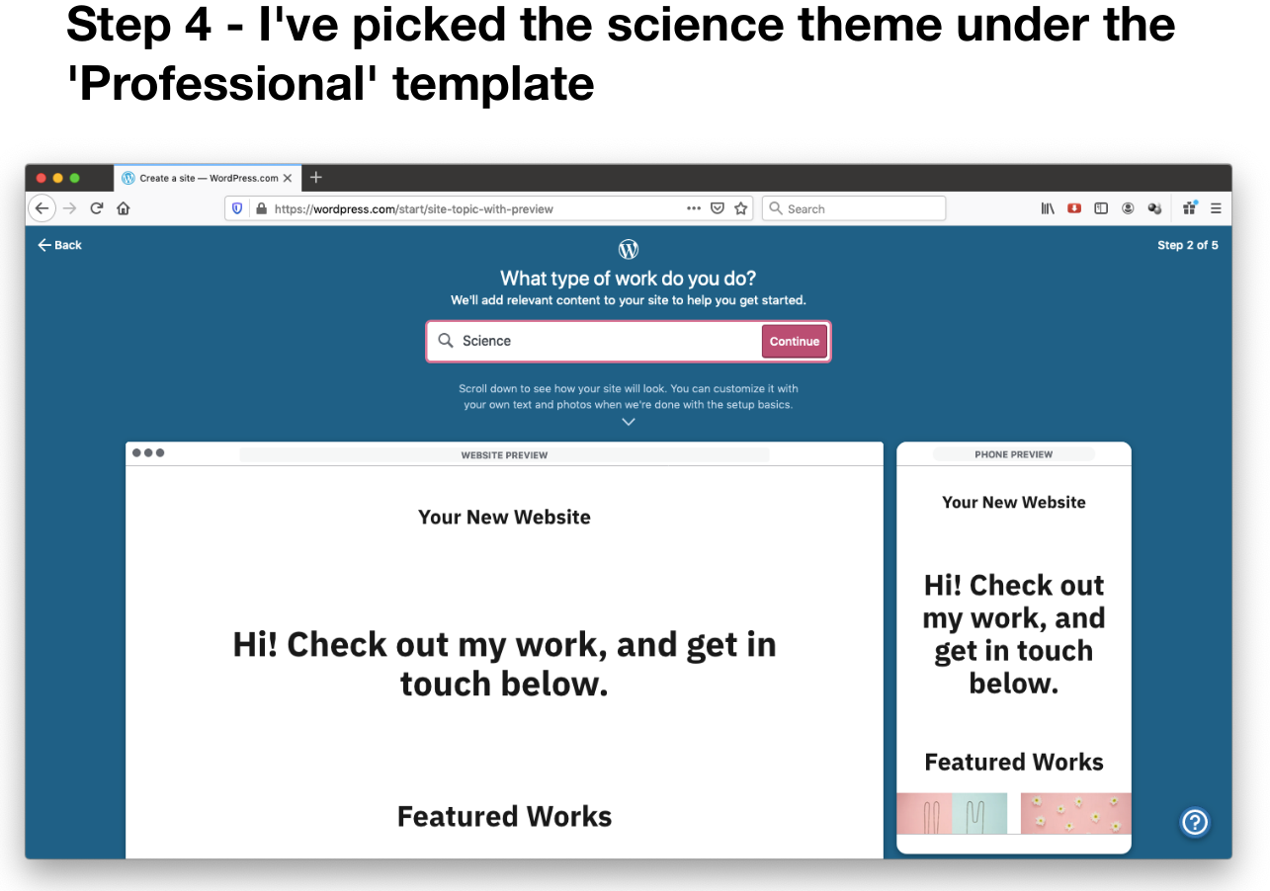

Slide 11
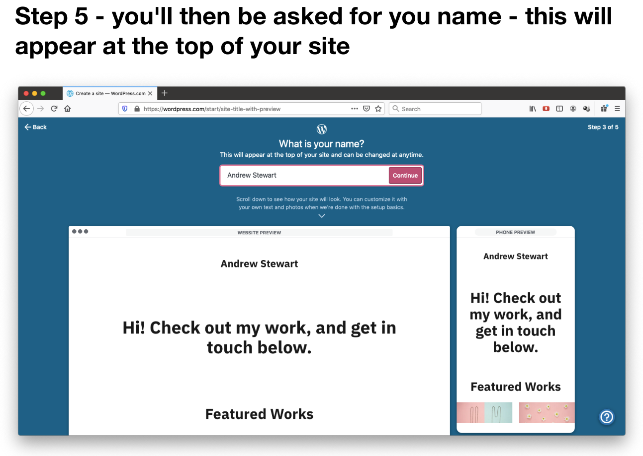

Slide 12
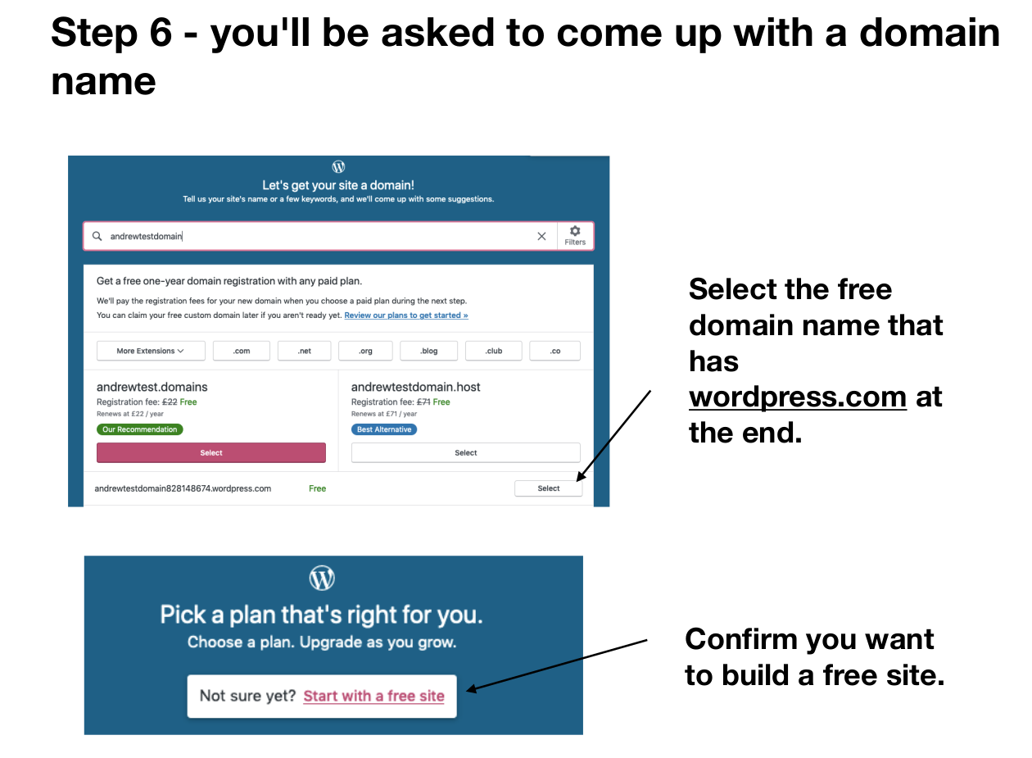

Slide 13
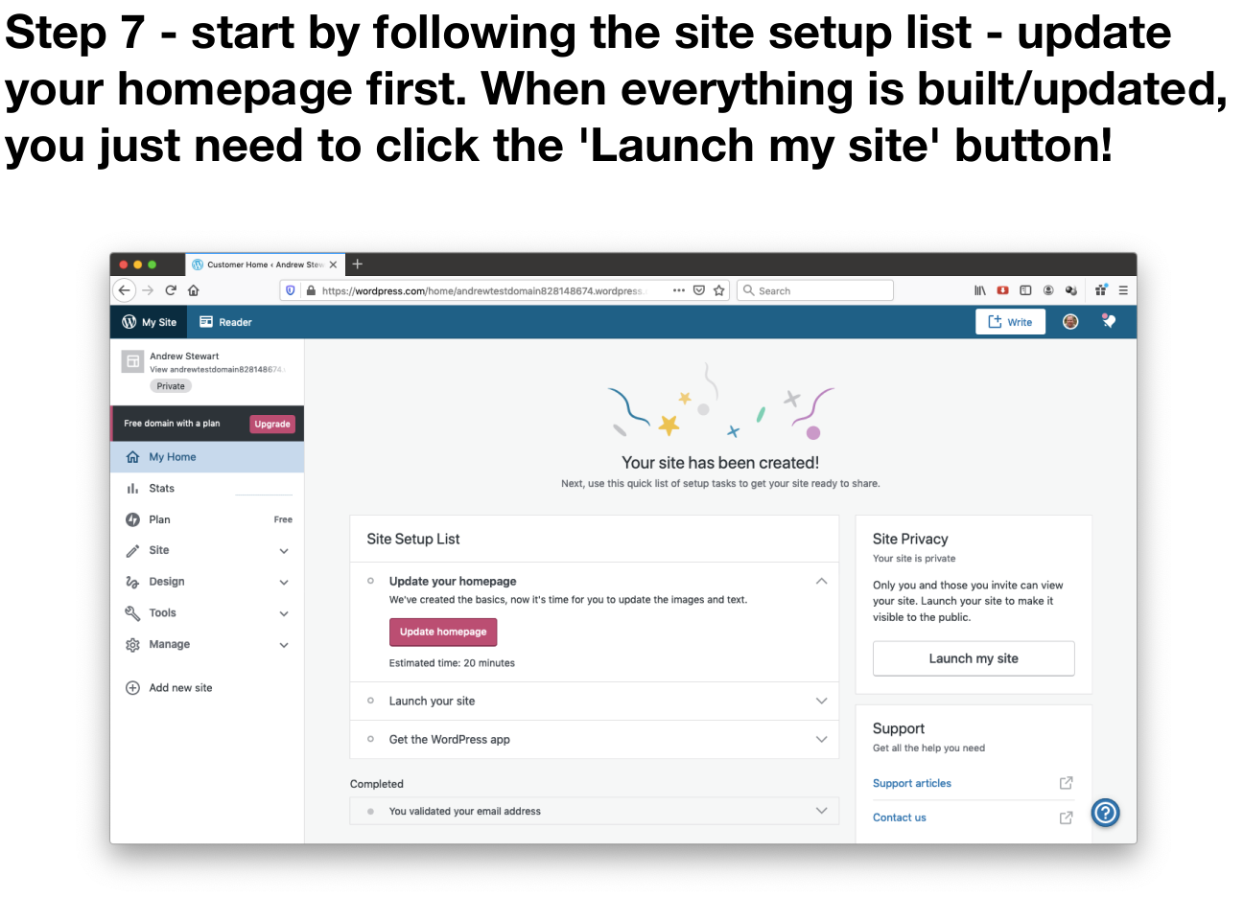

Slide 14
Using {blogdown} in R
Using a combination of R, the {blogdown} package, GitHub (hosting the repo of your website), and Netlify (that deploys your GitHub repo) you can set up a website that will automatically update when you make changes on your computer - this uses Netlify's continuous deployment method.
Pros - looks impressive, very flexible, allows you to embed presentations, R Markdown etc.
Cons - a bit more technically complex as requires several tools.

Slide 15
My Site
https://ajstewartlang.netlify.app
Siri Folstad's Site
https://www.sirifolstad.com
Duncan Bradley’s Site
https://duncan-bradley.netlify.app/
Dan Quintana's Site
https://www.dsquintana.com

Slide 16
The Dan Quintana Guide
• https://www.dsquintana.blog/free-website-in-r-easy/
• Step 1 - install the blogdown package with install.packages("blogdown")
• Step 2 - install the hugo framework with blogdown::install_hugo(version = “latest”, force = TRUE)although you may have to install an earlier version of hugo such as 0.68.1 with blogdown::install_hugo(version = “0.68.1”, force = TRUE)
• Step 3 - restart R

Slide 17
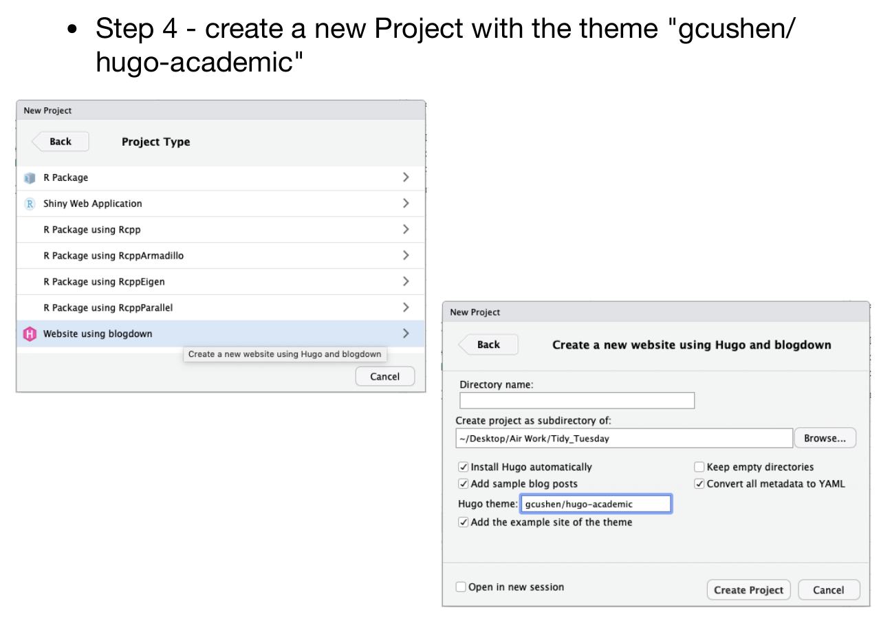

Slide 18
Step 5 - build the template with the command blogdown::serve_site()
You'll see the templated site render in the pane on the lower right. Click on the files button and you'll be able to modify the files that generate the content displayed in this site.
You'll start with editing the config.toml file. Follow the rest of the steps at: https://www.dsquintana.blog/free-website-in-r-easy/
Once your website is written, you need to deploy it on Netlify (www.netlify.com) - you can do this manually (by copying the public folder into the Deploy section on Netlify) or via GitHub where you link your website repo in GitHub to Netlify.

Slide 19
If you want to unleash the power of version control and continuous deployment...
Start by installing git and then connecting your website repo on GitHub to Netlify:
https://docs.google.com/presentation/d/1a23TkF2eFJegzMr6prB-WhqudR5oVOlvqI68TTZl8jQ/edit?usp=sharing

Slide 20
Your Turn
If you don't already have one, create a Twitter account and follow me if you want (@ajstewart_lang) plus others such as:
Brian Nosek (Virginia) - @BrianNosek; Dorothy Bishop (Oxford) - @deevybee; Marcus Munafò (Bristol) - @MarcusMunafo; Chris Chambers (Cardiff) - @chrisdc77; The UK Reproducibility Network - @UKRepro; Center for Open Science - @OSFramework
If you do have a personal Twitter account and want to keep it separate, create a new Twitter account using a different email address.
Start to build an academic website for yourself using either WordPress or blogdown in R (or if you'd rather try a different method - e.g., Weebly - that's fine too).

