Slide 1
Introduction to Cognition - Language 1
Andrew J. Stewart
Division of Neuroscience and Experimental Psychology
E: andrew.stewart@manchester.ac.uk
T: @ajstewart_lang

Slide 2
My background...
I am an experimental psychologist in DNEP with a research focus on eye-movements, reading comprehension, and how people understand data visualisations.
Applied work in industry examining consumer psychology related to reading about brands and text in print advertisements.
Interests in indirect meaning, conditionals (i.e., how do people understand ‘if’ statements), how people understand graph labels, text mining of (e.g.) social media posts etc.

Slide 3
Learning Objectives
By the end of this lecture you should:
Be aware of the challenges around having to deal with ambiguity in language comprehension.
Have an understanding of some of the key techniques used to measure language comprehension as it unfolds in real time.
Have an understanding of how sentences are processed and ambiguities resolved.
Have an understanding of the range of inferences that a reader typically has to make during discourse processing in order to connect together pieces of text.

Slide 4
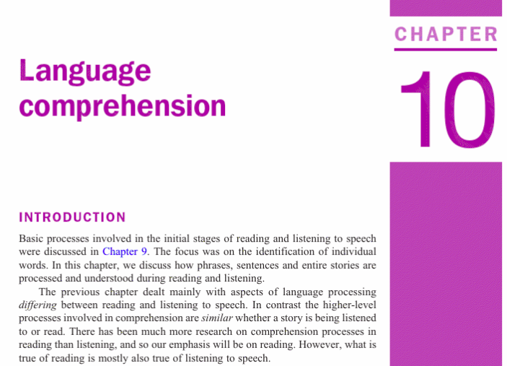
This session
This session is made up of a number of videos, with narrative I’ve written, and links to some resources that I hope you’ll find interesting.
Chapter 10 in Eysenck and Keane supports this session.

Slide 5
This session
Psycholinguistics is the study of human language processing and is a core component of Psychology drawing upon Cognitive Science, Philosophy and Linguistics.
Language is the way in which people communicate with others via written and spoken language comprehension, production, dialogue etc.
Language is a window to cognition (thoughts, emotions, goals etc).

Slide 6
This session
Language is central to:
Cognitive psychology (language processing is a core aspect of cognition).
Neuroscience (understanding the neural substrates underlying the language system).
Developmental psychology (language as a window into the mind of the developing child).
Social psychology (looking at communication between/within groups/people).
Clinical psychology (patient/doctor interactions, language deficits as indicators of disorders).
Applied psychology (incl. marketing, advertising etc.)

Slide 7
This session
We will examine some of the kinds of ambiguity that are pervasive in language.
We will look at how people understand sentences and how the words in a sentence relate to each other. This is called Parsing or Sentence Processing.
We will then look at Discourse Processing and how people create Situation Models to capture the meaning of text.
We will look at the inferences that people generate during reading, and how they interpret pronouns and other words that take their meaning from what they refer to.
We will finish by looking at shallow processing. Or what happens when you’re not reading in detail.

Slide 9
Ambiguity (is all around us)
Language input is often highly ambiguous (e.g., The spy saw the cop with the binoculars; The horse raced past the barn fell; I put my bag down near the bank).
Words and phrases with different meanings can sometimes sound the same.
We are rarely consciously aware of all the ambiguities in written and spoken language.

Slide 10
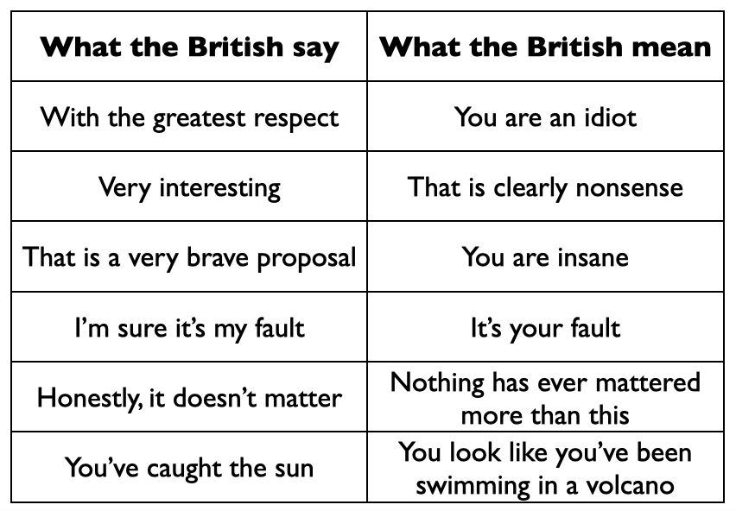
Some meanings are indirect

Slide 11

Have a look at this video...
https://www.youtube.com/watch?v=gi_6SaqVQSw\

Slide 13
Experimental approaches to examining language comprehension
Understanding how the brain processes language in real-time is critical for models of human language processing.
How best can we gain insight into the moment-by-moment processes associated with language comprehension?

Slide 14
Eye-tracking
Participants read text on a computer screen and have their eye-movements monitored as they do this.
Eye-movements consist of eye fixations (for about 250 msec. each) and saccades (where the eye jumps from one location to another).
10-15% of all eye-movements are backwards (called regressions) and they allow the reader to (re)look at previously read text.
When fixating at a point in a word, you can actually see about 4 characters to the left and about 12-15 to the right of fixation. This is the perceptual span (McConkie & Rayner, 1975).

Slide 15
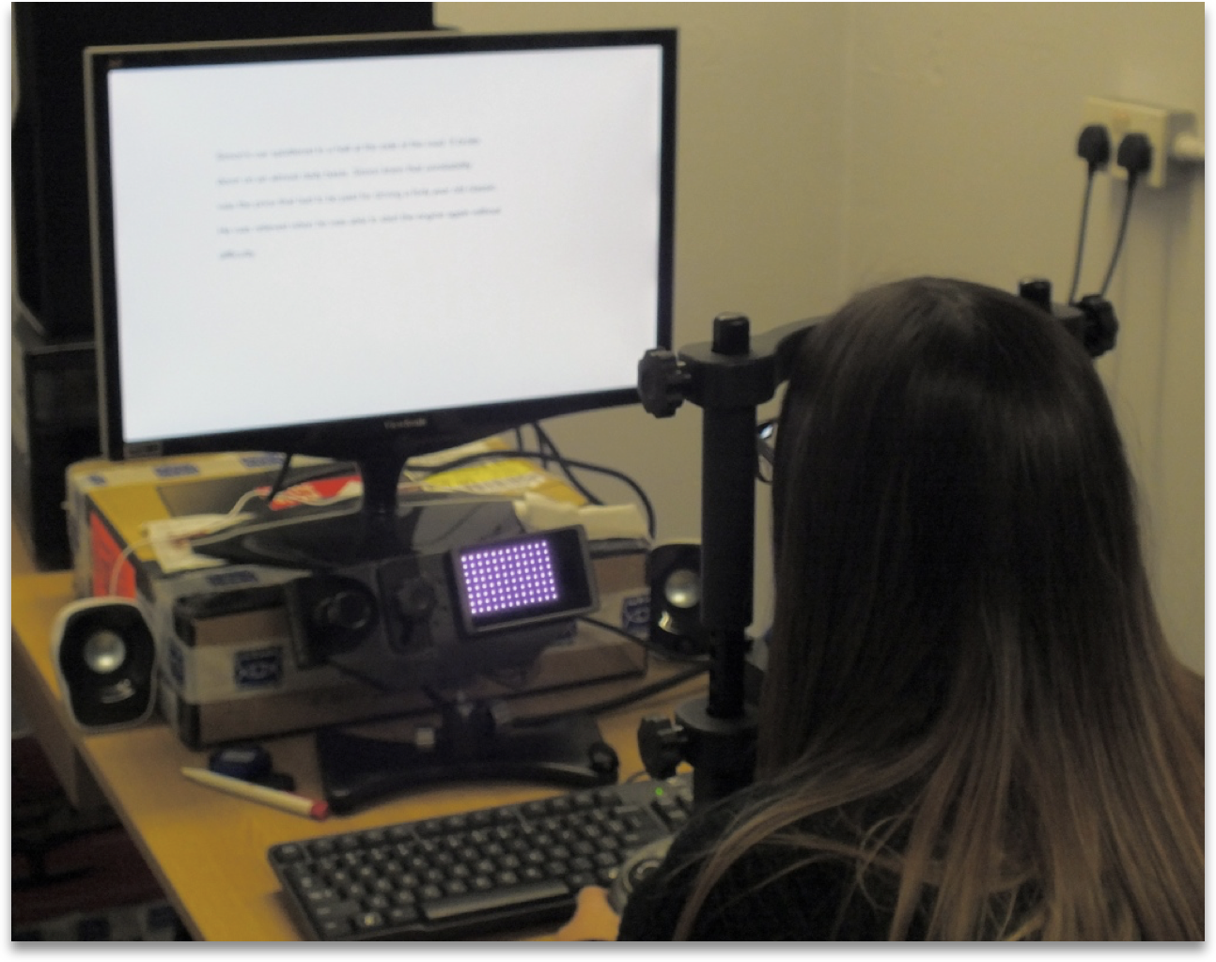
Eye-tracking
Infrared light is shone into the eye - it generates two reflections from the which are then measured by the eye-tracking camera.
Two reflections result - by measuring how these reflections move relative to each other, it’s possible to calculate what the eye is looking at.

Slide 16
What does eye-tracking tell us?
Eye-tracking tells us how long people’s eye fixate on particular words - and which words they go back to re-read.
The time spent on a word reflects the processes associated with how long it takes the reader to access the meaning of the word, and integrate with the meanings of the words read previously.
Eye-tracking also reflects how common (frequent) or rare (infrequent) words are:
The concerned student calmed the child.
The concerned steward calmed the child.
The only difference between the two sentences is ‘student’ (a frequent word) appears in the first example and ‘steward’ (an infrequent word) appears in the second.
Rayner and Duffy (1986) report increased fixation times to ‘steward’ over ‘student’.

Slide 17
What does eye-tracking tell us?
Reading rates reflect the time course of the operation of comprehension processes (Just & Carpenter, 1980).
The immediacy hypothesis – the reader tries to comprehend a word as soon as it is encountered (i.e., they don’t delay processing).
The eye-mind hypothesis – there is no delay between looking at a word and the brain processing that word.
So, together these assume that the brain starts processing a word as soon as it is encountered and the eye moving onto the next word signals processing has terminated.

Slide 19
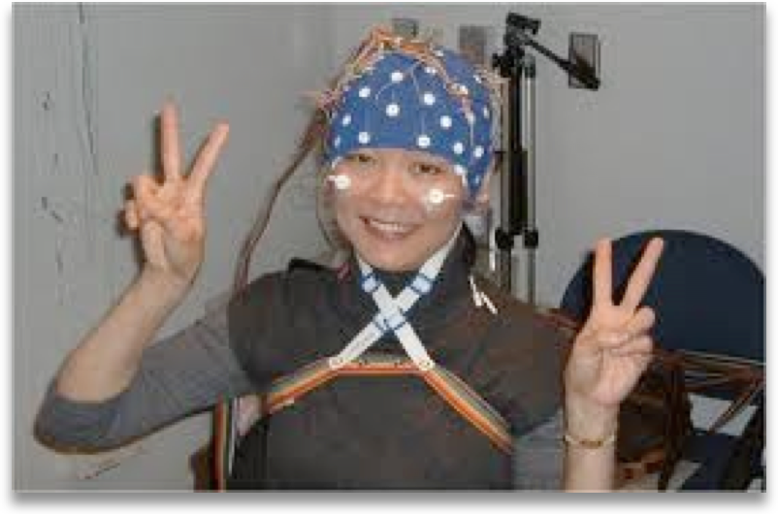
Electroencephalography (EEG)
EEG measures voltage changes on the scalp associated with presentation of stimuli.
Event-Related Potentials (ERPs) are components of the EEG and labelled according to their polarity (+ve or -ve) and the latency in milliseconds following onset of the stimulus.

Slide 20
The N400
The N400 and the P600 are two of the ERP components that are of most interest to psycholinguists.
The N400 is a negative potential that peaks around 400 msec. after stimulus onset.
Kutas and Hillyard (1980) in a landmark study demonstrated it reveals sensitivity to semantic incongruity.
I take coffee with cream and dog.
Last word is semantically anomalous and results in N400

Slide 21
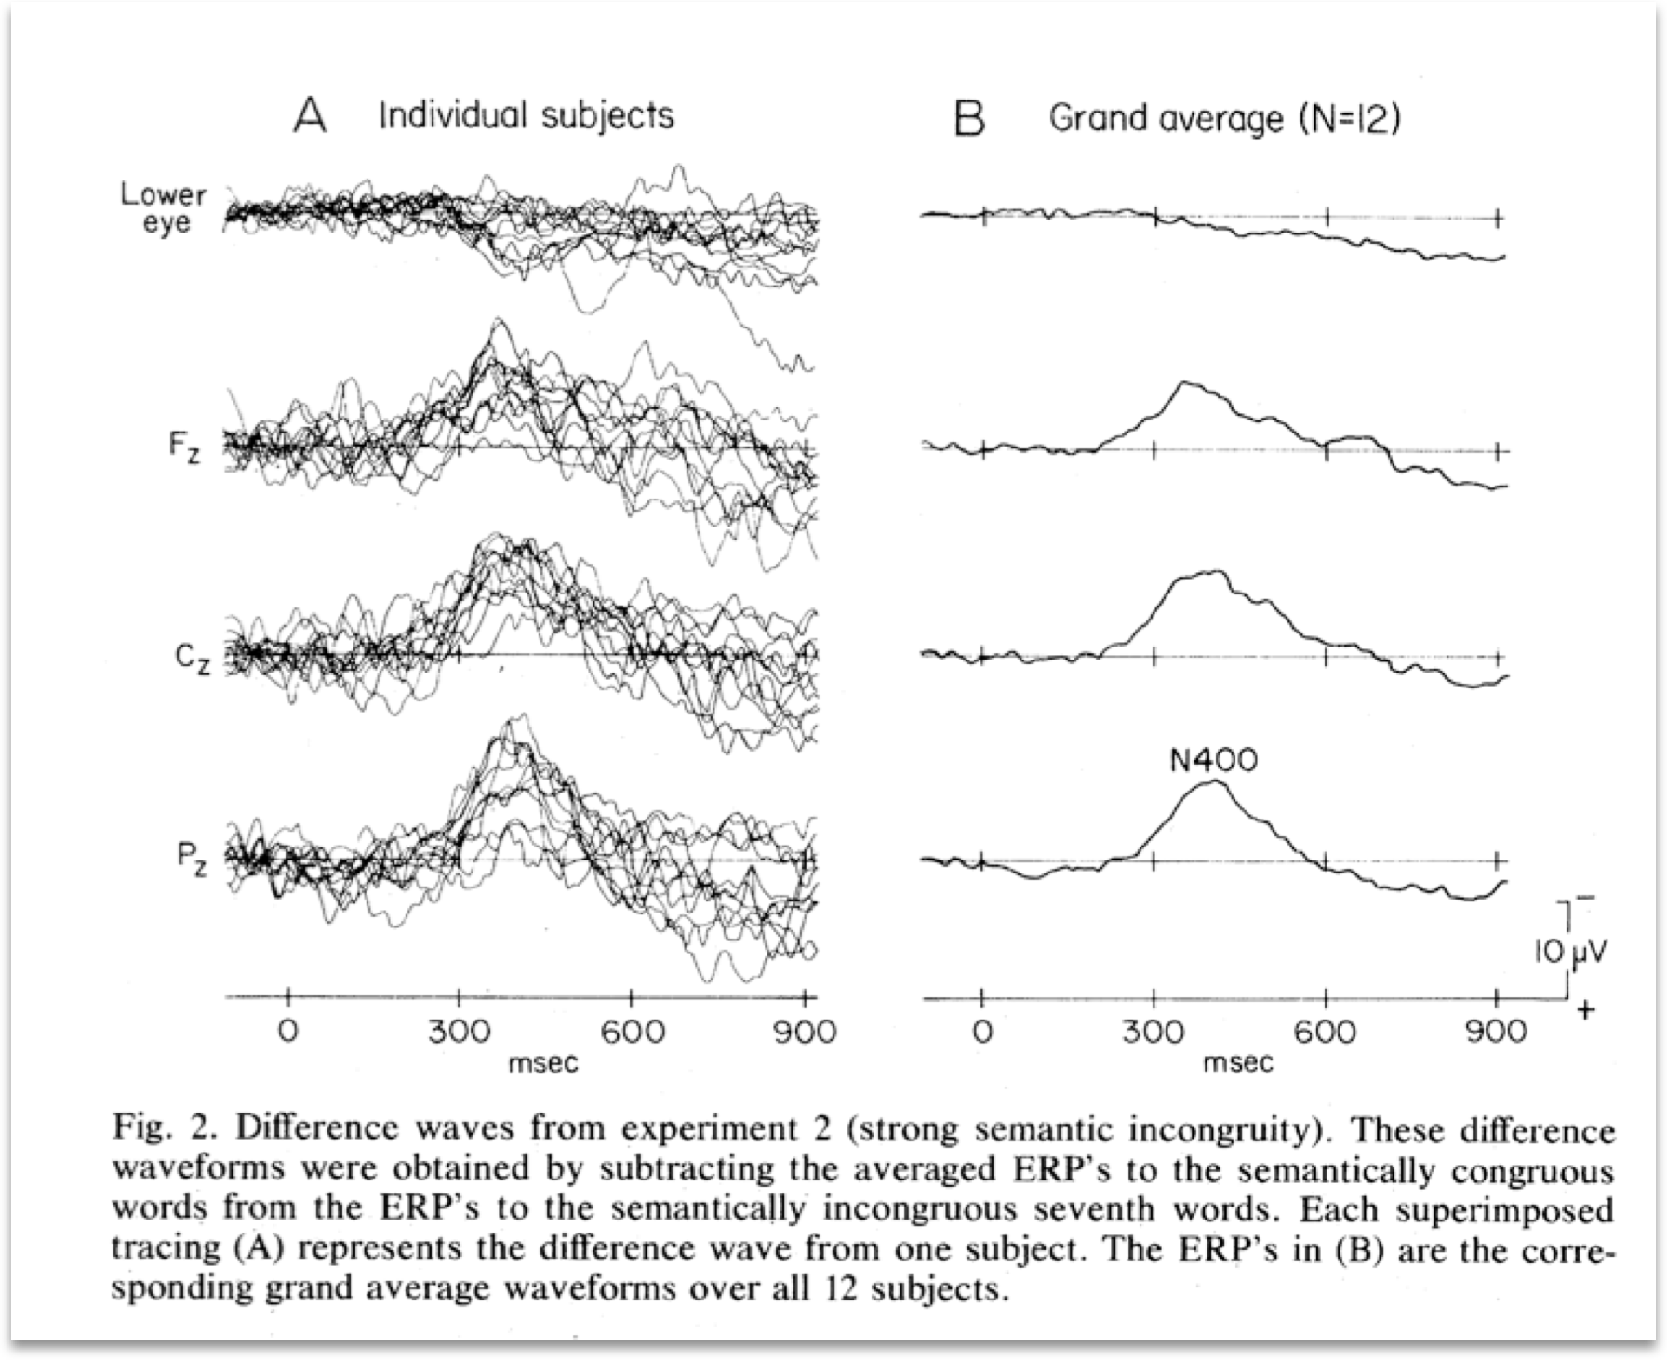
The N400

Slide 22
The P600
The P600 typically indexes syntactic violations.
The broker persuaded to sell the stock was tall.
The verb is initially interpreted as the past tense of ‘persuade’ rather than as a reduced relative (‘who was persuaded’).
Osterhout and Holcomb (1992) report a P600 associated with reading ‘to’.

Slide 24
Parsing
Computing the syntactic structure of sentences is called parsing.
Sentence parsing involves determining the relationship between the different elements of a sentence and assigning them to syntactic categories (e.g., noun, adjective, verb, etc.)
You use lots of implicit knowledge (i.e., knowledge you can’t consciously access or accurately describe) incredibly rapidly during parsing.
Syntax = building of sentences according to grammatical rules; arrangements of words into an order that results in a meaningful sentence.

Slide 25
Parsing
The dog bit the man.
The man was bitten by the dog.
Although these two sentences differ in syntactic structure, their underlying meanings are pretty much equivalent.
As readers, we have little conscious difficulty unravelling the syntactic relations between different elements in the language input.

Slide 26
Local Ambiguity
When Fred passes the ball......
When Fred passes the ball it always gets to its target.
When Fred passes the ball always gets to its target.
The phrase ‘the ball’ is temporarily ambiguous - it could be the object of the verb ‘passes’, or it could be the subject of the next phrase ‘always gets to its target’. You find out only after you’ve read ‘the ball’ which interpretation correct.
Another “classic” example is from Bever (1970):
The horse raced past the barn fell.

Slide 27
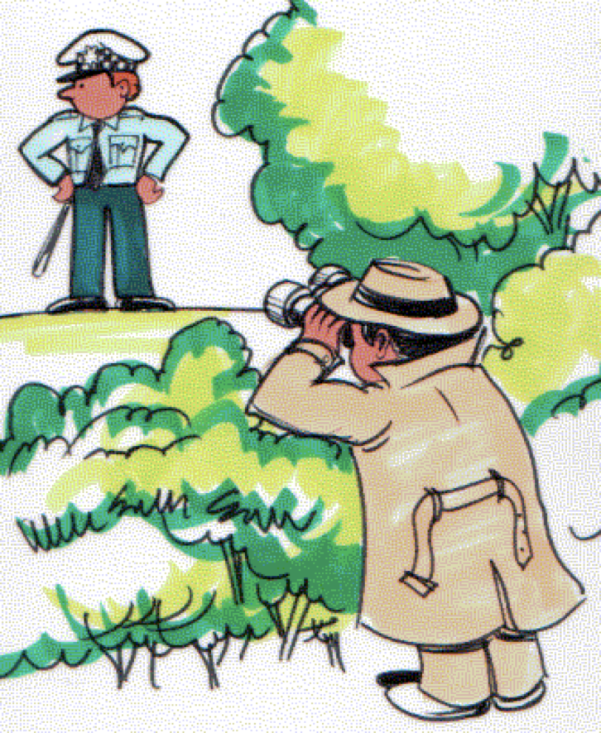
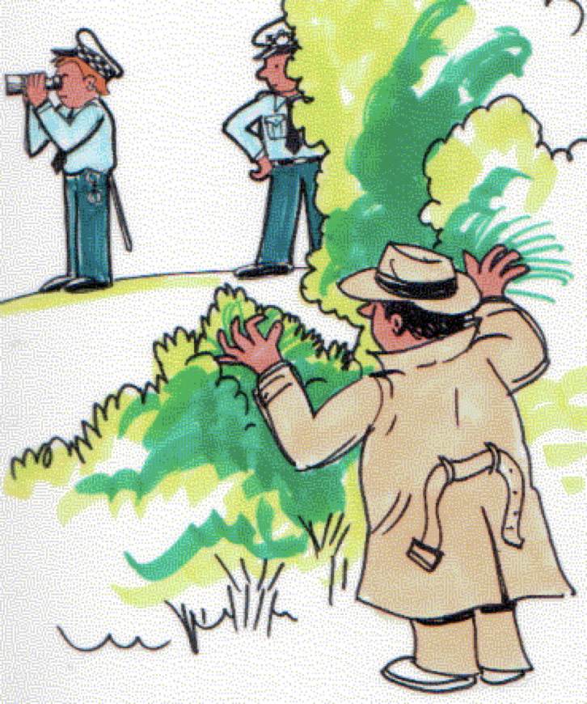
Global Ambiguity
Consider the sentence:
The spy saw the cop with the binoculars.
This is ambiguous between an interpretation where the phrase ‘with the binoculars’ is attached to the Verb Phrase (VP-attachment), and an interpretation where it is attached to the Noun Phrase (NP-attachment).

Slide 28
Models of Parsing
How does the language processing system decide whether the VP- or NP-attachment interpretation is correct?
If someone you are speaking to uttered this sentence, or you come across it during reading, choosing the incorrect interpretation will cause comprehension problems.
One class of parsing models says you use syntactic information to construct the ‘simplest’ syntactic representation.

Slide 29
The Garden Path Model
The Garden Path model (Frazier, 1979) defines simplicity in terms of the simplest syntactic structure that can be constructed.
Stage 1: identify syntactic categories and build initial structure
Stage 2: assess outcome against context, semantic plausibility, real-world knowledge
Revise if necessary.
This model was very influential - it made clear predictions and thus generated lots of experiments.
But the bulk of empirical evidence suggests that syntax isn’t ‘special’ and that lots of different types of information influence parsing as it unfolds in real-time. Constraint based models propose that the parser is able to utilise all potentially relevant information to guide the early stages of processing.

Slide 31
Discourse Processing
Discourse processing involves the linking together of units of text (e.g. sentences) in order to construct a coherent mental representation.
Van Dijk and Kintsch (1983) proposed that understanding a discourse involves three levels of representation:
A level representing the surface form
A level representing the text base
A level representing the situation model

Slide 32
Discourse Processing
(1) The frog ate the bug.
(2) The bug was eaten by the frog.
(3) The frog had the bug for breakfast.
(4) The bug had the frog for breakfast.
Each sentence has a unique surface code.
(1) and (2) have the same text base (or propositional) representation.
(1), (2) and (3) generate the same situation model.

Slide 33
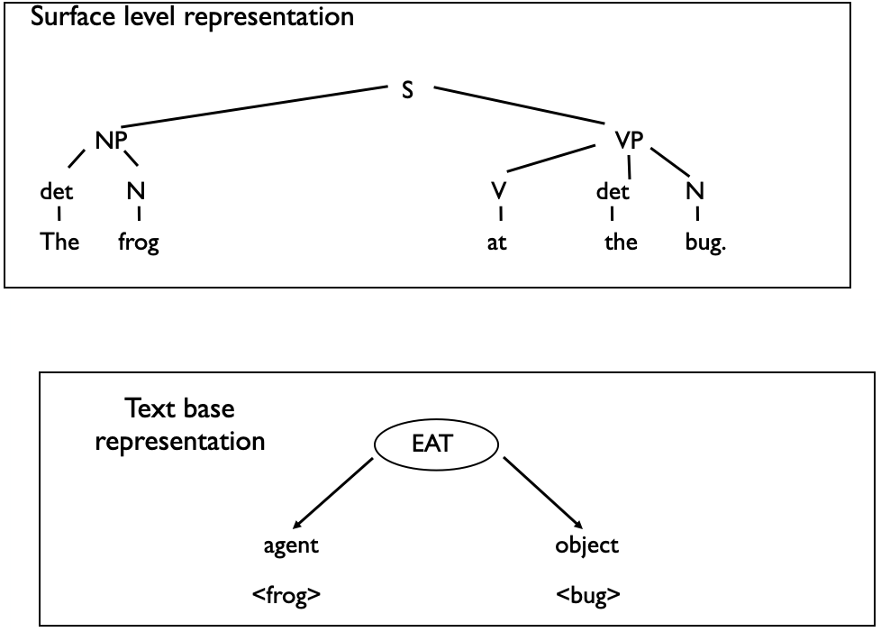
ate

Slide 34

Situation Model
Memory for the surface form of a discourse is rapidly lost. What people remember is something akin to the text base and the situation model levels of representation.

Slide 35
Memory for Gist (Bransford, Barclay and Franks, 1972)
1A Three turtles rested on a floating log, and a fish swam beneath them.
1B Three turtles rested on a floating log, and a fish swam beneath it.
2A Three turtles rested beside a floating log, and a fish swam beneath them.
2B Three turtles rested beside a floating log, and a fish swam beneath it.
Participants heard 1A or 2A during an initial phase. When they heard sentence 1B in the testing phase (following sentence 1A), they thought they had heard that sentence in the initial phase.
However, when they heard sentence 2B, they didn’t confuse it with 2A. As 1A and 1B lead to the same situation models (and 2A and 2B lead to different situation models).
Bransford et al. concluded that readers remember text at a situation model level.

Slide 37
Inferences
An inference is a piece of information that is not explicitly stated in the text but is represented in a Situation Model. So, in the Bransford et al. example, the fish swimming beneath the log is an inference that the reader could draw after reading 1A (Three turtles rested on a floating log, and a fish swam beneath them.)
Three common types of inferences - logical, bridging, and elaborative.

Slide 38
Logical Inferences
Logical inferences are based on formal rules and, as a result, are 100% certain’ (Singer 1994, p.481) ‘follow from the meanings of words’.
Examples:
Julie had seven oranges and gave five to Paul.
Therefore Julie had two oranges left.
John is a bachelor, therefore John is male.

Slide 39
Bridging Inferences
Bridging inferences help us to relate new to previous information.
We use them to make information coherent by linking new information to previously obtained information.
Example:
Mary unpacked some picnic supplies. The beer was warm.
The reader infers that ‘beer’ was part of the picnic.

Slide 40
Elaborative Inferences
Elaborative inferences involve extending what is in the text with world knowledge. Semantic associations form the basis for this type of inference making.
Example:
The delicate vase fell on the concrete floor.
The reader is likely to infer that the vase broke.

Slide 41
The Influence of Reader Preferences on Inference Generation
Imagine reading:
The director and cameraman were ready to shoot close-ups when suddenly the actress fell from the 14th story.
What inference would you generate?
Rapp and Gerrig (2006) found that the inferences people generated were influenced by how they felt about the characters in stories.

Slide 43
Event-Indexing Model
How do readers mentally represent the content and structure of sequences of events (e.g., stories)?
Zwaan, Langston, and Graesser (1995) proposed the Event-Indexing Model to account for how readers build situation models (see also Zwaan & Radvansky, 1998).
It proposes that events are connected along dimensions of time, space, protagonist, causality and intentionality and that readers (at least implicitly) keep track of events along these dimensions.
The model has led to much research and explains a number of previous findings.

Slide 44
O’Brien and Albrecht (1992)
O’Brien and Albrecht (1992) examined how readers keep track of spatial information during reading. Participants read passages like:
As Kim stood [inside/outside] the health club she felt a little sluggish. Workouts always made her feel better. Today she was particularly looking forward to the exercise class because it had been a long, hard day at work. Her boss had just been fired and she had to fill in for him on top of her own work. She decided to go outside and stretch her legs a little. She was getting anxious to start and was glad when she saw the instructor go in the door of the club. Kim really liked her instructor. Her enthusiasm and energy were contagious.
The sentence “She decided to go outside and stretch her legs a little.” matches one condition (inside) but not the other (outside). Reading times increased in the mismatched condition.

Slide 45
O’Brien and Albrecht (1992)
Similar effects have been reported by Albrecht and O’Brien (1993) for sentences that are consistent or inconsistent with physical properties of the central character (e.g., a young or an old person described later in a text as running quickly).
Data are not compatible with the Minimalist account of Inference Generation (McKoon and Ratcliff, 1992) which proposed that the only inferences that readers generate online are those that are:
Necessary in order to maintain local coherence.
Based on easily available information.

Slide 46
Shifts of Time, Space and Protagonist
Therriault, Rinck, & Zwaan (2006) presented participants with text containing shifts in time, space and protagonist. Instructions asked readers to focus on each of these three dimensions.
Shifts in time and protagonist always caused an increase in reading times. Spatial shifts had their biggest effect only when experimental instructions asked readers to focus on that aspect of the story.
Reading time increases can be thought of as reflecting the reader creating a new ‘chapter’ in their situation model.

Slide 47
Shifts in Time
Speer & Zacks (2005) examined how event boundaries (i.e., when one event ends and another begins) are mentally represented during reading.
Based on earlier work by Anderson, Garrod, & Sanford (1983):
At the cinema.
Jenny found the film rather boring. The projectionist had to keep changing reels. It was supposed to be a silent classic. Ten minutes/seven hours later the film was forgotten. He was fast asleep.
The final sentence took longer to read in the ‘seven hours’ condition as the character ‘the projectionist’ is considered scenario bound.

Slide 48
Shifts in Time
Speer & Zacks (2005) presented readers with words after time shifts (e.g., a moment later/an hour later). The words related to content that was presented before the time shift.
Participants were slower to respond to these words after long time shifts suggesting that the long time shift resulted in information related to events before the time shift being less accessible to memory.

Slide 50
Anaphors
Jim bumped into Bill and he fell over.
Jim bumped into Bill and the fool fell over.
Jim bumped into Bill and Bill fell over.
The words in italics are all anaphors - they take their meaning from the thing they refer back to.
They differ in their level of ambiguity (i.e., how clear it is to which character they refer).

Slide 51
Anaphors
Do anaphors always have to refer to explicitly mentioned referents ? Haviland and Clark (1974) found that (3) was read more slowly after (1) than after (2).
(1) Mary unpacked some picnic supplies.
(2) Mary unpacked some beer.
(3) The beer was warm.
They proposed that when ‘The beer’ was encountered in (3) it triggered a search for an explicit antecedent. When it was not found, readers then had to engage in inferential processing (which takes time). This is a necessary inference has readers have to have made it in order to understand the text (or maintain textual cohesion).

Slide 52
Anaphors
However, Sanford and Garrod (1983) showed that for highly constraining contexts, situational anaphora can be easy to understand:
(1) Keith took his car to London.
versus
(2) Keith drove to London.
(3) The car kept overheating.
They found that (3) was as easy to read following (1) as following (2). Sanford and Garrod proposed that ‘The car’ in (3) is not explicitly mentioned in (2) but arises from the role associated with the vehicle used to ‘drive to London’. Anaphors can map onto entities in the situation model that might not be in the text base.

Slide 53
Anaphors
But this doesn’t work for pronouns as they usually need explicit antecedents :
Keith drove to London yesterday.
It kept breaking down.
As pronouns carry only number and gender information, they can usually match many possible referents in a text. So how then do we find interpreting them so easy ?
Pronouns refer to characters that are in focus (Grosz & Sidner, 1985).

Slide 54
The Repeated Name Penalty
When a character is in focus, it should be referred to by using a pronoun. Gordon, Grosz, and Gilliom (1993) report a repeated name penalty in (1) when compared with (2).
(1a) Bruno was the bully of the neighbourhood.
(1b) Bruno chased Tommy all the way home from school one day.
(1c) Bruno watched Tommy hide behind a big tree and start to cry.
(1d) Bruno yelled at Tommy so loudly that the neighbours came outside.
(2a) Bruno was the bully of the neighbourhood.
(2b) He chased Tommy all the way home from school one day.
(2c) He watched Tommy hide behind a big tree and start to cry.
(2d) He yelled at Tommy so loudly that the neighbours came outside.

Slide 55
The Repeated Name Penalty
This finding is explained by Centering Theory (Grosz, Joshi, & Weinstein, 1995).
Centering is a model of how attention shifts during a discourse.
The repeated name penalty arises when the character in focus is referred to using a proper name rather than a pronoun.

Slide 57
Quantifiers
Quantifiers are expressions that communicate something about quantity - e.g., more than, less than, few, a few etc.
Sanford, Moxey and Paterson (1996) examined how different discourse elements can be brought into focus by quantifier. For example:
1. A few of the fans went to the match. They...
2. Few of the fans went to the match. They...
People are likely to continue (1) with something like ‘...had a really good time.’
People are likely to continue (2) with something like ‘...watched it on TV instead.’
The pronoun ‘They’ is therefore being used to refer to different subsets of people in each of the two cases.

Slide 58
Scalar Expressions
Jarvella et al. (1995) had readers read:
In the first round, John Smith got almost/only 500 votes.
The Irish lawyer was leading.
What was key was the expectation generated by almost 500 vs. only 500. This influenced how ‘The Irish lawyer’ was interpreted - whether it referred to ‘John Smith’ or to some other (unmentioned) person.

Slide 59
Depth of Processing
How many animals of each type did Moses take on the Ark ?

Slide 60
Depth of Processing
Erickson and Mattson (1981) found that participants tended to respond ‘two’ rather than realise that it was Noah, not Moses, who was engaged in Ark-related activities. This is known as The Moses Illusion.
After a plane crash, where should the survivors be buried?
Higher detection rates of the anomaly if participants are given the sentence ‘After a bicycle crash, where should the survivors be buried ?’
Knowledge about crashes involving bicycles would include the information that death is an unlikely outcome – therefore the idea of anybody being buried is hard to integrate with situation knowledge.

Slide 61
Summary
Parsing is the process by which people understand sentences. Sentences can often be locally or globally ambiguous.
Readers build a situation model in their head during reading that corresponds to the gist of the narrative. This model likely contains many inferences.
The Event Indexing Model proposes key dimensions that people keep track of during reading.
Readers also need to understand how to interpret pronouns and other types of anaphoric expressions.
Chapter 10 in Eysenck and Keane complements today’s lecture.

