Slide 1
Introduction to Cognition - Language 2
Andrew J. Stewart
Division of Neuroscience and Experimental Psychology
E: andrew.stewart@manchester.ac.uk
T: @ajstewart_lang

Slide 2
Learning Objectives
By the end of this lecture you should:
Explain to your peers how we produce and understand speech.
Describe to your peers the key components and stages of speech production and perception.
Describe and critically appraise theories and empirical evidence for speech production and perception.

Slide 3
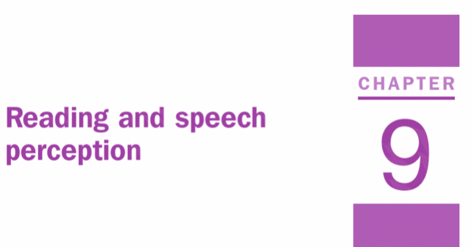
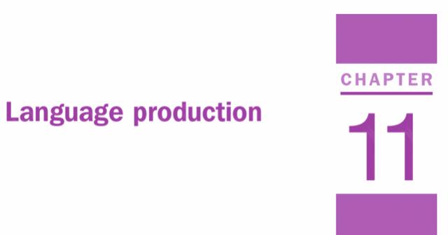
This session
This session is made up of a number of videos, with narrative I’ve written, and links to some resources that I hope you’ll find interesting.
Chapters 9 and 11 in Eysenck and Keane supports this session.

Slide 4
Components of language & definitions
Phonemes: elementary (smallest) units of sound. For example, ‘rice’ and ‘lice’ differ from each other by just one phoneme
Morphemes: elementary (smallest) units of meaning in language. For example, dog-s
Phonology: rules governing the sound of words and parts of words.
Syntax: rules governing word order and meaning resulting in sentences. For example, ‘pass the salt’, not ‘the pass salt’
Semantics: the meanings of words and sentences. For example, ‘bank’, ‘oink’
Pragmatics: the use of language as a function of content & social rules. For example, ‘hello’, ‘hi’ or ‘hey’

Slide 6
What is Language?
Language is a system of symbols and rules that enable us to communicate.
Symbols: written and spoken words, signs.
Rules: specify how sentences are formed.
The paradox of language: it is rapidly produced and understood, yet complex.

Slide 7
How straightforward is speech production?
Average speech rate ≈ 150 words per minute
Speech Errors:
You have hissed all of my mystery lectures.
Where is my tennis bat? instead of Where is my tennis racquet?
He has already trunked two packs.
The key to the cabinets were well hidden.

Slide 8
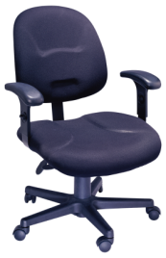
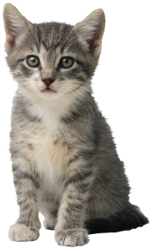
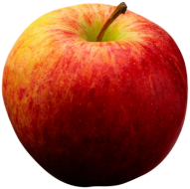
How straightforward is speech perception?
Imagine hearing the speech fragment “The child ate the…” while looking at a visual scene containing these objects:
There’s good evidence that you’ll look at the picture of the apple in anticipation of what is likely to come next in the sentence (Altmann & Kamide, 1999).

Slide 9
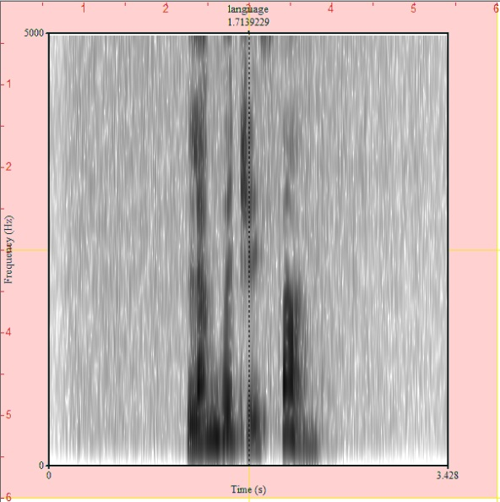
How straightforward is speech perception?
When you listen to speech, you’ll hear a continuous pattern of speech sounds. You need to segment these sounds - which isn’t always easy, especially where there is variability in the speech signal.

Slide 11
Speech Production
Conceptualization
  Think of something to say
Formulation
  Find a way to express your idea given the specific language tools
Articulation
  Physical action of moving your muscles to produce speech

Slide 12
Theories of Speech Production
WEAVER ++ (Levelt et al., 1999)
Feed-forward processing
Spreading activation (Dell,1986)
Interactive processing

Slide 13
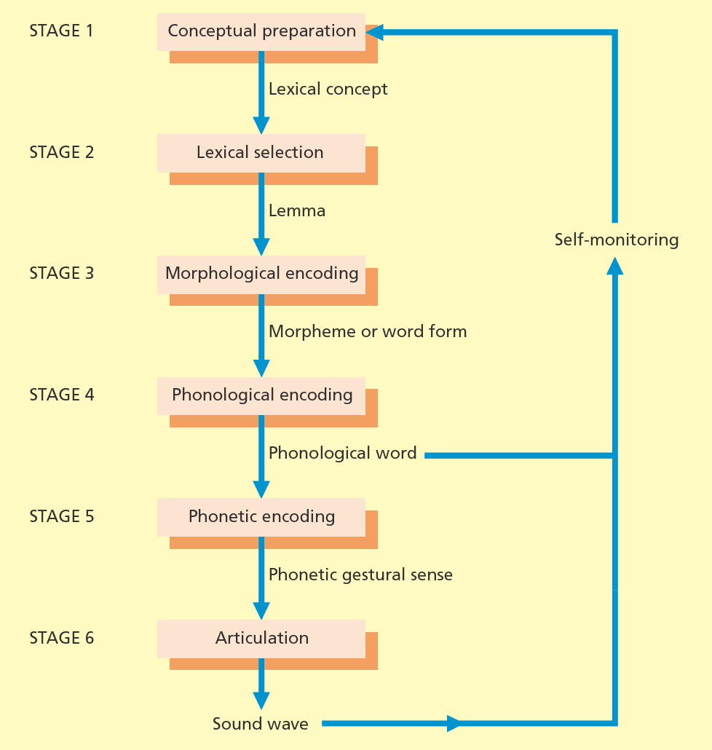
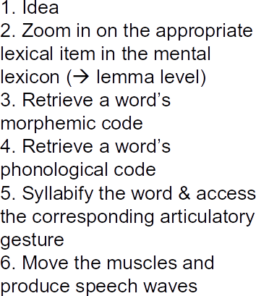
WEAVER ++ (Levelt et al., 1999)

Slide 14
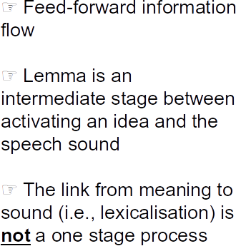
WEAVER ++ (Levelt et al., 1999)

Slide 15
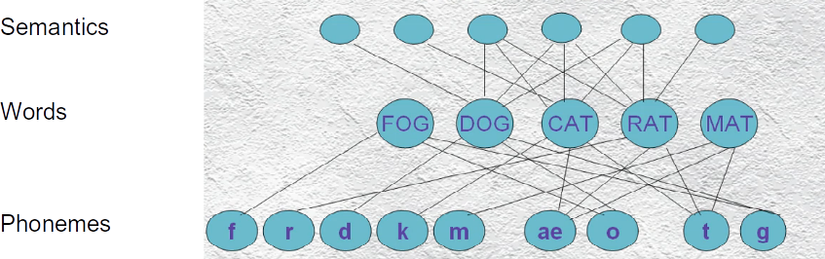
Spreading Activation (Dell, 1986)

Slide 16
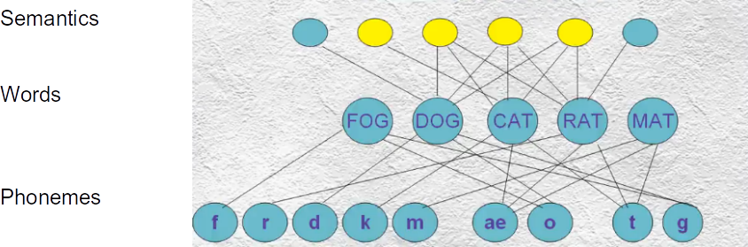
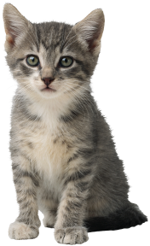
Spreading Activation (Dell, 1986)

Slide 17
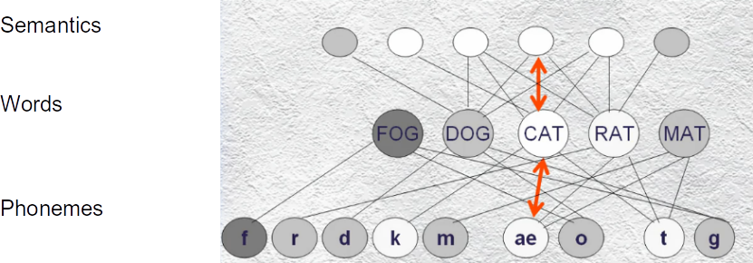
Spreading Activation (Dell, 1986)

Slide 18
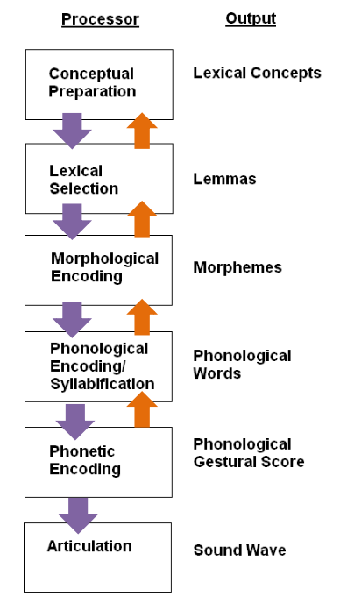
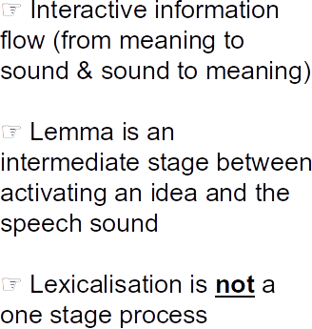
Spreading Activation (Dell, 1986)

Slide 20
End of video 3
Ask students to watch this video before moving on: Nice video about TOTs:
https://www.youtube.com/watch?v=sFeibGnZ6tc

Slide 21
Supporting evidence for the models of speech production
Tip-of-the-tongue state (TOTs)
Picture-word interference
Speech errors

Slide 22
Tip of the Tongue States (TOTs)
What word means to formally renounce the throne?
Do you feel you know the word? How many syllables it has? What does it sound like?

Slide 23
Tip of the Tongue States (TOTs)
TOTs occur when we have an idea or concept in mind but cannot find the appropriate word.
☞ Lexicalisation is not a one stage process
Some TOTs features:
While in TOTs, people can retrieve the first phoneme of the target word, the number of syllables of the target word, and the gender of the target word.
Most of the TOTs occur with low-frequency words (Harley & Bown, 1998).

Slide 24

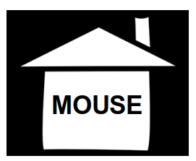
Picture-word interference
Semantic relatedness slows down picture naming.
☞ Lexicalisation is not a one stage process.
Phonological relatedness speeds up picture naming.
Arieh & Algom (2002)

Slide 25
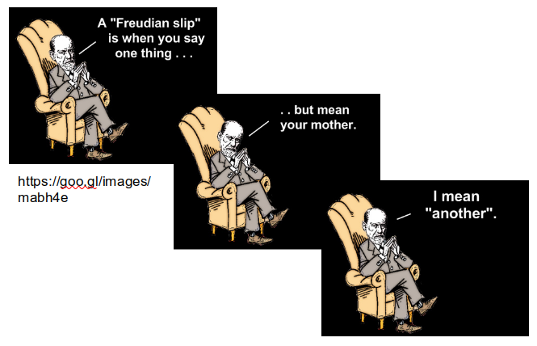
Speech Errors
Why study errors?
1. We gain insights into how the complex cognitive system involved in speech production works when it actually breaks!
2. We understand how information flows between different mental processes during speech production
3. We understand how much planning speakers do when they speak

Slide 26
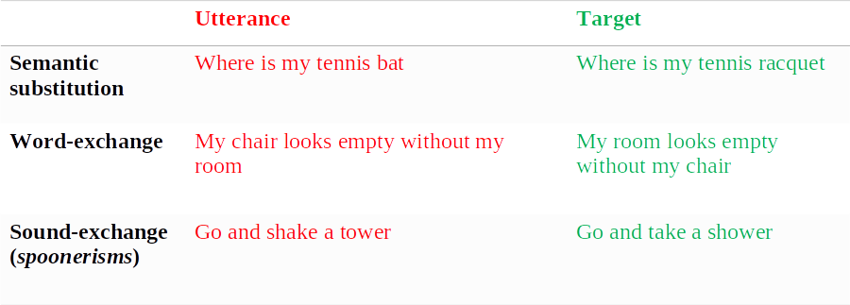
Types of Speech Errors

Slide 27
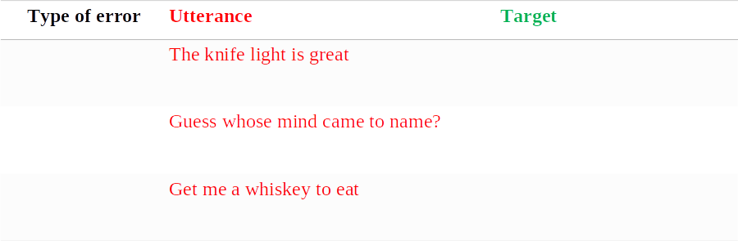
Activity

Slide 28
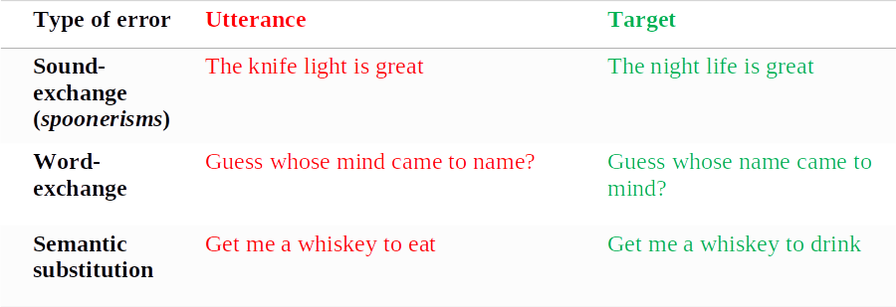
Activity
Q: Can you think of any constraints? Do you think you would ever say the night grife is leat?

Slide 29

Errors are Not Random
Lexical bias effect
  ‘Fig beet’ instead of ‘big feet’ more often than ‘hig borse’ instead of ‘big horse’ (Baars, Motley, & MacKay, 1975)
Mixed-error effect
  ‘Let’s start’ but not ‘Let’s begin’ instead of ‘Let’s stop’ (Dell, 1986)
  ‘I thought that there would still be some cookies left, but there were…’ If image of is shown. ‘none’ instead of ‘not’ (Ferreira & Griffin, 2003)

Slide 30
Support
☞ Lexicalisation is not a one stage process
But what about information flow in the models of speech production?
Tip-of-the-tongue state (TOTs)
Picture-word interference
Speech errors

Slide 31
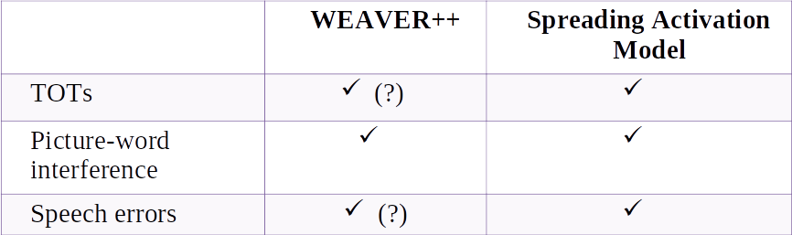
Evaluation
BUT
Lexical bias effect Mixed-errors
BUT
Prospecting

Slide 32
Summary So Far
Speaking is a complex multi-stage process
  From having an idea you want to talk about to move your articulators and produce the sound waves
Several theoretical models have tried to describe the process
  WEAVER++ (feed-forward)
  Spreading activation (interactive)
Several empirical evidence support different components of the models
  TOTs, picture-word interference, speech errors

Slide 34
Speech Perception
Co-articulation
The pronunciation of a phoneme by a speaker depends on the preceding and following phonemes.
The /b/ phonemes in ‘bill’, ‘ball’, ‘able’, ‘rub’ are acoustically different.
The word ‘job’ is likely to be misperceived if the ‘jo’ part was recorded from the word ‘jog’.
Bad news
No one-to-one relationship between acoustic signal and phonemes.
Good news
Allows for prediction and makes perception faster.

Slide 35
Theories of Speech Perception
Motor theory (Liberman et al., 1967)
TRACE (McClelland & Elman, 1986)

Slide 36
Motor Theory (Liberman et al., 1967)
‘Listeners perceive spoken words by reproducing the movements of the speaker’s vocal tract rather than by identifying the sound patterns that speech generates’
The motor system is involved in both speech production and perception
  There is a ‘bridge’ between production and perception

Slide 37
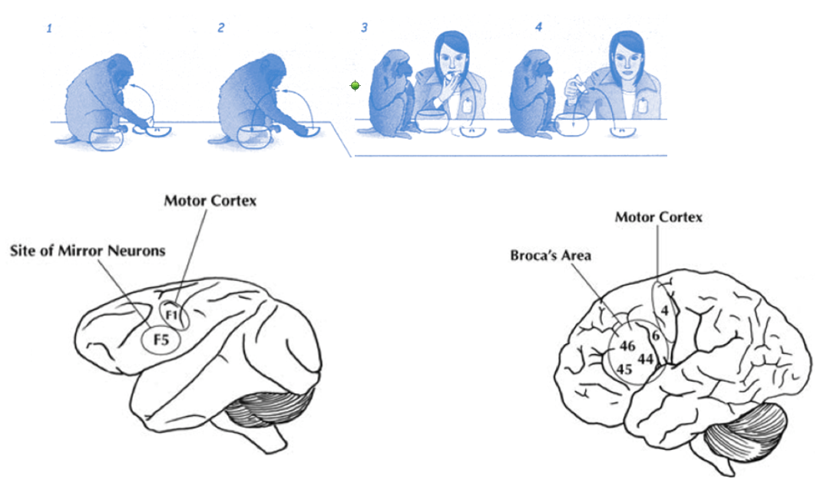
Motor Theory and Mirror Neurons
Rizollatti’s work, early 1990s

Slide 38
Support
McGurk effect
Categorical perception
Motor cortex is functionally involved in speech perception

Slide 39
McGurk Effect
An illusion occurs when the auditory component of one sound is paired with the visual component of another sound, leading to the perception of a third sound.
We integrate non-acoustic information into what we hear.
Our auditory and visual information processing is merged.

Slide 40

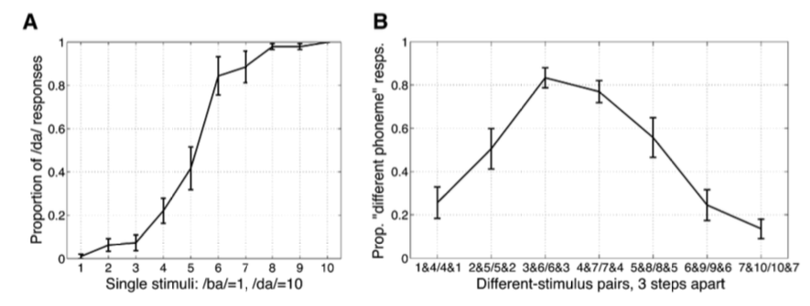
Categorical Speech Perception
Artificial 1 to 10 sound continuum where 1 sounded as /b/ and 10 as /d/
Speakers did not perceive gradual change.
They suddenly switched from perceiving one sound to perceiving the other.
Better discrimination of pairs of sounds when sounds were across the crucial point.
Raizada & Poldrack (2007)

Slide 41
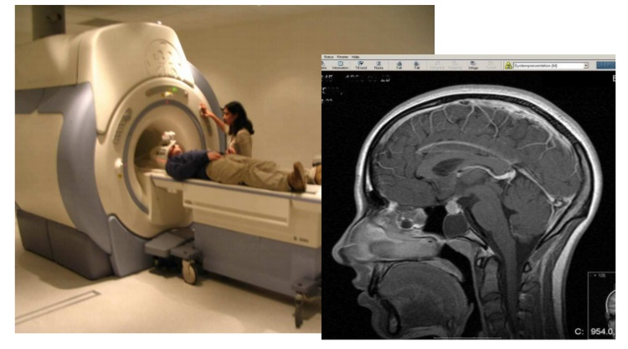
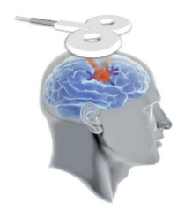
Motor Cortex and Speech Perception
fMRI
  Listening to speech and imagining you are speaking activates speech motor cortex.
TMS
  Motor TMS decreases phoneme discrimination.
Iacobini (2008)

Slide 42
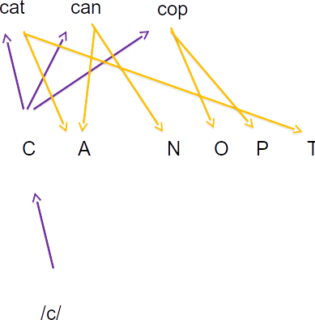
TRACE (McClelland & Elman, 1986)
Words
Phonemes
Auditory features

Slide 43
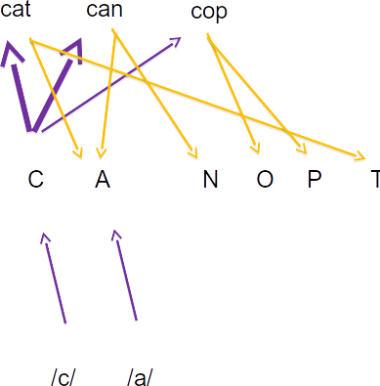
TRACE (McClelland & Elman, 1986)
Words
Phonemes
Auditory features

Slide 44

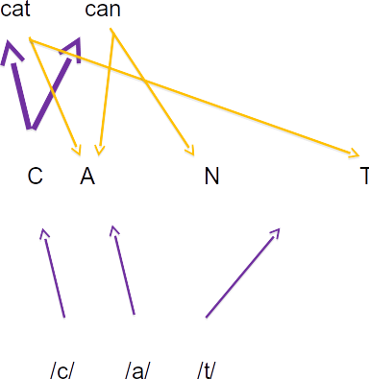
TRACE (McClelland & Elman, 1986)
Words
Phonemes
Auditory features

Slide 45
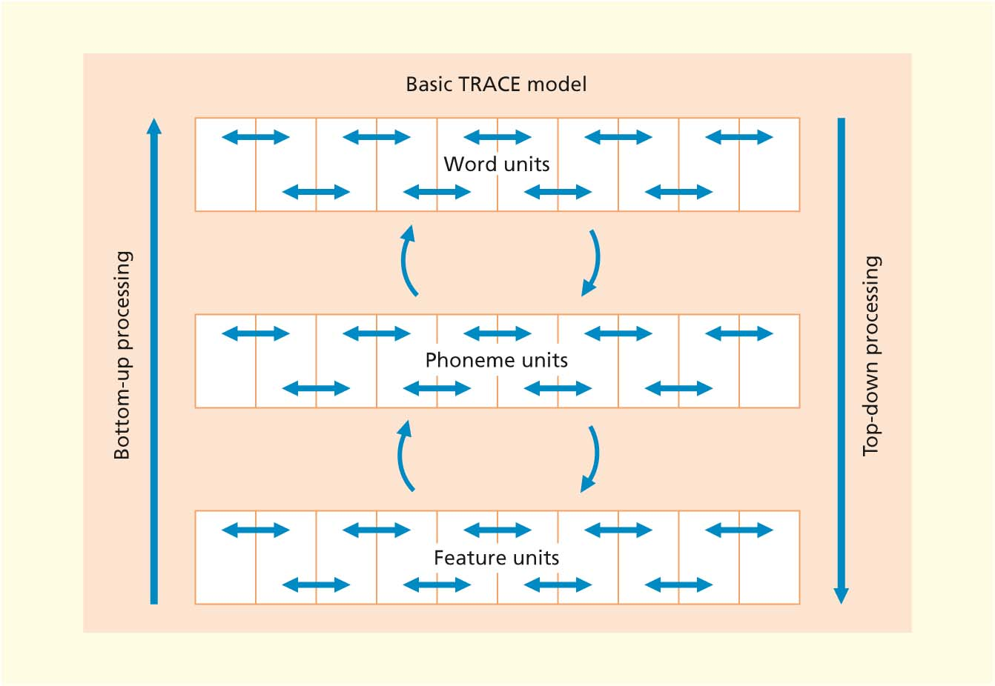
TRACE (McClelland & Elman, 1986)
1. Nodes influence each other creating patterns of activation
2. Interaction of bottom-up and top-down processes

Slide 46
Support
Lexical identification shift aka Ganong effect
  When listening to sounds ranging from /dash/ to /tash/, phonemes were assigned to words rather than non-words (Ganong, 1980)
Phonemic restoration effect
  http://www4.uwm.edu/APL/demonstrations.html
  When listening to ‘It was found that the *eel was on the shoe’, participants heard ‘heel’.
  When listening to ‘It was found that the *eel was on the orange’, participants heard ‘peel’ (Warren & Warren, 1970)
☞ Interactive processing

Slide 48
Summary Part Two
Understanding speech is a complex multi-stage process
  From registering the presence of a speech stimulus to figuring out what it means
Several theoretical accounts have tried to describe the process
  Motor theory (feed-forward)
  TRACE (interactive)
Several empirical evidence support different components of the theories
  McGurk effect, categorical perception, motor cortex involvement, phonemic restoration, Ganong effect

Slide 49
