Slide 1

Lecture 10: Language 2
Speech production and perception
PSYC10421 and 10431: Introduction to Cognition
Andrew Stewart
Andrew.Stewart@manchester.ac.uk
Notes:
Right so, I Evi I am a psycholinguist, so I work on the psychology of language and particular body language and I will give you the last lecture on language

Slide 2
What are we going to learn about?
Week 1: Introduction to the unit (JM)
Week 2: Attention 1 (JM)
Week 3: Attention 2 (JM)
Week 4: Learning (NM)
Week 5: Applied Learning (NM)
Week 6: No lecture this week (reading week)
Week 7: Memory (JT)
Week 8: Process Models of Memory (JT)
Week 9: Remembering and Forgetting (JT)
Week 10: Language 1 (AS)
Week 11: Language 2 (AS)
Week 12: Free slot for catch-up/revision

Slide 3
Learning objectives
By the end of this lecture you should be able to:
  Explain to your peers how we produce and understand speech
  Describe to your peers the key components and stages of speech production and perception
  Describe and critically appraise theories and empirical evidence for speech production and perception
Notes:
FIRST SAY THE OBJECTIVES
The lecture might be a bit overwhelming so bear with me. And I know that you might find it boring. But bear with me and I will try to make it us simple and as fun as possible. Please stop me and ask questions if you don’t understand what I am saying. So by the end of this lecture you should be able to…
Just a heads-up, if you think it’s too abstract. Stop me. I will explain. Or you might think it’s full of jargon. Don’t panic. There is a glossary in your textbooks and I will try to repeat and remind you of the key definitions and terms. Or you might think why do we have so many models? And not the good ones who walk on catwalks. Again stop me, bear with me, modelling is important to explain and describe some very complex processes such as speech perception but we will try to simplify things. Or you might feel I am not saying anything definitive, and that more than one things might be true. Well this is actually fine and it’s one of the aims we have in this course. Language is complex, and so is the research around it. and there are many things we do not know or things that change depending on the methods we are using or the exact questions we are asking, but this is actually what makes it so fascinating, its liveness!

Slide 4
What is language?
Language is a system of symbols and rules that enable us to communicate
  Symbols: written and spoken words, signs
  Rules: specify how sentences are formed
The paradox of language: it is rapidly produced and understood, yet complex
Notes:
Some reminders and to put things into context. Language is a system of symbols and rules. Rules are the set of guidelines we have depending on what language we speak which specify how sentences are formed (the things that you discussed with Andrew).
So do you think speaking is easy? I have an idea I want to talk about, I choose the words and there it is? What about understanding? Same easy and piece of cake? I hear someone talking and get what they say? And what is it really that enters my ear?
Language is complex. Why is that? Language is the means of expressing our thoughts and we have many many thoughts and many ideas so you can imagine that the system to express our thoughts should be so complex and so creative as the thoughts themselves. The paradox has to do with the fact that even though language is so complex, we speak and we understand what others say immensely well! So how do we do it? In today’s lecture I will try to share with you how researchers have tried so far to answer this question of how we do it? How do we talk and how do we understand what other people say? These are functions of the human brain and I say human because it’s only humans that learn how to speak and understand language in this way – no other animal. So in today’s lecture I will talk about these two important and fundamental functions and how researchers try to understand these functions. And the aim of today’s lecture is for you to understand how speech production and comprehension work together in everyday communication

Slide 5
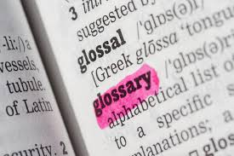
Components of language & definitions
https://goo.gl/images/GtDkQh
Phonemes: elementary (smallest) units of sound
  E.g., ‘rice’ and ‘lice’ differ from each other by just one phoneme
Morphemes: elementary (smallest) units of meaning in language
  E.g., in-com-ing
Phonology: rules governing the sound of words and parts of words
  E.g., ‘pass thuh (not thee) salt’
Syntax: rules governing word order and meaning resulting in sentences
  E.g., ‘pass the salt’, not ‘the pass salt’
Semantics: the meanings of words and sentences
  E.g., ‘bank’, ‘oink’
Pragmatics: the use of language as a function of content & social rules
  E.g., ‘hello’, ‘hi’ or ‘hey’
Notes:
Some key components of language that all interact and some key terms I will be using quite often in today’s lecture
Before we swim into deep waters of psycholinguistic research I will draw your attention to some key definitions – do not panick – all these terms are explained in the glossary section in the end of your textbooks
Note 1: for example, Bank = is a polysemous word; more than one meaning; how we resolve ambiguity; and oink is a sound mimetic work; how is meaning assigned to words?
Note 2: Pragmatics = factors influencing the words and sentences one chooses as a function of content and social rules
As you may have already guessed, all of these levels/components of language interact in order to produce and understand language. And processing in some levels, such as semantics for example, might be more complicated than others such as sounds.

Slide 6
How straightforward is speech production?
Average speech rate ≈ 150 words per minute
“[…] the national committee of orgasm oops organ donors […]”
“[…] I like travelling, hiking and you know things like that […]”
Speech errors
Underspecification
Notes:
If you were to answer this question intuitively you would probably say, oh come on it’s very easy, I can easily chat with my friends. And it is true, fun fact that the average speaker produces 150 words per minute which is impressive.
But, you will see, and see myself actually making errors why do we make mistakes, slips? Why do we need to reduce the processing load when speaking and planning our speech by using phrases like ‘things like that’. There must be some difficulty and speech production should be a more complex process.
Underspecification is a strategy used to reduce processing costs (probably to use load to plan for the next word) in speech production by using simplified expressions. (EXAM)
So these are simple observations that suggest that most likely producing speech it’s not that simple, or this one stage process of having an idea and producing it.

Slide 7


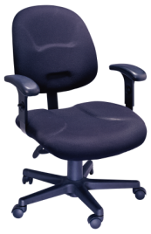


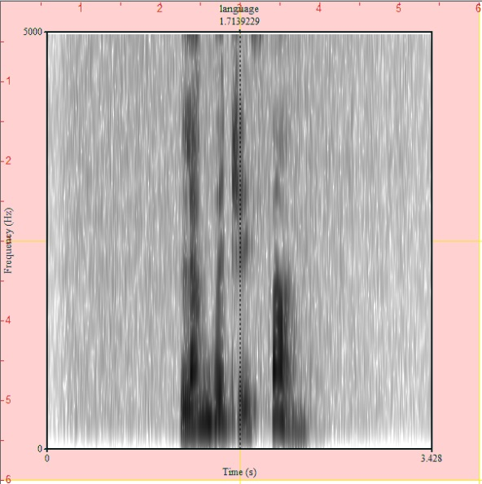
How straightforward is speech perception?
‘The child ate the…’
Altmann & Kamide (1999)
Continuous pattern of speech sounds & need for segmentation
Variability of the speech signal
Notes:
The same goes with speech perception. Although it is very fast and smart and at a first thought seems easy and everyone does extremely well on average – for In this experiment, participants would listen to sentences related to some pictures they would show them. Their eye movements were recorded with an eye tracker (you have seen that with Andrew last week) and when they listen to the sentence the child ate their eyes looked at the apple icon. And you would say okay yes that’s normal because the apple is the only edible object in the icons, but the interesting thing is when this happens. And this happens the moment the listeners heard the sound -t- in the verb ate. Which means that there is anticipation of upcoming words when we hear speech. We plan ahead. So even though we haven’t heard the whole sentence, not even the whole verb ate even half information leads us to think that the sentence is about an edible object.
But, this is (spectogram) how the speech signal looks like; and it is continuous, so how do we segment the sounds? NOTE: DO IT IN CLASS; ask if we have any speakers who know greek; if not say something in Greek quickly and ask them how many words they think they heard. So how do we do it?
Plus there are some phonemes like /b/ which sound differently depending on what follows.
So again, speech perception is far from straightforward. And this is why we need this lecture, to understand and look at the theories which have tried to explain these two crucial processes for social interaction.
[EXAM: the segmentation problem, the problem of distinguishing words from the pattern of speech sounds]

Slide 8
(I) Speech production

Slide 9
Speech production
Conceptualization
  Think of something to say
Formulation
  Find a way to express your idea given the specific language tools
Articulation
  Physical action of moving your muscles to produce speech
Mental operations
Notes:
Speech production requires at least three kinds of mental operations, which rely more or less on different components of language as we saw (semantics, phonology)
Important thing to note: the process from conceptualization to articulation is not a very straightforward one in the sense that thinking of ‘cat’ does not necessarily activate the sounds /k/ /a/ /t/ for cat. All the intermediate processing is what counts and what makes production complex and this procedures have ben attempted to be explained by some theoretical models of production. So the key point is that the process from meaning to sound is not a one stage process

Slide 10
Theories of speech production
WEAVER ++ (Levelt et al., 1999)
  Feed-forward processing
Spreading activation (Dell,1986)
  Interactive processing
Notes:
Interactive model: means that processes at any level can influence those at any level.
Feed-forward model: means that processing happens only towards one direction, forward and does not go backwards.
Dell’s is a computational model.

Slide 11
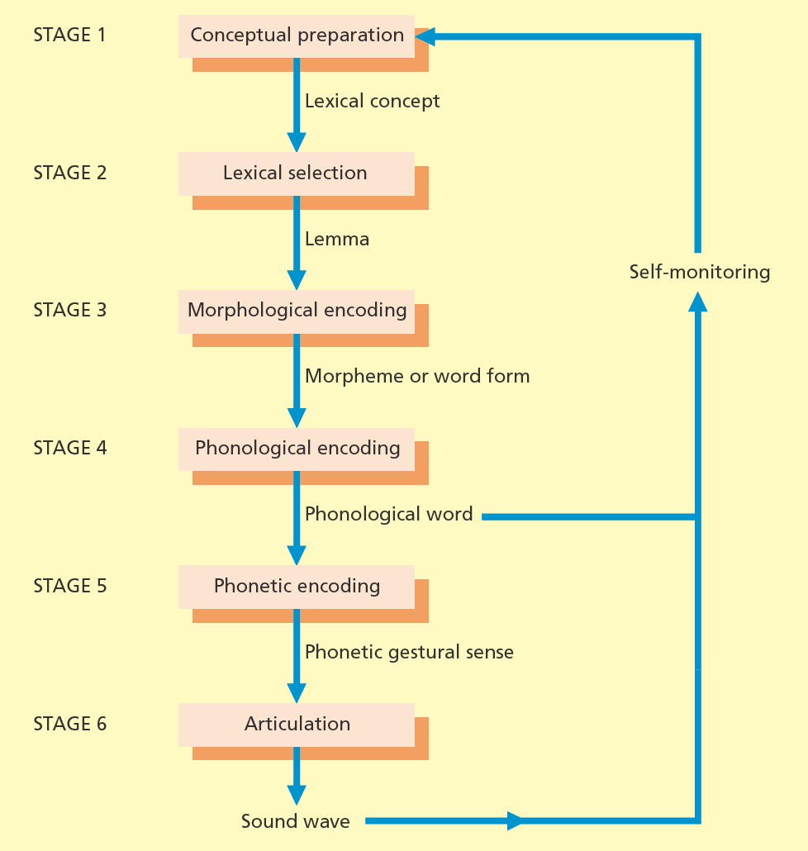
WEAVER ++ (Levelt et al., 1999)
1. Idea
2. Zoom in on the appropriate lexical item in the mental lexicon (→ lemma level)
3. Retrieve a word’s morphemic code
4. Retrieve a word’s phonological code
5. Syllabify the word & access the corresponding articulatory gesture
6. Move the muscles and produce speech waves
Notes:
Each box indicates a mental process. It stands for Word-form Encoding by Activation and VERification. This is a model which suggests that the activation of words (it also focuses on words only rather than phrases) happens and proceeds toward one direction and not backwards. And in particular we proceed from meaning to sound which is basically called lexicalisation. We basically translate the meaning of a word into its form and sound. Proceeding from one step to the other happens serially.
Why do we need lexicalisation: this procedure is the intermediate, between the non linguistic ideas and lexical linguistic forms to express these ideas. And we need this extra time because the relationship between ideas and form is not always an easy one-to-one.
Lexical concept = it is an idea that can be expressed in a word. Once we have that, then we can proceed to lexical selection
The outcome of lexical selection is the lemma, which is a mental representation that reflects an intermediate stage between activating an idea and activating the speech sounds that you need to express the idea. Then once you have some lemmas activated, you proceed to morphological encoding. And why is this important. Because we need to select specific morphemes depending on the word in the sentence, eg. It could be you need past tense. Note: we speak in phonological words. For example escort us is two words but pronounced in one phonological word. Phonological encoding = involves the activation of metric structure and syllabifiation. Then we need the phonetic encoding which will activate the syllables and will poke the muscles to move, the actual articulation and produce the waves of speech.
Do not worry too much about the complexities of the model. The important things to keep is that: the highest level on the top is the lexical concepts. At the second level we have the lemmas which are units that carry syntactic and semantic information but not phonological – they are some intermediate units before the word and after the concept. While we proceed to the bottom of the model we have the more segment related levels, about morphology and phonology. The main things you need to keep in mind: this model allows information flow only in one direction. It introduces the existence of the intermediate level of lemmas (which is between concept and word, an abstract conceptual form which has been mentally selected for utterance in early stages of speech production) and suggests that lexicalisation is not happening in one stage but in two stages – the output of the one which deals with syntax and semantics is the lemma, and the output of the second stage is the sounds (lexicalisation is the process of phonological retrieval in speech production given a semantic input; the one stage models suggest that semantic representation of a word is mapped directly on phonological representation). Also, production begins with a set of activated concepts, which leads to activation of a set of lemmas. Before sound information can be activated one of those lemmas needs to be selected. Information flows only in one direction from lemmas to lexemes to phonemes. So according to this account the semantic substitution error happens because a concept activates several lemmas and the wrong lemma thus lexeme/word is selected BUT this explanation does not fully explain why most of the times errors, in particular sound exchange errors, lead to words rather than non-words.

Slide 12
WEAVER ++ (Levelt et al., 1999)
☞ Feed-forward information flow
☞ Lemma is an intermediate stage between activating an idea and the speech sound
☞ The link from meaning to sound (i.e., lexicalisation) is not a one stage process
Notes:
Do not worry too much about the complexities of the model. The important things to keep is that: the highest level on the top is the lexical concepts. At the second level we have the lemmas which are units that carry syntactic and semantic information but not phonological – they are some intermediate units before the word and after the concept. While we proceed to the bottom of the model we have the more segment related levels, about morphology and phonology. The main things you need to keep in mind: this model allows information flow only in one direction. It introduces the existence of the intermediate level of lemmas (which is between concept and word, an abstract conceptual form which has been mentally selected for utterance in early stages of speech production) and suggests that lexicalisation is not happening in one stage but in two stages – the output of the one which deals with syntax and semantics is the lemma, and the output of the second stage is the sounds (lexicalisation is the process of phonological retrieval in speech production given a semantic input; the one stage models suggest that semantic representation of a word is mapped directly on phonological representation). Also, production begins with a set of activated concepts, which leads to activation of a set of lemmas. Before sound information can be activated one of those lemmas needs to be selected. Information flows only in one direction from lemmas to lexemes to phonemes. So according to this account the semantic substitution error happens because a concept activates several lemmas and the wrong lemma thus lexeme/word is selected BUT this explanation does not fully explain why most of the times errors, in particular sound exchange errors, lead to words rather than non-words.

Slide 13
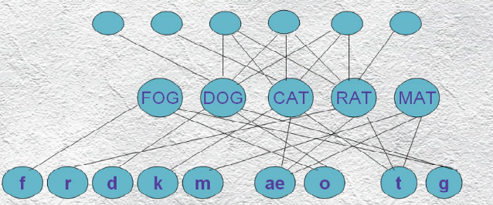
Spreading activation (Dell, 1986)
Semantics
Words
Phonemes
Notes:
The second model I will show you today is a computational model. It mimicks how the brain wires when we are trying to produce speech. This model explains the retrieval of words during speech production. It is based on the idea that the brain retrieves information through the spread of activation in a network of units/neural units. Three layers of units: the one in the top is the semantic information (such as pet), which is connected with the second layer which is the words such as cat, and the words are connected to the third layer which is the sound for example k, a and t for cat. So again think about the mental operations and linguistic components.
Retrieval of words and speech production according to this model happens in two steps/stages.

Slide 14

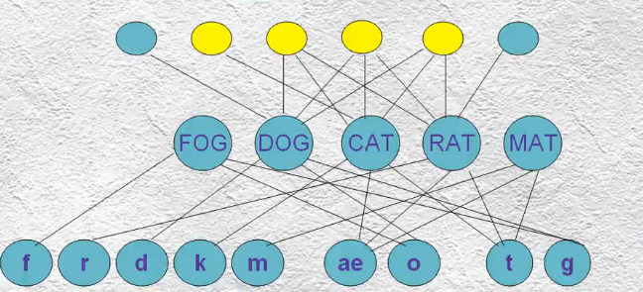
Spreading activation (Dell, 1986)
Semantics
Words
Phonemes
Notes:
So let’s say that you want to talk about cats. In the first step, word access, you activate the semantic features of the word cat (it could be anything related to the cat, like pet, animal – the yellow circles) – so you turn on the semantic features of cat which are the yellow nodes. The crucial thing with this model is that the activation spreads automatically and very fast to all other levels including words hence other words are activated based on similarity with the target word and the level of sounds. So everything is activated!

Slide 15
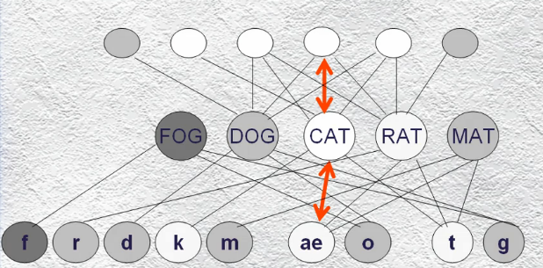
Spreading activation (Dell, 1986)
Semantics
Words
Phonemes
Notes:
Because the activation spreads both top-down and bottom-up, there is some competition there because you might be activating other words that sound like cat because you get activation from the phonological level as well.
Then the most activated word will be selected. Which hopefully is the word cat. So this was step 1

Slide 16
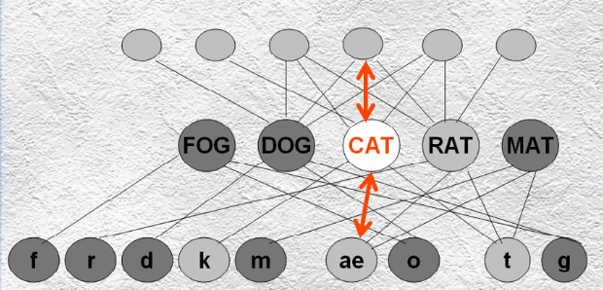
Spreading activation (Dell, 1986)
Semantics
Words
Phonemes
Notes:
Step two is the phonological access and begins with an activation of the selected word and spreads again top-down and bottom-up

Slide 17
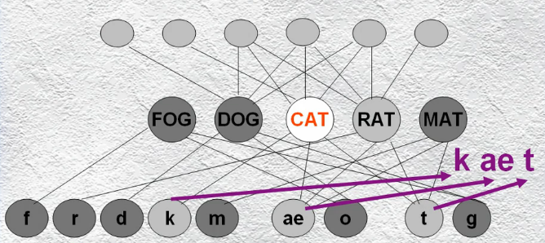
Spreading activation (Dell, 1986)
Semantics
Words
Phonemes
Notes:
and the most activated phonemes, sounds linked to the meaning you want to express and again the most active sounds are selected and you are done, you retrieved the word cat.
Think of words as lemmas
Phonological activation begins as soon as lemmas begin to be activated but before a final candidate is chosen. As individual phonemes begin to be activated they send feedback to the lemmas that they are connected to increasing activation of the lemmas. Only real words have representations as lemmas

Slide 18
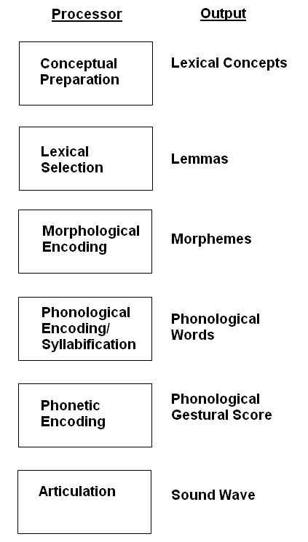
Spreading activation (Dell, 1986)
☞ Interactive information flow (from meaning to sound & sound to meaning)
☞ Lemma is an intermediate stage between activating an idea and the speech sound
☞ Lexicalisation is not a one stage process
Notes:
It consists of word selection prior to phonological encoding [EXAM]
Explain the model using help from https://en.wikiversity.org/wiki/Psycholinguistics/Models_of_Speech_Production
Dell’s model of spreading activation of lexical access is also commonly referred to as the Connectionist Model of speech production. Dell’s model claims, unlike the serial models of speech production, that speech is produced by a number of connected nodes representing distinct units of speech (i.e. phonemes, morphemes, syllables, concepts, etc.) that interact with one another in any direction, from the concept level (Semantic level), to the word level (Lexical selection level) and finally to the sound level (Phonological level) of representation (Fig. 3).[13][14] For example, the node for the phoneme /t/ might be connected in one direction to all morphemes containing that phoneme (i.e. cat, truck, tick, tock, tap etc.), and in another direction to the distinct features of that phoneme (i.e. voiced vs. fricative). In this same fashion, words with similar meaning will be connected to a common semantic node. For example, i the words cat and dog, which have several common semantic features (i.e. are both animals, have fur, can be domesticated) would share a common node within the semantic network (Fig. 3).[15]
When a word is selected, all of the nodes representing that words constituent morphemes, phonemes, semantics and syntax are activated and this activation spreads to the adjacent nodes until one node, the node that is most highly activated is selected for the output string. Since nodes within the same level or representation are competing for activation, the wrong node is often activated. For example, with the sentence “Put your boots on!”, one would certainly think that the speaker meant “Put your boots on your feet!”. As a result, the speaker may have activated the concept nodes that are semantically related to the target word boots, such as the node representing feet. This could result in the activation of the feet node and the production of the incorrect sentence “Put your feet on”. Figure 4 illustrates how this activation could occur the word boots and skates, which share some semantic properties. Both words would activate units with related semantic properties such as footwear, shoe, feet, snow or winter. Based on similar figures in Dell & O’Seaghdha (1994),[15] Dell's model covers syntactic coding and morphological coding (specification of the words constituent morphemes) but focuses primarily on phonological encoding (specification of morphemes constituent phonemes). In contrast to serial models of speech production, Dell’s model can account for word blends, phrase blends, phonemic slips, and cognitive intrusions. This model explains these errors as the simultaneous activation of nodes that are either semantically or phonetically similar to the target. With phoneme slips, for example, nodes of phonemes that are similar to the target, sharing common distinct features (i.e. voicing vs. fricative), are the ones that will compete with the target node for activation, while non-similar phoneme nodes will not be activated at all. Dell’s model explains the results of a study by Dell and Oppenheim (2007),[16] who exposed subjects to lists of primer phrases, induced phoneme exchanges, and recorded the nature of the output phrases. They found that subjects produced phoneme exchanges resulting in output that was semantically similar to priming phrases more frequently than phoneme exchanges resulting in semantically unrelated output.[16] The Dell model justifies these findings on the basis of semantic priming. Because the model consists of word selection prior to phonological encoding, it accounts for tip of the tongue speech errors, where speakers can often identify the syntactical, and even morphological properties of the intended word, but still not be able to encode the phonology.[17][18]

Slide 19
Supporting evidence for the models of speech production
Tip-of-the-tongue state (TOTs)
Picture-word interference
Speech errors
Notes:
For both models we can gain some support if we look at these three types of evidence

Slide 20

TOTs
https://goo.gl/images/hiosSu
What word means to formally renounce the throne?
  Do you feel you know the word? How many syllables it has? How does it sound like? (= prospecting)
Nice video about TOTs
  https://www.youtube.com/watch?v=sFeibGnZ6tc
Notes:
Answer: abdicate
Next type of evidence about the theories of speech production was the tip-of-the tongue states. Think and tell me if you know the term for…
This phenomenon happens when semantic processing is successful (we activate the correct lemma or abstract word) but the phonological processing is unsuccessful (we cannot produce the sound). It occurs when the link between the semantic and phonological systems are weak. The important question for this type of interruption is not whether you know the word or not, but these questions I am referring to as prospecting.
Most of the times it occurs when the target word is phonologically unusual (hence more difficult to be activated). This phenomenon suggests and provides evidence that lemmas exist and they are this intermediate stage that carry semantic and syntactic information (some types people can give information about the gender of the word) but not phonological. So we have two stages of lexicalisation simply because you can get stuck in the between
NOTE: you were talking about the TOTs in the seminar

Slide 21
TOTs
https://goo.gl/images/hiosSu
TOTs occur when we have an idea or concept in mind but cannot find the appropriate word
☞ Lexicalisation is not a one stage process
Some TOTs features:
  While in TOTs, people can retrieve the first phoneme of the target word, the number of syllables of the target word, and the gender of the target word
  Most of the TOTs occur with low-frequency words (Harley & Bown, 1998)
Notes:
So TOTs again provide evidence about the lexicalisation stage and the lemmas as described in the lemma theories. BUT ALSO. Think about as a meta-cognitive mechanism. Because we know that we don’t know something. And the interesting thing about TOTs is that they start looking as malfunctions but they always succeed to resolution and they activate (this knowing the word felling) the brain to find the target word. So think about old people maybe and how we can help them…
NOTE: the spreading activation also explains this phenomenon but in a different way; that speech production happens in two stages; the TOT does not give much information about whether it’s better to trust feed-forward or interactive models but it provides support for both models in terms of the existence of lemmas and the lexicalisation process in more than one stage!
[EXAM]

Slide 22



Picture-word interference
Semantic relatedness
slows down picture naming
☞ Lexicalisation is not a one stage process
Phonological relatedness
speeds up picture naming
MOUSE
Arieh & Algom (2002)
Notes:
BECAAUSE OF THE DISSOCIATION OF THE EFFECT; PROOVES THE DIFFERENT LEVELS
Third type of evidence was the Picture naming effects
What do these type of studies tell us about speech production and the models of speech production?
Because the semantic to meaning and the phonologic to meaning relationship has different patterns of interference it is suggested that there is a distinction between conceptual semantic activation processes and phonological encoding processing in speech production. These two processes are semi-independent so evidence for more than one stages in speech production and accessing meaning. So competition at the level of meaning is interfering, while competition at the level of sounds is helping. So different patterns of interference shows two different levels of lexicalisation.
This phenomenon again provides evidence for both models about two-stages processing

Slide 23
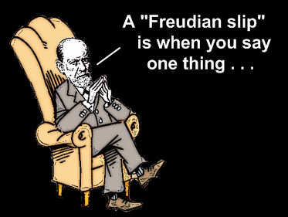
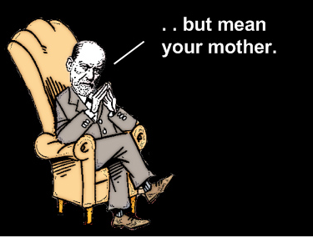
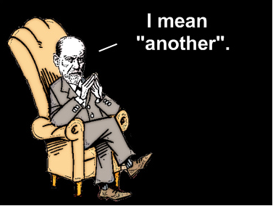
Speech errors
https://www.youtube.com/watch?v=Hpu_iEsISuI
Why study errors?
1. We gain insights into how the complex cognitive system involved in speech production works when it actually breaks!
2. We understand how information flows between different mental processes during speech production
3. We understand how much planning speakers do when they speak
https://goo.gl/images/mabh4e
Notes:
Let’s start with speech errors.
Like with pretty much everything Freud thought that speech errors are a window to the unconscious and they actually revealed our true inner thoughts and our true sexual desires– thoughts that we suppressed in order to be polite. So if this is right some of the people in the next video will be very much in trouble!
But there is more than suppressed sexual desire. And even if it sounds counter-intuitive studying what happens when speech production breaks down tells us a lot about what is happening in speech production.

Slide 24
Types of speech errors
 | Utterance | Target
Semantic substitution | Where is my tennis bat | Where is my tennis racquet
Word-exchange | My chair looks empty without my room | My room looks empty without my chair
Sound-exchange (spoonerisms) | Go and shake a tower | Go and take a shower
Notes:
Some types of errors are:
NOTE:
Errors in the lexical selection level give rise to semantic substitution errors. These errors occur when the correct word is replaced by a word with similar meaning. In 99% of the cases the substituted word is the same part of speech as the correct word (e.g., nouns substitute nouns). These errors suggest that speakers often plan the grammatical structure of their next utterance before finding the precise words to insert into that structure. And it also shows the top bottom activation and the spread activation of concepts that are similar semantically (IT IS IN THE EXAM)
Similarly we have word-exchange errors in which two words in a sentence switch places – within the sentence level. These errors suggest that speakers engage in forward planning of their utterances.
Spoonerisms occur when the initial letter of two words are switched. And they reflect a stage of processing after a set of lemmas and morphemes have been activated but before the articulatory plan.

Slide 25
In-class activity
Type of error | Utterance | Target
 | The knife light is great
 | Guess whose mind came to name?
 | Get me a whiskey to eat
Notes:
We do it together and I ask them orally to reply

Slide 26
In-class activity
Type of error | Utterance | Target
Sound-exchange (spoonerisms) | The knife light is great | The night life is great
 | Guess whose mind came to name?
 | Get me a whiskey to eat

Slide 27
In-class activity
Type of error | Utterance | Target
Sound-exchange (spoonerisms) | The knife light is great | The night life is great
Word-exchange | Guess whose mind came to name? | Guess whose name came to mind?
 | Get me a whiskey to eat

Slide 28
In-class activity
Type of error | Utterance | Target
Sound-exchange (spoonerisms) | The knife light is great | The night life is great
Word-exchange | Guess whose mind came to name? | Guess whose name came to mind?
Semantic substitution | Get me a whiskey to eat | Get me a whiskey to drink
Q: Can you think of any constraints?
Do you think you would ever say *the night grife is leat*?
Notes:
Make sure they understand why we study errors; 1. we gain insights into how the complex cognitive system involved in speech production works when it actually breaks! For example, the semantic substitution errors show us/ provide evidence for the existence of the lemma and the lexicalisation process from the model we saw. Because it shows that we have a concept (like an object we need to play tennis) but not the correct one. [EXAM: problems at the level of lexical selection may cause semantic substitution errors] So at the level of lemma we have more than one activated and we need to select from them the correct one. 2. also looking at errors we can conclude and understand how much planning speakers do when they speak. For example, look at the word exchange errors; we have words shifting places between different phrases but within the same clause which means that planning to produce speech happens at the clause level.
Question for them: ANSWER: The word exchange for example happen at a clause level. words from different phrases swap but still in the same clause. This is an important observation because we can tell that speech production involves planning (so you think ahead before you speak) at least at a clause level. In addition, most of the times word exchange happens within the same word category. For example, a noun would be swapped by a noun not a verb.
The sound exchange is again the same. Phonemes are swapped within the same clause not too far away between words and usually only one sound. So based on that let’s see some rules that even errors tend to follow.

Slide 29

Errors are not random
Lexical bias effect
  ‘Fig beet’ instead of ‘big feet’ more often than ‘hig borse’ instead of ‘big horse’ (Baars, Motley, & MacKay, 1975)
Mixed-error effect
  ‘Let’s start’ but not ‘Let’s begin’ instead of ‘Let’s stop’ (Dell, 1986)
  ‘I thought that there would still be some cookies left, but there were…’ If image of is shown → ‘none’ instead of ‘not’ (Ferreira & Griffin, 2003)
Notes:
Mixed error effect describes the errors that are semantically and phonologically related to the intended, the target word. These type of evidence show that interactive models are more likely to be correct.
For example, Dell (1986) listened to people often saying let’s stop instead of let’s start. And this is because the word stop is both semantically and phonologically related with the target word start. Also, in a study people had to finish some sentences like I thought there were gonna be cookies left while they were primed by pictures e.g. that of a priest. They would finish the sentence incorrectly with the word ‘none’ instead of ‘not’ because of the semantic similarity between the prime word priest and nun and the phonological identity between none and nun. The existence of this effect suggests that the various levels of processing interact flexibly with each other. More specifically the mixed-error effect suggests that semantic and phonological factors can both influence word selection at the same time.
Also, The lexical bias effect describes the tendency for sound exchange speech errors to consist of words rather than non words and this is because it is easier for words than nonwords to become activated because they have representations in the lexicon. So for example, you have more often mistakes like fig beet (which are real words AND thinking of Freud this can happen especially if you are hungry and you are thinking of a salad with figs and beetroot) instead of big feet than hig borse instead of ‘big horse’. So the fact that some errors are more frequent than others, and in particular the errors that create words rather than non words, suggests that there is again some interaction between sound and meaning while producing speech (and this points towards the fact that probably interactive models are better)

Slide 30
Support
Tip-of-the-tongue state (TOTs)
Picture-word interference
Speech errors
☞ Lexicalisation is not a one stage process
But what about information flow in the models of speech production?
Notes:
For both models we can gain some support if we look at these three types of evidence

Slide 31
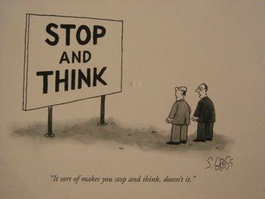
Evaluation
https://goo.gl/images/x3gcUX
 | WEAVER++ | Spreading Activation Model
TOTs | (?)
Picture-word interference
Speech errors | (?)
BUT
Prospecting
BUT
Lexical bias effect Mixed-errors
Notes:
EXPLAIN NICE how each of the previous evidence is supporting the theories
So we have evidence supporting both models regarding the existence of lemmas (remind them what this is) and the two-stage processing, that we don’t just think something and we say it, if we look at picture-word interference and TOTs.
We also get some support from studying errors, so when language breaks. But as we discussed one model describes and explains some errors better than the other. For example, the WEAVER++ that does not allow interactive processing does not provide a very satisfactory explanation for the mixed error effects when a person says the wrong word but this word is more likely to be related with the target word in terms of phonology (so there must be some interaction and flow of information from the phonological level). (note: WEAVER still explains the semantic substitution as in wrong lemma selection). Or why people tend to produce errors that are words rather than non-words – so again there is an interaction because only words are represented at the mental lexicon. Or why when in TOTs you can guess the sounds of the target word. [NOTE simply the existence/experience of TOTs is explained by WEAVER]
And of course note that this lemma theory is not accepted by all people. We won’t say much more about this. But there are some patients who have different error behaviour in speech and writing (e.g., they do not do semantic errors in speech but they don in writing) which shows that lemmas are not always necessary. This is caramazza’s work in 1997 who suggests that the lemma is not a necessary step between meaning and word
Maybe conclude that the models are kind of complementing each other because the spreading activation explains some errors that WEAVER cannot while WEAVER gives some focus on semantic knowledge (with lemmas) that spreading activation does not, because it kind of de-emphasizes the meaning construction. Like I said in the beginning some things in psycholinguistics are less definite… there are debates that keep going and it’s good for research. But do not think about them as the one is right the other one is wrong – try to understand them, critically evaluate them and use them to explain some things. Important and key to the next issue I will be discussing: for both models speech planning and monitoring is an issue and something that happens on the side… we are always taking some time to plan our speech, or we pay attention how to self-correct what we say…

Slide 32
Summary (I)
Speaking is a complex multi-stage process
  From having an idea you want to talk about to move your articulators and produce the sound waves
Several theoretical models have tried to describe the process
  WEAVER++ (feed-forward)
  Spreading activation (interactive)
Several empirical evidence support different components of the models
  TOTs, picture-word interference, speech errors
Notes:
Sum up and say what all these have to say to us about speech production and the theories]
What aspects of speech production are under demonstrable active control, and how do the many components of the linguistic and biological systems work together across speakers and social and linguistic contexts?

Slide 33
(II) Speech perception
Notes:
So the final outcome of speech production and articulation is the first stage for speech perception. And we will see that even though it’s sensory as en experience because we hear something, it’s more complicated because we need to add meaning.

Slide 34
Co-articulation
The pronunciation of a phoneme by a speaker depends on the preceding and following phonemes
  The /b/ phonemes in ‘bill’, ‘ball’, ‘able’, ‘rub’ are acoustically different
  The word ‘job’ is likely to be misperceived if the ‘jo’ part was recorded from the word ‘jog’
Bad news
No one-to-one relationship between acoustic signal and phonemes
Good news
Allows for prediction and makes perception faster
Notes:
This is a key feature of speech perception.
Why the previous slide is happening? Or okay it is fast but it can also be complex because of this second property of co-articulation.
This is because phonemes, sounds are co-articulated and this is a two-sided coin
You can say them better because I am not a native speaker. But think about it. Is tis necessarily good or bad thing?
Co-articulation enhances the efficiency of the system rather than being a destructive or communication-hampering force.
Co-articulation allows the speech signal to transfer information in parallel, transmitting messages more quickly than it could if language consisted of concatenated strings of context-free discrete units.
The bad news means that coarticulation increases variability and we can not easily detect and formally analyze the acoustic properties of the speech signal. So every phoneme has a different sound depending on whether it is pronounced with something different before or next
The good news is that it enables the identification of what sound will proceed so it makes perception faster!
Co-articulation: is not a mechanism actually – it is a property of speech that helps its perception. Co-articulation means that the way a phoneme is pronounced depends on what sound is before and after. For example, there is a difference when we pronounce the phoneme /b/ in ‘bill’ and ‘able’. THIS is actually a helpful cue; because it gives information for sounds that proceed and provides useful cues to word boundaries. NOTE: anticipation because of the co-articulation happens within words not between.

Slide 35
Theories of speech perception
Motor theory (Liberman et al., 1967)
TRACE (McClelland & Elman, 1986)
Notes:
So the models approach speech perception in a different way. The motor theory tries to explain how the brain perceives speech. And the TRACE is a computational model describing speech perception and the information flow from one to the other mental operation/linguistic component

Slide 36
Motor theory (Liberman et al., 1967)
‘Listeners perceive spoken words by reproducing the movements of the speaker’s vocal tract rather than by identifying the sound patterns that speech generates’
The motor system is involved in both speech production and perception
  ‘Bridge’ between production and perception
Notes:
Motor processes can facilitate speech perception
So the basic idea is that we use our motor system to internally reproduce what we heard. And this is how we understand what we heard by the activity of our motor system. When I hear the word ‘tree’ for example my motor system is activated in a way as if I would produce the word and this is how I understand it. It works a little bit like mental imagery, so you try to imagine saying the word into your mind. So perception is based on production
So for this type of theory the core unit of speech perception is what they call ‘gesture’ which is basically the movement plan rather than the sound
Understanding speech requires you to figure out which gestures created a given acoustic signal
Speech is understood because listeners can use the incoming acoustic signal to activate representations of the physical motions that created it.

Slide 37
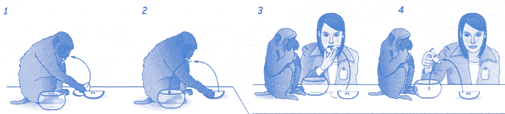
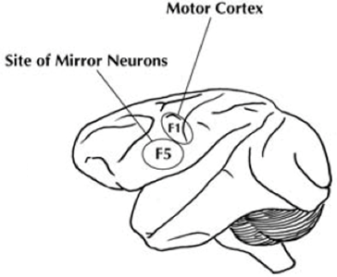
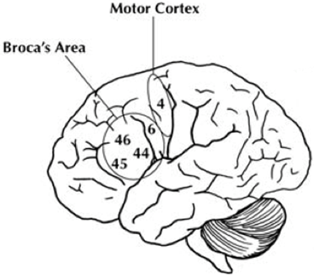
Motor theory and mirror neurons
Rizollatti’s work early ‘90s
Notes:
The first time we thought about this is by looking at action execution and observation in maqaues.
The motor theory has a link and is explained if you think of the mirror neurons. So before neuro-scientific methods were developed for humans, we investigated the maqacue brain. Mirror neurons found in macaque monkeys brain basically by the work of Rizollatti in the 90s. Class of visuomotor neurons originally discovered in area F5 of the monkey premotor cortex and they discharge both when the monkey performs a particular action (for example eating) and when it observes another individual (human or monkey) performing a similar action. They basically respond to mouth and hand actions, to sound associated with action and intention to act. Note that not all of the neurons in the motor cortex are mirror, only something around 20%.
So, if you look at the human brain the equivalent to the mirror neurons would be in the premotor cortex area which is also the area activated in language specific areas. And these areas are involved and link the perception and production of motor movements including the motor movements of the vocal tract.
So the concept is that when you perceive speech these neurons fire and the same neurons fire when you produce speech. The motor system is not only to produce speech but also to detect it. NOTE: HOWEVER I would not want to stress that too much – it is still an ongoing debate that needs more research in humans. Broca’s area is activated more for production and Wernicke for comprehension

Slide 38
Support
McGurk effect
Categorical perception
Motor cortex is functionally involved in speech perception
Notes:
2 lines of evidence from cognitive neuroscience: brain imaging reveals that listening to speech activates cortical motor areas and disrupting premotor areas with TMS impairs speech perception.
Speech perception involves cortical motor areas are functionally involved in speech perception
fMRI and TMS studies

Slide 39
McGurk effect
An illusion occurs when the auditory component of one sound is paired with the visual component of another sound, leading to the perception of a third sound
We integrate non-acoustic information into what we hear
  Our auditory and visual information processing is merged
https://www.youtube.com/watch?v=G-lN8vWm3m0
Notes:
Think of people with hearing problems. What do they do often? They use visual information from lips. Normal speakers/listeners can also do that; we tend to use information from the visual input when it is available. And actually sometimes we do it more than enough. Show the video. You hear ‘ba’, you see ‘ga’ and you perceive ‘da’! It sounds like a bad thing but use it and think of it as evidence that we can use visual information for example in a bar to hear what people say to us.
If you close your eyes you will listen the correct sound (e.g., ba in both videos) but in the one you saw someone saying da that’s why you got confused and said you heard something mixed.
McGurk effect: we said that people use visual information from lip movements and this influences the sound they hear. So truly motor systems are involved in speech perception. We use information from motoric movements from the lips to make sense of the acoustic signal, so this visual information and not the sound per se influences perception
Be careful: this does not mean that you necessarily need the visual modality to understand speech. If that was true how do we understand people on the phone. The McGurk effect only suggests that when visual information is available we are influenced by that.
Note: Tadoma is the so called tactile lip-reading. The deaf blind person (like Helen Keller a brilliant activist and author who was the first deaf blind person to gain a bachelor’s degree). It is a very difficult method and is not used now; it was developed in MIT; the deaf blind person puts their thumb close to the lips and the other fingers on the jawline of the speaker and they feel the movements and the vibrations
[EXAM]

Slide 40

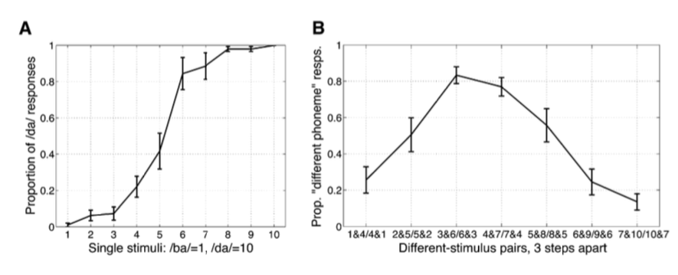
Categorical speech perception
Artificial 1 to 10 sound continuum where 1 sounded as /b/ and 10 as /d/
Speakers did not perceive gradual change
  They suddenly switched from perceiving one sound to perceiving the other
Better discrimination of pairs of sounds when sounds were across the crucial point
Raizada & Poldrack (2007)
Notes:
So the other type of evidence is that speech is categorical. Speech stimuli intermediate between two phonemes are typically categorised as the one phoneme or the other, and there is an abrupt boundary between phoneme categories.
We perceive sounds as belonging to discrete categories. Think about this gradual changes in the acoustic signal as the morphs in faces – I am sure you have seen in the movies like criminal minds how faces can gradually change – the same can be done with phonemes artificially
So Raizada and poldrack did a study which
We perceive sounds as belonging to discrete categories.
So Raizada and poldrack did a study (It’s an fMRI one) which showed that when we listen to artificial speech sounds that gradually change from one sound to another, we don’t perceive a gradual change – instead we suddenly switch from perceiving one sound to perceiving the other. At point 5.
Categorical perception: we saw that we abruptly understand phonemes as /b/ or /d/ and we do not understand the gradual changes in between that are artificially made by the software – and this is because we cannot understand what we cannot say [so this is the evidence for motor theory]. Because we humans cannot produce intermediate sounds – only the software can.
Basically this means that you are insensitive to some kinds of variation in the speech signal (between 1-4 for example) but when the speech signal changes enough (point 5 for example) you perceive that change as the difference between one phoneme and another.
According to motor theory this categorical perception of speech sounds provided further evidence that the speech perception system was special and different from the auditory perception processes that dealt with non-speech sounds. Also it shows how linked perception and production is because this study showed that we cannot understand what we cannot say.
NOTE: this was an fMRI study which at the same time showed that the low auditory cortex did not show much activation when the artificial sounds gradually changed but it showed activation only when they perceived the two sounds as seperate distinct categories, around point 5 that is. FIGURE: panel a shows how highly accurately subjects discriminate between /ba/ and /da/ at point 5 like we said. Panel B shows how differently they rated the sounds in pairs and this basically shows that the pairs which were judged as different more accurately where the ones that differed by points between categories (1-4 no different but 3 vs 6 different).
A few things about categorical perception: it should not sound strange. Perceptual categories often serve to break continuous variation into manageable chunks. Think about it as the colour discrimination. So listeners sacrifice sensitivity to acoustic detail in order to make speech category distinctions more automatic and less subject to variability. This type of categorical perception is more obvious with consonants rather than vowels. So to conclude categorical perception is summarized into two key concepts: there are sharp category boundaries and listeners are insensitive to discriminating within-category differences.

Slide 41
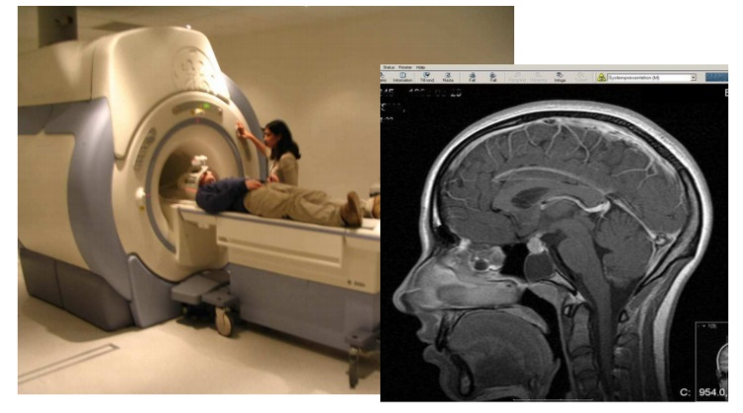
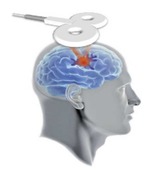
Motor cortex and speech perception
fMRI
  Listening to speech and
  imagining you are speaking activates speech motor cortex
TMS
  Motor TMS decreases phoneme
  discrimination
Iacobini (2008)
Notes:
Motor theory says the accessing representations of speech gestures must be stored in the parts of the brain that control articulatory movements. The parts of the brain that control articulation are the motor cortex in the frontal lobes of the brain and adjacent premotor cortex. Put this all together and it means that according to the motor theory you should activate the motor cortex when you perceive speech. And this is happening if you put people in the scanner and take pictures of their brains while they listen to speech or they imagine speaking – you see activation in the premotor cortex. The same if you apply magnetic stimulation to the motor cortex – so when you apply repeatedly this stimulation you are kind of blocking the area and you simulate kind of lesion, the neurons are discharged for a few minutes – so when you do that speech perception of participants is influenced. So motor areas in the brain are functionally involved in the perception of speech
CAUTION: this type of neuroscientific evidence is not the most readily epxlanation you can get. Because tms might give rise to leg related MEPS (=recording of muscle potentials) and legs don’t talk! So it’s not really clear what is happening there.

Slide 42
Some limitations
What about infants and patients?
What about context effects?
https://goo.gl/images/x3gcUX
Notes:
In general although the motor theory is a nice effort to bridge production and perception, and ideally this is something we are generally looking for in psycholinguistics – because these two basic procedures are the two sides of the same coin, but it has some limitations.
Infants are very good at perception but not at production. According to motor theory infants should be bad at perception because they do not have the means to mimic and simulate and produce what they hear, but this is not the case. Also, there are some aphasic patients who are impaired only in speech production but have intact perception (the non-fluent aphasics, who can understand what you tell them but cannot produce words)
Also, there are some times that meaning and context affects speech perception. Motor cortices (that the theory suggests that are involved in speech perception) cannot decode meaning so these types of phenomena and interactions cannot be addressed with the motor theory.
Other problems with motor theory:
Infants perceive speech sounds that they cannot produce.
Japanese quail and chinchillas perceive speech sounds that they cannot produce.
Duplex and categorical perception occur in non-speech stimuli.
Aphasia: Provides evidence for double-dissociations between speech production and perception abilities (even in bilateral brain-damaged patients).
Also, there should be an interest in larger, higher level units than phonemes, because these ones are not very psychologically real or this is not easy to test. That’s why we need to look at other factors that might influence speech perception processing

Slide 43
TRACE (McClelland & Elman, 1986)
Words
Phonemes
Auditory features
cat
can
cop
C
A N O P T
/c/
Notes:
Mak kleland
Think of this model like the spreading activation model in speech production but reverse!
So let’s say we hear the word cat, how do we perceive it.
At the auditory features level what is happening is that we heard the sound of /c/ in the first position. This gives activation from bottom up to the phoneme and also some words that can start with /c/ like cop, can, cat…
The yellow arrow suggests that we have some top-down activation from word to phonemes, so since the word cat was activated there is a pre-activation of the phoneme a in the second position and phoneme t in the third, or because the word cop was also activated, we have some activation of phoneme o for the second position [and this explains for example some priming effects]. But then on the auditory feature level we hear the sound /a/ which automatically inhibits the not matching sounds and words that do not have /a/ in the second position. So all this happens in cycles and same thing happens for all sounds.

Slide 44
TRACE (McClelland & Elman, 1986)
Words
Phonemes
Auditory features
cat
can
cop
C
A N T
O P
/c/
/a/
Notes:
Mak kleland
Think of this model like the spreading activation model in speech production but reverse!
So let’s say we hear the word cat, how do we perceive it.
At the auditory features level what is happening is that we heard the sound of /c/ in the first position. This gives activation from bottom up to the phoneme and also some words that can start with /c/ like cop, can, cat…
The yellow arrow suggests that we have some top-down activation from word to phonemes, so since the word cat was activated there is a pre-activation of the phoneme a in the second position and phoneme t in the third, or because the word cop was also activated, we have some activation of phoneme o for the second position [and this explains for example some priming effects]. But then on the auditory feature level we hear the sound /a/ which automatically inhibits the not matching sounds and words that do not have /a/ in the second position. So all this happens in cycles and same thing happens for all sounds.

Slide 45

TRACE (McClelland & Elman, 1986)
Words
Phonemes
Auditory features
cat
can
C
A T
N
/c/
/a/
/t/
Notes:
Think of FLMP like the spreading activation model in speech production but reverse!
Think of the fuzzy logical model of speech perception like the spreading activation model in speech production but reverse!
So let’s say we hear the word cat, how do we perceive it.
At the auditory features level what is happening is that we heard the sound of /c/ in the first position. This gives activation from bottom up to the phoneme and also some words that can start with /c/ like cop, can, cat…
The yellow arrow suggests that we have some top-down activation from word to phonemes, so since the word cat was activated there is a pre-activation of the phoneme a in the second position and phoneme t in the third, or because the word cop was also activated, we have some activation of phoneme o for the second position [and this explains for example some priming effects]. But then on the auditory feature level we hear the sound /a/ which automatically inhibits the not matching sounds and words that do not have /a/ in the second position. So all this happens in cycles and same thing happens for all sounds.
By competition you deactivate the other pre-activated. And in general words are activated by phonemes and words also activate phonemes
[NOTE: for seperating words you have a lot of top down processing]

Slide 46
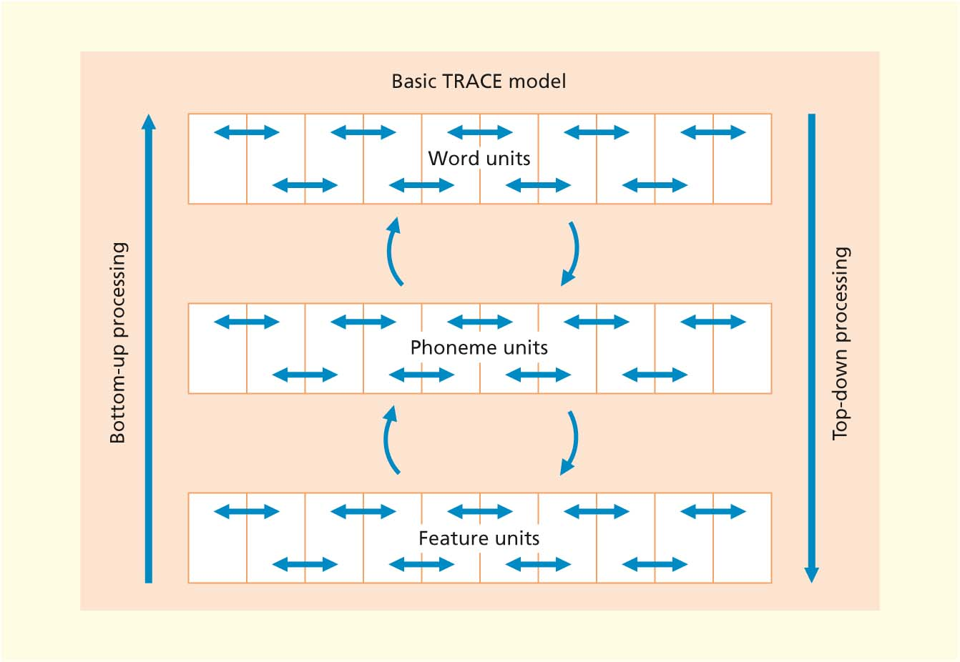
TRACE (McClelland & Elman, 1986)
1. Nodes influence each other creating patterns of activation
2. Interaction of bottom-up and top-down processes

Slide 47

Support
Lexical identification shift aka Ganong effect
  When sounds ranging from /dash/ to /tash/, phonemes were assigned to words rather than non-words (Ganong, 1980)
Phonemic restoration effect
  http://www4.uwm.edu/APL/demonstrations.html
  When ‘It was found that the *eel was on the shoe’, participants heard ‘heel’. When ‘It was found that the *eel was on the orange’, participants heard ‘peel’ (Warren & Warren, 1970)
☞ Interactive processing
Notes:
The ganong effect is evidence of context effects on speech perception.
People perceive and identify ambiguous phonemes in words and not in non-word. That is there is a bias towards perceiving an ambiguous phoneme so that a word is formed. So effect that top-down learning at the word level affected the phoneme categorisation. This is also called the word-superiority effect: so this phenomenon is explained by the FLMP only which allows interactions, because we cannot have top down activations from the word to the phoneme level with non-words because simply they do not exist in our lexicon!
A second line of evidence is the phonemic restoration effect. Let’s see what this is. This means basically that even when a sound in a word is missing we do not notice it and we still understand the word. This is happening because of top down processing. Listen to the demonstration. QUESTION: before I play everything. What sound was missing? Did anyone feel that the word is complete. So it doesn’t make a difference if –s- is missing. Our brain restores the missing items in the speech signal. There is a very nice study which shows this top down processing. There was a small portion of sound removed and replaced with something meaningless (e.g., a cough) and the perception of what was heard changed based on the context of the sentence. The phonemic restoration effect suggest that there is top down processing (from meaning phonetic features) in speech perception based on the sentence context. So even though the sound is missing we do not pay attention to that and we make sense of the word based on the context.
Basically the interactive nature of language processing is responsible for comprehension being rapid because it allows for anticipation. Top-down processing from meaning promotes prediction of upcoming words. NOTE: TRACE also explains the categorical perception in the sense of inhibition competition and one phonme becoming increasingly activated while other phonemes are inhibited

Slide 48
Summary (II)
Understanding speech is a complex multi-stage process
  From registering the presence of a speech stimulus to figuring out what it means
Several theoretical accounts have tried to describe the process
  Motor theory (feed-forward)
  TRACE (interactive)
Several empirical evidence support different components of the theories
  McGurk effect, categorical perception, motor cortex involvement, phonemic restoration, Ganong effect
Notes:
Some models provide more satidfactory explanations. I think the interactive win.

Slide 49
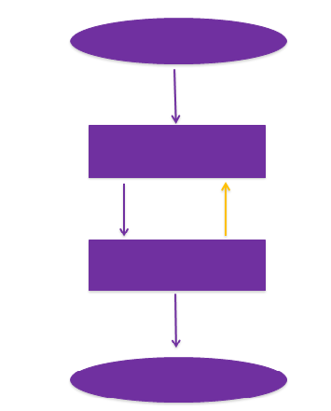
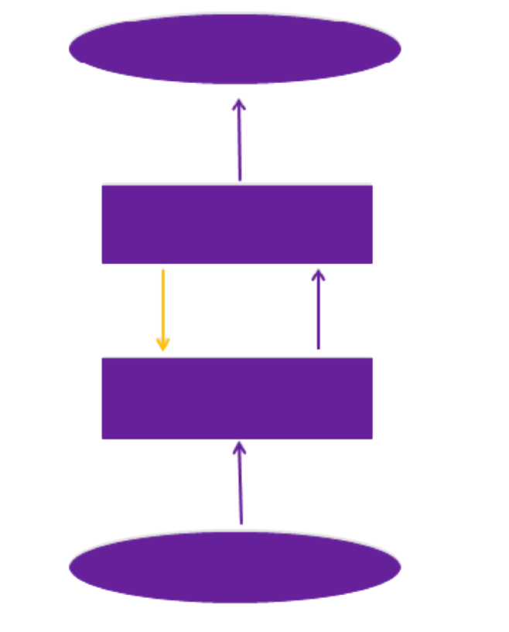
Speech Production
Is not just motor execution
Speech Perception
Is not just sensory interpretation
Intention to speak
Comprehended meaning
Semantics & Syntax
Semantics & Syntax
Word phonology
Word phonology
Articulation
Auditory input
Notes:
Interaction and two way flow of activation (from online talk to sum up); in the end
So think about speech production and perception more simplistically. What we learned about production is that we retrieve words from their semantic representations to their phonological representations and ultimately to the articulation of speech. The most important thing is that this processing happens not only top-down but interactively, bottom-up and this way we can explain errors like let’s stop instead of let’s start. The importance of the model is that if we simulate this model with a computer we can actually mimic these errors so think of the real life application – we can make Siri and google talk more naturally!
Comprehension is like production but in the opposite direction, we start from the sounds in the bottom and go up to the meaning. But like production is also interactive because it is the only way to be so rapid – we take information from all different levels to quickly understand what we hear.
Think of research in speech production as the overt behaviour and speech perception as the examination of the hidden and cognitive and neurological functions. It is important that we research in the intersection and investigate the inherent links between these two processes. Research in both should work complementary to make sense of human communication.
‘whatever signals generated in speech production should match those received in perception’ = signal parity
Speech is more than just acoustic patterns and motor plans that happen to coincide (and for example McGurk effect shows this – as in other cues like visual cues override listener’s auditory input) What accounts for the perceptual constancy across highly diverse contexts, speech styles and speakers? From a job interview in a quiet room to a reunion with an old friend at a cocktail party, from a southern belle to a Detroit body builder, what makes communication possible? Answers to these questions may lie in discovering the extent to which the speech perception processes tapped by experiments in word recognition and phoneme perception are related, and uncovering the nature of the neural substrates of language that allow adaptation to such diverse situations.

Slide 50
Practice MCQs
Right answers on Blackboard
1. What type of exchange happens in spoonerisms?
(A) Word-exchange
(B) Phoneme-exchange
(C) Meaning-exchange
(D) Morpheme-exchange
2. TOT states differ from ordinary word-finding problems in that:
(A) People can often say how many syllables the target word has
(B) People can often say what sound the word begins with
(C) People can often predict whether they will be able to remember the target word in the near future
(D) All of the above
3. WEAVER++ does not provide satisfactory explanation for:
(A) Two-stage lexicalisation
(B) Lexical bias effect
(C) Tip-of-the-tongue state
(D) B & C
4. Moving the muscles that create speech sounds is called:
(A) Ablation
(B) Conceptualisation
(C) Articulation
(D) Formulation
5. Imagine you are looking at a picture of a dog. Imagine that a word is printed on the picture. Which of the following words would help the most if you tried to name the object in the picture (i.e., dog)?
(A) Fog
(B) Wolf
(C) Cat
(D) Freedom
Notes:
Right answers: Q1-B, Q2-D, Q3-D, Q4-C, Q5-A

Slide 51
Reading for this lecture
Compulsory
Eysenck & Keane. Cognitive Psychology: A Student’s Handbook
6th edition (eBook available) Chapter 9 pp. 353-369 & Chapter 11 pp. 426-436 OR
7th edition (hard copies available in the library) Chapter 9 pp. 386-393 & Chapter 11 pp. 451-470
Optional
Casserly, E. D. & Pisoni, D. B. (2010). Speech perception and production. Wiley Interdiscip Rev Cogn Sci 1(5), 629-647.
Notes:
The chapters obviously are compulsory and questions in exam are based on what you find in the book
You can also read this review paper which includes a nice overview of research in speech production and perception giving some new directions.

Slide 52
Research papers from this lecture
Altmann, G. T., & Kamide, Y. (1999). Incremental interpretation at verbs: Restricting the domain of subsequent reference. Cognition, 73, 274-264.
Arieh, Y., & Algom, D. (2002). Processing picture-word stimuli: The contingent nature of picture and of word superiority. Journal of Experimental Psychology, 28(1), 221-232.
Harley, T. A., & Bown, H. (1998). What causes tip-of-the-tongue states? British Journal of Psychology, 89, 151-174.
Iacobini, M. (2008). The role of premotor cortex in speech perception: Evidence from fMRI and rTMS. Journal of Physiology – Paris, 102, 31–34.
Raizada, & Poldrack. (2007). Selective Amplification of Stimulus Differences during Categorical Processing of Speech. Neuron, 56(4), 726-740.
Notes:
I suggest you have a look at them, if you want to understand the studies better in more detail and have an idea of psycholinguistic research.

Slide 53
Next week
Revision session
  Use the discussion board for posting questions in advance

