Slide 1
TempoTuner
Allan Tuquero
Keefer Bibby
Shelly Suhling

Slide 2
Why do we need this?
To use unconvential song characteristics to create playlists.
User can discover music in a broad spectrum of genre’s keeping the integrity of their taste.
Can make playlists for workouts, night time, or whatever your mood is based on different attributes.

Slide 3
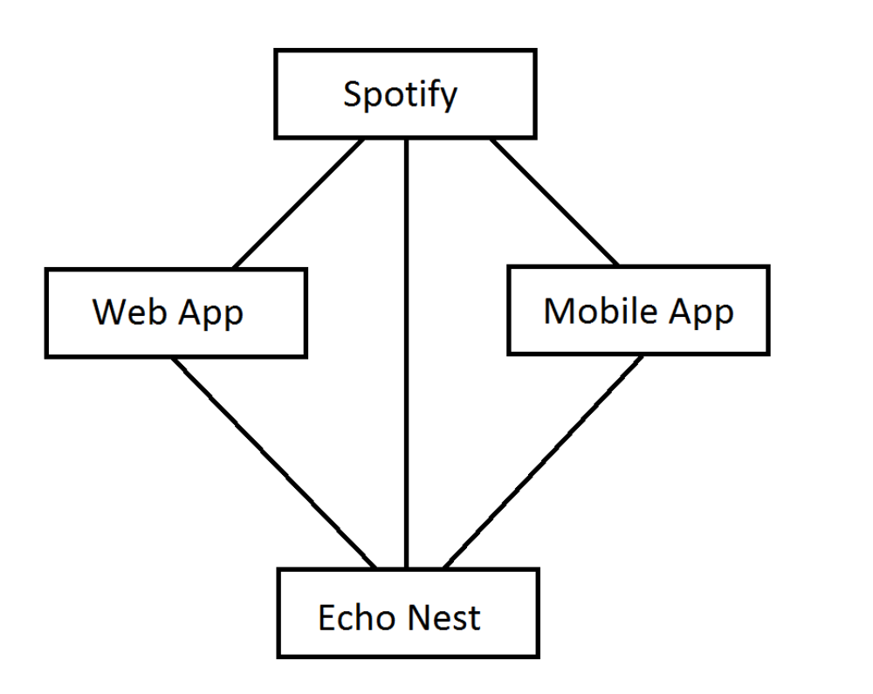
Functionality
Will take a request from either the web or mobile app.
Query Echo Nest and make a playlist based on the specifications.
This playlist will then be made in Spotify
Then a link to the playlist will be provided for the user in their app.

Slide 4
Tools
Java for the mobile app (android)
Python for the web app
API’s: Echo Nest, Spotify Web
Bitbucket

Slide 5
Objectives
Our objective is to provide people a medium to find and play the music they want through specific characteristics of songs.
The final product will take user inputs of given genres and tempo’s and generate a Spotify playlist for their account.
A sub-goal for when we have a functional app is to have one with minimized runtime.

Slide 6
Division of Labor
Work will be divided equally
Ideally it will be by task, but work delegation will be dynamic based on our strengths and what is needed to be done

