Slide 1

Capstone:
Whoop Explorer
Austin Juhl

Slide 2
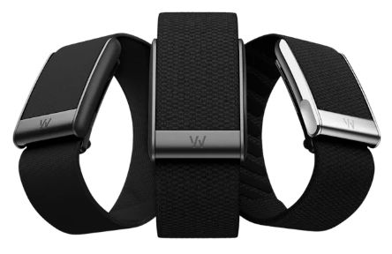
What is Whoop?
WHOOP is a wearable fitness and recovery platform.
Continuously tracks signals such as:
heart rate
heart rate variability (HRV)
respiratory rate
blood oxygen
skin temperature
sleep timing and sleep stages
daily strain / exertion
Allows user-entered behaviors such as
Consumed alcohol or caffeine, viewed screen and/or read before bed, shared bed, was ill/sick
Computes a daily recovery score based on current night sleep and previous day metrics.

Slide 3
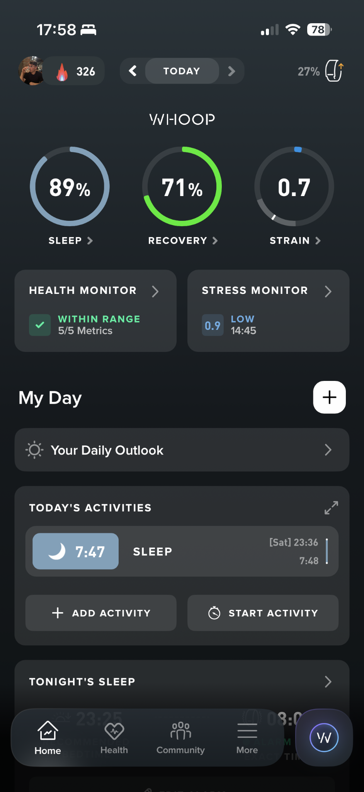
Project Overview
Using my personal WHOOP data
Data used: March 23, 2022 to April 15, 2026
Goals:
Understand how recovery and other physiological metrics relate to each other and my recorded daily behaviors.
Predict next-day changes in recovery using lagged data.

Slide 4
Data
Four datasets
Physiological_cycles.csv
Main dataset containing all time series data.
Each row is a cycle which starts at sleep onset and ends at the next sleep onset.
Workouts.csv
Workouts and duration in different heart rate zones
Turned into an Activity boolean indicating if I did an activity that cycle
Journal_entries.csv
All recorded behaviors

Slide 5
Data [Cleaning]
Convert timestamps to UTC
Raw data was in different time zones
Trim data to earliest date with valid blood oxygen and skin temperature measurements
I started using Whoop in December 2020, but they didn't have some features at that time
Collected a lot of behaviors in a journal, but filtered down to the ones with the least amount of NaNs.
Alcohol, caffeine, screen in bed, reading a book in bed, shared bed, sick/ill
Pivoted journal into wide features and add Activity from workout datasets, then merged with main cycles dataset.
Identified gaps in data
There were periods where I would lose my charger.
I removed anomalous rows around those gaps as well.
Small Gaps: interpolate numerical, front/back fill categorical
Large Gaps: labeled sections of continuous data then compute lags in sections so that they don’t jump gaps

Slide 6
[ Demo ]

Slide 7
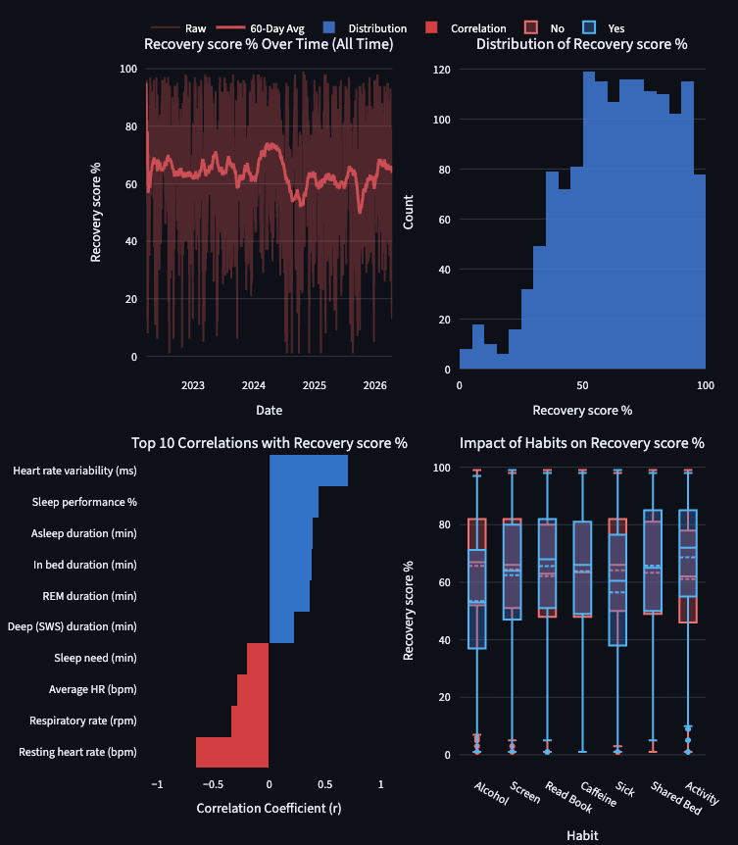
Data [Analysis]
Select a metric, time window, and number of correlations you want to see
Plots
Metric over selected time
Distribution for selected time
Correlation coefficients for selected time
Box and Whiskers showing impact of categorical “habits” on selected metric
Recovery Insights
All Time plot shows an increase in recovery at the beginning of 2024 and sharp decline at the end of 2024
Corresponds to pre-dissertation defense when I was very regimented and disciplined then the decline in recovery occurs after my defense where I started going out and having more fun with my friends and family.
Heart rate variability has a string positive correlation with recovery.
Resting heart rate has a strong negative correlation with recovery.
Recovery is ~20% worse when I drink alcohol

Slide 8
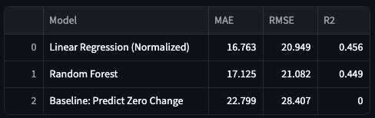
Model
Main Takeaways
Both learned models beat the naive baseline
Linear regression performed slightly better than random forest on the test set
It’s strange to me that the simpler model (Linear) performed slightly better than the more flexible model (Random Forest)
Neither model performs particularly great.
I believe next day recovery is typically computed with next day sleep metrics which I did not use
Predict: next-day change in recovery
Features include current and 3 day lag for:
Recovery score, Heart rate variability, Day Strain, Average HR, Sleep performance, Sleep consistency, Respiratory rate, Asleep duration, Alcohol
80/20 Test/Train Chronological Split
1164 training cycles
292 testing cycles
Models

Slide 9
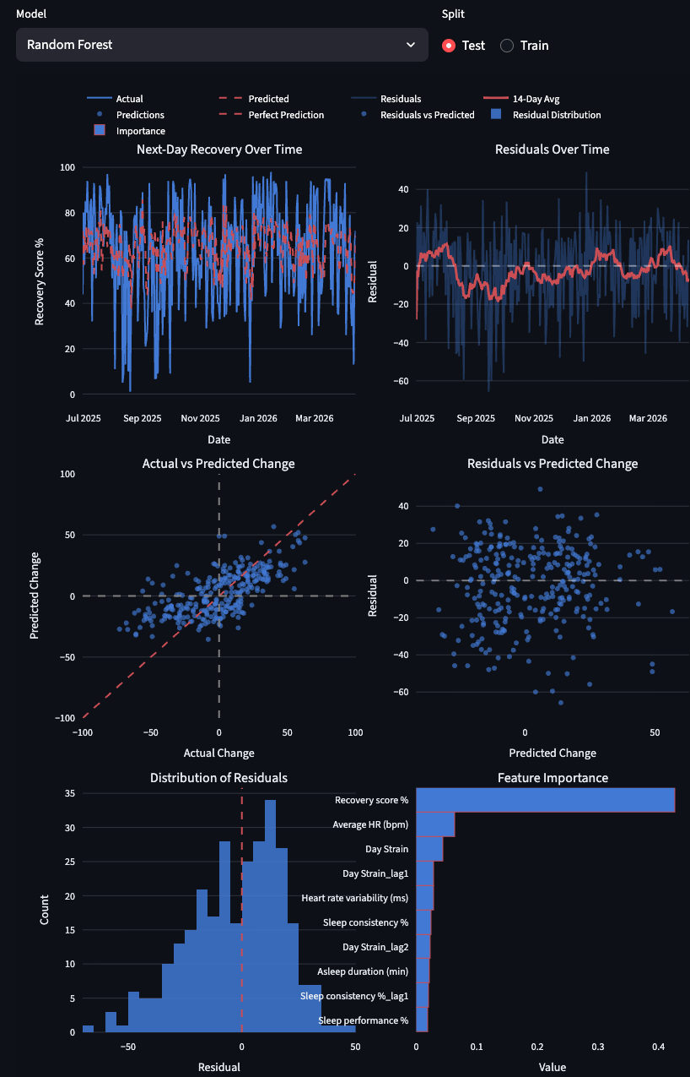
Model [Analysis]
Select a model and a split
Plots
Next-day recovery over time
Predicted and actual
Residuals over time
Raw and smoothed
Actual vs predicted change
Residual vs predicted change
Distribution of residuals and feature/coefficient importance
Recovery Insights
Time series plots show the Random Forest model doesn’t predict big changes in recovery very well
In actual vs predicted change scatter, we would hope to see the scatter hug the 45 degree dashed red line, but the scatter is more spread out and is slightly flatter than it should be.
Meaning we under predict big increases and decreases.
Previous day recovery and average hr show the highest feature importance.

