Slide 1
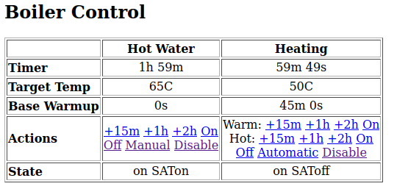
http://boiler.local/
Time left to run
Add 1/2/3 hours extra time
For heating pick warm or hot
Off will stop now but continue with next schedule
Manual stops scheduling
Automatic enables scheduling
Disable turns it off completely (e.g. going away)

Slide 2
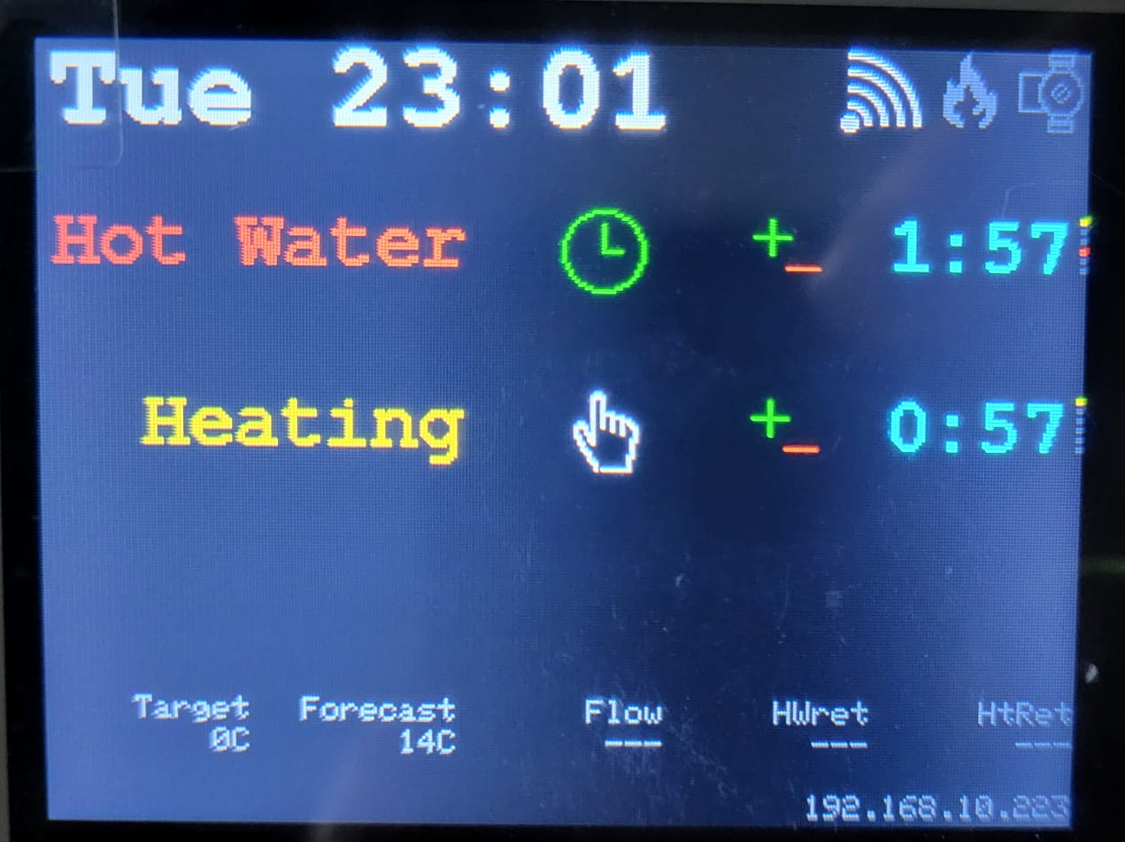
Touch and release to add 1 hour
Press and hold to turn off
Enable/disable
(e.g. on holiday)
Clock = automatic
Hand = manual
No Entry = off
Boiler and Pump
Grey = off
Blue = cooling
Red = on
Orange = Low temp
Red = High temp
(set before time)
Remaining time
Display goes off after 30s, touch to wake it again

