Slide 1

Customer Churn Prediction
Presented by:
Aju Peter
Graduate Diploma In Data Analytics (New Zealand School Of Education)
Email: ajupeter.t@gmail.com Mobile:02102663340
Notes:
Hi Good morning, everyone. My name is Aju Peter, first of all I would like to thank your for giving this wonderful opportunity, and today I will be presenting on customer churn prediction. Let's jump into the next slide

Slide 2
Introduction
What is Customer Churn?
Customer churn occurs when customers leave one company for another.
Reasons for churn: Poor customer service, lack of features, insufficient discounts, better deals elsewhere.
Impact: High cost of acquiring new customers compared to retaining existing ones. High churn rates can damage a company's reputation.
Solution: Companies use data science and machine learning to predict and reduce churn by analysing usage patterns, transaction history, and customer feedback.
Objective: Implement targeted retention strategies like personalized discounts to retain customers.
Notes:
Customer churn is a major issue for companies, when customers leave for a competitor. This can happen due to various reasons like poor customer service, lack of features, or better deals from competitors. Churn is costly because acquiring new customers is more expensive than retaining existing ones. High churn rates can also harm a company's reputation. To address this, companies use data science and machine learning to predict and reduce churn by analyzing customer data and deploying targeted retention strategies.

Slide 3
Dataset Source: Bank customer churn dataset from Kaggle. Objective: Predict if a customer will leave the bank (binary classification: 1 = Exit, 0 = Stay).
Surname: Customer's surname
CreditScore
Geography: Country (Germany, France, Spain)
Gender: Female, Male
Age
Tenure: Years as a customer
Balance: Account balance
NumOfProducts: Number of bank products used
HasCrCard: Credit card status (0 = No, 1 = Yes)
IsActiveMember: Active membership status (0 = No, 1 = Yes)
EstimatedSalary: Estimated salary
Exited: Churn status (0 = No, 1 = Yes)
Notes:
For this presentation , I used a bank customer churn dataset from Kaggle. The goal is to predict whether a customer will leave the bank or stay, which is a binary classification task. The dataset includes features like credit score, geography, gender, age, tenure, balance, number of products used, credit card status, active membership status, estimated salary, and whether the customer has exited or not.

Slide 4
Project Overview
Data Loading and Preprocessing: Handle missing values, encode categorical variables, and normalize numerical variables.
1
Exploratory Data Analysis (EDA): Understand data relationships and insights.
2
Model Training: Train the model on pre-processed data.
3
Model Evaluation: Evaluate model performance using metrics like accuracy, precision, recall, and F1-score.
4
Notes:
In this project involves four main steps:
Data Loading and Preprocessing: This includes handling missing values, encoding categorical variables, and
scaling numerical variables. 2. Exploratory Data Analysis (EDA): We explore and visualize the data to gain insights and understand relationships between features.
Model Training: We train the model on the pre-processed data.
Model Evaluation: We evaluate the model's performance using metrics like accuracy

Slide 5
Tools and Libraries
Python: Programming language.
Pandas: Data manipulation and analysis.
NumPy: Numerical computations.
Matplotlib and Seaborn: Data visualization.
Scikit-learn: Machine learning tasks including data preprocessing, model training, and evaluation.
Notes:
For this project, I used Python as a programming language which is widely used in data science. and several libraries:
Pandas for data manipulation and analysis.
NumPy for numerical computations.
Matplotlib and Seaborn for data visualization.
Scikit-learn for machine learning tasks, including data preprocessing, model training, and evaluation.

Slide 6
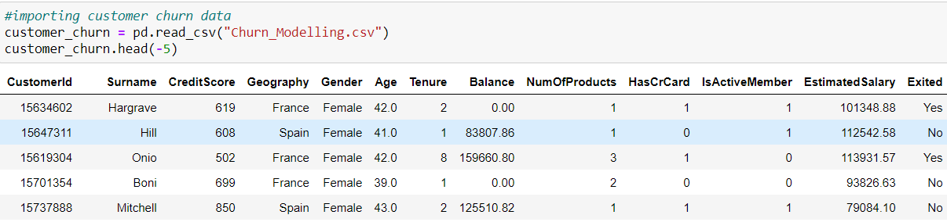
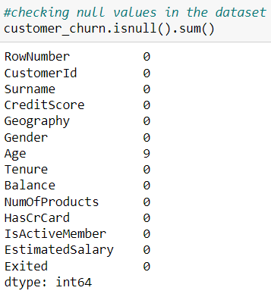
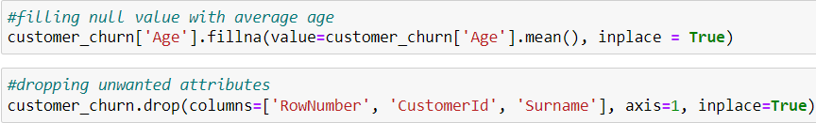
Data Preprocessing
Load the data.
Handle missing values.
Notes:
In the data preprocessing stage, I started with loading the dataset into python
Then find the missing values and Handle missing values.
This is moreover cleaning the dataset before processing

Slide 7
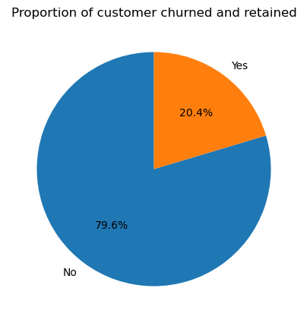
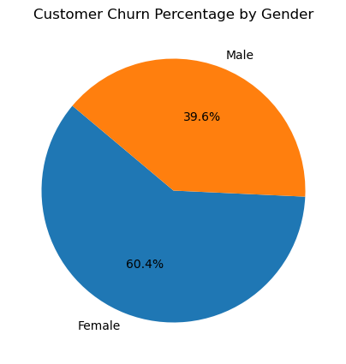
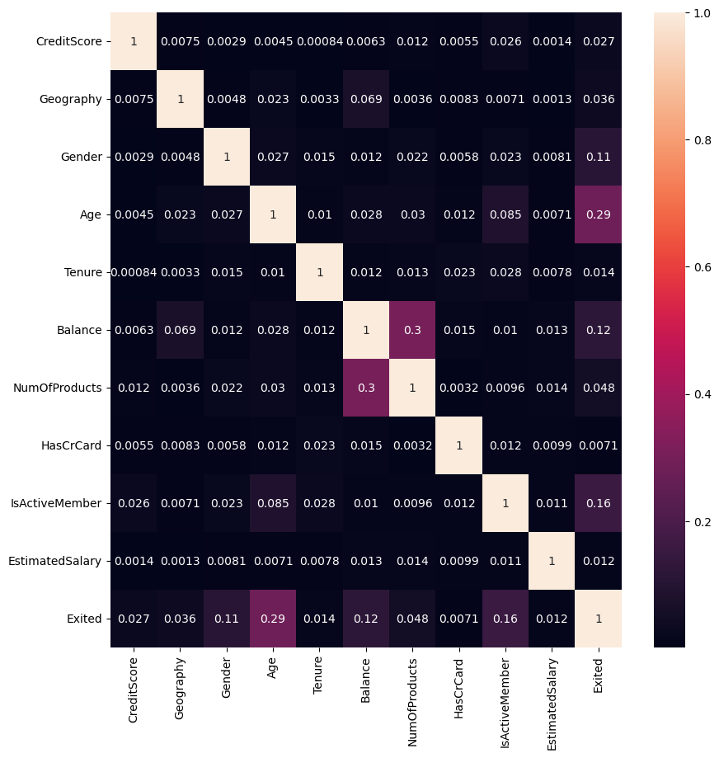
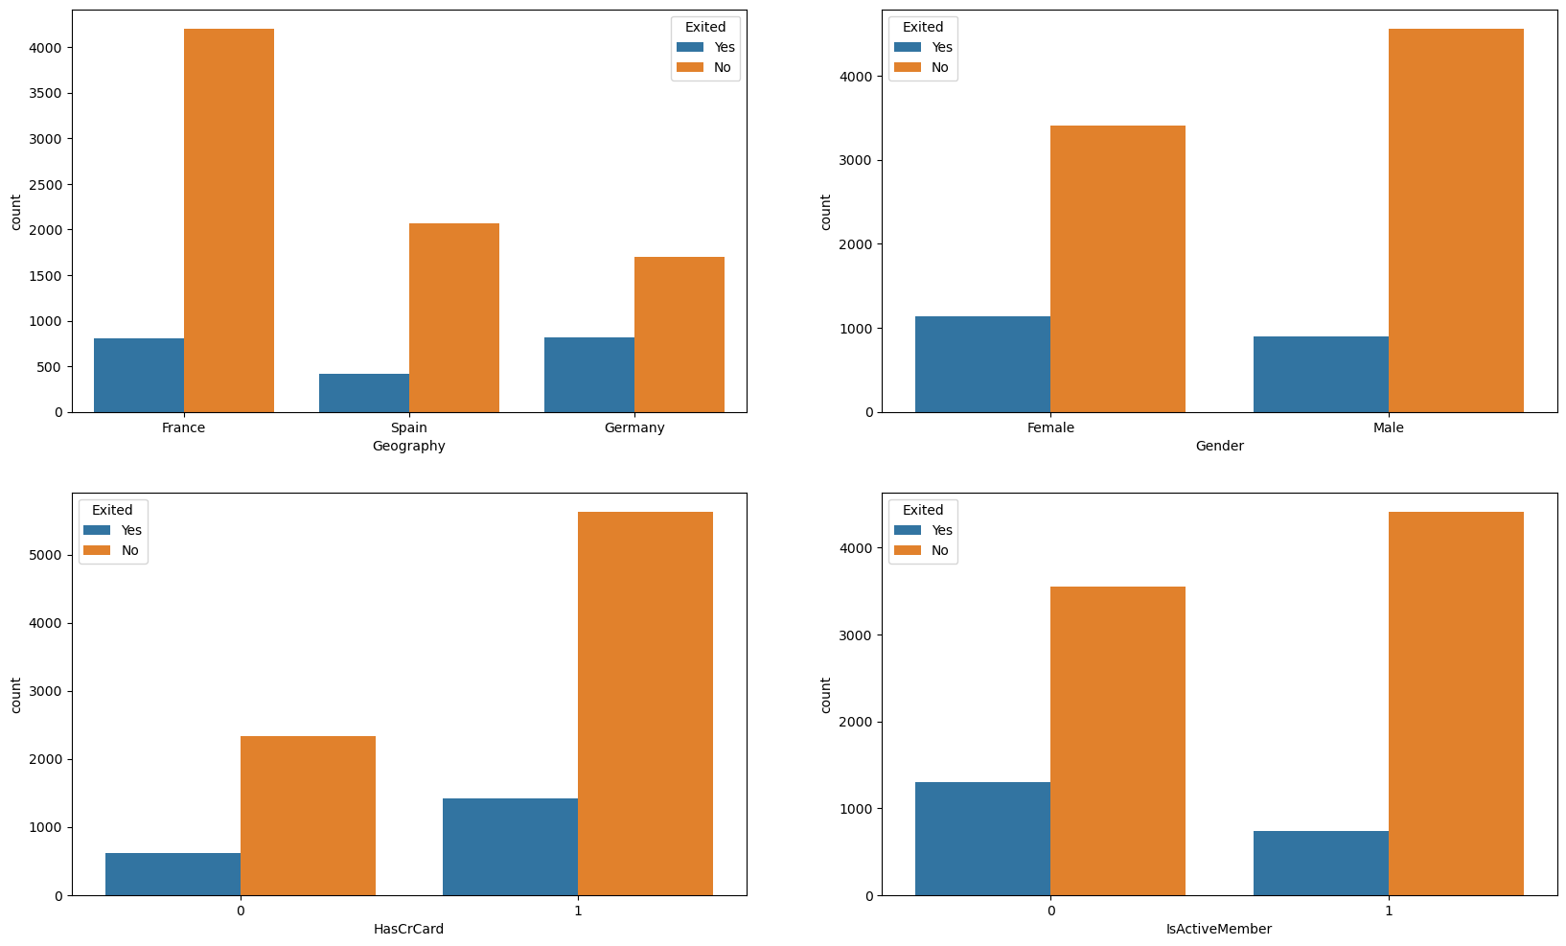
Exploratory Data Analysis (EDA)
Analyse and visualize data to gain insights.
Understand relationships between features.
Notes:
During the exploratory data analysis, we analyze and visualize the data to gain insights and understand relationships between different features. This helps us identify patterns and trends that can help our model. From most of the customers retain and only 20% of customer exited.
Female customer churn rate is higher than male customers.
High churn in customers from Germany.
Higher churn rate in customers with credit cards compared to those without credit cards.
Higher churn in non-active customers.

Slide 8
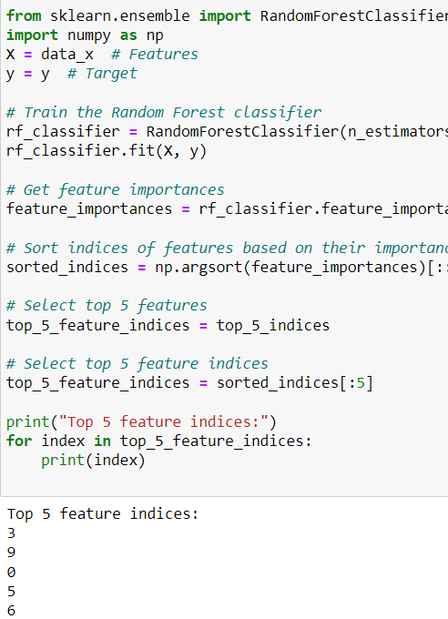
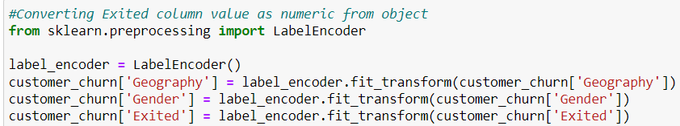
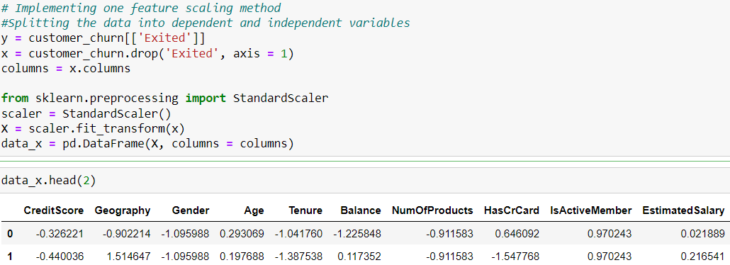
Feature Engineering
Encoding: Label encoding for categorical variables.
Scaling: Standard scaler for normalizing the variables.
Feature Importance: Used Random Forest classifier to identify the top 5 features.
Notes:
For feature engineering, we:
I Used label encoding for categorical variables.
Applied standard scaling to numerical variables.
I Used Random Forest classifier to identify the top 5 most important features in the dataset.
This prepares our data for model building.

Slide 9
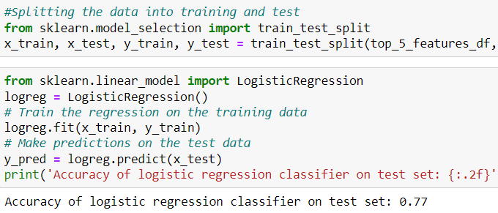
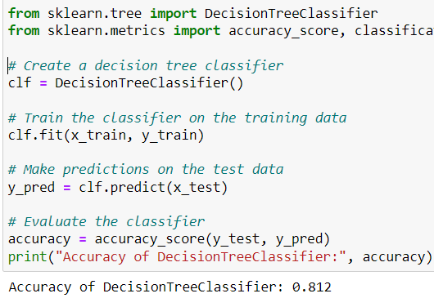
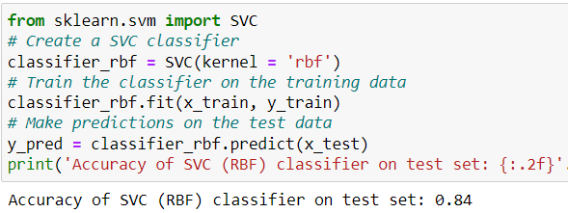
Model building and comparison
Data Split: 85% training, 15% testing.
Model Performance:
Logistic Regression: 77% accuracy
SVC (RBF): 84% accuracy
Decision Tree Classifier: 81.2% accuracy
Notes:
We split the dataset into 85% for training and 15% for testing. We tested several models:
Logistic Regression achieved 77% accuracy.
SVC (RBF) achieved 84% accuracy.
Decision Tree Classifier achieved 81.2% accuracy.

Slide 10

Conclusion and Recommendation
Findings:
High churn in customers from Germany.
Female customer churn rate is higher than male customers.
Higher churn rate in customers with credit cards compared to those without credit cards.
Higher churn in non-active customers.
Results:
Predictions were made using 3 classification models.
The highest accuracy was achieved with the Support Vector Classification (SVC) model.
Future Work:
Include more models like Random Forest and deep learning models.
Perform hyperparameter tuning.
Use k-fold cross-validation.
Apply dimensionality reduction techniques to improve model accuracy.
Higher churn in customers aged 40-65.
Notes:
Our aim was to develop a model to predict customer churn. We worked with a dataset of 10,000 rows and 13 variables,. Key findings include:

Slide 11

Thank You! Questions?
Notes:
This is end of my presentation. Thank you for your attention and patience. Is there any questions about the presentation?

