Slide 1
Accelerated Visualization of Transparent Molecular Surfaces in Molecular Dynamics
Adam Jurcik, Jiri Sochor, Barbora Kozlikova (Masaryk Univesity)
Julius Parulek (University of Bergen)
PacificVIS 2016
April 19, Taipei
Notes:
- thank you for comming
- In this presentation:
1) I will introducte to you why MSs are important subjects to study
2) I will comment on the previous state of the art
3) then I will describe the ideas that is our method based on and how it works
4) and finally, I will show you both visual and perfromance results of the method

Slide 2
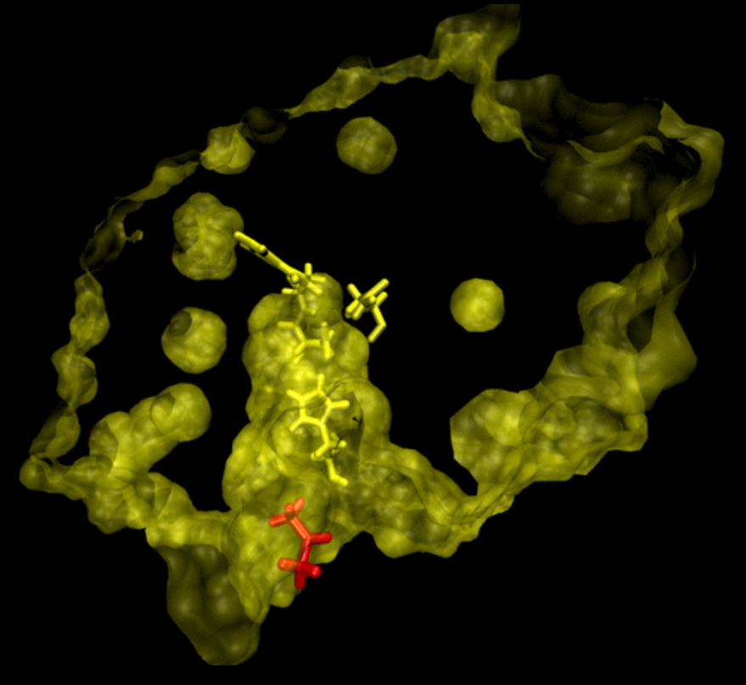
Protein Surfaces in Biochemistry
Proteins – in all living cells
Protein features – delimited by surfaces
  Molecular surface – pockets
  Transport pathways – tunnels
  Closed voids – cavities
Molecular Dynamics
  Simulation of natural motion
  Surfaces change
Notes:
- proteins play vast roles in cells
- features: (pockets), tunnels, cavities
- surface moves and also changes its topology
- výslovnost et al.

Slide 3
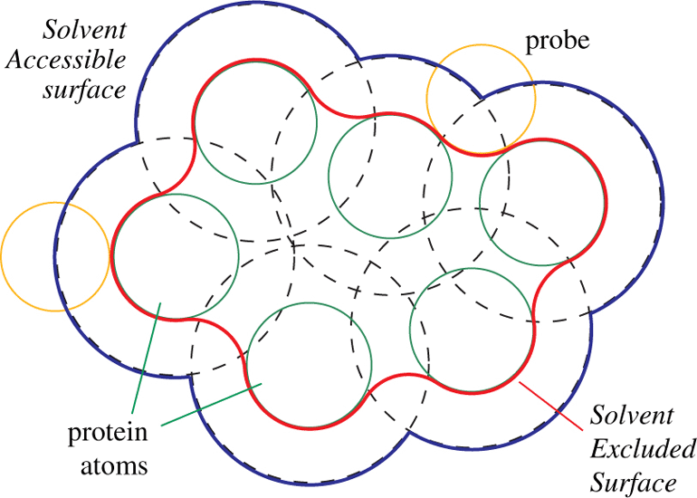
Molecular Surface
Solvent Accessible Surface [Lee et al. '71]
  Spherical patches
Solvent Excluded Surface [Connolly '83]
  Spherical patches
  Toroidal patches
  Spherical triangles
    reentrant
Notes:
- dva obrázky

Slide 4
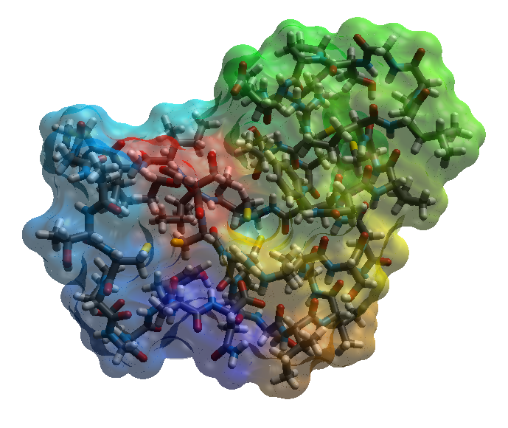
Transparency for Molecular Surface
Order-independent transparency (OIT)
  Depth Peeling – draw layers by depth and blend
  A-buffer – store all fragments and sort
Molecular surface using OIT [Kauker et al. '13]
  CSG on fragments of spheres
  Correct transparency
  High depth complexity
    188 layers/10000 atoms

Slide 5
Our Accelerated Method
Idea: Compute and render surface only
Method overview:
  Parallel SES computation
  Surface components analysis
  SES patches ray-casting
Visual enhancements:
  Cavity coloring by area
  Opacity modulation

Slide 6
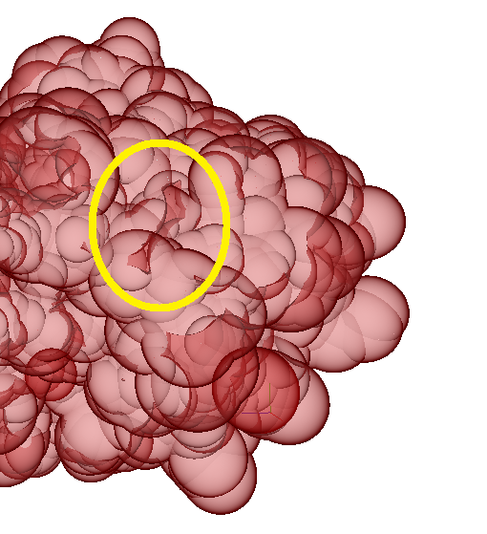
Contour-Buildup Algorithm
Contour-buildup algorithm [Totrov et al. '96]
  Accelerated and localized computation
Parallelization
  Mutliple CPUs [Lindow et al. '10]
  Single GPU [Krone et al. '11]
Rendering SES using transparency
  Artifacts – surface of cavities
Notes:
- hranaté závorky menším písmem

Slide 7
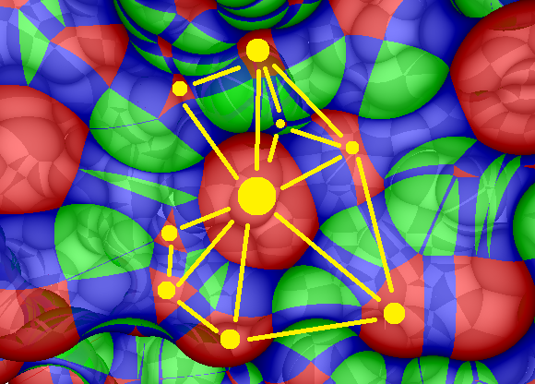
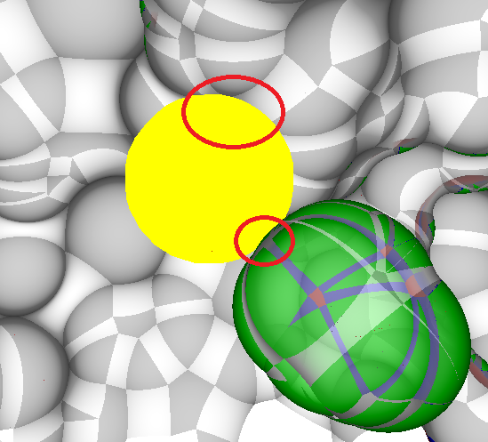
Surface Graph I
Surfaces = isolated connected components:
  Spheres connected with tori
    Easy – already computed during CB
    Spheres may form multiple surfaces!

Slide 8
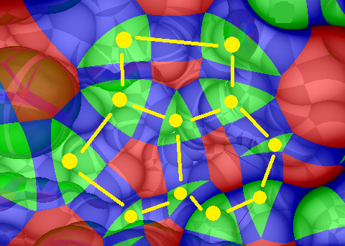
Surface Graph II
Surfaces = isolated connected components:
  Triangles connected with tori
    Spherical polygons enclosed with tori
    Benefit – every vertex has three edges

Slide 9
Surface Graph
Ideas:
  Surfaces = isolated connected components (CC)
  Spherical patches are enclosed with tori
  Tori connect triangles
Algorithm:
  Build adjacency list
  Find CCs – use BFS
  Find circles for patches

Slide 10
Extended GPU Contour-Buildup
Surface graph
  Extraction of all SES patches
  Extraction of inner cavities
  Improved memory efficiency – contour arcs are stored in a hash table
Ray-casting
  Improved performance of ray-casting individual SES patches using OBBs
Notes:
- rozdvojit

Slide 11
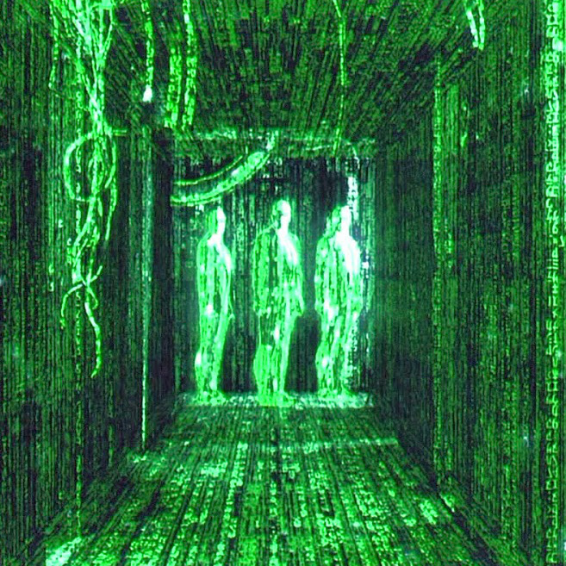
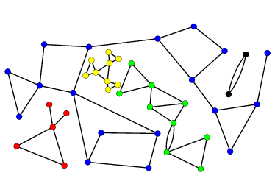
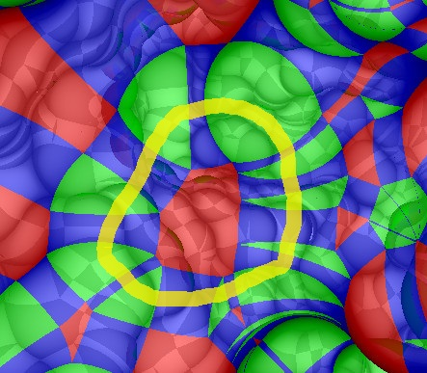
Surface Graph – Implementation
CB modifications – output SG edges
CC analysis – on GPU:
  Build adjacency matrix
  Label components – parallel BFS
  Find polygon circles – CC again

Slide 12
Results I
Dynamic transparent SES visualization:
  1CRN (327), 1VIS () and LINB-ACE ()
  probe 1,4 Å

Slide 13
Results II
Performance comparison (FPS@1024x768)
 | Solvent excluded surface (SES) |  |  |  | Solvent accesible surface (SAS)
PDB | 1YV8 |  | 1VIS |  | 1YV8 |  | 1VIS
Atoms | 641 |  | 2482 |  | 641 |  | 2482
Coverage | 18,0 % |  | 48,0 % |  | 23,0 % |  | 55,4 %
Method | our | Kauker | our | Kauker | our | Kauker | our | Kauker
GTX 580 | 18,3 | 31,0 | 7,3 | 11,2 | 17,8 | 14,7 | 7,4 | 4,8
GTX 680 | 32,3 | 22,1 | 13,9 | 7,7 | 33,2 | 10,3 | 14,9 | 3,3
R9 270X | 19,8 | - | 9,4 | - | 20,5 | - | 10,1 | -
GTX 980 | 48,3 | - | 21,8 | - | 49,8 | - | 22,5 | -

Slide 14
Summary
Contribution
  Accelerated transparent dynamic SES visualization
  Improved memory efficiency
Limitations
  Uneasy to perceive transparency in still images
  Unable to detect open pathways – tunnels
Future work
  Detection and coloring of tunnels
  (Employment of efficient BFS algorithm)

Slide 15
Thank you for your attention!

