Slide 1
Process extraction
Aju T. Scaria
Joint work with – Jonathan Berant and Prof. Chris Manning

Slide 2
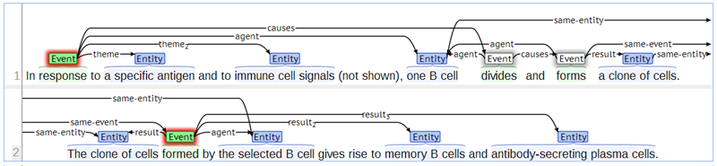
Project goal
In response to a specific antigen and to immune cell signals (not shown), one B cell divides and forms a clone of cells. The remaining B cells, which have antigen receptors specific for other antigens, do not respond. The clone of cells formed by the selected B cell gives rise to memory B cells and antibody-secreting plasma cells.
Model

Slide 3
Motivation
In collaboration with Vulcan
“Project Halo”
Input: A textbook
Output: A system that can answer questions

Slide 4
Overview
Dataset
Prior work

Slide 5
Dataset
Around 150 paragraphs from Biology, 9th Edition, by Campbell and Reece
Manual annotation by biologists
Events trigger identification
Argument identification and Semantic Role Labeling
Event-event relations
Currently annotating more paragraphs and another annotator for finding agreement.

Slide 6
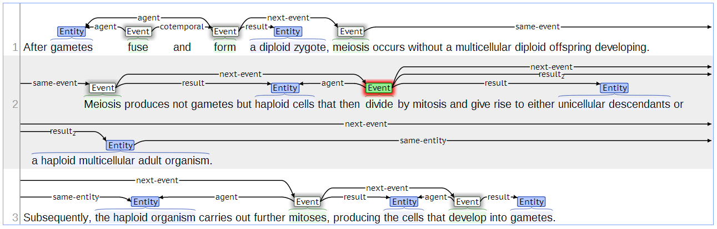
Example- Annotation

Slide 7
Prior work
BIONLP
Specific event triggers
Phosphorylation, Binding, Cause
Specific arguments
Protein extraction
Temporal event ordering
Events before/after
Timeline construction

Slide 8
Stages
Two high level stages
Event extraction
Event trigger prediction
Argument identification for triggers
Semantic role labeling
Event-event relation prediction

Slide 9

Representation
The hydrogen bonds are broken, and the two chains unwind and separate.
S
S
,
CC
S
NP
VP
NP
VP
DT
NN
NNS
VBP
VP
DT
CD
NNS
VB
CC
VB
VBN
The
hydrogen
bonds
are
broken
,
and
the
two
chains
unwind
and
separate

Slide 10
Representation – Event triggers
The hydrogen bonds are broken, and the two chains unwind and separate.
S
S
,
CC
S
NP
VP
NP
VP
DT
NN
NNS
VBP
VP
DT
CD
NNS
VB
CC
VB
VBN
The
hydrogen
bonds
are
broken
,
and
the
two
chains
unwind
and
separate

Slide 11
Representation - Entities
The hydrogen bonds are broken, and the two chains unwind and separate.
S
S
,
CC
S
NP
VP
NP
VP
DT
NN
NNS
VBP
VP
DT
CD
NNS
VB
CC
VB
VBN
The
hydrogen
bonds
are
broken
,
and
the
two
chains
unwind
and
separate

Slide 12
Models: Event extraction

Slide 13
BaseModel: MaxEnt based classifier
Features
Lexical
Dependency tree based
Parse tree based
Use Stanford CoreNLP modules

Slide 14
Event trigger prediction
S
S
,
CC
S
NP
VP
NP
VP
DT
NN
NNS
VBP
VP
DT
CD
NNS
VB
CC
VB
VBN
The
hydrogen
bonds
are
broken
,
and
the
two
chains
unwind
and
separate

Slide 15
Event trigger prediction
S
S
,
CC
S
NP
VP
NP
VP
DT
NN
NNS
VBP
VP
DT
CD
NNS
VB
CC
VB
VBN
The
hydrogen
bonds
are
broken
,
and
the
two
chains
unwind
and
separate

Slide 16

Event argument prediction
For each trigger
$$P\left(phrase=argument \right| trigger, sentence)$$
Non overlapping constraint
Dynamic program

Slide 17
Argument prediction for trigger
S
S
,
CC
S
NP
VP
NP
VP
DT
NN
NNS
VBP
VP
DT
CD
NNS
VB
CC
VB
VBN
The
hydrogen
bonds
are
broken
,
and
the
two
chains
unwind
and
separate

Slide 18
Argument prediction for trigger
S
S
,
CC
S
NP
VP
NP
VP
DT
NN
NNS
VBP
VP
DT
CD
NNS
VB
CC
VB
VBN
The
hydrogen
bonds
are
broken
,
and
the
two
chains
unwind
and
separate

Slide 19
Dynamic program
Actual
Predicts both
NP
NP
DT
CD
NNS
NNS
DT
CD
NNS
the
two
chains
chains
the
two
chains

Slide 20
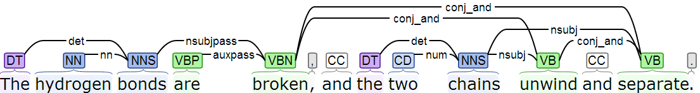
Can we use entities to predict triggers?
Dependency parse

Slide 21
Iterative optimization
Event Trigger Prediction
Argument Prediction for Trigger
sentence
events

Slide 22
Iterative optimization
Event Trigger Prediction
Argument Prediction for Trigger
sentence
events
Entity Prediction
sentence

Slide 23
Iterative optimization
Event Trigger Prediction
Argument Prediction for Trigger
sentence
events
Entity Prediction
Event Trigger Prediction
sentence
entities

Slide 24
Iterative optimization
Event Trigger Prediction
Argument Prediction for Trigger
sentence
events
Entity Prediction
Event Trigger Prediction
sentence
entities

Slide 25

Entity Prediction
$$P\left(phrase=argument \right| sentence)$$
S
S
,
CC
S
NP
VP
NP
VP
DT
NN
NNS
VBP
VP
DT
CD
NNS
VB
CC
VB
VBN
The
hydrogen
bonds
are
broken
,
and
the
two
chains
unwind
and
separate

Slide 26
Iterative optimization
$$P\left(word∈\left\{TRIGGER\right\} \right| \left\{ENTITIES\right\}, sentence)$$
S
S
,
CC
S
NP
VP
NP
VP
DT
NN
NNS
VBP
VP
DT
CD
NNS
VB
CC
VB
VBN
The
hydrogen
bonds
are
broken
,
and
the
two
chains
unwind
and
separate

Slide 27
Iterative optimization
S
S
,
CC
S
NP
VP
NP
VP
DT
NN
NNS
VBP
VP
DT
CD
NNS
VB
CC
VB
VBN
The
hydrogen
bonds
are
broken
,
and
the
two
chains
unwind
and
separate

Slide 28
Iterative optimization
S
S
,
CC
S
NP
VP
NP
VP
DT
NN
NNS
VBP
VP
DT
CD
NNS
VB
CC
VB
VBN
The
hydrogen
bonds
are
broken
,
and
the
two
chains
unwind
and
separate

Slide 29
Results – Event extraction
Event trigger prediction
Event argument prediction
Type | Precision | Recall | F1
Baseline | 0.47 | 0.73 | 0.57
MaxEnt_Basic | 0.69 | 0.66 | 0.67
MaxEnt_Iterative | 0.72 | 0.70 | 0.71
Type | Precision | Recall | F1
Baseline | 0.44 | 0.53 | 0.48
MaxEnt_Basic | 0.56 | 0.45 | 0.50
MaxEnt_Iterative | 0.55 | 0.50 | 0.52

Slide 30
Models : Event-Event Relation extraction

Slide 31
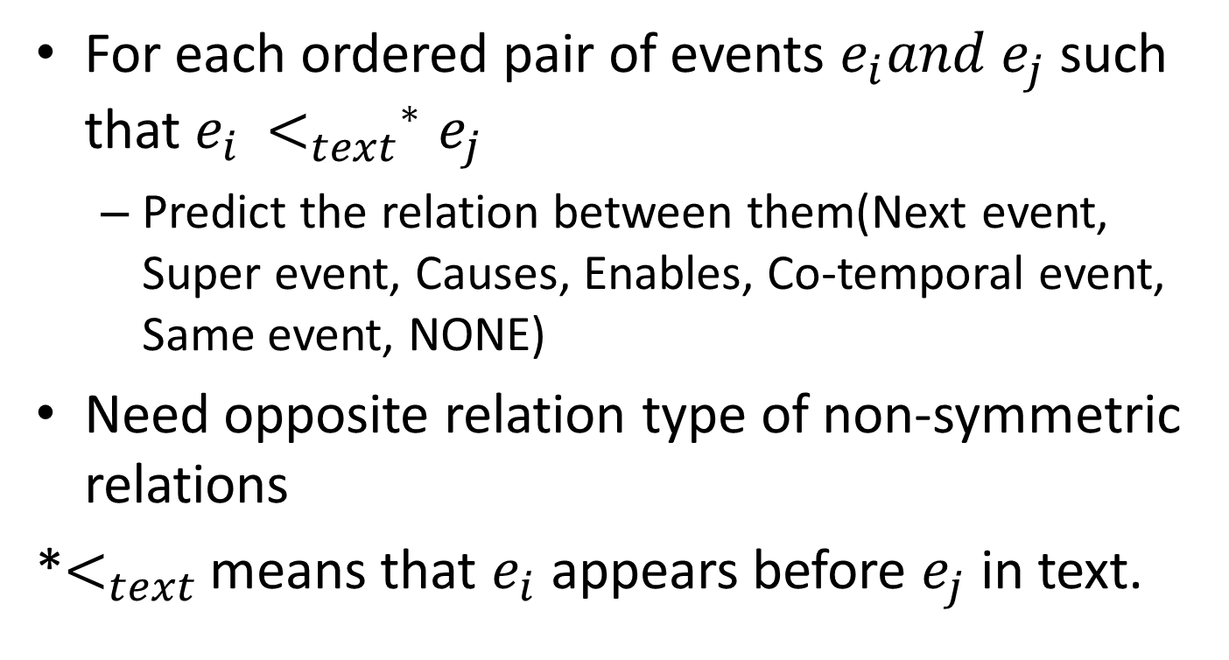
Problem formulation
For each ordered pair of events $e_{i}and e_{j}$such that $e_{i }{<_{text}^{}}^{∗}e_{j}$
Predict the relation between them(Next event, Super event, Causes, Enables, Co-temporal event, Same event, NONE)
Need opposite relation type of non-symmetric relations
*$<_{text}$means that $e_{i}$ appears before $e_{j}$ in text.

Slide 32
Modeling
Local model
For each ordered pair, predict relation
MaxEnt based
Global model
Ensures consistency
Favor some structures

Slide 33
Local model examples and features
Confusion matrix
Rare events ignored

Slide 34
Global
Some structures do not appear in gold
Some appears in gold but we don’t predict
Cotemporal constraint did not work well
Double penalization

Slide 35
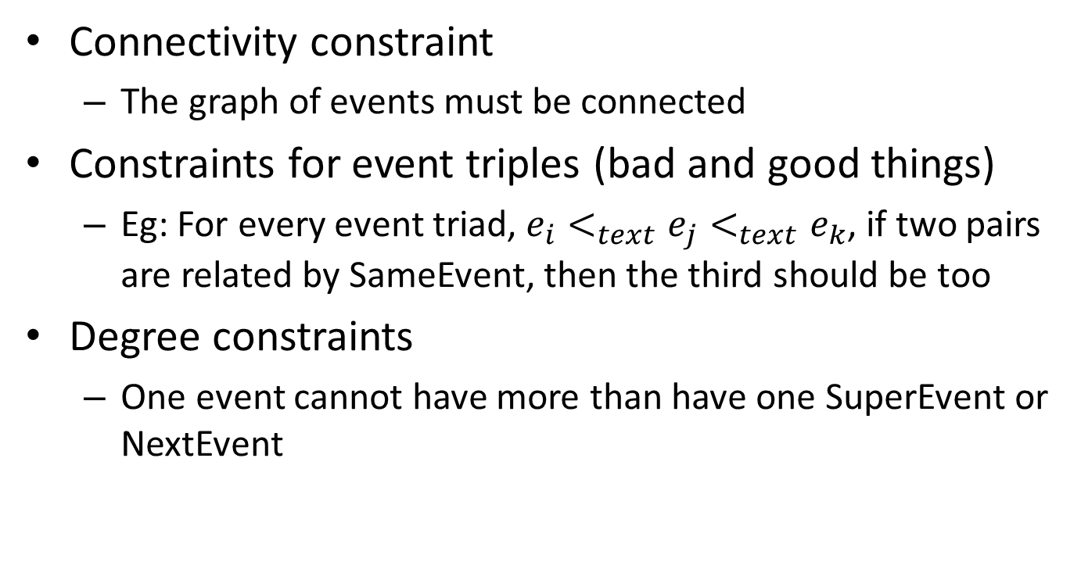
Global constraints
Connectivity constraint
The graph of events must be connected
Constraints for event triples (bad and good things)
Eg: For every event triad, $e_{i}<_{text}e_{j}<_{text}e_{k}$, if two pairs are related by SameEvent, then the third should be too
Degree constraints
One event cannot have more than have one SuperEvent or NextEvent

Slide 36
Examples for all 3

Slide 37
ILP formulation for connectivity constraint

