Slide 1
Introduction
The smart agriculture engages advanced technologies such as IoT, Sensors and connected devices. Smart agriculture helps in automated farming, collection of data from the field and then analyses it so that the farmer can make accurate decision in order to grow high quality crop. The field data are collected with the help of sensors, micro controllers, and actuators. The collected data are transferred via internet to the operator or the farmer for better decision making on his/her mobile application.

Slide 2
Purpose
In our country, agriculture depends on the monsoons which has insufficient source of water. So the irrigation is used in agriculture field. In agriculture, two things are very important, first to get information of about the fertility of soil and second to measure moisture content in soil. And mostly this technique is driven by electrical power and on/off scheduling.
In this technique, water level indicator placed in water reservoir and soil moisture sensors are placed root zone of plant and near the module and gateway unit handles the sensor information and transmit data to the controller which in turns the control the flow of water through the valves.

Slide 3
System functionality
Registration & Login
User Verification using OTP
Forgot Password
Map of India (Type of soil wise)
Notification for water supply
Alert for switches (ON/OFF)
Manage water supply(Manual & Automatic)
Reports for soil conditions
SMS & Email sending for alert
Manage Sensor Data

Slide 4
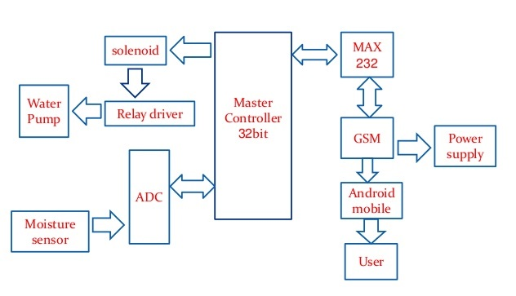
Architecture and block diagram

Slide 5
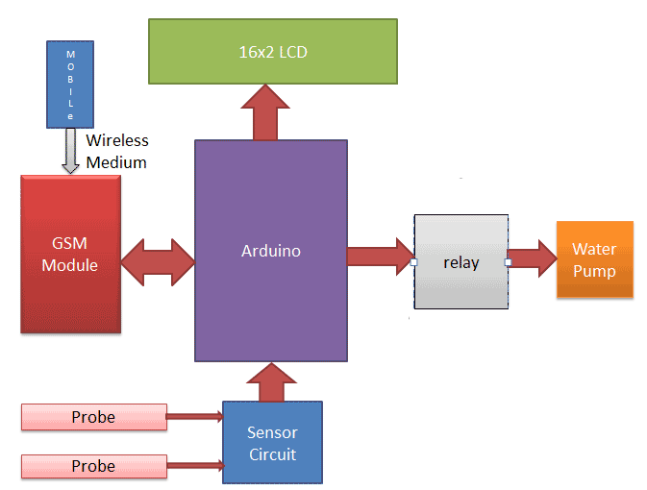
Continue…

Slide 6
System components
Arduino UNO R3
Humidity Sensor
Soil Moisture sensor
GSM Module (TTL SIM800)
Transistor BC547
Connecting Jumper wires
16*2 LCD(optional)
Power supply 12v 1A
Relay 12v
Water Cooler pump
Resistors(1k,10k)
Variable Resister(10k,100k)
Terminal connector
Voltage Regulator IC LM317

Slide 7
Continue…
Arduino is used for controlling whole the process of this Automatic Plant Watering System. The output of soil sensor circuit is directly connected to digital pin D7 of Arduino. A LED is used at the sensor circuit, this LED’s ON state indicates the presence of moisture in the soil and OFF state indicates the absence of moisture in the soil.
Humidity sensors are used for determining the moisture content. Therefore, an accurate and precise means of testing moisture content in grain will help farmers monitor their crops. With the aid of monitoring, farmers may dry their grain until the preferred moisture content is achieved.
A 12V Relay is used to control the 220VAC small water pump. The relay is driven by a BC547 Transistor which is further connected to digital pin 11 of Arduino.

Slide 8
Continue…
Here we have used TTL SIM800 GSM module. The SIM800 is a complete Quad-band GSM/GPRS Module which can be embedded easily by customer or hobbyist. SIM900 GSM Module provides an industry-standard interface; the SIM800 delivers GSM/GPRS 850/900/1800/1900MHz performance for voice, SMS, Data with low power consumption. The design of this SIM800 GSM Module is slim and compact.
The Soil Moisture Sensor is used to measure the volumetric water content of soil.
Range: 0 to 45% volumetric water content in soil (capable of 0 to 100% VWC with alternate calibration)
Accuracy: ±4% typical
Typical Resolution: 0.1%
Power: 3 mA @ 5VDC
Operating temperature: –40°C to +60°C
Dimensions: 8.9 cm × 1.8 cm × 0.7 cm (active sensor length 5 cm)

Slide 9
Thank you

