Slide 1
Physics Capstone
Topics:
21st-Century Physics Careers
Skills of Physicists

Slide 2
Preparing Physics Students for 21st-Century Careers
What skills and knowledge should the next generation of undergraduate physics degree holders possess to be well prepared for a diverse set of careers?
Notes:
Read it! We’re not going to read it for you today.

Slide 3
Which skills do physicists have/need? (Group discussion)
Physics-specific knowledge
Use fundamental concepts to solve problems
Apply basic laws of physics to applied contexts
Solve problems involving multiple topic areas
Scientific & technical skills
Use numbers and statistics to solve problems
Solve problems through experiments, simulations, and analytical models; and identify resource needs
Analyze a problem to develop creative, innovative, and workable solutions; and implement them
Competent in instrumentation, software, coding and data analytics

Slide 4
Which skills do physicists have/need? (Group discussion)
Communication skills
Oral & written communication for audiences with a wide range of backgrounds and needs
Convince or influence others
Professional & workplace skills
Ability to work in diverse teams
Obtain knowledge about relevant technology resources
Effective management of difficult situations
Awareness of physics career opportunities and effective practices for job seeking
Familiar with project management and budgeting
Planning, organizing, and prioritizing work

Slide 5
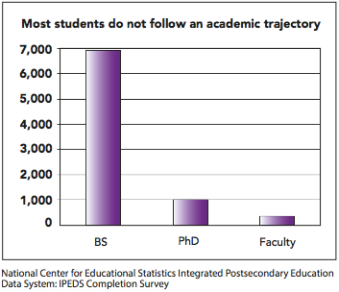
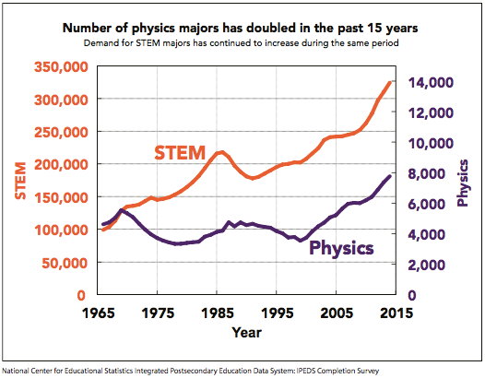
Physics Employment (1/5)
5% of physics bachelor’s graduates become physics professors
Notes:
Read it! We’re not going to read it for you today.

Slide 6
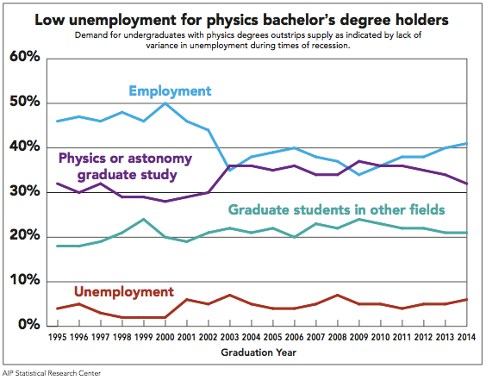
Physics Employment (2/5)
30% of physics bachelor’s graduates enroll in physics grad school
Notes:
Read it! We’re not going to read it for you today.

Slide 7
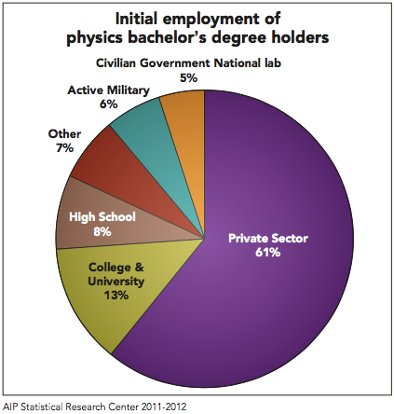
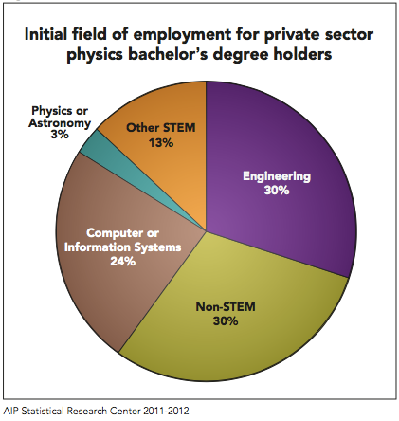
Physics Employment (3/5)
22% of physics bachelor’s graduates work in non-STEM jobs
Notes:
Read it! We’re not going to read it for you today.

Slide 8
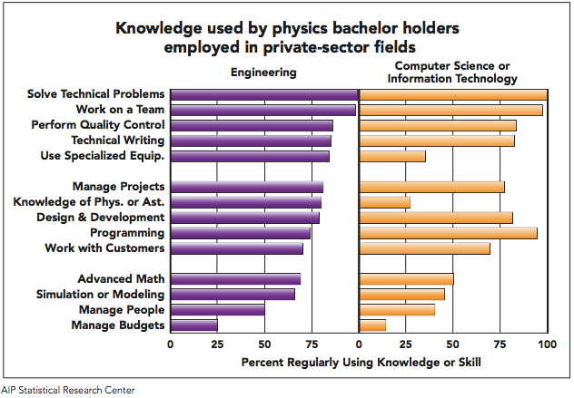
Physics Employment (4/5)
21% of physics bachelor’s graduates work in engineering; 17% work in computer or information systems
Notes:
Read it! We’re not going to read it for you today.

Slide 9
Physics Employment (5/5)
82% of physics bachelor’s graduates working in private-sector STEM positions are satisfied with their job security
84% of physics bachelor’s graduates working as high school physics teachers are satisfied with the level of responsibility
84% of physics bachelor’s graduates working in government or national labs are satisfied with their salary and benefits
93% of physics bachelor’s graduates working in active military are satisfied with their opportunity for advancement
Notes:
Read it! We’re not going to read it for you today.

Slide 10
Physics Careers
There is no standard physics career path
Physicists have a multitude and variety of skills that employers are very interested in
Which skills do you have?
Which skills do you currently have?
For the current skills, what evidence do you have?
Which skills do you expect to have at graduation?
(Individual activity)

