Slide 1
Physics Capstone
Class #8
Physics Careers

Slide 2
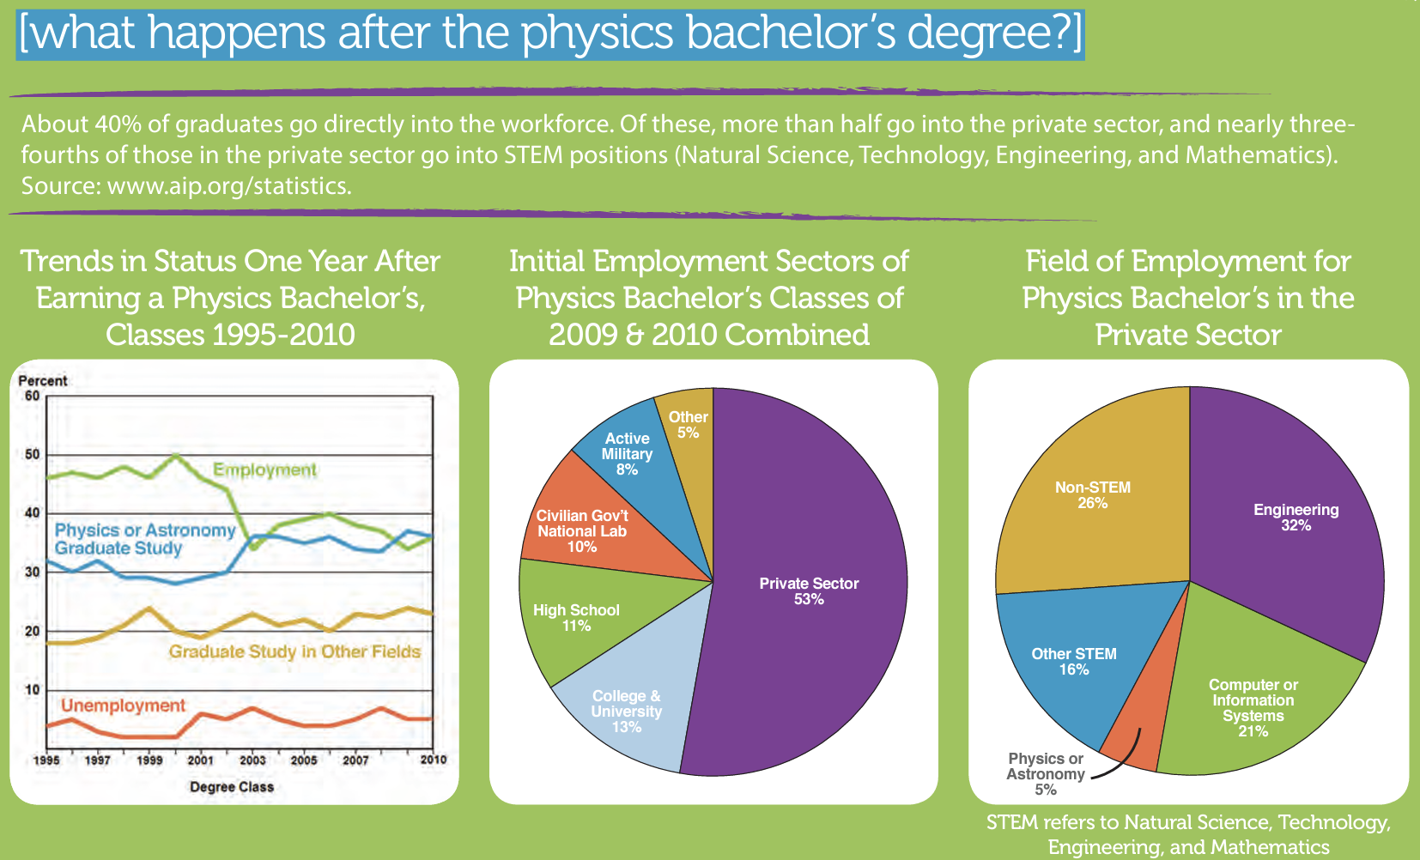
Physics Careers – Fact Sheet
https://students.aip.org/plan-your-future

Slide 3
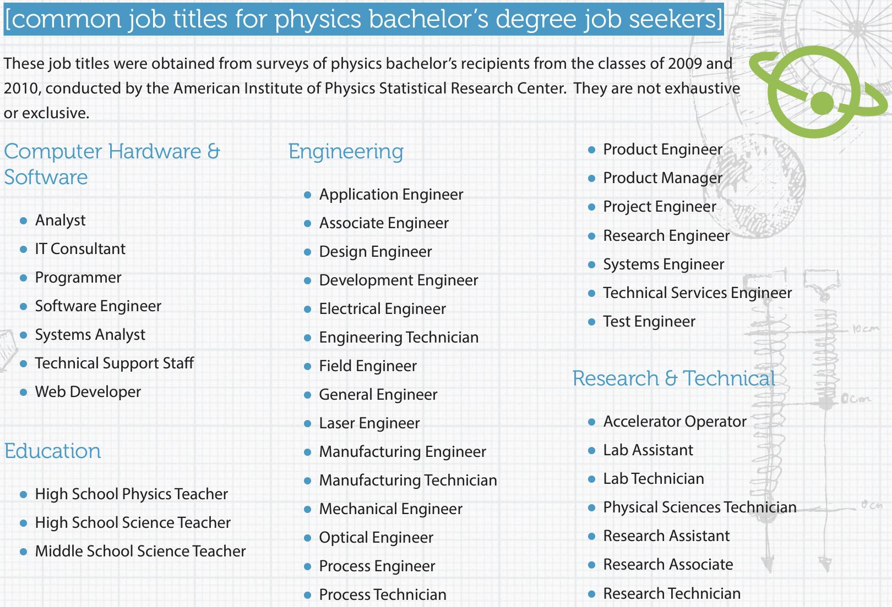
Physics Careers – Fact Sheet
https://students.aip.org/plan-your-future

Slide 4

Physics Careers – Resources
https://students.aip.org/plan-your-future (Society of Physics Students)
https://www.aip.org/statistics (American Institute of Physics - Statistics)
https://www.aip.org/statistics/whos-hiring-physics-bachelors
https://www.aps.org/careers/ (American Physical Society)

