Slide 1
Physics Capstone
Class #13
Physics as a Community
(Partly based on presentations by E.J. Downie)

Slide 2
Physics as a Community
Every community has issues, including the physics community
Variety of issues encountered by community members, possibly including students in this class
Today + next week: discussions on community, and issues of diversity & inclusion
Discussion of the issues is the first step to addressing them
Be mindful that these issues can be personal to individuals in the discussion
Stories shared in these class discussions should be treated as confidential
Take away from these classes: ideas & inspiration to improve the physics community
Assume good intent

Slide 3
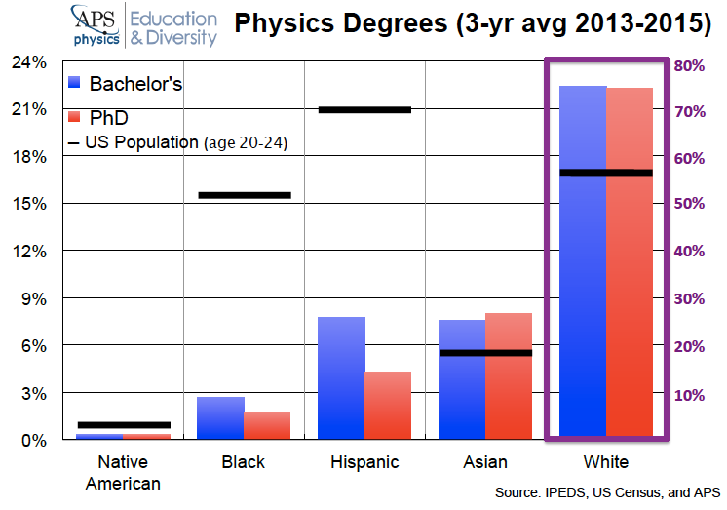
Diversity in Physics: Visible Minorities

Slide 4

TEAM-UP Report
AIP National Task Force to Elevate African American Representation in Undergraduate Physics & Astronomy
Factors responsible for success/failure:
Belonging
Physics Identity
Academic Support
Personal Support
Leadership & Structures
Research findings and recommendations
In summary, persistent underrepresentation is due to:
lack of a supportive environment in many departments
enormous financial challenges
Solving problems requires addressing systemic & cultural issues

Slide 5
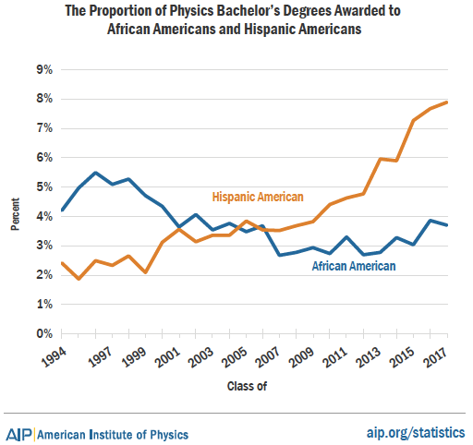
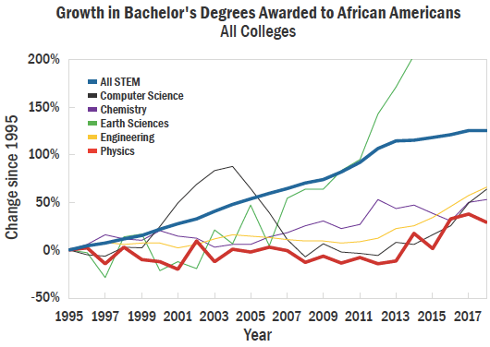
TEAM-UP Report
“From 1995 to 2015, the number of physics bachelor’s degrees awarded to African Americans increased by 4% compared with a 36% increase for all physical sciences (Merner & Tyler 2019).”

Slide 6
TEAM-UP Report: Factors
Fostering a sense of belonging is essential for African American student persistence and success
To persist, African American students must perceive themselves, and be perceived by others, as future physicists and astronomers
Effective teaching and strengths-based approach to academic support are necessary for African American student retention and success
Many African American students need support to offset financial burdens and stress
For sustainability, academic and disciplinary leaders must prioritize creating environments, policies and structures that maximize African American student success
A new level of thinking is required to solve a persistent problem

Slide 7
Diversity in Physics: Visible Minorities
Experiencing bias due to race, nationality and/or ethnicity
Professional societies are working to address this
https://www.aps.org/programs/minorities/
https://aas.org/comms/committee-status-minorities-astronomy-csma
https://www.nsbp.org
http://www.hispanicphysicists.org
What can we do to reduce the incidence and impact of bias due to race, nationality and/or ethnicity? (Group discussion)
On an individual level
On a department level
On a university level
On a community level

Slide 8
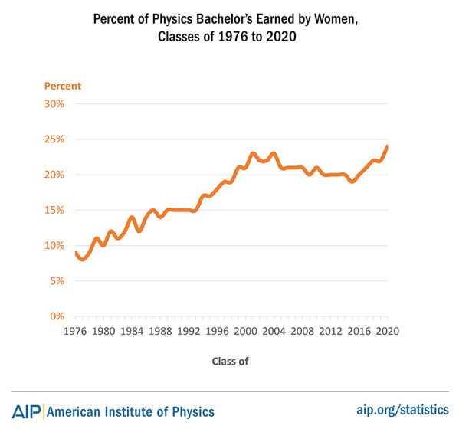
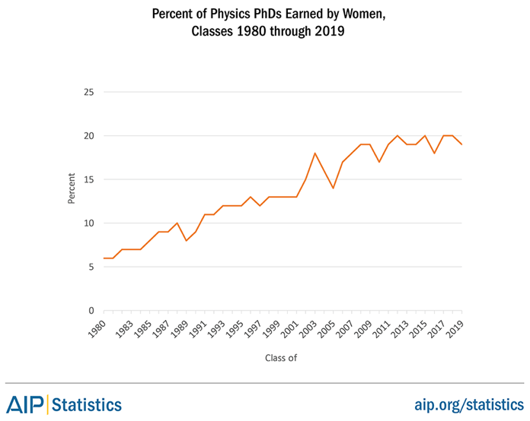
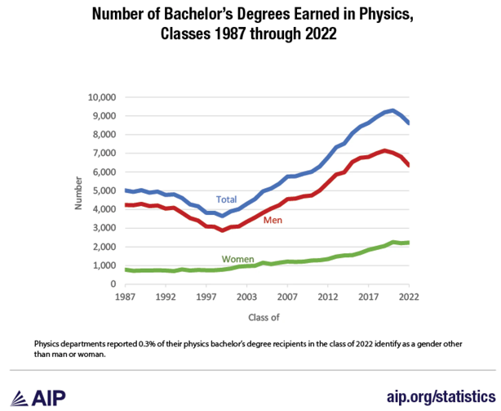
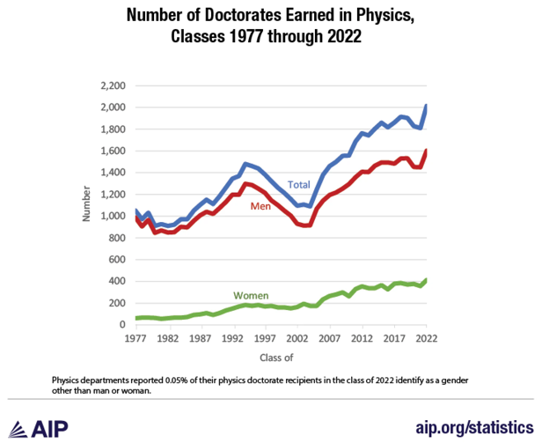
Diversity in Physics: Gender Minorities

Slide 9
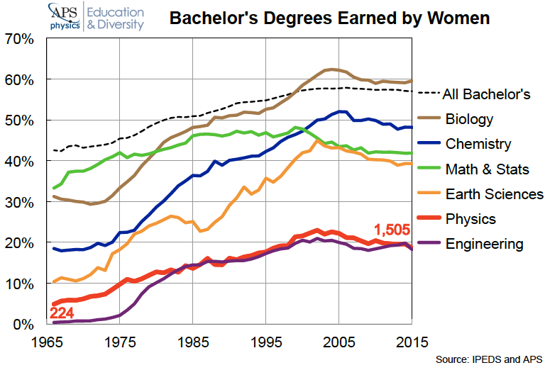
Diversity in Physics: Gender Minorities

Slide 10
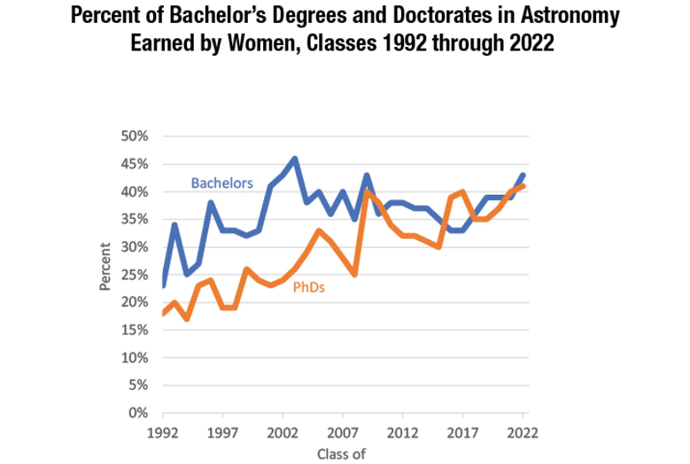
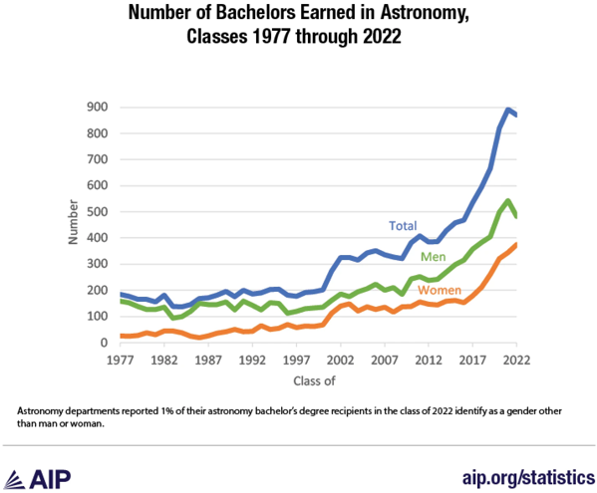
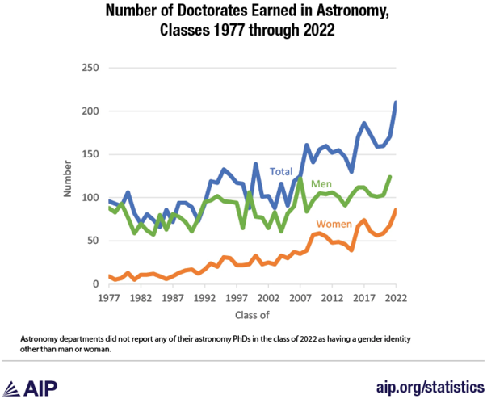
Diversity in Physics: Gender Minorities

Slide 11
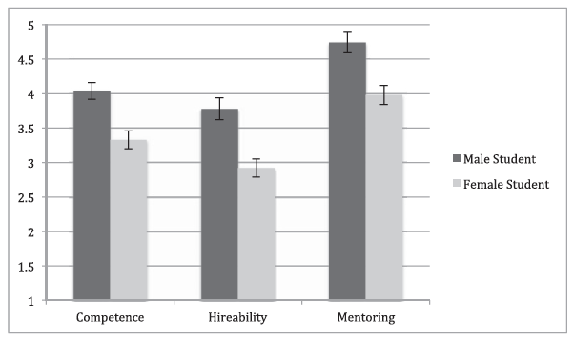
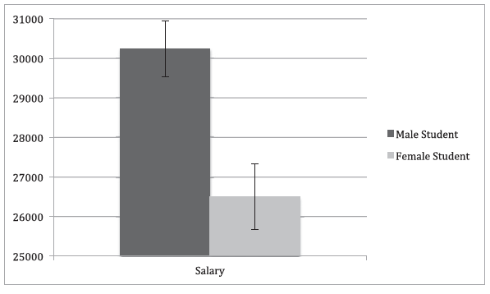
Diversity in Physics: Gender Minorities
Peer-reviewed research: “Science faculty’s subtle gender biases favor male students” (Moss-Racusin et al. 2012, PNAS, 109, 16474)
Double-blind study: faculty review of application materials, with randomly assigned male/female names
Female student was perceived less competent than male student
Female student was better liked than male → no overt hostility
Independent of faculty gender, discipline, age, etc.
Likely unintentional bias → cultural stereotypes

Slide 12
Diversity in Physics: Gender Minorities
Peer-reviewed research: “Sexual harassment reported by undergrad. female physicists” (Aycock et al. 2019, Phys. Rev. PER, 15, 010121)
Results from CUWiP: 74% (338/455) of women experienced harassment

Slide 13
Diversity in Physics: Gender Minorities

Slide 14
Diversity & Inclusion: Some More Resources
Conference for Undergraduate Women and Gender Miniorities in Physics: https://www.aps.org/initiatives/inclusion/gender-inclusive/undergraduate-women-minorities
Step Up 4 Women: https://engage.aps.org/stepup/home
APS Bridge Program: https://www.aps.org/initiatives/inclusion/bridge-program
National Mentoring Community: https://www.aps.org/initiatives/physics-education/national-mentoring-community

Slide 15
Unconscious / Implicit Bias
Definition: The positions we hold about others that are influenced by past experiences, forming filters that cause conclusions to be reached, about groups or ethnicities, by ways other than through active thought or reasoning. (insighteducationsystems.com)
In what professional situations can these biases be most present / pervasive? (Group discussion)
What can we do to minimize the effects of unconscious / implicit bias? (Group discussion)
On an individual level
On a department level
On a university level
On a community level
Try the Implicit Bias Tests
https://implicit.harvard.edu/implicit/

Slide 16
Issues of Diversity & Inclusion
Many different issues, for example:
Visible Minority Status
Unconscious / Implicit Bias
Stereotype Threat
Imposter Syndrome
Harassment / Discrimination
First Generation Students
LGBTQ+ Status
Caring / Parenting Responsibilities
Socio-economic Disadvantage
Visible / Invisible Disabilities
Today: topics 1 & 2
Next week: other topics

Slide 17
Diversity & Inclusion (Discussions – Homework)
Discussion topics:
Group 1: Stereotype Threat
Group 2: Imposter Syndrome
Group 3: Harassment / Discrimination
Group 4: First Generation Students
Group 5: LGBTQ+ Status
Group 6: Caring / Parenting Responsibilities
Group 7: Socio-economic Disadvantage
Group 8: Visible / Invisible Disabilities
Every group gets resources and 3 questions for 1 topic
Given resources are to be used as reference material, but more resources can be explored (and shared with the instructor / class)
Every student should be prepared to answer 1 question, and the group has to answer all 3 questions for their topic
Resources & questions on following slides

Slide 18
Diversity & Inclusion: Stereotype Threat
Resources:
https://www.colorado.edu/center/teaching-learning/inclusivity/stereotype-threat
https://www.simplypsychology.org/stereotype-threat.html
Q1: What is stereotype threat and in what kind of situations has it been observed / studied?
Q2: How does stereotype threat impact upon an individual’s performance as a physicist?
Q3: What can be done to minimize stereotype threat within the physics department and the physics community?

Slide 19
Diversity & Inclusion: Imposter Syndrome
Resources:
https://www.tci-thaijo.org/index.php/IJBS/article/view/521
https://careers.seas.gwu.edu/blog/2023/02/24/imposter-syndrome-and-how-you-can-fight-against-it/
Q1: What is imposter syndrome and in what kind of situations has it been observed / studied?
Q2: How does imposter syndrome impact upon an individual’s performance as a physicist?
Q3: What can an individual do to minimize their own imposter syndrome and/or support individuals with imposter syndrome?

Slide 20
Diversity & Inclusion: Harassment / Discrimination
Resources:
https://i-sight.com/resources/11-types-of-workplace-harassment-and-how-to-stop-them/
https://www.projectcallisto.org
https://haven.gwu.edu
https://diversity.gwu.edu/bias-incident-response
Q1: What types of harassment can occur in the professional physics environment?
Q2: What steps can individuals and the community take to minimize the incidence of harassment?
Q3: How can individuals react to minimize harm in situations where harassment has occurred or is occurring?

Slide 21
Diversity & Inclusion: First Generation Students
Resources:
https://www.chronicle.com/search?q=How+to+Help+First+Generation+Students+Succeed
https://theinclusionsolution.me/a-point-of-view-lessons-from-a-first-gen/
https://students.gwu.edu/first-generation
Q1: What hurdles do first-generation students face within the physics community?
Q2: What hurdles do first-generation students face within the university environment?
Q3: What can be done to improve inclusion of first-generation students within the physics department and the physics community?

Slide 22
Diversity & Inclusion: LGBTQ+ Status
Resources:
https://www.aps.org/publications/reports/lgbt-climate-in-physics
Q1: What hurdles do LGBTQ+ individuals face within the physics community?
Q2: What hurdles do LGBTQ+ individuals face within the university environment?
Q3: What can be done to improve inclusion of LGBTQ+ individuals within the physics department and the physics community?

Slide 23
Diversity & Inclusion: Caring Responsibilities
Resources:
https://www.oecd-ilibrary.org/social-issues-migration-health/supporting-informal-carers-of-older-people_0f0c0d52-en
https://www.theguardian.com/lifeandstyle/parents-and-parenting+money/work-and-careers
Q1: What issues are there for parents in the physics community?
Q2: What issues are there for carers in the physics community?
Q3: What can be done to make life easier for parents and/or carers within the physics department and the physics community?

Slide 24
Diversity & Inclusion: Socio-Economic Disadvantage
Resources:
https://www.researchgate.net/publication/255642041_Socio-Economic_Disadvantage_and_Access_to_Higher_Education
Q1: What issues are there for individuals experiencing socio-economic disadvantage while pursuing education and a career in physics?
Q2: What aspects of common community practice cause problems for physicists experiencing socio-economic disadvantage?
Q3: What can be done to make life easier for individuals experiencing socio-economic disadvantage within the physics department and the physics community?

Slide 25
Diversity & Inclusion: Visible / Invisible Disabilities
Resources:
https://www.iop.org/sites/default/files/2021-03/access-for-all-disability-good-practice-university-2008.pdf
https://www.symmetrymagazine.org/article/approaching-disability-like-a-scientist
https://healthcenter.gwu.edu/counseling-and-psychological-services
Q1: What issues are there for individuals experiencing visible and/or invisible disabilities while pursuing education and a career in physics?
Q2: What aspects of common community practice cause problems for physicists experiencing visible and/or invisible disabilities?
Q3: What can be done to make life easier for individuals experiencing visible and/or invisible disabilities within the physics department and the physics community?

