Slide 1


CAPSTONE PROJECT Lex-RAG
Presented By
Student Name: Ashutosh Jena
College Name: vitam
Department: CSE
Email ID: ashutoshje223@gmail.com
AICTE STUDENT ID: STU643e2980cfb3b1681795456

Slide 2
OUTLINE
Problem Statement
Proposed Solution
System Development Approach
Algorithm & Deployment
Result
Conclusion
Future Scope
References

Slide 3
Problem Statement
Law firms, legal organizations or corporations, individual prosecutors and citizens face significant challenges when searching through vast repositories of unstructured policies, forums, case studies or files, laws, amendments and other relevant documents. Traditional on-paper or scrolling keyword-based search tools often fail to capture the context and semantics of queries leading to inefficient gathering and increased time spent on research. Even several natives lack exposure to their rights and general laws. The legal system is facing a growing backlog of cases due to increased crime and litigation, reduced resources which leads to complex and lengthy legal procedures.

Slide 4
Proposed Solution
Proposed system is designed specifically for legal documents processing and interaction, with strong emphasis on accuracy and context-awareness in legal responses. The RAG implementation ensures that responses are grounded in actual legal documents while maintaining conversational fluidity through the Gemini model. The solution will consist of the following components:
Data Collection:
Utilizes Hugging Face to store PDF documents as parquet structure with proper metadata and manage it using dataset repo-ID
Implemented a flexible upload system for new legal documents via FastAPI endpoints
Data Preprocessing:
Converts PDF documents to text using PyMuPDF (fitz library) for processing pipeline
Implements document chunking using Character Text Splitter: chunk size = 1000 char, overlap = 200 char for context continuity
Vector Database and Embedding System:
Document Vectorization achieved using HuggingFace Embeddings with “sentence-transformers/all-MiniLM-L6-v2” model
The system employs state-of –the-art Natural Language Processing (NLP) model
Implements FAISS vector store for efficient similarity search and contextual responses

Slide 5
Proposed Solution
RAG implementation & API layer:
Context-aware response generation using Google’s Gemini model
Custom Gemini RAG class for handling – Question processing, Context retrieval, Response generation
Fast API Backend for session management with secure middleware, rate limiting (2 queries per session)
Endpoints: /chat for user interactions, /upload for document management, Static file serving for frontend
Deployment:
Containerization using Docker with configured load balancer in environment and set up Session Secret Key for secure implementation
Container Registry in Azure for model and container versioning

Slide 6
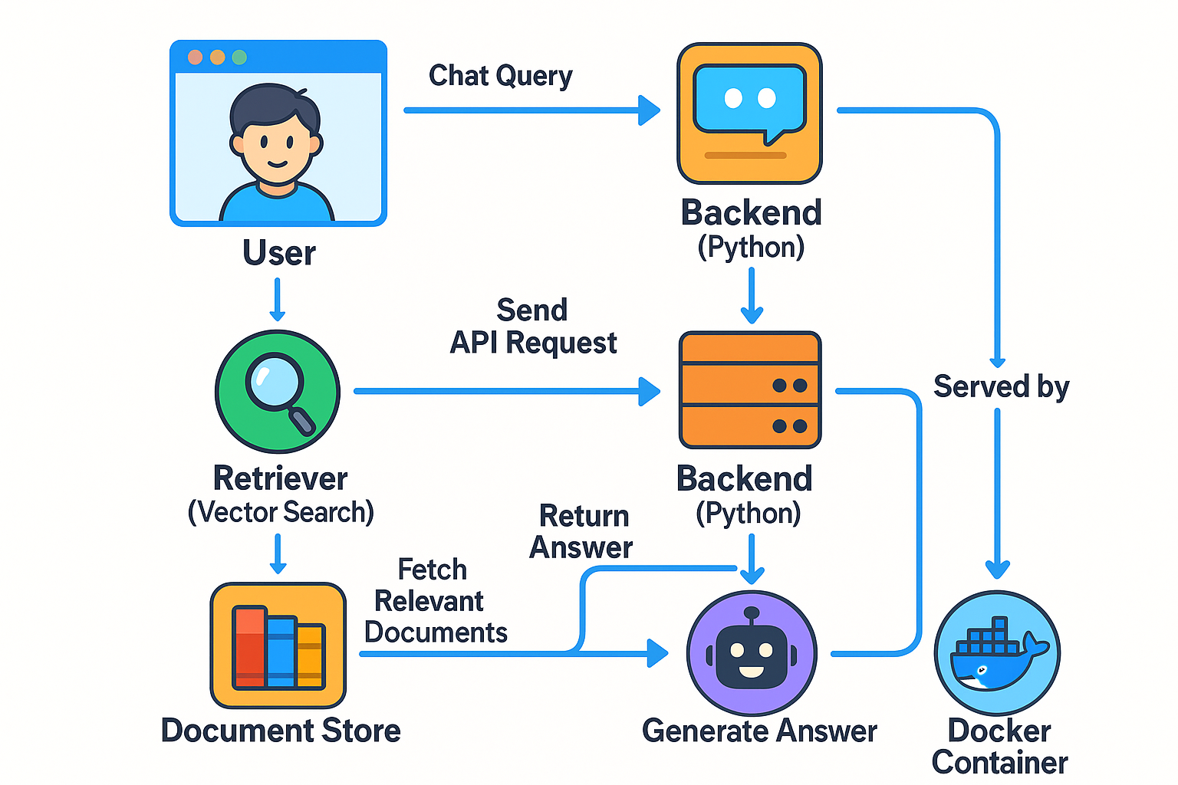
System Approach
Programming Languages:
Python: Core backend API logic, data processing, data retrieval, RAG model and integration with pre-trained NLP models
JavaScript (Vanilla): Interactive front-end components and client-side logic
HTML: User interface and presentation layers
Dockerfile and Git for containerization and version control
Frameworks and Libraries:
FastAPI: deployment and backend services
Hugging Face Transformers: pre-trained language models
FAISS: for efficient vector-based and lexical search indexing
Hugging Face Spaces & CLI: for dataset storage, access and parquet data version
Langchain: for chaining LLMs, integrating retrieval and generation
Uvicorn: ASGI server to run the FastAPI app
Starlette: Middleware and session management
Pydantic: Data validation for API models
PyMuPDF & pdfplumber: for PDF parsing and processing
Google Gemini: Used as the LLM for generating contextual answers

Slide 7
Algorithm & Deployment
Core Workflow (RAG pipeline):
Document Ingestion:
Load legal documents from Hugging Face dataset via API token in integrating with CLI
Parses PDFs using PyMuPDF
Text splitting and Vectorization:
Splits large documents into manageable chunks using CharacterTextSplitter from LangChain
Embeds document chunks using HuggingFaceEmbeddings with the model sentence-transformers/all-MiniLM-L6-v2
Retrieval and Generation:
At query time, retrieves the top relevant chunks using semantic similarity
Combines the retrieved context with the users' question
Constructs a prompt for Gemini LLM and calls it via google-generativeai to generate the final output ; implemented using python SDK
Integrated a usage limit up to 2 queries per session

Slide 8
Algorithm & Deployment
Deployment:
Local:
Clone the repo: git clone https://github.com/ajverse/LexRAG.git
Set up .env with GOOGLE_API_KEY and HF_DATASET_ID
Install dependencies from –r requirement.txt
Uvicorn app.main:app –host 0.0.0.0 –port 7860
Docker Deployment:
The Dockerfile sets up a Python 3.10-slim base
Build the image docker build –t lexrag
Run the Container docker run –p 7860 –env-file .env lexrag the app will be available at http://localhost:7860
Container registry using Azure service
Hugging Face Auth:
Copy my public dataset from repo ID: ajverse/law-docs
Authenticate with HUGGINGFACEHUB_API_TOKEN in CLI

Slide 9
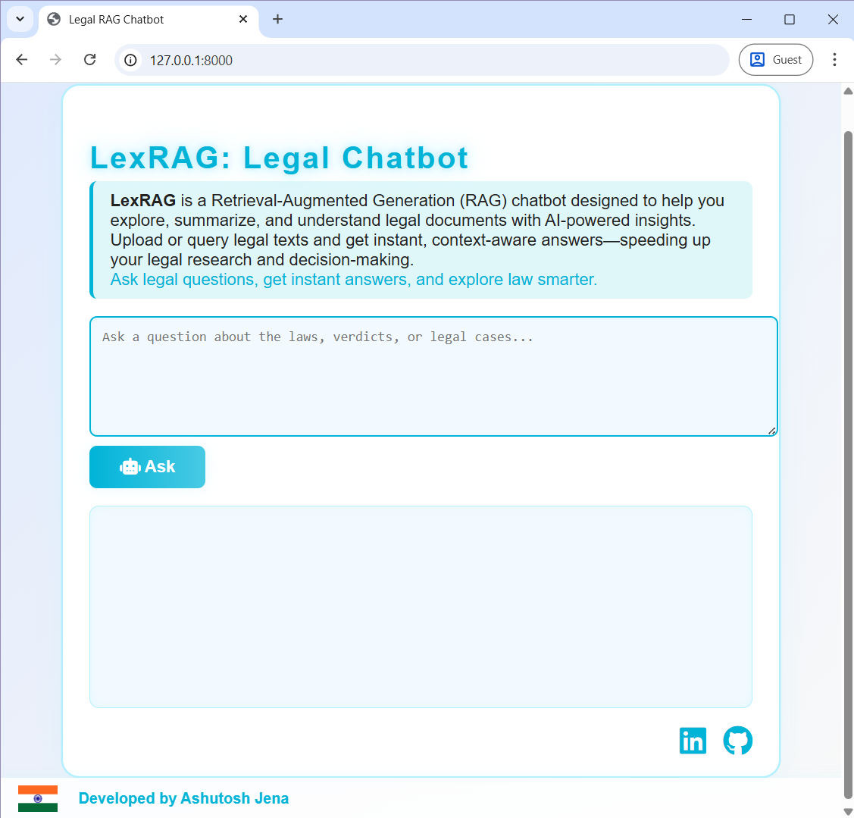
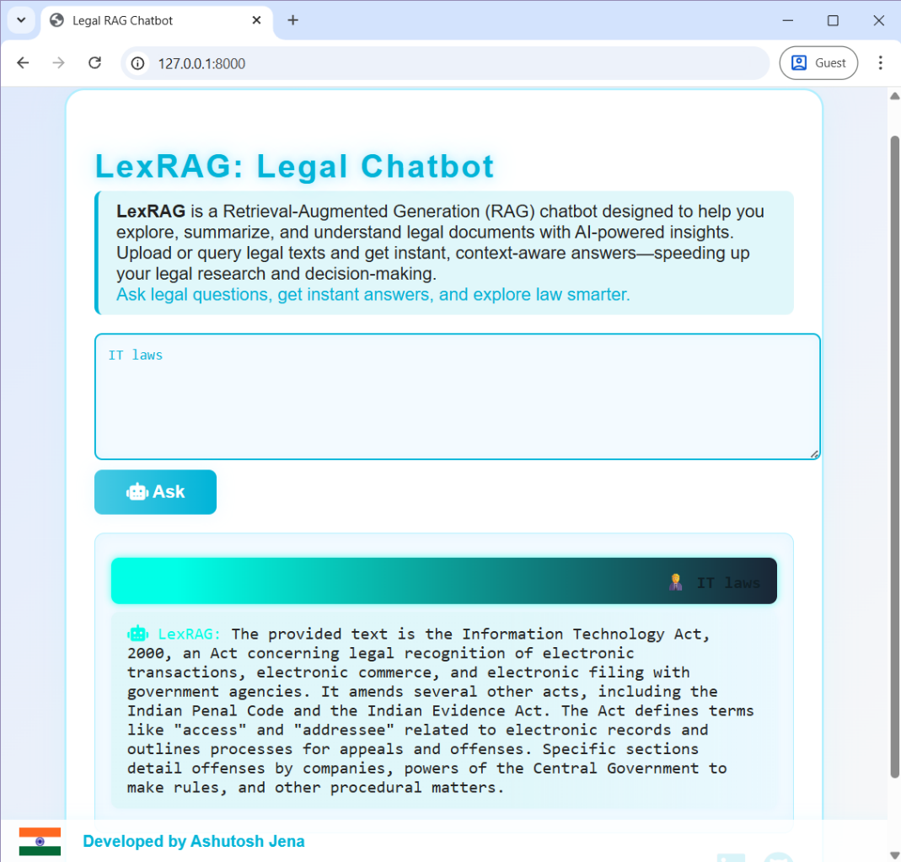
Result

Slide 10
Conclusion
LexRAG addresses the limitations of Black-Box models for predictive judgments & traditional search systems by combining lexical and semantic retrieval with advanced generative capabilities. It empowers users to access precise and context-aware information from large-scale document repositories, boosting productivity and decision-making. Through its modular and scalable architecture, LexRAG is adaptable to various organizational needs and data environments.

Slide 11
Future scope
Multilingual Support: Incorporating NLP models for multiple languages to broaden usability
Real-time Data Ingestion: Enabling dynamic ingestion and indexing of streaming or frequently updated data
Enhanced Summarization: Integrating more sophisticated generative models for abstractive summarization and report generation
Personalization: Leveraging user profiles and past queries to deliver personalized results
Integration with knowledge graphs: Enhancing contextual understanding by linking entities and concepts across documents

Slide 12
References
GitHub Link: https://github.com/ajverse/LexRAG/
HF Transformers Documentation: https://huggingface.co/transformers/
FAISS: https://github.com/facebookresearch/faiss/
Langchain: https://docs.langchain.com/
Docker: https://docs.docker.com/
FastAPI: https://fastapi.tiangolo.com/
BERT: Pre-training of Deep Bidirectional Transformers for Understanding: https://arxiv.org/abs/1810.04805
Retrieval-Augmented Generation for Knowledge-Intensive NLP Tasks: https://arxiv.org/abs/2005.11401

Slide 13
Thank you

