Slide 1


Title ….. By ……… Supervisor: Prof. Hamid Sarbazi-Azad Spring 2022
Sharif University of Technology

Slide 2
Before outline slide it’s better to introduce our work in 4 primary slides:
Context
Problem
Observation
Solution

Slide 3
Outline
Problem (and its importance)
Previous solutions (and their limitations)
Motivation (key observations)
Our solution
Conclusion

Slide 4
GPU architecture
Streaming Multiprocessors
GPU
Streaming Multiprocessor
. . .
. . .
. . .
SP
SP
SP
SP
SP
SP
. . .
. . .
SP
SP
Schedulers
. . .
. . .
. . .
. . .
. . .
. . .
. . .
. . .
. . .
. . .
. . .
SP
On-chip Memories
SP
SP
SP
SP
SP
. . .
SP
SP
Previous solutions >> Motivation >> Our solution >> Conclusion
Global memory
Instruction cache
Constant cache
Texture cache
L1 data cache
Shared memory
Register file
On-chip memories ….. (The conclusion of each slide comes here!)

Slide 5
Access latency of different solutions
Maxwell GPU
Register access latency = 2 cycles
Previous solutions >> Motivation >> Our solution >> Conclusion
All methods have ……(each slide has a conclusion in this box!)

Slide 6
Outline
Problem
Previous solutions
Motivation
Our solution
Conclusion

Slide 7
Observation: …..
Volta GPU with 128KB L1
Previous solutions >> Motivation >> Our solution >> Conclusion
E.g., you can report the results here!….

Slide 8
Outline
Problem
Previous solutions
Motivation
Our solution
Conclusion

Slide 9
Our solution
Streaming Multiprocessors
GPU
Streaming Multiprocessor
. . .
. . .
. . .
SP
SP
SP
SP
SP
SP
. . .
. . .
SP
SP
Schedulers
. . .
. . .
. . .
. . .
. . .
. . .
. . .
. . .
. . .
. . .
. . .
SP
On-chip Memories
SP
SP
SP
SP
SP
. . .
SP
SP
Previous solutions >> Motivation >> Our solution >> Conclusion
Global memory
Instruction cache
Constant cache
Texture cache
L1 data cache
Shared memory
Register file
….

Slide 10
Evaluation methodology
Simulation:
GPGPU-Sim V3.2.2 and GPUWattch, modeling a Maxwell-like GPU configuration
Benchmarks:
Standard codes from Polybench and NVIDIA CUDA SDK benchmark suites
Previous solutions >> Motivation >> Our solution >> Conclusion
Comparison points:
Standard, Our solution, and Ideal case
Comparison metrics:
Overall GPU IPC and power consumption

Slide 11
Power consumption
Previous solutions >> Motivation >> Our solution >> Conclusion
….

Slide 12
Overheads
Previous solutions >> Motivation >> Our solution >> Conclusion
Our solution imposes area overhead ….

Slide 13
Outline
Problem
Previous solutions
Motivation
Our solution
Conclusion

Slide 14
Conclusion
Data sharing is widely observed in GPGPU applications and is handled in GPUs using L1 data cache, texture cache, shared memory, and new shuffle instructions.
Among them, the L1 data cache is the major solution used by most applications.
L1 cache latency becomes very large for high data sharing rates observed in a wide range of Stencil applications e.g. Image processing, graphics, and learning algorithms (neighbor data sharing), and other popular applications e.g. graph algorithms and scientific computations (non-neighbor data sharing).
→ Need to have solution to reduce the negative effects of L1 latency .
In this research, we introduced:
NeDa to handle neighbor data sharing with 22% performance improvement, 9% power improvement, for about 1.3% area overhead.
Previous solutions >> Motivation >> Our solution >> Conclusion

Slide 15
Future directions
Previous solutions >> Motivation >> Our solution >> Conclusion

Slide 16
Published papers
Previous solutions >> Motivation >> Our solution >> Conclusion

Slide 17
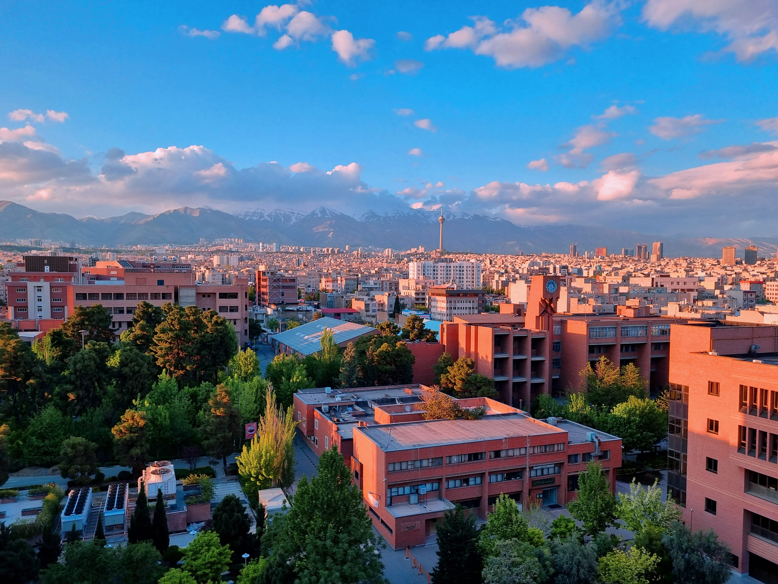
Thanks for your attention!

Slide 18
Backup slides

Slide 19
………………………
…………

Slide 20
………………..
…………

