Slide 1

PRISM
Seminar in Software Verification
Dr. Katerina korenbalt
Ajwad Zidan
Mohammad abu hamad

Slide 2
What is
Probabilistic model checking ?
-Is a formal verification technique for modelling and analyzing systems that exhibit probabilistic behavior.
-Formal verification is the application of rigorous, mathematics-based techniques to establish the correctness of computerized systems.

Slide 3
Probabilistic model checking PRISM supported
Models: variants of Markov chains:
− Discrete-time Markov chains (DTMCs)
− Continuous-time Markov chains (CTMCs)
− Markov decision processes (MDPs)
Specifications :
− Informally:
• “probability of delivery within time deadline is …”
• “expected time until message delivery is …”
• “expected power consumption is …”
− Formally:
• probabilistic temporal logics (PCTL, CSL, LTL, PCTL*, …)

Slide 4
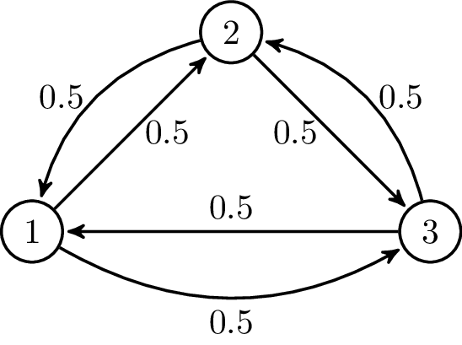
Markov chain
Is a stochastic model describing a sequence of possible events in which the probability of each event depends only on the state attained in the previous event.
A countably infinite sequence, in which the chain moves state at discrete time steps, gives a discrete-time Markov chain (DTMC).
A continuous-time process is called a continuous-time Markov chain (CTMC).

Slide 5
PRISM
-Probabilistic symbolic model checker
-A tool for formal modelling and analysis of systems that exhibit random or probabilistic behavior
-It has been used to analyze systems from many different application domains, including communication and multimedia protocols, randomized distributed algorithms and many others
-Can build and analyze many types of probabilistic models like variants of Markov chains

Slide 6
PRISM
-Models are described using the PRISM language, a simple, state-based language.
-The property specification language incorporates the temporal logics PCTL, CSL, LTL and PCTL*.
-Also extensions for quantitative specifications and costs/rewards.
-Furthermore, PRISM makes it easy to combine such properties into more complex expressions, compute their values for a range of parameters and plot graphs of the results using experiments.

Slide 7
PRISM LANGUAGE
Definition of a module:
module moduleName ... endmodule
The definition of a module contains two parts: its variables and its commands.
The variables describe the possible states that the module can be in, and the commands describe its behavior.
Variable definition example :
x : [0..2] init 0;
[0..2] value range (inside the brackets) , init 0 the initial value .
b : bool init false;
Variable update (value change) example :
x’ = 2 ;
The behavior of each module is described by commands (brackets define the command start) , example :
[ ] x=0 -> 0.8:(x'=0) + 0.2:(x'=1);

Slide 8
Traffic Lights System
Traffic Lights System :
describe a work of simple crossroad with four traffic lights. The time of “green” phase for the main road is defined to be 15-30 seconds, and the time of “green” phase for the second road is defined to be 15 seconds.
Colors : Red and Green
Two possible states
Green traffic lights in main road
(in the second road are red)
0
Green traffic lights in second road
(in the main road are red)
1

Slide 9
PRISM modelling language on Traffic light system
module trafficLight
// local states
s : [0..1] init 0;
// value of the traffic lights with two colors , 0 red , 1 green
a1 : [0..1] init 1;//a1 is first traffic light in the main road
b1 : [0..1] init 1;//b1 is second traffic light in the main road
a2 : [0..1] init 0;//a2 is first traffic light in the second road
b2 : [0..1] init 0;//b2 is second traffic light in the second road
time : [0..44] init 0;// total time system
time2 : [0..14] init 0;// time for second road green phase
y: [1..50] init 1;
[ ] s=0 & time < 14 -> (s'=0)&(time'=time+1);
[ ] s=0 & time > =14 & time < 29 -> 0.5:(s'=0)&(time'=time+1) + 0.5:(s'=1)&(time'=time+1)&(a1'=0)&(b1'=0)&(a2'=1)&(b2'=1);
[ ] s=0 & time = 29 -> 1:(s'=1)&(a1'=0)&(b1'=0)&(a2'=1)&(b2'=1)&(time'=time+1);
[ ] s=1 & time2 < 14 & time < 44 -> 1:(s'=1)&(time2'=time2+1)&(time'=time+1);
[ ] s=1 & time2 = 14 & time = 44 -> 1:(s'=0)&(time’=0)&(a1'=1)&(b1'=1)&(a2'=0)&(b2'=0)&(time2’=0);
endmodule

Slide 10
The Traffic Lights System satisfies the following properties:
R1: It can't happen that all four-traffic lights red at the same time .
With which probability eventually all four traffic lights are red ?
P = ? [ G ! ( a1=0 & b1=0 & a2=0&b2=0) ] ( F = “eventually” , G=“always ” )
R2: If the traffic light on the main road changes “green” to “red”, it will be “green” again in no more than 30 sec.
With which probability eventually the traffic lights in the main road are red after 15 seconds that the traffic lights in the second road were green ? (time2 is a seconds counter when traffic lights in second road are green)
P = ? [ F a1 = 0 & b1 = 0 & time2 > 14 ]

Slide 11

Thank you

