Slide 1


Implementation of the solver for coupled heat transfer in gas and solid
Instructors: 1) I. Marchevsky, Ph.D., Assoc.prof.
2) M. Kraposhin, Ph.D., Senior Researcher

Slide 2
Contents
Problem description
Choice of the numerical method
Implementation
Test problems

Slide 3
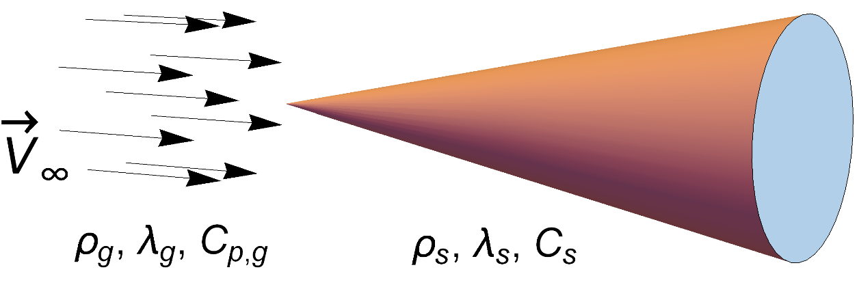
Problem description
Mach number – 0 < Ma < 5
EoS – perfect gas
Viscous flow of Newtonian media
Transient heat transfer in solid (Fourier law)

Slide 4
Governing equations
Perfect gas
Solid
Ideal heat contact

Slide 5
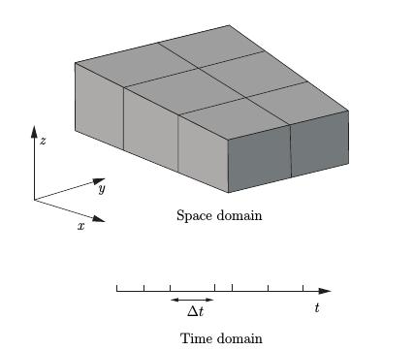
Numerical model
Space & time discretization
Finite Volume Method – space and time divided on non-intersecting cells (intervals)
Numerical schemes
Mean theorem + Gauss theorem
Time integration algorithm
Operator-splitting methods like PISO or PIMPLE

Slide 6
Models coupling
Single matrix
Single equation of energy for both gas & solid.
Stable and robust, but hard to implement and use.
Multiple domains, iterative coupling
Easy to work with complex geometries, performance degradation^{*)}.
Needs data interpolation on the interface.
^{*)} Not very important when using operator splitting methods like PISO

Slide 7
Implementation in OpenFOAM
Current implementation in OpenFOAM – chtMultiRegionFoam:
Iterative solution of energy balance between several solid and fluid regions.
Uses outer PIMPLE loop and special B.C. for coupling between domains.
List of domains managed through the regionProperties dictionary.
Connection between regions established via boundary conditions for temperature.
Main limitation – subsonic speeds of fluid (Ma<1).
OpenFOAM version: 2112
Temperature
Heat flux
Solid
Gas
Heat flux
Temperature

Slide 8
Designing new solver
PISO/SIMPLE/PIMPLE are known to be oscillatory at high speeds
we need different method for flows with Ma > 1.
rhoCentralFoam was designed for flows with Ma > 1.
it is explicit , not efficient when Ma < 1.
Solution – hybrid approach
Combine pimpleCentralFoam and chtMultiRegionFoam
For the most general implementation, see
https://github.com/TonkomoLLC/hybridCentralSolvers

Slide 9
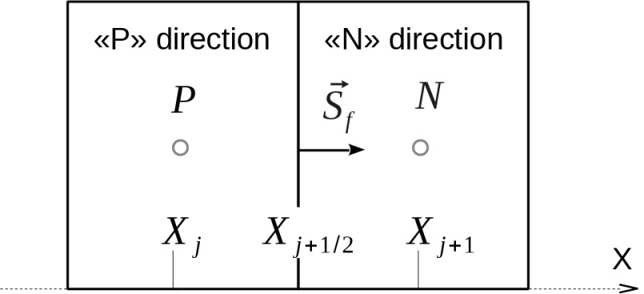
pimpleCentralFoam
Implicit KT/KNP fluxes for advection
PIMPLE algorithm for coupling
incompressible
compressible

Slide 10
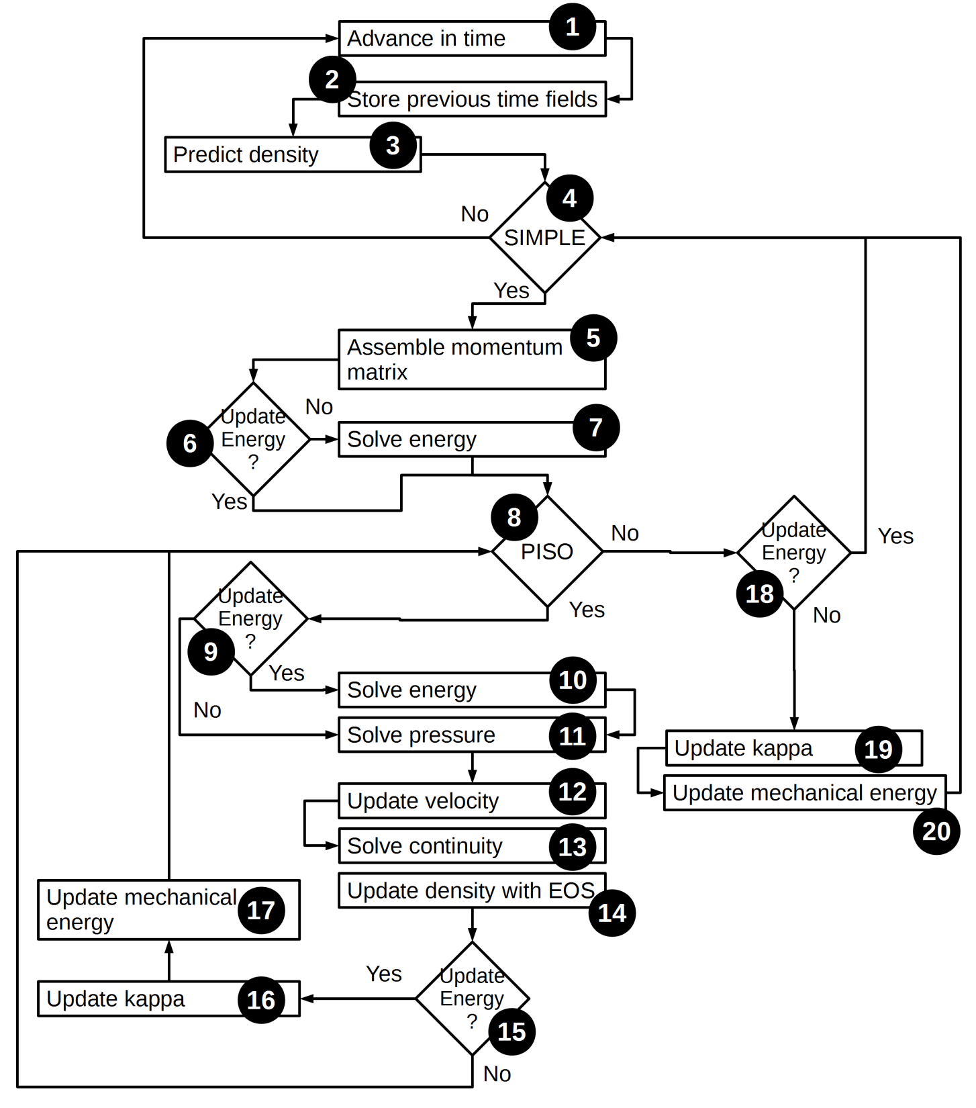
Hybrid PIMPLE/KT algorithm
Increase current time – 1
Solve explicit equation for density – 3
Start SIMPLE loop – 4
Assemble momentum matrix – 5
If only PISO iterations, solve for energy – 7
Start PISO loop – 8
If more then 1 SIMPLE iterations, solve for energy – 9
Solve continuity equation formulated for pressure, update velocity and density with EOS – 10-14
Update blending field “kappa” – 16
Update mechanical energy transport – 17

Slide 11
pimpleCentralFoam source code
hybridCentralSolvers/OpenFOAM-v2112/
pimpleCentral/
commonIncludes/
Eqns
createCommonCentralFields.H
updateKappa.H
kappaFunctions/
pimpleCentralFoam/
Make/
createFields.H
hEqn.H
pEqn.H
pimpleCentralFoam.C
Library libpimpleCentral.so with common operations used pimpleCentralFoam
Source code for pimpleCentralFoam solver

Slide 12
Hybrid PIMPLE/KT algorithm sources
commonIncludes/
massEqn.H
UEqn.H
hEqn.H
pEqn.H
updateCentralWeights.H psiUpdateCentralFields.H
updateMechanicalFields.H
updateKappa.H

Slide 13
Other hybrid PIMPLE/KT solvers
pimpleCentralDyMFoam – solver with mesh motion
rhoPimpleCentralFoam – solver for gases with equations of state, different to perfect gas
reactingPimpleCentralFoam – solver for multicomponent mixtures flow with chemical reactions
twoPhaseMixingCentralFoam – solver for two phase homogeneous liquids flows (water & air, for example)
chtMultiRegionCentralFoam – this Track solver

Slide 14
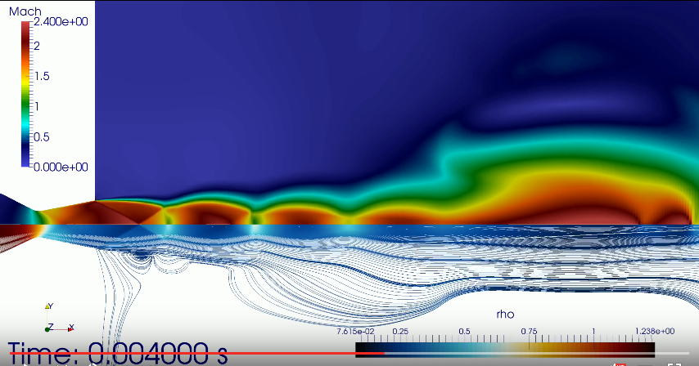
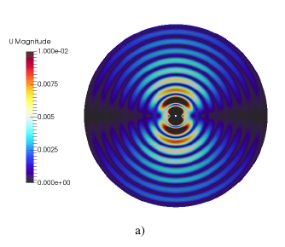
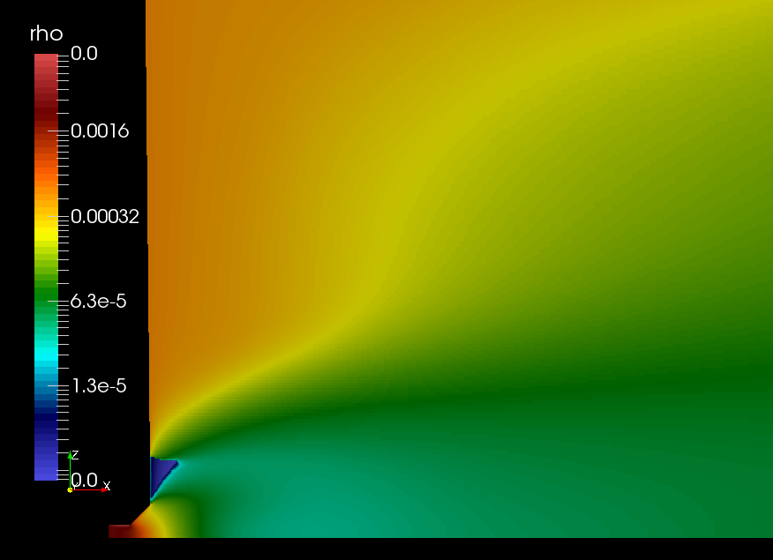
Examples of pimpleCentralFoam solver
Supersonic jet flows
Acoustics
Plasma flows

Slide 15
Boundary conditions
Inlet (for subsonic and supersonic flows)
Outlet – mixed subsonic/supersonic (subsonicSupersonicPressureOutlet, libcompressibleTools, can be downloaded from github.com)
Walls – adiabatic, coupled to solids

Slide 16
Steps to develop supersonic coupled with heat transfer solver
Step 1. Create new solver and link with regionProperties to allow multiple domains in single case.
Step 2. Move fluid domain from default location to user-specified.
Step 3. Create source code to solve for heat transfer in several (solid) bodies.
Step 4. Link created code with new solver. Compile the solver.
Resulting source codes of each step stored in separate folders of training track materials
in the folder src/
https://github.com/unicfdlab/TrainingTracks/tree/master/OpenFOAM/gasThermoCoupled-OFv2112

Slide 17
Simplifications
Single domain for fluid, multiple domains for solids
Fluid
Solid 1
Solid 2
Solid 4
Solid 3
Application: flow over several bodies, or structure composed of several materials
Benefits: No need to rewrite most of the code for gas dynamics
More general case – ToncomoLLC github page
https://github.com/TonkomoLLC/hybridCentralSolvers

Slide 18
Simplifications - 2
Nearest cell interpolation — for meshes with relatively uniform and equal grid distribution on external boundaries
turbulentTemperatureCoupledBaffleMixed uses approximated expressions for heat fluxes to satisfy ideal heat contact condition
Domain 1
Domain 2

Slide 19
Initialization steps
Download hybridCentralSolvers https://github.com/unicfdlab/hybridCentralSolvers
Build library and solvers: ./Allwmake
Download libcompressibleTools https://github.com/unicfdlab/libcompressibleTools
Build library ./makeLib.sh

Slide 20
Step 1
Make a copy of pimpleCentralFoam solver, rename it to myChtPimpleCentralFoam and update its wmake settings:
mv pimpleCentralFoam.C myChtPimpleCentralFoam.C
Update Make/files
myChtPimpleCentralFoam.C EXE = $(FOAM_USER_APPBIN)/myChtPimpleCentralFoam
Update Make/options
HCS_SRC=/path/to/library/source/pimpleCentral
EXE_INC = \
-I$(HCS_SRC)/lnInclude \
...
-I$(LIB_SRC)/regionModels/regionModel/lnInclude
...
EXE_LIBS = \
...
-lregionModels
Include path and library of classes for handling multi-domain cases

Slide 21
Step 1 results
After this step we have new solver “myChtPimpleCentralFoam” which can work potentially with multiple domains (meshes) simultaneously.

Slide 22
Step 2
Change space discretization storage for gas from «defaultRegion» to «fluid» region
Goal of this step is to separate mesh storage for fluid (gas) and solids. Each mesh is stored in the unique folder on HDD (and object in memory)
0/
0/
constant/
constant/
polyMesh/
fluid/
system/
polyMesh/
system/
fluid/
regionProperties rp(runTime);
To manage several domains
regionProperties object must be created in the program before executing all other mesh operations

Slide 23
General settings
Create file createMeshes.H:
regionProperties rp(runTime);
#include "createFluidMeshes.H"
Update createFields.H:
#include "createFluidFields.H"
Update Make/options:
EXE_INC = \
…
-I./fluid
Operations to create mesh and fields for fluid are now stored in new files
Fluid model files are stored in folder «fluid»
which is known to compiler to lookup for includes

Slide 24
Remove LTS
Update main procedure in myChtPimpleCentralFoam.C — remove LTS *)
Start of the time step will look like:
....
while (pimple.loop())
{
#include "readAdditionalPimpleControl.H"
#include "acousticCourantNo.H"
#include "centralCompressibleCourantNo.H"
#include "readTimeControls.H"
#include "setDeltaT.H"
Add include for regionProperties class:
#include «regionProperties.H»
if (LTS)
{
…
}
*) LTS – Local Time Stepping

Slide 25
Create fluid mesh & fields
Put fluid-associated operations in separate files:
mkdir fluid; cd fluid/
mv ../hEqn.H ./
mv ../pEqn.H ./
mv ../createFields.H createFluidFields.H
touch createFluidMeshes.H
Create mesh for gas domain - createFluidMeshes.H:
const wordList fluidNames(rp["fluid"]);
autoPtr<fvMesh> fluidMeshPtr;
fluidMeshPtr.reset(
new fvMesh(
IOobject(
fluidNames[0],
runTime.timeName(),
runTime,
IOobject::MUST_READ
)
)
);
Fluid fields are now created in
createFluidFields.H
Pointer to gas mesh
Specify location for gas mesh
Create reference to fluid (gas) mesh
fvMesh& fluidMesh = fluidMeshPtr();
fvMesh& mesh = fluidMesh;

Slide 26
Update createFluidFields.H
Move initialization operations related to fluid (gas) domain from myChtPimpleCentralFoam.C to createFluidFields.H:
#include "readAdditionalPimpleControl.H"
#include "createCommonCentralFields.H",
autoPtr<compressible::turbulenceModel> turbulence
(compressible::turbulenceModel::New(rho,U,phi,thermo));
#include "createFvOptions.H"
#include "createMRF.H"
#include "initContinuityErrs.H"
#include "readCourantType.H"
#include "markBadQualityCells.H"
#include "psiUpdateCentralFields.H"
#include "updateKappa.H"
#include "updateCentralWeights.H"
#include "createCentralCourantNo.H"

Slide 27
Step 2 results
At this step gas domain relocated from standard folder to location specified by user in the regionProperties dictionary.
Source code of gas dynamics equations approximation is now stored in separate folder “fluid/”.

Slide 28
Step 3
Create source code to solve for heat transfer equations in solids and link necessary libraries to executable.
mkdir solid
Examples of the source code can be retrieved from chtMultiRegionPimpleFoam sources.
Add “includes” to main procedure (myChtPimpleCentralFoam.C):
#include "coordinateSystem.H"
#include "solidThermo.H"
Update wmake settings (Make/options):
-I$(LIB_SRC)/thermophysicalModels/ solidThermo/lnInclude \
Resulting source code structure will become:
Folder to store sources for solid body heat transfer model
myChtPimpleCentralFoam/
fluid/
solid/
Make/

Slide 29
General solution procedure for solids
Create meshes for solids.
Create fields describing heat exchange process in solids.
Create approximations of energy balance equations in solids (matrices).
Solve matrices (equations) for energy balances for all solids.

Slide 30
Create solid domains
Unlike gas, for solids we have several computational domains and thus we have to store several meshes, several temperature fields, several thermal conductivity coefficients and so on.
Create createSolidMeshes.H:
Names for solid domains
const wordList solidsNames(rp["solid"]);
PtrList<fvMesh> solidRegions(solidsNames.size());
forAll(solidsNames, i)
{
solidRegions.set
(
i,
new fvMesh
(
IOobject
(
solidsNames[i],
runTime.timeName(),
runTime,
IOobject::MUST_READ
...
Number of solid
domains
For solid No. i,
create mesh
Loop over all solid domains
For complete example see createSolidMeshes.H from training materials

Slide 31
Create solid fields and objects
Place initialization operations in createSolidFields.H file.
For each solid we must create:
Coordinate system transformation tensor (for anisotropic conductivity)
PtrList<coordinateSystem> coordinates(solidRegions.size());
Thermodynamic library
PtrList<solidThermo> thermos(solidRegions.size());
Volumetric heat sources (fvOptions objects)
PtrList<fv::options> solidHeatSources(solidRegions.size());
Porosity field
PtrList<volScalarField> betavSolid(solidRegions.size());
Field of anisotropic thermal diffusivity coefficient
PtrList<volSymmTensorField> aniAlphas(solidRegions.size());

Slide 32
Initialization of solid fields and objects
After declaration, objects are initialized (see createSolidFields.H for example) in cycle:
forAll(solidRegions, i)
{
...
thermos.set(i, solidThermo::New(solidRegions[i]));
...
solidHeatSources.set
(i,new fv::options(solidRegions[i]));
...
coordinates.set
(i,coordinateSystem::New(solidRegions[i],thermos[i]));
...
aniAlphas.set(i,new volSymmTensorField...
...
betavSolid.set(i, new volScalarField...
...
}

Slide 33
Solution process for heat transfer in multiple solid bodies
Loop over all solids (solveSolidRegions.H)
forAll(solidRegions, i)
{
Create refernces for fields, coefficients and mesh for region No. i
#include "setRegionSolidFields.H“
Solve for energy balance for solid No. I
#include "solveSolid.H"

Slide 34
Energy equation in solid
In case of isotropic material properties, energy balance in solid (in terms of enthalpy) reads:
Change of energy in volume
Heat flux
Volumetric energy sources
fvScalarMatrix hEqn
(
fvm::ddt(solidBetav,solidRho,solidH)
-
fvm::laplacian
(
solidBetav*solidThermo.alpha(),
solidH,
"laplacian(alpha,h)"
)
==
solidFvOptions(solidRho, solidH)
);
Notes:
<number>

Slide 35
Step 3 results
Source code for simulation of heat transfer in solids using single solver was create
Simulation process includes:
Initialization of meshes and fields for each solid: createSolidMeshes.H and createSolidFields.H
Energy balance equation discretization and solution: files solveSolidRegions.H, setRegionSolidFields.H and solveSolid.H
Source code of heat transfer approximation for solid bodies stored in separate folder “solid/”
Though sources created, they are not linked to the main program

Slide 36
Step 4
Put solid equations solution block in PIMPLE algorithm for coupled simulation:
Update createMeshes.H:
#include "createFluidMeshes.H"
#include "createSolidMeshes.H"
Update createFields.H:
#include "createFluidFields.H"
#include "createSolidFields.H"
Update Make/options:
EXE_INC = \
… \
-I./solid
Update myChtPimpleCentralFoam.C — insert solution for heat transfer in solids in the PIMPLE algorithm

Slide 37
Where to place solid body heat transfer block
Add steps to solve for
energy balance in solids
before solving energy
balance in fluid
solveSolidRegions.H
solveSolidRegions.H

Slide 38
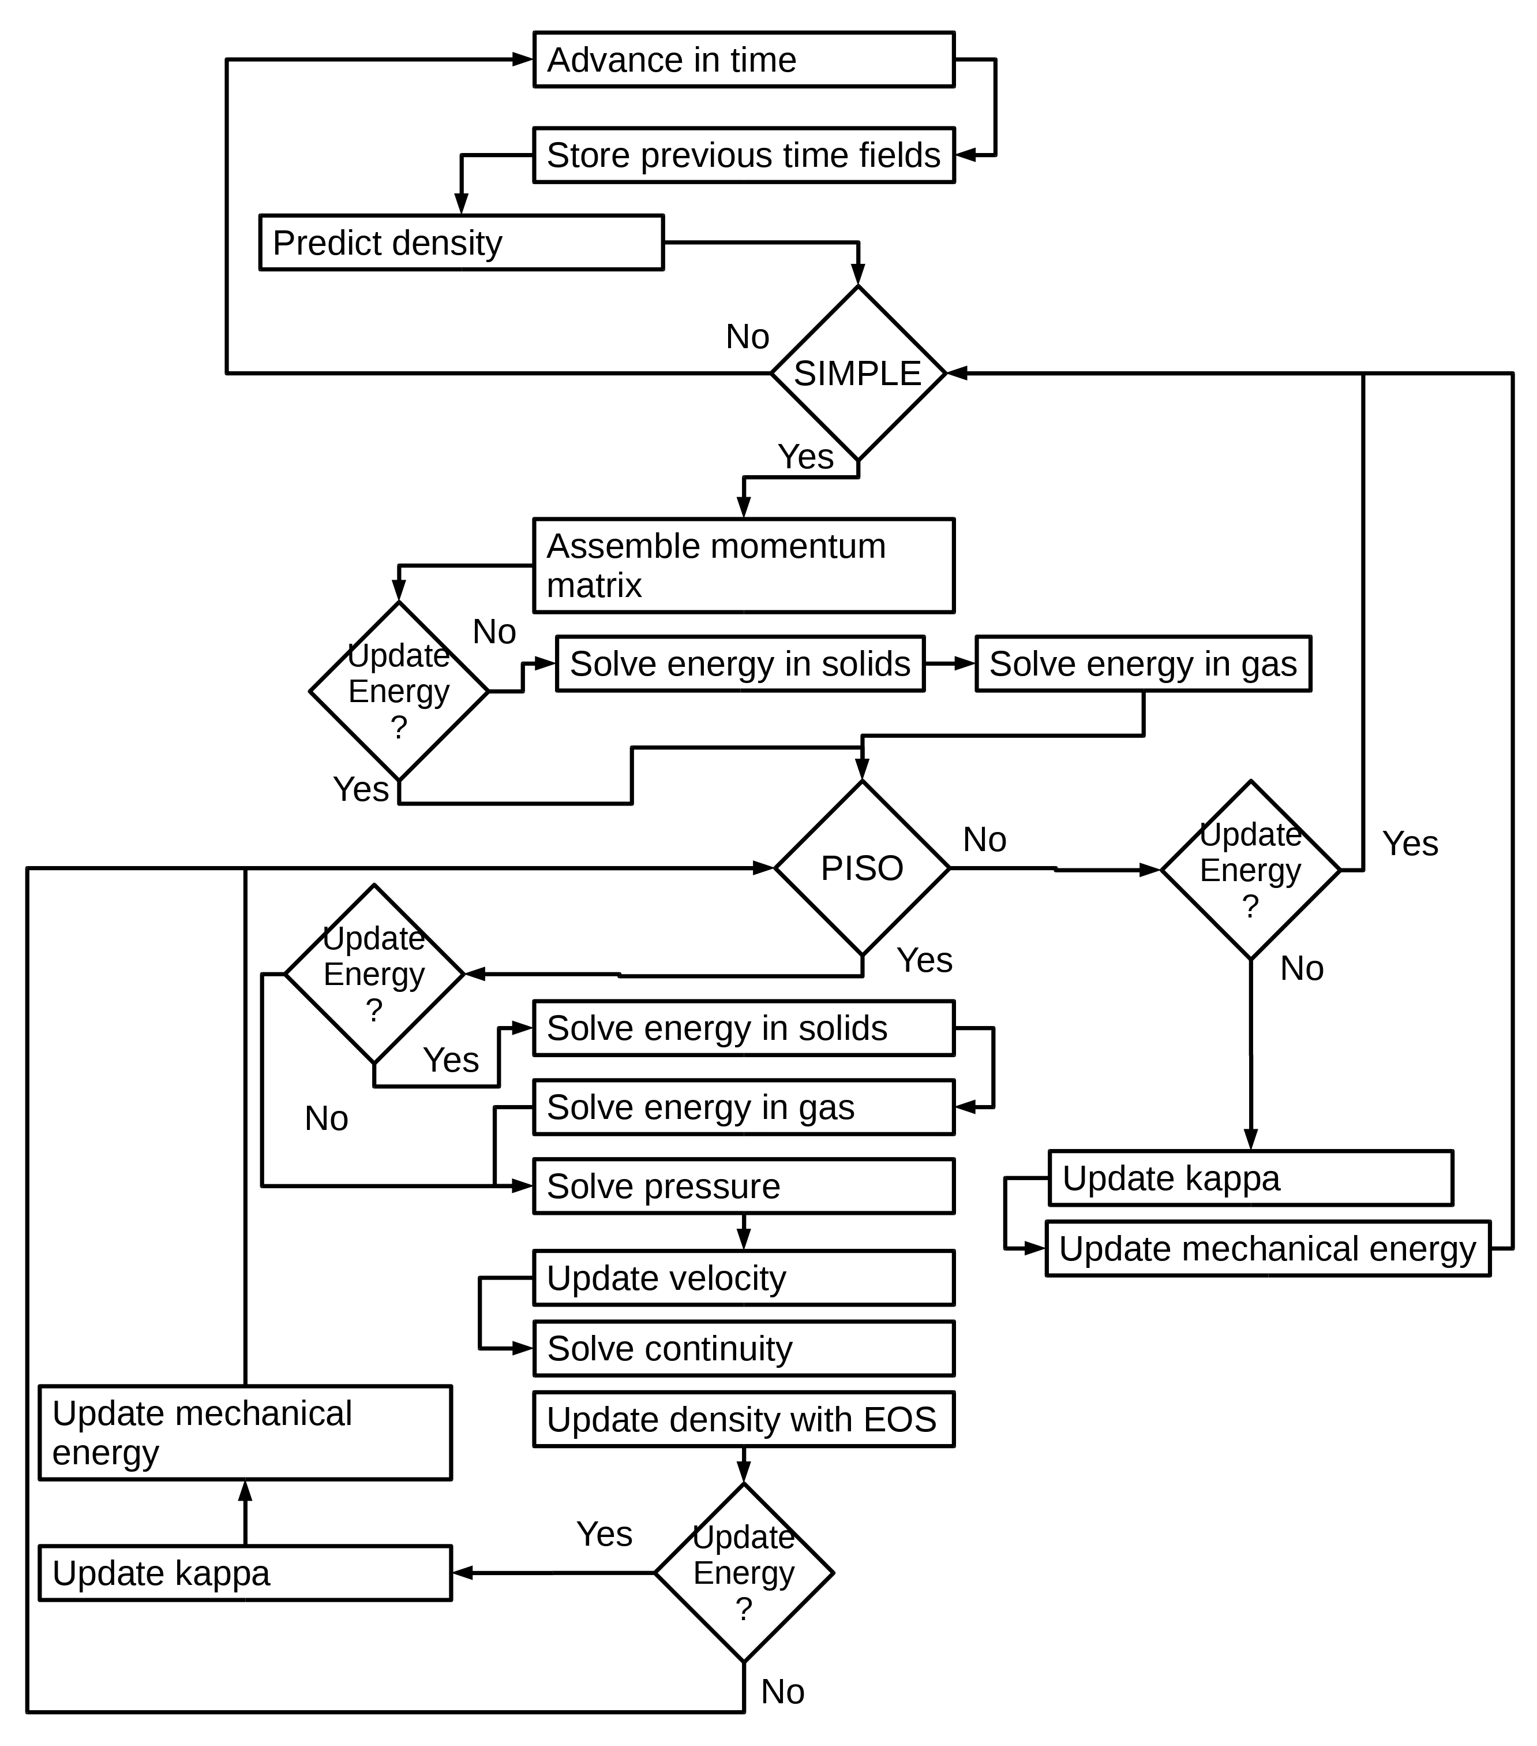
Final PIMPLE algorithm

Slide 39
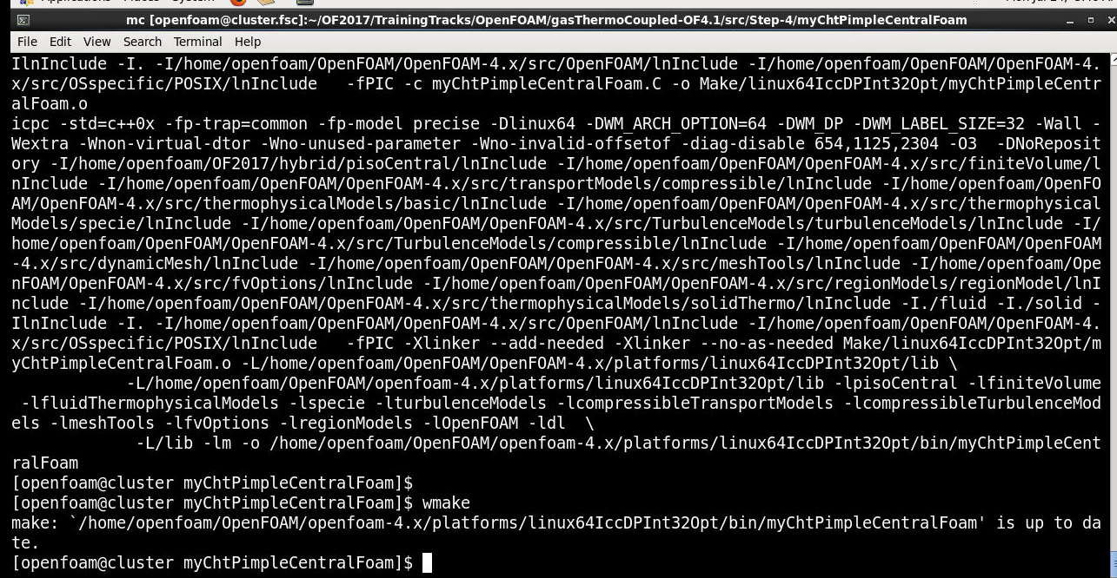
Compile solver
To compile solver, type
wmake
Screenshot

Slide 40
Step 4 results
Source code for simulation of heat transfer in solid bodies added to main program.
Energy balance equations for solids are solved in PIMPLE algorithm before solving for energy balance of gas.
New solver myChtPimpleCentralFoam was compiled.

Slide 41
Test cases
Laminar flow
Turbulent flow
Viscosity model - Sutherland
RAS simulation – k-w SST turbulence model
https://github.com/unicfdlab/TrainingTracks/tree/master/OpenFOAM/gasThermoCoupled-OFv2112/cases

Slide 42
Run test cases
Laminar flow
Turbulent flow
Decompose regions
decomposePar -region solid
decomposePar -region fluid
Run cases
mpirun -np 4 myChtPimpleCentralFoam -parallel
Reconstruct solution (if necessary)
reconstructPar

Slide 43
wallHeatFlux postprocessor
Source code is copied to /src
/Make/options is changed
($FOAM_APPBIN $FOAM_USER_APPBIN)
To compile: wmake libso
Run:
mpirun -np 4 wallHeatFlux -parallel -region solid
or
wallHeatFlux -region solid
Computed heat flux (wedge angle 5 deg.)
for laminar case: ~ 100 W
for turbulent case: ~ 1150 W

Slide 44
Thank you for your attention!
All the source codes and numerical examples are available online
https://github.com/unicfdlab/

