Slide 1
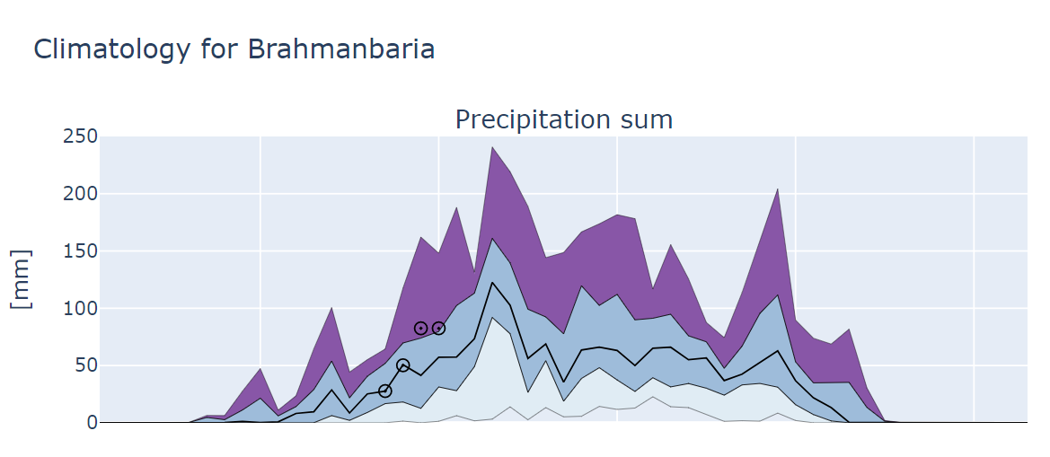
Max
S2S forecasts
Q3
Median
Q1
Min

